Slide 1
Lecture 32: Alternative Architectures
Objectives:
Recurrent Networks (RNN) Long Short-Term Networks (LSTM) Bidirectional LSTMs (BLSTM) Convolutional Neural Networks (CNN) Connectionist Temporal Classification (CTC)
Resources: Learning Architectures for AI Contrastive Divergence RBMs

Slide 2
Introduction
Recurrent Neural Networks
Long Short-Term Memory Networks
Deep Recurrent Neural Networks
Deep Bidirectional Long Short-Term Memory Networks
Convolutional Neural Networks
EEG Classification Using Deep Learning
Notes:
I start from scratch with Recurrent Neural Networks. Then I’ll explain Long Short-Term Memory Networks. After that I will continue with Deep Recurrent Neural Networks. Then I will introduce you to Deep Bidirectional Long Short-Term Memory Networks. And finally I’ll wrap up the discussion with an overview on EEG classification using deep learning.

Slide 3
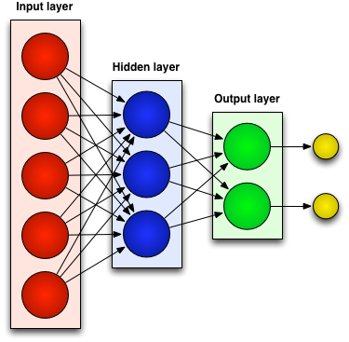
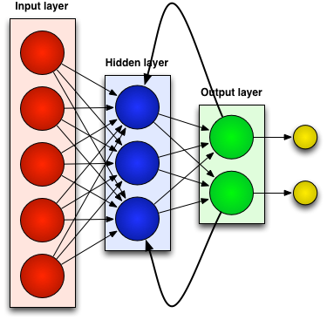
Neural Networks
Generally there are two kinds of neural networks:
Feedforward Neural Networks:
connections between the units do not form a cycle
Recurrent Neural Network:
connections between units form cyclic paths
Notes:
In recent years, neural networks composed of multiple layers, which are often termed as Deep Learning, have emerged as a powerful machine learning approach.
A feedforward neural network is an artificial neural network where connections between the units do not form a cycle. In other word in feedforward networks processing of information is piped through the network from input layers to output layers.
In contrast, a recurrent neural network (RNN) is an artificial neural network where connections between units form cyclic paths.

Slide 4
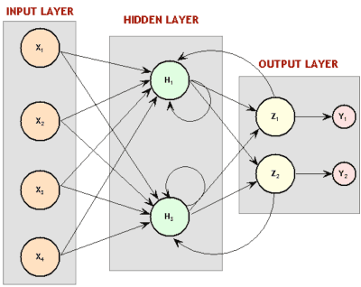
Recurrent Neural Network (RNN)
Recurrent since they receive inputs, update the hidden states depending on the previous computations, and make predictions for every element of a sequence.
RNNs are a neural network with memory.
RNNs are very powerful dynamic system for sequential tasks such as speech recognition or handwritten recognition since they maintain a state vector that implicitly contains information about the history of all the past elements of a sequence.
Notes:
RNNs are called recurrent …
We can consider RNNs as …
RNNs are very …

Slide 5
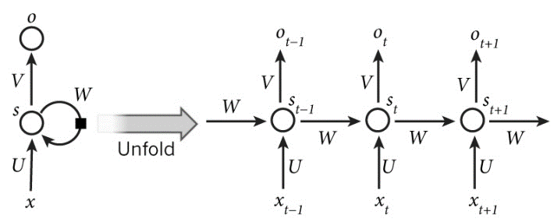
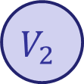

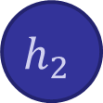
Unrolling an RNN for Sequential Modeling
An unrolled RNN (in time) can be considered as a deep neural network (DNN) with indefinitely many layers:
$x_{t}$: input at time $t$
$s_{t}$: hidden state at time $t$ (memory of the network).
$f$: is an activation function (e.g, $tanh()$ and ReLUs).
U, V, W: network parameters (unlike a feedforward neural network, an RNN shares the same parameters across all time steps).
g: activation function for the output layer (typically a softmax function).
y: the output of the network at time $t$
$$s_{t}=f\left(Ux_{t}+Ws_{t−1}\right)$$
$$\left.y=g(Vs_{t}\right)$$
Notes:
In these equations $x_{t}$is the input at time step t. $S_{t}$ is the hidden state at time step t which is in fact the memory of the network and it is calculated based on the input at the current step and the previous hidden state. $f$ is a activation function which transforms the inputs of the layer into its outputs and allows us to fit nonlinear hypotheses. Common choices for $f$ are tanh and ReLUs. $S_{−1}$ which is required to initialize the first hidden state is typically set to all zeroes. The output of the network is $y$ which is calculated by a nonlinear function of matrix multiplication of V and $S_{t}$. In fact this nonlinear function, g, is the activation function for the output layer and usually it is the softmax function. It is simply a way to convert raw scores to probabilities. Unlike feed forward neural networks, which have different parameters at each layer, a RNN shares the same parameters (U, V, W in Eq. 2.1 and Eq. 2.2) across all steps.
rectified linear unit (ReLU)

Slide 6
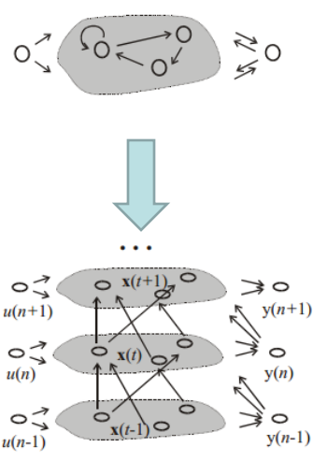
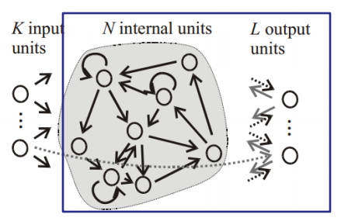
RNN Training
There are different approaches for training of RNNs:
Back-Propagation Through Time (BPTT): Unfolding an RNN in time and using the extended version of backpropagation.
Extended Kalman Filtering (EKF): a set of mathematical equations that provides an efficient computational means to estimate the state of a process, in a way that minimizes the mean of the squared error on linear system.
BPTT
Real-Time Recurrent Learning (RTRL): Computing the error gradient and update weights for each time step.
RTRL
Notes:
The feedforward neural networks can be trained by backpropagation algorithm. In RNNs, a slightly modified version of this algorithm called Backpropagation through Time (BPTT) is used to train the network.

Slide 7
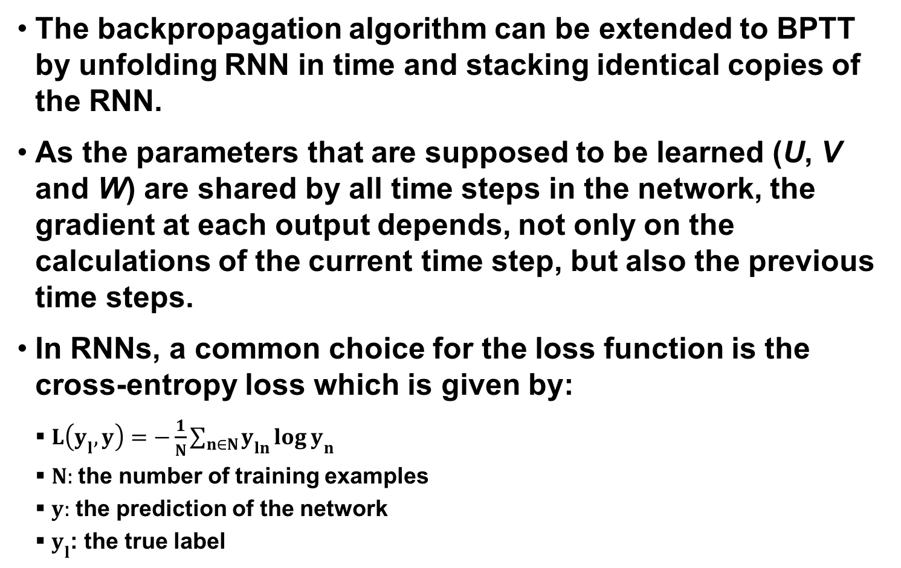
Backpropagation Through Time
The backpropagation algorithm can be extended to BPTT by unfolding RNN in time and stacking identical copies of the RNN.
As the parameters that are supposed to be learned (U, V and W) are shared by all time steps in the network, the gradient at each output depends, not only on the calculations of the current time step, but also the previous time steps.
In RNNs, a common choice for the loss function is the cross-entropy loss which is given by:
$L\left(y_{l},y\right)=−\frac{1}{N}\sum_{n∈N}{y_{ln}\log{y_{n}}}$
$N:$the number of training examples
$y:$ the prediction of the network
$y_{l}$: the true label
Notes:
The backpropagation algorithm can be extended to BPTT by unfolding RNN in time and stacking identical copies of the RNN.
As the parameters that are supposed to be learnt (U, V and W) are shared by all time steps in the network, the gradient at each output depends not only on the calculations of the current time step, but also the previous time steps.

Slide 8
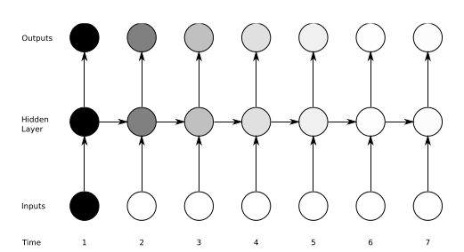
The Vanishing Gradient Problem
Definition: The influence of a given input on the hidden layer, and therefore on the network output, either decays or grows exponentially as it propagates through an RNN.
In practice, the range of contextual information that standard RNNs can access are limited to approximately 10 time steps between the relevant input and target events.
Solution: LSTM networks.
Notes:
While RNNs are powerful structures, they are hard to train.
One of the main reason is “vanishing gradient problem” which explored in depth by Bengio and it refers to
They found that in theory RNNs can make use of information in arbitrarily long sequences, but in practice they are limited to looking back only a few steps.
This means in practice …
The most successful solution is to use Long Short-Term Memory (LSTM) which will be introduced in next chapter.

Slide 9
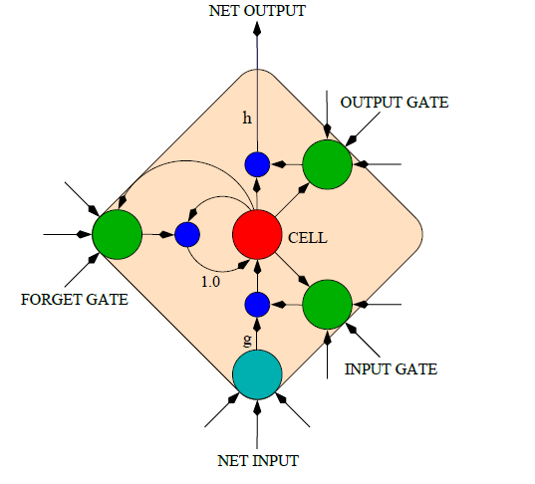
Long Short-Term Memory (LSTM)
An LSTM is a special kind of RNN architecture, capable of learning long-term dependencies.
An LSTM can learn to bridge time intervals in excess of 1000 steps.
LSTM networks outperform RNNs and Hidden Markov Models (HMMs):
Speech Recognition: 17.7% phoneme error rate on TIMIT acoustic phonetic corpus.
Winner of the ICDAR handwriting competition for the best known results in handwriting recognition.
This is achieved by multiplicative gate units that learn to open and close access to the constant error flow.
LSTM Memory Cell
Notes:
Long Short Term Memory networks are a special kind …

Slide 10
Memory Cell in LSTM
LSTM networks introduce a new structure called a memory cell.
Each memory cell contains four main elements:
Input gate
Forget gate
Output gate
Neuron with a self-recurrent
These gates allow the cells to keep and access information over long periods of time.
LSTM Memory Cell

Slide 11
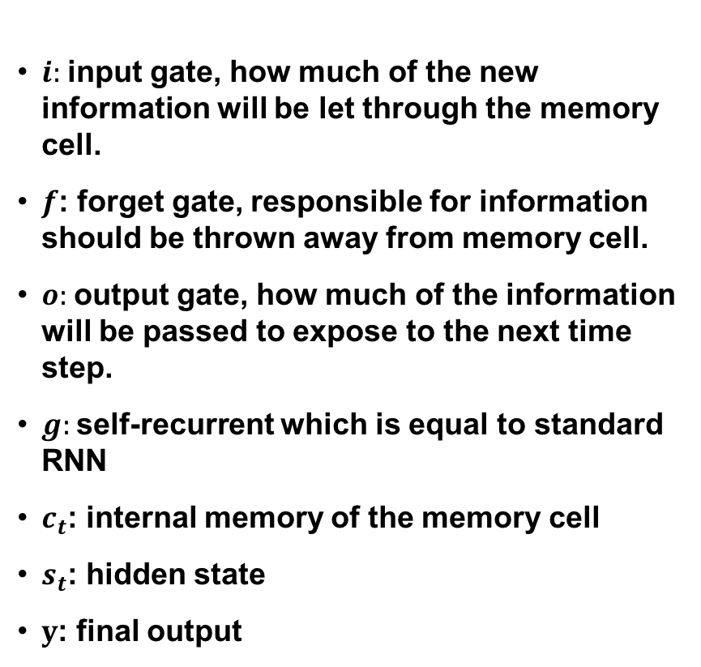
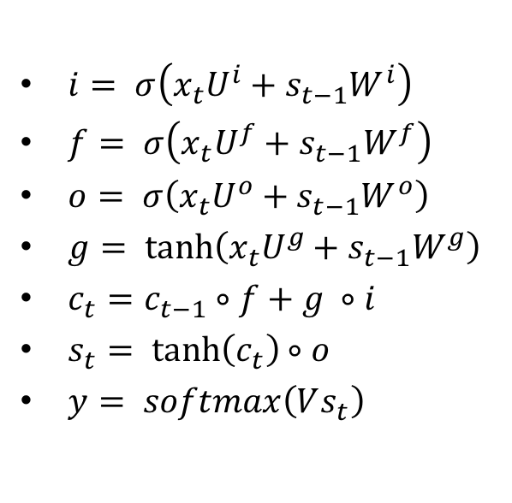
LSTM Equations
$i:$input gate, how much of the new information will be let through the memory cell.
$f$: forget gate, responsible for information should be thrown away from memory cell.
$o:$output gate, how much of the information will be passed to expose to the next time step.
$g:$self-recurrent which is equal to standard RNN
$c_{t}$: internal memory of the memory cell
$s_{t}$: hidden state
$y$: final output
$i= σ\left(x_{t}U^{i}+s_{t−1}W^{i}\right)$
$f= σ\left(x_{t}U^{f}+s_{t−1}W^{f}\right)$
$o= σ\left(x_{t}U^{o}+s_{t−1}W^{o}\right)$
$g= \tanh\left(x_{t}U^{g}+s_{t−1}W^{g}\right)$
$c_{t}=c_{t−1}∘f+g ∘i$
$s_{t}= \tanh\left(c_{t}\right)∘o$
$y= softmax\left(Vs_{t}\right)$
LSTM Memory Cell

Slide 12
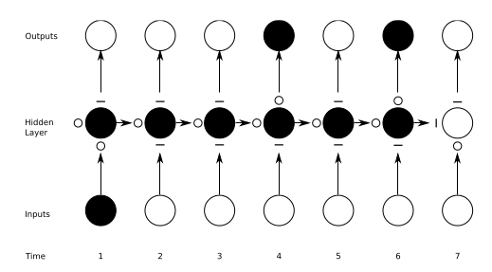
Preserving the information in LSTM
A demonstration of how an unrolled LSTM preserves sequential information.
The input, forget, and output gate activations are displayed to the left and above the memory block (respectively). The gates are either entirely open (‘O’) or entirely closed (‘—’).
Traditional RNNs are a special case of LSTMs: Set the input gate to all ones (passing all new information), the forget gate to all zeros (forgetting all of the previous memory) and the output gate to all ones (exposing the entire memory).

Slide 13
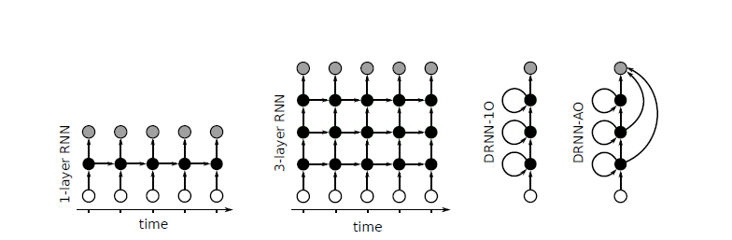
Deep Recurrent Neural Networks (DRNN)
Standard RNN: the information only passes through one layer of processing before going to the output.
In sequence tasks we usually process information at several time scales.
DRNN: a combination of the concepts of deep neural networks (DNN) with RNNs.
By stacking RNNs, every layer is an RNN in the hierarchy that receives the hidden state of the previous layer as input.
Processing of different time scales at different levels, and therefore a temporal hierarchy will be created.
Notes:
One potential disadvantage of traditional RNN which explained in the first part of the presentation is that,
In this part a structure called deep recurrent neural network(DRNN) will be explained which is basically
In DRNN by stacking RNNs,
In this way processing

Slide 14
DRNN-1O vs. DRNN-AO
Two variants of DRNN structures:
DRNN-1O: the output will be computed just based on the hidden state of the last layer.
DRNN-AO: the output will be the combination of the hidden states of the all layers.
DRNN-AO has two great advantages:
Using BPTT for DRNN-AO, the error will propagate from the top layer down the hierarchy without attenuation of the magnitude. As a result, training will be more effective.
It gives us the ability to evaluate the impact of each layer in solving the task by leaving out an individual layer’s contribution.
Notes:
Different variations of the structures of DRNNs are depicted in this slide.
In this picture connection matrices are shown by arrows.
Also input frames, hidden states, and output frames are represented by white,black and grey circles respectively.
In both of these structures the looped arrows represent the recurrent weights.

Slide 15
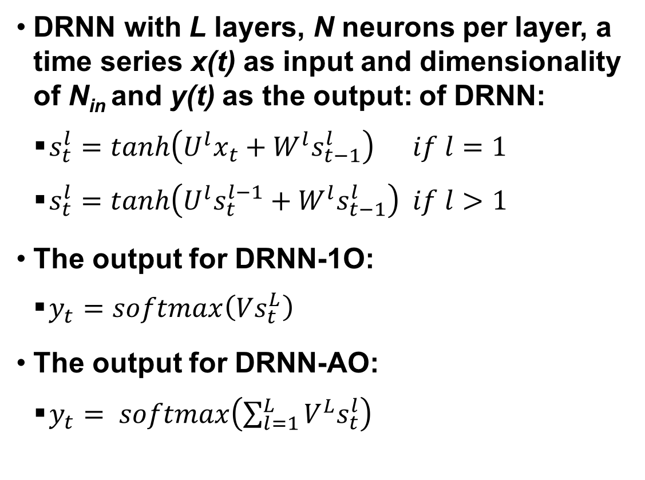
DRNN Equations
DRNN with L layers, N neurons per layer, a time series x(t) as input and dimensionality of N_{­in} and y(t) as the output: of DRNN:
$s_{t}^{l}=tanh\left(U^{l}x_{t}+W^{l}s_{t−1}^{l}\right) if l=1$
$s_{t}^{l}=tanh\left(U^{l}s_{t}^{l−1}+W^{l}s_{t−1}^{l}\right) if l>1$
The output for DRNN-1O:
$y_{t}=softmax\left(Vs_{t}^{L}\right)$
The output for DRNN-AO:
$y_{t}= softmax\left(\sum_{l=1}^{L}{{V^{L}s}_{t}^{l}}\right)$

Slide 16
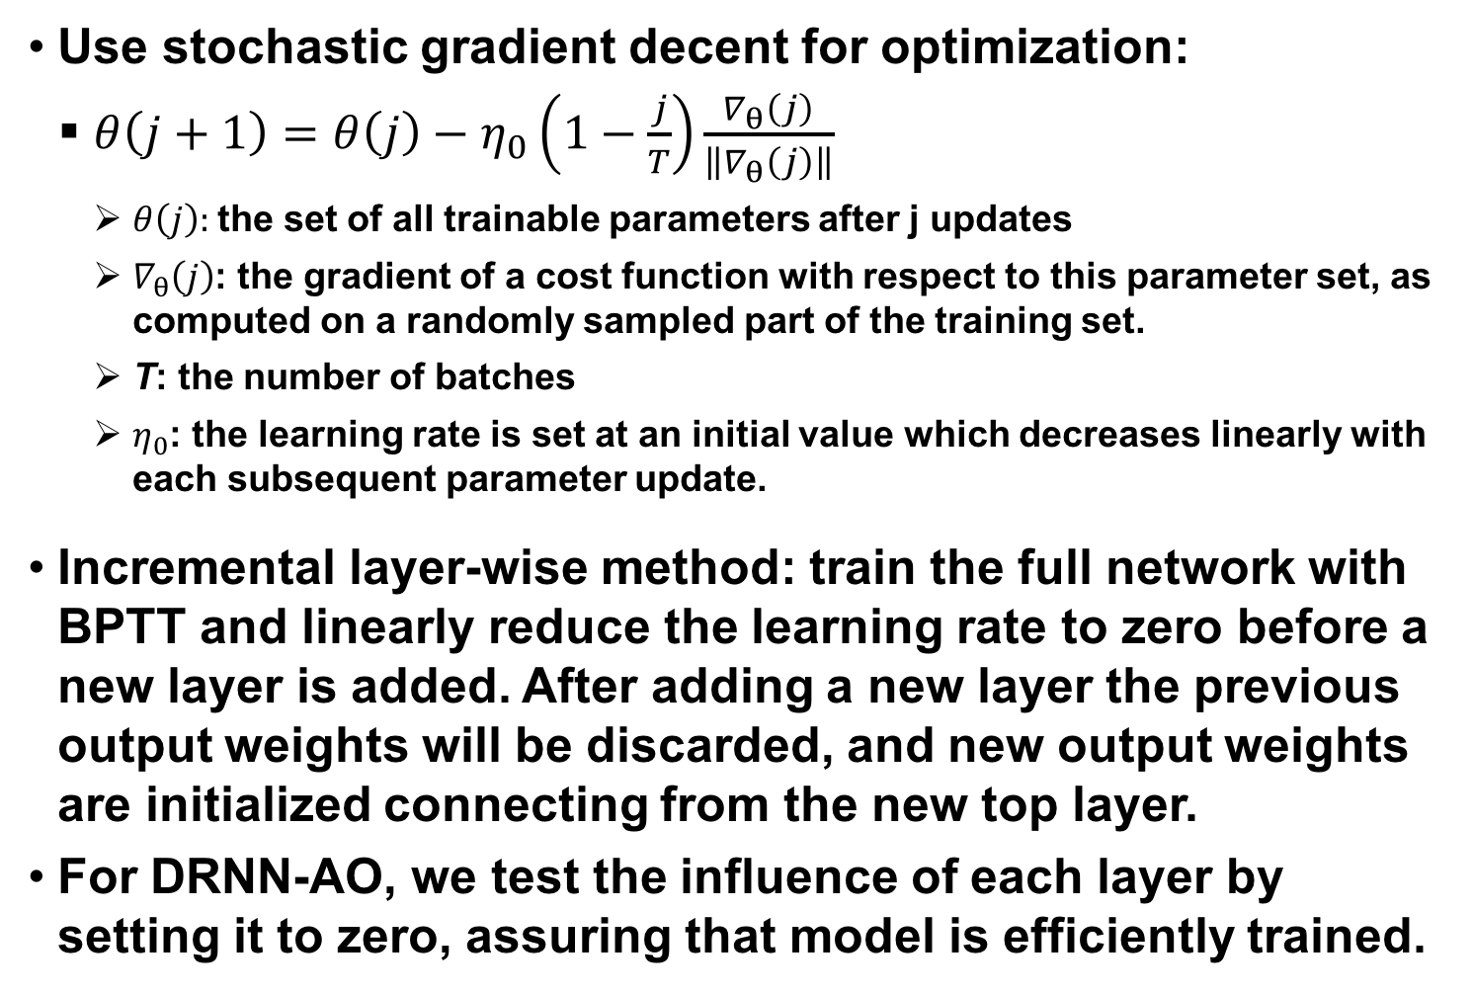
DRNN Training
Use stochastic gradient decent for optimization:
$θ\left(j+1\right)=θ\left(j\right)−η_{0}\left(1−\frac{j}{T}\right)\frac{∇_{θ}\left(j\right)}{\left\|∇_{θ}\left(j\right)\right\|}$
$θ\left(j\right):$the set of all trainable parameters after j updates
$∇_{θ}\left(j\right)$: the gradient of a cost function with respect to this parameter set, as computed on a randomly sampled part of the training set.
T: the number of batches
$η_{0}$: the learning rate is set at an initial value which decreases linearly with each subsequent parameter update.
Incremental layer-wise method: train the full network with BPTT and linearly reduce the learning rate to zero before a new layer is added. After adding a new layer the previous output weights will be discarded, and new output weights are initialized connecting from the new top layer.
For DRNN-AO, we test the influence of each layer by setting it to zero, assuring that model is efficiently trained.
Notes:
In order to train a DRNN, …

Slide 17
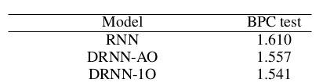
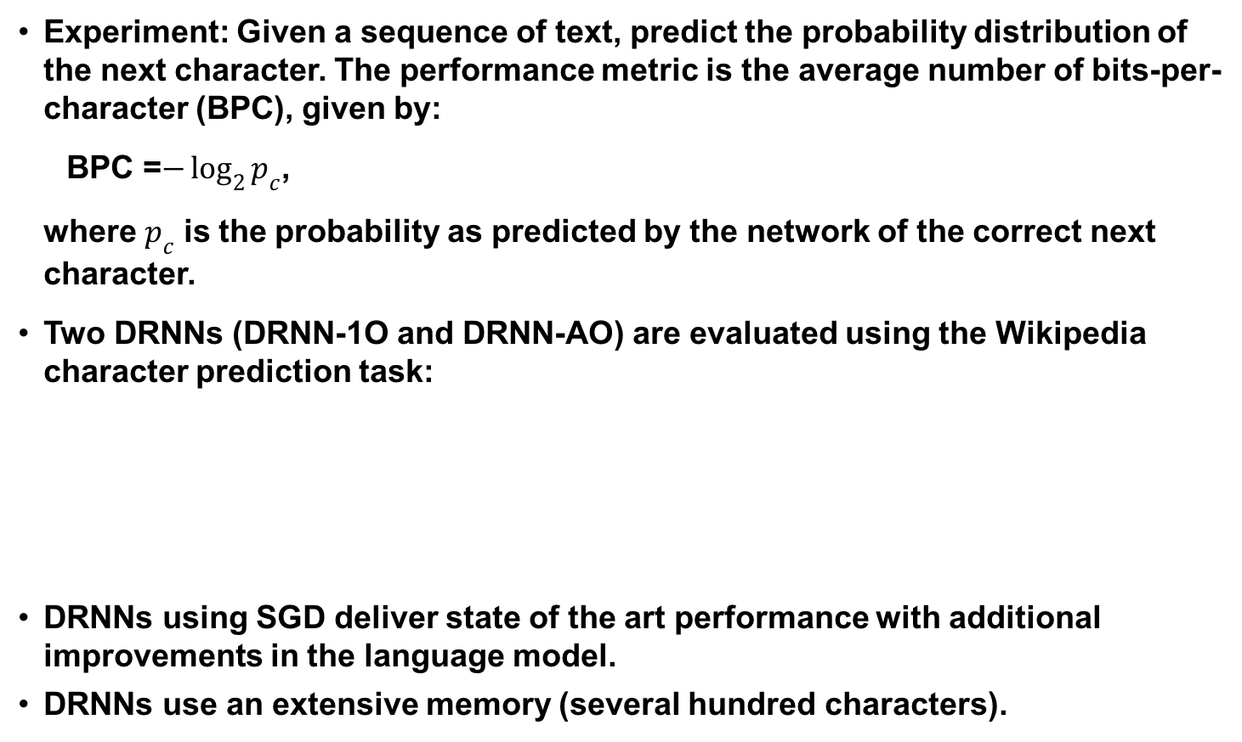
Performance of DRNNs
Experiment: Given a sequence of text, predict the probability distribution of the next character. The performance metric is the average number of bits-per-character (BPC), given by:
BPC =$−\log_{2}{p_{c}}$,
where $p_{c}$ is the probability as predicted by the network of the correct next character.
Two DRNNs (DRNN-1O and DRNN-AO) are evaluated using the Wikipedia character prediction task:
DRNNs using SGD deliver state of the art performance with additional improvements in the language model.
DRNNs use an extensive memory (several hundred characters).

Slide 18
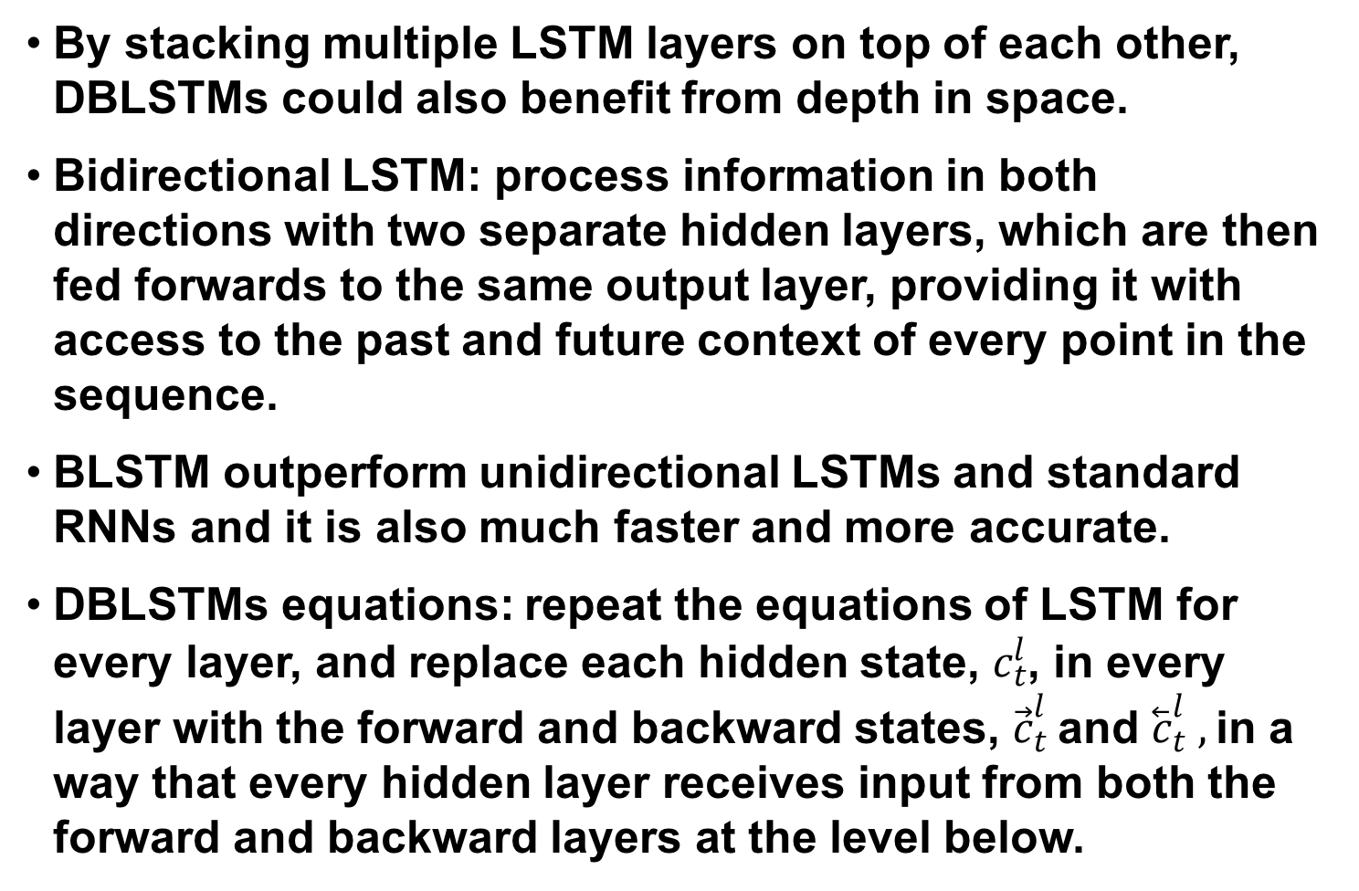
Deep Bidirectionsal LSTMs (DBLSTM)
By stacking multiple LSTM layers on top of each other, DBLSTMs could also benefit from depth in space.
Bidirectional LSTM: process information in both directions with two separate hidden layers, which are then fed forwards to the same output layer, providing it with access to the past and future context of every point in the sequence.
BLSTM outperform unidirectional LSTMs and standard RNNs and it is also much faster and more accurate.
DBLSTMs equations: repeat the equations of LSTM for every layer, and replace each hidden state, $c_{t}^{l}$, in every layer with the forward and backward states, ${\vec{c}}_{t}^{l}$and ${\overset{⃖}{c}}_{t}^{l} ,$in a way that every hidden layer receives input from both the forward and backward layers at the level below.
Notes:
One of the greatest disadvantageous of RNN and LSTM structures that were introduced in part 1 and 2, is that they are processing information just based on the previous context.
In a lot of application including speech recognition, we prefer another structure called bidirectional LSTM (BLSTM) which can …
BLSTMs contain two separate hidden layers, one of them processes the input sequence forwards, while the other processes it backwards. Both hidden layers are connected to the same output layer, providing it with access to the past and future context of every point in the sequence.

Slide 19
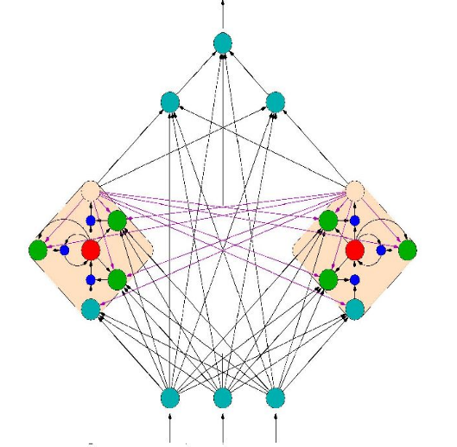
DBLSTM Training and Regularization
End-to-end training methods :
Connectionist Temporal Classification (CTC);
RNN Transducer.
Regularization:
early stopping: monitoring the model’s performance on a validation set.
weight noise: adding Gaussian noise to the network weights during training. Weight noise was added once per training sequence, rather than at every time step.

Slide 20
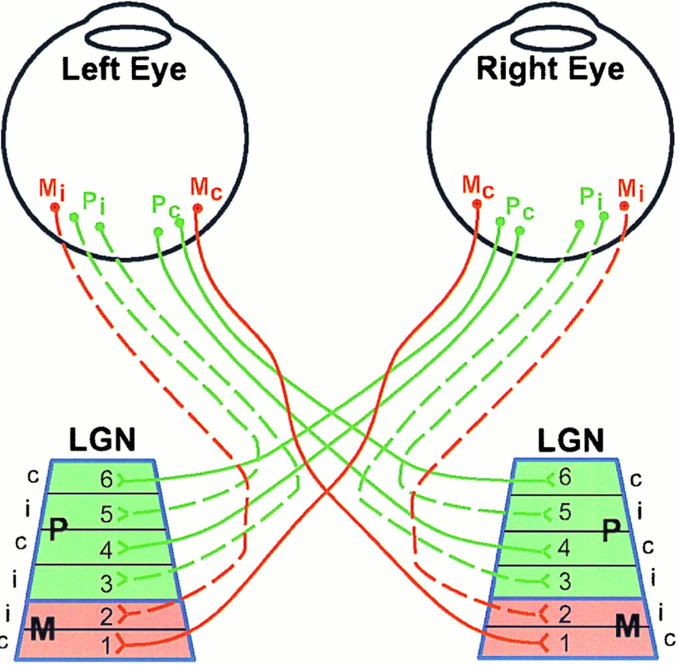
The Visual System: Inspiration for CNNs
The visual system contains a complex arrangement of cells
Each cell is responsible for only a sub-region of the visual field, or receptive field
The arrangement of these sub-regions is such, that the entire visual field is covered
Convolutional Neural Networks (CNNs) were proposed to emulate the animal visual cortex, which exploits the spatially local correlations present in natural images.
Before reaching the primary visual cortex, fibers on the optic nerve make a synapse in the lateral geniculate nucleus (LGN), cells from the fovea (in eye) project to layers composed parvocellular layers. These take care of the fine details that necessary to determine what an object is. Ganglion cells from the peripheral retina project to the Magnocellular (M) layers, which help determine where an object is.

Slide 21
CNNs Connectivity
To exploit the spatially local correlations, the neurons in a layer receive inputs only from a subset of units in the previous layer (spatially contiguous visual field).
The units (neurons) are unresponsive to changes outside of their receptive fields
Higher layers, become more global
Receptive Field = 3
These units have a receptive field of 3, therefore, they are only connected to 3 contiguous units in the previous layer

Slide 22
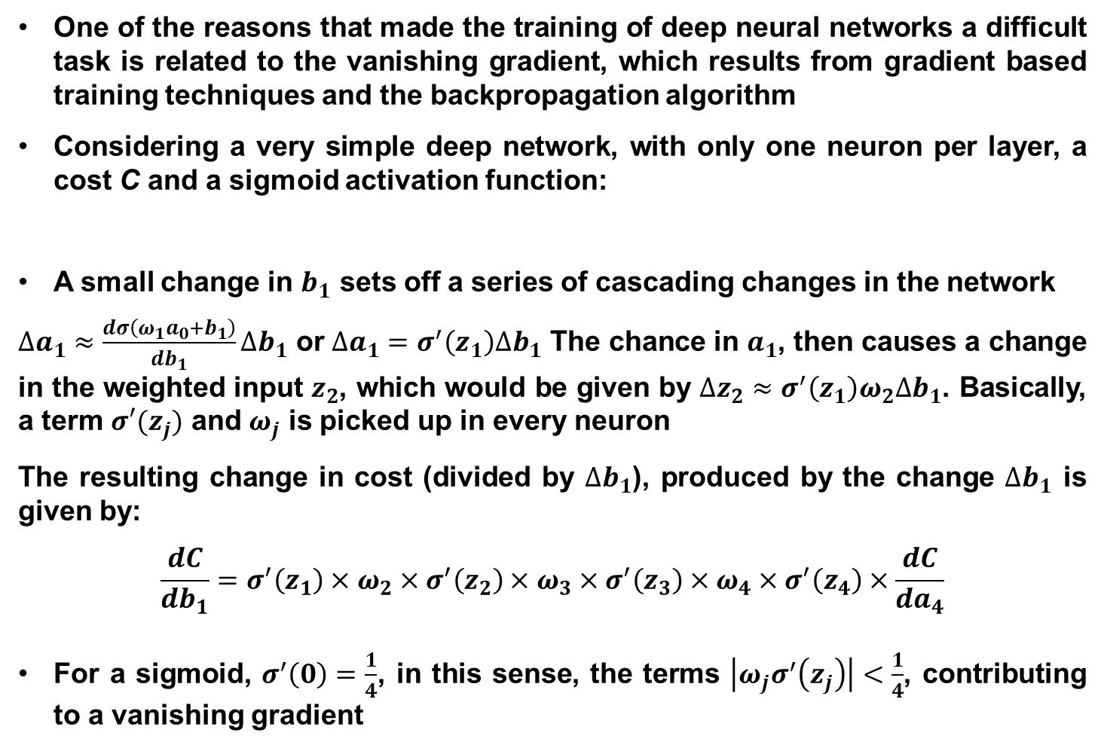
CNNs Convolutional Layer
The convolutional layer is comprised of several “filters” that search for different patterns in the entire input
A feature map can be generated with the information from the learned filters as follows:
$$h_{ij}^{k}=tahn{\left({(W}^{k}⋆x\right)}_{ij}+b_{k})$$
Where $h^{k}$ represents the $k^{th}$ feature map in a hidden layer.
Note that the weight and bias parameters are shared within the same filter
Gradient descent is commonly used for the training of CNNs, but the gradient of the shared weights is given by the sum of the shared parameters
Parameter sharing allows the search of the same pattern in the entire visual field
Each hidden layer is formed of several feature maps
Filter 2

Slide 23
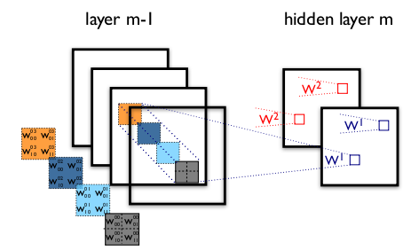
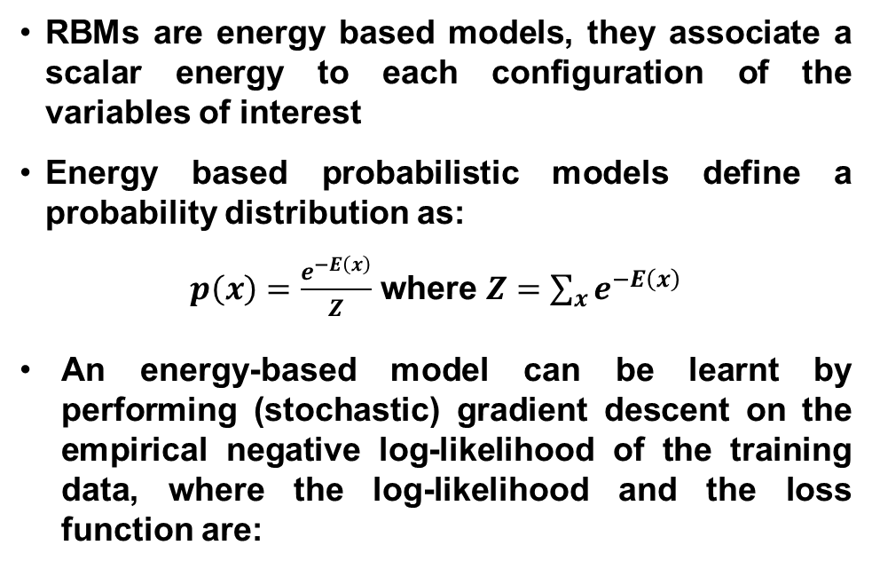
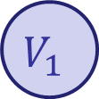
CNNs Convolutional Layer
The figure contains two different CNN layers. Layer $m−1$ contains four feature maps, while layer $m$ contains 2 ($h^{0}$ and $h^{1}$).
The blue and red squares in $m$ are computed from pixels of layer $m−1$ that fall within their 2x2 receptive field (squares in $m−1$).
$W_{ij}^{kl}$ then denotes the weight connecting each pixel of the $k^{th}$feature map at layer $m$ with the pixel at coordinates $(i,j)$ of the $l^{th}$ feature map at layer $m−1$.
It is important to know that the frame length of the filter for image recognition, called stride, is usually set to 1 or 2.
To control the spatial size of the output, zero-padding around the borders is commonly performed

Slide 24
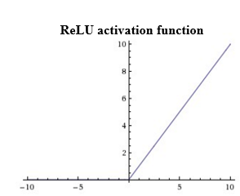
CNNs ReLU Layer
An activation layer is added after one or more convolutional layers.
Typically, for the image recognition tasks, a Rectified Linear Unit activation function (ReLU) is used.
This function is given by
$$f\left(x\right)=max(0,x)$$
Using this activation function increases the non-linear properties of the decision function without affecting the receptive fields of the convolutional layer.
$$x=0$$

Slide 25
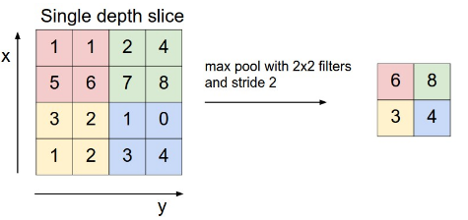
CNNs Pooling Layer
Another typical layer in a CNN is a pooling layer
Pooling layers reduce the resolution through a local maximum, which also reduces the amount of computations and parameters in the network
The pooling layer needs two hyperparameters:
$F:$ Spatial extent (size)
$S:$ Stride (frame length)
Common parameters used in literature are
$$F=2×2$$
$$S=2$$
The most common pooling operation is maxPooling, which partitions the input into a set of non-overlapping section and, for each sub-region outputs the max value.
Pooling helps to make the representation become approximately invariant to small translations in the input.

Slide 26
CNNs Fully Connected Layer
If classification is being performed, a fully-connected layer is added
This layer corresponds to a traditional Multilinear Perceptron (MLP)
As the name indicates it, the neurons in the fully connected layer have full connections to all activations in the previous layers
Adding this layer allows the classification of the input described by the feature maps extracted by the previous layers
This layer works in the same way as an MLP and activation functions used commonly include the sigmoid function and the tahn function

Slide 27
CNN: All Together
Summarizing the layers shown so far, a CNN is depicted:
ReLu Layer
Convolutional Layer
Pooling Layer
Fully Connected Layer

Slide 28
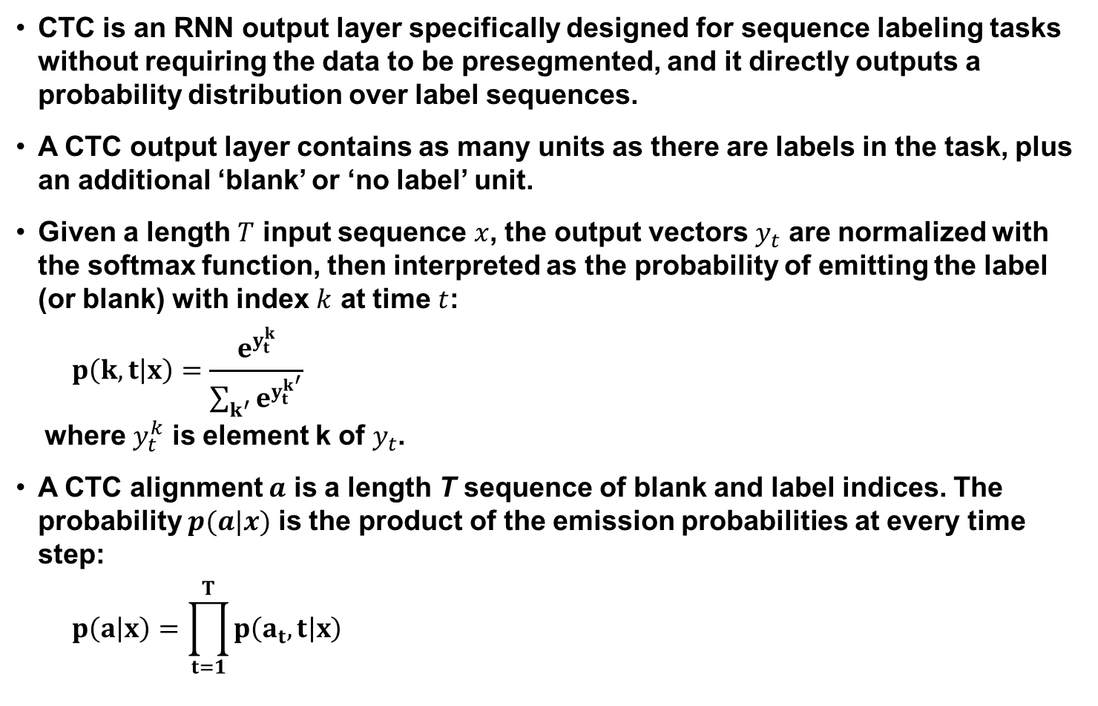
Connectionist Temporal Classification (CTC)
CTC is an RNN output layer specifically designed for sequence labeling tasks without requiring the data to be presegmented, and it directly outputs a probability distribution over label sequences.
A CTC output layer contains as many units as there are labels in the task, plus an additional ‘blank’ or ‘no label’ unit.
Given a length $T$ input sequence $x$, the output vectors $y_{t}$ are normalized with the softmax function, then interpreted as the probability of emitting the label (or blank) with index $k$ at time $t$:
$$p\left(k,t | x\right)=\frac{e^{y_{t}^{k}}}{\sum_{k^{′}}{e^{y_{t}^{k^{′}}}}}$$
where $y_{t}^{k}$ is element k of $y_{t}$.
A CTC alignment $a$ is a length T sequence of blank and label indices. The probability $p(a|x)$ is the product of the emission probabilities at every time step:
$$p\left(a | x\right)=\prod_{t=1}^{T}{p\left(a_{t},t | x\right) }$$

Slide 29
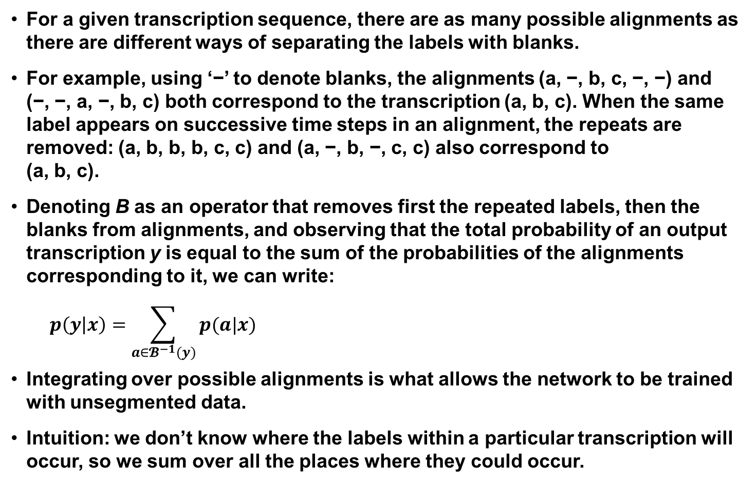
Connectionist Temporal Classification (CTC)
For a given transcription sequence, there are as many possible alignments as there are different ways of separating the labels with blanks.
For example, using ‘−’ to denote blanks, the alignments (a, −, b, c, −, −) and (−, −, a, −, b, c) both correspond to the transcription (a, b, c). When the same label appears on successive time steps in an alignment, the repeats are removed: (a, b, b, b, c, c) and (a, −, b, −, c, c) also correspond to (a, b, c).
Denoting B as an operator that removes first the repeated labels, then the blanks from alignments, and observing that the total probability of an output transcription y is equal to the sum of the probabilities of the alignments corresponding to it, we can write:
$$p\left(y | x\right)=\sum_{a∈𝓑^{−1}(y)}{p(a|x)}$$
Integrating over possible alignments is what allows the network to be trained with unsegmented data.
Intuition: we don’t know where the labels within a particular transcription will occur, so we sum over all the places where they could occur.

Slide 30
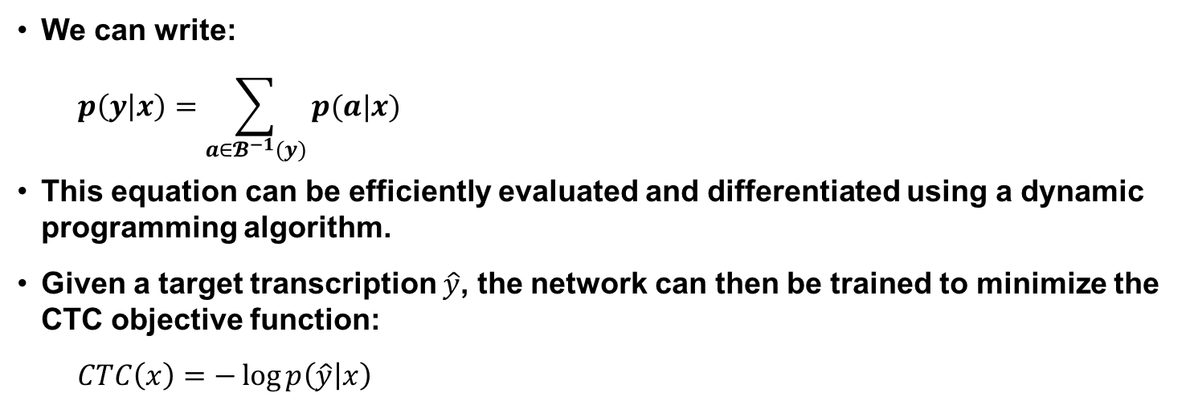
Connectionist Temporal Classification (Continued)
We can write:
$$p\left(y | x\right)=\sum_{a∈𝓑^{−1}(y)}{p(a|x)}$$
This equation can be efficiently evaluated and differentiated using a dynamic programming algorithm.
Given a target transcription $\hat{y}$, the network can then be trained to minimize the CTC objective function:
$$CTC\left(x\right)=−\log{p\left(\hat{y} | x\right)}$$

Slide 31
RNN Transducers
A combination of a CTC network with a separate DBLSTM that predicts each phoneme given the previous one.
Unlike CTC which is an acoustic-only model, an RNN transducer can integrate acoustic and linguistic information during a speech recognition task and yields a jointly trained acoustic and language model.
While CTC predicts an output distribution at each input time step, an RNN transducer determines a separate distribution P(k|t,u) for every combination of input time step t and output time step u.
An RNN transducer uses two networks:
Transcription network: scans the input sequence and outputs the sequence of transcription vectors.
Prediction network: scans the output sequence and outputs the prediction vector sequence.
RNN transducers can be decoded with beam search to yield an N-best list of candidate transcriptions.

Slide 32
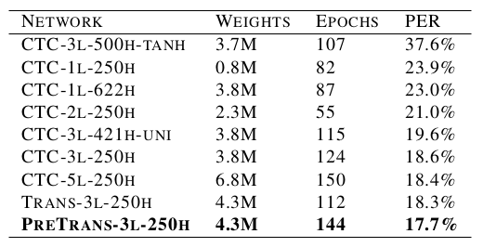
DBLSTM Performance
Phoneme recognition experiments on the TIMIT Corpus.
A bidirectional LSTM was used for all networks except CTC-3l-500h-tanh, which had tanh units instead of LSTM cells, and CTC-3l-421h-uni where the LSTM layers were unidirectional.
LSTM works much better than tanh for this task.
Bidirectional LSTMs have a slight advantage over unidirectional LSTMs.
Depth is more important than layer size.

Slide 33
Summary and Future Work
Deep recurrent neural networks and deep bidirectional long short-term memory once were giving the best known results on sequential tasks such as speech recognition.
Conformers, a synthesis of CNNs, transfer learning and Transformers, are now the ‘hot’ architecture.
Residual Networks (ResNets) combined with transfer learning are good candidates for sequential decoding tasks.
Future directions include unsupervised and self-supervised training.

