Slide 1
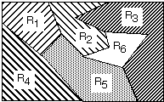
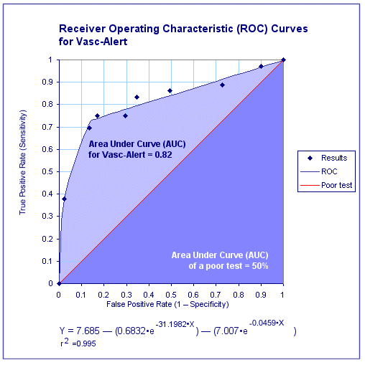
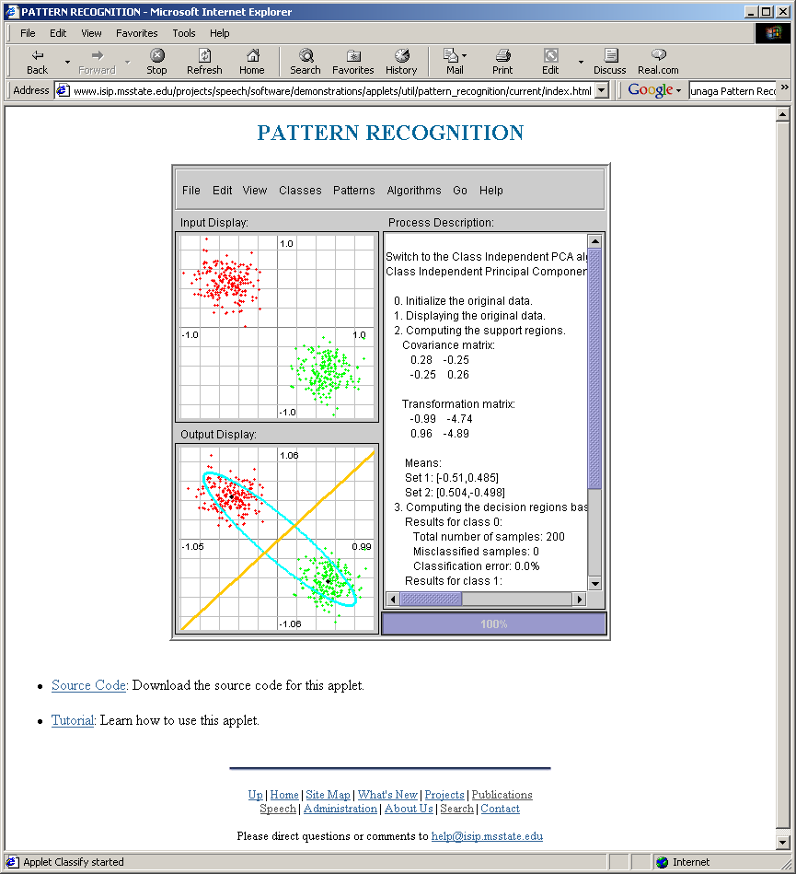
Lecture 03: Gaussian Classifiers
• Objectives:
Decision Surfaces
Multivariate Gaussian Distributions Discriminant Functions Gaussian Classifiers Linear Machines Threshold Decoding
• Resources:
Textbook (Sections 9.3, 9.4)
DHS: Chapter 2
MurphK: Gaussian Classifiers

Slide 2
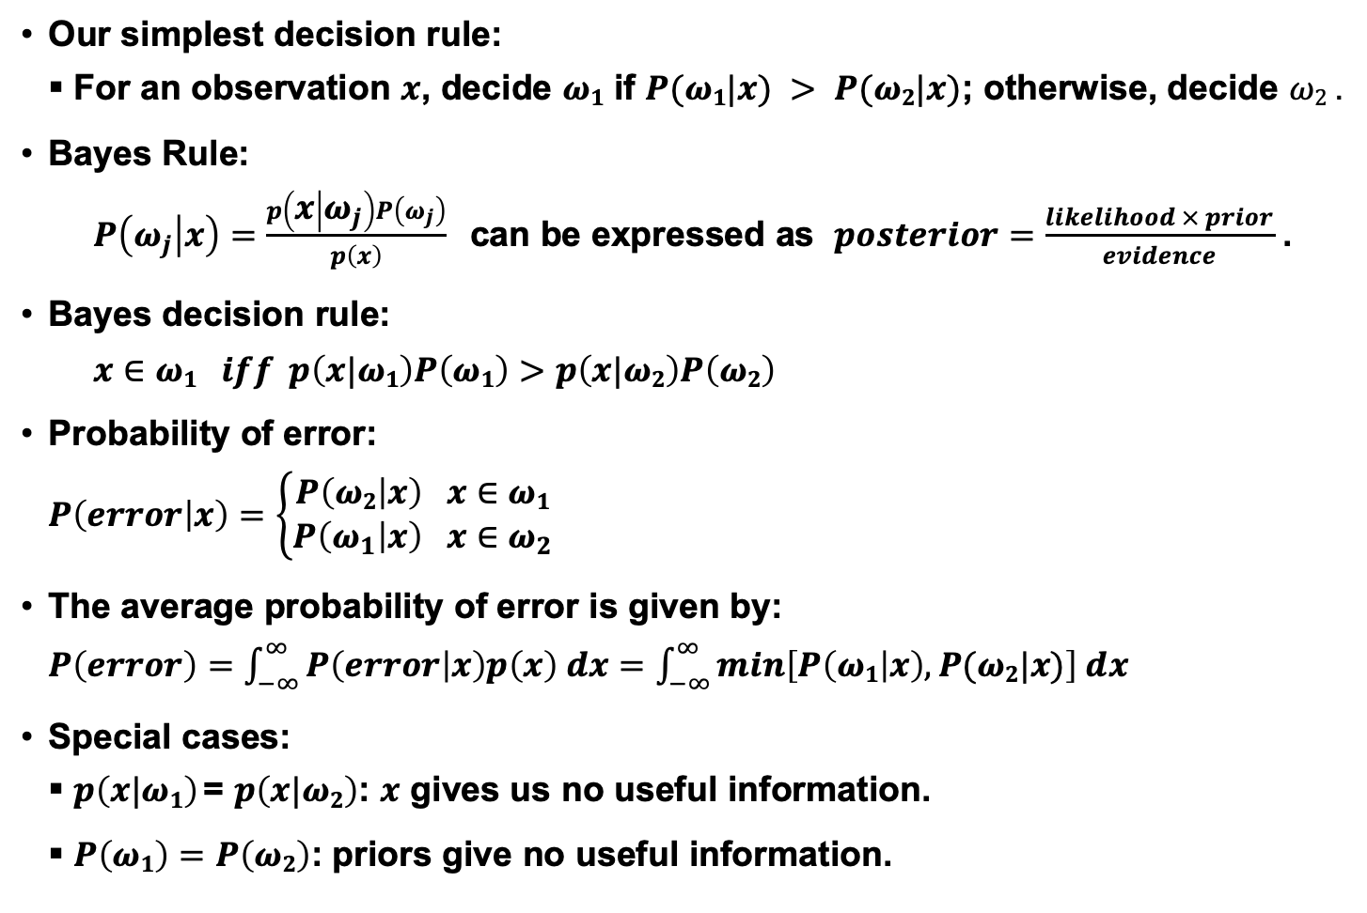
Posterior Probabilities
Our simplest decision rule:
For an observation $x$, decide $ω1$ if $P(ω1|x) > P(ω2|x)$; otherwise, decide $ω2$ .
Bayes Rule:
$P\left(ω_{j} | x\right)=\frac{p\left(x | ω_{j}\right)P\left(ω_{j}\right)}{p\left(x\right)}$ can be expressed as $posterior=\frac{likelihood × prior}{evidence}$ .
Bayes decision rule:
$$x∈ω1 iff p\left(x|ω1\right)P\left(ω1\right)>p\left(x|ω2\right)P\left(ω2\right)$$
Probability of error:
$$P\left(error | x\right)=\left\{\begin{matrix}P\left(ω2 | x\right) x∈ω1 \\ P\left(ω_{1} | x\right) x∈ω_{2}\end{matrix}\right.$$
The average probability of error is given by:
$P\left(error\right)=\int_{−∞}^{∞}{P\left(error | x\right)p\left(x\right) dx=}$ $\int_{−∞}^{∞}{min\left[P\left(ω1 | x\right),P(ω2|x)\right] dx}$
Special cases:
$p\left(x|ω1\right)$= $p\left(x|ω2\right)$: $x$ gives us no useful information.
$P\left(ω1\right)=P\left(ω2\right)$: priors give no useful information.

Slide 3
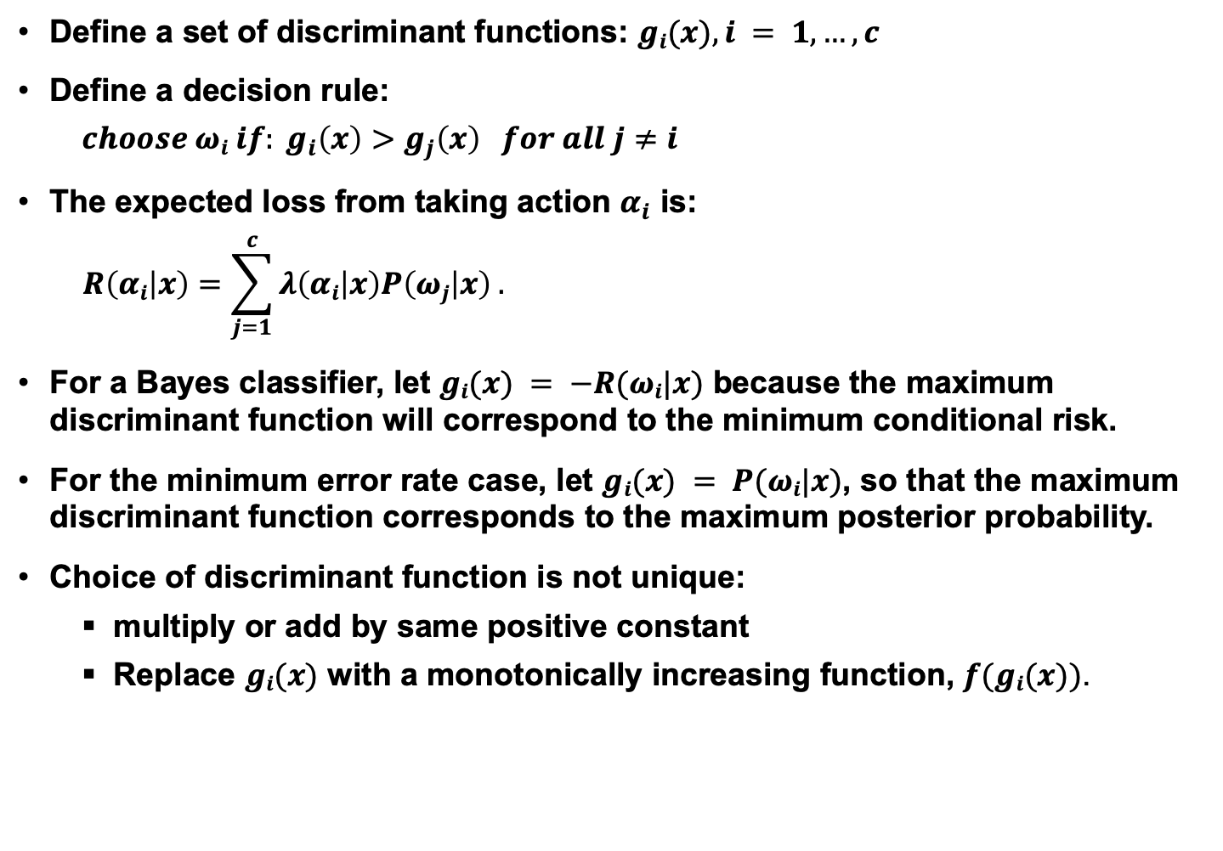
Multicategory Decision Surfaces
Define a set of discriminant functions: $gi(x), i = 1,…, c$
Define a decision rule:
$$choose ωi if: g_{i}\left(x\right)>g_{j}\left(x\right) for all j≠i$$
The expected loss from taking action $α_{i}$ is:
$$R\left(αi | x\right)=\sum_{j=1}^{c}{λ\left(αi | x\right)P\left(ωj | x\right) .}$$
For a Bayes classifier, let $gi(x) = −R(ωi|x)$ because the maximum discriminant function will correspond to the minimum conditional risk.
For the minimum error rate case, let $gi(x) = P(ωi|x)$, so that the maximum discriminant function corresponds to the maximum posterior probability.
Choice of discriminant function is not unique:
multiply or add by same positive constant
Replace $gi(x)$ with a monotonically increasing function, $f(gi(x))$.

Slide 4

Log Probabilities
Some monotonically increasing functions can simplify calculations considerably:
$g_{i}\left(x\right)=P\left(ω_{i} | x\right)=\frac{p\left(x | ω_{i}\right)P\left(ω_{i}\right)}{\sum_{j=1}^{c}{p\left(x | ω_{j}\right)P\left(ω_{j}\right)}}$ (1)
$g_{i}\left(x\right)=$ $p\left(x | ω_{i}\right)P\left(ω_{i}\right)$ (2)
$f\left(g_{i}\left(x\right)\right)=ln\left(g_{i}\left(x\right)\right)=ln\left(p\left(x | ω_{i}\right)\right)+ln\left(P\left(ω_{i}\right)\right)$ (3)
What are some of the reasons (3) is particularly useful?
Computational complexity (e.g., Gaussian)
Numerical accuracy (e.g., probabilities tend to zero)
Decomposition (e.g., likelihood and prior are separated and can be weighted differently)
Normalization (e.g., likelihoods are channel dependent).

Slide 5
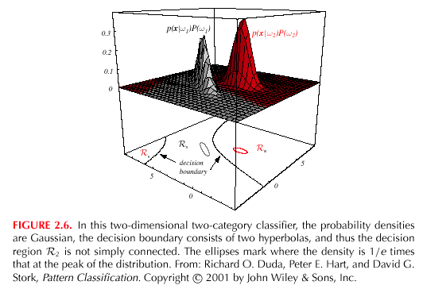
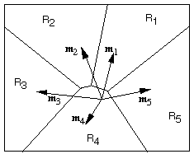

Decision Surfaces
We can visualize our decision rule several ways:
$$choose ωi if: g_{i}\left(x\right)>g_{j}\left(x\right) for all j≠i$$

Slide 6
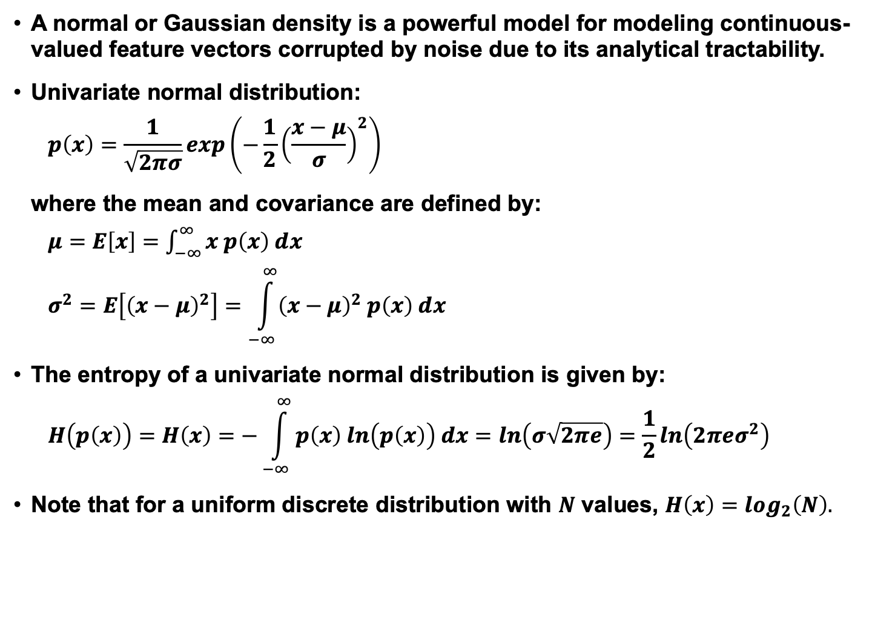
Univariate Normal Distribution
A normal or Gaussian density is a powerful model for modeling continuous-valued feature vectors corrupted by noise due to its analytical tractability.
Univariate normal distribution:
$$p\left(x\right)=\frac{1}{\sqrt{2πσ}}exp\left(−\frac{1}{2}{\left(\frac{x−μ}{σ}\right)}^{2}\right)$$
where the mean and covariance are defined by:
$μ=E\left[x\right]=$ $\int_{−∞}^{∞}{x p\left(x\right) dx}$
$$σ^{2}=E\left[{\left(x−μ\right)}^{2}\right]=\int_{−∞}^{∞}{{\left(x−μ\right)}^{2} p\left(x\right) dx}$$
The entropy of a univariate normal distribution is given by:
$$H\left(p\left(x\right)\right)=H\left(x\right)=−\int_{−∞}^{∞}{p\left(x\right) ln\left(p\left(x\right)\right) dx=ln\left(σ\sqrt{2πe}\right)=\frac{1}{2}ln\left(2πeσ^{2}\right)}$$
Note that for a uniform discrete distribution with $N$ values, $H\left(x\right)=\log_{2}\left(N\right).$

Slide 7

Multivariate Gaussian (Normal) Distributions
Recall the definition of a normal distribution (Gaussian):
$$p\left(x\right)=\frac{1}{\left({2π}^{d/2}\right){\left|Σ\right|}^{1/2}}exp\left(−\frac{1}{2}{\left(x−μ\right)}^{t}Σ^{−1}\left(x−μ\right)\right)$$
Why is this distribution so important in engineering?
Mean: $μ=E\left[x\right]$ $=\int_{−∞}^{∞}{x p\left(x\right) dx}$
Covariance: $∑=E\left[{\left(x−μ\right)\left(x−μ\right)}^{t}\right]$
Statistical independence?
Higher-order moments?
Occam’s Razor?
Entropy?
Linear combinations of normal random variables?
Central Limit Theorem?

Slide 8
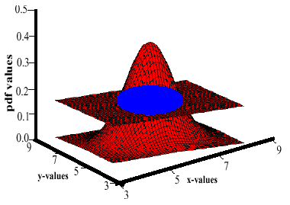
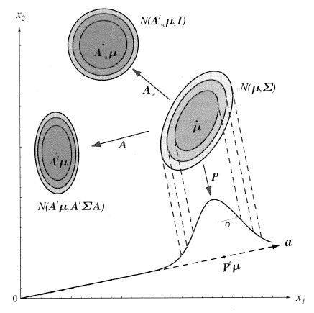
Support Regions
A support region is the obtained by the intersection of a Gaussian distribution with a plane.
For a horizontal plane, this generates an ellipse whose points are of equal probability density.
The shape of the support region is defined by the covariance matrix.

Slide 9
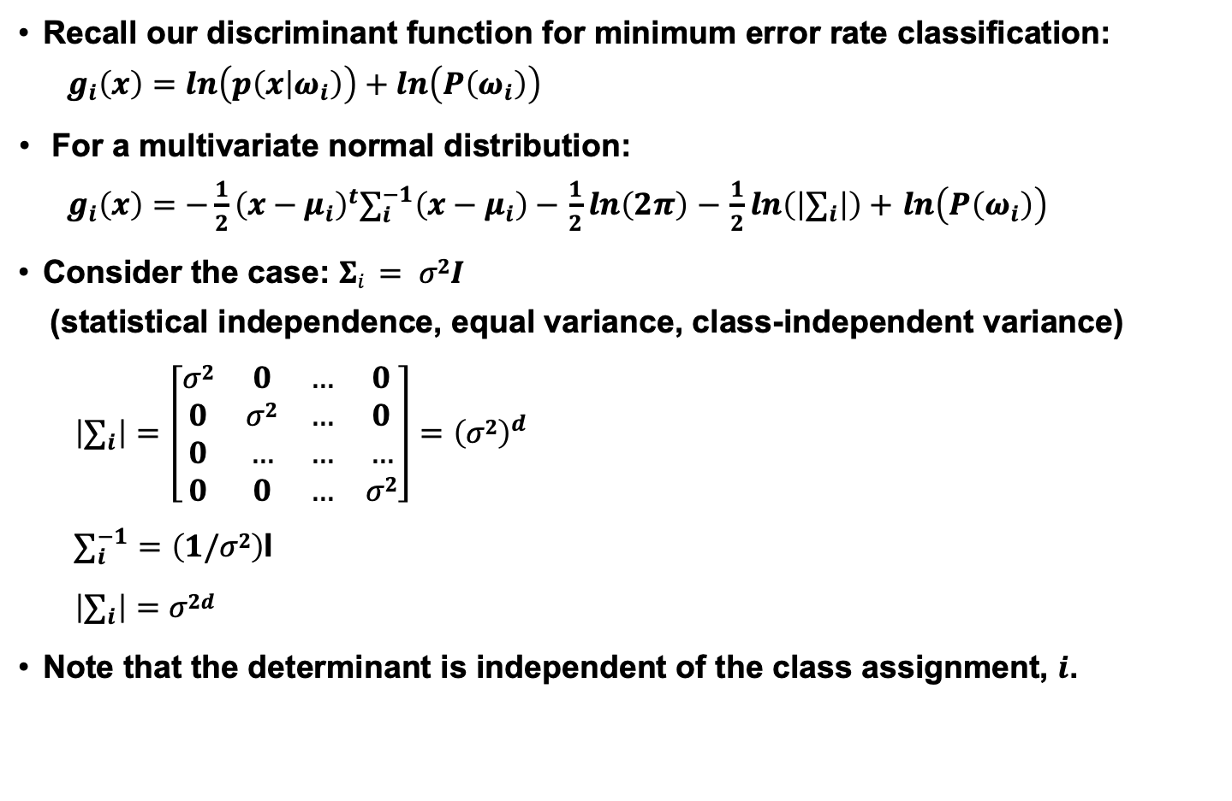
Discriminant Functions
Recall our discriminant function for minimum error rate classification:
$$g_{i}\left(x\right)=ln\left(p\left(x | ω_{i}\right)\right)+ln\left(P\left(ω_{i}\right)\right)$$
For a multivariate normal distribution:
$g_{i}\left(x\right)=−\frac{1}{2}{\left(x−μ_{i}\right)}^{t}∑_{i}^{−1}\left(x−μ_{i}\right)−$ $\frac{1}{2}ln\left(2π\right)$ $−$ $\frac{1}{2}ln\left(\left|∑_{i}\right|\right)+$ $ln\left(P\left(ω_{i}\right)\right)$
Consider the case: $Σi = σ2I$
(statistical independence, equal variance, class-independent variance)
$$\left|∑_{i}\right|=\left[\begin{matrix}σ2 & 0 & … & 0 \\ 0 & σ2 & … & 0 \\ 0 & … & … & … \\ 0 & 0 & … & σ2\end{matrix}\right]={\left(σ2\right)}^{d}$$
$∑_{i}^{−1}=\left(1/σ2\right)$I
$$\left|∑_{i}\right|=σ2d$$
Note that the determinant is independent of the class assignment, $i$.

Slide 10
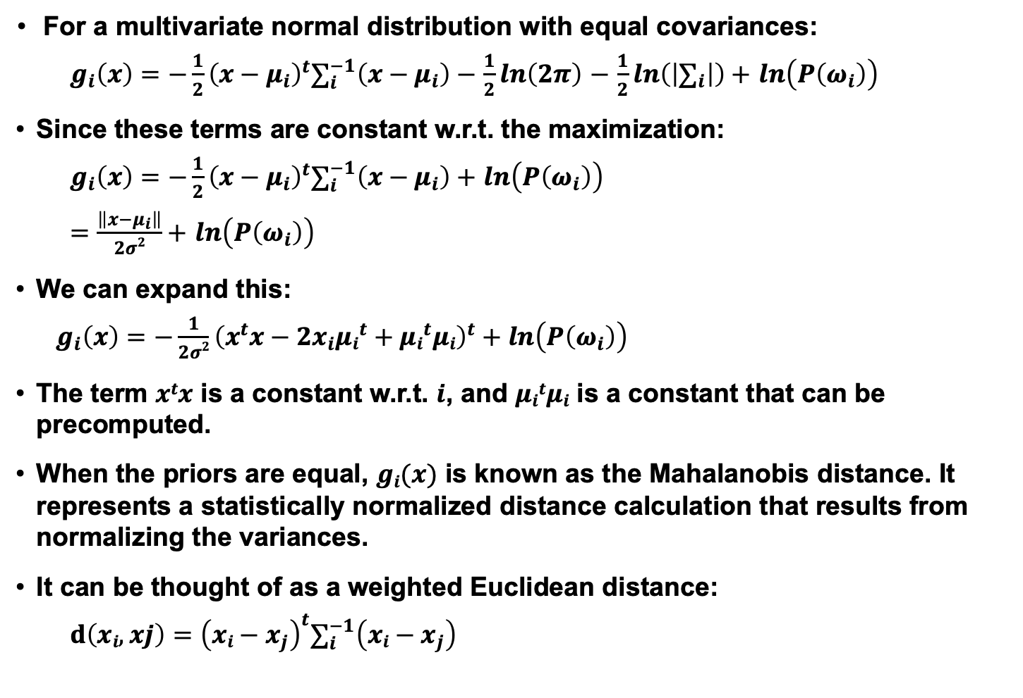
Gaussian Classifiers
For a multivariate normal distribution with equal covariances:
$g_{i}\left(x\right)=−\frac{1}{2}{\left(x−μ_{i}\right)}^{t}∑_{i}^{−1}\left(x−μ_{i}\right)−$ $\frac{1}{2}ln\left(2π\right)$ $−$ $\frac{1}{2}ln\left(\left|∑_{i}\right|\right)+$ $ln\left(P\left(ω_{i}\right)\right)$
Since these terms are constant w.r.t. the maximization:
$g_{i}\left(x\right)=−\frac{1}{2}{\left(x−μ_{i}\right)}^{t}∑_{i}^{−1}\left(x−μ_{i}\right)+$ $ln\left(P\left(ω_{i}\right)\right)$
$=\frac{\left\|x−μ_{i}\right\|}{2σ2}+$ $ln\left(P\left(ω_{i}\right)\right)$
We can expand this:
$g_{i}\left(x\right)=−\frac{1}{2σ2}{\left(x^{t}x−{2x}_{i}{μi}^{t}+{μi}^{t}μi\right)}^{t}+$ $ln\left(P\left(ω_{i}\right)\right)$
The term $xtx$ is a constant w.r.t. $i$, and $μitμi$ is a constant that can be precomputed.
When the priors are equal, $gi(x)$ is known as the Mahalanobis distance. It represents a statistically normalized distance calculation that results from normalizing the variances.
It can be thought of as a weighted Euclidean distance:
$$d\left(xi,xj\right)={\left(xi−x_{j}\right)}^{t}∑_{i}^{−1}\left(xi−x_{j}\right)$$

Slide 11
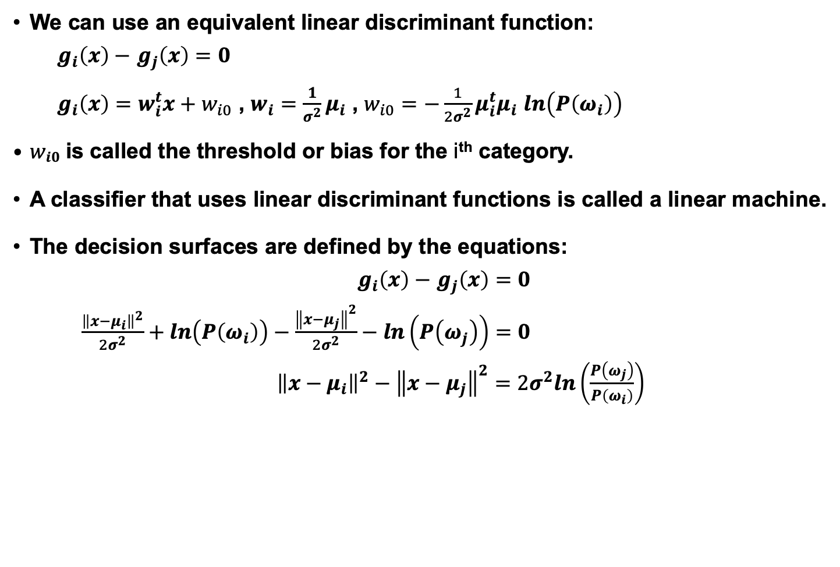
Linear Machines
We can use an equivalent linear discriminant function:
$g_{i}\left(x\right)−$ $g_{j}\left(x\right)=0$
$g_{i}\left(x\right)=w_{i}^{t}x+w_{i0}$ , $w_{i}=\frac{1}{σ^{2}}μ_{i}$ , $w_{i0}=−\frac{1}{2σ^{2}}{μ_{i}^{t}μ}_{i}$ $ln\left(P\left(ω_{i}\right)\right)$
$wi0$ is called the threshold or bias for the i^{th} category.
A classifier that uses linear discriminant functions is called a linear machine.
The decision surfaces are defined by the equations:
$g_{i}\left(x\right)−$ $g_{j}\left(x\right)=0$
$\frac{{\left\|x−μ_{i}\right\|}^{2}}{2σ^{2}}+ln\left(P\left(ω_{i}\right)\right)−\frac{{\left\|x−μ_{j}\right\|}^{2}}{2σ^{2}}−ln\left(P\left(ω_{j}\right)\right)=0$
${\left\|x−μ_{i}\right\|}^{2}−{\left\|x−μ_{j}\right\|}^{2}=2σ^{2}ln\left(\frac{P\left(ω_{j}\right)}{P\left(ω_{i}\right)}\right)$

Slide 12
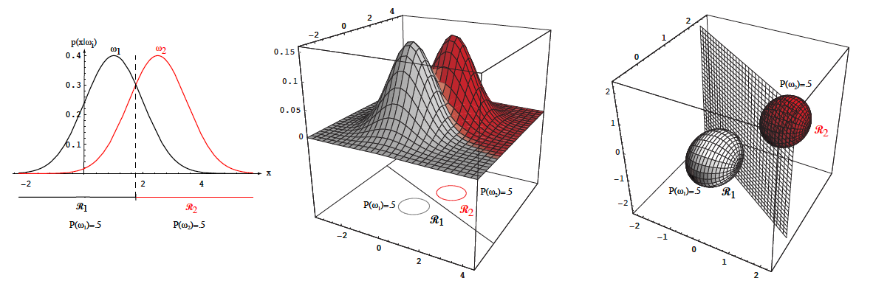
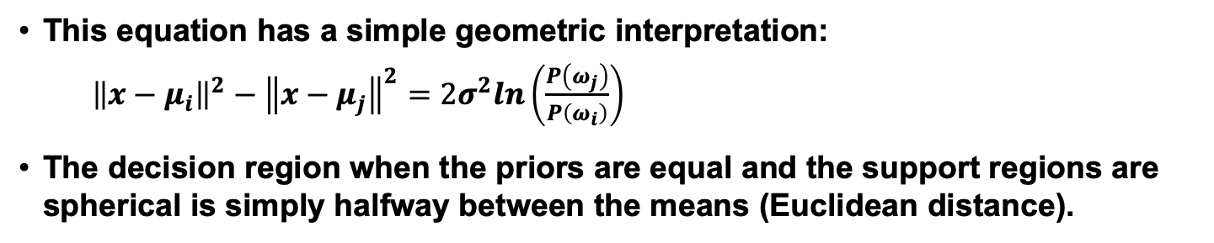
Threshold Decoding
This equation has a simple geometric interpretation:
${\left\|x−μ_{i}\right\|}^{2}−{\left\|x−μ_{j}\right\|}^{2}=2σ^{2}ln\left(\frac{P\left(ω_{j}\right)}{P\left(ω_{i}\right)}\right)$
The decision region when the priors are equal and the support regions are spherical is simply halfway between the means (Euclidean distance).

Slide 13
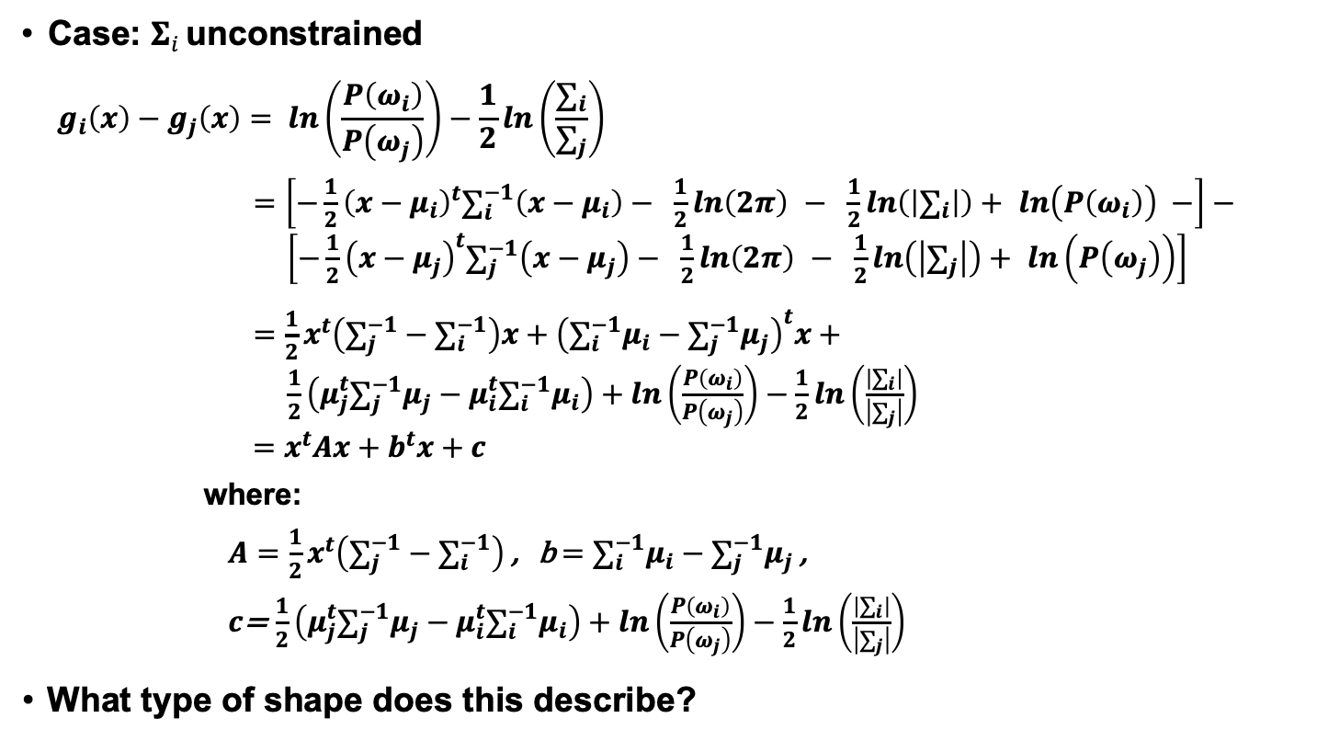
General Case for Gaussian Classifiers
Case: $Σi$ unconstrained
$$g_{i}\left(x\right)−g_{j}\left(x\right)= ln\left(\frac{P\left(ω_{i}\right)}{P\left(ω_{j}\right)}\right)−\frac{1}{2}ln\left(\frac{∑_{i}}{∑_{j}}\right)$$
$=\left[−\frac{1}{2}{\left(x−μ_{i}\right)}^{t}∑_{i}^{−1}\left(x−μ_{i}\right)− \frac{1}{2}ln\left(2π\right) − \frac{1}{2}ln\left(\left|∑_{i}\right|\right)+ ln\left(P\left(ω_{i}\right)\right) −\right]−$
$\left[−\frac{1}{2}{\left(x−μ_{j}\right)}^{t}∑_{j}^{−1}\left(x−μ_{j}\right)− \frac{1}{2}ln\left(2π\right) − \frac{1}{2}ln\left(\left|∑_{j}\right|\right)+ ln\left(P\left(ω_{j}\right)\right)\right]$
$=\frac{1}{2}x^{t}\left(∑_{j}^{−1}−∑_{i}^{−1}\right)x+{\left(∑_{i}^{−1}μ_{i}−∑_{j}^{−1}μ_{j}\right)}^{t}x+$
$\frac{1}{2}\left(μ_{j}^{t}∑_{j}^{−1}μ_{j}−μ_{i}^{t}∑_{i}^{−1}μ_{i}\right)+ln\left(\frac{P\left(ω_{i}\right)}{P\left(ω_{j}\right)}\right)−\frac{1}{2}ln\left(\frac{\left|∑_{i}\right|}{\left|∑_{j}\right|}\right)$
$=x^{t}Ax+b^{t}x+c$
where:
$A=$ $\frac{1}{2}x^{t}\left(∑_{j}^{−1}−∑_{i}^{−1}\right)$ , b $=$ $∑_{i}^{−1}μ_{i}−∑_{j}^{−1}μ_{j}$ ,
$c$= $\frac{1}{2}\left(μ_{j}^{t}∑_{j}^{−1}μ_{j}−μ_{i}^{t}∑_{i}^{−1}μ_{i}\right)+ln\left(\frac{P\left(ω_{i}\right)}{P\left(ω_{j}\right)}\right)−\frac{1}{2}ln\left(\frac{\left|∑_{i}\right|}{\left|∑_{j}\right|}\right)$
What type of shape does this describe?

Slide 14
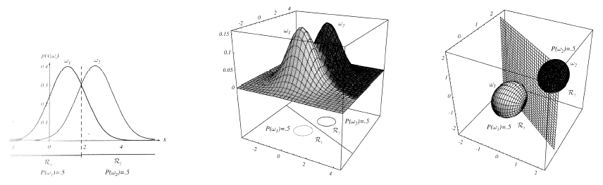
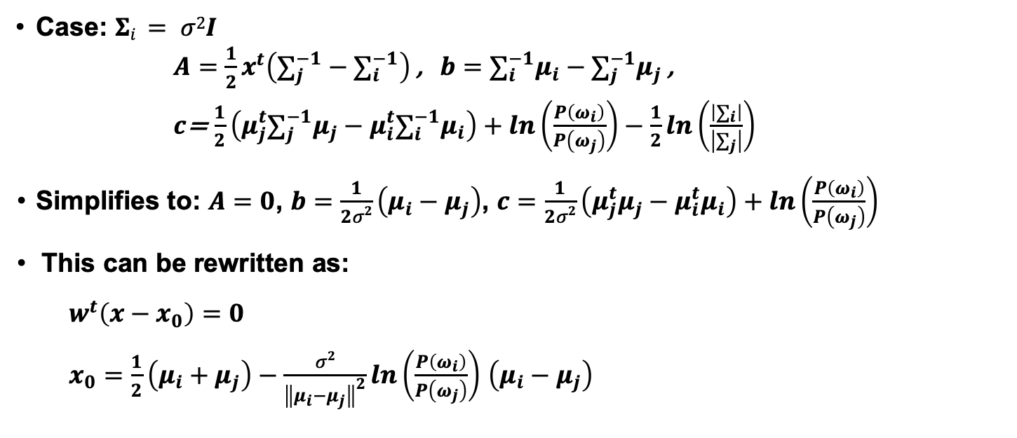
Special Case: Identity Covariance
Case: $Σi = σ2I$
$A=$ $\frac{1}{2}x^{t}\left(∑_{j}^{−1}−∑_{i}^{−1}\right)$ , $b=$ $∑_{i}^{−1}μ_{i}−∑_{j}^{−1}μ_{j}$ ,
$c$= $\frac{1}{2}\left(μ_{j}^{t}∑_{j}^{−1}μ_{j}−μ_{i}^{t}∑_{i}^{−1}μ_{i}\right)+ln\left(\frac{P\left(ω_{i}\right)}{P\left(ω_{j}\right)}\right)−\frac{1}{2}ln\left(\frac{\left|∑_{i}\right|}{\left|∑_{j}\right|}\right)$
Simplifies to: $A=0$, $b=$ $\frac{1}{2σ2}\left(μ_{i}−μ_{j}\right)$, $c=\frac{1}{2σ2}\left(μ_{j}^{t}μ_{j}−μ_{i}^{t}μ_{i}\right)+ln\left(\frac{P\left(ω_{i}\right)}{P\left(ω_{j}\right)}\right)$
This can be rewritten as:
$$w^{t}\left(x−x_{0}\right)=0$$
$x_{0}=\frac{1}{2}\left(μ_{i}+μ_{j}\right)−\frac{σ2}{{\left\|μ_{i}−μ_{j}\right\|}^{2}}ln\left(\frac{P\left(ω_{i}\right)}{P\left(ω_{j}\right)}\right)$ $\left(μ_{i}−μ_{j}\right)$

Slide 15
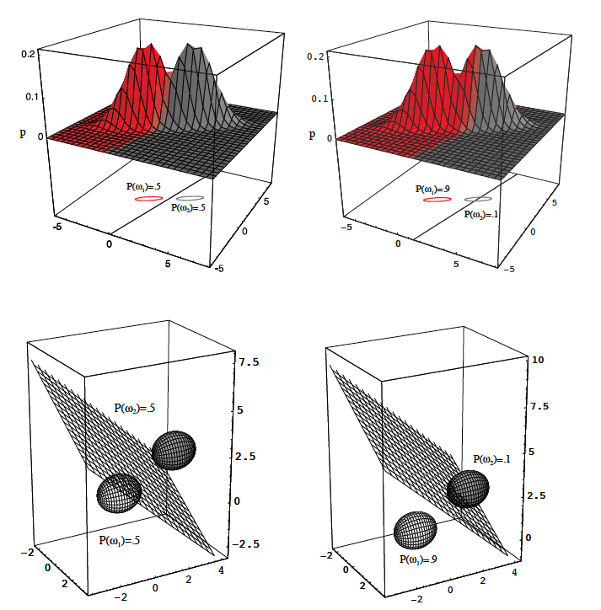
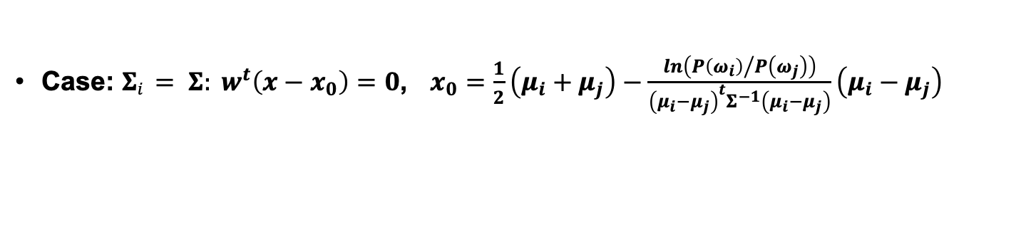
Equal Covariances (But Not Diagonal)
Case: $Σi = Σ: w^{t}\left(x−x_{0}\right)=0$, $x_{0}=\frac{1}{2}\left(μ_{i}+μ_{j}\right)−\frac{ln\left({P\left(ω_{i}\right)}/{P\left(ω_{j}\right)}\right)}{{\left(μ_{i}−μ_{j}\right)}^{t}Σ^{−1}\left(μ_{i}−μ_{j}\right)}\left(μ_{i}−μ_{j}\right)$

Slide 16
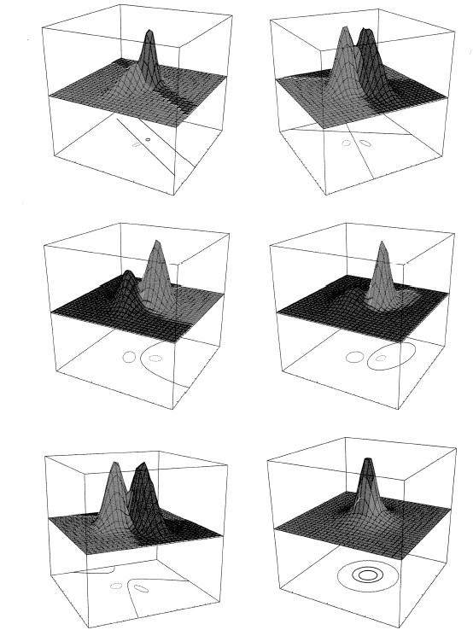
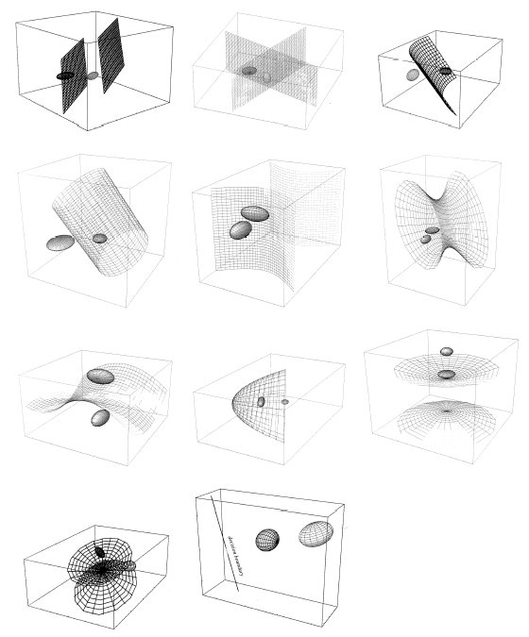
Gaussian Classifiers: Arbitrary Covariances

Slide 17
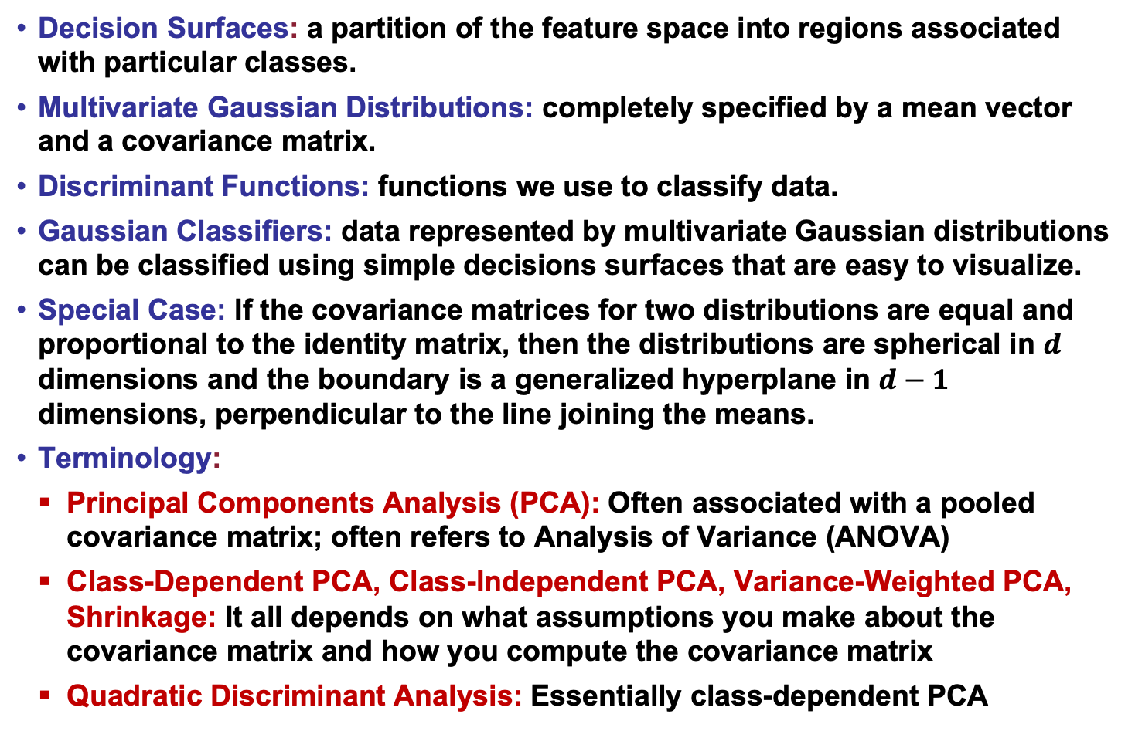
Summary
Decision Surfaces: a partition of the feature space into regions associated with particular classes.
Multivariate Gaussian Distributions: completely specified by a mean vector and a covariance matrix.
Discriminant Functions: functions we use to classify data.
Gaussian Classifiers: data represented by multivariate Gaussian distributions can be classified using simple decisions surfaces that are easy to visualize.
Special Case: If the covariance matrices for two distributions are equal and proportional to the identity matrix, then the distributions are spherical in $d$ dimensions and the boundary is a generalized hyperplane in $d−1$ dimensions, perpendicular to the line joining the means.
Terminology:
Principal Components Analysis (PCA): Often associated with a pooled covariance matrix; often refers to Analysis of Variance (ANOVA)
Class-Dependent PCA, Class-Independent PCA, Variance-Weighted PCA, Shrinkage: It all depends on what assumptions you make about the covariance matrix and how you compute the covariance matrix
Quadratic Discriminant Analysis: Essentially class-dependent PCA

