Slide 1
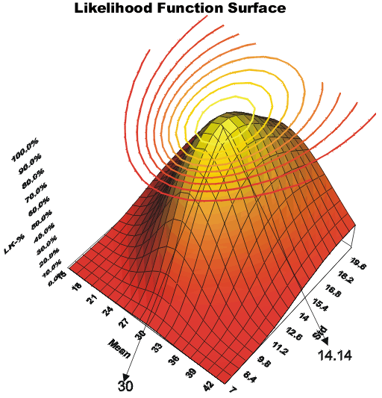
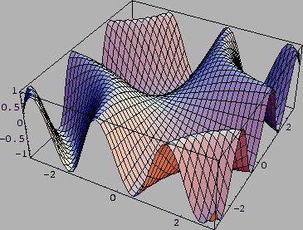
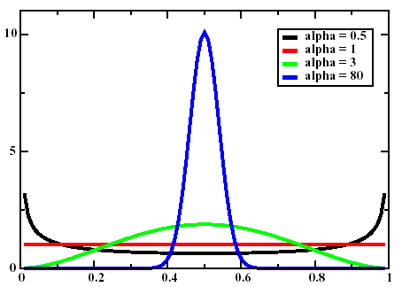
Lecture 05: Maximum Likelihood Parameter Estimation
• Objectives:
Parameter Estimation
Maximum Likelihood
Unknown Mean
Unknown Mean and Variance
Convergence of the Mean
Variance of the Mean Estimate
Resources:
Textbook (Sections 9.5 – 9.A) DHS: Sections 3.1, 3.2

Slide 2
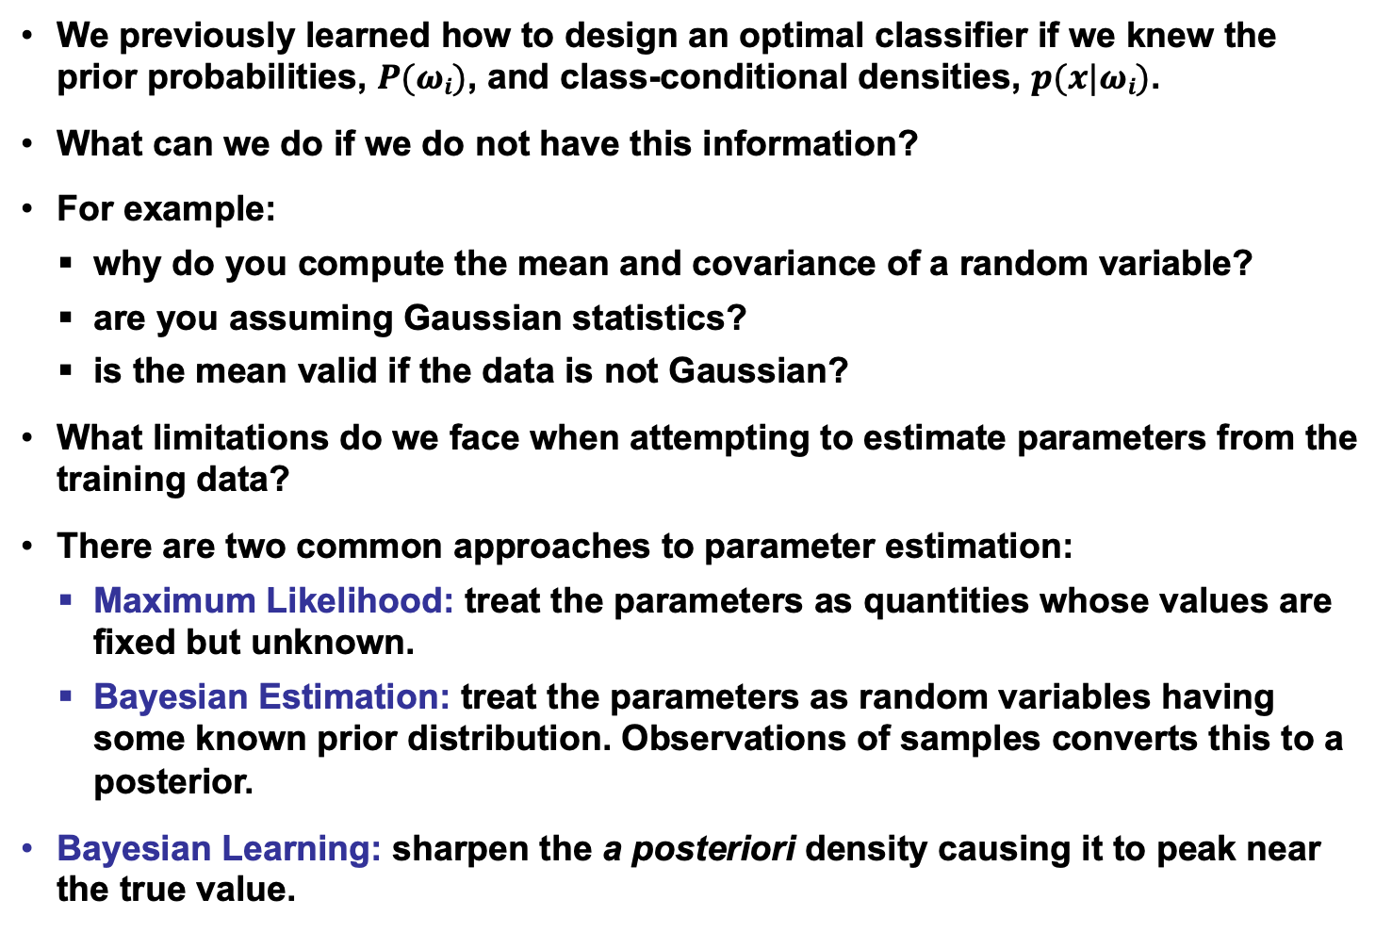
Introduction to Maximum Likelihood Estimation
We previously learned how to design an optimal classifier if we knew the prior probabilities, $P(ωi)$, and class-conditional densities, $p(x|ωi)$.
What can we do if we do not have this information?
For example:
why do you compute the mean and covariance of a random variable?
are you assuming Gaussian statistics?
is the mean valid if the data is not Gaussian?
What limitations do we face when attempting to estimate parameters from the training data?
There are two common approaches to parameter estimation:
Maximum Likelihood: treat the parameters as quantities whose values are fixed but unknown.
Bayesian Estimation: treat the parameters as random variables having some known prior distribution. Observations of samples converts this to a posterior.
Bayesian Learning: sharpen the a posteriori density causing it to peak near the true value.

Slide 3
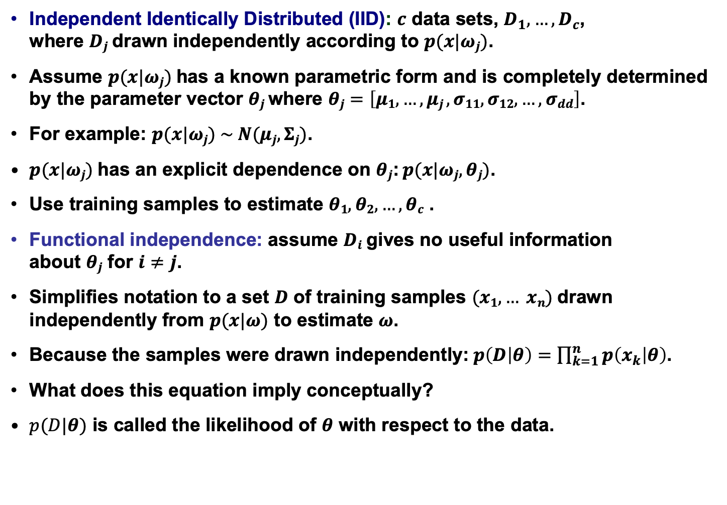
General Principle
Independent Identically Distributed (IID): $c$ data sets, $D_{1},…,D_{c}$, where $Dj$drawn independently according to $p(x|ωj)$.
Assume $p(x|ωj)$has a known parametric form and is completely determined by the parameter vector $θj$ where $θj=\left[μ1, …, μj , σ11, σ12, …, σdd\right]$.
For example: $p(x|ωj) \sim N(μj, Σj)$.
$p(x|ωj)$has an explicit dependence on $θj$: $p(x|ωj, θj)$.
Use training samples to estimate $θ1, θ2,…, θc$ .
Functional independence: assume $Di$gives no useful information about $θj$ for $i≠j$.
Simplifies notation to a set $D$ of training samples $(x1,… xn)$drawn independently from $p(x|ω)$ to estimate $ω$.
Because the samples were drawn independently:$p\left(D | θ\right)=\prod_{k=1}^{n}{p\left(x_{k} | θ\right)}$.
What does this equation imply conceptually?
$p(D|θ)$ is called the likelihood of $θ$ with respect to the data.

Slide 4
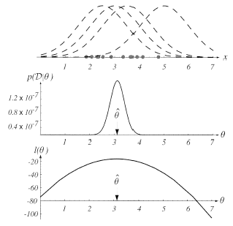

Example of ML Estimation
The value of $θ$ that maximizes this likelihood, denoted $\hat{θ}$, is the maximum likelihood estimate (ML) of $θ$.
Example:
We are given several data points of a 1D random variable, shown as points along the x-axis.
Top: candidate source distributions are shown. Note each point has a corresponding distribution whose mean is the data point.
Which distribution is the ML estimate?
Middle: an estimate of the likelihood of the data as a function of the mean, $θ$.
Bottom: log likelihood as a function of $θ$.

Slide 5
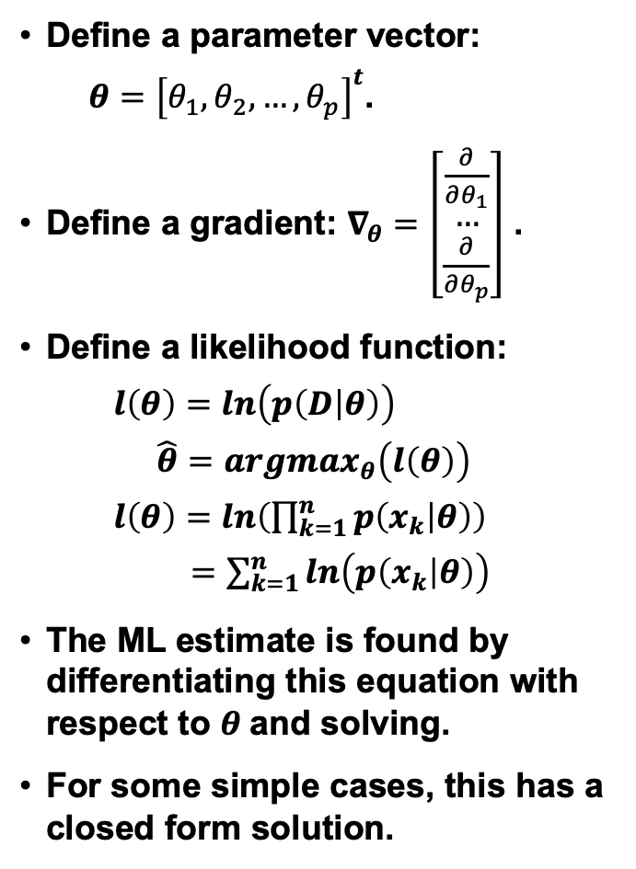
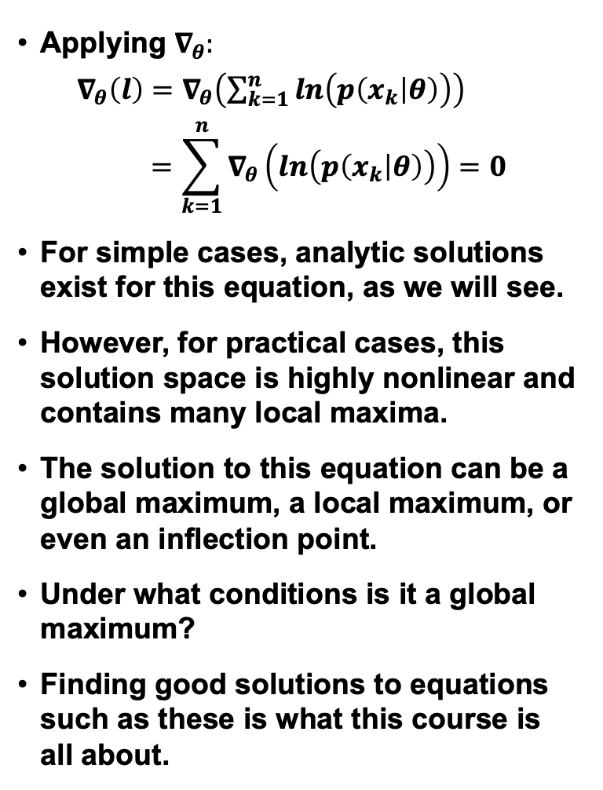
General Mathematics
Define a parameter vector:
$θ={\left[θ_{1},θ_{2},…,θ_{p}\right]}^{t}$.
Define a gradient: $∇_{θ}=\left[\begin{matrix}\frac{∂}{∂θ_{1}} \\ … \\ \frac{∂}{∂θ_{p}}\end{matrix}\right]$ .
Define a likelihood function:
$l\left(θ\right)=ln\left(p\left(D | θ\right)\right)$
$\hat{θ}={argmax}_{θ}\left(l\left(θ\right)\right)$
$l\left(θ\right)=ln\left(\prod_{k=1}^{n}{p\left(x_{k} | θ\right)}\right)$
$=\sum_{k=1}^{n}{ln\left(p\left(x_{k} | θ\right)\right)}$
The ML estimate is found by differentiating this equation with respect to $θ$and solving.
For some simple cases, this has a closed form solution.
Applying $∇_{θ}:$
$∇_{θ}\left(l\right)=$ $∇_{θ}\left(\sum_{k=1}^{n}{ln\left(p\left(x_{k} | θ\right)\right)}\right)$
$$=\sum_{k=1}^{n}{∇_{θ}\left(ln\left(p\left(x_{k} | θ\right)\right)\right)=0}$$
For simple cases, analytic solutions exist for this equation, as we will see.
However, for practical cases, this solution space is highly nonlinear and contains many local maxima.
The solution to this equation can be a global maximum, a local maximum, or even an inflection point.
Under what conditions is it a global maximum?
Finding good solutions to equations such as these is what this course is all about.

Slide 6

Maximum A Posteriori Estimation
A class of estimators – maximum a posteriori (MAP) – maximize $l\left(θ\right)p\left(θ\right)$ where$l\left(θ\right)$describes the prior probability of different parameter values.
An ML estimator is a MAP estimator for uniform priors.
A MAP estimator finds the peak, or mode, of a posterior density.
MAP estimators are not transformation invariant (if we perform a nonlinear transformation of the input data, the estimator is no longer optimum in the new space). This observation will be useful later in the course.

Slide 7
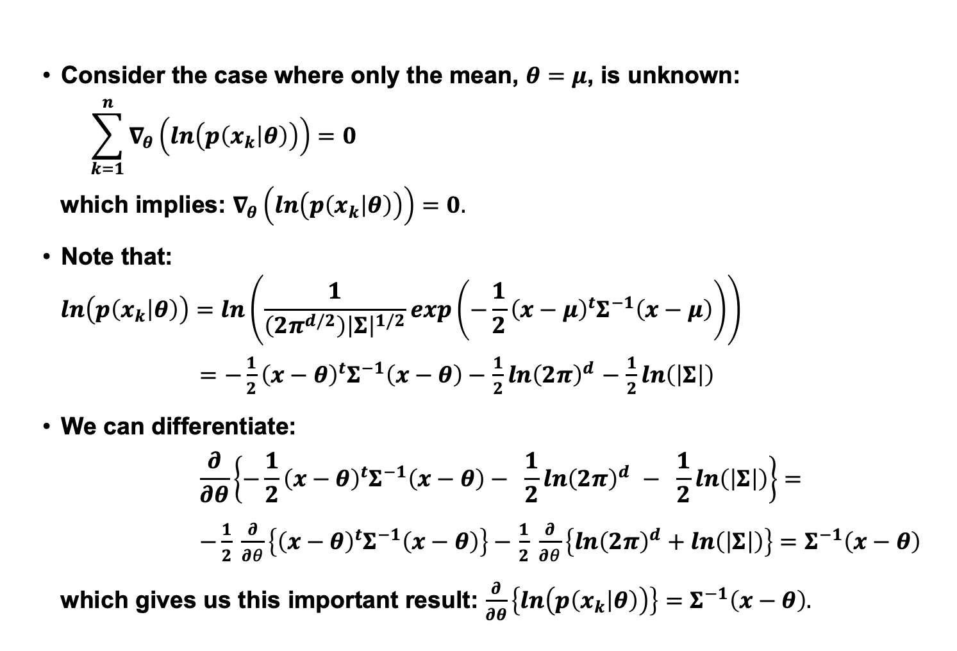
Gaussian Case: Unknown Mean
Consider the case where only the mean, $θ=μ$, is unknown:
$$\sum_{k=1}^{n}{∇_{θ}\left(ln\left(p\left(x_{k} | θ\right)\right)\right)=0}$$
which implies: $∇_{θ}\left(ln\left(p\left(x_{k} | θ\right)\right)\right)=0.$
Note that:
$$ln\left(p\left(x_{k} | θ\right)\right)=ln\left(\frac{1}{\left({2π}^{d/2}\right){\left|Σ\right|}^{1/2}}exp\left(−\frac{1}{2}{\left(x−μ\right)}^{t}Σ^{−1}\left(x−μ\right)\right)\right)$$
$=$ $−\frac{1}{2}{\left(x−θ\right)}^{t}Σ^{−1}\left(x−θ\right)−$ $\frac{1}{2}ln{\left(2π\right)}^{d}$ $−$ $\frac{1}{2}ln\left(\left|Σ\right|\right)$
We can differentiate:
$$\frac{∂}{∂θ}\left\{−\frac{1}{2}{\left(x−θ\right)}^{t}Σ^{−1}\left(x−θ\right)− \frac{1}{2}ln{\left(2π\right)}^{d} − \frac{1}{2}ln\left(\left|Σ\right|\right)\right\}=$$
$−\frac{1}{2} \frac{∂}{∂θ}\left\{{\left(x−θ\right)}^{t}Σ^{−1}\left(x−θ\right)\right\}−$ $\frac{1}{2} \frac{∂}{∂θ}\left\{ln{\left(2π\right)}^{d}+ln\left(\left|Σ\right|\right)\right\}=$ $Σ^{−1}\left(x−θ\right)$
which gives us this important result: $\frac{∂}{∂θ}\left\{ln\left(p\left(x_{k} | θ\right)\right)\right\}=$ $Σ^{−1}\left(x−θ\right).$

Slide 8
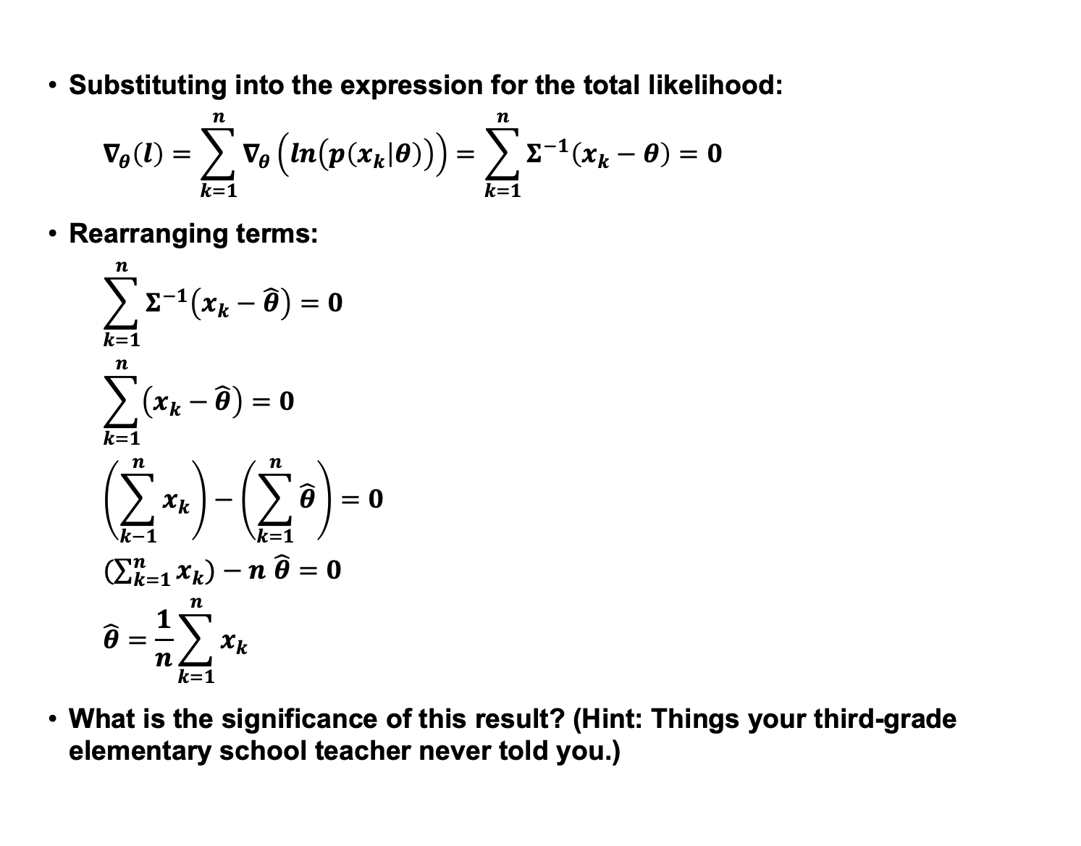
Gaussian Case: Unknown Mean
Substituting into the expression for the total likelihood:
$$∇_{θ}\left(l\right)=\sum_{k=1}^{n}{∇_{θ}\left(ln\left(p\left(x_{k} | θ\right)\right)\right)=\sum_{k=1}^{n}{Σ^{−1}\left(x_{k}−θ\right)}=0}$$
Rearranging terms:
$$\sum_{k=1}^{n}{Σ^{−1}\left(x_{k}−\hat{θ}\right)}=0$$
$$\sum_{k=1}^{n}{\left(x_{k}−\hat{θ}\right)}=0$$
$$\left(\sum_{k−1}^{n}{x_{k}}\right)−\left(\sum_{k=1}^{n}{\hat{θ}}\right)=0$$
$(\sum_{k=1}^{n}{x_{k})−n}$ $\hat{θ}=0$
$$\hat{θ}=\frac{1}{n}\sum_{k=1}^{n}{x_{k}}$$
What is the significance of this result? (Hint: Things your third-grade elementary school teacher never told you.)

Slide 9
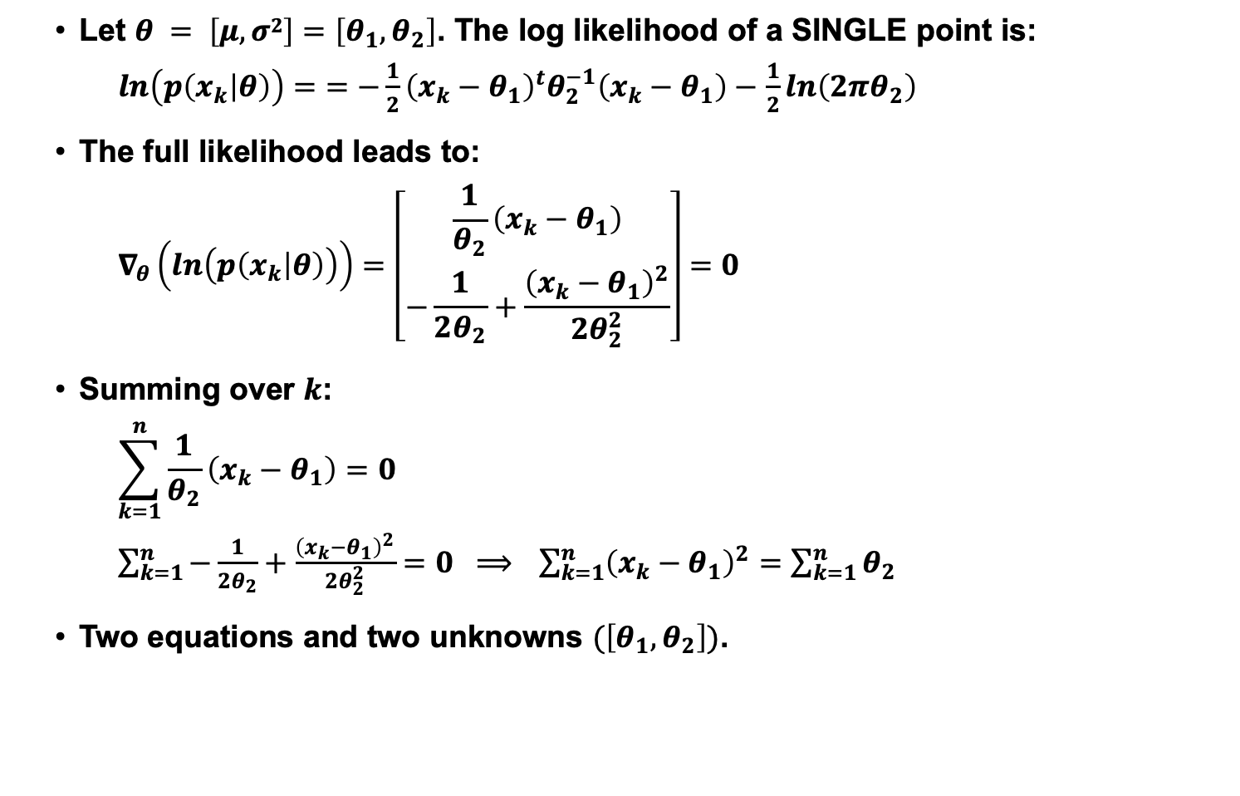
Gaussian Case: Unknown Mean and Variance
Let $θ = \left[μ,σ2\right]=\left[θ_{1},θ_{2}\right]$. The log likelihood of a SINGLE point is:
$ln\left(p\left(x_{k} | θ\right)\right)=$ $=$ $−\frac{1}{2}{\left(x_{k}−θ_{1}\right)}^{t}θ_{2}^{−1}\left(x_{k}−θ_{1}\right)−$ $\frac{1}{2}ln\left(2πθ_{2}\right)$
The full likelihood leads to:
$$∇_{θ}\left(ln\left(p\left(x_{k} | θ\right)\right)\right)=\left[\begin{matrix}\frac{1}{θ_{2}}\left(x_{k}−θ_{1}\right) \\ −\frac{1}{2θ_{2}}+\frac{{\left(x_{k}−θ_{1}\right)}^{2}}{{2θ}_{2}^{2}}\end{matrix}\right]=0$$
Summing over $k$:
$$\sum_{k=1}^{n}{\frac{1}{θ_{2}}\left(x_{k}−θ_{1}\right)}=0$$
$\sum_{k=1}^{n}{−\frac{1}{2θ_{2}}+\frac{{\left(x_{k}−θ_{1}\right)}^{2}}{{2θ}_{2}^{2}}}=0 ⟹$ $\sum_{k=1}^{n}{{\left(x_{k}−θ_{1}\right)}^{2}}=$ $\sum_{k=1}^{n}{θ_{2}}$
Two equations and two unknowns $(\left[θ_{1},θ_{2}\right])$.

Slide 10
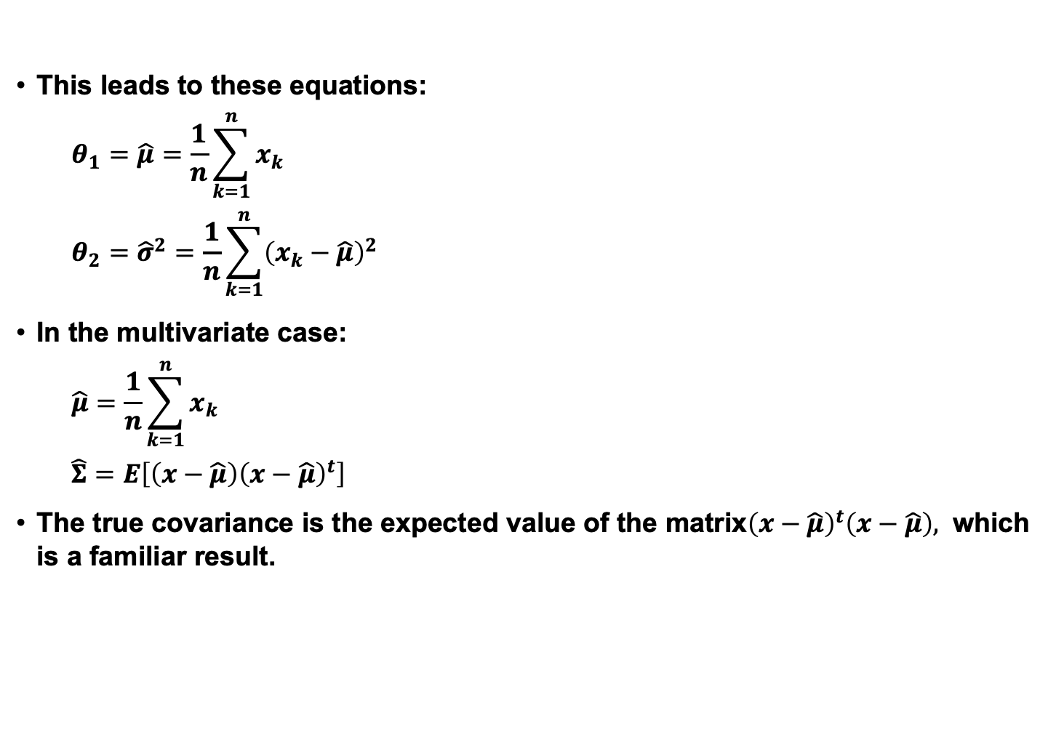
Gaussian Case: Unknown Mean and Variance
This leads to these equations:
$$θ_{1}=\hat{μ}=\frac{1}{n}\sum_{k=1}^{n}{x_{k}}$$
$$θ_{2}={\hat{σ}}^{2}=\frac{1}{n}\sum_{k=1}^{n}{{\left(x_{k}−\hat{μ}\right)}^{2}}$$
In the multivariate case:
$$\hat{μ}=\frac{1}{n}\sum_{k=1}^{n}{x_{k}}$$
$$\hat{Σ}=E\left[\left(x−\hat{μ}\right){\left(x−\hat{μ}\right)}^{t}\right]$$
The true covariance is the expected value of the matrix${\left(x−\hat{μ}\right)}^{t}\left(x−\hat{μ}\right),$ which is a familiar result.

Slide 11
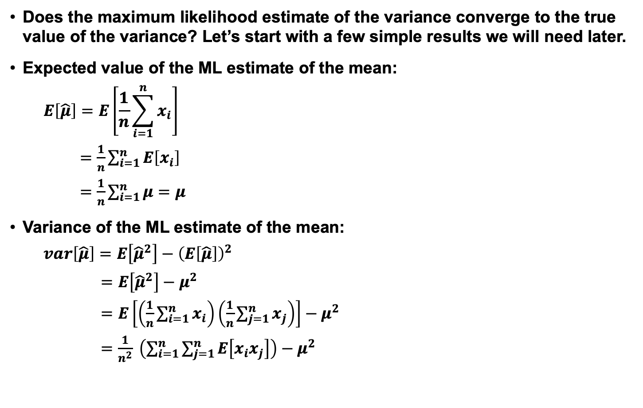
Convergence of the Mean
Does the maximum likelihood estimate of the variance converge to the true value of the variance? Let’s start with a few simple results we will need later.
Expected value of the ML estimate of the mean:
$$E\left[\hat{μ}\right]=E\left[\frac{1}{n}\sum_{i=1}^{n}{x_{i}}\right]$$
$=$ $\frac{1}{n}\sum_{i=1}^{n}{E\left[x_{i}\right]}$
$=\frac{1}{n}\sum_{i=1}^{n}{μ=μ}$
Variance of the ML estimate of the mean:
$$var\left[\hat{μ}\right]=E\left[{\hat{μ}}^{2}\right]−{\left(E\left[\hat{μ}\right]\right)}^{2}$$
$=$ $E\left[{\hat{μ}}^{2}\right]−μ^{2}$
$=$ $E\left[\left(\frac{1}{n}\sum_{i=1}^{n}{x_{i}}\right)\left(\frac{1}{n}\sum_{j=1}^{n}{x_{j}}\right)\right]−μ^{2}$
$=$ $\frac{1}{n^{2}} \left(\sum_{i=1}^{n}{\sum_{j=1}^{n}{E\left[x_{i}x_{j}\right]}}\right)−μ^{2}$

Slide 12
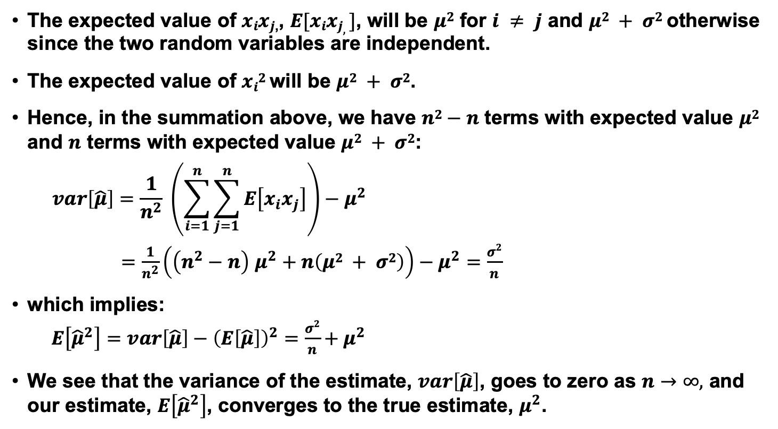
Variance of the ML Estimate of the Mean
The expected value of $xixj$,, $E[xixj,]$, will be $μ2$ for $i ≠ j$ and $μ2 + σ2$ otherwise since the two random variables are independent.
The expected value of $xi2$ will be $μ2 + σ2$.
Hence, in the summation above, we have $n2−n$ terms with expected value $μ2$ and $n$ terms with expected value $μ2 + σ2$:
$$var\left[\hat{μ}\right]=\frac{1}{n^{2}} \left(\sum_{i=1}^{n}{\sum_{j=1}^{n}{E\left[x_{i}x_{j}\right]}}\right)−μ^{2}$$
$=\frac{1}{n^{2}}\left(\left(n^{2}−n\right) μ^{2}+n\left(μ2 + σ2\right)\right)−μ^{2}=\frac{σ2}{n}$
which implies:
$E\left[{\hat{μ}}^{2}\right]=var\left[\hat{μ}\right]−{\left(E\left[\hat{μ}\right]\right)}^{2}=\frac{σ2}{n}+μ^{2}$
We see that the variance of the estimate, $var\left[\hat{μ}\right]$, goes to zero as $n→∞,$ and our estimate, $E\left[{\hat{μ}}^{2}\right]$, converges to the true estimate, $μ^{2}$.

Slide 13
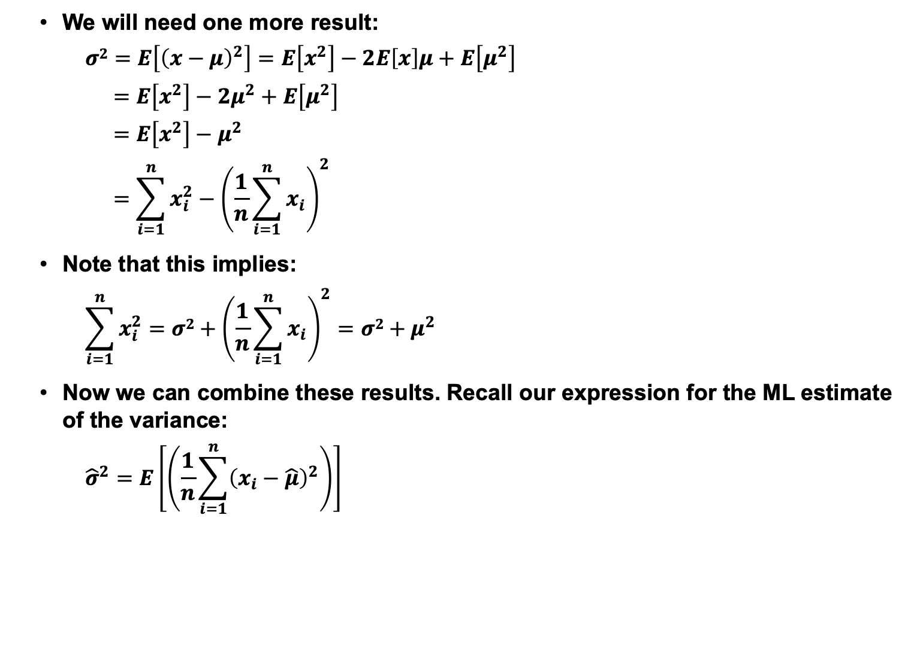
Variance Relationships
We will need one more result:
$$σ2=E\left[{\left(x−μ\right)}^{2}\right]=E\left[x^{2}\right]−2E\left[x\right]μ+E\left[μ^{2}\right]$$
$$=E\left[x^{2}\right]−2μ^{2}+E\left[μ^{2}\right]$$
$$=E\left[x^{2}\right]−μ^{2}$$
$$=\sum_{i=1}^{n}{x_{i}^{2}−{\left(\frac{1}{n}\sum_{i=1}^{n}{x_{i}}\right)}^{2}}$$
Note that this implies:
$$\sum_{i=1}^{n}{x_{i}^{2}}=σ2+{\left(\frac{1}{n}\sum_{i=1}^{n}{x_{i}}\right)}^{2}={σ2+μ}^{2}$$
Now we can combine these results. Recall our expression for the ML estimate of the variance:
$${\hat{σ}}^{2}=E\left[\left(\frac{1}{n}\sum_{i=1}^{n}{{\left(x_{i}−\hat{μ}\right)}^{2}}\right)\right]$$

Slide 14
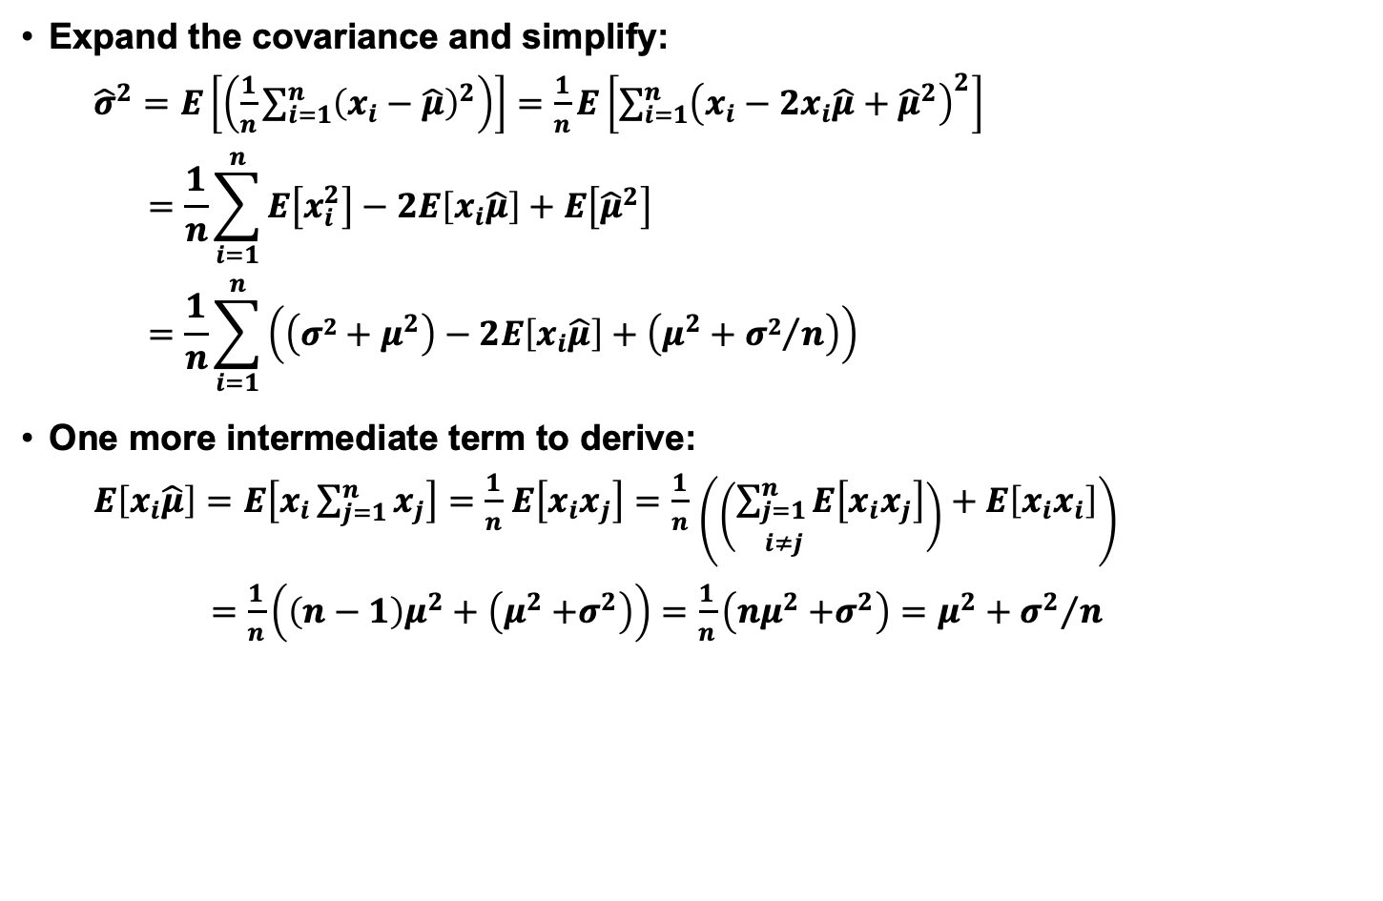
Covariance Expansion
Expand the covariance and simplify:
${\hat{σ}}^{2}=E\left[\left(\frac{1}{n}\sum_{i=1}^{n}{{\left(x_{i}−\hat{μ}\right)}^{2}}\right)\right]=$ $\frac{1}{n}E\left[\sum_{i=1}^{n}{{\left(x_{i}−2x_{i}\hat{μ}+{\hat{μ}}^{2}\right)}^{2}}\right]$
$$=\frac{1}{n}\sum_{i=1}^{n}{E\left[x_{i}^{2}\right]−2E\left[x_{i}\hat{μ}\right]+E\left[{\hat{μ}}^{2}\right]}$$
$$=\frac{1}{n}\sum_{i=1}^{n}{\left(\left({σ2+μ}^{2}\right)−2E\left[x_{i}\hat{μ}\right]+\left(μ^{2}+{σ2}/n\right)\right)}$$
One more intermediate term to derive:
$E\left[x_{i}\hat{μ}\right]=E\left[x_{i}\sum_{j=1}^{n}{x_{j}}\right]=$ $\frac{1}{n}$ $E\left[x_{i}x_{j}\right]=$ $\frac{1}{n}$ $\left(\left(\sum_{\begin{matrix}j=1 \\ i≠j\end{matrix}}^{n}{E\left[x_{i}x_{j}\right]}\right)+E\left[x_{i}x_{i}\right]\right)$
$=\frac{1}{n}\left(\left(n−1\right)μ^{2}+\left(μ^{2}{+σ}^{2}\right)\right)=$ $\frac{1}{n}\left(nμ^{2}{+σ}^{2}\right)=$ $μ^{2}+{σ^{2}}/n$

Slide 15
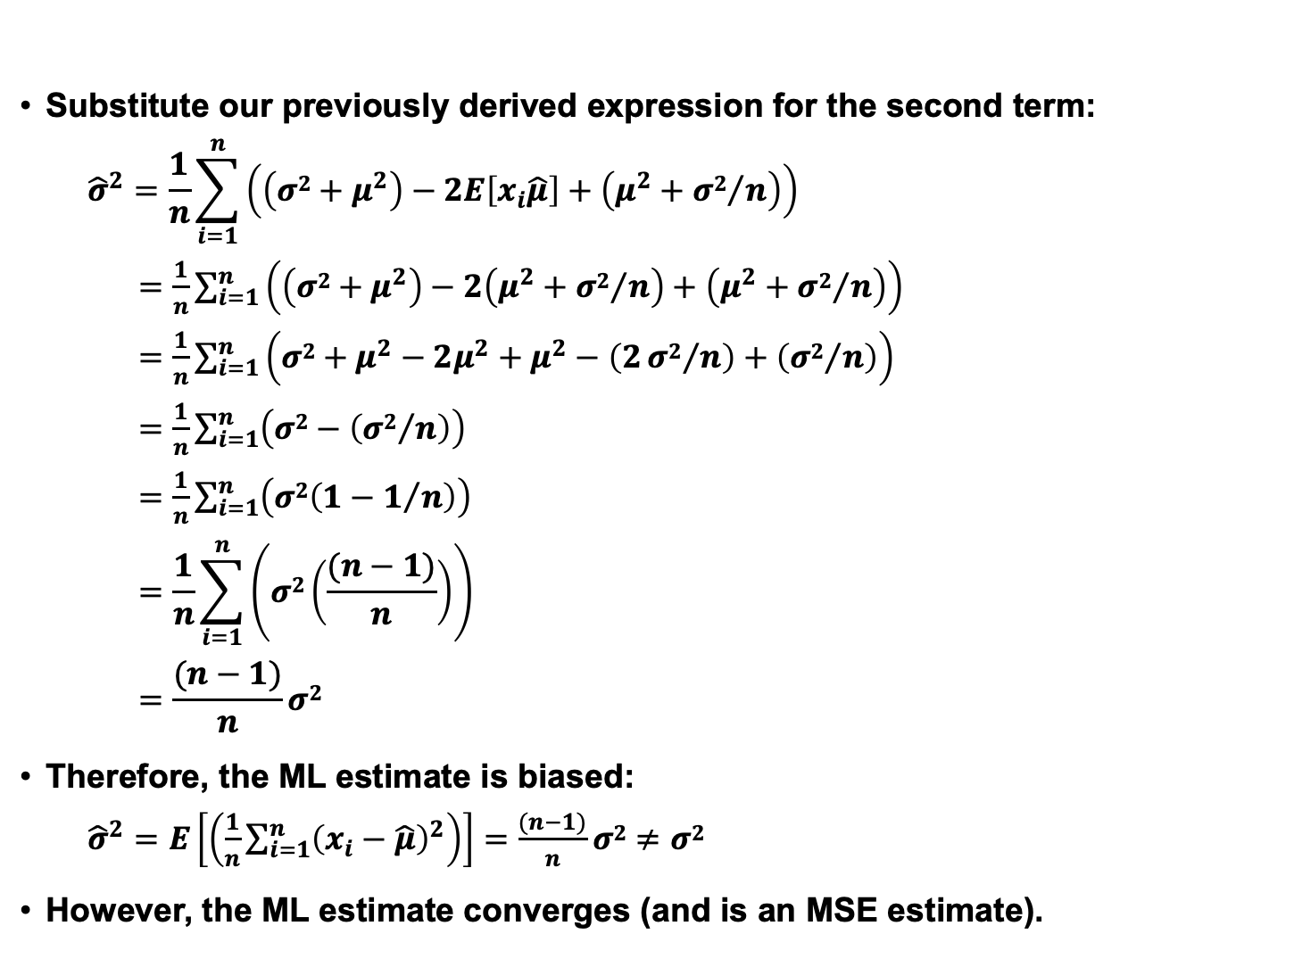
Biased Variance Estimate
Substitute our previously derived expression for the second term:
$${\hat{σ}}^{2}=\frac{1}{n}\sum_{i=1}^{n}{\left(\left({σ2+μ}^{2}\right)−2E\left[x_{i}\hat{μ}\right]+\left(μ^{2}+{σ2}/n\right)\right)}$$
$=\frac{1}{n}\sum_{i=1}^{n}{\left(\left({σ2+μ}^{2}\right)−2\left(μ^{2}+{σ2}/n\right)+\left(μ^{2}+{σ2}/n\right)\right)}$
$=\frac{1}{n}\sum_{i=1}^{n}{\left({σ2+μ}^{2}−2μ^{2}+μ^{2}−\left(2{σ2}/n\right)+\left({σ2}/n\right)\right)}$
$=\frac{1}{n}\sum_{i=1}^{n}{\left(σ2−\left({σ2}/n\right)\right)}$
$=\frac{1}{n}\sum_{i=1}^{n}{\left(σ2\left({1−1}/n\right)\right)}$
$$=\frac{1}{n}\sum_{i=1}^{n}{\left(σ2\left(\frac{(n−1)}{n}\right)\right)}$$
$$=\frac{(n−1)}{n}σ2$$
Therefore, the ML estimate is biased:
${\hat{σ}}^{2}=E\left[\left(\frac{1}{n}\sum_{i=1}^{n}{{\left(x_{i}−\hat{μ}\right)}^{2}}\right)\right]=\frac{(n−1)}{n}σ2≠$ $σ2$
However, the ML estimate converges (and is an MSE estimate).

Slide 16
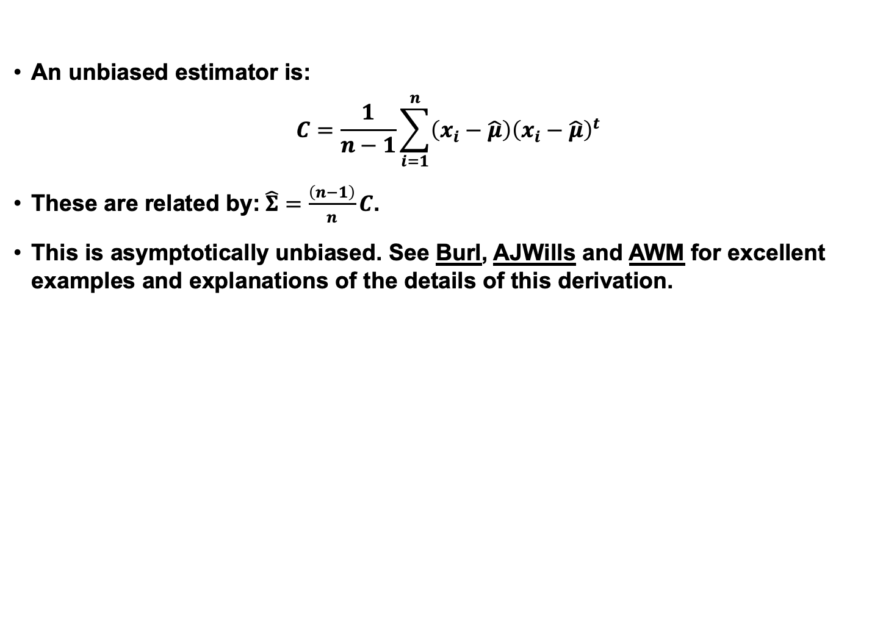
Conversion to an Unbiased Estimate
An unbiased estimator is:
$$C=\frac{1}{n−1}\sum_{i=1}^{n}{\left(x_{i}−\hat{μ}\right){\left(x_{i}−\hat{μ}\right)}^{t}}$$
These are related by:$\hat{Σ}=\frac{\left(n−1\right)}{n}C$.
This is asymptotically unbiased. See Burl, AJWills and AWM for excellent examples and explanations of the details of this derivation.

Slide 17
Summary
To develop an optimal classifier, we need reliable estimates of the statistics of the features (e.g, mean and covariance).
In Maximum Likelihood (ML) estimation, we treat the parameters as having unknown but fixed values.
This is justified many well-known results for estimating parameters (e.g., computing the mean by summing the observations).
For a Gaussian model, the estimate of the mean converges to the true mean and the variance of this estimate goes to zero.
The estimate of the covariance converges but is slightly biased. In practice, for large N, this is not a problem.

