Slide 1
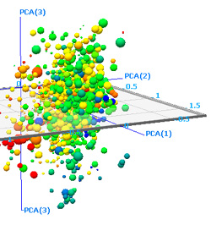
Lecture 07: Discriminant Analysis
• Objectives:
Mean-Square Error Objective Function
Projection Operator
Whitening Transformation
Principal Component Analysis
Fisher Linear Discriminant Analysis
Multiple Discriminant Analysis
Independent Component Analysis
Resources:
Textbook (Section 10.4)
JL: Layman’s Explanation
QT: PCA Introduction
Wiki: PCA
Py: Quadratic Discriiminant Analysis TDS: Quadratic Discriminant Analysis

Slide 2
Component Analysis
Component analysis is a technique that combines features to reduce the dimension of the feature space.
Is also the basis for a classification algorithm since it is from the same family of algorithms as MLE and MAP estimation under Gaussian assumptions.
Features of this approach include:
Statistical decorrelation of the data.
Linear combinations are simple to compute and tractable.
Project a high dimensional space onto a lower dimensional space.
Gain insight into the relative importance of each feature.
Three classical approaches for finding the optimal transformation:
Principal Component Analysis (PCA): projection that best represents the data in a least-square sense.
Multiple Discriminant Analysis (MDA): projection that best separates the data in a least-squares sense.
Independent Component Analysis (ICA): projection that minimizes the mutual information of the components.

Slide 3
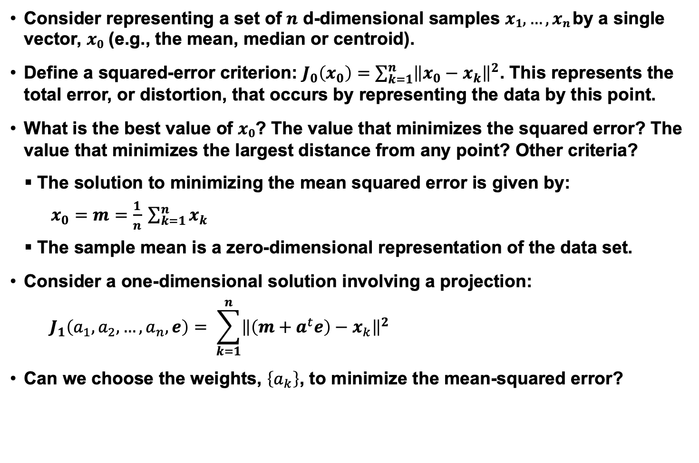
Principal Component Analysis
Consider representing a set of $n$ d-dimensional samples $x1,…,xn$by a single vector, $x0$ (e.g., the mean, median or centroid).
Define a squared-error criterion: $J_{0}\left(x_{0}\right)=\sum_{k=1}^{n}{{\left\|x_{0}−x_{k}\right\|}^{2}}$. This represents the total error, or distortion, that occurs by representing the data by this point.
What is the best value of $x0$? The value that minimizes the squared error? The value that minimizes the largest distance from any point? Other criteria?
The solution to minimizing the mean squared error is given by:
$x_{0}=m=\frac{1}{n} \sum_{k=1}^{n}{x_{k}}$
The sample mean is a zero-dimensional representation of the data set.
Consider a one-dimensional solution involving a projection:
$$J_{1}\left(a_{1},a_{2},…,a_{n},e\right)= \sum_{k=1}^{n}{{\left\|\left(m+a^{t}e\right)−x_{k}\right\|}^{2}}$$
Can we choose the weights, $\left\{a_{k}\right\}$, to minimize the mean-squared error?

Slide 4
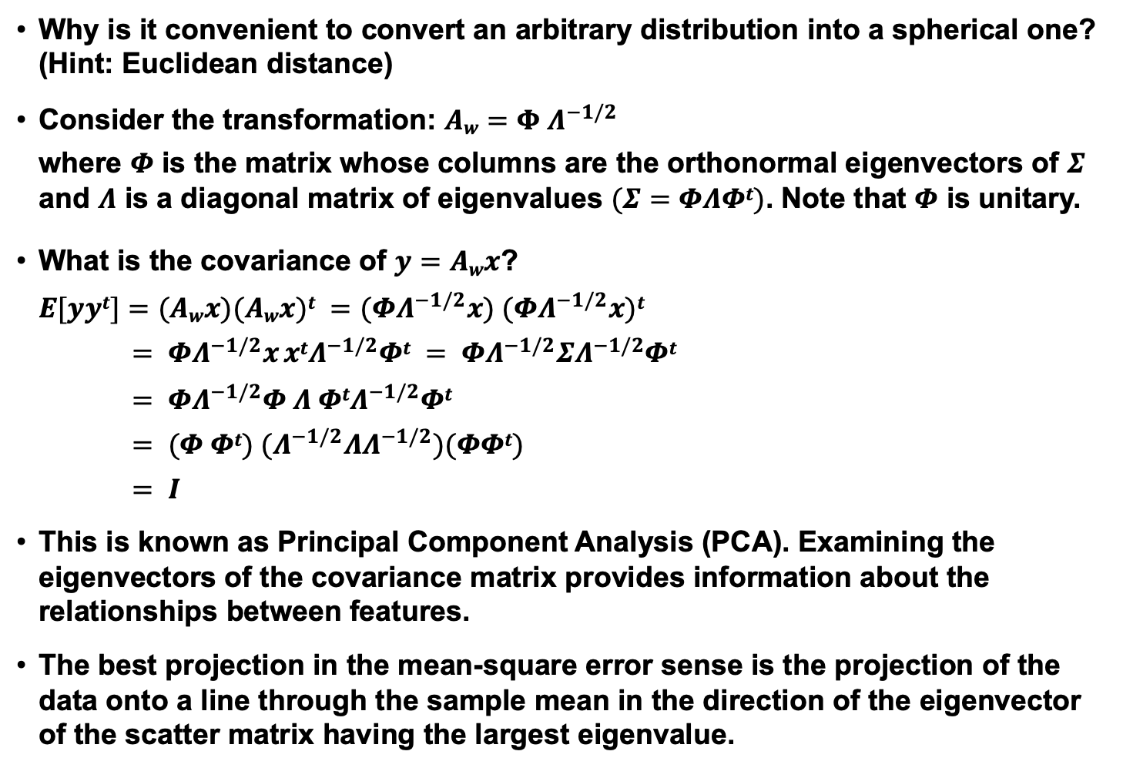
Alternate View: Coordinate Transformations
Why is it convenient to convert an arbitrary distribution into a spherical one? (Hint: Euclidean distance)
Consider the transformation: $Aw=Φ Λ^{−1/2}$
where $Φ$ is the matrix whose columns are the orthonormal eigenvectors of $Σ$ and $Λ$ is a diagonal matrix of eigenvalues $(Σ=ΦΛΦt)$. Note that $Φ$ is unitary.
What is the covariance of $y=Awx$?
$E[yyt]=(Awx)(Awx)t =(ΦΛ^{−1/2}x) (ΦΛ^{−1/2}x)t$
$= ΦΛ^{−1/2}x xtΛ^{−1/2}Φt = ΦΛ^{−1/2}ΣΛ^{−1/2}Φt$
$= ΦΛ^{−1/2}Φ Λ ΦtΛ^{−1/2}Φt$
$= (Φ Φt) (Λ^{−1/2}ΛΛ^{−1/2})(ΦΦt)$
$= I$
This is known as Principal Component Analysis (PCA). Examining the eigenvectors of the covariance matrix provides information about the relationships between features.
The best projection in the mean-square error sense is the projection of the data onto a line through the sample mean in the direction of the eigenvector of the scatter matrix having the largest eigenvalue.

Slide 5
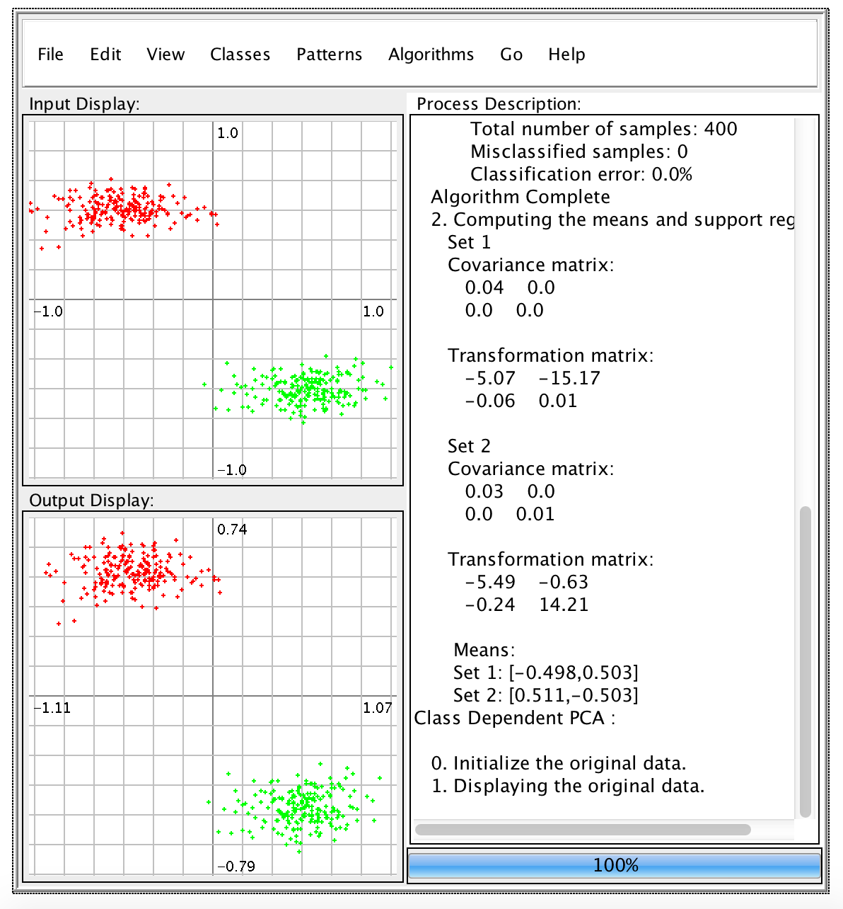
Examples of Maximum Likelihood Classification
For the Gaussian case, the eigenvectors are the principal axes of the hyperellipsoidally shaped support region.
Let’s work some examples (class-independent and class-dependent PCA).
In class-independent PCA, a global covariance matrix is computed:
In this case, the covariance will be an ellipsoid.
The first principal component will be the major axis of this ellipsoid.
The second principal component will be the minor axis.
In class-dependent PCA, which requires labeled training data, transformations are computed independently for each class.
The ML decision surface is a line (or a parabola in this case).

Slide 6
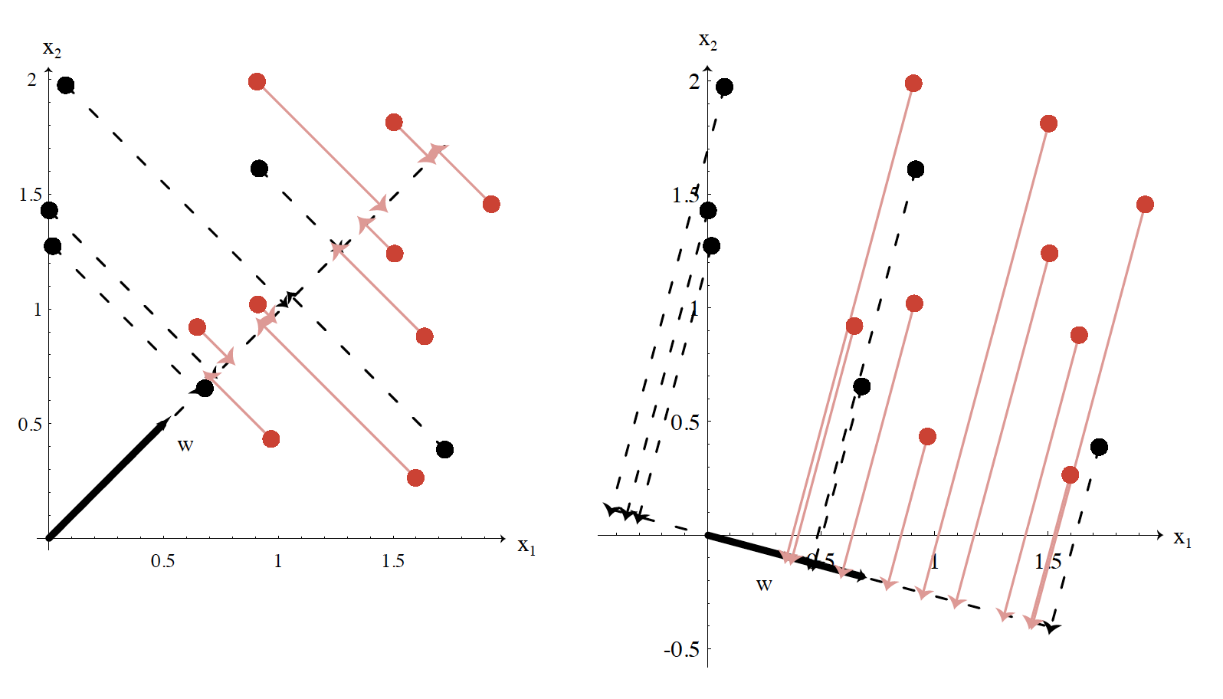
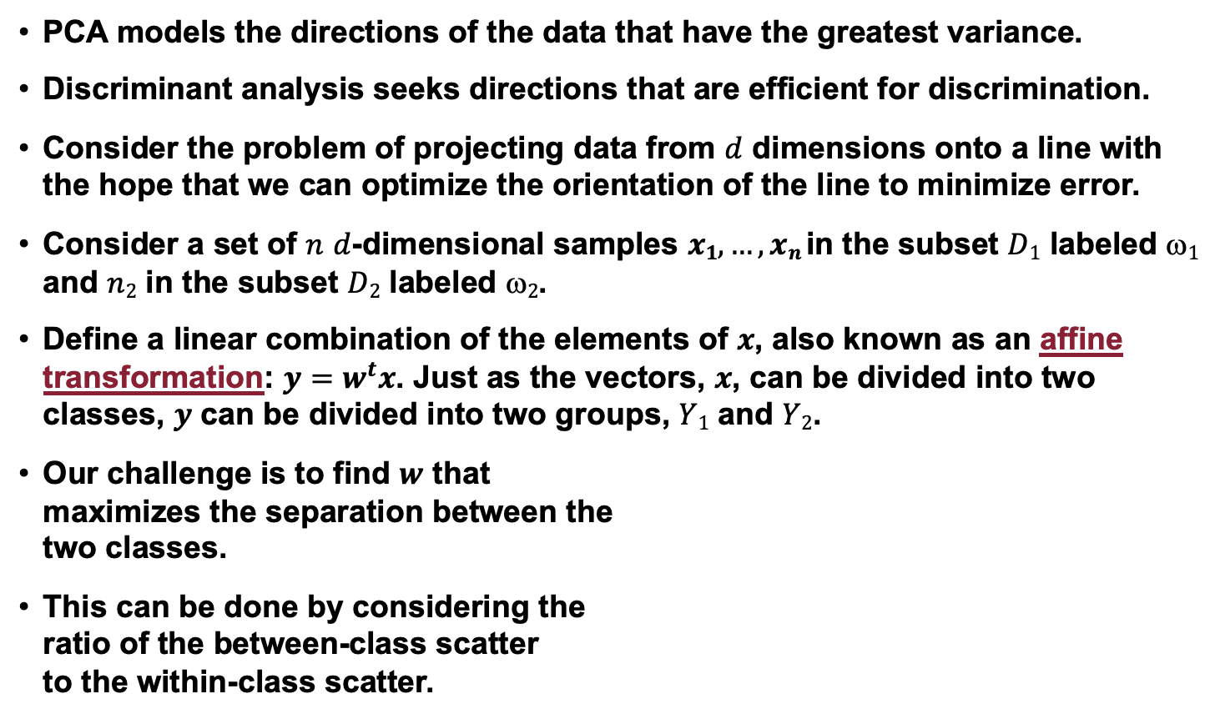
Discriminant Analysis
PCA models the directions of the data that have the greatest variance.
Discriminant analysis seeks directions that are efficient for discrimination.
Consider the problem of projecting data from $d$ dimensions onto a line with the hope that we can optimize the orientation of the line to minimize error.
Consider a set of $n$ $d$-dimensional samples $x1,…,xn$in the subset $D1$ labeled $1$ and $n2$ in the subset $D2$ labeled $2$.
Define a linear combination of the elements of $x$, also known as an affine transformation: $y=w^{t}x$. Just as the vectors, $x$, can be divided into two classes, $y$ can be divided into two groups, $Y1$ and $Y2$.
Our challenge is to find $w$ that maximizes the separation between the two classes.
This can be done by considering the ratio of the between-class scatter to the within-class scatter.

Slide 7
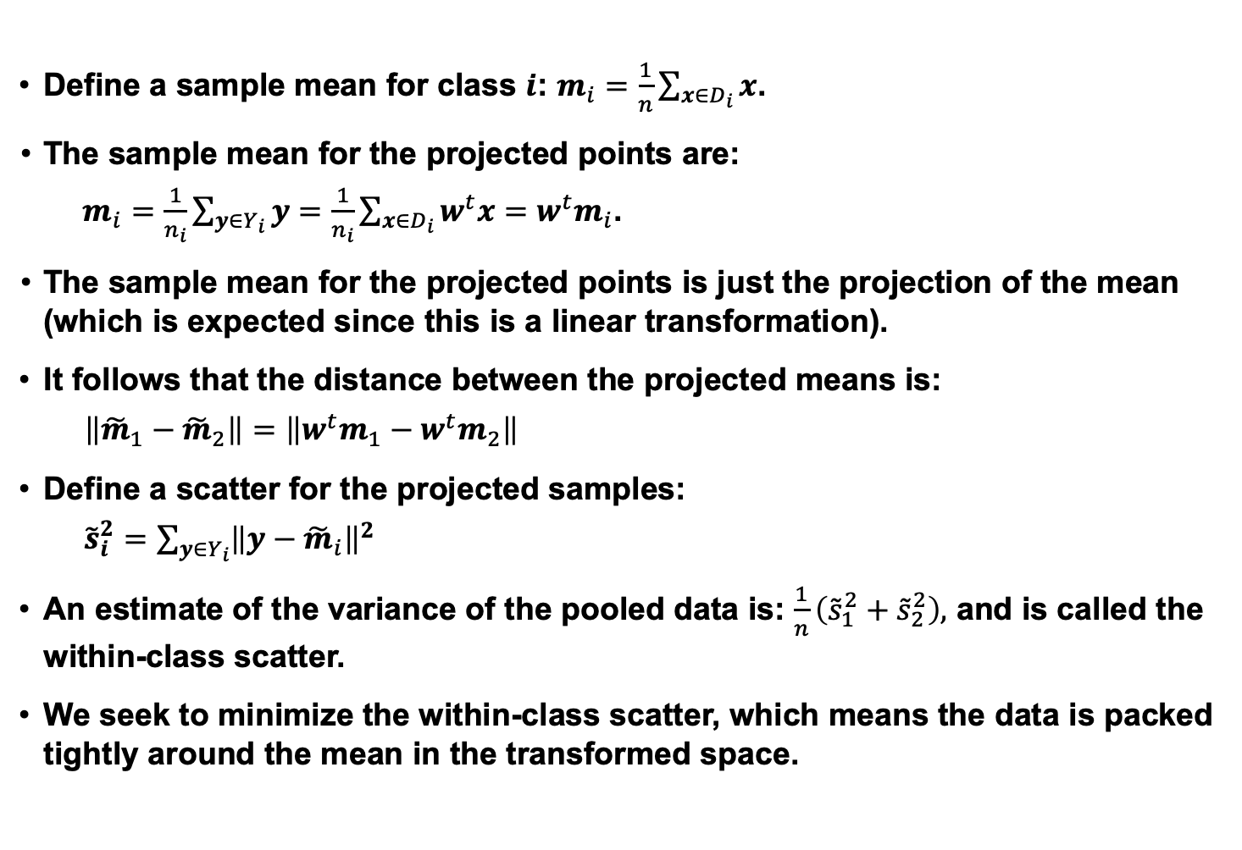
Separation of the Means and Scatter
Define a sample mean for class $i$: $m_{i}=\frac{1}{n}\sum_{x∈D_{i}}{x}$.
The sample mean for the projected points are:
$m_{i}=\frac{1}{n_{i}}\sum_{y∈Y_{i}}{y}=\frac{1}{n_{i}}\sum_{x∈D_{i}}{w^{t}x}=w^{t}m_{i}$.
The sample mean for the projected points is just the projection of the mean (which is expected since this is a linear transformation).
It follows that the distance between the projected means is:
$\left\|{\tilde{m}}_{1}−{\tilde{m}}_{2}\right\|=$ $\left\|w^{t}m_{1}−w^{t}m_{2}\right\|$
Define a scatter for the projected samples:
${\tilde{s}}_{i}^{2}=$ $\sum_{y∈Y_{i}}{{\left\|y−{\tilde{m}}_{i}\right\|}^{2}}$
An estimate of the variance of the pooled data is: $\frac{1}{n}\left({\tilde{s}}_{1}^{2}+{\tilde{s}}_{2}^{2}\right),$ and is called the within-class scatter.
We seek to minimize the within-class scatter, which means the data is packed tightly around the mean in the transformed space.

Slide 8
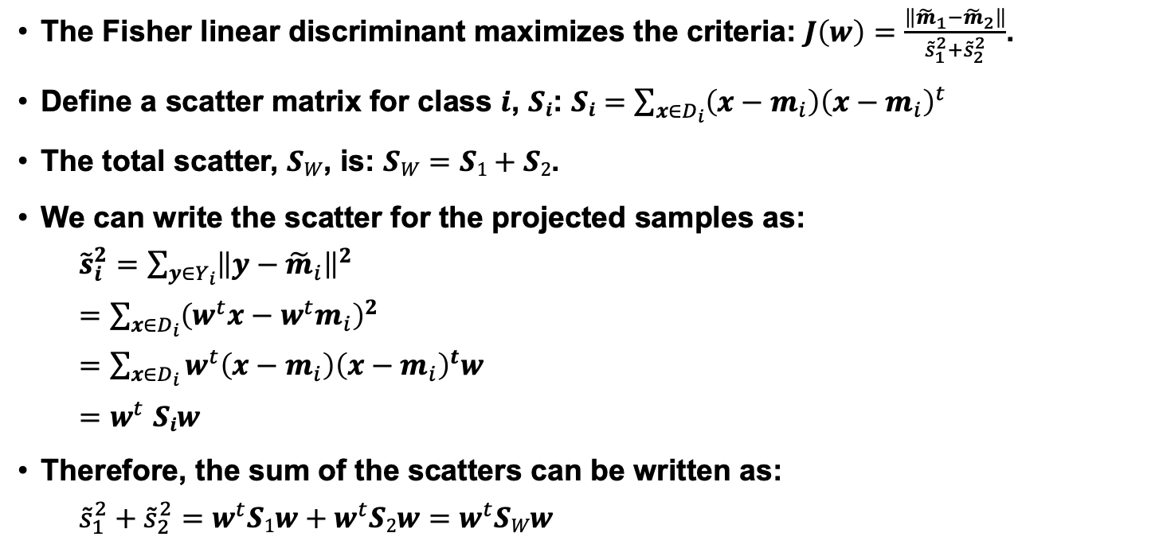
Fisher Linear Discriminant and Scatter
The Fisher linear discriminant maximizes the criteria: $J\left(w\right)=\frac{\left\|{\tilde{m}}_{1}−{\tilde{m}}_{2}\right\|}{{\tilde{s}}_{1}^{2}+{\tilde{s}}_{2}^{2}}$.
Define a scatter matrix for class $i$, $Si$: $Si$ $=$ $\sum_{x∈D_{i}}{{\left(x−m_{i}\right)\left(x−m_{i}\right)}^{t}}$
The total scatter, $SW$, is: $SW=$ $S1+S2$.
We can write the scatter for the projected samples as:
${\tilde{s}}_{i}^{2}=$ $\sum_{y∈Y_{i}}{{\left\|y−{\tilde{m}}_{i}\right\|}^{2}}$
$=$ $\sum_{x∈D_{i}}{{\left(w^{t}x−w^{t}m_{i}\right)}^{2}}$
$=$ $\sum_{x∈D_{i}}{w^{t}\left(x−m_{i}\right){\left(x−m_{i}\right)}^{t}w}$
$${=w}^{t}Siw$$
Therefore, the sum of the scatters can be written as:
${\tilde{s}}_{1}^{2}+{\tilde{s}}_{2}^{2}=$ $w^{t}S1w+w^{t}S2w$ $=$ $w^{t}SWw$

Slide 9
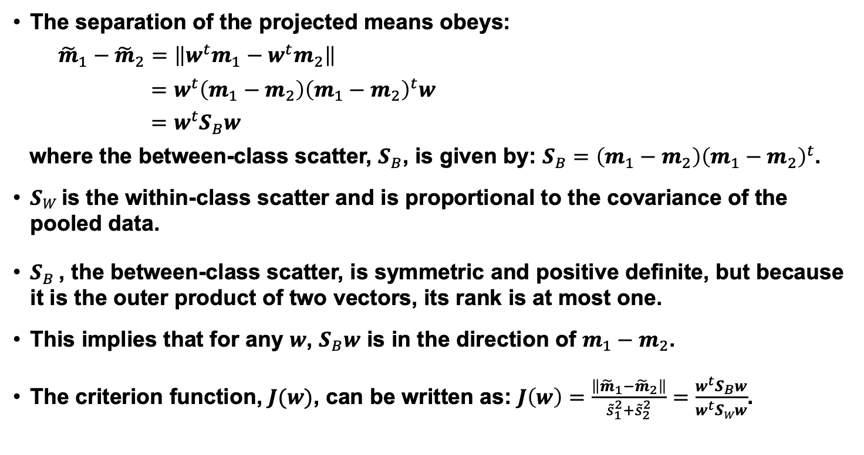
Separation of the Projected Means
The separation of the projected means obeys:
${\tilde{m}}_{1}−{\tilde{m}}_{2}=$ $\left\|w^{t}m_{1}−w^{t}m_{2}\right\|$
$$=w^{t}\left(m_{1}−m_{2}\right){\left(m_{1}−m_{2}\right)}^{t}w$$
$$=w^{t}S_{B}w$$
where the between-class scatter, $S_{B}$, is given by: $S_{B}=\left(m_{1}−m_{2}\right){\left(m_{1}−m_{2}\right)}^{t}$.
$SW$ is the within-class scatter and is proportional to the covariance of the pooled data.
$S_{B}$ , the between-class scatter, is symmetric and positive definite, but because it is the outer product of two vectors, its rank is at most one.
This implies that for any $w$, $S_{B}w$ is in the direction of $m_{1}−m_{2}$.
The criterion function, $J(w)$, can be written as: $J\left(w\right)=\frac{\left\|{\tilde{m}}_{1}−{\tilde{m}}_{2}\right\|}{{\tilde{s}}_{1}^{2}+{\tilde{s}}_{2}^{2}}=\frac{w^{t}S_{B}w}{w^{t}SWw}$.

Slide 10
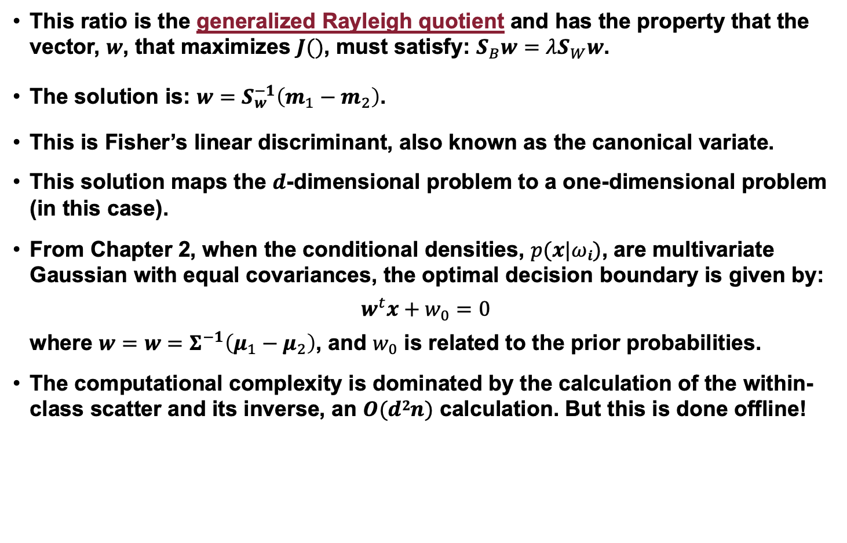
Linear Discriminant Analysis
This ratio is the generalized Rayleigh quotient and has the property that the vector, $w$, that maximizes $J()$, must satisfy: $S_{B}w=λS_{W}w$.
The solution is: $w=S_{w}^{−1}\left(m_{1}−m_{2}\right)$.
This is Fisher’s linear discriminant, also known as the canonical variate.
This solution maps the $d$-dimensional problem to a one-dimensional problem (in this case).
From Chapter 2, when the conditional densities, $p(x|ωi)$, are multivariate Gaussian with equal covariances, the optimal decision boundary is given by:
$$w^{t}x+w_{0}=0$$
where $w=$ $w=Σ^{−1}\left(μ_{1}−μ_{2}\right)$, and $w_{0}$ is related to the prior probabilities.
The computational complexity is dominated by the calculation of the within-class scatter and its inverse, an $O(d2n)$ calculation. But this is done offline!

Slide 11
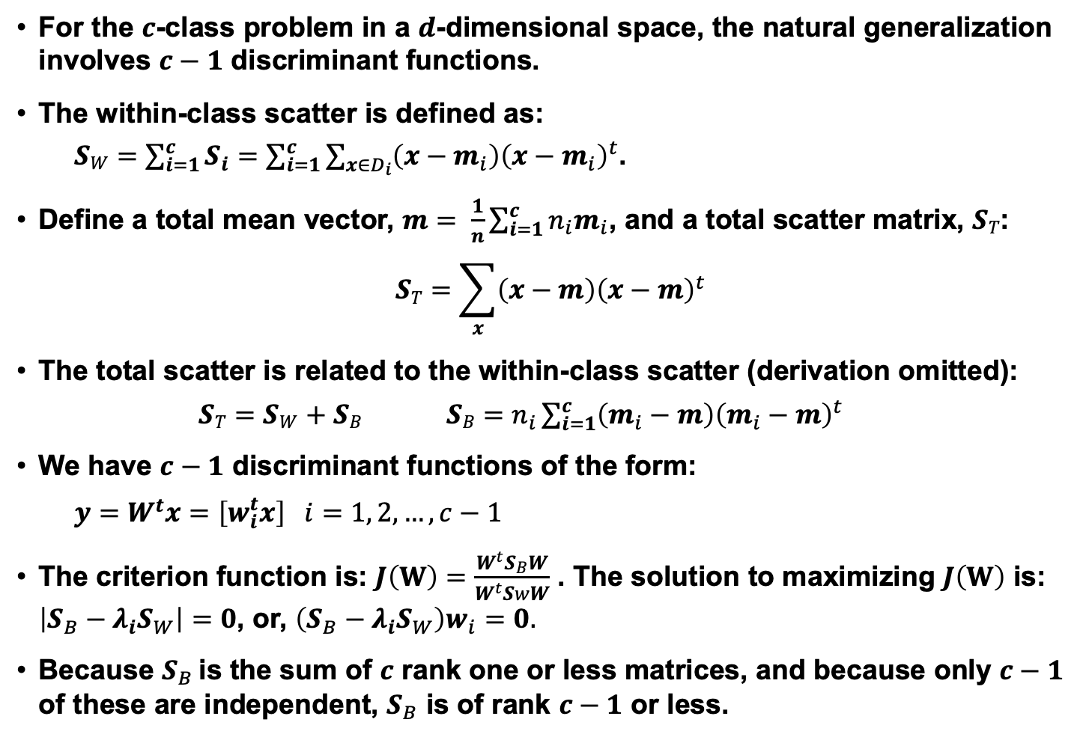
Multiple Discriminant Analysis
For the $c$-class problem in a $d$-dimensional space, the natural generalization involves $c−1$ discriminant functions.
The within-class scatter is defined as:
$SW=$ $\sum_{i=1}^{c}{S_{i}}=$ $\sum_{i=1}^{c}{\sum_{x∈D_{i}}{{\left(x−m_{i}\right)\left(x−m_{i}\right)}^{t}}}$.
Define a total mean vector, $m= \frac{1}{n}\sum_{i=1}^{c}{{n_{i}m}_{i}}$, and a total scatter matrix, $ST$:
$$ST=\sum_{x}{{\left(x−m\right)\left(x−m\right)}^{t}}$$
The total scatter is related to the within-class scatter (derivation omitted):
$ST=$ $SW$ $+ SB$ $SB=n_{i}\sum_{i=1}^{c}{\left(m_{i}−m\right){\left(m_{i}−m\right)}^{t}}$
We have $c−1$ discriminant functions of the form:
$$y=W^{t}x=\left[w_{i}^{t}x\right] i=1, 2, …, c−1$$
The criterion function is: $J\left(W\right)=\frac{W^{t}S_{B}W}{W^{t}SwW}$ . The solution to maximizing $J\left(W\right)$ is: $\left|S_{B}−λ_{i}S_{W}\right|=0$, or, $\left(S_{B}−λ_{i}S_{W}\right)w_{i}=0.$
Because $S_{B}$ is the sum of $c$ rank one or less matrices, and because only $c−1$ of these are independent, $S_{B}$ is of rank $c−1$ or less.

Slide 12
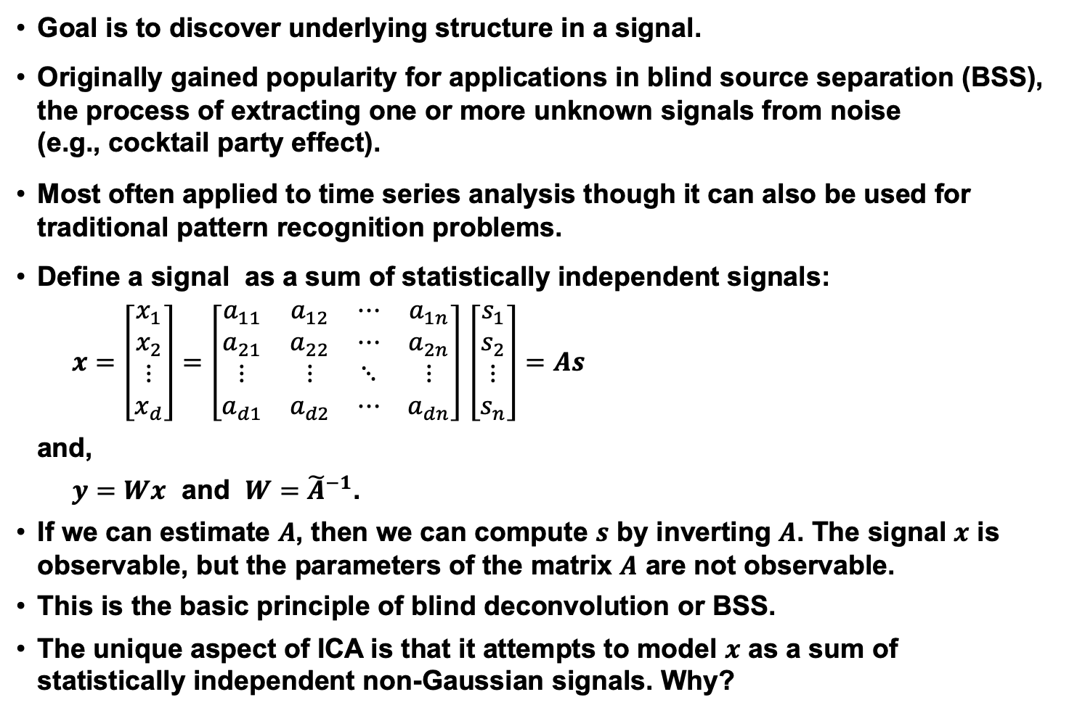
Independent Component Analysis (ICA)
Goal is to discover underlying structure in a signal.
Originally gained popularity for applications in blind source separation (BSS), the process of extracting one or more unknown signals from noise (e.g., cocktail party effect).
Most often applied to time series analysis though it can also be used for traditional pattern recognition problems.
Define a signal as a sum of statistically independent signals:
$x=\left[\begin{matrix}x_{1} \\ x_{2} \\ ⋮ \\ x_{d}\end{matrix}\right]=\left[\begin{matrix}a_{11} & a_{12} & ⋯ & a_{1n} \\ a_{21} & a_{22} & ⋯ & a_{2n} \\ ⋮ & ⋮ & ⋱ & ⋮ \\ a_{d1} & a_{d2} & ⋯ & a_{dn}\end{matrix}\right]$ $\left[\begin{matrix}s_{1} \\ s_{2} \\ ⋮ \\ s_{n}\end{matrix}\right]=As$
and,
$y=Wx$ and $W={\tilde{A}}^{−1}$.
If we can estimate $A$, then we can compute $s$ by inverting $A$. The signal $x$ is observable, but the parameters of the matrix $A$ are not observable.
This is the basic principle of blind deconvolution or BSS.
The unique aspect of ICA is that it attempts to model $x$ as a sum of statistically independent non-Gaussian signals. Why?

Slide 13
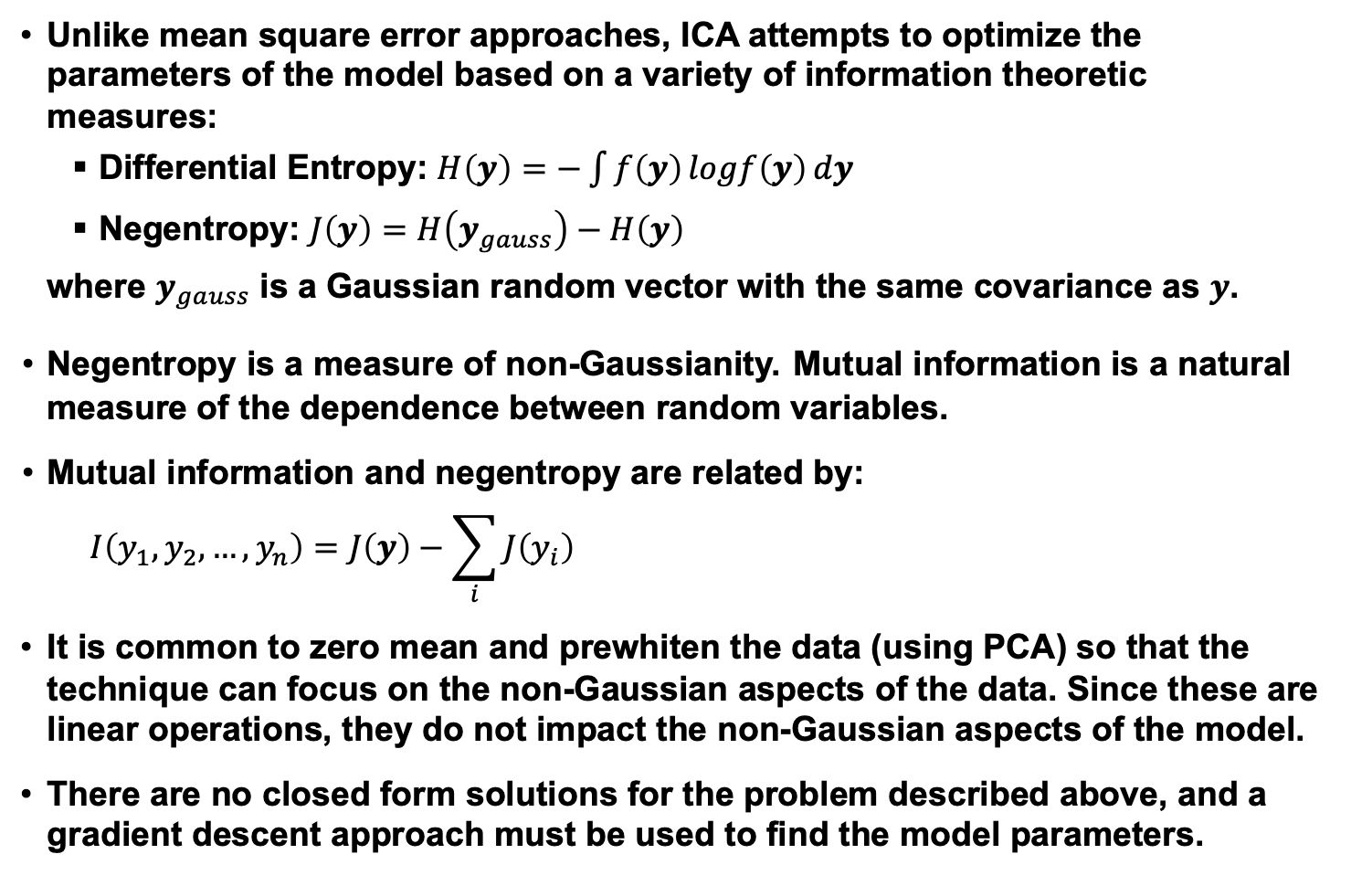
Objective Function
Unlike mean square error approaches, ICA attempts to optimize the parameters of the model based on a variety of information theoretic measures:
Differential Entropy: $H\left(y\right)=−\int{f\left(y\right)}logf\left(y\right)ⅆy$
Negentropy: $J\left(y\right)=H\left(y_{gauss}\right)−H\left(y\right)$
where $y_{gauss}$ is a Gaussian random vector with the same covariance as $y$.
Negentropy is a measure of non-Gaussianity. Mutual information is a natural measure of the dependence between random variables.
Mutual information and negentropy are related by:
$$I\left(y_{1},y_{2},…,y_{n}\right)=J\left(y\right)−\sum_{i}{J\left(y_{i}\right)}$$
It is common to zero mean and prewhiten the data (using PCA) so that the technique can focus on the non-Gaussian aspects of the data. Since these are linear operations, they do not impact the non-Gaussian aspects of the model.
There are no closed form solutions for the problem described above, and a gradient descent approach must be used to find the model parameters.

Slide 14
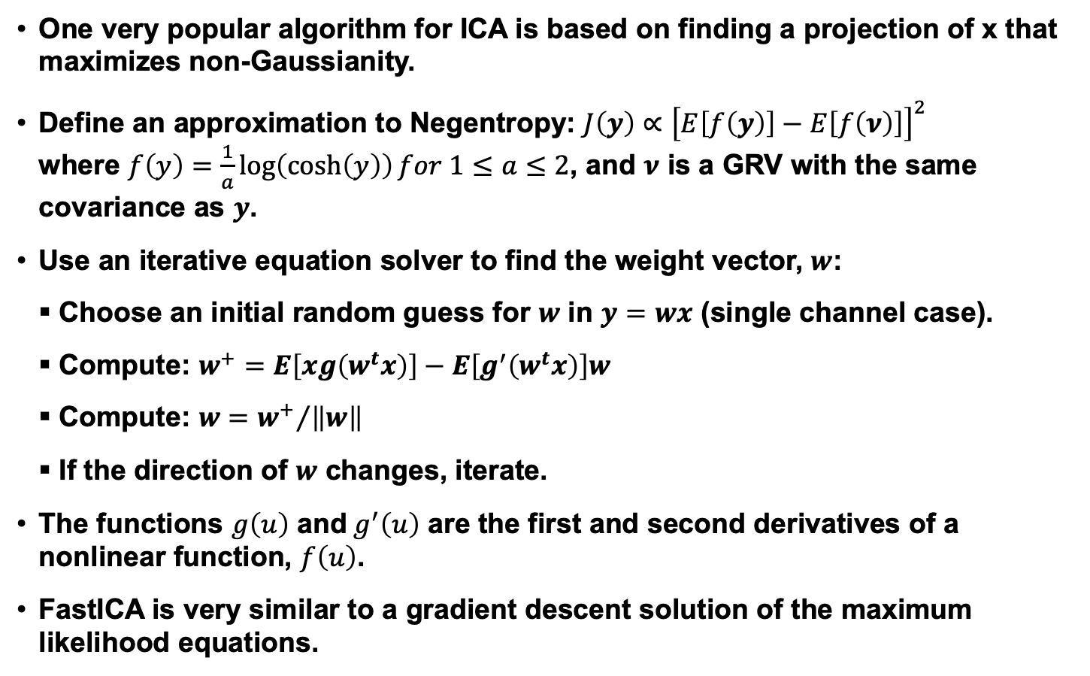
FastICA
One very popular algorithm for ICA is based on finding a projection of x that maximizes non-Gaussianity.
Define an approximation to Negentropy: $J\left(y\right)∝{\left[E\left[f\left(y\right)\right]−E\left[f\left(ν\right)\right]\right]}^{2}$ where $f\left(y\right)=\frac{1}{a}\log\left(\cosh\left(y\right)\right)for 1≤a≤2$, and $ν$ is a GRV with the same covariance as $y$.
Use an iterative equation solver to find the weight vector, $w$:
Choose an initial random guess for $w$ in $y=wx$ (single channel case).
Compute: $w^{+}=E\left[xg\left(w^{t}x\right)\right]−E\left[g^{′}\left(w^{t}x\right)\right]w$
Compute: $w={w^{+}}/{\left\|w\right\|}$
If the direction of $w$ changes, iterate.
The functions $g\left(u\right)$ and$g^{′}\left(u\right)$ are the first and second derivatives of a nonlinear function, $f\left(u\right)$.
FastICA is very similar to a gradient descent solution of the maximum likelihood equations.

Slide 15
Summary
Principal Component Analysis (PCA): represents the data by minimizing the squared error (representing data in directions of greatest variance).
PCA is commonly applied in a class-dependent manner where a whitening transformation is computed for each class, and the distance from the mean of that class is measured using this class-specific transformation.
PCA gives insight into the important dimensions of your problem by examining the direction of the eigenvectors.
Linear Discriminant Analysis (LDA): attempts to project the data onto a line that represents the direction of maximum discrimination.
LDA can be generalized to a multi-class problem through the use of multiple discriminant functions (c classes require c-1 discriminant functions).
Independent Component Analysis (ICA): an effective technique for blind source separation that is based on information theoretic principles.
There are many other forms of component analysis including heteroscedastic LDA (HLDA), neural network-based approaches (e.g., nonlinear PCA, learning vector quantization – LVQ), kernel-based approaches that use data-driven kernels, probabilistic ICA, and support vector machines.

Slide 16
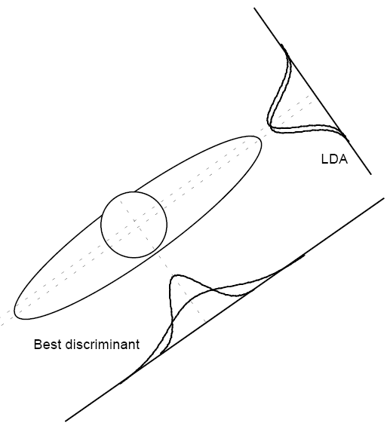
Heteroscedastic Linear Discriminant Analysis (HLDA)
Heteroscedastic: when random variables have different variances.
When might we observe heteroscedasticity?
Suppose 100 students enroll in a typing class — some of which have typing experience and some of which do not.
After the first class there would be a great deal of dispersion in the number of typing mistakes.
After the final class the dispersion would be smaller.
The error variance is non-constant — it decreases as time increases.
An example is shown to the right. The two classes have nearly the same mean, but different variances, and the variances differ in one direction.
LDA would project these classes onto a line that does not achieve maximal separation.
HLDA seeks a transform that will account for the unequal variances.
HLDA is typically useful when classes have significant overlap.

Slide 17
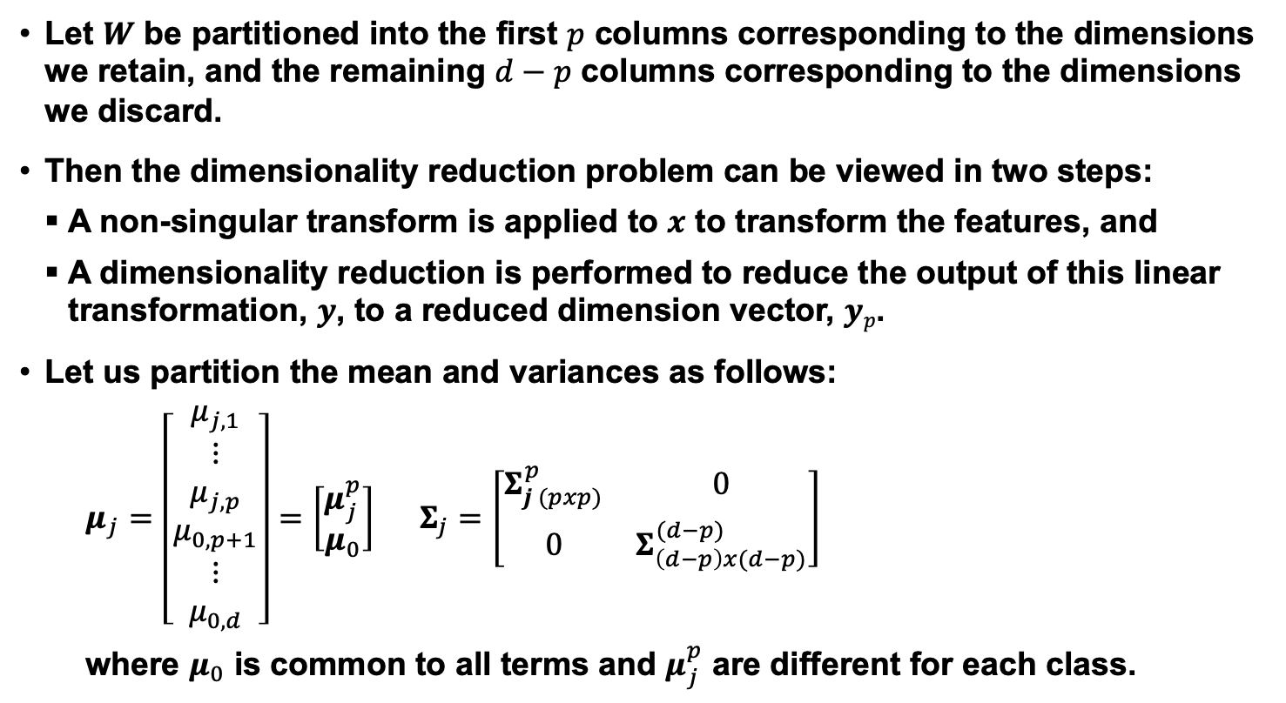
Partitioning Our Parameter Vector
Let $W$ be partitioned into the first $p$ columns corresponding to the dimensions we retain, and the remaining $d−p$ columns corresponding to the dimensions we discard.
Then the dimensionality reduction problem can be viewed in two steps:
A non-singular transform is applied to $x$ to transform the features, and
A dimensionality reduction is performed to reduce the output of this linear transformation, $y$, to a reduced dimension vector, $yp$.
Let us partition the mean and variances as follows:
$μ_{j}=\left[\begin{matrix}μ_{j,1} \\ ⋮ \\ μ_{j,p} \\ μ_{0,p+1} \\ ⋮ \\ μ_{0,d}\end{matrix}\right]=$ $\left[\begin{matrix}μ_{j}^{p} \\ μ_{0}\end{matrix}\right]$ $Σ_{j}=\left[\begin{matrix}Σ_{j (pxp)}^{p} & 0 \\ 0 & Σ_{\left(d−p\right)x(d−p)}^{(d−p)}\end{matrix}\right]$
where $μ_{0}$ is common to all terms and $μ_{j}^{p}$ are different for each class.

Slide 18
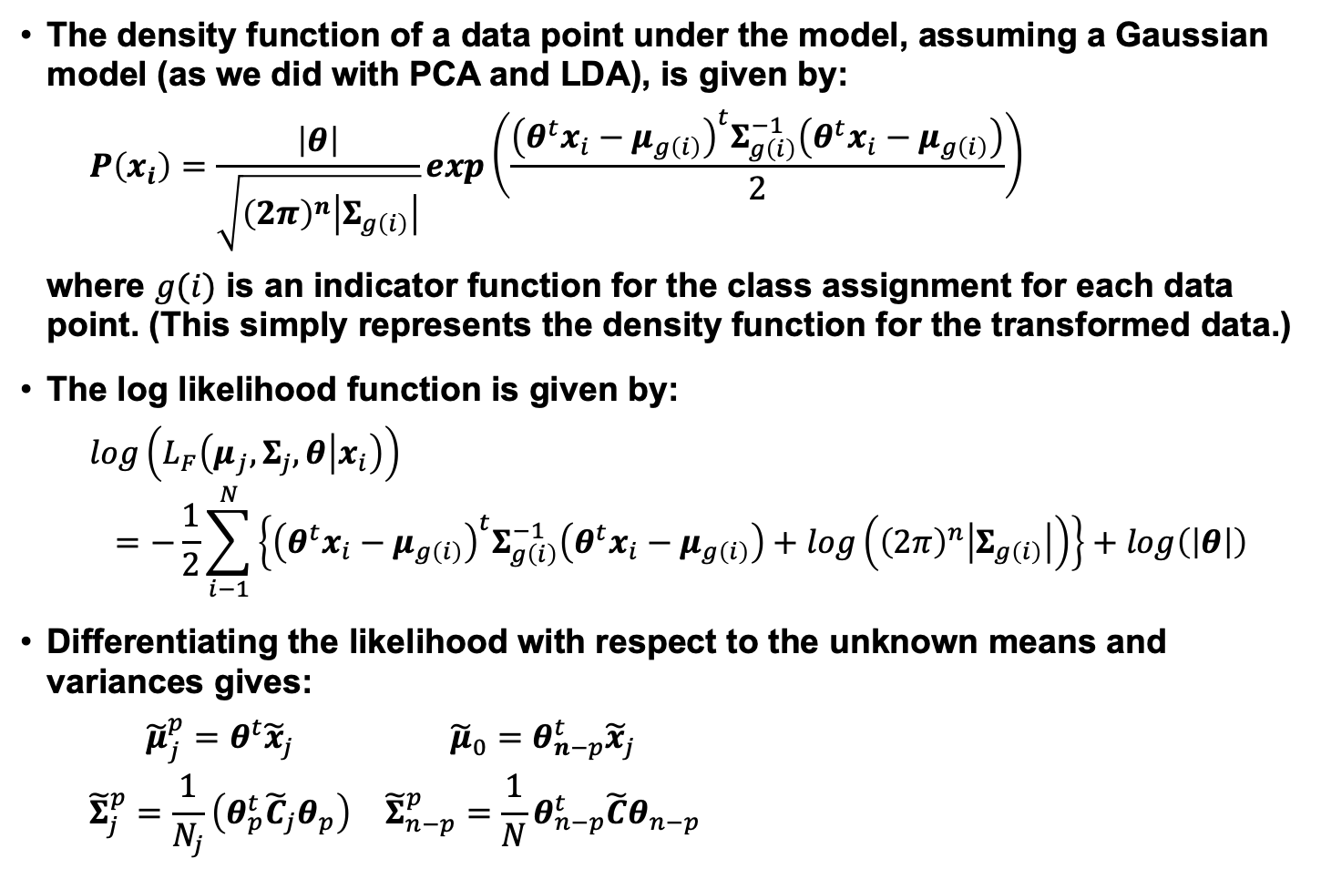
Density and Likelihood Functions
The density function of a data point under the model, assuming a Gaussian model (as we did with PCA and LDA), is given by:
$$P\left(x_{i}\right)=\frac{\left|θ\right|}{\sqrt{{\left(2π\right)}^{n}\left|Σ_{g\left(i\right)}\right|}}exp\left(\frac{{\left(θ^{t}x_{i}−μ_{g\left(i\right)}\right)}^{t}Σ_{g\left(i\right)}^{−1}\left(θ^{t}x_{i}−μ_{g\left(i\right)}\right)}{2}\right)$$
where $g(i)$ is an indicator function for the class assignment for each data point. (This simply represents the density function for the transformed data.)
The log likelihood function is given by:
$$log\left(L_{F}\left(μ_{j},Σ_{j},θ | x_{i}\right)\right)$$
$$=−\frac{1}{2}\sum_{i−1}^{N}{\left\{{\left(θ^{t}x_{i}−μ_{g\left(i\right)}\right)}^{t}Σ_{g\left(i\right)}^{−1}\left(θ^{t}x_{i}−μ_{g\left(i\right)}\right)+log\left({\left(2π\right)}^{n}\left|Σ_{g\left(i\right)}\right|\right)\right\}}+log\left(\left|θ\right|\right)$$
Differentiating the likelihood with respect to the unknown means and variances gives:
$$\begin{matrix}{\tilde{μ}}_{j}^{p}=θ^{t}{\tilde{x}}_{j} & {\tilde{μ}}_{0}=θ_{n−p}^{t}{\tilde{x}}_{j} \\ {\tilde{Σ}}_{j}^{p}=\frac{1}{N_{j}}\left(θ_{p}^{t}{\tilde{C}}_{j}θ_{p}\right) & {\tilde{Σ}}_{n−p}^{p}=\frac{1}{N}θ_{n−p}^{t}\tilde{C}θ_{n−p}\end{matrix}$$

Slide 19
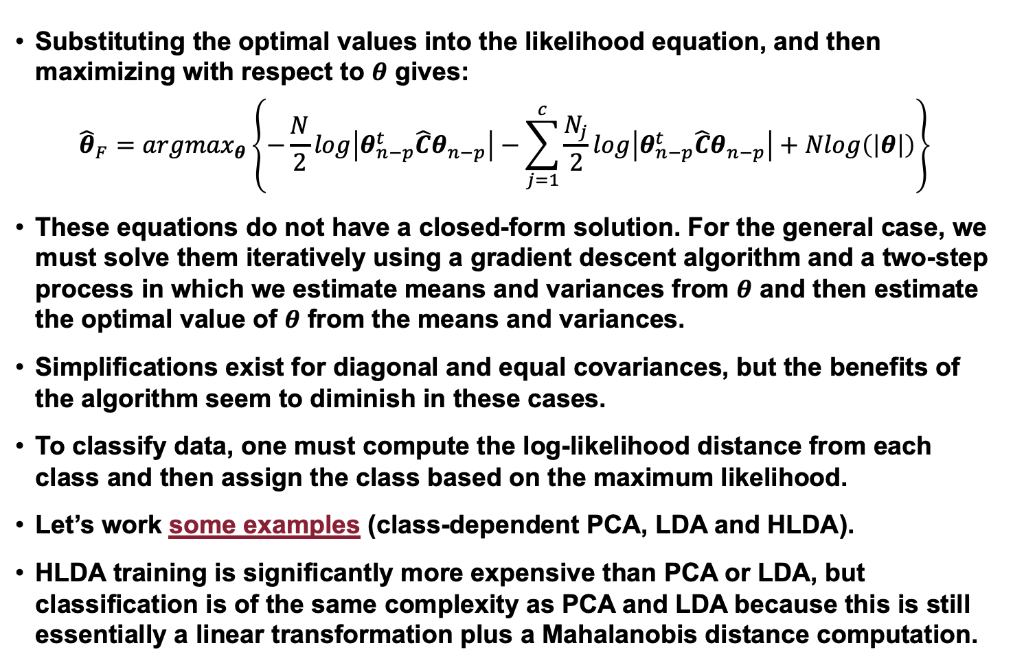
Optimal Solution
Substituting the optimal values into the likelihood equation, and then maximizing with respect to $θ$ gives:
$${\hat{θ}}_{F}={argmax}_{θ}\left\{−\frac{N}{2}log\left|θ_{n−p}^{t}\hat{C}θ_{n−p}\right|−\sum_{j=1}^{c}{\frac{N_{j}}{2}log\left|θ_{n−p}^{t}\hat{C}θ_{n−p}\right|+Nlog\left(\left|θ\right|\right)}\right\}$$
These equations do not have a closed-form solution. For the general case, we must solve them iteratively using a gradient descent algorithm and a two-step process in which we estimate means and variances from $θ$ and then estimate the optimal value of $θ$ from the means and variances.
Simplifications exist for diagonal and equal covariances, but the benefits of the algorithm seem to diminish in these cases.
To classify data, one must compute the log-likelihood distance from each class and then assign the class based on the maximum likelihood.
Let’s work some examples (class-dependent PCA, LDA and HLDA).
HLDA training is significantly more expensive than PCA or LDA, but classification is of the same complexity as PCA and LDA because this is still essentially a linear transformation plus a Mahalanobis distance computation.

