Slide 1
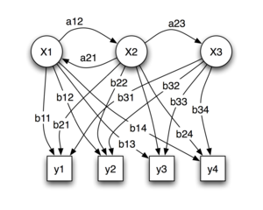
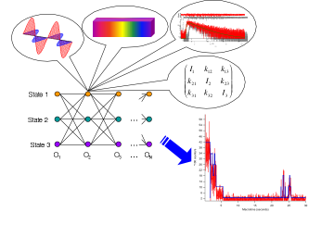
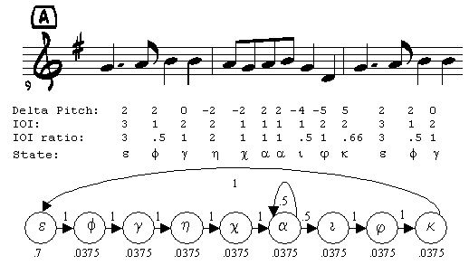
Lecture 09: Hidden Markov Models – Basic Elements
Objectives:
Markov Processes
Doubly Stochastic Systems
Elements of a Discrete Model
Example Calculations
Resources:
Rabiner: Tutorial
Deller, et al.: Speech Processing
Jelinek: Statistical Methods Rabiner and Juang: Fundamentals
Picone: HMM Overview

Slide 2
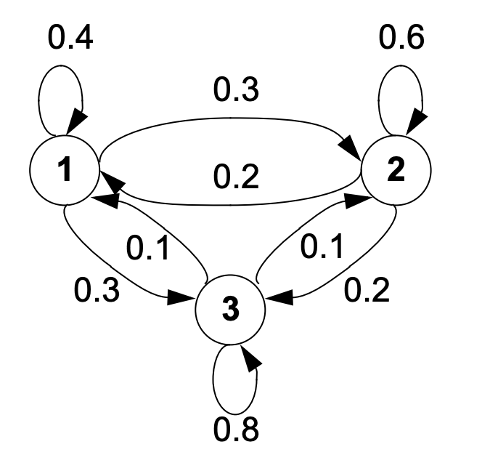
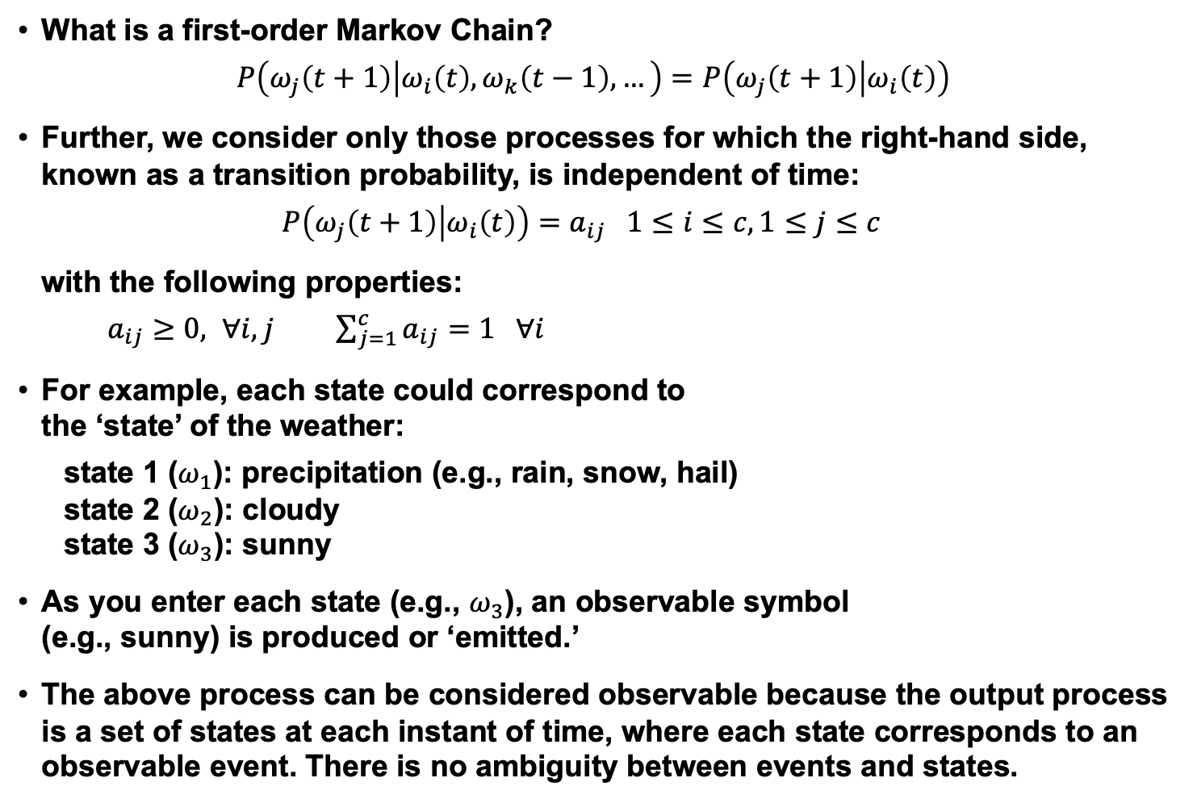
Definition of a Hidden Markov Model
What is a first-order Markov Chain?
$$P\left(ω_{j}\left(t+1\right) | ω_{i}\left(t\right),ω_{k}\left(t−1\right),…\right)=P\left(ω_{j}\left(t+1\right) | ω_{i}\left(t\right)\right)$$
Further, we consider only those processes for which the right-hand side, known as a transition probability, is independent of time:
$$P\left(ω_{j}\left(t+1\right) | ω_{i}\left(t\right)\right)=a_{ij} 1≤i≤c, 1≤j≤c$$
with the following properties:
$a_{ij}≥0, ∀i,j$ $\sum_{j=1}^{c}{a_{ij}=1 ∀i}$
For example, each state could correspond to the ‘state’ of the weather:
state 1 ($ω_{1}$): precipitation (e.g., rain, snow, hail)
state 2 ($ω_{2}$): cloudy
state 3 ($ω_{3}$): sunny
As you enter each state (e.g., $ω_{3}$), an observable symbol (e.g., sunny) is produced or ‘emitted.’
The above process can be considered observable because the output process is a set of states at each instant of time, where each state corresponds to an observable event. There is no ambiguity between events and states.

Slide 3
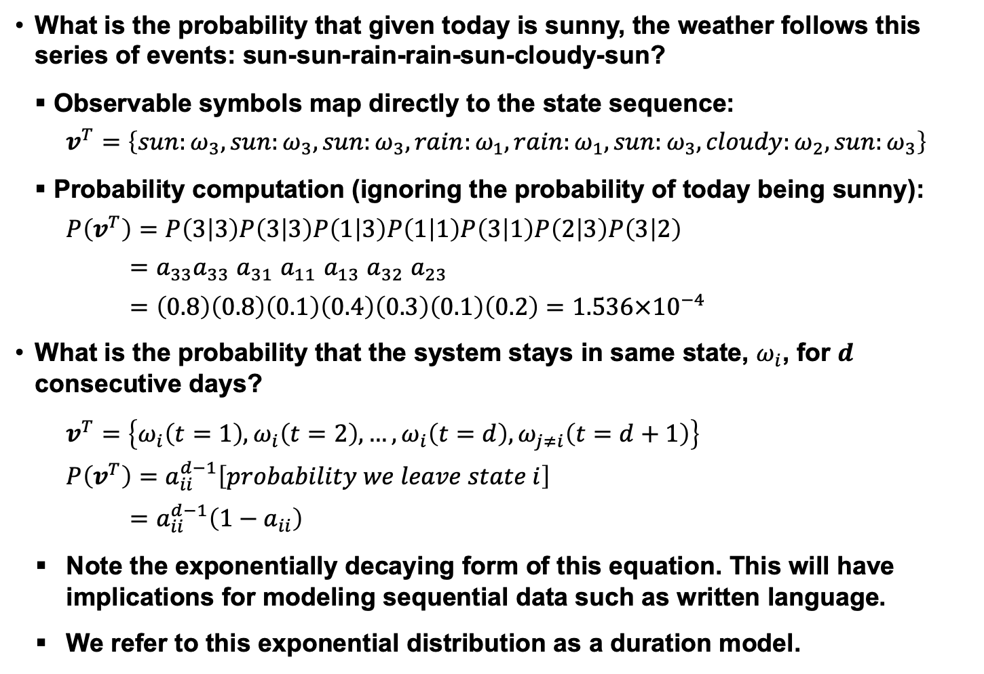
Example Calculations
What is the probability that given today is sunny, the weather follows this series of events: sun-sun-rain-rain-sun-cloudy-sun?
Observable symbols map directly to the state sequence:
$$v^{T}=\left\{sun:ω_{3},sun:ω_{3},sun:ω_{3},rain:ω_{1},rain:ω_{1},sun:ω_{3},cloudy:ω_{2},sun:ω_{3}\right\}$$
Probability computation (ignoring the probability of today being sunny):
$$P\left(v^{T}\right)=P\left(3 | 3\right)P\left(3 | 3\right)P\left(1 | 3\right)P\left(1 | 1\right)P\left(3 | 1\right)P\left(2 | 3\right)P\left(3 | 2\right)$$
$=a_{33}a_{33}$ $a_{31}$ $a_{11}$ $a_{13}$ $a_{32}$ $a_{23}$
$$=\left(0.8\right)\left(0.8\right)\left(0.1\right)\left(0.4\right)\left(0.3\right)\left(0.1\right)\left(0.2\right)=1.536×{10}^{−4}$$
What is the probability that the system stays in same state, $ω_{i}$, for $d$ consecutive days?
$$v^{T}=\left\{ω_{i}\left(t=1\right),ω_{i}\left(t=2\right),…,ω_{i}\left(t=d\right),ω_{j≠i}\left(t=d+1\right)\right\}$$
$$P\left(v^{T}\right)=a_{ii}^{d−1}\left[probability we leave state i\right]$$
$$=a_{ii}^{d−1}\left(1−a_{ii}\right)$$
Note the exponentially decaying form of this equation. This will have implications for modeling sequential data such as written language.
We refer to this exponential distribution as a duration model.

Slide 4
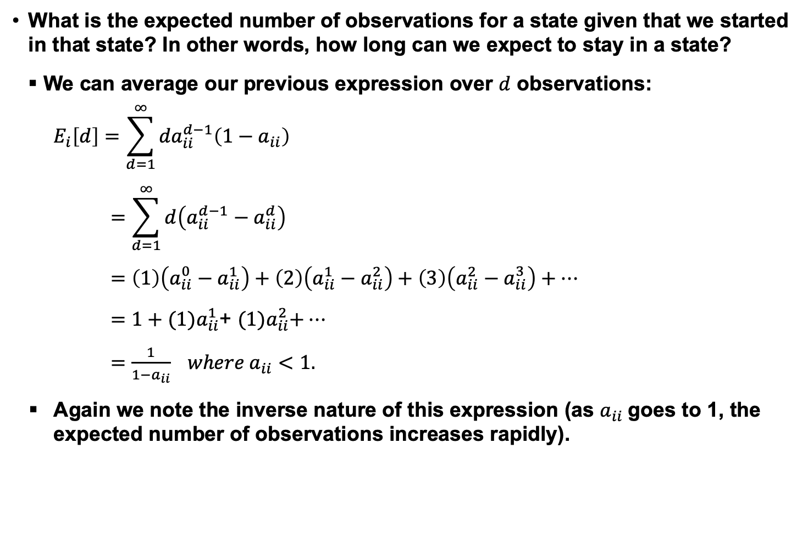
One More Example Calculation
What is the expected number of observations for a state given that we started in that state? In other words, how long can we expect to stay in a state?
We can average our previous expression over $d$ observations:
$$E_{i}\left[d\right]=\sum_{d=1}^{∞}{{da}_{ii}^{d−1}\left(1−a_{ii}\right)}$$
$$=\sum_{d=1}^{∞}{d\left(a_{ii}^{d−1}−a_{ii}^{d}\right)}$$
$$=\left(1\right)\left(a_{ii}^{0}−a_{ii}^{1}\right)+\left(2\right)\left(a_{ii}^{1}−a_{ii}^{2}\right)+\left(3\right)\left(a_{ii}^{2}−a_{ii}^{3}\right)+…$$
$=1+(1)a_{ii}^{1}$+ ${(1)a}_{ii}^{2}+…$
$=\frac{1}{1−a_{ii}} where a_{ii}<1.$
Again we note the inverse nature of this expression (as $a_{ii}$goes to 1, the expected number of observations increases rapidly).

Slide 5
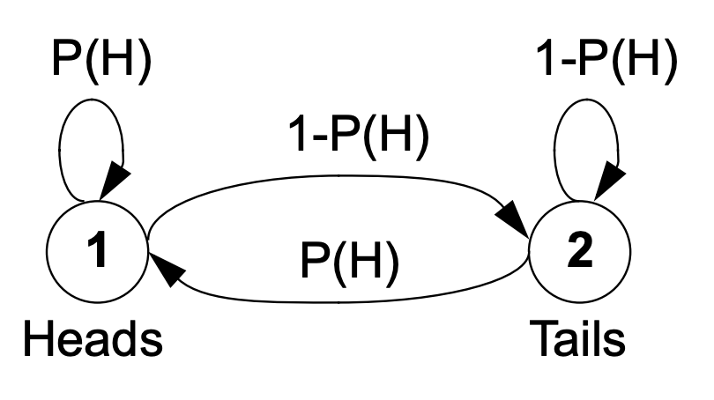
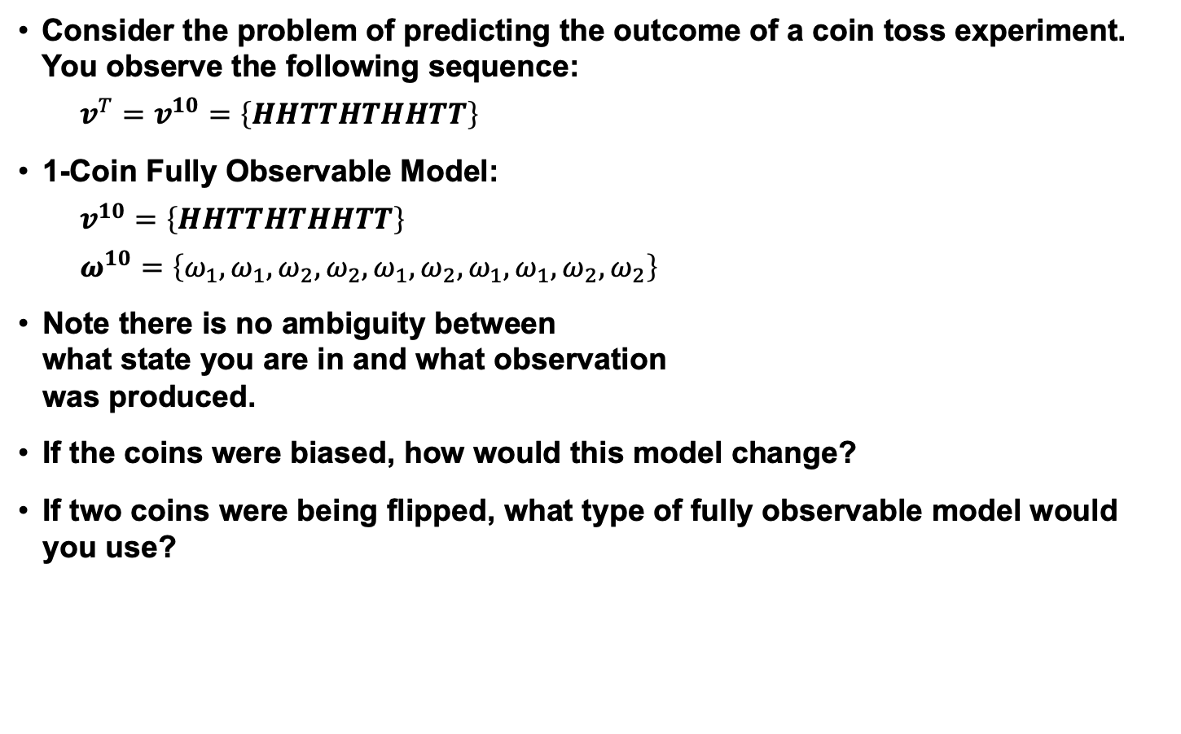
A Single Coin Toss Model – Fully Observable
Consider the problem of predicting the outcome of a coin toss experiment. You observe the following sequence:
$$v^{T}=v^{10}=\left\{HHTTHTHHTT\right\}$$
1-Coin Fully Observable Model:
$$v^{10}=\left\{HHTTHTHHTT\right\}$$
$$ω^{10}=\left\{ω_{1},ω_{1},ω_{2},ω_{2},ω_{1},ω_{2},ω_{1},ω_{1},ω_{2},ω_{2}\right\}$$
Note there is no ambiguity between what state you are in and what observation was produced.
If the coins were biased, how would this model change?
If two coins were being flipped, what type of fully observable model would you use?

Slide 6
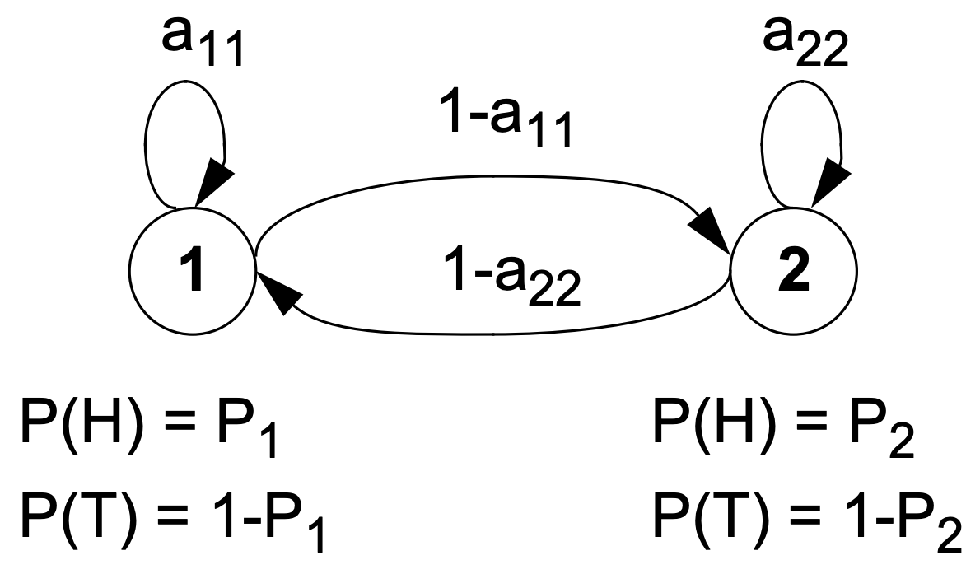
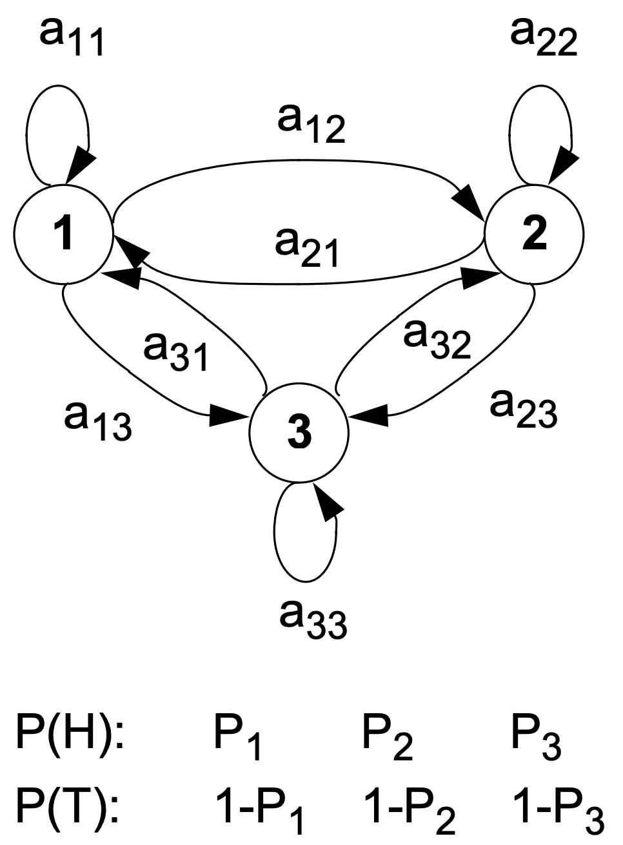
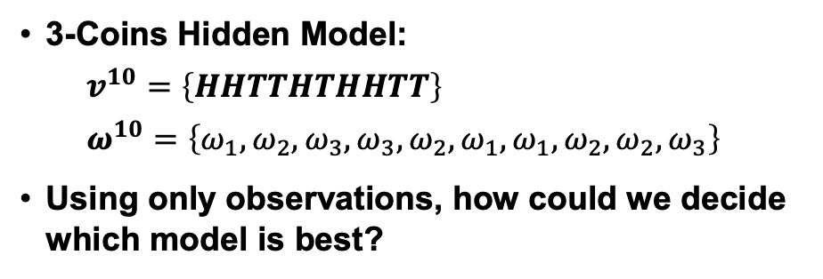
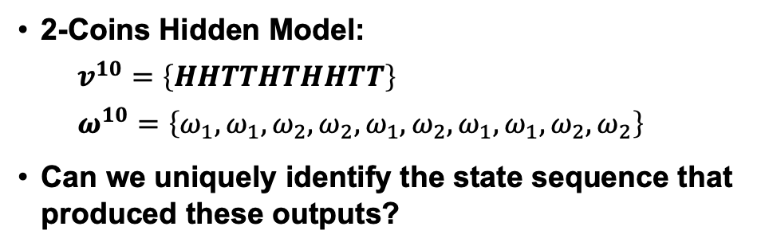
Multiple Coin Models – Hidden Markov Models
2-Coins Hidden Model:
$$v^{10}=\left\{HHTTHTHHTT\right\}$$
$$ω^{10}=\left\{ω_{1},ω_{1},ω_{2},ω_{2},ω_{1},ω_{2},ω_{1},ω_{1},ω_{2},ω_{2}\right\}$$
Can we uniquely identify the state sequence that produced these outputs?
3-Coins Hidden Model:
$$v^{10}=\left\{HHTTHTHHTT\right\}$$
$$ω^{10}=\left\{ω_{1},ω_{2},ω_{3},ω_{3},ω_{2},ω_{1},ω_{1},ω_{2},ω_{2},ω_{3}\right\}$$
Using only observations, how could we decide which model is best?

Slide 7
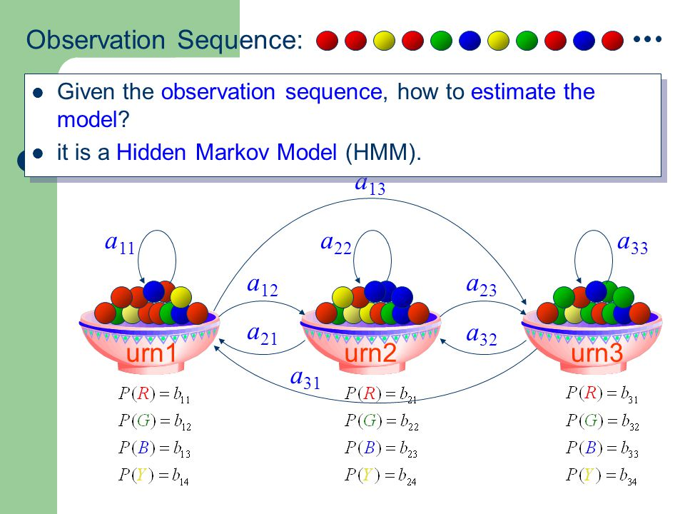
Balls and Urns: Another Example of a Hidden Model

Slide 8
Motivation
Thus far we have dealt with parameter estimation for the static pattern classification problem: estimating the parameters of class-conditional densities needed to make a single decision.
Many problems have an inherent temporal dimension – the vectors of interest come from a time series that unfolds as a function of time. Modeling temporal relationships between these vectors is an important part of the problem.
Markov models are a popular way to model such signals. There are many generalizations of these approaches, including Markov Random Fields and Bayesian Networks.
First-order Markov processes are very effective because they are sufficiently powerful and computationally efficient.
Higher-order Markov processes can be represented using first-order processes.
Markov models are very attractive because of their ability to automatically learn underlying structure. Often this structure has relevance to the pattern recognition problem (e.g., the states represents physical attributes of the system that generated the data).

Slide 9
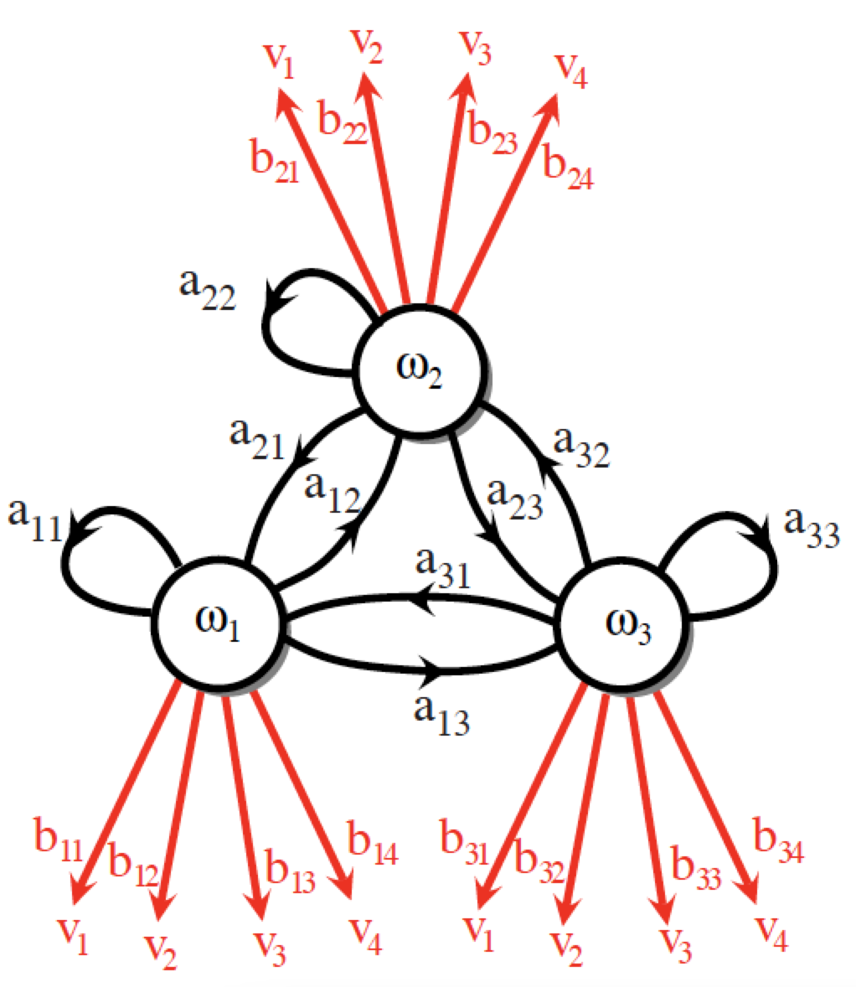
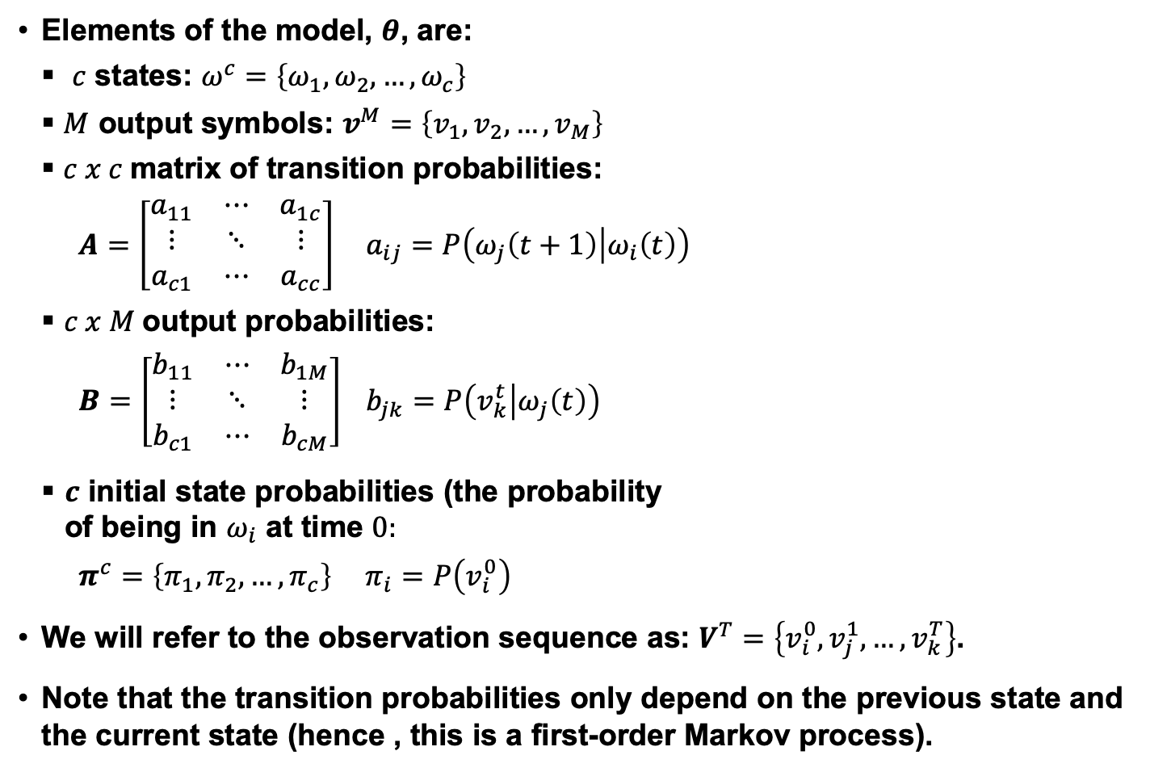
Discrete Hidden Markov Models
Elements of the model, $θ$, are:
$c$ states: $ω^{c}=\left\{ω_{1},ω_{2},…,ω_{c}\right\}$
$M$ output symbols: $v^{M}=\left\{v_{1},v_{2},…,v_{M}\right\}$
$c x c$matrix of transition probabilities:
$A=\left[\begin{matrix}a_{11} & ⋯ & a_{1c} \\ ⋮ & ⋱ & ⋮ \\ a_{c1} & ⋯ & a_{cc}\end{matrix}\right]$ $a_{ij}=P\left(ω_{j}\left(t+1\right) | ω_{i}\left(t\right)\right)$
$c x M$output probabilities:
$B=\left[\begin{matrix}b_{11} & ⋯ & b_{1M} \\ ⋮ & ⋱ & ⋮ \\ b_{c1} & ⋯ & b_{cM}\end{matrix}\right]$ $b_{jk}=P\left(v_{k}^{t} | ω_{j}\left(t\right)\right)$
$c$ initial state probabilities (the probability of being in $ω_{i}$ at time $0:$
$π^{c}=\left\{π_{1},π_{2},…,π_{c}\right\}$ $π_{i}=P\left(v_{i}^{0}\right)$
We will refer to the observation sequence as: $V^{T}=\left\{v_{i}^{0},v_{j}^{1},…,v_{k}^{T}\right\}$.
Note that the transition probabilities only depend on the previous state and the current state (hence , this is a first-order Markov process).

Slide 10
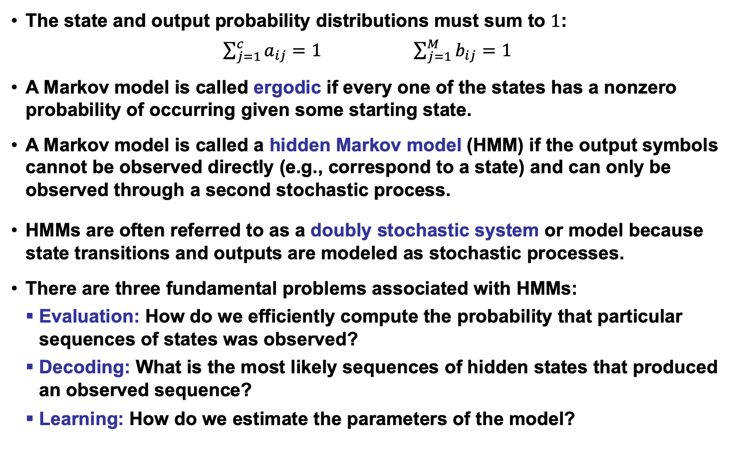
More Definitions and Comments
The state and output probability distributions must sum to $1$:
$\sum_{j=1}^{c}{a_{ij}=1}$ $\sum_{j=1}^{M}{b_{ij}=1}$
A Markov model is called ergodic if every one of the states has a nonzero probability of occurring given some starting state.
A Markov model is called a hidden Markov model (HMM) if the output symbols cannot be observed directly (e.g., correspond to a state) and can only be observed through a second stochastic process.
HMMs are often referred to as a doubly stochastic system or model because state transitions and outputs are modeled as stochastic processes.
There are three fundamental problems associated with HMMs:
Evaluation: How do we efficiently compute the probability that particular sequences of states was observed?
Decoding: What is the most likely sequences of hidden states that produced an observed sequence?
Learning: How do we estimate the parameters of the model?

Slide 11
Summary
Progress thus far:
Formally introduced a hidden Markov model.
Described three fundamental problems (evaluation, decoding, and training).
Derived general properties of the model.
Remaining issues:
Introduce the Forward Algorithm as a fast way to do evaluation.
Introduce the Viterbi Algorithm as a reasonable way to do decoding.
Introduce dynamic programming using a string matching example.
Derive the reestimation equations using the EM Theorem so we can guarantee convergence.
Generalize the output distribution to a continuous distribution using a Gaussian mixture model.

