Slide 1
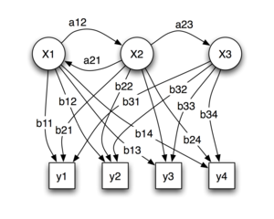
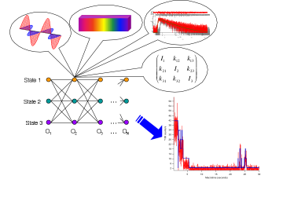
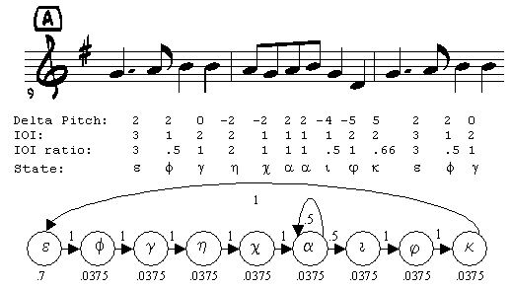
Lecture 10: Hidden Markov Models – Evaluation
Objectives:
Evaluation
Decoding
Dynamic Programming (Intro)
Resources:
Rabiner and Juang: Fundamentals Deller, et al.: Speech Processing
Shen: Derivation

Slide 2
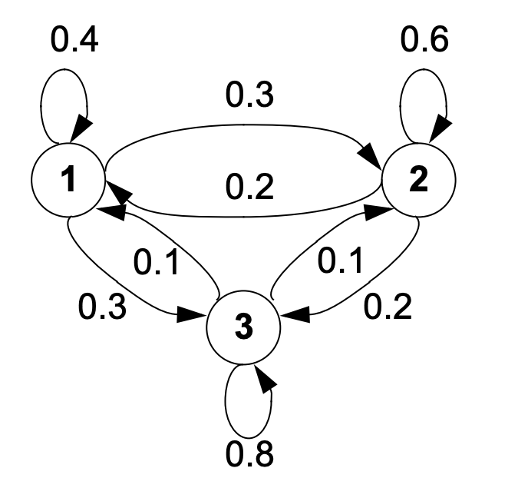
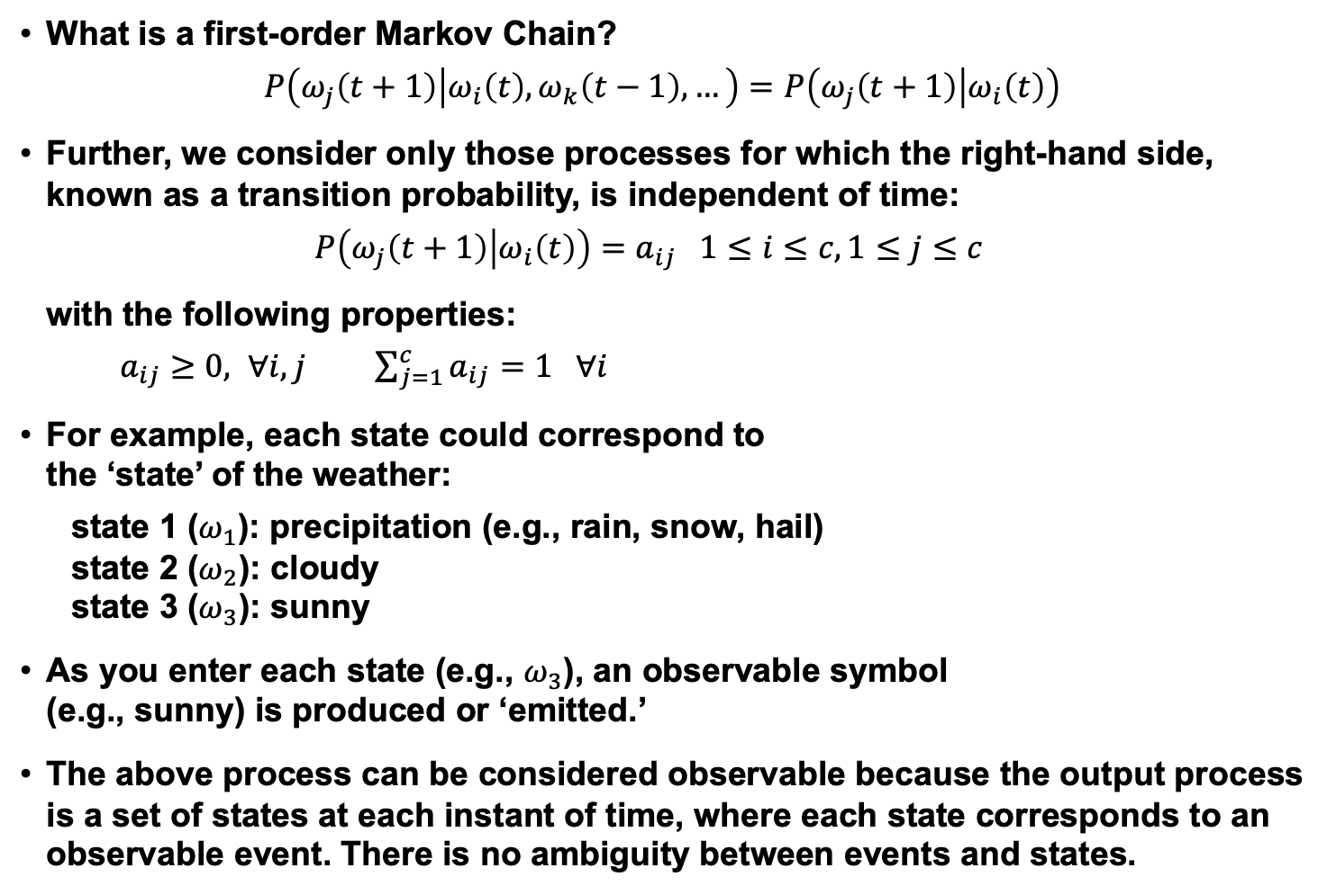
Definition of a Hidden Markov Model
What is a first-order Markov Chain?
$$P\left(ω_{j}\left(t+1\right) | ω_{i}\left(t\right),ω_{k}\left(t−1\right),…\right)=P\left(ω_{j}\left(t+1\right) | ω_{i}\left(t\right)\right)$$
Further, we consider only those processes for which the right-hand side, known as a transition probability, is independent of time:
$$P\left(ω_{j}\left(t+1\right) | ω_{i}\left(t\right)\right)=a_{ij} 1≤i≤c, 1≤j≤c$$
with the following properties:
$a_{ij}≥0, ∀i,j$ $\sum_{j=1}^{c}{a_{ij}=1 ∀i}$
For example, each state could correspond to the ‘state’ of the weather:
state 1 ($ω_{1}$): precipitation (e.g., rain, snow, hail)
state 2 ($ω_{2}$): cloudy
state 3 ($ω_{3}$): sunny
As you enter each state (e.g., $ω_{3}$), an observable symbol (e.g., sunny) is produced or ‘emitted.’
The above process can be considered observable because the output process is a set of states at each instant of time, where each state corresponds to an observable event. There is no ambiguity between events and states.

Slide 3
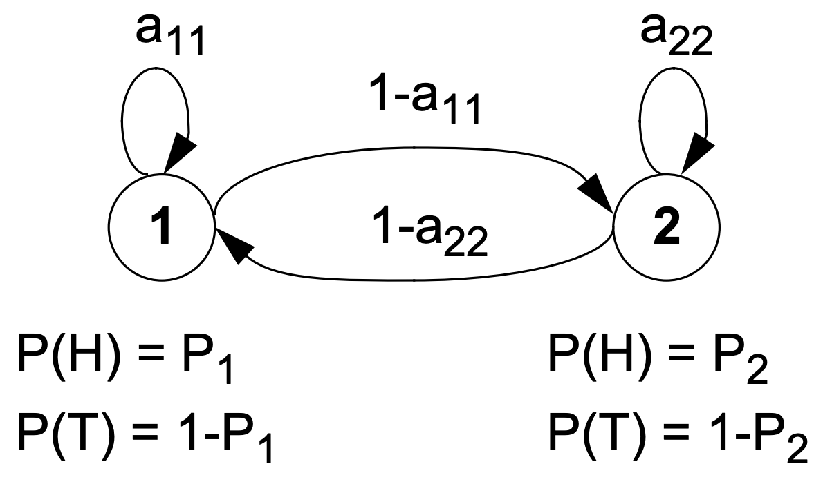
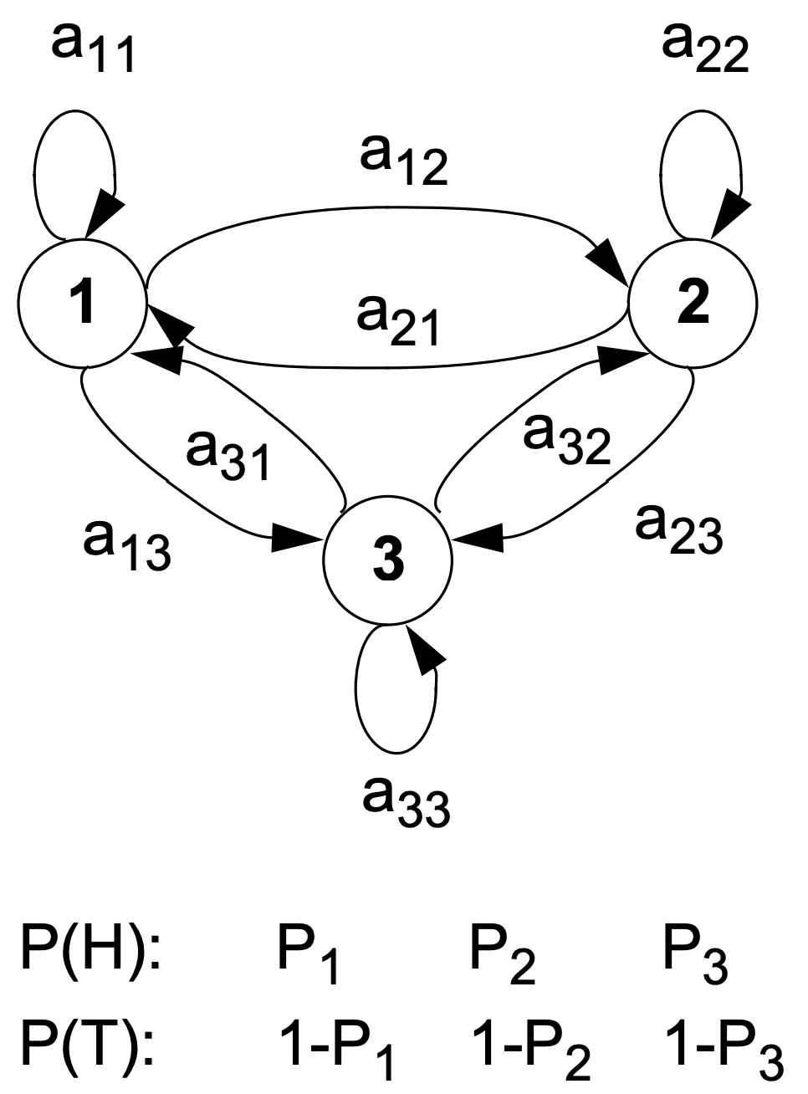
Multiple Coin Models – Hidden Markov Models
2-Coins Hidden Model:
$$v^{10}=\left\{HHTTHTHHTT\right\}$$
$$ω^{10}=\left\{ω_{1},ω_{1},ω_{2},ω_{2},ω_{1},ω_{2},ω_{1},ω_{1},ω_{2},ω_{2}\right\}$$
Can we uniquely identify the state sequence that produced these outputs?
3-Coins Hidden Model:
$$v^{10}=\left\{HHTTHTHHTT\right\}$$
$$ω^{10}=\left\{ω_{1},ω_{2},ω_{3},ω_{3},ω_{2},ω_{1},ω_{1},ω_{2},ω_{2},ω_{3}\right\}$$
Using only observations, how could we decide which model is best?

Slide 4
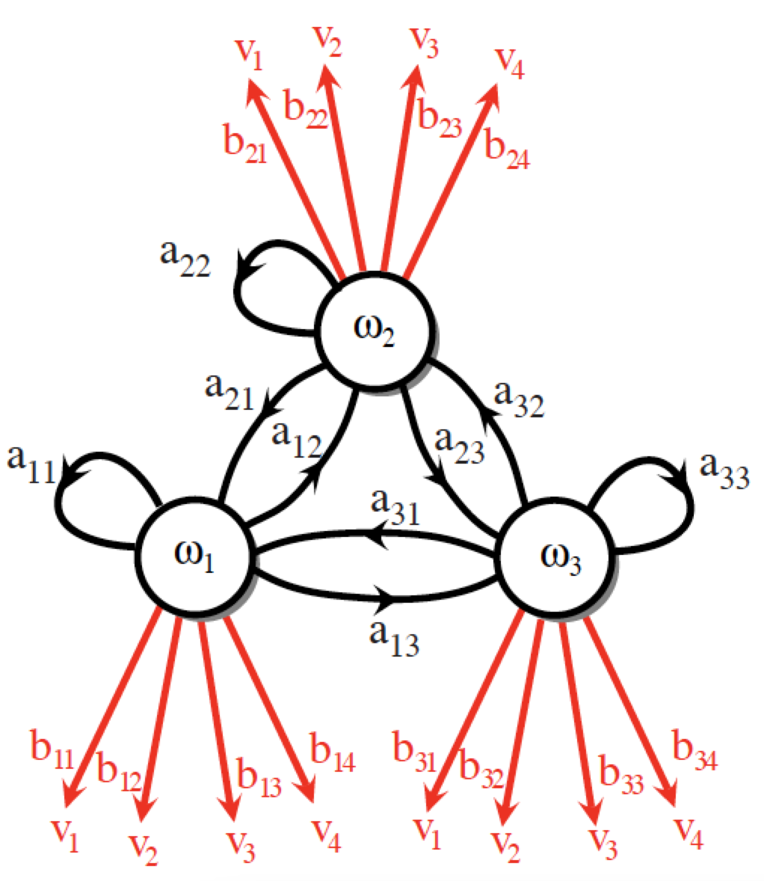
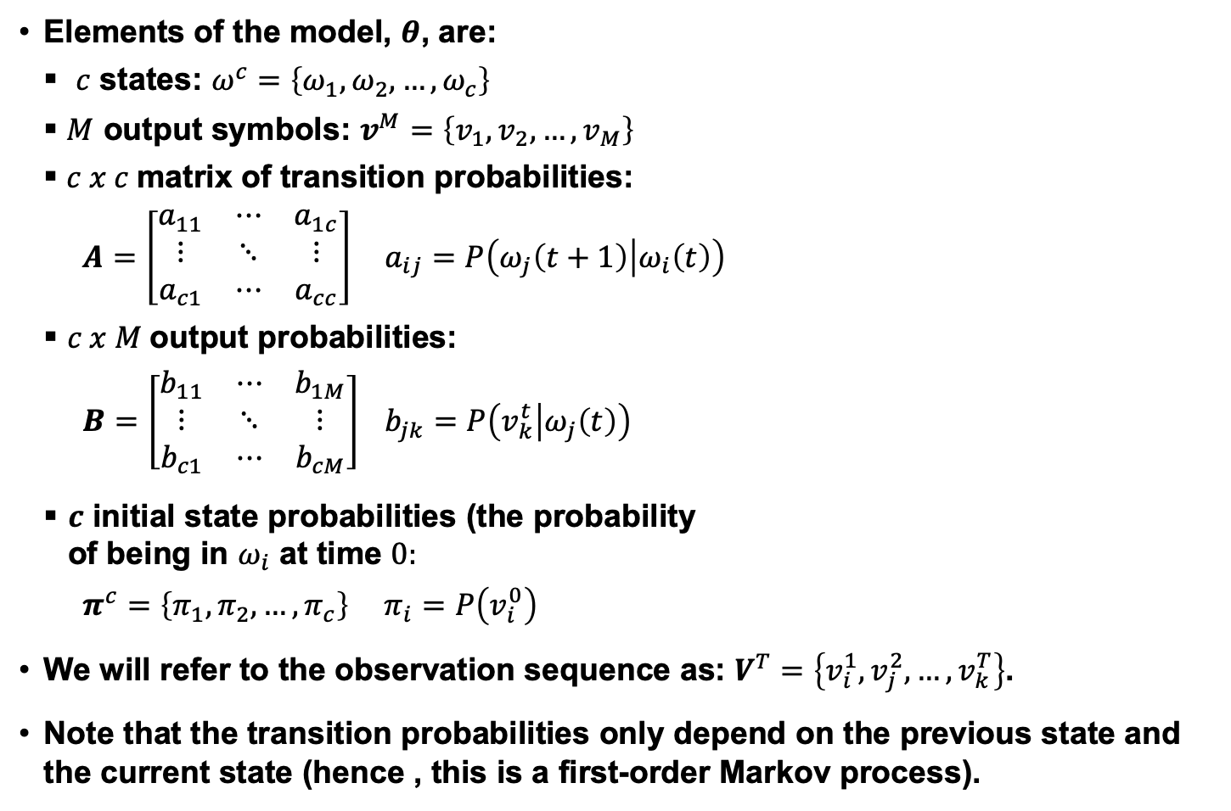
Discrete Hidden Markov Models
Elements of the model, $θ$, are:
$c$ states: $ω^{c}=\left\{ω_{1},ω_{2},…,ω_{c}\right\}$
$M$ output symbols: $v^{M}=\left\{v_{1},v_{2},…,v_{M}\right\}$
$c x c$matrix of transition probabilities:
$A=\left[\begin{matrix}a_{11} & ⋯ & a_{1c} \\ ⋮ & ⋱ & ⋮ \\ a_{c1} & ⋯ & a_{cc}\end{matrix}\right]$ $a_{ij}=P\left(ω_{j}\left(t+1\right) | ω_{i}\left(t\right)\right)$
$c x M$output probabilities:
$B=\left[\begin{matrix}b_{11} & ⋯ & b_{1M} \\ ⋮ & ⋱ & ⋮ \\ b_{c1} & ⋯ & b_{cM}\end{matrix}\right]$ $b_{jk}=P\left(v_{k}^{t} | ω_{j}\left(t\right)\right)$
$c$ initial state probabilities (the probability of being in $ω_{i}$ at time $0:$
$π^{c}=\left\{π_{1},π_{2},…,π_{c}\right\}$ $π_{i}=P\left(v_{i}^{0}\right)$
We will refer to the observation sequence as: $V^{T}=\left\{v_{i}^{1},v_{j}^{2},…,v_{k}^{T}\right\}$.
Note that the transition probabilities only depend on the previous state and the current state (hence , this is a first-order Markov process).

Slide 5
More Definitions and Comments
The state and output probability distributions must sum to $1$:
$\sum_{j=1}^{c}{a_{ij}=1}$ $\sum_{j=1}^{M}{b_{ij}=1}$
A Markov model is called ergodic if every one of the states has a nonzero probability of occurring given some starting state.
A Markov model is called a hidden Markov model (HMM) if the output symbols cannot be observed directly (e.g., correspond to a state) and can only be observed through a second stochastic process.
HMMs are often referred to as a doubly stochastic system or model because state transitions and outputs are modeled as stochastic processes.
There are three fundamental problems associated with HMMs:
Evaluation: How do we efficiently compute the probability that particular sequences of states was observed?
Decoding: What is the most likely sequences of hidden states that produced an observed sequence?
Learning: How do we estimate the parameters of the model?

Slide 6
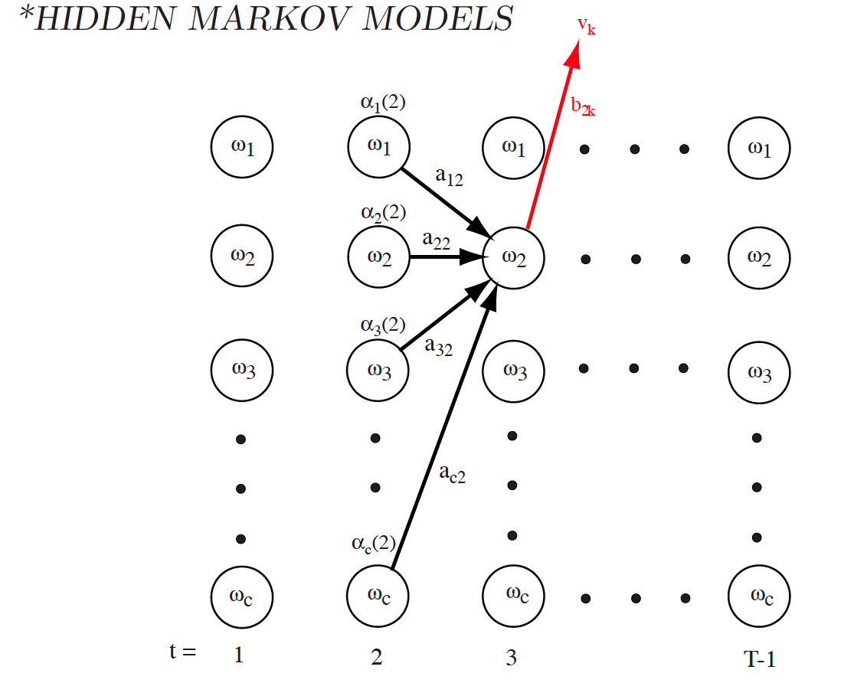

Evaluation
Evaluation: How do we efficiently compute the probability that a particular sequence of events was observed?
Unroll the model into a ‘lattice’.
The probability of being in any state at time $t=0, 1, …$ is easily computed by exploiting the 1st-order property.
We can sum all possible paths from previous states:
$$\left[\begin{matrix}P\left(ω_{1}^{0}\right) \\ ⋮ \\ P\left(ω_{c}^{0}\right)\end{matrix}\right]=\left[\begin{matrix}π_{1} \\ ⋮ \\ π_{c}\end{matrix}\right],$$
$$\left[\begin{matrix}P\left(ω_{1}^{1}\right) \\ ⋮ \\ P\left(ω_{c}^{1}\right)\end{matrix}\right]=\left[\begin{matrix}a_{11} & a_{12} & … & a_{1c} \\ a_{21} & a_{22} & … & a_{2c} \\ … & … & … & … \\ a_{c1} & a_{c2} & … & a_{cc}\end{matrix}\right]\left[\begin{matrix}π_{1} \\ π_{2} \\ ⋮ \\ π_{c}\end{matrix}\right]$$
$$\left[\begin{matrix}P\left(ω_{1}^{t}\right) \\ ⋮ \\ P\left(ω_{c}^{t}\right)\end{matrix}\right]=A^{t}π$$

Slide 7
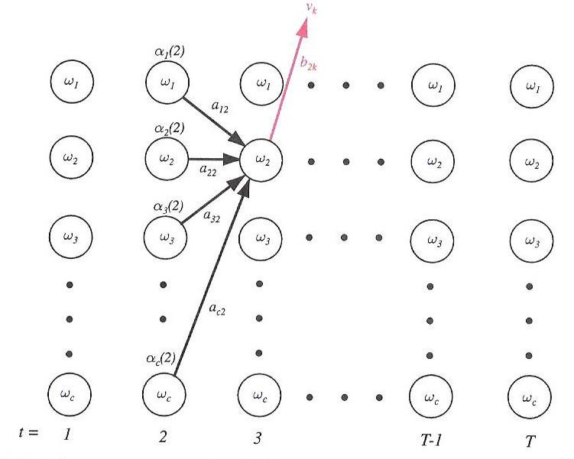
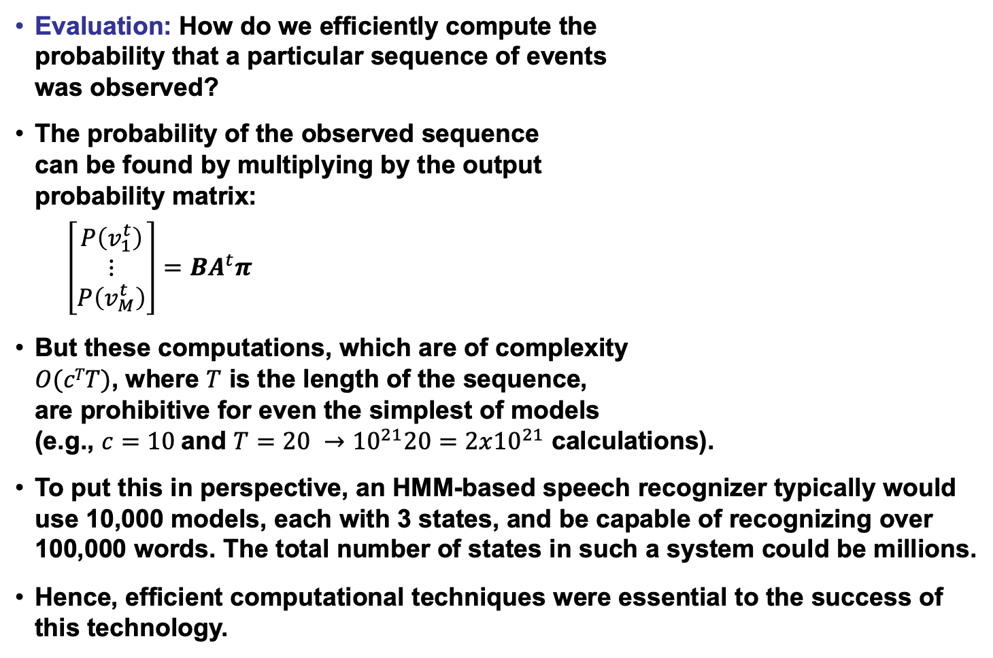
Computational Complexity of Direct Evaluation
Evaluation: How do we efficiently compute the probability that a particular sequence of events was observed?
The probability of the observed sequence can be found by multiplying by the output probability matrix:
$$\left[\begin{matrix}P\left(v_{1}^{t}\right) \\ ⋮ \\ P\left(v_{M}^{t}\right)\end{matrix}\right]={BA}^{t}π$$
But these computations, which are of complexity $O(cTT)$, where $T$ is the length of the sequence, are prohibitive for even the simplest of models (e.g., $c=10$and $T=20 →{10}^{21}20=2x{10}^{21}$ calculations).
To put this in perspective, an HMM-based speech recognizer typically would use 10,000 models, each with 3 states, and be capable of recognizing over 100,000 words. The total number of states in such a system could be millions.
Hence, efficient computational techniques were essential to the success of this technology.

Slide 8
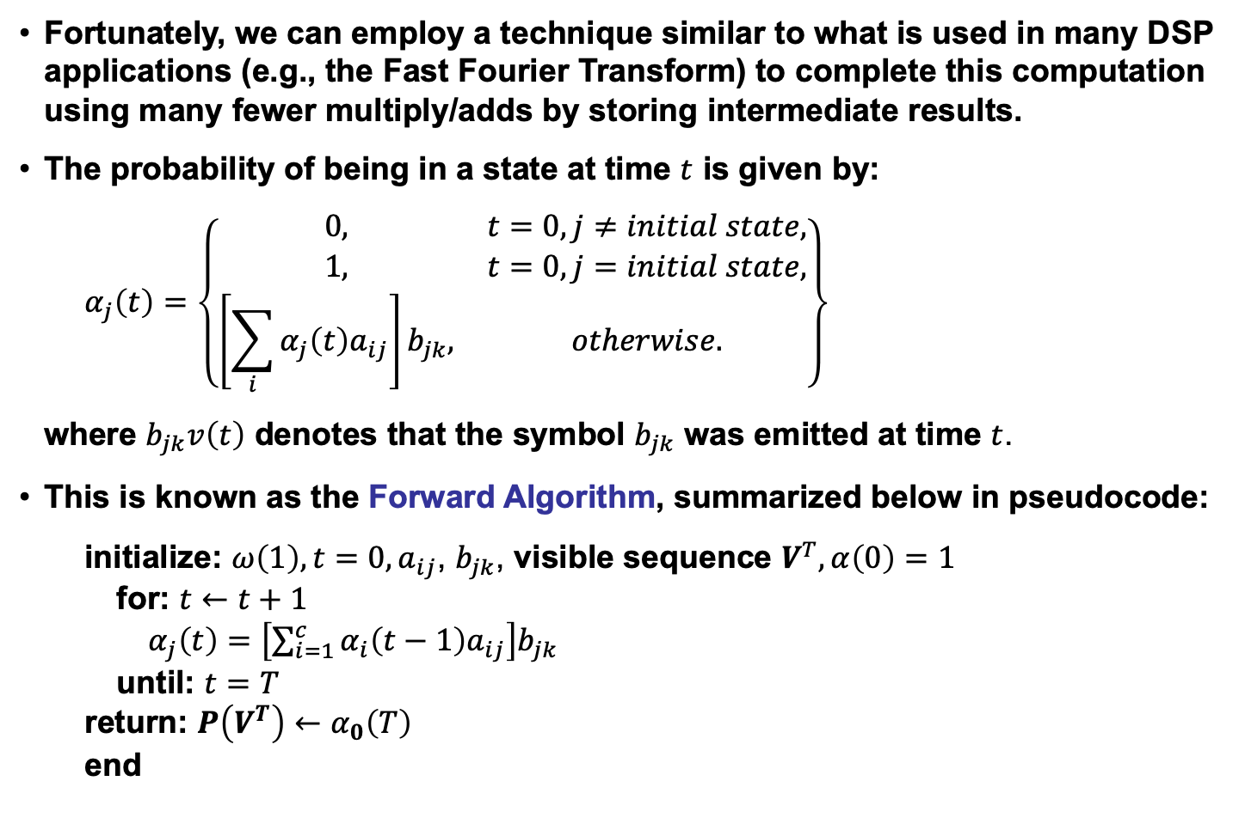
The Forward Algorithm
Fortunately, we can employ a technique similar to what is used in many DSP applications (e.g., the Fast Fourier Transform) to complete this computation using many fewer multiply/adds by storing intermediate results.
The probability of being in a state at time $t$ is given by:
$$α_{j}\left(t\right)=\left\{\begin{matrix}0, & t=0, j≠initial state, \\ 1, & t=0, j=initial state, \\ \left[\sum_{i}{α_{j}\left(t\right)a_{ij}}\right]b_{jk}, & otherwise.\end{matrix}\right\}$$
where $b_{jk}v\left(t\right)$ denotes that the symbol $b_{jk}$ was emitted at time $t$.
This is known as the Forward Algorithm, summarized below in pseudocode:
initialize: $ω\left(1\right), t=0, a_{ij}$, $b_{jk}$, visible sequence $V^{T}, α\left(0\right)=1$
for: $t←t+1$
$α_{j}\left(t\right)=$ $\left[\sum_{i=1}^{c}{α_{i}\left(t−1\right)a_{ij}}\right]b_{jk}$
until: $t=T$
return: $P\left(V^{T}\right)←α_{0}\left(T\right)$
end

Slide 9
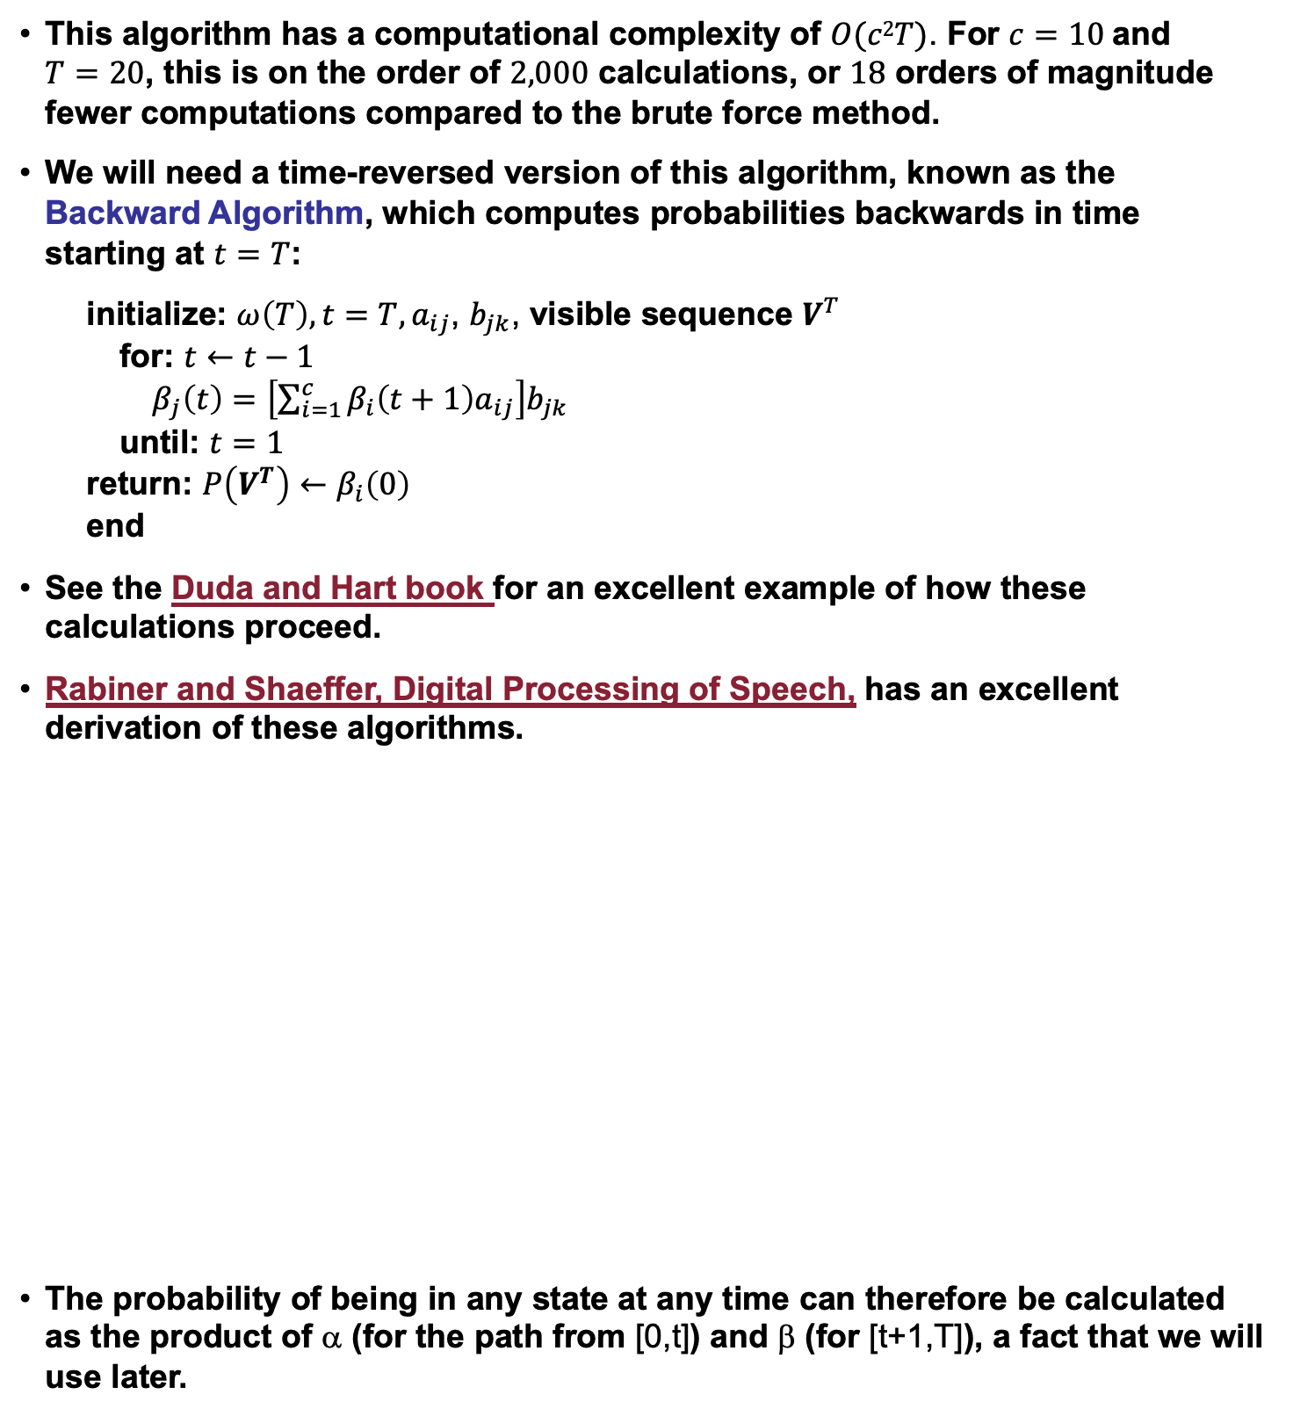
The Backward Algorithm
This algorithm has a computational complexity of $O(c2T)$. For $c=10$and $T=20$, this is on the order of $2,000$ calculations, or $18$ orders of magnitude fewer computations compared to the brute force method.
We will need a time-reversed version of this algorithm, known as the Backward Algorithm, which computes probabilities backwards in time starting at $t=T$:
initialize: $ω\left(T\right), t=T, a_{ij}$, $b_{jk}$, visible sequence $V^{T}$
for: $t←t−1$
$β_{j}\left(t\right)=$ $\left[\sum_{i=1}^{c}{β_{i}\left(t+1\right)a_{ij}}\right]b_{jk}$
until: $t=1$
return: $P\left(V^{T}\right)←β_{i}\left(0\right)$
end
See the Duda and Hart book for an excellent example of how these calculations proceed.
Rabiner and Shaeffer, Digital Processing of Speech, has an excellent derivation of these algorithms.
The probability of being in any state at any time can therefore be calculated as the product of α (for the path from [0,t]) and β (for [t+1,T]), a fact that we will use later.

Slide 10
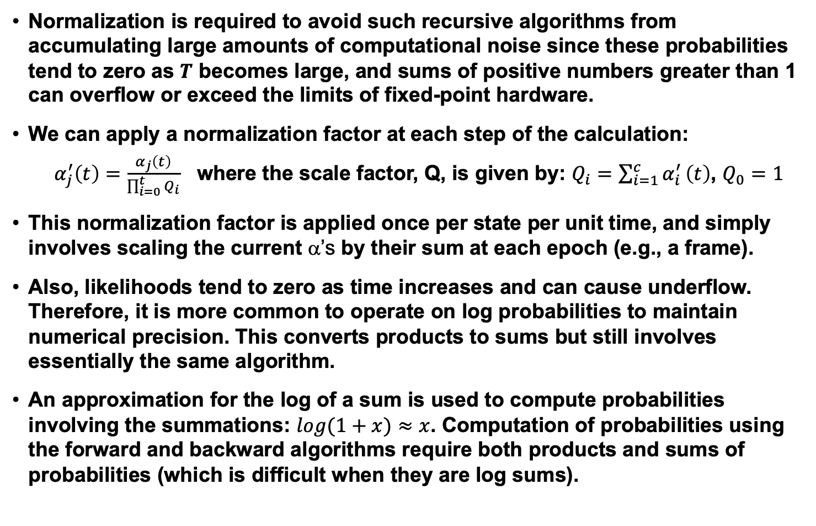
Normalization Is Important
Normalization is required to avoid such recursive algorithms from accumulating large amounts of computational noise since these probabilities tend to zero as $T$ becomes large, and sums of positive numbers greater than 1 can overflow or exceed the limits of fixed-point hardware.
We can apply a normalization factor at each step of the calculation:
$α_{j}^{′}\left(t\right)=\frac{α_{j}\left(t\right)}{\prod_{i=0}^{t}{Q_{i}}}$ where the scale factor, Q, is given by: $Q_{i}=\sum_{i=1}^{c}{α_{i}^{′}}\left(t\right)$, $Q_{0}=1$
This normalization factor is applied once per state per unit time, and simply involves scaling the current α’s by their sum at each epoch (e.g., a frame).
Also, likelihoods tend to zero as time increases and can cause underflow. Therefore, it is more common to operate on log probabilities to maintain numerical precision. This converts products to sums but still involves essentially the same algorithm.
An approximation for the log of a sum is used to compute probabilities involving the summations: $log(1+x)≈x$. Computation of probabilities using the forward and backward algorithms require both products and sums of probabilities (which is difficult when they are log sums).

Slide 11
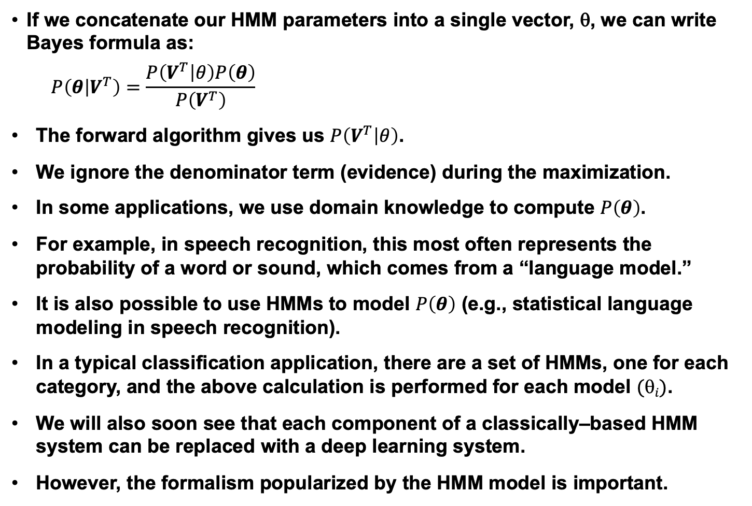
Classification Using HMMs
If we concatenate our HMM parameters into a single vector, θ, we can write Bayes formula as:
$$P\left(θ | V^{T}\right)=\frac{P\left(V^{T} | θ\right)P\left(θ\right)}{P\left(V^{T}\right)}$$
The forward algorithm gives us $P\left(V^{T} | θ\right)$.
We ignore the denominator term (evidence) during the maximization.
In some applications, we use domain knowledge to compute $P\left(θ\right)$.
For example, in speech recognition, this most often represents the probability of a word or sound, which comes from a “language model.”
It is also possible to use HMMs to model $P\left(θ\right)$ (e.g., statistical language modeling in speech recognition).
In a typical classification application, there are a set of HMMs, one for each category, and the above calculation is performed for each model $(i)$.
We will also soon see that each component of a classically–based HMM system can be replaced with a deep learning system.
However, the formalism popularized by the HMM model is important.

Slide 12


Decoding (Finding The Most Probable State Sequence)
Why might the most probable sequence of hidden states that produced an observed sequence be useful to us?
How do we find the most probable sequence of hidden states?
Since any symbol is possible at any state, the obvious approach would be to compute the probability of each possible path and choose the most probable:
$V^{T∗}=$ ${arg max}_{r}P\left(V^{T} | ω_{r}^{T}\right)P\left(ω_{r}^{T}\right)$
where $r$ represents an index that enumerates the $cT$ possible sequences of length $T$.
However, an alternate solution to this problem is provided by dynamic programming, and is known as Viterbi Decoding.
Note that computing $P\left(V^{T} | θ\right)$ using the Viterbi algorithm gives a different result than the Forward algorithm.
HMM (Viterbi) Decoding:
begin initialize: $Path←\{\}, t←0$
for $t←t+1, j←j+1$
for $j←j+1$
$α_{j}\left(t\right)←b_{jk}v\left(t\right)$ $\sum_{i=1}^{c}{α_{i}\left(t−1\right)a_{ij}}$
until $j=c$
$j^{′}←{arg max}_{j}$ $α_{j}\left(t\right)$
Append $ω_{j^{′}} to Path$
until $t=T$
return$Path$
end

Slide 13
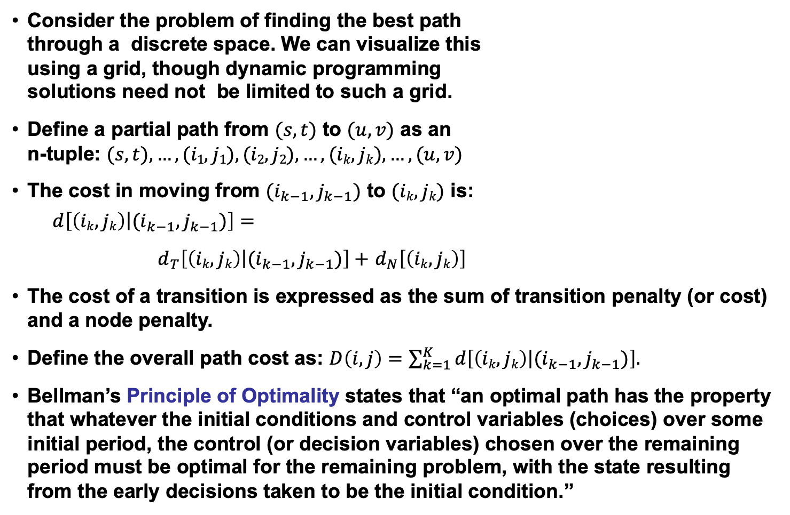
Dynamic Programming
Consider the problem of finding the best path through a discrete space. We can visualize this using a grid, though dynamic programming solutions need not be limited to such a grid.
Define a partial path from $(s,t)$ to $(u,v)$ as an n-tuple: $(s,t), …, (i1,j1), (i2,j2),…,(ik,jk),…,(u,v)$
The cost in moving from $(i_{k−1},j_{k−1})$ to $(ik,jk)$ is:
$$d\left[\left.\left(ik,jk\right)\right|(i_{k−1},j_{k−1})\right]=$$
$d_{T}\left[\left.\left(ik,jk\right)\right|(i_{k−1},j_{k−1})\right]+$ $d_{N}\left[\left(ik,jk\right)\right]$
The cost of a transition is expressed as the sum of transition penalty (or cost) and a node penalty.
Define the overall path cost as: $D\left(i,j\right)=\sum_{k=1}^{K}{d\left[\left.\left(ik,jk\right)\right|(i_{k−1},j_{k−1})\right].}$
Bellman’s Principle of Optimality states that “an optimal path has the property that whatever the initial conditions and control variables (choices) over some initial period, the control (or decision variables) chosen over the remaining period must be optimal for the remaining problem, with the state resulting from the early decisions taken to be the initial condition.”
(u,v)
(i_{k},j_{k})
(s,t)

Slide 14
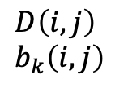
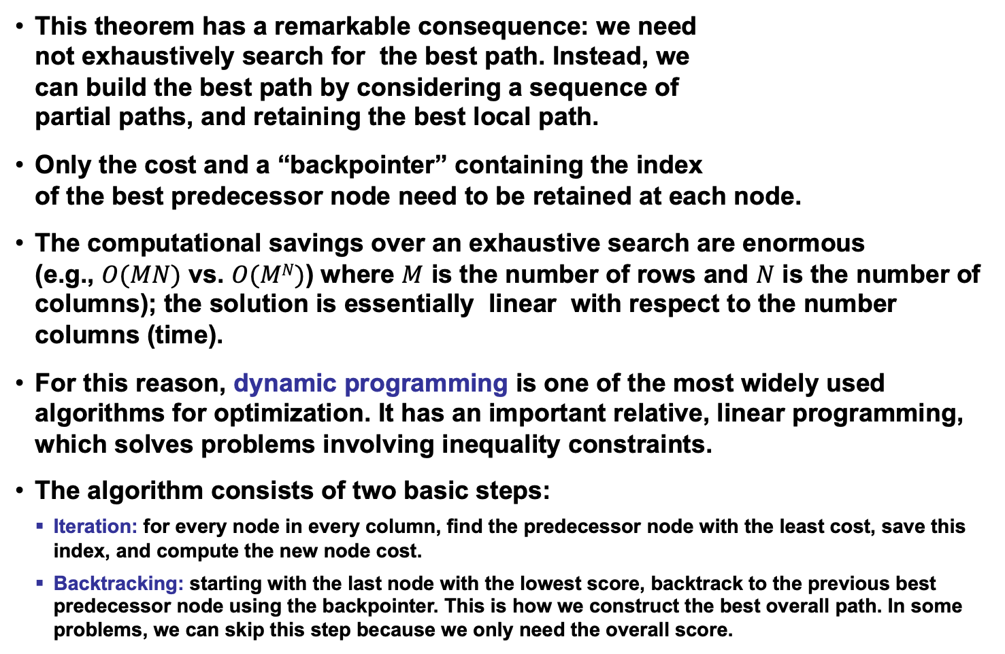
The DP Algorithm (Viterbi Decoding)
This theorem has a remarkable consequence: we need not exhaustively search for the best path. Instead, we can build the best path by considering a sequence of partial paths, and retaining the best local path.
Only the cost and a “backpointer” containing the index of the best predecessor node need to be retained at each node.
The computational savings over an exhaustive search are enormous (e.g., $O(MN)$ vs. $O(MN)$) where $M$ is the number of rows and $N$ is the number of columns); the solution is essentially linear with respect to the number columns (time).
For this reason, dynamic programming is one of the most widely used algorithms for optimization. It has an important relative, linear programming, which solves problems involving inequality constraints.
The algorithm consists of two basic steps:
Iteration: for every node in every column, find the predecessor node with the least cost, save this index, and compute the new node cost.
Backtracking: starting with the last node with the lowest score, backtrack to the previous best predecessor node using the backpointer. This is how we construct the best overall path. In some problems, we can skip this step because we only need the overall score.
$$D\left(i,j\right) \\ b_{k}\left(i,j\right)$$

Slide 15
Summary
Where are we in the process:
Formally introduced a hidden Markov model.
Described three fundamental problems (evaluation, decoding, and training).
Derived general properties of the model.
Introduced the Forward Algorithm as a fast way to do evaluation.
Introduced the Viterbi Algorithm as a reasonable way to do decoding.
Remaining issues:
Derive the reestimation equations using the EM Theorem so we can guarantee convergence.
Generalize the output distribution to a continuous distribution using a Gaussian mixture model.

