Slide 1
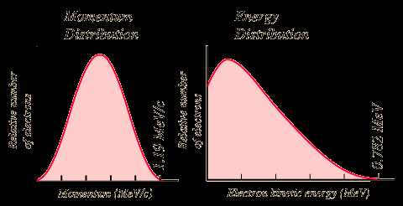
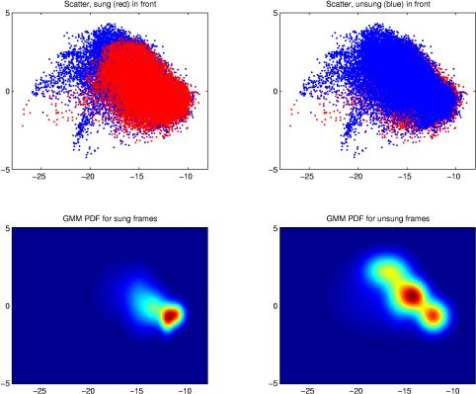
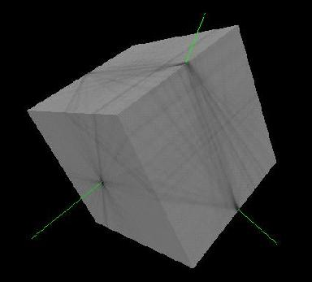
Lecture 12: Reestimation, EM and Mixtures
Objectives:
Reestimation Equations
Continuous Distributions
Gaussian Mixture Models
EM Derivation of Reestimation
Resources:
Rabiner and Juang: Fundamentals Deller, et al.: Speech Processing
Shen: Derivation

Slide 2
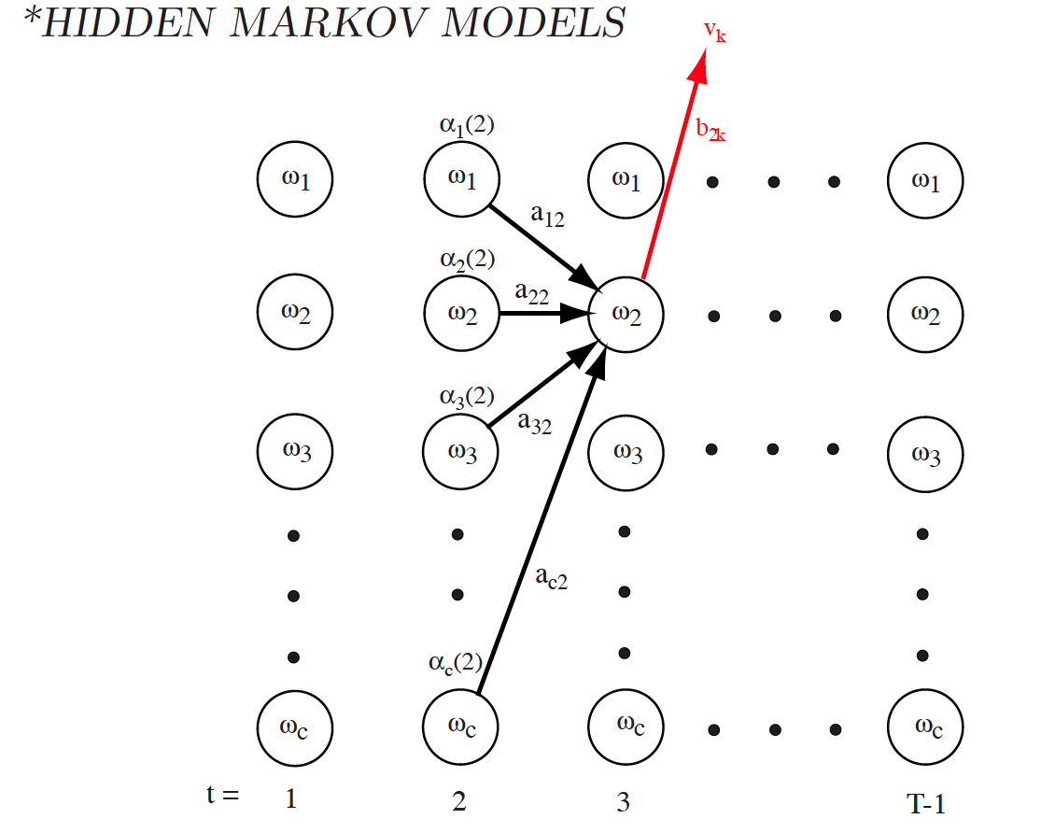


Evaluation and Decoding (Review)
Forward Algorithm:
initialize: $ω\left(1\right), t=0, a_{ij}$, $b_{jk}$, visible sequence $V^{T}, α\left(0\right)=1$
for: $t←t+1$
$α_{j}\left(t\right)=$ $\left[\sum_{i=1}^{c}{α_{i}\left(t−1\right)a_{ij}}\right]b_{jk}$
until: $t=T$
return: $P\left(V^{T}\right)←α_{0}\left(T\right)$
end
Backward Algorithm:
initialize: $ω\left(T\right), t=T, a_{ij}$, $b_{jk}$, $V^{T}$
for: $t←t−1$
$β_{j}\left(t\right)=$ $\left[\sum_{i=1}^{c}{β_{i}\left(t+1\right)a_{ij}}\right]b_{jk}$
until: $t=1$
return: $P\left(V^{T}\right)←β_{i}\left(0\right)$
end
HMM (Viterbi) Decoding:
begin initialize: $Path←\{\}, t←0$
for $t←t+1, j←j+1$
for $j←j+1$
$α_{j}\left(t\right)←b_{jk}$ $\sum_{i=1}^{c}{α_{i}\left(t−1\right)a_{ij}}$
until $j=c$
$j^{′}←{arg max}_{j}$ $α_{j}\left(t\right)$
Append $ω_{j^{′}} to Path$
until $t=T$
return$Path$
end

Slide 3
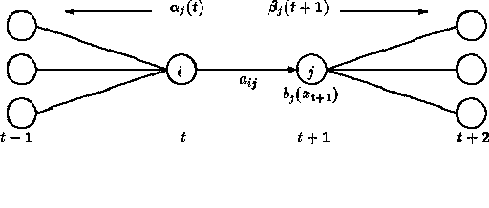
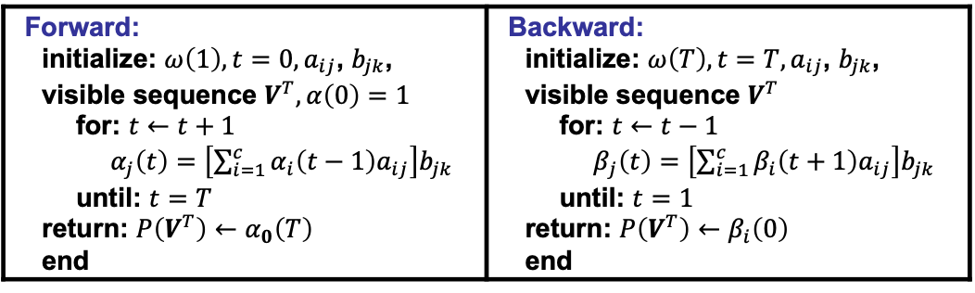
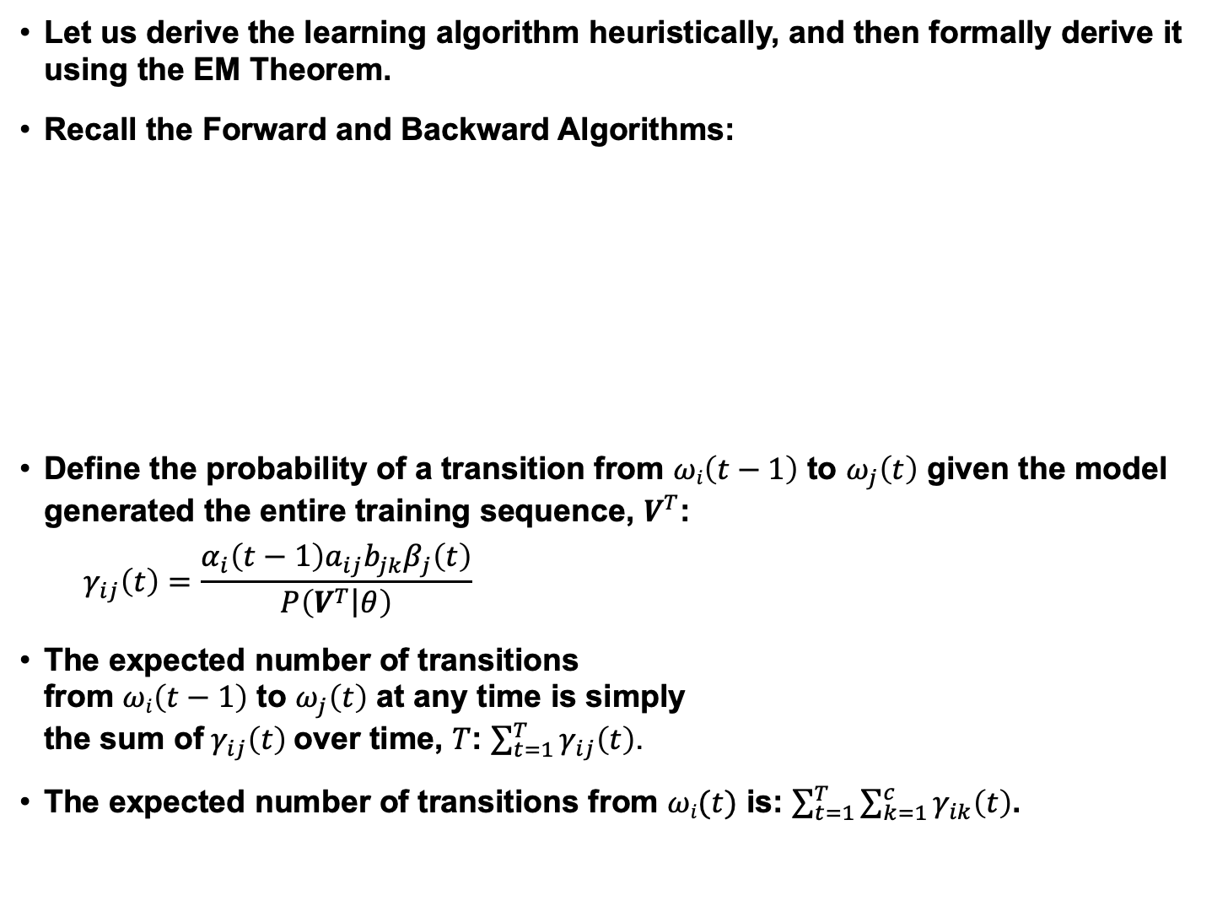
Learning Model Parameters
Let us derive the learning algorithm heuristically, and then formally derive it using the EM Theorem.
Recall the Forward and Backward Algorithms:
Define the probability of a transition from $ωi\left(t−1\right)$ to $ω_{j}\left(t\right)$ given the model generated the entire training sequence, $V^{T}$:
$$γ_{ij}\left(t\right)=\frac{α_{i}\left(t−1\right)a_{ij}b_{jk}β_{j}\left(t\right)}{P\left(V^{T}\left|θ\right.\right)}$$
The expected number of transitions from $ωi\left(t−1\right)$ to $ω_{j}\left(t\right)$ at any time is simply the sum of$γ_{ij}\left(t\right)$over time, $T$: $\sum_{t=1}^{T}{γ_{ij}\left(t\right)}$.
The expected number of transitions from $ωi(t)$ is: $\sum_{t=1}^{T}{\sum_{k=1}^{c}{γ_{ik}\left(t\right)}}$.
Forward: initialize: $ω\left(1\right), t=0, a_{ij}$, $b_{jk}$, visible sequence $V^{T}, α\left(0\right)=1$ for: $t←t+1$ $α_{j}\left(t\right)=$ $\left[\sum_{i=1}^{c}{α_{i}\left(t−1\right)a_{ij}}\right]b_{jk}$ until: $t=T$ return: $P\left(V^{T}\right)←α_{0}\left(T\right)$ end | Backward: initialize: $ω\left(T\right), t=T, a_{ij}$, $b_{jk}$, visible sequence $V^{T}$ for: $t←t−1$ $β_{j}\left(t\right)=$ $\left[\sum_{i=1}^{c}{β_{i}\left(t+1\right)a_{ij}}\right]b_{jk}$ until: $t=1$ return: $P\left(V^{T}\right)←β_{i}\left(0\right)$ end

Slide 4
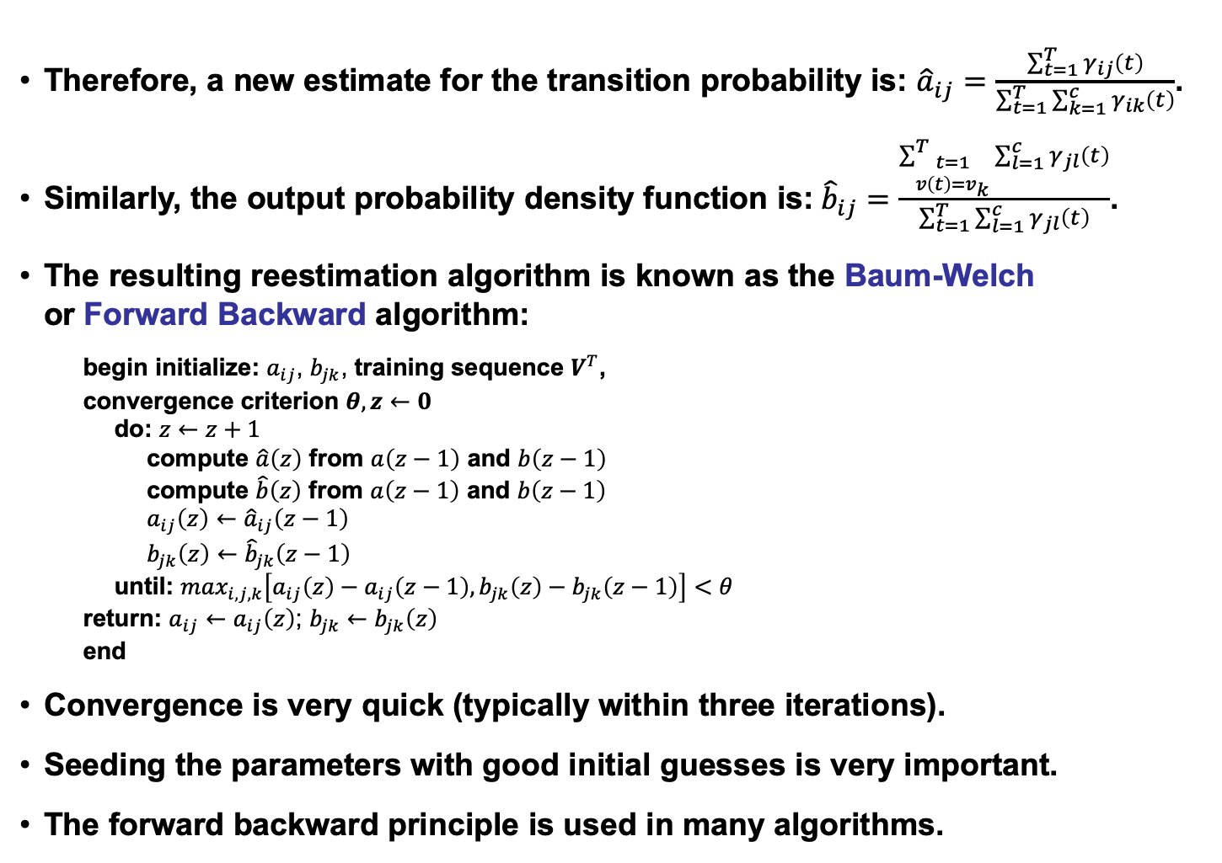
Reestimating Probabilities
Therefore, a new estimate for the transition probability is: ${\hat{a}}_{ij}=\frac{\sum_{t=1}^{T}{γ_{ij}\left(t\right)}}{\sum_{t=1}^{T}{\sum_{k=1}^{c}{γ_{ik}\left(t\right)}}}$.
Similarly, the output probability density function is:${\hat{b}}_{ij}=\frac{\begin{matrix}\sum_{\begin{matrix}t=1 \\ v\left(t\right)=v_{k}\end{matrix}}^{T}{\sum_{l=1}^{c}{γ_{jl}\left(t\right)}}\end{matrix}}{\sum_{t=1}^{T}{\sum_{l=1}^{c}{γ_{jl}\left(t\right)}}}$.
The resulting reestimation algorithm is known as the Baum-Welch or Forward Backward algorithm:
begin initialize: $a_{ij}$, $b_{jk}$, training sequence $V^{T}$,
convergence criterion $θ,z←0$
do: $z←z+1$
compute $\hat{a}\left(z\right)$ from $a\left(z−1\right)$ and $b\left(z−1\right)$
compute $\hat{b}\left(z\right)$ from $a\left(z−1\right)$ and $b\left(z−1\right)$
$a_{ij}\left(z\right)←$ ${\hat{a}}_{ij}\left(z−1\right)$
$b_{jk}\left(z\right)←$ ${\hat{b}}_{jk}\left(z−1\right)$
until: $\max_{i,j,k}\left[a_{ij}\left(z\right)−a_{ij}\left(z−1\right),b_{jk}\left(z\right)−b_{jk}\left(z−1\right)\right]<θ$
return: $a_{ij}←$ $a_{ij}\left(z\right)$; $b_{jk}←$ $b_{jk}\left(z\right)$
end
Convergence is very quick (typically within three iterations).
Seeding the parameters with good initial guesses is very important.
The forward backward principle is used in many algorithms.

Slide 5
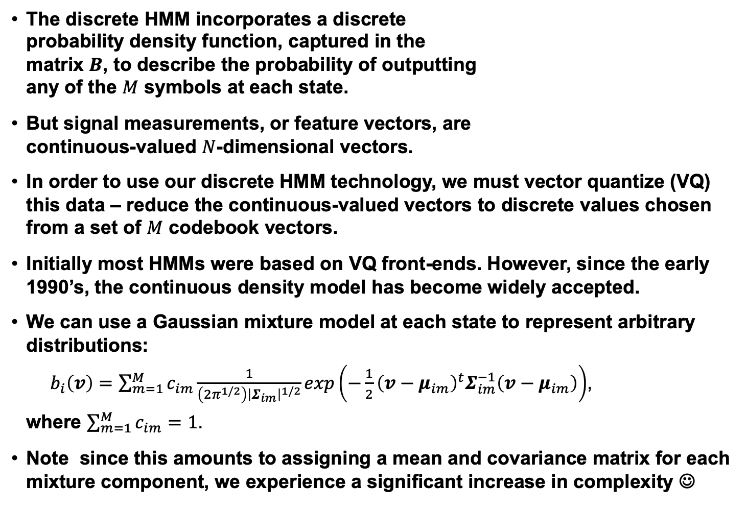
Continuous Probability Density Functions
The discrete HMM incorporates a discrete probability density function, captured in the matrix $B$, to describe the probability of outputting any of the $M$ symbols at each state.
But signal measurements, or feature vectors, are continuous-valued $N$-dimensional vectors.
In order to use our discrete HMM technology, we must vector quantize (VQ) this data – reduce the continuous-valued vectors to discrete values chosen from a set of $M$ codebook vectors.
Initially most HMMs were based on VQ front-ends. However, since the early 1990’s, the continuous density model has become widely accepted.
We can use a Gaussian mixture model at each state to represent arbitrary distributions:
$b_{i}\left(v\right)=\sum_{m=1}^{M}{c_{im}\frac{1}{\left({2π}^{1/2}\right){\left|Σ_{im}\right|}^{1/2}}exp\left(−\frac{1}{2}{\left(v−μ_{im}\right)}^{t}Σ_{im}^{−1}\left(v−μ_{im}\right)\right)}$,
where $\sum_{m=1}^{M}{c_{im}}=1$.
Note since this amounts to assigning a mean and covariance matrix for each mixture component, we experience a significant increase in complexity ☺
0
1
2
3
4
5
6
…

Slide 6
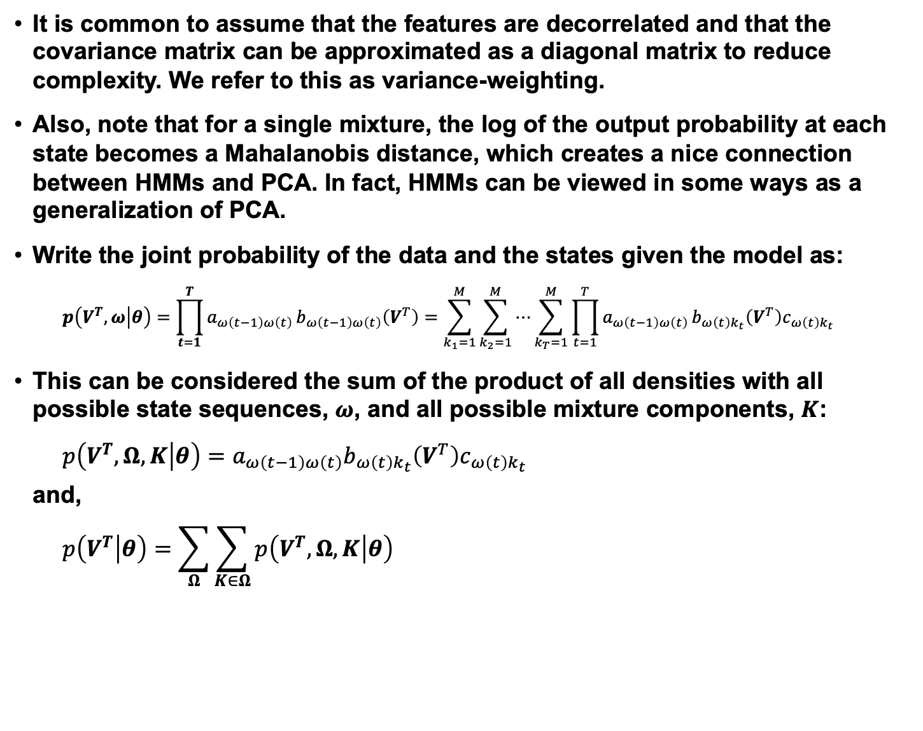
Parameter Reestimation Using EM
It is common to assume that the features are decorrelated and that the covariance matrix can be approximated as a diagonal matrix to reduce complexity. We refer to this as variance-weighting.
Also, note that for a single mixture, the log of the output probability at each state becomes a Mahalanobis distance, which creates a nice connection between HMMs and PCA. In fact, HMMs can be viewed in some ways as a generalization of PCA.
Write the joint probability of the data and the states given the model as:
$$p\left(V^{T},ω | θ\right)=\prod_{t=1}^{T}{a_{ω\left(t−1\right)ω\left(t\right)}}b_{ω\left(t−1\right)ω\left(t\right)}\left(V^{T}\right)=\sum_{k_{1}=1}^{M}{\sum_{k_{2}=1}^{M}{⋯}}\sum_{k_{T}=1}^{M}{\prod_{t=1}^{T}{a_{ω\left(t−1\right)ω\left(t\right)}}b_{ω\left(t\right)k_{t}}\left(V^{T}\right)c_{ω\left(t\right)k_{t}}}$$
This can be considered the sum of the product of all densities with all possible state sequences, $ω$, and all possible mixture components, $K$:
$$p\left(V^{T},Ω,K | θ\right)=a_{ω\left(t−1\right)ω\left(t\right)}b_{ω\left(t\right)k_{t}}\left(V^{T}\right)c_{ω\left(t\right)k_{t}}$$
and,
$$p\left(V^{T} | θ\right)=\sum_{Ω}{\sum_{K∈Ω}{p\left(V^{T},Ω,K | θ\right)}}$$

Slide 7
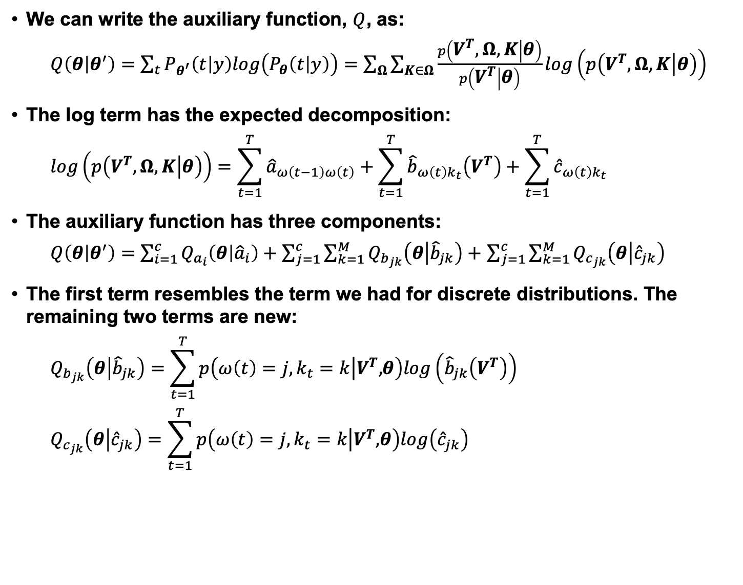
Application of EM: An Outline of the Derivation
We can write the auxiliary function, $Q$, as:
$Q\left(θ | θ^{′}\right)=\sum_{t}{P_{θ^{′}}\left(t | y\right)log\left(P_{θ}\left(t | y\right)\right)=}$ $\sum_{Ω}{\sum_{K∈Ω}{\frac{p\left(V^{T},Ω,K | θ\right)}{p\left(V^{T} | θ\right)}}log\left(p\left(V^{T},Ω,K | θ\right)\right)}$
The log term has the expected decomposition:
$$log\left(p\left(V^{T},Ω,K | θ\right)\right)=\sum_{t=1}^{T}{{\hat{a}}_{ω\left(t−1\right)ω\left(t\right)}}+\sum_{t=1}^{T}{{\hat{b}}_{ω\left(t\right)k_{t}}\left(V^{T}\right)}+\sum_{t=1}^{T}{{\hat{c}}_{ω\left(t\right)k_{t}}}$$
The auxiliary function has three components:
$Q\left(θ | θ^{′}\right)=$ $\sum_{i=1}^{c}{Q_{a_{i}}\left(θ | {\hat{a}}_{i}\right)}+\sum_{j=1}^{c}{\sum_{k=1}^{M}{Q_{b_{jk}}\left(θ | {\hat{b}}_{jk}\right)+}}$ $\sum_{j=1}^{c}{\sum_{k=1}^{M}{Q_{c_{jk}}\left(θ | {\hat{c}}_{jk}\right)}}$
The first term resembles the term we had for discrete distributions. The remaining two terms are new:
$$Q_{b_{jk}}\left(θ | {\hat{b}}_{jk}\right)=\sum_{t=1}^{T}{p\left(ω\left(t\right)=j,k_{t}=k\left|V^{T},\right.θ\right)log\left({\hat{b}}_{jk}\left(V^{T}\right)\right)}$$
$$Q_{c_{jk}}\left(θ | {\hat{c}}_{jk}\right)=\sum_{t=1}^{T}{p\left(ω\left(t\right)=j,k_{t}=k\left|V^{T},\right.θ\right)log\left({\hat{c}}_{jk}\right)}$$

Slide 8
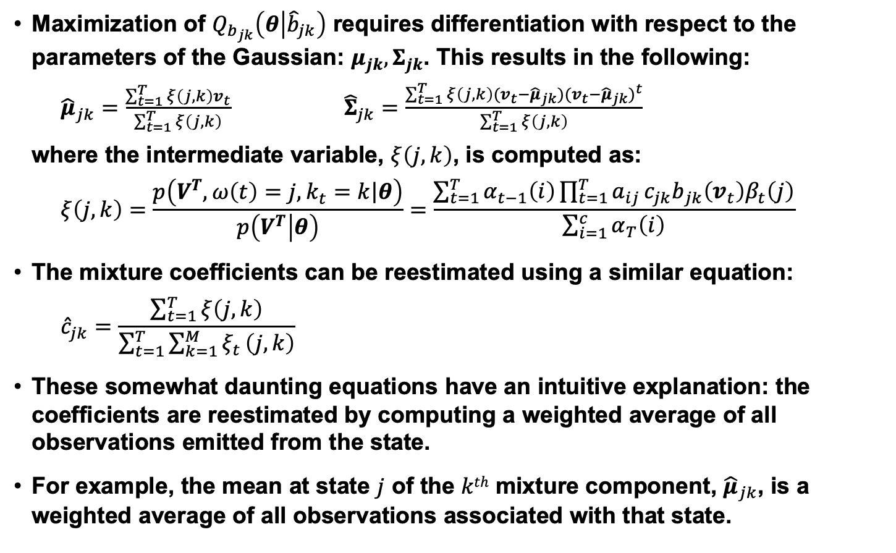
Reestimation Equations
Maximization of $Q_{b_{jk}}\left(θ | {\hat{b}}_{jk}\right)$ requires differentiation with respect to the parameters of the Gaussian: $μ_{jk}, Σ_{jk}$. This results in the following:
${\hat{μ}}_{jk}=\frac{\sum_{t=1}^{T}{ξ\left(j,k\right)v_{t}}}{\sum_{t=1}^{T}{ξ\left(j,k\right)}}$ ${\hat{Σ}}_{jk}=\frac{\sum_{t=1}^{T}{ξ\left(j,k\right){(v}_{t}−{\hat{μ}}_{jk}){{(v}_{t}−{\hat{μ}}_{jk})}^{t}}}{\sum_{t=1}^{T}{ξ\left(j,k\right)}}$
where the intermediate variable, $ξ\left(j,k\right)$, is computed as:
$$ξ\left(j,k\right)=\frac{p\left(V^{T},ω\left(t\right)=j,k_{t}=k\left|θ\right.\right)}{p\left(V^{T} | θ\right)}=\frac{\sum_{t=1}^{T}{α_{t−1}\left(i\right)\prod_{t=1}^{T}{a_{ij}}{c_{jk}b}_{jk}\left(v_{t}\right)β_{t}\left(j\right)}}{\sum_{i=1}^{c}{α_{T}\left(i\right)}}$$
The mixture coefficients can be reestimated using a similar equation:
$${\hat{c}}_{jk}=\frac{\sum_{t=1}^{T}{ξ\left(j,k\right)}}{\sum_{t=1}^{T}{\sum_{k=1}^{M}{ξ_{t}}\left(j,k\right)}}$$
These somewhat daunting equations have an intuitive explanation: the coefficients are reestimated by computing a weighted average of all observations emitted from the state.
For example, the mean at state $j$ of the $kth$ mixture component, ${\hat{μ}}_{jk}$, is a weighted average of all observations associated with that state.

Slide 9
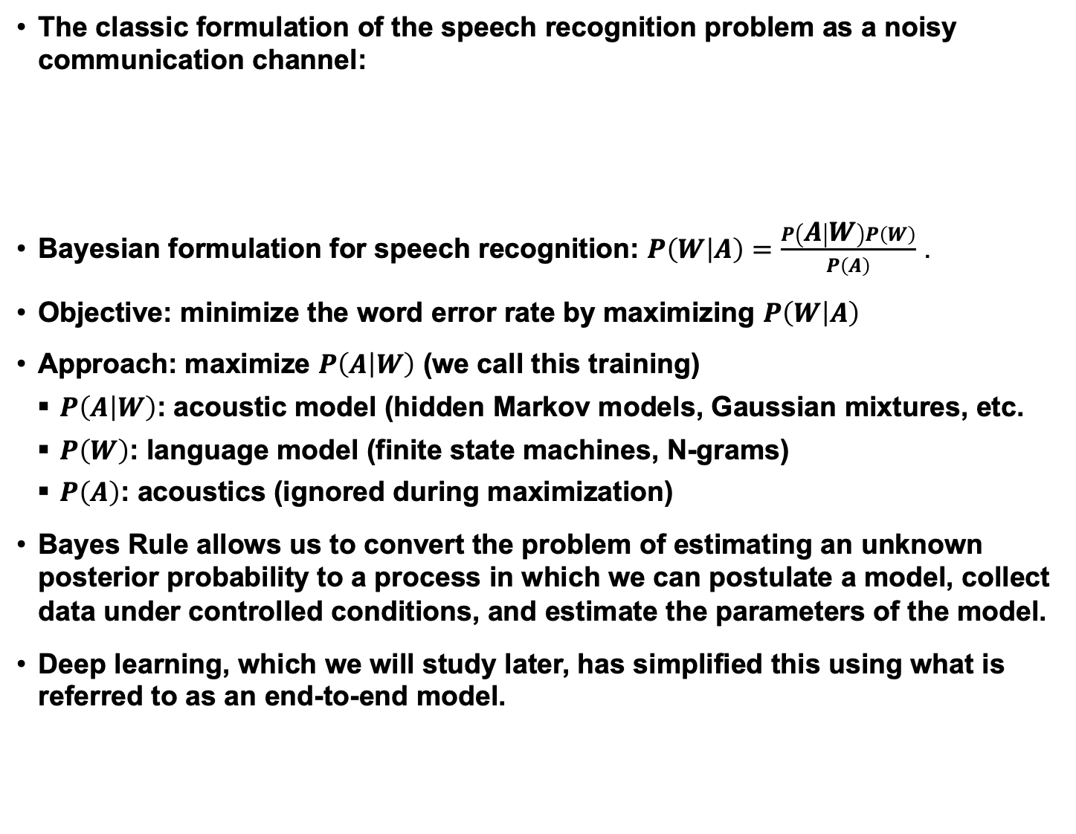
Bayesian Formulations
The classic formulation of the speech recognition problem as a noisy communication channel:
Bayesian formulation for speech recognition: $P\left(W | A\right)=\frac{P\left(A | W\right)P\left(W\right)}{P\left(A\right)}$ .
Objective: minimize the word error rate by maximizing $P\left(W | A\right)$
Approach: maximize $P\left(A | W\right)$ (we call this training)
$P\left(A | W\right)$: acoustic model (hidden Markov models, Gaussian mixtures, etc.
$P\left(W\right)$: language model (finite state machines, N-grams)
$P\left(A\right)$: acoustics (ignored during maximization)
Bayes Rule allows us to convert the problem of estimating an unknown posterior probability to a process in which we can postulate a model, collect data under controlled conditions, and estimate the parameters of the model.
Deep learning, which we will study later, has simplified this using what is referred to as an end-to-end model.
Message Source
Linguistic Channel
Articulatory Channel
Acoustic Channel
Message
Words
Phones
Features

Slide 10
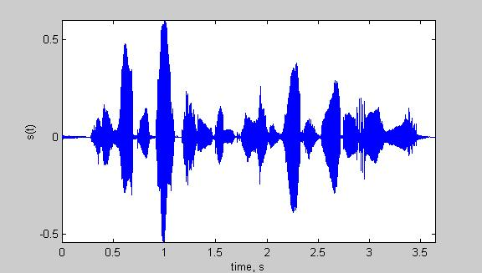
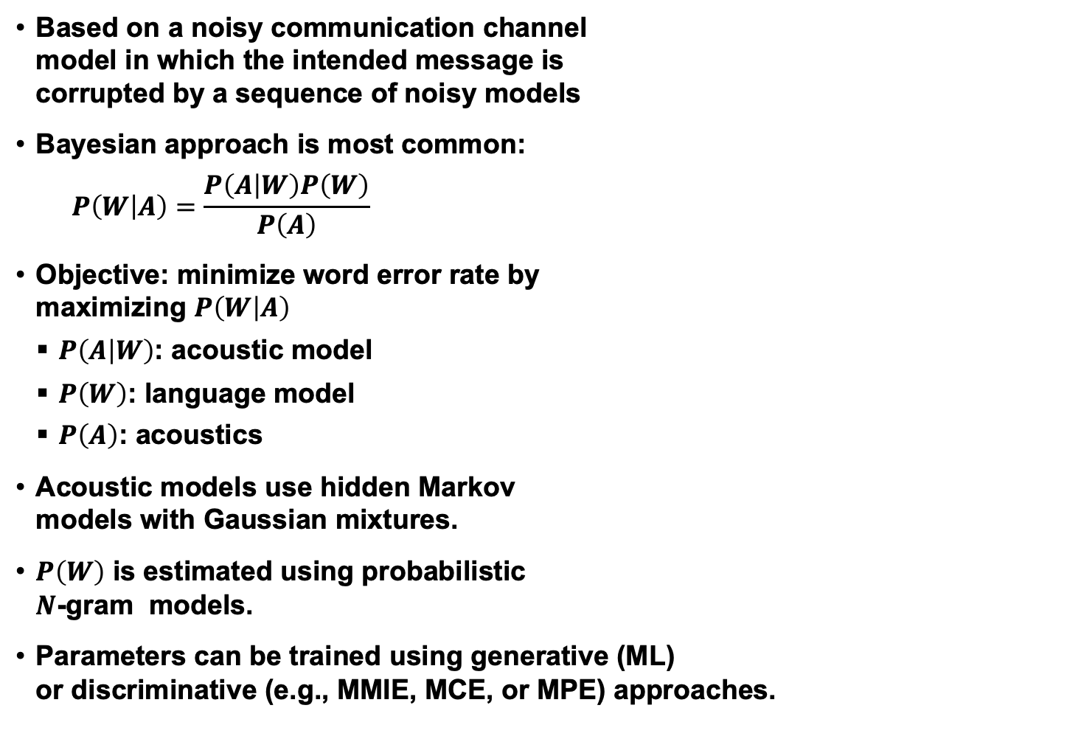
Case Study: Speech Recognition
Based on a noisy communication channel model in which the intended message is corrupted by a sequence of noisy models
Bayesian approach is most common:
$$P\left(W | A\right)=\frac{P\left(A | W\right)P\left(W\right)}{P\left(A\right)}$$
Objective: minimize word error rate by maximizing $P\left(W | A\right)$
$P\left(A | W\right)$: acoustic model
$P\left(W\right)$: language model
$P\left(A\right)$: acoustics
Acoustic models use hidden Markov models with Gaussian mixtures.
$P\left(W\right)$ is estimated using probabilistic $N$-gram models.
Parameters can be trained using generative (ML) or discriminative (e.g., MMIE, MCE, or MPE) approaches.
Input Speech
Acoustic Front-end
Acoustic Models P(A/W)
Language Model P(W)
Search
Recognized Utterance

Slide 11
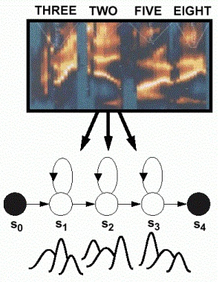
Case Study: Acoustic Modeling in Speech Recognition
Acoustic models encode the temporal evolution of the features (spectrum).
Gaussian mixture distributions are used to account for variations in speaker, accent and pronunciation.
Phonetic model topologies are simple left-to-right structures.
Skip states (time-warping) and multiple paths (alternative pronunciations) are also common features of models.
Gender-dependent models were popular at one time.
Sharing model parameters is a common strategy to reduce complexity.

Slide 12
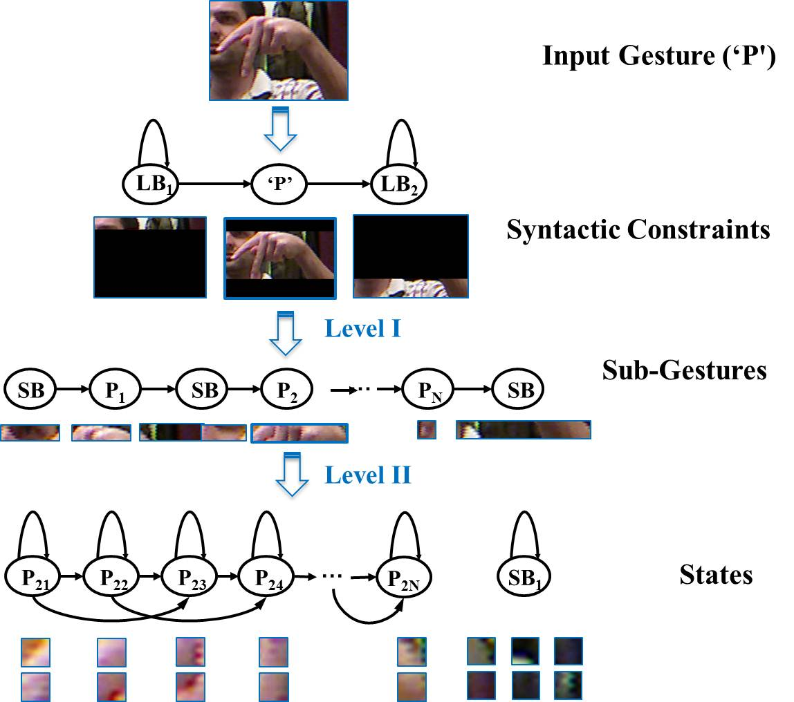
Case Study: Fingerspelling Recognition

Slide 13
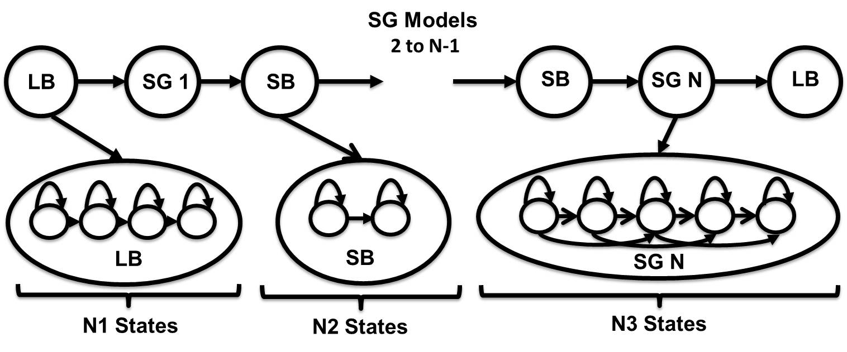



Case Study: Fingerspelling Recognition

Slide 14
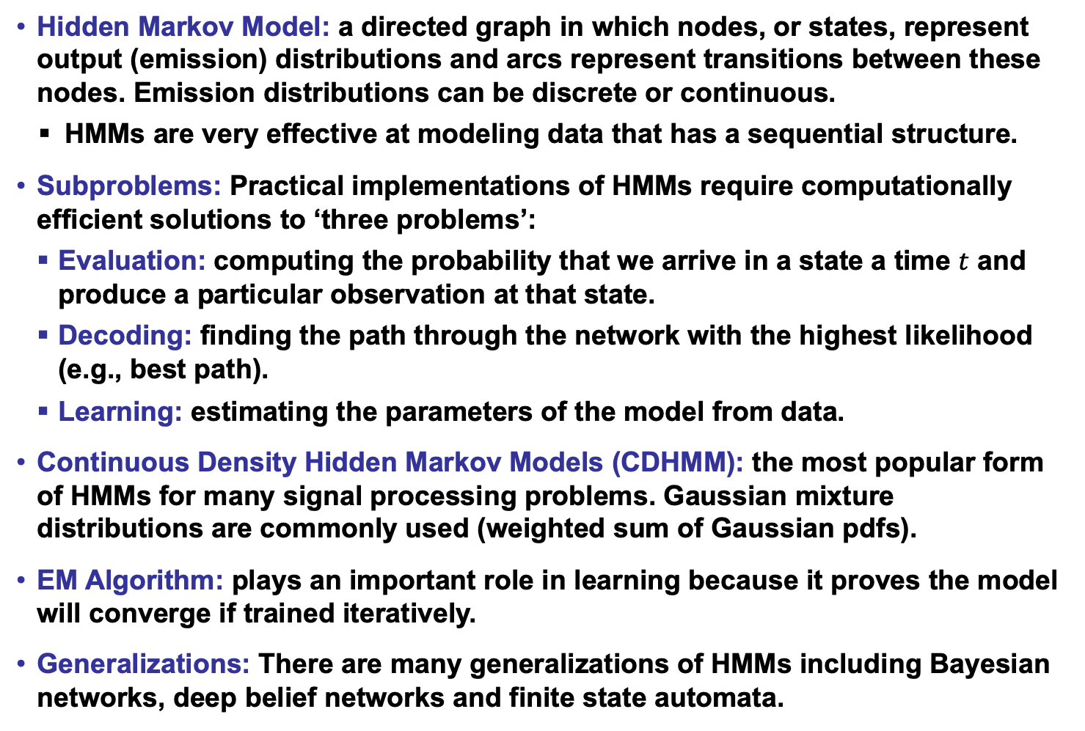
Summary
Hidden Markov Model: a directed graph in which nodes, or states, represent output (emission) distributions and arcs represent transitions between these nodes. Emission distributions can be discrete or continuous.
HMMs are very effective at modeling data that has a sequential structure.
Subproblems: Practical implementations of HMMs require computationally efficient solutions to ‘three problems’:
Evaluation: computing the probability that we arrive in a state a time $t$ and produce a particular observation at that state.
Decoding: finding the path through the network with the highest likelihood (e.g., best path).
Learning: estimating the parameters of the model from data.
Continuous Density Hidden Markov Models (CDHMM): the most popular form of HMMs for many signal processing problems. Gaussian mixture distributions are commonly used (weighted sum of Gaussian pdfs).
EM Algorithm: plays an important role in learning because it proves the model will converge if trained iteratively.
Generalizations: There are many generalizations of HMMs including Bayesian networks, deep belief networks and finite state automata.

