Slide 1
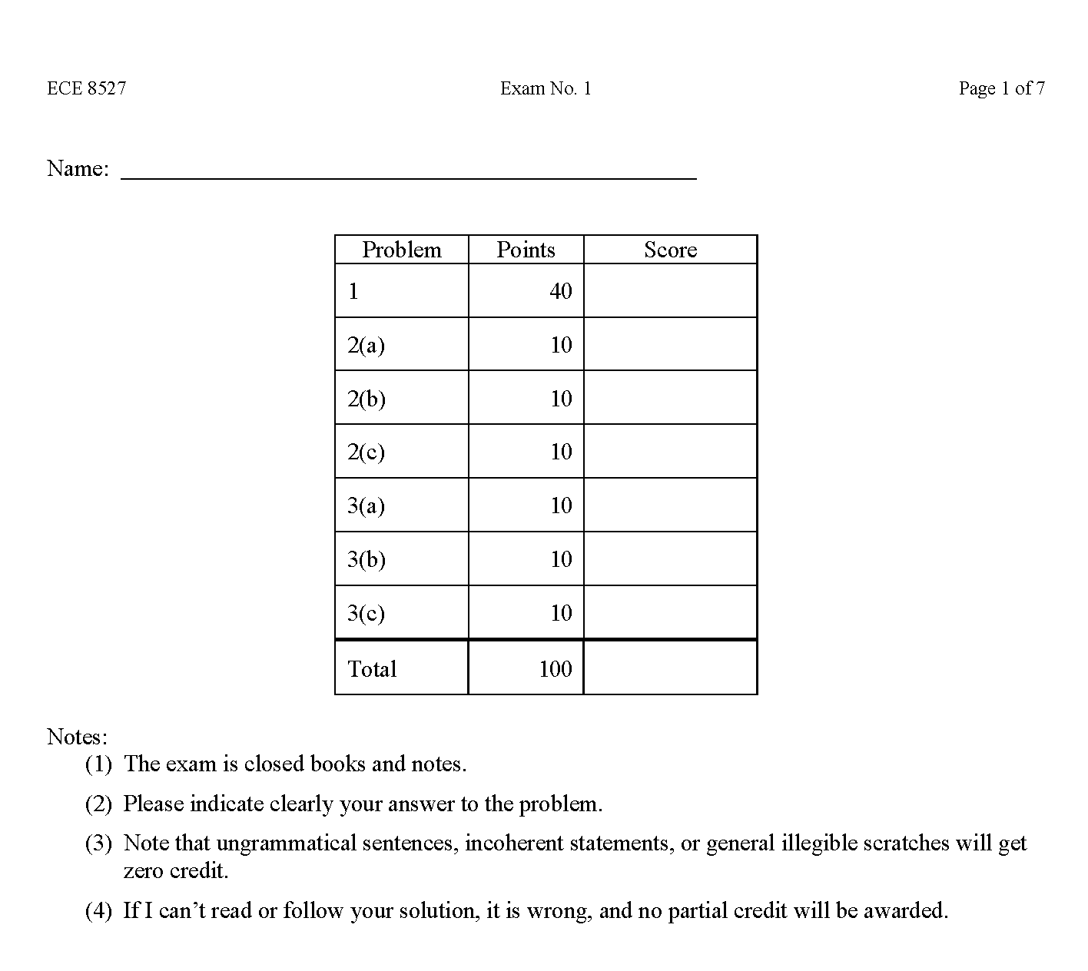
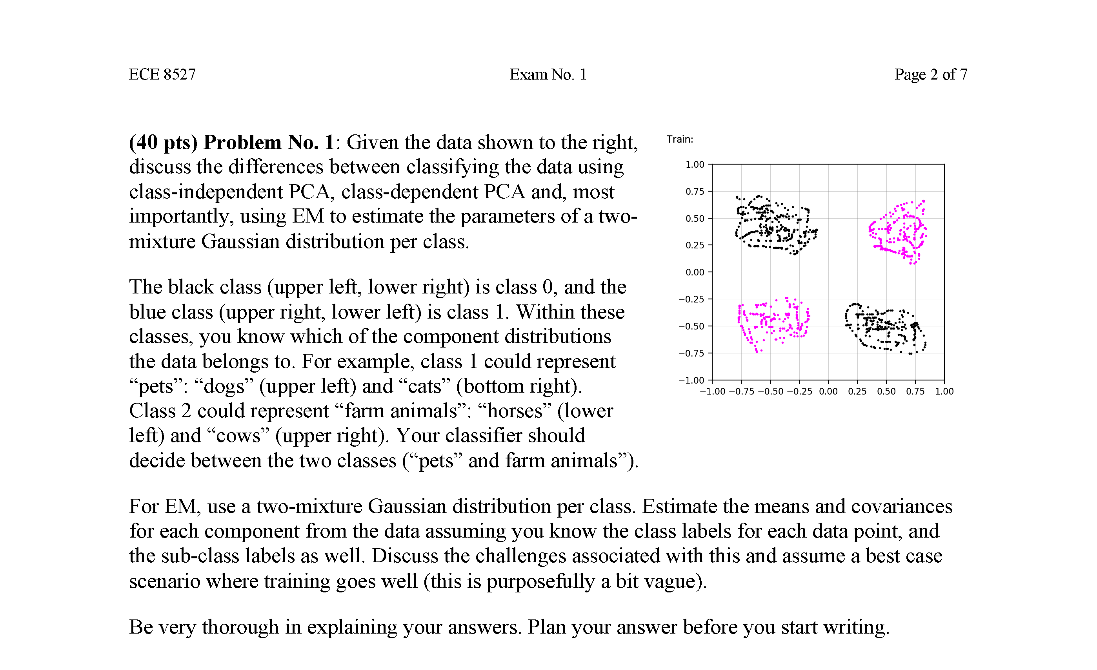
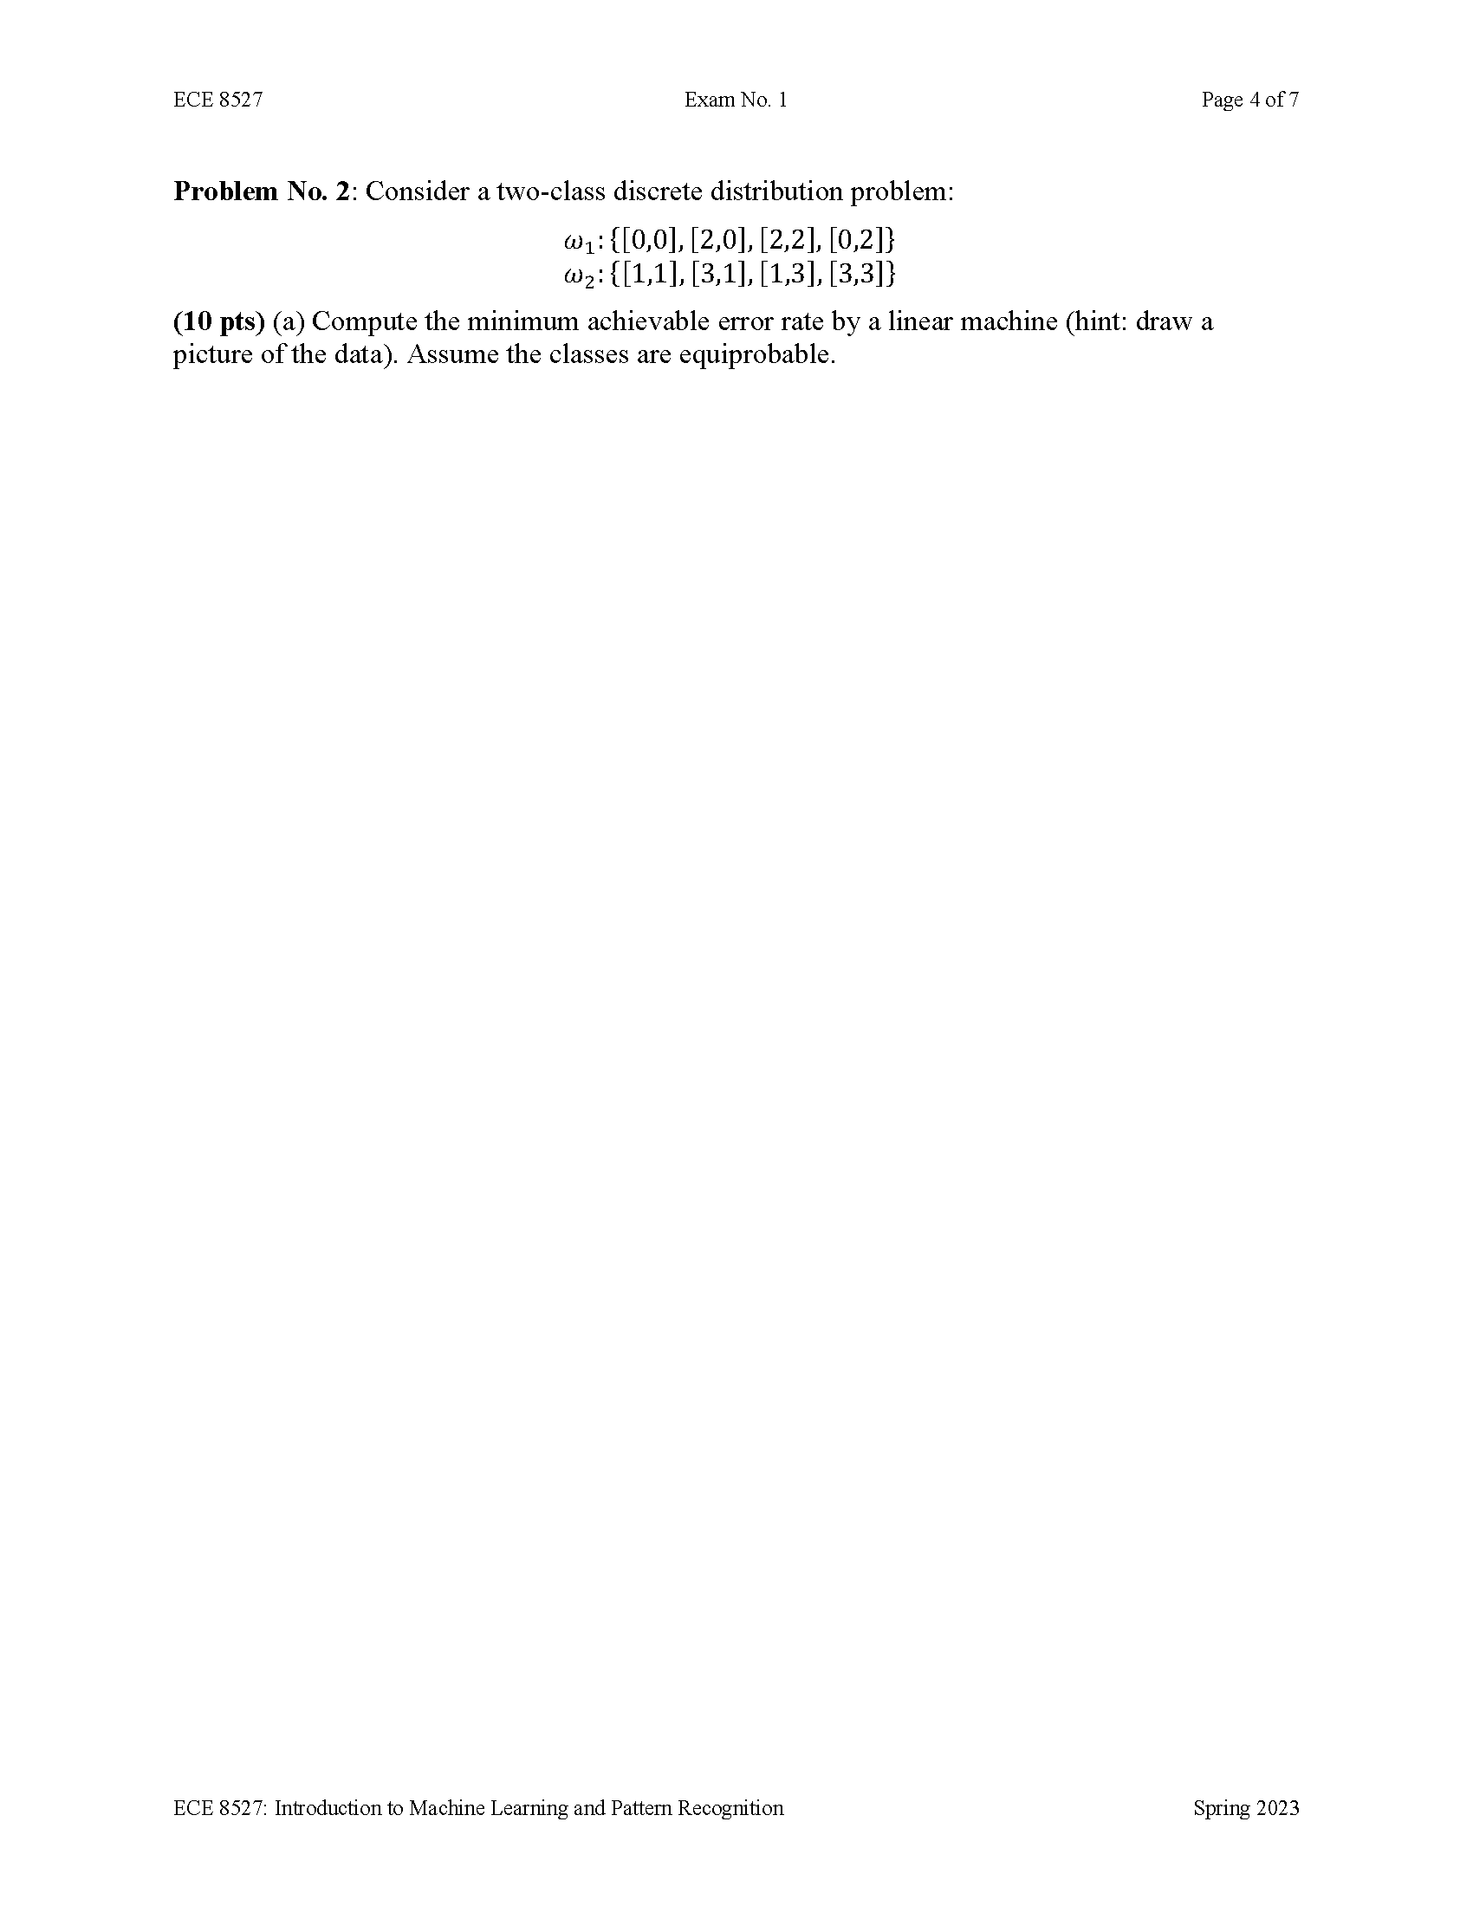
Lecture 14: Exam No. 1 Post-Mortem
Objectives:
Visualize Solutions in a 2D Space
Develop Intuition About Performance
Understand Theoretical Basic for P(E) Calculations
Resources:
ISIP: The ISIP Machine Learning Demo

