Slide 1
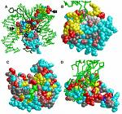
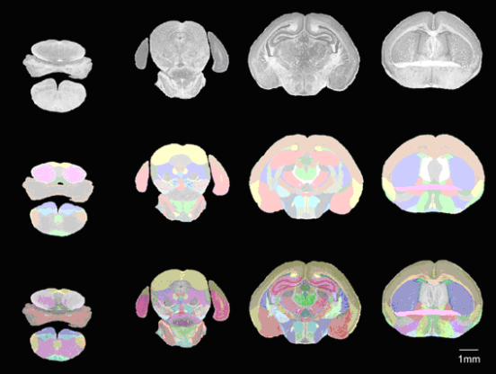
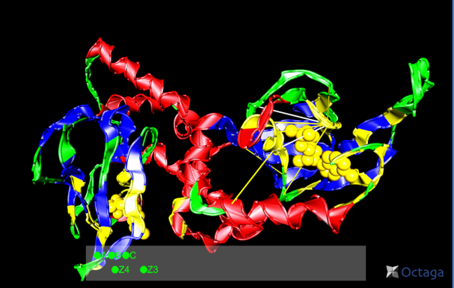
Lecture 15: Parameter Estimation – Information Theory Review
Objectives:
Entropy Mutual Information
Joint Entropy Applications to Bayes Rule
Conditional Entropy
Resources:
MachineLearningMastery: Information Entropy TowardsDataScience: Information Theory for Data Science
KeithVertanen: Discriminative Training

Slide 2
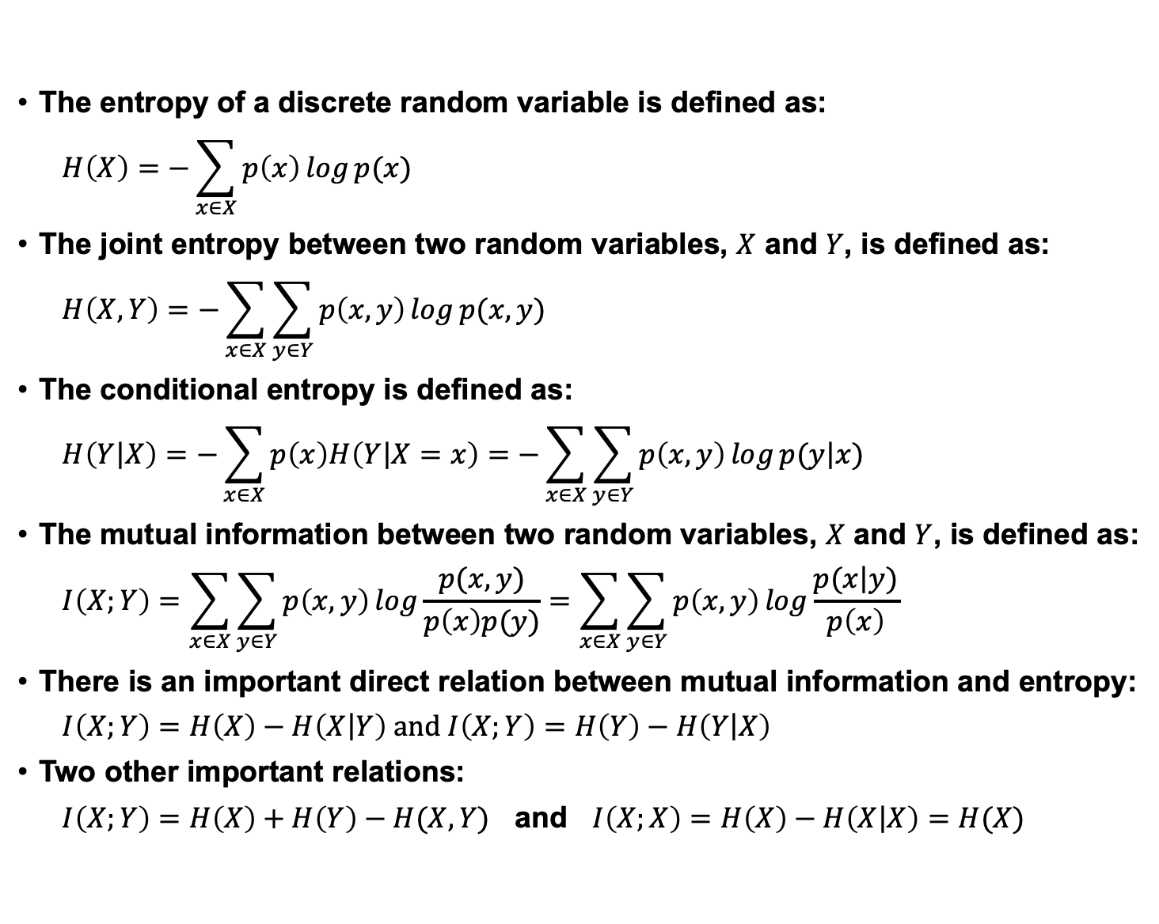
Entropy and Mutual Information
The entropy of a discrete random variable is defined as:
$$H\left(X\right)=−\sum_{x∈X}{p\left(x\right)\log{p(x)}}$$
The joint entropy between two random variables, $X$ and $Y$, is defined as:
$$H\left(X,Y\right)=−\sum_{x∈X}{\sum_{y∈Y}{p\left(x,y\right)\log{p(x,y)}}}$$
The conditional entropy is defined as:
$$H\left(\left.Y\right|X\right)=−\sum_{x∈X}{p\left(x\right)H\left(\left.Y\right|X=x\right)=−\sum_{x∈X}{\sum_{y∈Y}{p\left(x,y\right)\log{p(\left.y\right|x)}}}}$$
The mutual information between two random variables, $X$ and $Y$, is defined as:
$$I\left(X;Y\right)=\sum_{x∈X}{\sum_{y∈Y}{p\left(x,y\right)\log{\frac{p(x,y)}{p\left(x\right)p(y)}=\sum_{x∈X}{\sum_{y∈Y}{p\left(x,y\right)\log{\frac{p(\left.x\right|y)}{p\left(x\right)}}}}}}}$$
There is an important direct relation between mutual information and entropy:
$I\left(X;Y\right)=H\left(X\right)−H\left(\left.X\right|Y\right)$ and $I\left(X;Y\right)=H\left(Y\right)−H\left(\left.Y\right|X\right)$
Two other important relations:
$I\left(X;Y\right)=H\left(X\right)+H\left(Y\right)−H(X,Y)$ and $I\left(X;X\right)=H\left(X\right)−H\left(\left.X\right|X\right)=H(X)$

Slide 3
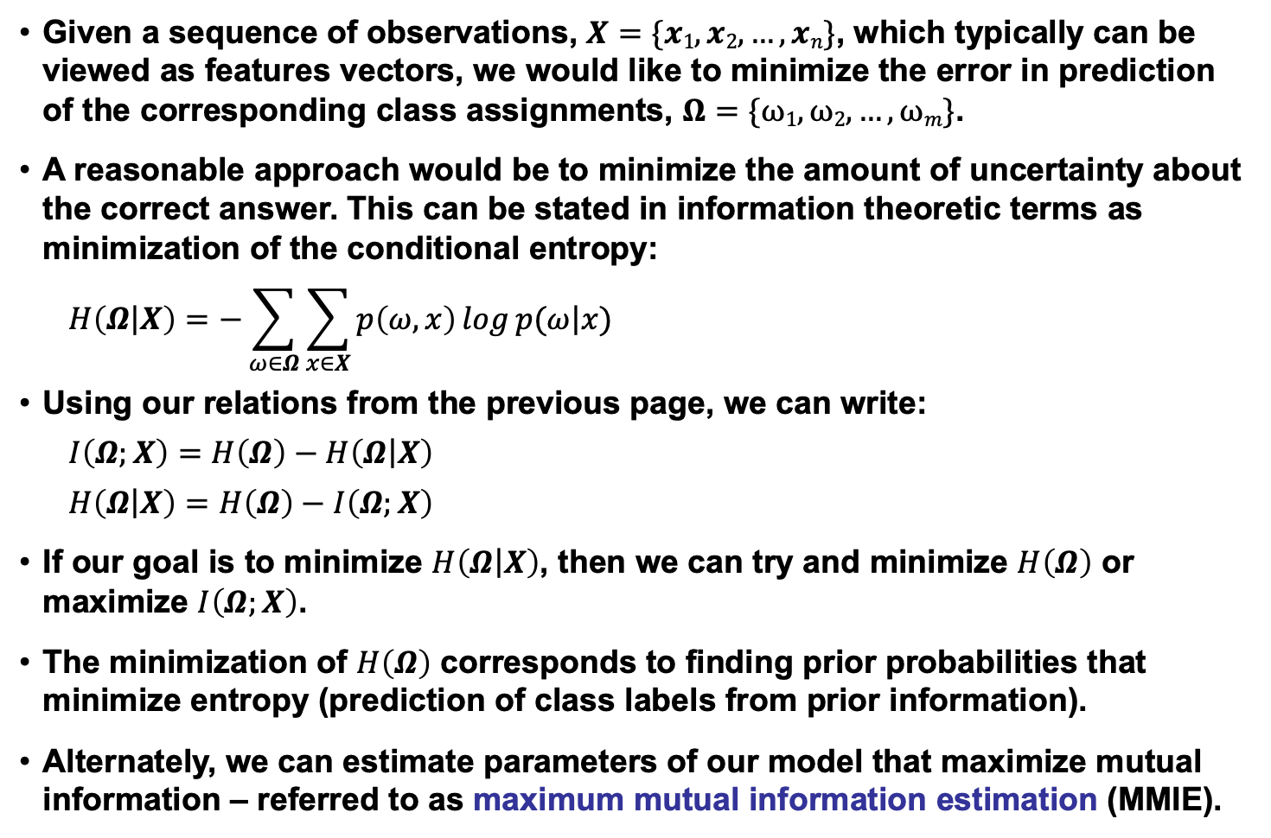
Mutual Information in Pattern Recognition
Given a sequence of observations, $X=\{x1, x2, …, xn\}$, which typically can be viewed as features vectors, we would like to minimize the error in prediction of the corresponding class assignments, $Ω=\{ω1, ω2, …,ωm\}$.
A reasonable approach would be to minimize the amount of uncertainty about the correct answer. This can be stated in information theoretic terms as minimization of the conditional entropy:
$$H\left(Ω\left|X\right.\right)=−\sum_{ω∈Ω}{\sum_{x∈X}{p\left(ω,x\right)\log{p(ω\left|x\right.)}}}$$
Using our relations from the previous page, we can write:
$$I\left(Ω;X\right)=H\left(Ω\right)−H\left(Ω\left|X\right.\right)$$
$H\left(Ω\left|X\right.\right)=$ $H\left(Ω\right)−I\left(Ω;X\right)$
If our goal is to minimize $H\left(Ω\left|X\right.\right)$, then we can try and minimize $H\left(Ω\right)$ or maximize $I\left(Ω;X\right)$.
The minimization of $H\left(Ω\right)$ corresponds to finding prior probabilities that minimize entropy (prediction of class labels from prior information).
Alternately, we can estimate parameters of our model that maximize mutual information – referred to as maximum mutual information estimation (MMIE).

Slide 4
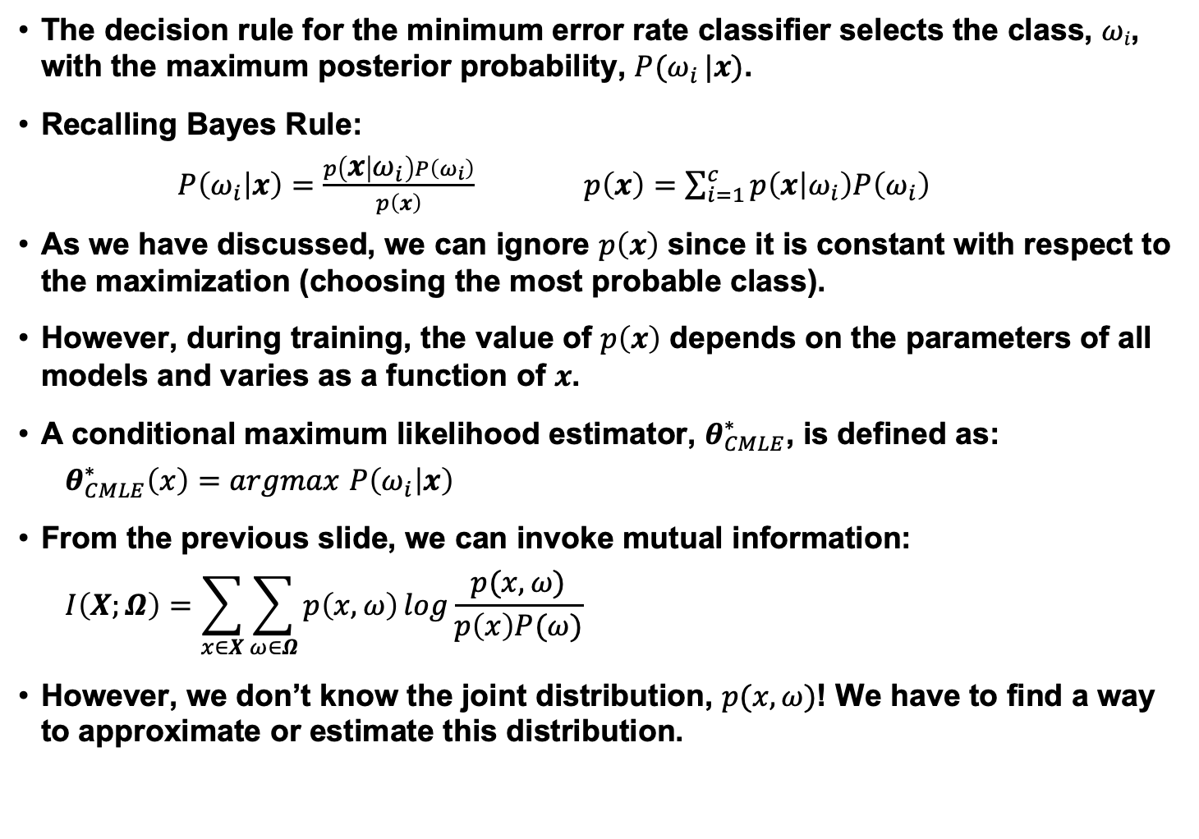
Posteriors and Bayes Rule
The decision rule for the minimum error rate classifier selects the class, $ωi$, with the maximum posterior probability, $P(ω_{i} |x)$.
Recalling Bayes Rule:
$P\left(ω_{i} | x\right)=\frac{p\left(x | ω_{i}\right)P\left(ω_{i}\right)}{p\left(x\right)}$ $p\left(x\right)=\sum_{i=1}^{c}{p\left(x | ω_{i}\right)P\left(ω_{i}\right)}$
As we have discussed, we can ignore $p\left(x\right)$ since it is constant with respect to the maximization (choosing the most probable class).
However, during training, the value of $p\left(x\right)$ depends on the parameters of all models and varies as a function of $x$.
A conditional maximum likelihood estimator, $θ_{CMLE}^{∗}$, is defined as:
$θ_{CMLE}^{∗}\left(x\right)=argmax$ $P\left(ω_{i} | x\right)$
From the previous slide, we can invoke mutual information:
$$I\left(X;Ω\right)=\sum_{x∈X}{\sum_{ω∈Ω}{p\left(x,ω\right)\log{\frac{p(x,ω)}{p\left(x\right)P(ω)}}}}$$
However, we don’t know the joint distribution, $p(x,ω)$! We have to find a way to approximate or estimate this distribution.

Slide 5
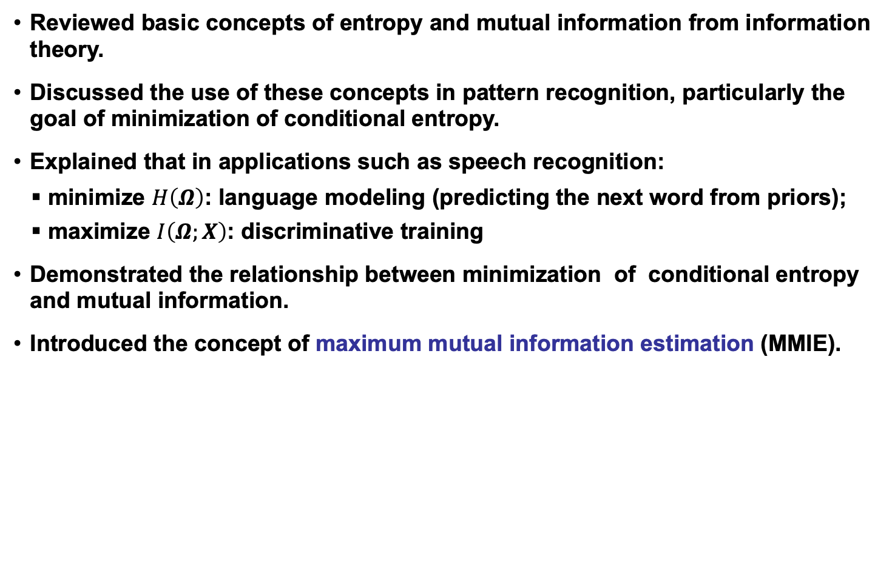
Summary
Reviewed basic concepts of entropy and mutual information from information theory.
Discussed the use of these concepts in pattern recognition, particularly the goal of minimization of conditional entropy.
Explained that in applications such as speech recognition:
minimize $H\left(Ω\right)$: language modeling (predicting the next word from priors);
maximize $I\left(Ω;X\right)$: discriminative training
Demonstrated the relationship between minimization of conditional entropy and mutual information.
Introduced the concept of maximum mutual information estimation (MMIE).

