Slide 1
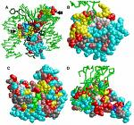
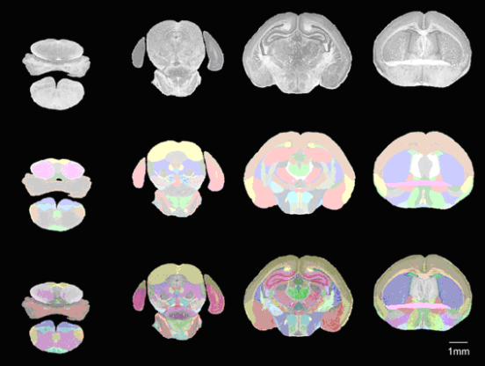
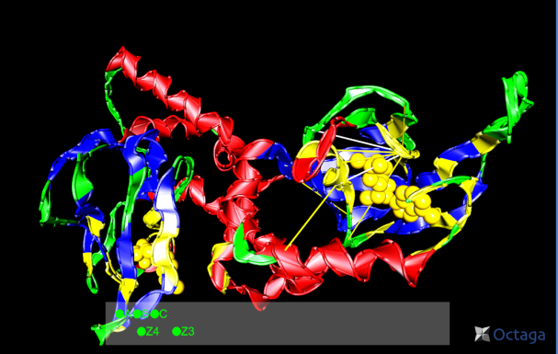
Lecture 16: Parameter Estimation – Discriminative Training
Objectives:
Maximum MI Estimation (MMIE) Minimum Classification Error (MCE)
Resources:
KeithVertanen: Discriminative Training
DanPovey: Large Scale Discriminative Training fpr Speech Recognition
HuangArceroHon: Spoken Language Processing

Slide 2
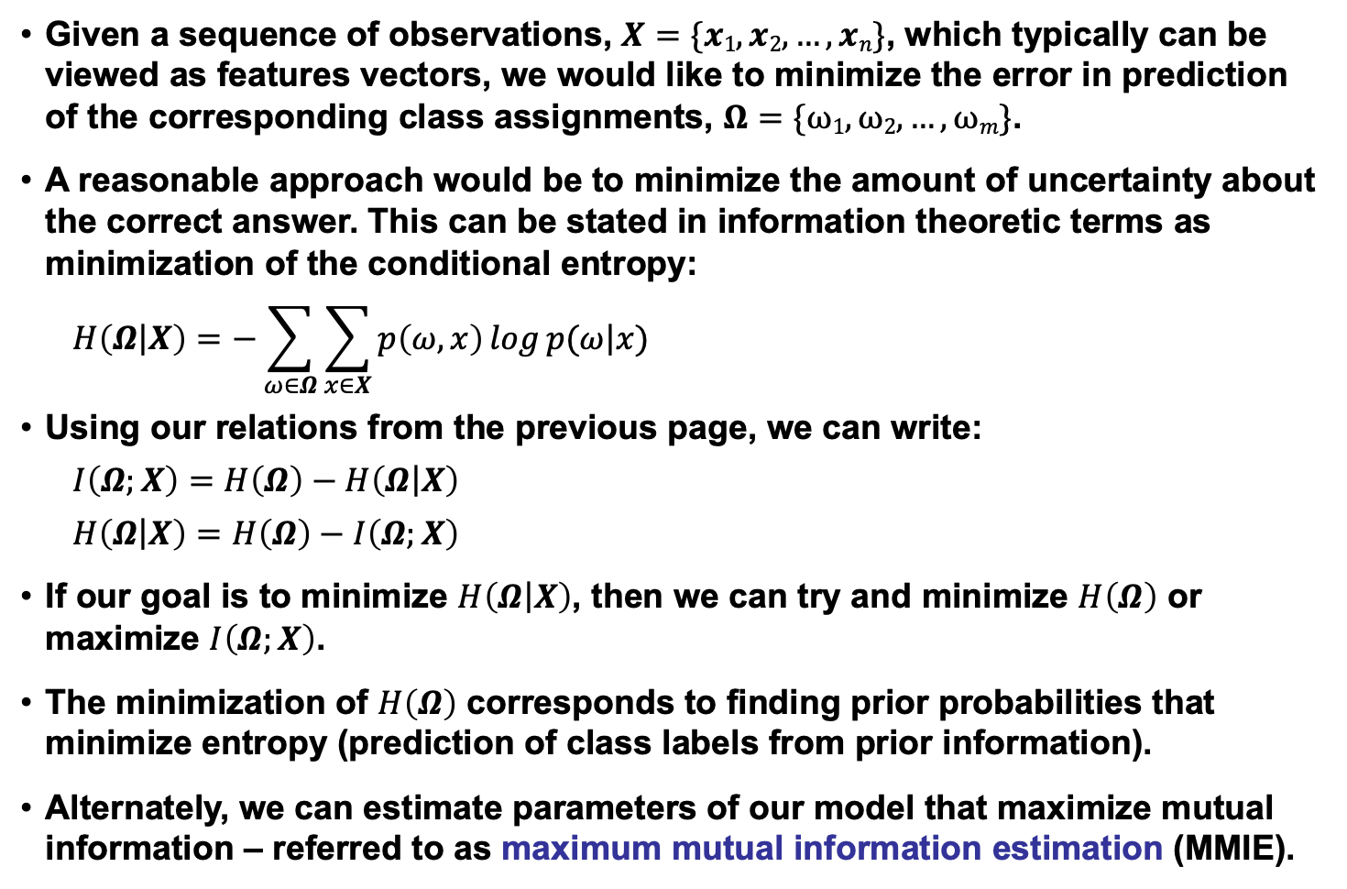
Mutual Information in Pattern Recognition
Given a sequence of observations, $X=\{x1, x2, …, xn\}$, which typically can be viewed as features vectors, we would like to minimize the error in prediction of the corresponding class assignments, $Ω=\{ω1, ω2, …,ωm\}$.
A reasonable approach would be to minimize the amount of uncertainty about the correct answer. This can be stated in information theoretic terms as minimization of the conditional entropy:
$$H\left(Ω\left|X\right.\right)=−\sum_{ω∈Ω}{\sum_{x∈X}{p\left(ω,x\right)\log{p(ω\left|x\right.)}}}$$
Using our relations from the previous page, we can write:
$$I\left(Ω;X\right)=H\left(Ω\right)−H\left(Ω\left|X\right.\right)$$
$H\left(Ω\left|X\right.\right)=$ $H\left(Ω\right)−I\left(Ω;X\right)$
If our goal is to minimize $H\left(Ω\left|X\right.\right)$, then we can try and minimize $H\left(Ω\right)$ or maximize $I\left(Ω;X\right)$.
The minimization of $H\left(Ω\right)$ corresponds to finding prior probabilities that minimize entropy (prediction of class labels from prior information).
Alternately, we can estimate parameters of our model that maximize mutual information – referred to as maximum mutual information estimation (MMIE).

Slide 3
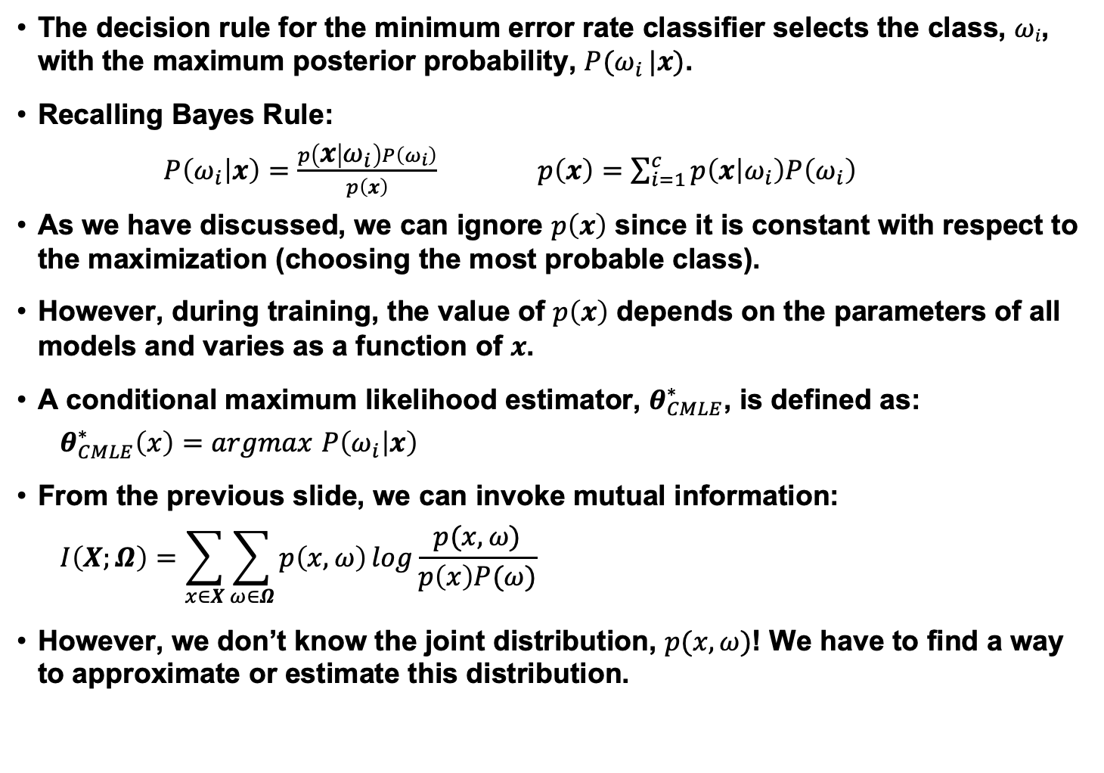
Posteriors and Bayes Rule
The decision rule for the minimum error rate classifier selects the class, $ωi$, with the maximum posterior probability, $P(ω_{i} |x)$.
Recalling Bayes Rule:
$P\left(ω_{i} | x\right)=\frac{p\left(x | ω_{i}\right)P\left(ω_{i}\right)}{p\left(x\right)}$ $p\left(x\right)=\sum_{i=1}^{c}{p\left(x | ω_{i}\right)P\left(ω_{i}\right)}$
As we have discussed, we can ignore $p\left(x\right)$ since it is constant with respect to the maximization (choosing the most probable class).
However, during training, the value of $p\left(x\right)$ depends on the parameters of all models and varies as a function of $x$.
A conditional maximum likelihood estimator, $θ_{CMLE}^{∗}$, is defined as:
$θ_{CMLE}^{∗}\left(x\right)=argmax$ $P\left(ω_{i} | x\right)$
From the previous slide, we can invoke mutual information:
$$I\left(X;Ω\right)=\sum_{x∈X}{\sum_{ω∈Ω}{p\left(x,ω\right)\log{\frac{p(x,ω)}{p\left(x\right)P(ω)}}}}$$
However, we don’t know the joint distribution, $p(x,ω)$! We have to find a way to approximate or estimate this distribution.

Slide 4
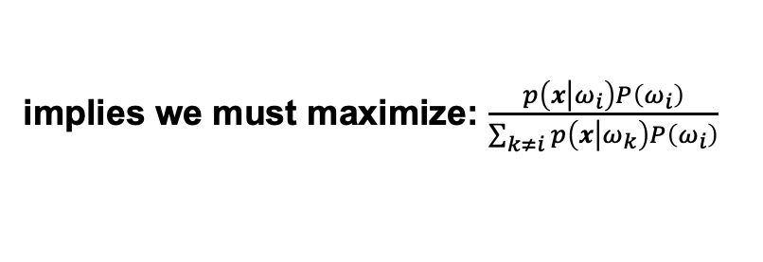
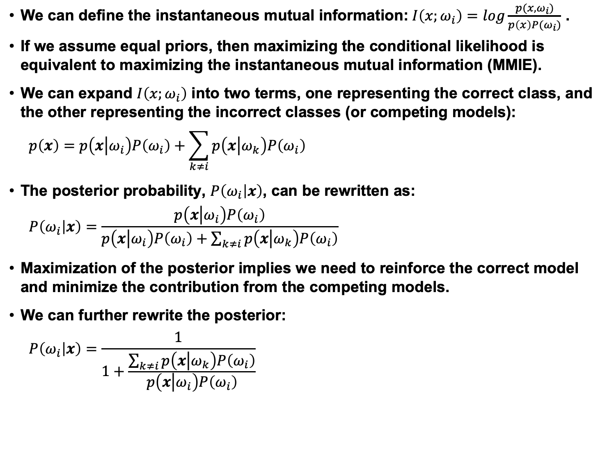
Approximations to Mutual Information
We can define the instantaneous mutual information:$I\left(x;ω_{i}\right)=\log{\frac{p(x,ω_{i})}{p\left(x\right)P(ω_{i})}}$ .
If we assume equal priors, then maximizing the conditional likelihood is equivalent to maximizing the instantaneous mutual information (MMIE).
We can expand $I\left(x;ω_{i}\right)$ into two terms, one representing the correct class, and the other representing the incorrect classes (or competing models):
$$p\left(x\right)=p\left(x\left|ω_{i}\right.\right)P\left(ω_{i}\right)+\sum_{k≠i}{p\left(x\left|ω_{k}\right.\right)P\left(ω_{i}\right)}$$
The posterior probability, $P\left(ω_{i} | x\right)$, can be rewritten as:
$$P\left(ω_{i} | x\right)=\frac{p\left(x\left|ω_{i}\right.\right)P\left(ω_{i}\right)}{p\left(x\left|ω_{i}\right.\right)P\left(ω_{i}\right)+\sum_{k≠i}{p\left(x\left|ω_{k}\right.\right)P\left(ω_{i}\right)}}$$
Maximization of the posterior implies we need to reinforce the correct model and minimize the contribution from the competing models.
We can further rewrite the posterior:
$$P\left(ω_{i} | x\right)=\frac{1}{1+\frac{\sum_{k≠i}{p\left(x\left|ω_{k}\right.\right)P\left(ω_{i}\right)}}{p\left(x\left|ω_{i}\right.\right)P\left(ω_{i}\right)}}$$
implies we must maximize: $\frac{p\left(x\left|ω_{i}\right.\right)P\left(ω_{i}\right)}{\sum_{k≠i}{p\left(x\left|ω_{k}\right.\right)P\left(ω_{i}\right)}}$

Slide 5
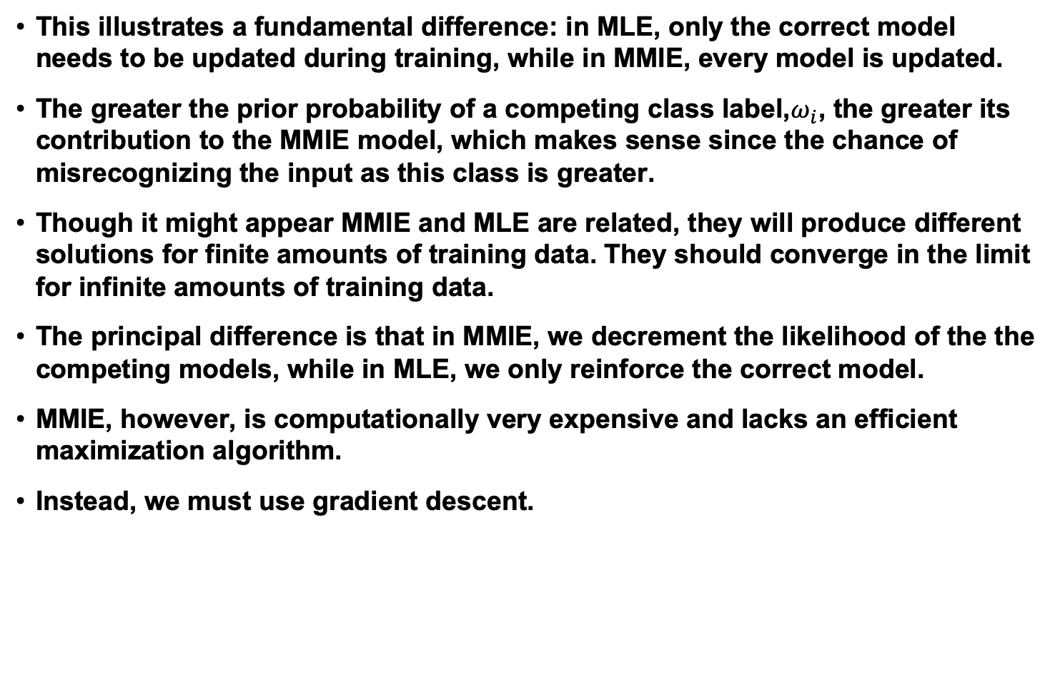
Additional Comments
This illustrates a fundamental difference: in MLE, only the correct model needs to be updated during training, while in MMIE, every model is updated.
The greater the prior probability of a competing class label,$ω_{i}$, the greater its contribution to the MMIE model, which makes sense since the chance of misrecognizing the input as this class is greater.
Though it might appear MMIE and MLE are related, they will produce different solutions for finite amounts of training data. They should converge in the limit for infinite amounts of training data.
The principal difference is that in MMIE, we decrement the likelihood of the the competing models, while in MLE, we only reinforce the correct model.
MMIE, however, is computationally very expensive and lacks an efficient maximization algorithm.
Instead, we must use gradient descent.

Slide 6
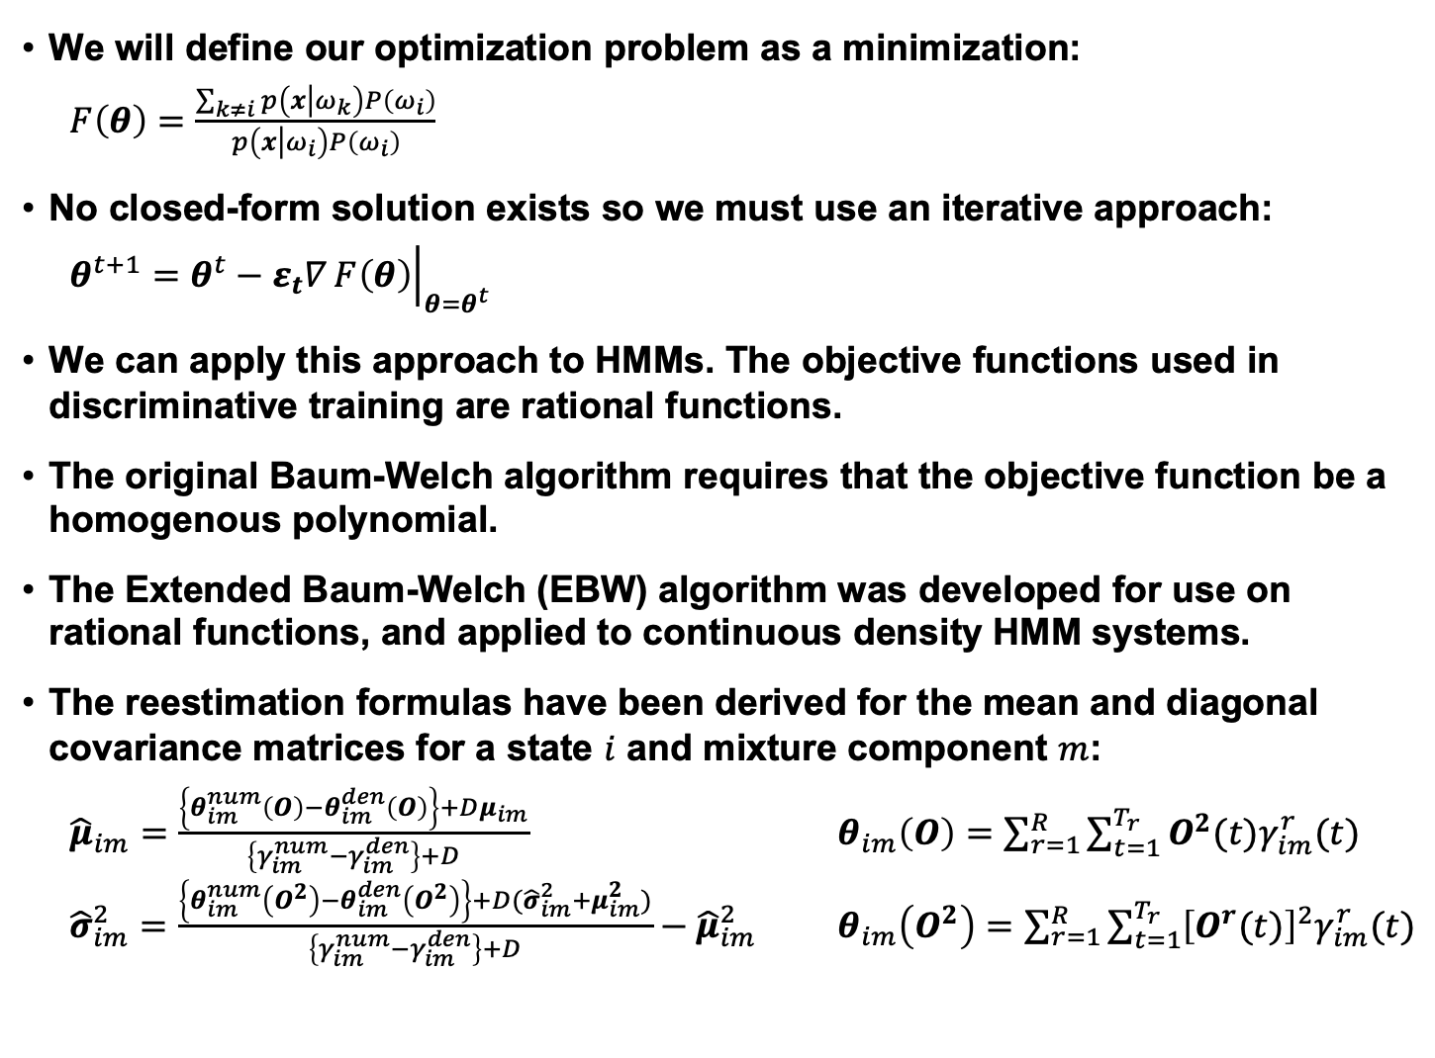
Gradient Descent
We will define our optimization problem as a minimization:
$F\left(θ\right)=$ $\frac{\sum_{k≠i}{p\left(x\left|ω_{k}\right.\right)P\left(ω_{i}\right)}}{p\left(x\left|ω_{i}\right.\right)P\left(ω_{i}\right)}$
No closed-form solution exists so we must use an iterative approach:
$$θ^{t+1}=θ^{t}−ε_{t}∇{\left.F\left(θ\right)\right|}_{θ=θ^{t}}$$
We can apply this approach to HMMs. The objective functions used in discriminative training are rational functions.
The original Baum-Welch algorithm requires that the objective function be a homogenous polynomial.
The Extended Baum-Welch (EBW) algorithm was developed for use on rational functions, and applied to continuous density HMM systems.
The reestimation formulas have been derived for the mean and diagonal covariance matrices for a state $i$ and mixture component $m$:
${\hat{μ}}_{im}=\frac{\left\{θ_{im}^{num}\left(O\right)−θ_{im}^{den}\left(O\right)\right\}+Dμ_{im}}{\left\{γ_{im}^{num}−γ_{im}^{den}\right\}+D}$ $θ_{im}\left(O\right)=\sum_{r=1}^{R}{\sum_{t=1}^{T_{r}}{O^{2}(t)γ_{im}^{r}(t)}}$ ${\hat{σ}}_{im}^{2}=\frac{\left\{θ_{im}^{num}\left(O^{2}\right)−θ_{im}^{den}\left(O^{2}\right)\right\}+D({\hat{σ}}_{im}^{2}+μ_{im}^{2})}{\left\{γ_{im}^{num}−γ_{im}^{den}\right\}+D}−{\hat{μ}}_{im}^{2}$ $θ_{im}\left(O^{2}\right)=\sum_{r=1}^{R}{\sum_{t=1}^{T_{r}}{{\left[O^{r}(t)\right]}^{2}γ_{im}^{r}(t)}}$

Slide 7
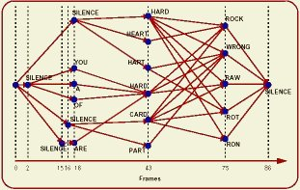
Estimating Probabilities
Estimation of mixture coefficients and transition probabilities have not delivered significant improvements in performance.
Similarly, it is possible to integrate mixture splitting into the discriminative training process, but that has provided only marginal gains as well.
There are various strategies for estimating the learning parameter, D, and making this specific to the mixture component and the state.
We note that calculation of the Gaussian occupancies (i.e. the probability of being in state j and component m summed over all time) is required. In MLE training, these quantities are calculated for each training observation using the forward-backward algorithm (and transcriptions of the data).
For MMIE training, we need counts for both the correct model (numerator) and all competing models (denominator).
The latter is extremely expensive and has been the subject of much research. The preferred approach is to use a lattice to approximate the calculation of the probability of the competing models.

Slide 8
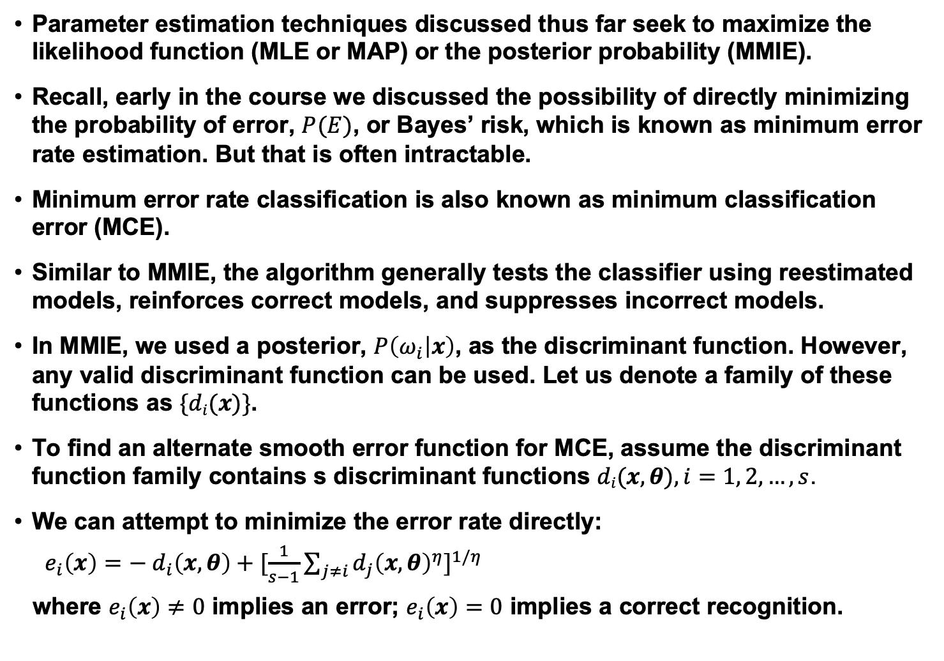
Minimum Error Rate Estimation
Parameter estimation techniques discussed thus far seek to maximize the likelihood function (MLE or MAP) or the posterior probability (MMIE).
Recall, early in the course we discussed the possibility of directly minimizing the probability of error, $P(E)$, or Bayes’ risk, which is known as minimum error rate estimation. But that is often intractable.
Minimum error rate classification is also known as minimum classification error (MCE).
Similar to MMIE, the algorithm generally tests the classifier using reestimated models, reinforces correct models, and suppresses incorrect models.
In MMIE, we used a posterior, $P\left(ω_{i} | x\right)$, as the discriminant function. However, any valid discriminant function can be used. Let us denote a family of these functions as $\{di(x)\}$.
To find an alternate smooth error function for MCE, assume the discriminant function family contains s discriminant functions $di(x,θ), i=1, 2, …, s$.
We can attempt to minimize the error rate directly:
$e_{i}\left(x\right)=−$ $d_{i}\left(x,θ\right)+{[\frac{1}{s−1}\sum_{j≠i}{{d_{j}\left(x,θ\right)}^{η}}]}^{1/η}$
where $e_{i}\left(x\right)≠0$ implies an error; $e_{i}\left(x\right)=0$ implies a correct recognition.

Slide 9
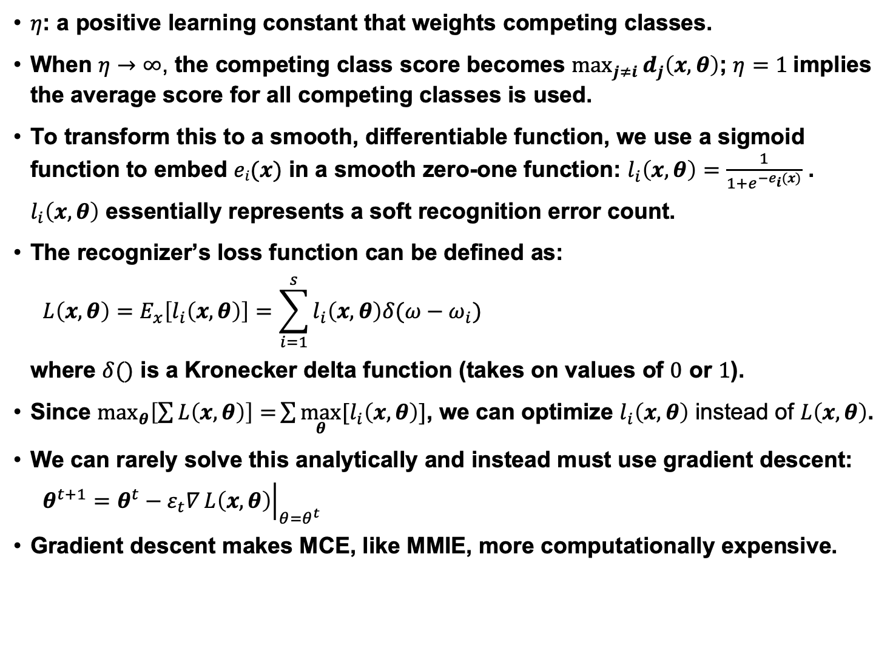
Minimum Error Rate Estimation (cont.)
$η$: a positive learning constant that weights competing classes.
When $η→∞$, the competing class score becomes $\max_{j≠i}{d_{j}\left(x,θ\right)}$; $η=1$implies the average score for all competing classes is used.
To transform this to a smooth, differentiable function, we use a sigmoid function to embed $ei(x)$ in a smooth zero-one function: $l_{i}\left(x,θ\right)=\frac{1}{{1+e}^{−e_{i}(x)}}$ .
$l_{i}\left(x,θ\right)$ essentially represents a soft recognition error count.
The recognizer’s loss function can be defined as:
$$L\left(x,θ\right)=E_{x}\left[l_{i}\left(x,θ\right)\right]=\sum_{i=1}^{s}{l_{i}\left(x,θ\right)δ(ω−ω_{i})}$$
where $δ()$ is a Kronecker delta function (takes on values of $0$ or $1$).
Since $\max_{θ}\left[\sum{L\left(x,θ\right)}\right]=\sum{\max_{θ}{[l}_{i}\left(x,θ\right)]}$, we can optimize $l_{i}\left(x,θ\right)$ instead of $L\left(x,θ\right)$.
We can rarely solve this analytically and instead must use gradient descent:
$$θ^{t+1}=θ^{t}−ε_{t}∇{\left.L\left(x,θ\right)\right|}_{θ=θ^{t}}$$
Gradient descent makes MCE, like MMIE, more computationally expensive.

Slide 10
Minimum Error Rate Estimation (cont.)
The gradient descent approach is often referred to as generalized probabilistic descent (GPD).
A simpler and more pragmatic approach to discriminative training is known as corrective training:
A labeled training set is used to train parameters using MLE. A list of confusable or near-miss classes is generated (using N-best lists or lattices).
The parameters of the models corresponding to the correct classes are reinforced; the parameters of the confusion classes are decremented. This is easy to do in Baum-Welch training because the “counts” are accumulated.
Corrective training was first introduced, and then later generalized into MMIE and MCE.
Neural networks offer an alternative to these functional approaches to discriminative training.
Discriminative training has been applied to every aspect of the pattern recognition problem including feature extraction, frame-level statistical modeling, and adaptation.
Minimization of error in a closed-loop training paradigm is very powerful.

Slide 11
Summary
Reviewed basic concepts of entropy and mutual information, and reviewed the use of these concepts in pattern recognition, particularly the goal of minimization of conditional entropy.
Derived a method of training that maximizes mutual information (MMIE).
Discussed its implementation within an HMM framework.
Introduced an alternative to MMIE that directly minimizes errors (MCE).
Discussed approaches to MCE using gradient descent.
In practice, MMIE and MCE produce similar results.
These methods carry the usual concerns about generalization: can models trained on one particular corpus or task transfer to another task?
In practice, generalization has not been robust across widely varying applications or channel conditions.
In controlled environments, performance improvements are statistically significant but not overwhelmingly impressive.

