Slide 1

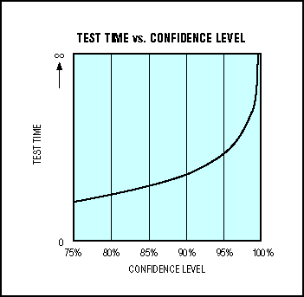
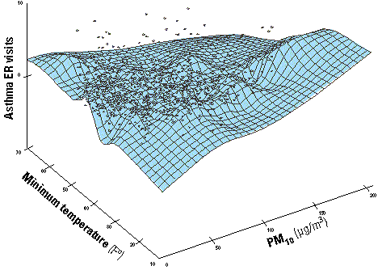
Lecture 19: Statistical Significance and Confidence
Objectives:
Statistical Significance
Hypothesis Testing Confidence Intervals
Resources:
BMJ: Populations and Samples
BMJ: Differences Between Means
C.R.S.: Statistical Significance Yale: Confidence Intervals
Khan: P-Values and Significance Tests
JG: p-Values Explained Intuitively
GM: t-Test, Chi-Square Test, and p-Value

Slide 2
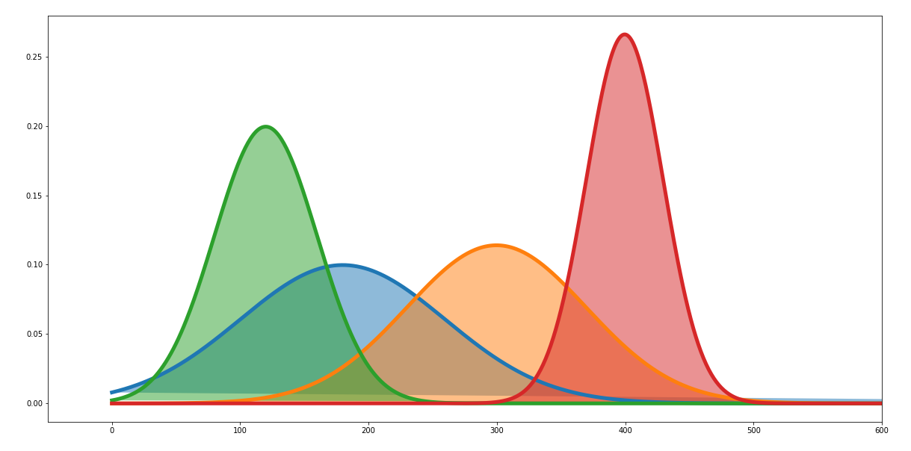
Statistical Significance
We address the question: to what extent could this experimental result be attributed to chance? Are these differences real?
True Value (Unknown)
Experimental Result
Which is better?

Slide 3
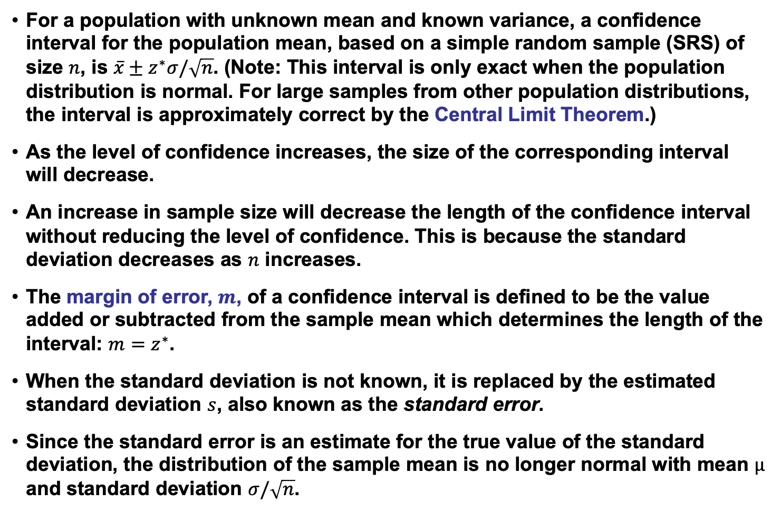
Unknown Mean and Known Variance
For a population with unknown mean and known variance, a confidence interval for the population mean, based on a simple random sample (SRS) of size $n$, is $\overline{x}±z^{∗}σ/\sqrt{n}$. (Note: This interval is only exact when the population distribution is normal. For large samples from other population distributions, the interval is approximately correct by the Central Limit Theorem.)
As the level of confidence increases, the size of the corresponding interval will decrease.
An increase in sample size will decrease the length of the confidence interval without reducing the level of confidence. This is because the standard deviation decreases as $n$ increases.
The margin of error, $m$, of a confidence interval is defined to be the value added or subtracted from the sample mean which determines the length of the interval: ${m=z}^{∗}$.
When the standard deviation is not known, it is replaced by the estimated standard deviation $s$, also known as the standard error.
Since the standard error is an estimate for the true value of the standard deviation, the distribution of the sample mean is no longer normal with mean $µ$ and standard deviation $σ/\sqrt{n}$.

Slide 4
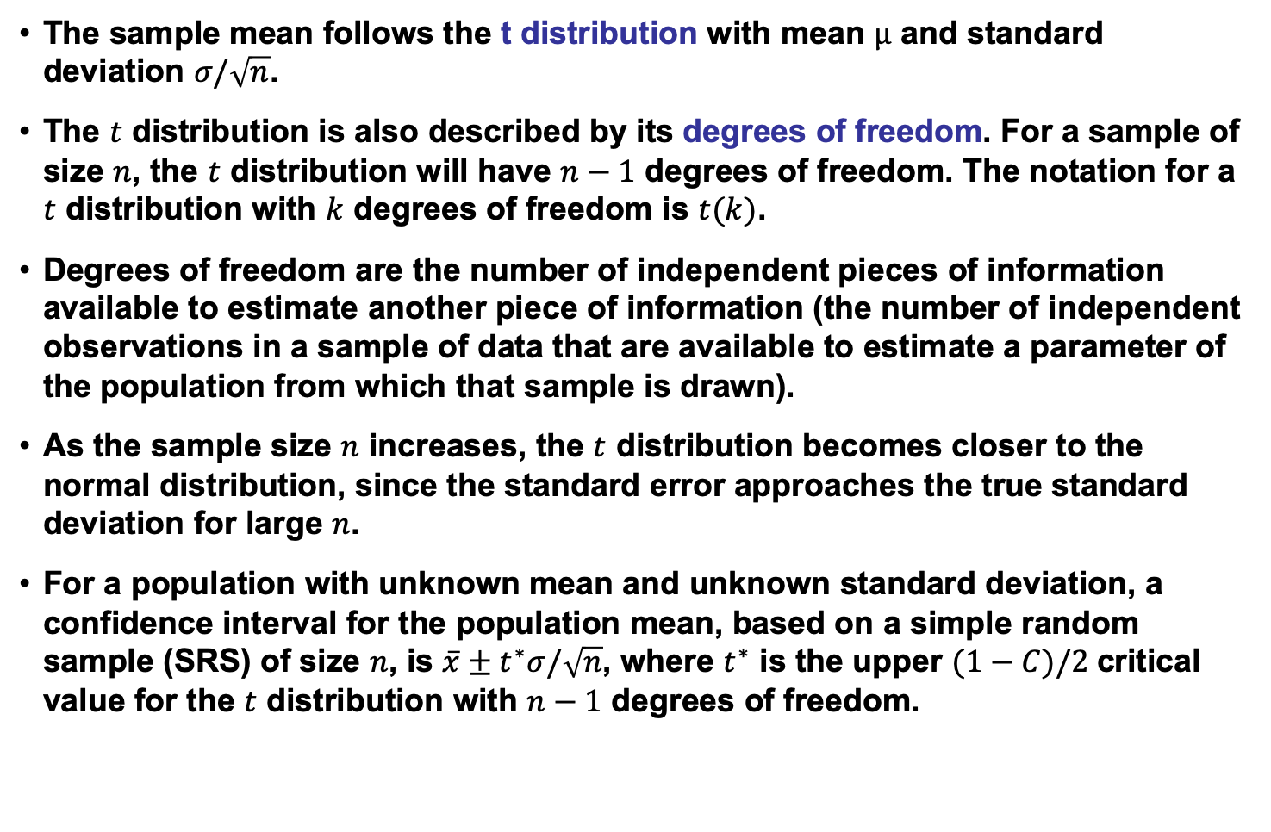
Unknown Mean and Unknown Variance
The sample mean follows the t distribution with mean $µ$ and standard deviation $σ/\sqrt{n}$.
The $t$ distribution is also described by its degrees of freedom. For a sample of size $n$, the $t$ distribution will have $n−1$ degrees of freedom. The notation for a $t$ distribution with $k$ degrees of freedom is $t(k)$.
Degrees of freedom are the number of independent pieces of information available to estimate another piece of information (the number of independent observations in a sample of data that are available to estimate a parameter of the population from which that sample is drawn).
As the sample size $n$ increases, the $t$ distribution becomes closer to the normal distribution, since the standard error approaches the true standard deviation for large $n$.
For a population with unknown mean and unknown standard deviation, a confidence interval for the population mean, based on a simple random sample (SRS) of size $n$, is $\overline{x}±t^{∗}σ/\sqrt{n}$, where $t^{∗}$ is the upper $(1−C)/2$critical value for the $t$ distribution with $n−1$ degrees of freedom.

Slide 5
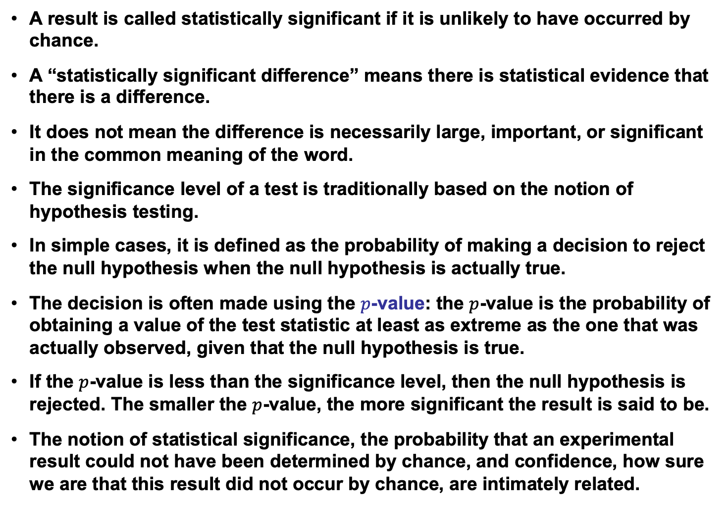
Statistical Significance
A result is called statistically significant if it is unlikely to have occurred by chance.
A “statistically significant difference” means there is statistical evidence that there is a difference.
It does not mean the difference is necessarily large, important, or significant in the common meaning of the word.
The significance level of a test is traditionally based on the notion of hypothesis testing.
In simple cases, it is defined as the probability of making a decision to reject the null hypothesis when the null hypothesis is actually true.
The decision is often made using the $p$-value: the $p$-value is the probability of obtaining a value of the test statistic at least as extreme as the one that was actually observed, given that the null hypothesis is true.
If the $p$-value is less than the significance level, then the null hypothesis is rejected. The smaller the $p$-value, the more significant the result is said to be.
The notion of statistical significance, the probability that an experimental result could not have been determined by chance, and confidence, how sure we are that this result did not occur by chance, are intimately related.

Slide 6
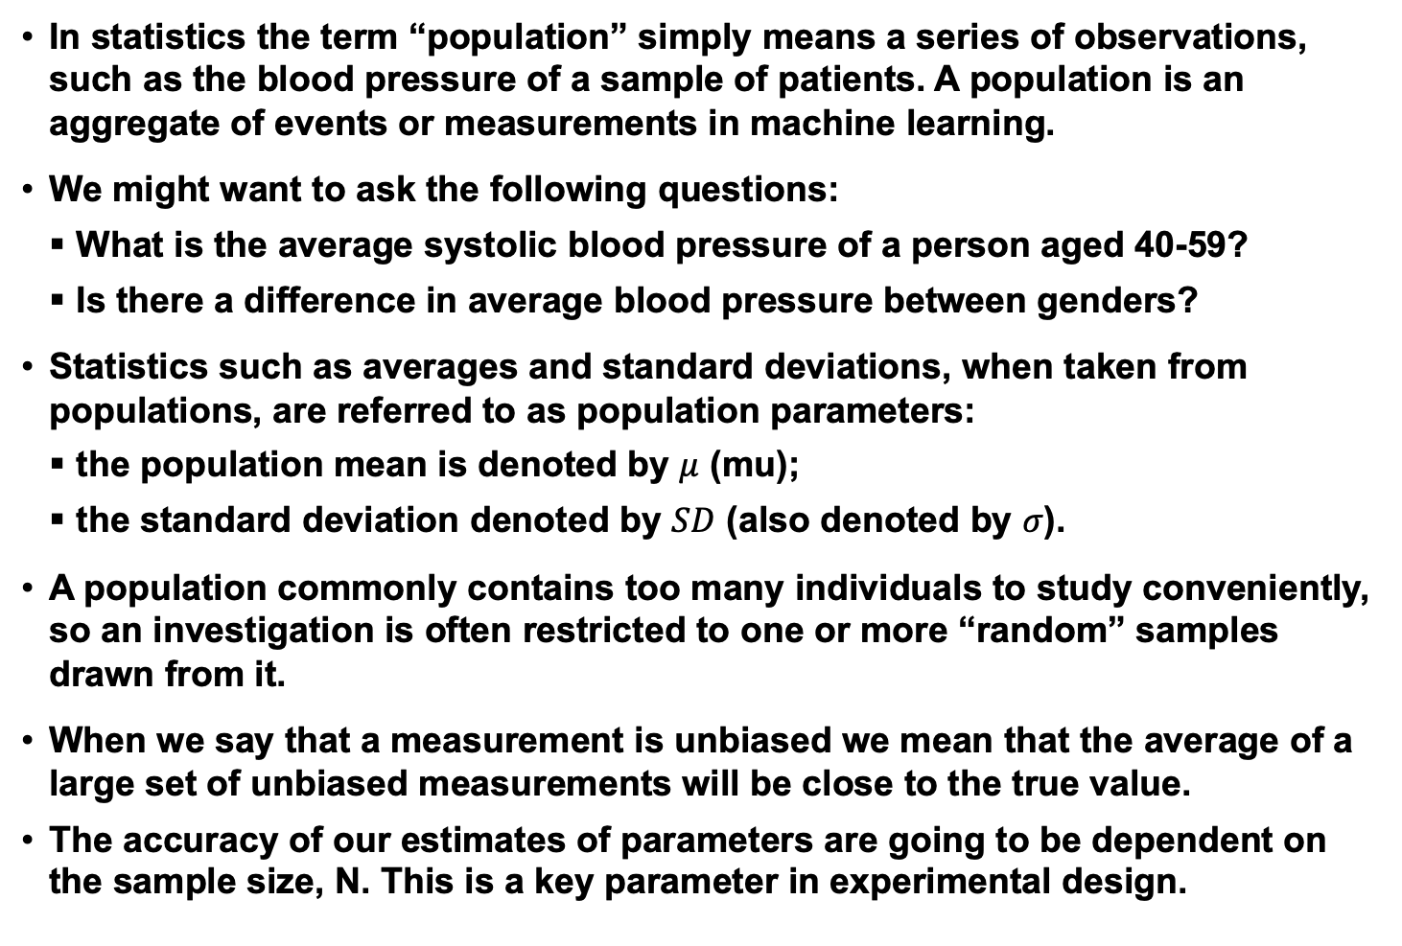
Populations and Sample Means
In statistics the term “population” simply means a series of observations, such as the blood pressure of a sample of patients. A population is an aggregate of events or measurements in machine learning.
We might want to ask the following questions:
What is the average systolic blood pressure of a person aged 40-59?
Is there a difference in average blood pressure between genders?
Statistics such as averages and standard deviations, when taken from populations, are referred to as population parameters:
the population mean is denoted by $μ$ (mu);
the standard deviation denoted by $SD$ (also denoted by $σ$).
A population commonly contains too many individuals to study conveniently, so an investigation is often restricted to one or more “random” samples drawn from it.
When we say that a measurement is unbiased we mean that the average of a large set of unbiased measurements will be close to the true value.
The accuracy of our estimates of parameters are going to be dependent on the sample size, N. This is a key parameter in experimental design.

Slide 7
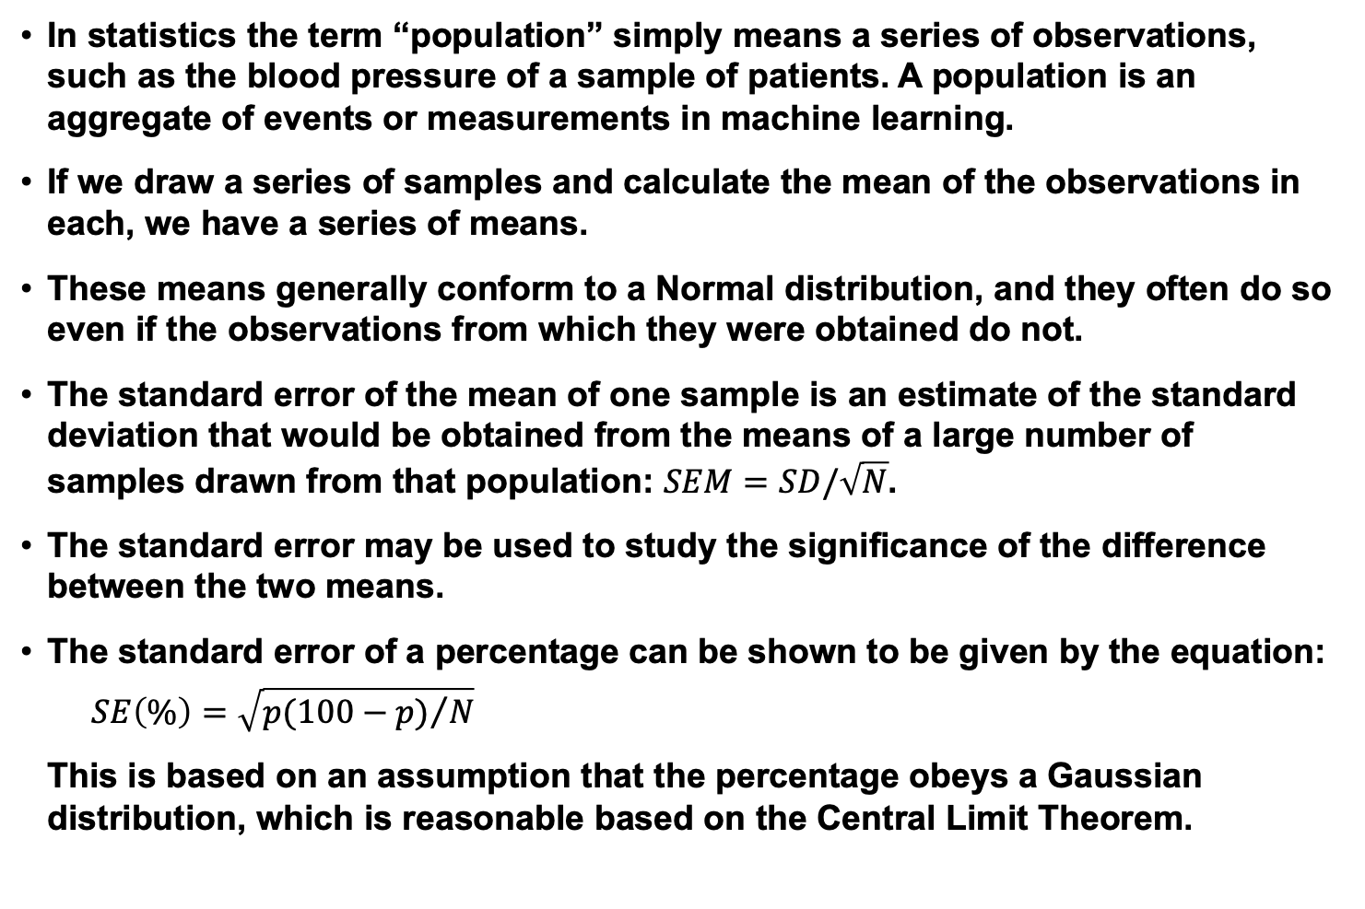
Standard Error of the Mean
In statistics the term “population” simply means a series of observations, such as the blood pressure of a sample of patients. A population is an aggregate of events or measurements in machine learning.
If we draw a series of samples and calculate the mean of the observations in each, we have a series of means.
These means generally conform to a Normal distribution, and they often do so even if the observations from which they were obtained do not.
The standard error of the mean of one sample is an estimate of the standard deviation that would be obtained from the means of a large number of samples drawn from that population: $SEM=SD/\sqrt{N}$.
The standard error may be used to study the significance of the difference between the two means.
The standard error of a percentage can be shown to be given by the equation:
$$SE\left(\%\right)=\sqrt{{p(100−p)}/N}$$
This is based on an assumption that the percentage obeys a Gaussian distribution, which is reasonable based on the Central Limit Theorem.

Slide 8
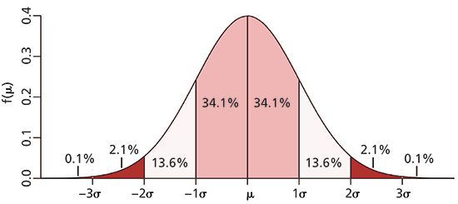
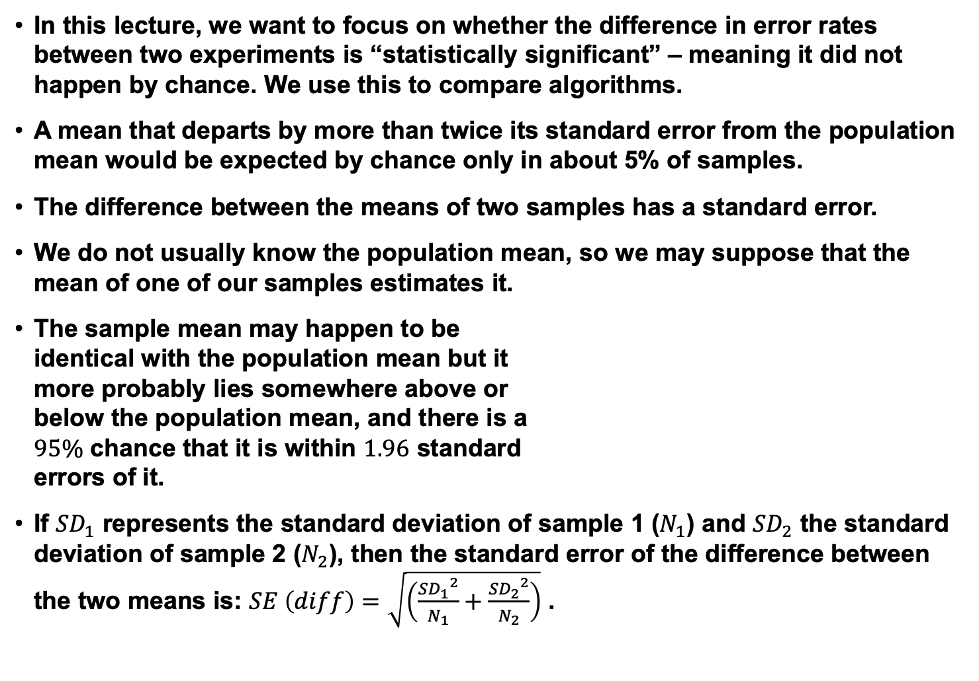
Differences Between Means
In this lecture, we want to focus on whether the difference in error rates between two experiments is “statistically significant” – meaning it did not happen by chance. We use this to compare algorithms.
A mean that departs by more than twice its standard error from the population mean would be expected by chance only in about 5% of samples.
The difference between the means of two samples has a standard error.
We do not usually know the population mean, so we may suppose that the mean of one of our samples estimates it.
The sample mean may happen to be identical with the population mean but it more probably lies somewhere above or below the population mean, and there is a $95\%$ chance that it is within $1.96$ standard errors of it.
If ${SD}_{1}$ represents the standard deviation of sample 1 ($N_{1}$) and ${SD}_{2}$ the standard deviation of sample 2 ($N_{2}$), then the standard error of the difference between the two means is: $SE \left(diff\right)=\sqrt{\left(\frac{{{SD}_{1}}^{2}}{N_{1}}+\frac{{{SD}_{2}}^{2}}{N_{2}}\right)}$ .

Slide 9

Differences Between Means (Cont.)
For two means, $μ_{1}$ and $μ_{2}$, the expected range for a value to fall within for a $95\%$ confidence is: $\left[μ_{min},μ_{max}\right]=\left[\left(\frac{\left(μ_{1}+μ_{2}\right)}{2}\right)±1.96∗SE\left(diff\right)\right].$
The confidence value is referred to as $C$ ($95$% in this case). Values of $80\%$ and $95\%$ are common in the machine learning literature.
However, we have a problem. We don’t often know ${SD}_{1}$ and ${SD}_{2}$. We can estimate these using a cross-validation approach, but it is more common to use a “$z$-statistic” and what is known as a significance of proportions test.

Slide 10
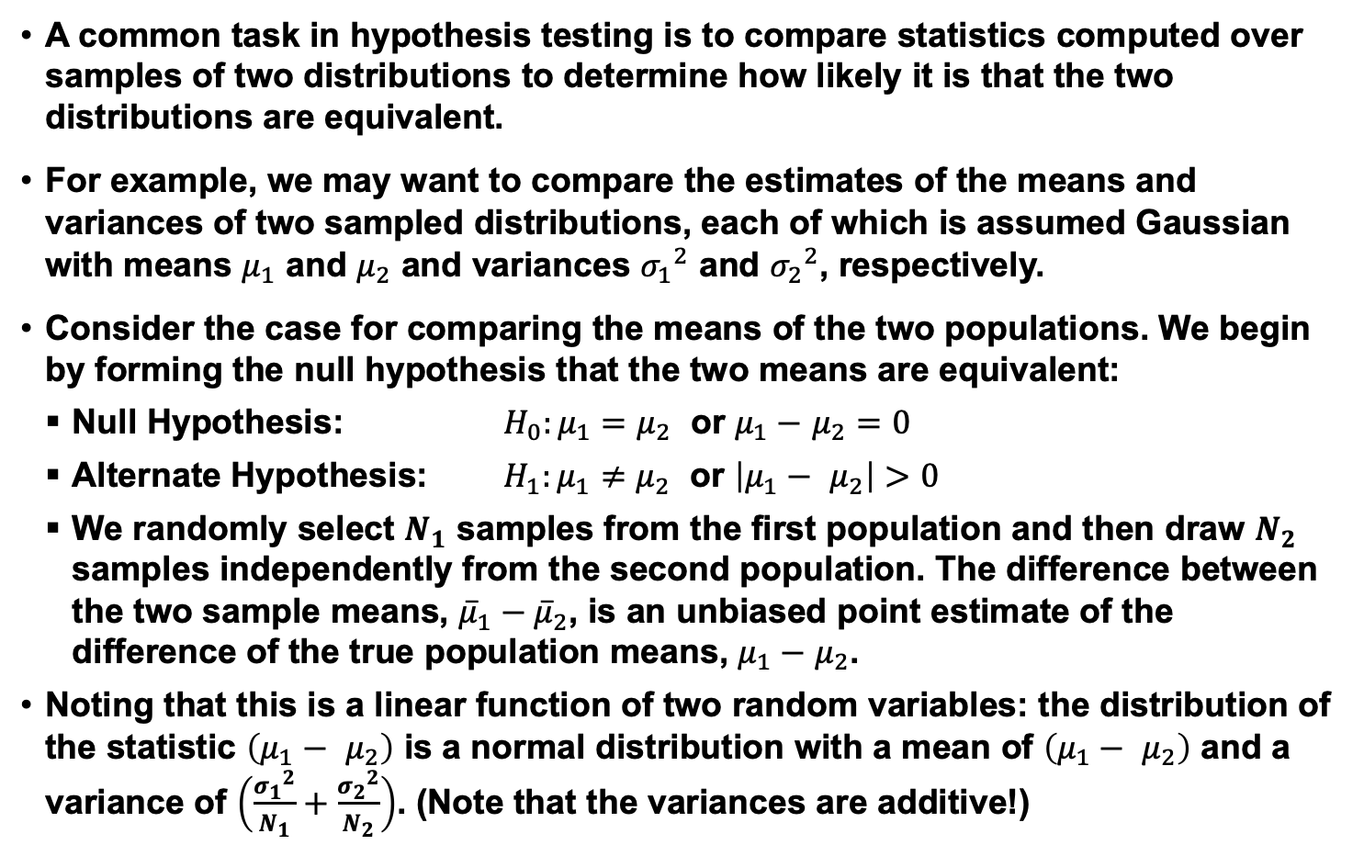
z-Statistic
A common task in hypothesis testing is to compare statistics computed over samples of two distributions to determine how likely it is that the two distributions are equivalent.
For example, we may want to compare the estimates of the means and variances of two sampled distributions, each of which is assumed Gaussian with means $μ_{1}$ and $μ_{2}$ and variances ${σ_{1}}^{2}$ and ${σ_{2}}^{2}$, respectively.
Consider the case for comparing the means of the two populations. We begin by forming the null hypothesis that the two means are equivalent:
Null Hypothesis: $H_{0}:μ_{1}=$ $μ_{2}$ or $μ_{1}−$ $μ_{2}=0$
Alternate Hypothesis: $H_{1}:μ_{1}≠$ $μ_{2}$ or $\left|μ_{1}− μ_{2}\right|>0$
We randomly select $N_{1}$ samples from the first population and then draw $N_{2}$ samples independently from the second population. The difference between the two sample means, ${\overline{μ}}_{1}−{\overline{μ}}_{2}$, is an unbiased point estimate of the difference of the true population means, $μ_{1}−$ $μ_{2}$.
Noting that this is a linear function of two random variables: the distribution of the statistic $\left(μ_{1}− μ_{2}\right)$ is a normal distribution with a mean of $\left(μ_{1}− μ_{2}\right)$ and a variance of $\left(\frac{{σ_{1}}^{2}}{N_{1}}+\frac{{σ_{2}}^{2}}{N_{2}}\right)$. (Note that the variances are additive!)

Slide 11
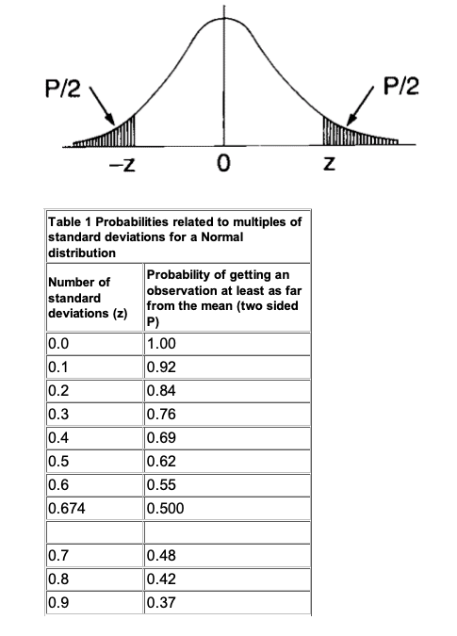
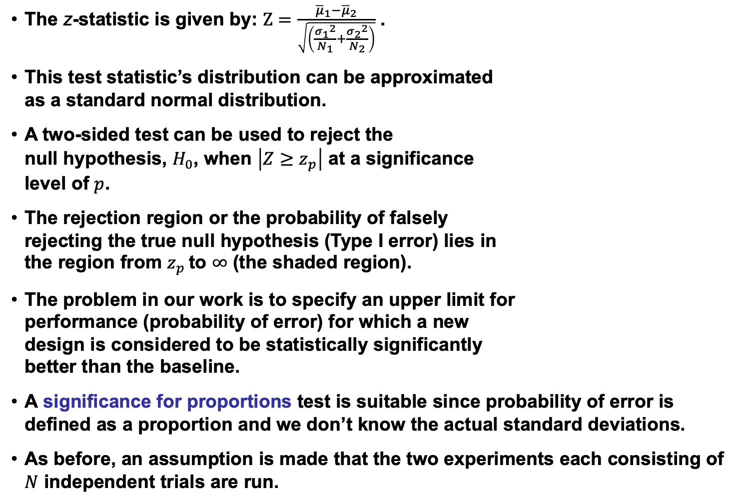
z-Statistic (Cont.)
The z-statistic is given by: $Z=\frac{{\overline{μ}}_{1}−{\overline{μ}}_{2}}{\sqrt{\left(\frac{{σ_{1}}^{2}}{N_{1}}+\frac{{σ_{2}}^{2}}{N_{2}}\right)}}$ .
This test statistic’s distribution can be approximated as a standard normal distribution.
A two-sided test can be used to reject the null hypothesis, $H_{0}$, when $\left|Z≥z_{p}\right|$ at a significance level of $p$.
The rejection region or the probability of falsely rejecting the true null hypothesis (Type I error) lies in the region from $z_{p}$ to $∞$ (the shaded region).
The problem in our work is to specify an upper limit for performance (probability of error) for which a new design is considered to be statistically significantly better than the baseline.
A significance for proportions test is suitable since probability of error is defined as a proportion and we don’t know the actual standard deviations.
As before, an assumption is made that the two experiments each consisting of $N$ independent trials are run.

Slide 12
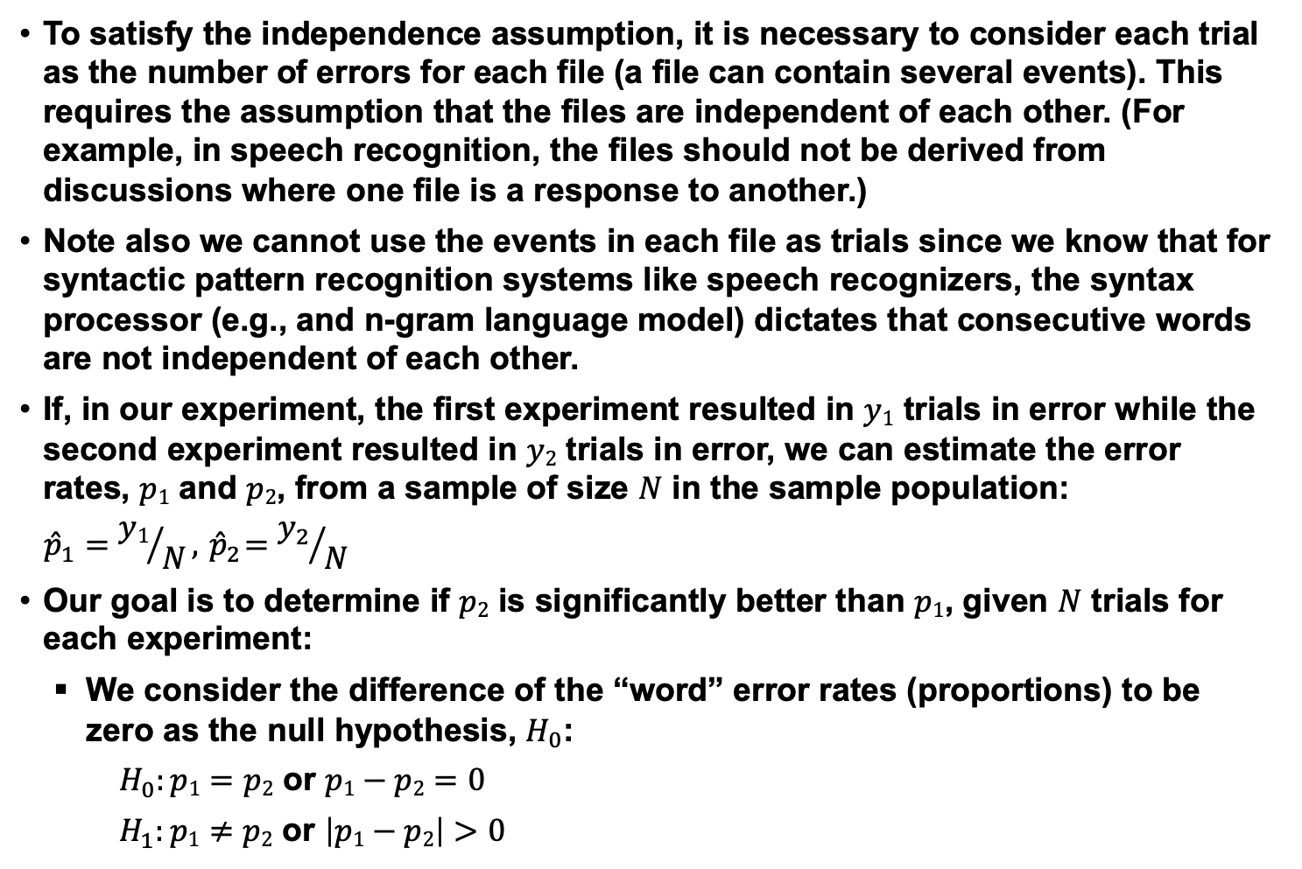
z-Statistic (Cont.)
To satisfy the independence assumption, it is necessary to consider each trial as the number of errors for each file (a file can contain several events). This requires the assumption that the files are independent of each other. (For example, in speech recognition, the files should not be derived from discussions where one file is a response to another.)
Note also we cannot use the events in each file as trials since we know that for syntactic pattern recognition systems like speech recognizers, the syntax processor (e.g., and n-gram language model) dictates that consecutive words are not independent of each other.
If, in our experiment, the first experiment resulted in $y1$ trials in error while the second experiment resulted in $y2$ trials in error, we can estimate the error rates, $p1$ and $p2$, from a sample of size $N$ in the sample population:
$${\hat{p}}_{1}={y1}/N, { \hat{p}}_{2}={y_{2}}/N$$
Our goal is to determine if $p2$ is significantly better than $p1$, given $N$ trials for each experiment:
We consider the difference of the “word” error rates (proportions) to be zero as the null hypothesis, $H_{0}$:
$H_{0}:p1=p2$ or $p1−p2=0$
$H_{1}:p1≠p2$ or $\left|p1−p2\right|>0$

Slide 13
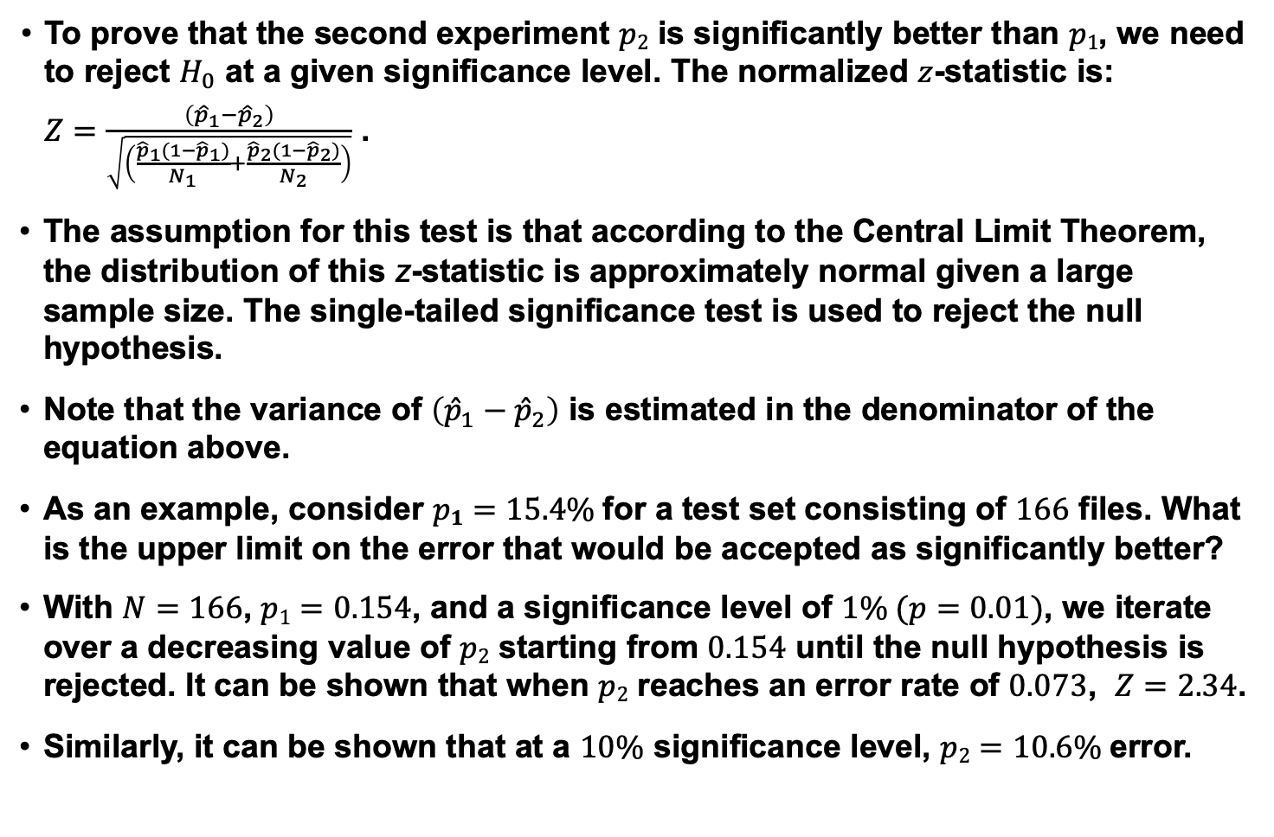
z-Statistics (Cont.)
To prove that the second experiment $p2$ is significantly better than $p1$, we need to reject $H_{0}$ at a given significance level. The normalized $z$-statistic is:
$Z=\frac{\left({\hat{p}}_{1}−{\hat{p}}_{2}\right)}{\sqrt{\left(\frac{{\hat{p}}_{1}(1−{\hat{p}}_{1})}{N_{1}}+\frac{{\hat{p}}_{2}(1−{\hat{p}}_{2})}{N_{2}}\right)}}$ .
The assumption for this test is that according to the Central Limit Theorem, the distribution of this z-statistic is approximately normal given a large sample size. The single-tailed significance test is used to reject the null hypothesis.
Note that the variance of $\left({\hat{p}}_{1}−{\hat{p}}_{2}\right)$ is estimated in the denominator of the equation above.
As an example, consider $p1=15.4\%$for a test set consisting of $166$ files. What is the upper limit on the error that would be accepted as significantly better?
With $N=166$, $p1=0.154$, and a significance level of $1\% (p=0.01)$, we iterate over a decreasing value of $p2$ starting from $0.154$ until the null hypothesis is rejected. It can be shown that when $p2$ reaches an error rate of $0.073$, $Z=2.34$.
Similarly, it can be shown that at a $10\%$ significance level, $p2=10.6\%$error.

Slide 14
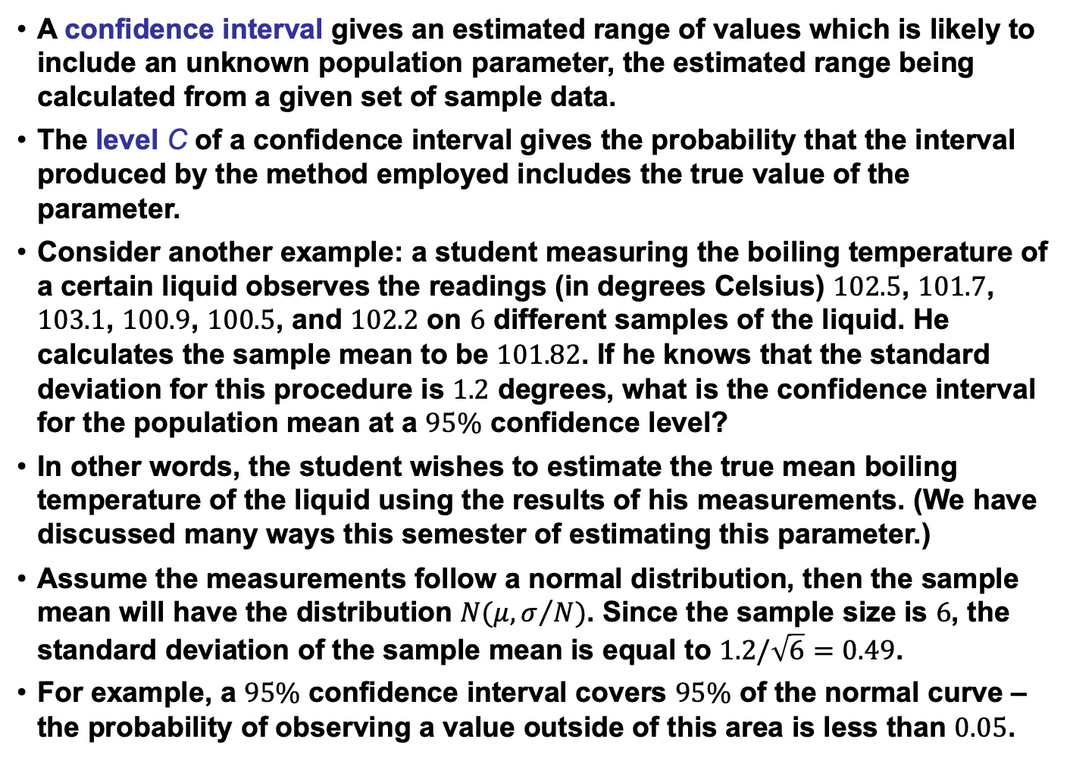
Confidence Intervals
A confidence interval gives an estimated range of values which is likely to include an unknown population parameter, the estimated range being calculated from a given set of sample data.
The level C of a confidence interval gives the probability that the interval produced by the method employed includes the true value of the parameter.
Consider another example: a student measuring the boiling temperature of a certain liquid observes the readings (in degrees Celsius) $102.5$, $101.7$, $103.1$, $100.9$, $100.5$, and $102.2$ on $6$ different samples of the liquid. He calculates the sample mean to be $101.82$. If he knows that the standard deviation for this procedure is $1.2$ degrees, what is the confidence interval for the population mean at a $95\%$ confidence level?
In other words, the student wishes to estimate the true mean boiling temperature of the liquid using the results of his measurements. (We have discussed many ways this semester of estimating this parameter.)
Assume the measurements follow a normal distribution, then the sample mean will have the distribution $N(μ,σ/N)$. Since the sample size is $6$, the standard deviation of the sample mean is equal to $1.2/\sqrt{6}=0.49$.
For example, a $95\%$ confidence interval covers $95\%$ of the normal curve – the probability of observing a value outside of this area is less than $0.05$.

Slide 15
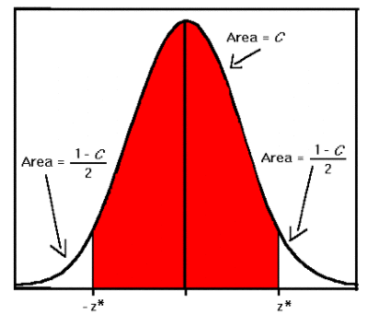
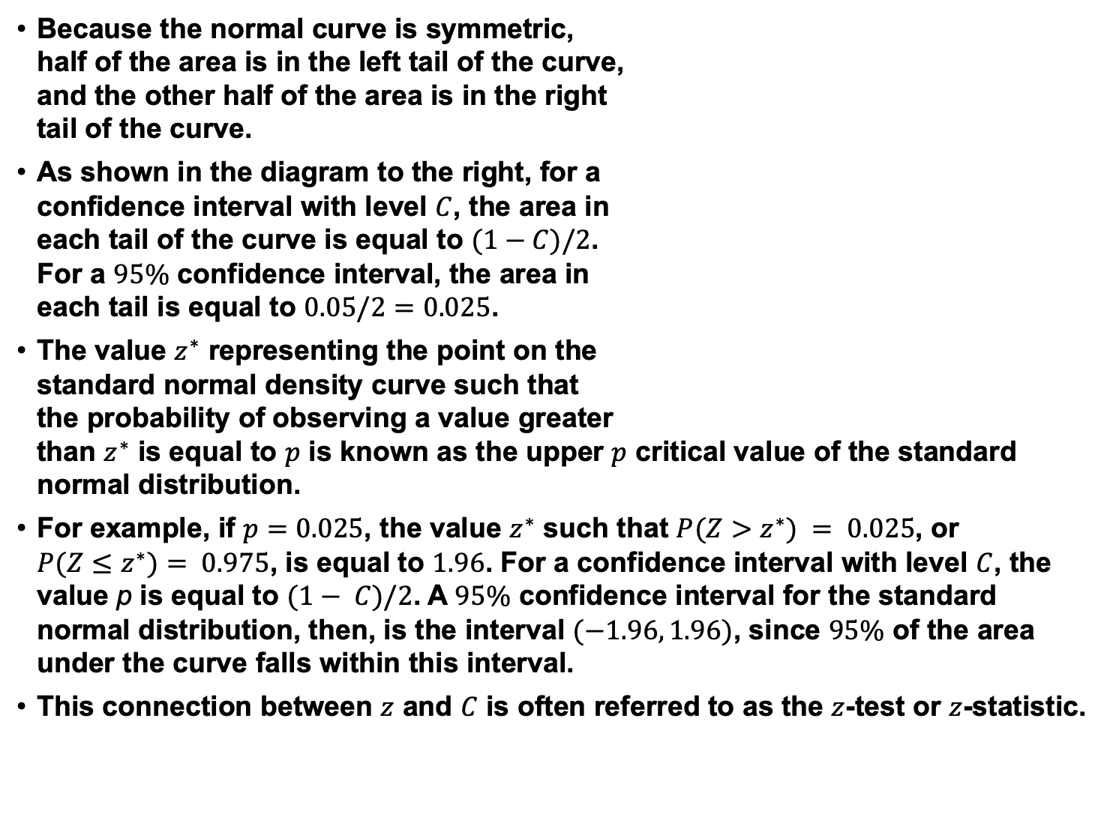
Confidence Intervals (Cont.)
Because the normal curve is symmetric, half of the area is in the left tail of the curve, and the other half of the area is in the right tail of the curve.
As shown in the diagram to the right, for a confidence interval with level $C$, the area in each tail of the curve is equal to $(1−C)/2$. For a $95\%$ confidence interval, the area in each tail is equal to $0.05/2=0.025$.
The value $z^{∗}$ representing the point on the standard normal density curve such that the probability of observing a value greater than $z^{∗}$ is equal to $p$ is known as the upper $p$ critical value of the standard normal distribution.
For example, if $p=0.025$, the value $z^{∗}$ such that $P(Z>z^{∗}) = 0.025$, or $P(Z≤z^{∗})= 0.975$, is equal to $1.96$. For a confidence interval with level $C$, the value p is equal to $(1− C)/2$. A $95\%$ confidence interval for the standard normal distribution, then, is the interval $(−1.96, 1.96)$, since $95\%$ of the area under the curve falls within this interval.
This connection between $z$ and $C$ is often referred to as the $z$-test or $z$-statistic.

Slide 16
Summary
Reviewed basic concepts in statistics such as standard error, confidence and statistical significance.
Demonstrated the influence sample size has on statistical significance.
Note that Microsoft Excel has excellent support for statistical testing (look under “insert function->more functions->statistical” and scroll down to find items like t.test).

Slide 17
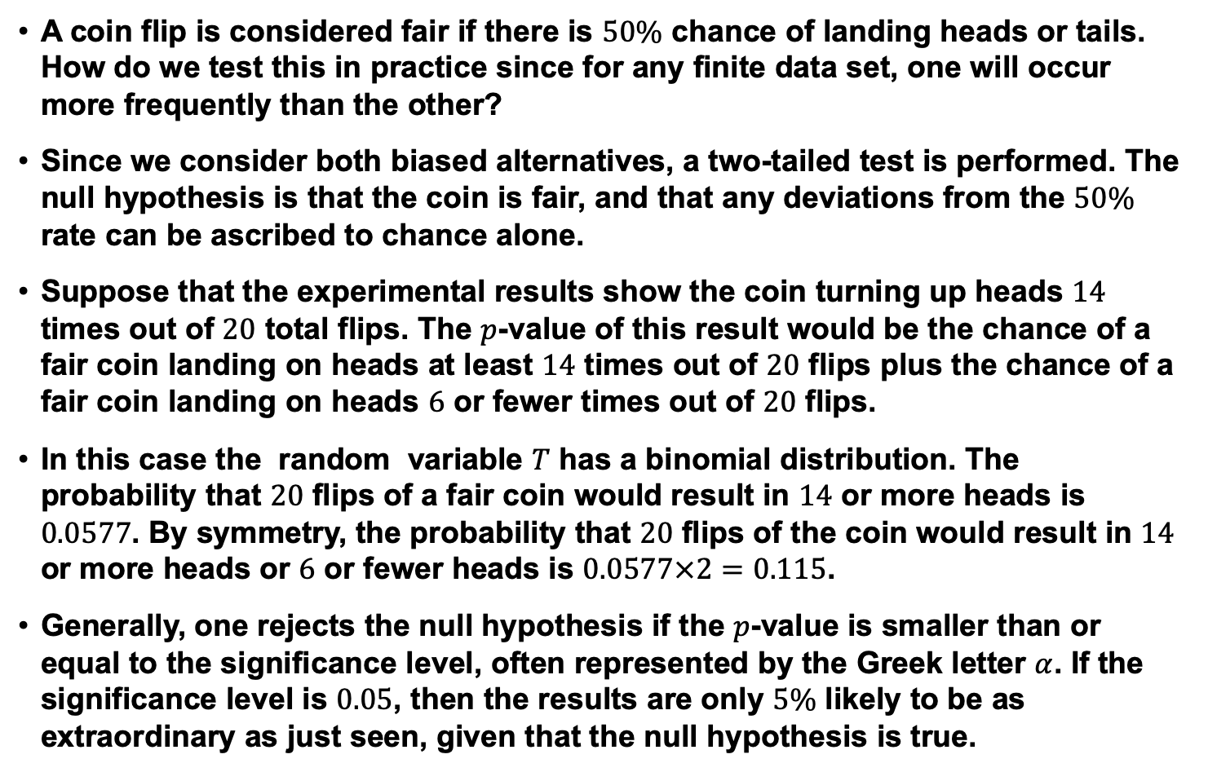
Example: Coin Toss
A coin flip is considered fair if there is $50\%$ chance of landing heads or tails. How do we test this in practice since for any finite data set, one will occur more frequently than the other?
Since we consider both biased alternatives, a two-tailed test is performed. The null hypothesis is that the coin is fair, and that any deviations from the $50\%$ rate can be ascribed to chance alone.
Suppose that the experimental results show the coin turning up heads $14$ times out of $20$ total flips. The $p$-value of this result would be the chance of a fair coin landing on heads at least $14$ times out of $20$ flips plus the chance of a fair coin landing on heads $6$ or fewer times out of $20$ flips.
In this case the random variable $T$ has a binomial distribution. The probability that $20$ flips of a fair coin would result in $14$ or more heads is $0.0577$. By symmetry, the probability that $20$ flips of the coin would result in $14$ or more heads or $6$ or fewer heads is $0.0577×2=0.115$.
Generally, one rejects the null hypothesis if the $p$-value is smaller than or equal to the significance level, often represented by the Greek letter $α$. If the significance level is $0.05$, then the results are only $5\%$ likely to be as extraordinary as just seen, given that the null hypothesis is true.

Slide 18
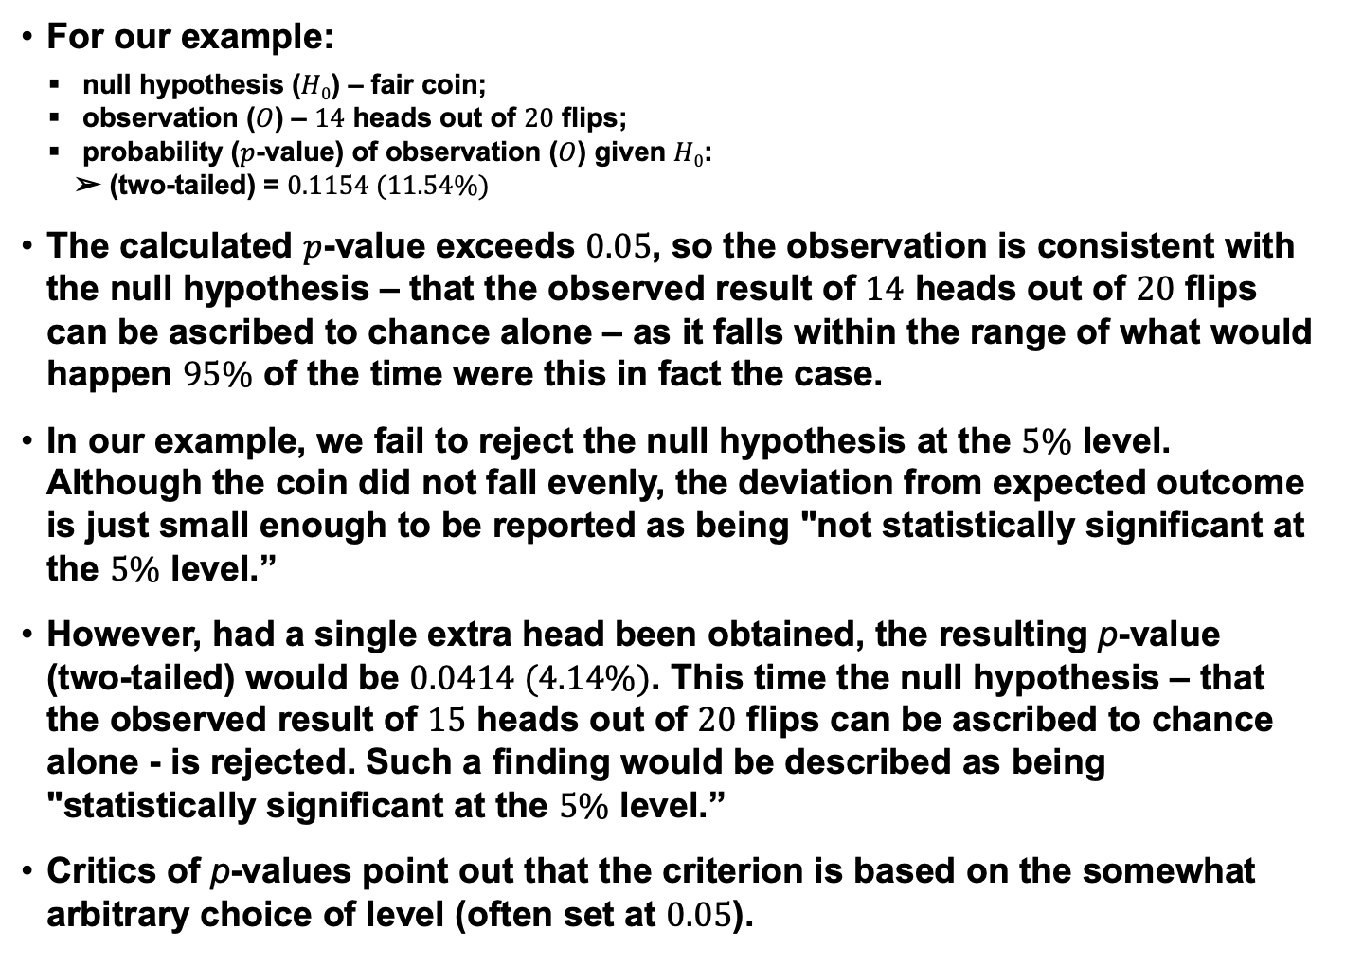
Example: Coin Toss (Cont.)
For our example:
null hypothesis ($H0$) – fair coin;
observation ($O$) – $14$ heads out of $20$ flips;
probability ($p$-value) of observation ($O$) given $H0$:
➢ (two-tailed) = $0.1154 (11.54\%)$
The calculated $p$-value exceeds $0.05$, so the observation is consistent with the null hypothesis – that the observed result of $14$ heads out of $20$ flips can be ascribed to chance alone – as it falls within the range of what would happen $95\%$ of the time were this in fact the case.
In our example, we fail to reject the null hypothesis at the $5\%$ level. Although the coin did not fall evenly, the deviation from expected outcome is just small enough to be reported as being "not statistically significant at the $5\%$ level.”
However, had a single extra head been obtained, the resulting p-value (two-tailed) would be $0.0414 (4.14\%)$. This time the null hypothesis – that the observed result of $15$ heads out of $20$ flips can be ascribed to chance alone - is rejected. Such a finding would be described as being "statistically significant at the $5\%$ level.”
Critics of p-values point out that the criterion is based on the somewhat arbitrary choice of level (often set at $0.05$).

