Slide 1
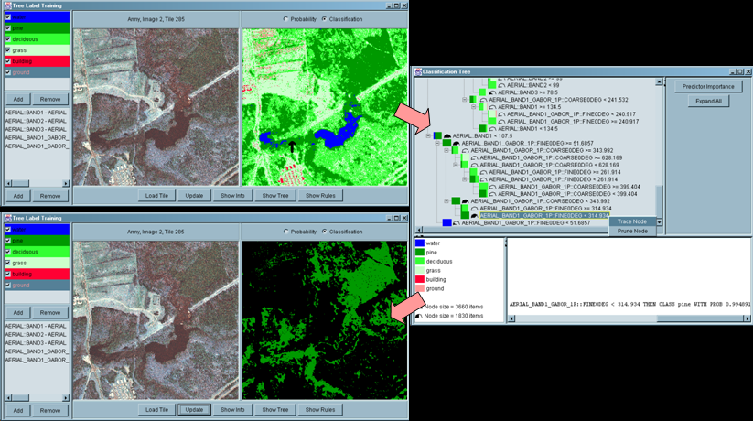
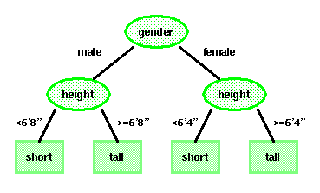
Lecture 24: Decision Trees
Objectives:
Tree-Growing Via CART Splitting, Stopping and Pruning Attributes Node Impurity Priors and Costs
Resources:
DHS: Chapter 8 WIKI: Definitions AAAI: Decision Trees AM: Data Mining DTDM: Resources JB: Examples
Notes:
MS Equation 3.0 was used with settings of: 18, 12, 8, 18, 12.

Slide 2
Overview
Previous techniques have consisted of real-valued feature vectors (or discrete-valued) and natural measures of distance (e.g., Euclidean).
Consider a classification problem that involves nominal data – data described by a list of attributes (e.g., categorizing people as short or tall using gender, height, age, and ethnicity).
How can we use such nominal data for classification? How can we learn the categories of such data? Nonmetric methods such as decision trees provide a way to deal with such data.
Decision trees attempt to classify a pattern through a sequence of questions. For example, attributes such as gender and height can be used to classify people as short or tall. But the best threshold for height is gender dependent.
A decision tree consists of nodes and leaves, with each leaf denoting a class.
Classes (tall or short) are the outputs of the tree.
Attributes (gender and height) are a set of features that describe the data.
The input data consists of values of the different attributes. Using these, the decision tree generates a class as the output for each input data.

Slide 3
Basic Principles
The top, or first node, is called the root node.
The last level of nodes are the leaf nodes and contain the final classification.
The intermediate nodes are the descendant or “hidden” layers.
Binary trees, like the one shown to the right, are the most popular type of tree. However, M-ary trees (M branches at each node) are possible.
Nodes can contain one more questions. In a binary tree, by convention if the answer to a question is “yes”, the left branch is selected. Note that the same question can appear in multiple places in the network.
Decision trees have several benefits over neural network-type approaches, including interpretability and data-driven learning.
Key questions include how to grow the tree, how to stop growing, and how to prune the tree to increase generalization.
Decision trees are very powerful and can give excellent performance on closed-set testing. Generalization is a challenge.

Slide 4
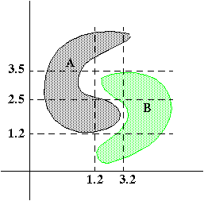
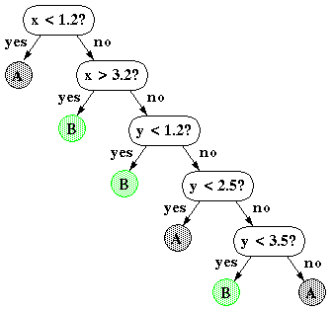
Nonlinear Decision Surfaces
Decision trees can produce nonlinear decision surfaces:
They are an attractive alternative to other classifiers we have studied because they are data-driven and can give arbitrarily high levels of precision on the training data.
But… generalization becomes a challenge.

Slide 5
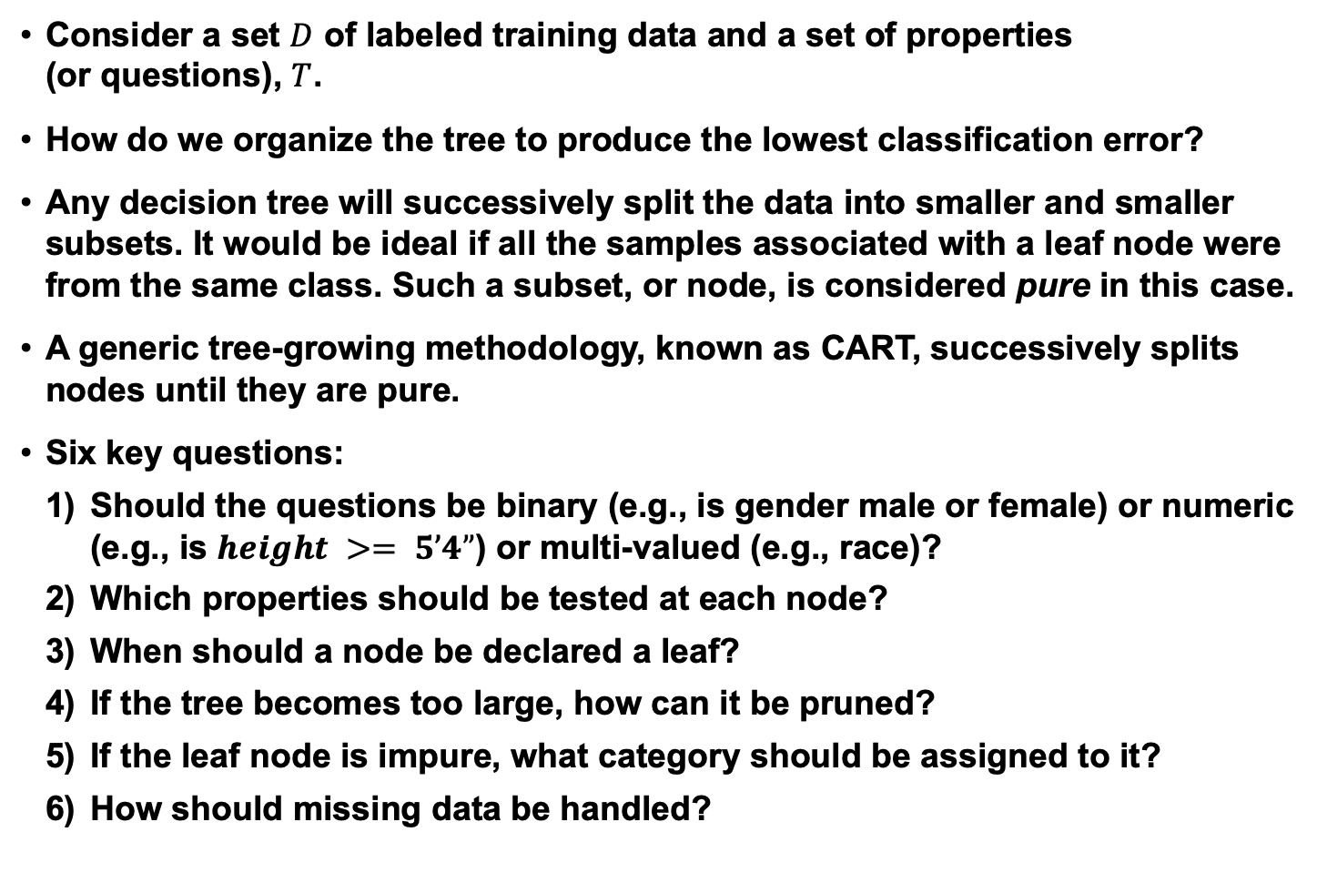
Classification and Regression Trees (CART)
Consider a set $D$ of labeled training data and a set of properties (or questions), $T$.
How do we organize the tree to produce the lowest classification error?
Any decision tree will successively split the data into smaller and smaller subsets. It would be ideal if all the samples associated with a leaf node were from the same class. Such a subset, or node, is considered pure in this case.
A generic tree-growing methodology, known as CART, successively splits nodes until they are pure.
Six key questions:
Should the questions be binary (e.g., is gender male or female) or numeric (e.g., is $height >= 5’4”$) or multi-valued (e.g., race)?
Which properties should be tested at each node?
When should a node be declared a leaf?
If the tree becomes too large, how can it be pruned?
If the leaf node is impure, what category should be assigned to it?
How should missing data be handled?

Slide 6
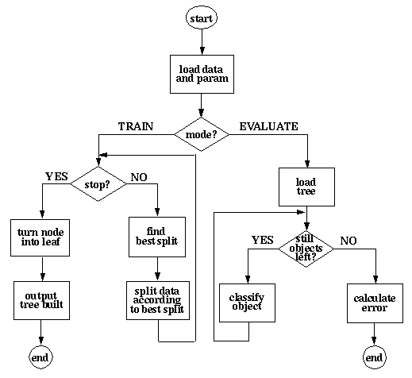
Operation

Slide 7
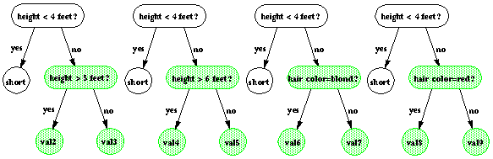
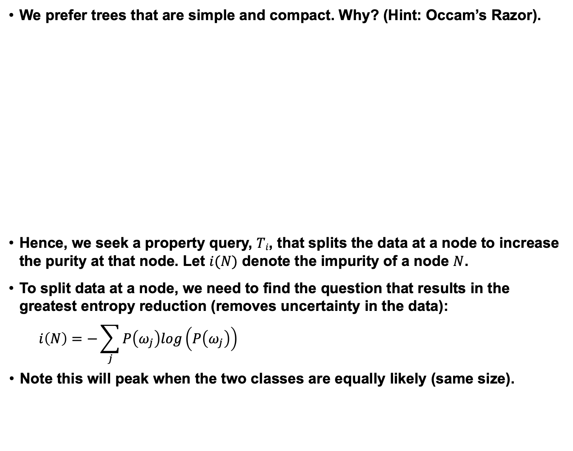
Entropy-Based Splitting Criterion
We prefer trees that are simple and compact. Why? (Hint: Occam’s Razor).
Hence, we seek a property query, $Ti$, that splits the data at a node to increase the purity at that node. Let $i(N)$ denote the impurity of a node $N$.
To split data at a node, we need to find the question that results in the greatest entropy reduction (removes uncertainty in the data):
$$i\left(N\right)=−\sum_{j}{P\left(ω_{j}\right)log\left(P\left(ω_{j}\right)\right)}$$
Note this will peak when the two classes are equally likely (same size).
Notes:
XOR: x_1, x_2, and we want to transform to x_1^2, x_2^2, x_1 x_2
It can also be viewed as feature extraction from the feature vector x, but now we extract more feature than the number of features in x.

Slide 8
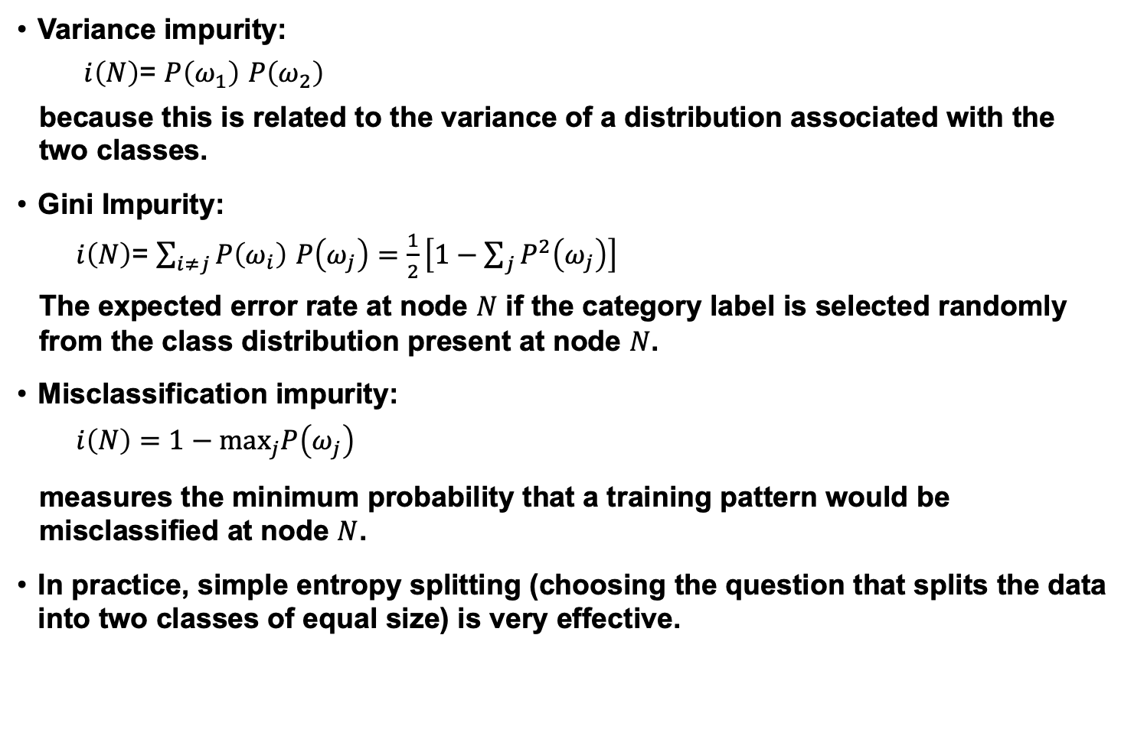
Alternate Splitting Criteria
Variance impurity:
$i\left(N\right)$= $P\left(ω_{1}\right)$ $P\left(ω_{2}\right)$
because this is related to the variance of a distribution associated with the two classes.
Gini Impurity:
$i\left(N\right)$= $\sum_{i≠j}{P\left(ω_{i}\right) P\left(ω_{j}\right)}=\frac{1}{2}\left[1−\sum_{j}{P^{2}\left(ω_{j}\right)}\right]$
The expected error rate at node $N$ if the category label is selected randomly from the class distribution present at node $N$.
Misclassification impurity:
$i\left(N\right)=$ $1−\max_{j}P\left(ω_{j}\right)$
measures the minimum probability that a training pattern would be misclassified at node $N$.
In practice, simple entropy splitting (choosing the question that splits the data into two classes of equal size) is very effective.
Notes:
XOR: x_1, x_2, and we want to transform to x_1^2, x_2^2, x_1 x_2
It can also be viewed as feature extraction from the feature vector x, but now we extract more feature than the number of features in x.

Slide 9
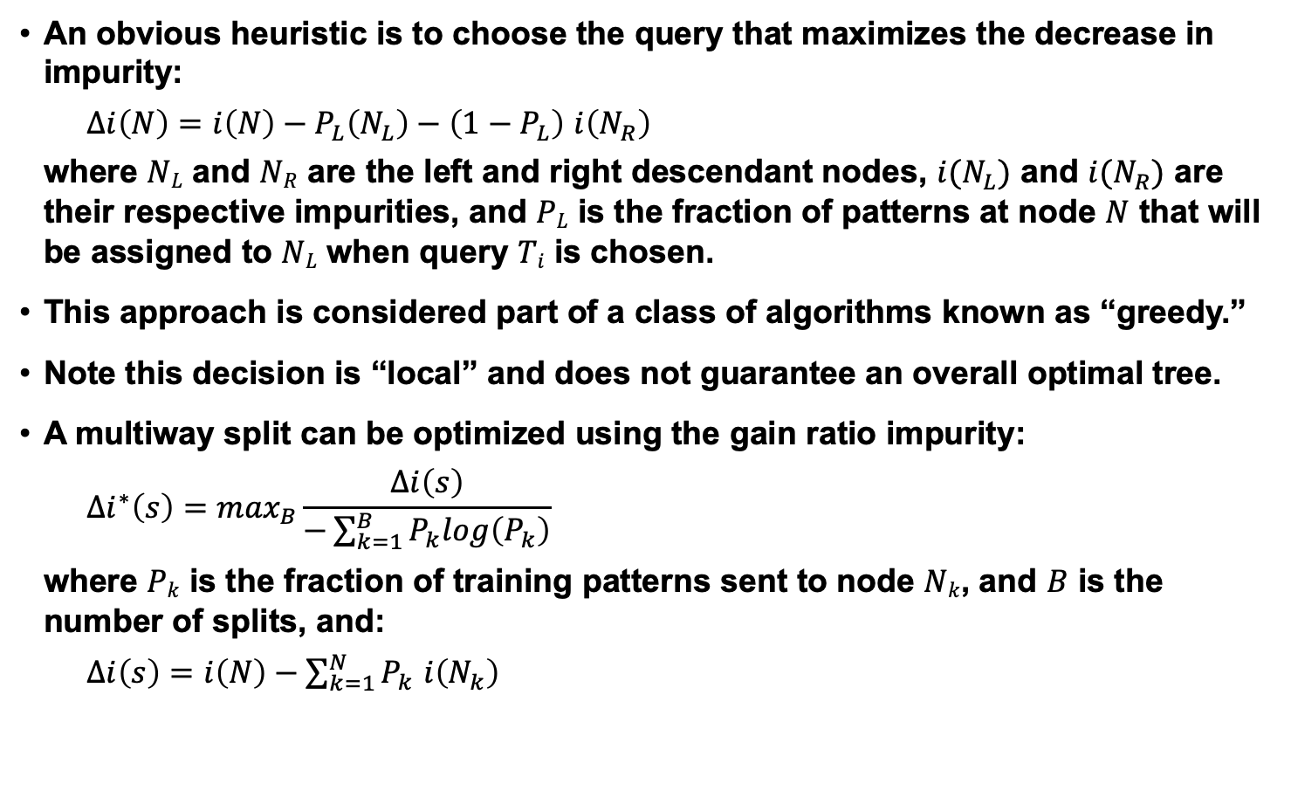
Choosing A Question
An obvious heuristic is to choose the query that maximizes the decrease in impurity:
$∆i\left(N\right)=i\left(N\right)−P_{L}\left(N_{L}\right)−\left(1−P_{L}\right)$ $i\left(N_{R}\right)$
where $NL$ and $NR$ are the left and right descendant nodes, $i(N_{L})$ and $i(N_{R})$ are their respective impurities, and $PL$ is the fraction of patterns at node $N$ that will be assigned to $NL$ when query $Ti$ is chosen.
This approach is considered part of a class of algorithms known as “greedy.”
Note this decision is “local” and does not guarantee an overall optimal tree.
A multiway split can be optimized using the gain ratio impurity:
$$∆i^{∗}\left(s\right)=\max_{B}\frac{∆i\left(s\right)}{−\sum_{k=1}^{B}{P_{k}log\left(P_{k}\right)}}$$
where $Pk$ is the fraction of training patterns sent to node $Nk$, and $B$ is the number of splits, and:
$∆i\left(s\right)=i\left(N\right)−\sum_{k=1}^{N}{P_{k}}$ $i\left(N_{k}\right)$
Notes:
XOR: x_1, x_2, and we want to transform to x_1^2, x_2^2, x_1 x_2
It can also be viewed as feature extraction from the feature vector x, but now we extract more feature than the number of features in x.

Slide 10
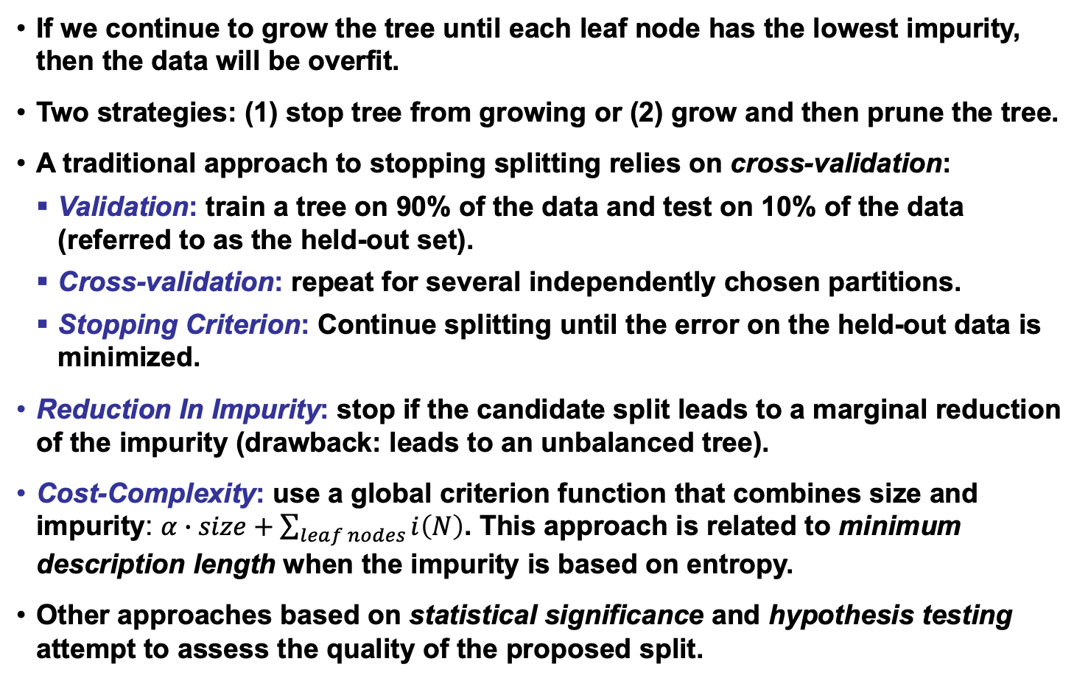
When To Stop Splitting
If we continue to grow the tree until each leaf node has the lowest impurity, then the data will be overfit.
Two strategies: (1) stop tree from growing or (2) grow and then prune the tree.
A traditional approach to stopping splitting relies on cross-validation:
Validation: train a tree on 90% of the data and test on 10% of the data (referred to as the held-out set).
Cross-validation: repeat for several independently chosen partitions.
Stopping Criterion: Continue splitting until the error on the held-out data is minimized.
Reduction In Impurity: stop if the candidate split leads to a marginal reduction of the impurity (drawback: leads to an unbalanced tree).
Cost-Complexity: use a global criterion function that combines size and impurity: $α∙size+\sum_{leaf nodes}{i\left(N\right)}$. This approach is related to minimum description length when the impurity is based on entropy.
Other approaches based on statistical significance and hypothesis testing attempt to assess the quality of the proposed split.
Notes:
XOR: x_1, x_2, and we want to transform to x_1^2, x_2^2, x_1 x_2
It can also be viewed as feature extraction from the feature vector x, but now we extract more feature than the number of features in x.

Slide 11
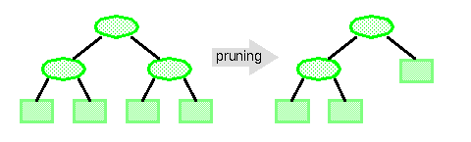

Pruning
The most fundamental problem with decision trees is that they "overfit" the data and hence do not provide good generalization. A solution to this problem is to prune the tree:
But pruning the tree will always increase the error rate on the training set ☹.
Cost-complexity Pruning: $α∙size+\sum_{leaf nodes}{i\left(N\right)}$. Each node in the tree can be classified in terms of its impact on the cost-complexity if it were pruned. Nodes are successively pruned until certain heuristics are satisfied.
By pruning the nodes that are far too specific to the training set, it is hoped the tree will have better generalization. In practice, we use techniques such as cross-validation and held-out training data to better calibrate the generalization properties.
Notes:
XOR: x_1, x_2, and we want to transform to x_1^2, x_2^2, x_1 x_2
It can also be viewed as feature extraction from the feature vector x, but now we extract more feature than the number of features in x.

Slide 12
ID3 and C4.5
Third Interactive Dichotomizer (ID3) uses nominal inputs and allows node-specific number of branches, B_{j}. Growing continues until all nodes as pure.
C4.5, the successor to ID3, is one of the most popular decision tree methods:
Handles real-valued variables;
Allows multiway splits for nominal data;
Splitting based on maximization of the information gain ratio while preserving better than average information gain;
Stopping based on node purity;
Pruning based on confidence/average node error rate (pessimistic pruning).
Bayesian methods and other common modeling techniques have been successfully applied to decision trees.

Slide 13
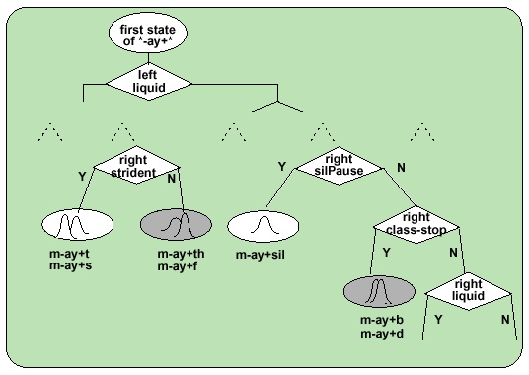
Example Application: Parameter Tying
Decision trees are popular for many reasons including their ability to achieve high performance on closed-set evaluations.
They can be closely integrated with hidden Markov models to provide a very powerful methodology for clustering and reducing complexity.
Consider the problem in speech recognition of context-dependent phonetic modeling, which can potentially involve ten thousand acoustic models.
On what basis should we cluster or reduce the number of acoustic models?
The questions can be drawn from linguistics (e.g., vowel, consonant, sibilant).
The tree growing process is intimately integrated into the Baum-Welch training process using the same likelihood calculations available during HMM parameter training.

Slide 14
Summary
A classification and regression tree (CART) algorithm can be summarized as follows:
Create a set of questions that consists of all possible questions about the measured variables (phonetic context).
Select a splitting criterion (likelihood).
Initialization: create a tree with one node containing all the training data.
Splitting: find the best question for splitting each terminal node. Split the one terminal node that results in the greatest increase in the likelihood.
Stopping: if each leaf node contains data samples from the same class, or some pre-set threshold is not satisfied, stop. Otherwise, continue splitting.
Pruning: use an independent test set or cross-validation to prune the tree.
There are ways to estimate and incorporate priors into the decision tree (though these methods somewhat predate Bayesian methods).
Decision trees can be used in many ways and closely integrated with other pattern recognition algorithms (e.g., hidden Markov models).
They can be used to control complexity in a system by supporting decisions about parameter tying.
Computational complexity is very low for both evaluation and training.

Slide 15
Random Forest
Predrag Radenković 3237/10
Faculty of Electrical Engineering
University Of Belgrade

Slide 16
Definition
Random forest (or random forests) is an ensemble classifier that consists of many decision trees and outputs the class that is the mode of the class's output by individual trees.
The term came from random decision forests that was first proposed by Tin Kam Ho of Bell Labs in 1995.
The method combines Breiman's "bagging" idea and the random selection of features.

Slide 17
Decision trees
Decision trees are individual learners that are combined. They are one of the most popular learning methods commonly used for data exploration.
One type of decision tree is called CART… classification and regression tree.
CART … greedy, top-down binary, recursive partitioning, that divides feature space into sets of disjoint rectangular regions.
Regions should be pure wrt response variable
Simple model is fit in each region – majority vote for classification, constant value for regression.

Slide 18
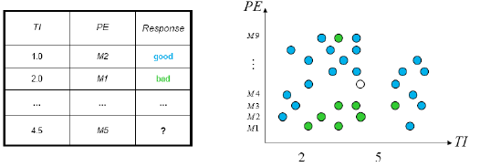
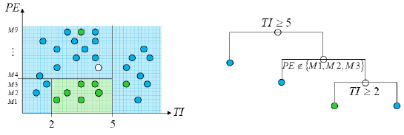
Decision tress involve greedy, recursive partitioning.
Simple dataset with two predictors
Greedy, recursive partitioning along TI and PE

Slide 19
Algorithm
Each tree is constructed using the following algorithm:
Let the number of training cases be N, and the number of variables in the classifier be M.
We are told the number m of input variables to be used to determine the decision at a node of the tree; m should be much less than M.
Choose a training set for this tree by choosing n times with replacement from all N available training cases (i.e. take a bootstrap sample). Use the rest of the cases to estimate the error of the tree, by predicting their classes.
For each node of the tree, randomly choose m variables on which to base the decision at that node. Calculate the best split based on these m variables in the training set.
Each tree is fully grown and not pruned (as may be done in constructing a normal tree classifier).
For prediction a new sample is pushed down the tree. It is assigned the label of the training sample in the terminal node it ends up in. This procedure is iterated over all trees in the ensemble, and the average vote of all trees is reported as random forest prediction.

Slide 20
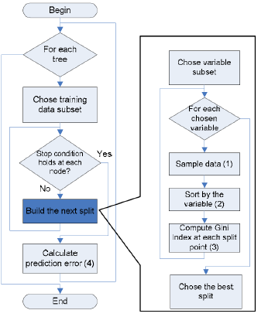
Algorithm flow chart
For computer scientists:

Slide 21
Random Forest – practical consideration
Splits are chosen according to a purity measure:
E.g. squared error (regression), Gini index or devinace (classification)
How to select N?
Build trees until the error no longer decreases
How to select M?
Try to recommend defaults, half of them and twice of them and pick the best.

Slide 22
Features and Advantages
The advantages of random forest are:
It is one of the most accurate learning algorithms available. For many data sets, it produces a highly accurate classifier.
It runs efficiently on large databases.
It can handle thousands of input variables without variable deletion.
It gives estimates of what variables are important in the classification.
It generates an internal unbiased estimate of the generalization error as the forest building progresses.
It has an effective method for estimating missing data and maintains accuracy when a large proportion of the data are missing.

Slide 23
Features and Advantages
It has methods for balancing error in class population unbalanced data sets.
Generated forests can be saved for future use on other data.
Prototypes are computed that give information about the relation between the variables and the classification.
It computes proximities between pairs of cases that can be used in clustering, locating outliers, or (by scaling) give interesting views of the data.
The capabilities of the above can be extended to unlabeled data, leading to unsupervised clustering, data views and outlier detection.
It offers an experimental method for detecting variable interactions.

Slide 24
Disadvantages
Random forests have been observed to overfit for some datasets with noisy classification/regression tasks.
For data including categorical variables with different number of levels, random forests are biased in favor of those attributes with more levels. Therefore, the variable importance scores from random forest are not reliable for this type of data.

Slide 25
RM - Additional information
Estimating the test error:
While growing forest, estimate test error from training samples
For each tree grown, 33-36% of samples are not selected in bootstrap, called out of bootstrap (OOB) samples
Using OOB samples as input to the corresponding tree, predictions are made as if they were novel test samples
Through book-keeping, majority vote (classification), average (regression) is computed for all OOB samples from all trees.
Such estimated test error is very accurate in practice, with reasonable N

Slide 26
RM - Additional information
Estimating the importance of each predictor:
Denote by ê the OOB estimate of the loss when using original training set, D.
For each predictor xp where p∈{1,..,k}
Randomly permute pth predictor to generate a new set of samples D' ={(y1,x'1),…,(yN,x'N)}
Compute OOB estimate êk of prediction error with the new samples
A measure of importance of predictor xp is êk – ê, the increase in error due to random perturbation of pth predictor

Slide 27
Conclusions & summary:
Fast fast fast!
RF is fast to build. Even faster to predict!
Practically speaking, not requiring cross-validation alone for model selection significantly speeds training by 10x-100x or more.
Fully parallelizable … to go even faster!
Automatic predictor selection from large number of candidates
Resistance to over training
Ability to handle data without preprocessing
data does not need to be rescaled, transformed, or modified
resistant to outliers
automatic handling of missing values
Cluster identification can be used to generate tree-based clusters through sample proximity

Slide 28
Thank you!

Slide 29
RANDOM FORESTS
PRESENTER: MITHUN ALVA

Slide 30
AGENDA
Definition
Origin of Random Forests
The Algorithm
Advantages, Shortcomings and Applications of Random Forests
An example of using Random Forests (using R)
Readings/ References for further review

Slide 31
DEFINITION
Random Forests are an ensemble learning method for classification & regression
Ensemble methods are made up of multiple learning algorithms, which collectively provide better prediction as compared to any single one of them.
They are made up of multiple decision trees
The output is
the mode of the predicted classes ( in case of classification), and
the mean of the prediction value ( in case of regression) provided by the individual trees.

Slide 32
ORIGIN OF RANDOM FORESTS
Algorithm developed by Leo Breiman and Adele Cutler.
Leo Breiman
January 27, 1928 – July 5, 2005
Professor Emeritus of Statistics at University of California, Berkeley.
Adele Cutler is his long-time collaborator and former Ph.D student.
“Random Forests” is their trademark.

Slide 33
ORIGIN OF RANDOM FORESTS
Decision Tree Models
Involve segmenting the predictor space into a number of simple regions.
Since the rules to segment the space can be summarized in a tree, these models are called “Decision Tree” models.
Can be applied to both ‘classification’ and ‘regression’ problems.

Slide 34
ORIGIN OF RANDOM FORESTS
Decision Tree Models: An Example
Predicting the ‘Choice’ (of car model) chosen based on:
Expense: Expense tolerance of the subject
Gender : Gender of the subject
PreviousOwnership: Number of cars previously owned by subject
Sample training dataset
Gender | Previous Ownership | Expense | Choice
Male | 0 | Less | Yaris
Male | 1 | Less | Yaris
Female | 0 | Less | Yaris
Male | 1 | Less | Yaris
Female | 1 | More | Tundra
Male | 2 | More | Tundra
Female | 2 | More | Tundra
Female | 1 | Less | Prius
Male | 0 | Average | Prius
Female | 1 | Average | Prius

Slide 35
ORIGIN OF RANDOM FORESTS
Process of building the tree
Link in ‘References’ section: Step-by-Step Decision Tree building
Key concept: Gini Index
Gini Index is a measure of node purity.
Calculated as Σ P_{j} * (1- Pj),
where Pj represents the proportion of observations in the “j^{th}” class
For our dataset, P_{j} values are:
And, the Gini Index is (0.4)*(0.6)+(0.3)*(0.7)+(0.3)*(0.7) = 0.66
Final tree:
Use Gini Index to calculate ‘Information Gain’ for each variable.
The variable providing the best ‘Information Gain’ is plotted on the tree. Repeat till a full tree is generated.
P(Yaris) | 0.4
P(Tundra) | 0.3
P(Prius) | 0.3

Slide 37
ORIGIN OF RANDOM FORESTS
Advantages of Decision Tree Models
Easy to interpret and explain
Implicitly perform variable screening
Variables associated with top few nodes are the most important
Require relatively less data preparation effort
Can handle a mix of categorical and continuous variables
Can handle missing values
Not sensitive to outliers
Scaling of parameters ( e.g. revenue in millions and loan age in years in the same dataset) is not necessary.
Can handle non-linear relationships.

Slide 38
ORIGIN OF RANDOM FORESTS
Shortcomings of Decision Tree Models
High Variance: If we split the training data into two parts at random and fit a decision tree to both halves, we could get very different trees.
Tend to favor categorical predictors with many levels. Variables with a large number of levels can cause severe overfitting.
‘Bagging’ attempts to address the above shortcomings.

Slide 39
ORIGIN OF RANDOM FORESTS
Bagging (also known as ‘bootstrap aggregation’)
From your full dataset, take a sample , generate a tree and obtain predictions.
Repeat with a different sample, from the same dataset. The new tree will typically make different predictions.
Continue sampling and generating trees in this manner till about 500 trees are obtained.
This process is called “Bagging”.

Slide 40
ORIGIN OF RANDOM FORESTS
‘Out of Bag’ (OOB) Data
If we sample from available data and build a tree, we already have holdout data available for that tree. This data is referred to as “Out of Bag” data.
Every tree grown has a different holdout sample
Every record in the full dataset is “in bag” for some trees(about 2/3rd) and “out of bag” for the other trees.

Slide 41
ORIGIN OF RANDOM FORESTS
‘Out of Bag’ (OOB) Data
Suppose a given record was “in bag” for 375 trees and “out of bag” for the remaining 125 trees.
Predictions for this record could be generated using just the “out of bag” trees.
Always having OOB data means we can effectively work with relatively small datasets.

Slide 42
ORIGIN OF RANDOM FORESTS
5 1 1 4 1
Bagging
The sampling method here is bootstrap sampling
Each time the # of observations in the sample = # of observations in the training data
However, sampling is done with replacement.
Therefore all observations will not be present in the chosen sample
Example: if the training data is {1,2,3,4,5}
Sample 1 could be {5,1,1,4,1}
Sample 2 could be {2,1,5,3,3}
Sample 3 could be {1,2,3,2,5}
…and so on

Slide 43
ORIGIN OF RANDOM FORESTS
Bagging & Predictor subset-ing
Trees in the Bagger were found to be too similar to each other
To address this, Breiman introduced randomness into the actual tree growing as well
Normally, all possible predictors are evaluated for their ability to form a node in the tree and partition the data in the best possible manner.
Instead, every time we are forming a node, a subset of the predictors is considered.
From among these predictors, the one providing the best partitioning is used to form the node.
A new random subset of predictors is chosen to build each node.
‘Random Forests’ combines the concepts of decision trees, bagging and predictor subset-ing.

Slide 44
ORIGIN OF RANDOM FORESTS
Breiman and Cutler suggested using one of the following rules to form the subset of predictors.
Predictors(N) | sqrt(N) | 0.5*sqrt(N) | 2*sqrt(N) | Log₂(N)
100 | 10 | 5 | 20 | 7
1,000 | 31 | 15.5 | 62 | 10
10,000 | 100 | 50 | 200 | 13
100,000 | 316 | 158 | 632 | 17
1,000,000 | 1000 | 500 | 2000 | 20

Slide 45
ALGORITHM

Slide 46
ADVANTAGES OF RANDOM FORESTS
Automatic identification of important predictors
Good for wide data; provide good accuracy and generate reliable predictor importance rankings.
Resistant to over training.
Each decision tree is independent. Therefore trees can be grown on different cores or different computers, allowing for quicker analysis.

Slide 47
SHORTCOMINGS OF RANDOM FORESTS
Suited for wide datasets with only a moderate number of rows. Breiman recommends the use of other tools for larger datasets.
Large memory needed to store built models.
Overfitting might be seen with noisy data.

Slide 48
APPLICATIONS OF RANDOM FORESTS
Online targeted marketing
Credit card fraud detection
Text analytics
Credit risk and insurance risk
Retail Sales prediction
Biological & Medical Research
Manufacturing Quality Control

Slide 49
EXAMPLE
R packages used in example
randomForest: Breiman and Cutler's random forests for classification and regression.
rpart: Recursive partitioning for classification, regression and survival trees. An implementation of most of the functionality of the 1984 book by Breiman, Friedman, Olshen and Stone.
caret: Miscellaneous functions for training and plotting classification and regression models.

Slide 50
EXAMPLE
Titanic dataset https://www.kaggle.com/c/titanic
Predictors :
pclass Passenger Class (1 = 1st; 2 = 2nd; 3 = 3rd)
name Name
sex Sex (“female”, “male”)
age Age ( in years)
sibsp Number of Siblings/Spouses Aboard
parch Number of Parents/Children Aboard
ticket Ticket Number
fare Passenger Fare
cabin Cabin
embarked Port of Embarkation(C = Cherbourg; Q = Queenstown;
S = Southampton)

Slide 51
EXAMPLE
Titanic dataset
Response :
survived 0 = No; 1 = Yes
Ask:
“predict which passengers survived the tragedy”

Slide 52
EXAMPLE
Additional features created:
Title:
Isolating ‘Titles” (i.e Col, Dr, Lady, Master, Miss, etc…) from the ‘Name’ field.
converting them into “Mlle”, “Sir” or “Lady”
FamilyID
Large families might have had trouble getting to lifeboats together
SibSp+Parch+1 will give Family Size
Last Name like “Johnson” is common.
Join with Last Name with count to uniquely identify Family Name & Size.

Slide 53
EXAMPLE
Data Preparation:
‘randomForest’ package in R cannot handle missing values
‘Age’ has 263 missing values
Could be replaced by mean/median of all other non-missing values
Another way is to use a decision tree & do a prediction on missing values
tree is build using the ‘rpart’ package
‘Embarked’ has missing values in two rows
Replace them with ‘S’.
Nearly 70 % of the population embarked at Southampton
‘Fare’ had 1 missing value
Replace with median of non-missing fare values

Slide 54
EXAMPLE
Data Preparation:
Random Forests in R can only digest factors with up to 32 levels
FamilyID has a larger number of levels
Create a new feature called FamilyID2
Equal to “Small” if FamilySize < =3, and FamilyID otherwise

Slide 55
EXAMPLE
Install the ‘randomForest’ package in R
Install.packages (‘randomForest’)
To obtain same results every time you run the code, use ‘set.seed’
Syntax: fit=
randomForest(as.factor(Survived) ~ Pclass + Sex + Age + SibSp + Parch + Fare + Embarked + Title + FamilySize +FamilyID2,
data=train,
importance=TRUE, # enables inspection of variable importance
ntree=2000) # number of tree to grow. Default is 500

Slide 56
EXAMPLE
Inspect variable importance plots
varImpPlot(fit)
Will tell us which variables have the highest impact on the predictive ability of the model
Variable associated with the most decrease of the appropriate measure has the highest impact.

Slide 57
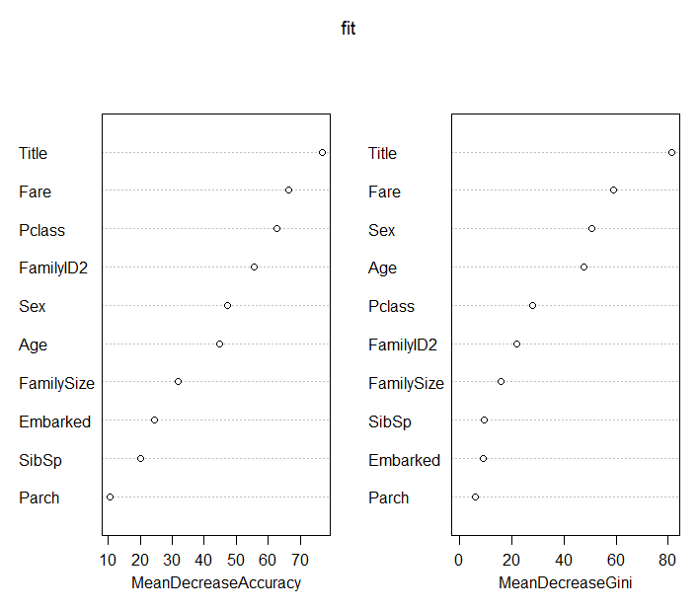
EXAMPLE
‘Title’ has the strongest impact, in terms of both Accuracy and Gini Index
Added features ‘FamilyID2’ and ‘FamilySize’ have substantial impact

Slide 58
EXAMPLE
Additional parameters for model
randomForest(as.factor(Survived) ~
Pclass+Sex +Age + SibSp +Parch + Fare + Embarked +Title + FamilySize +FamilyID2,
data=train,
importance=TRUE, # enables inspection of variable importance
ntree= , # number of tree to grow. Default is 500
mtry= , #number of variables selected at each node.
#Default is square root of the number of variables
nodesize= , #minimum size of terminal nodes. Setting this to the value ‘k’ #means that no node with fewer than k cases will be split.
#Default =1 for classification and 5 for regression
………..)

Slide 59
EXAMPLE
Performance Evaluation
Confusion Matrix
Accuracy = (491 + 250)/(549+342) = 0.8316
95% CI : (0.8054, 0.8557)
 | Predicted
Actual | 0 | 1
0 | 491 | 92
1 | 58 | 250
 | 549 | 342

Slide 60
EXAMPLE
Tuning the Random Forests model
Objective is to find the best value of mtry (i.e. number of predictors chosen at each node)
tunefit= train(as.factor(Survived)~ .,
data=train1,
method="rf", # ‘rf’ stands for random forest
metric="Accuracy", # what are we trying to improve
tuneGrid=data.frame(mtry=c(2,3,4))) # set of values to be considered

Slide 61
EXAMPLE
Tuning the Random Forests model
Objective is to find the best value of mtry (i.e. number of features chosen at each node)
mtry Accuracy
2 0.8236414
3 0.8310338
4 0.8302738

Slide 62
EXAMPLE
Apply model to test data
Prediction = predict (tunefit, newdata =test)
Will give you predictions for ‘Survival’. ‘0’ and ‘1’ values

Slide 63
REFERENCES
Leo Breiman's Random Forests Page
An Introduction to Random Forest for Beginners: Salford Systems
Random Forests Lecture by Nando Freitas, University of British Columbia
Random Forests Lecture by Derek Kane
The Elements of Statistical Learning: Hastie, Tibshirani & Friedman
Introduction to Statistical Learning: James, Witten, Hastie and Tibshirani
Trevor Stephens: Titanic Dataset Analysis using R
Curt Wehrley: Titanic Dataset Analysis using R
randomForest package in R
rpart package in R
caret package in R
Step-by-Step Decision Tree building
Machine Learning Benchmarks and Random Forest Regression, Mark Segal

