Slide 1

Membership
Peihsi Chen, Yookyung Jo
Some of the slides borrowed from Prof. Gupta’s slides

Slide 2
Membership protocol
X
pi
Asynchronous
Lossy Network
pj
Notes:
Find out : who other members are?
Used as a middleware service

Slide 3
Membership protocol
In dynamic distributed system, a node needs knowledge of the states(alive/failed) of other nodes
Membership protocol
  Failure detection protocol :
    Complete knowledge of who is faulty/non-faulty
  Protocols with different requirements :
    Ransub : partial set of alive nodes

Slide 4

How is it useful?

Slide 5
How is it useful?
Application scenarios for Membership protocol
Adaptive overlays
  Probing peers for best connection
Epidemic algorithms
Content Distribution Networks
Peer to Peer system
Parallel downloads
Trading floor of NewYork Stock Exchange Market

Slide 6
Basic protocols
Centralized : hot-spot
Ring-based : unpredictable in multiple failures
All-to-All : scalability issue

Slide 7
Centralized Heartbeating
☹ Hotspot
pi
…
pj

Slide 8
Ring Heartbeating
☹ Unpredictable on
simultaneous multiple failures
pi
pj
…
…

Slide 9
All-to-All Heartbeating
Unscalable : network load
O(N^2)
pi
…
pj

Slide 10
Evaluation metric
Correctness properties
Completeness
Accuracy
Speed
  First detection time
  Dissemination time
Scalability
  Load : network load, per node overhead
  How above metrics perform with N
Resilience
  Guarantee of properties in large failures
Notes:
Different membership protocol

Slide 11
Completeness & Accuracy
Completeness
  The failure of a node eventually detected by every other non-faulty node
Accuracy
  No mistake in detection : no alive(non-faulty) node detected as failed

Slide 12
Completeness & Accuracy
?
Accuracy?
?
Completeness?
Impossibility result (asynchronous, lossy network)
  Completeness : declare all as failed
  Accuracy : declare all as alive

Slide 13
Completeness & Accuracy
In practice :
  Completeness : guaranteed
  Accuracy : probabilistic guarantee
Notes:
Completeness : declare all nodes failed, accuracy : declare all nodes alive

Slide 14
Speed
Failure
First detection
Detection by all nodes
Time axis
Detection time = First detection time + Dissemination time

Slide 15
Gossip-style
failure detection service
Robbert van Renesse, Yaron Minsky, and Mark Hayden

Slide 16
What it delivers
Scalable failure detection
  Detection time : O(NlogN)
  Network load : O(N), Per node : O(1)
Detects all faulty nodes within some mistake bound (Pmistake) (low-drift)
Resilient to message loss, number of failed nodes

Slide 17
System assumption
  Accuracy : practical definition
    Faulty node : actual failure, very slow, network lossy
  No bound on message delivery
    Most messages delivered in reasonable time (Parrival)
  Failure model
    fail-stop (no byzantine, no lie)
  Low-drift

Slide 18
Basic protocol
Each member maintains a list (O(N)) of < Mi, Hi, Tlast,Mi >
  Mi : member address, Hi : heartbeat count, Tlast,Mi : last time of heartbeat increase
Every Tgossip, each member
  Increments its heartbeat
  Select a random member and send a list of <Mi, Hi>
A member, upon receiving gossip message,
  Merge the list (maximum heartbeat)
If TlastMi + Tfail < t,
  member Mi is considered failed
  But remember Mi for Tcleanup (~ 2*Tfail), to prevent resurrection
Tfail(Pmistake, Parrival, f)

Slide 19
Basic protocol
At t=104
Tfail = 10
Tcleanup = 20
H2++
M2
H1++
H3++
Mi, Hi, Tlast_i
M2, 7, 100
M4, 5, 97
M7, 4, 93
M1
M3
N-f
M2,6
M4,8
…
H4++
M4
H5++
H6++
M5
M6
Mi, Hi, Tlast_i
M2, 7, 100
M4, 8, 104
M7,X,93
M7

Slide 20
Basic protocol
Tfail(Pmistake, Parrival, f)
Tfail : speed of detection (initial detection+dissemination)
1-Pmistake : accuracy
Parrival : lossyness of network
f : # of failed members

Slide 21
Analysis(1)
Assumption
  Each round : one member gossips
  All f initially fail

Slide 22
Analysis(2)

Slide 23
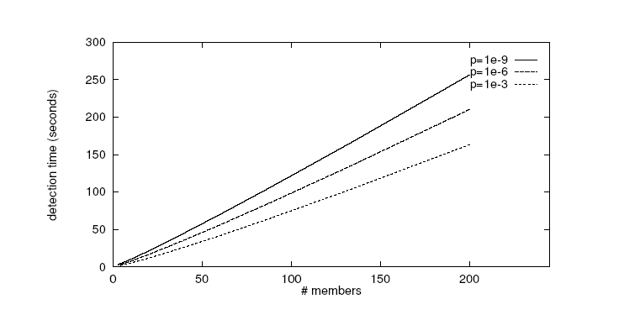
Analysis(3)
Notes:
Maybe more graphs?

Slide 24
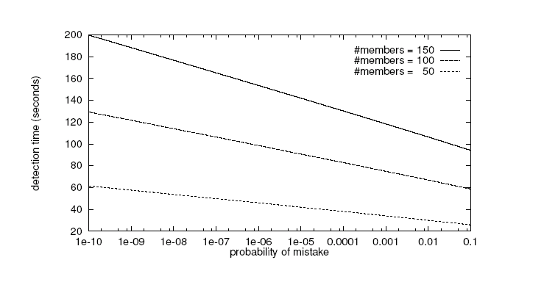
Analysis(4)

Slide 25
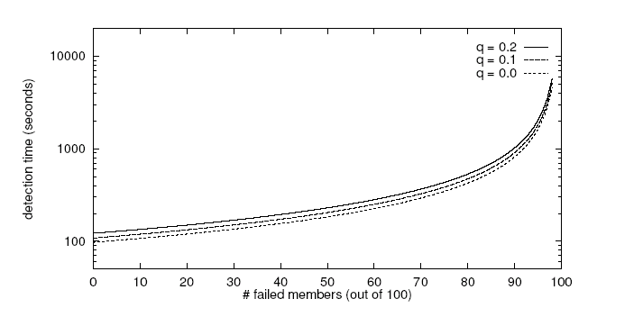
Analysis(5)

Slide 26
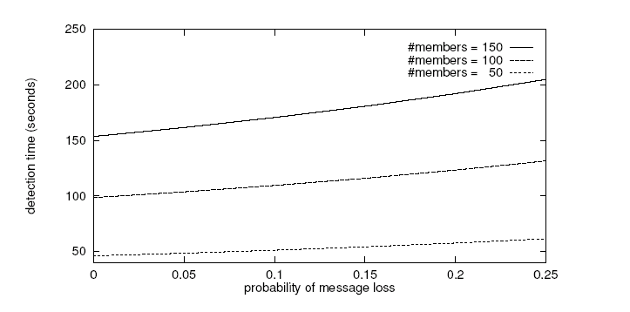
Analysis(6)

Slide 27
Problem with flat protocol
Bottleneck : cross-subnet link
Network partition : membership service not functioning
Notes:
Bottleneck, network partition

Slide 28
Hierarchical protocol(1)
3 parallel protocols
  Intra-subnet : normal gossip protocol
  Inter-subnet : 1 gossip per period(1/m probability)
  Inter-domain : 1 gossip per period(1/(m*n) probability)
As a result :
  + Reduction of bandwidth at bottleneck
  + Accelerated failure detection at intra-subnet
  + Resilient to network partition
  Slower detection across subnets and domains

Slide 29
Hierarchical protocol(2)

Slide 30
Catastrophe recovery
Broadcast
  In case of large # of crashes or partition
  A new node join
Broadcast probability
  (t/20)^a
  To meet expected frequency of broadcast

Slide 31
Summary (in the perspective of evaluation metric)
Completeness | Eventual detection Expected detection time with known mistake
Accuracy | Bypassed (practical notion of failure)
Speed | Detection time : O(NlogN)
Scalability | Detection time : O(NlogN) Network load : O(N) Per node overhead : O(1)
Resilience | Basic : resilient to message loss, # of failures Hierarchical, broadcast : resilient to network partition, large # of failures

Slide 32
Using Random Subsets to Build Scalable Network Services
Dejan Kostic, Adolfo Rodriguez, Jeannie Albrecht, Abhijeet Bhirud, and Amin Vahdat

Slide 33
New problem definition
?

Slide 34
New problem definition
Is it really necessary to provide a complete knowledge(O(N)) of who is faulty/non-faulty?
Could it be an overkill (to certain application scenario)?

Slide 35
Back to App. scenario
Epidemic protocols : k(=2) contacts
M1,M6
M2
M1
M3,M7
M5
M4
M3
M8
M7
M6
<M1, M3, M4, M5, M6, M7> : necessary?
<Mi, Mj> : sufficient? Faster? Fresher?

Slide 36
Back to App. Scenarios
Adaptive overlays
  Probing peers for best connection
Epidemic algorithms
Content Distribution Networks
Peer to Peer system : O(log N)
Parallel downloads

Slide 37
Service definition
To deliver each node a subset of alive nodes
  Random
  Uniform : representation of all nodes over time

Slide 38
RanSub
Distribute phase
A
Collect phase
Tree overlay
Each epoch
  Distribute (↓)
    Random subset of all nodes
  Collect (↑)
    Random subset of subtree
CSC={F,G}
DSC={B,G,D}
B
C
D
E
F
G
H
DSD ={A,C,F}
CSE={E}
CSG={G}

Slide 39
Ransub (RanSub-all)
DS’P
Random subset of all nodes
Invariants
  DS’z : random subset of all nodes except its subtree
DS’Z
P
Z

Slide 40
Ransub (Ransub-nondescendants)
Random subset of all nodes except the subtree
Loop prevention
DSA
DSX
A
X

Slide 41
RanSub (RanSub-ordered)
DSA
Order
  node -> left subtree -> right subtree
Ordered random subset (nodes before it)
Loop prevention
1
DSX
2
5
A
6
3
X
4

Slide 42
SARO
Scalable Adaptive Randomized Overlay
Tree topology multicast overlay
Goal
  Achieve optimal delay, satisfying bandwidth bound
Properties
  Scalable
    Tracking, probing per node : O(log N)
    No global locking
  Degree-bound
  Adaptive, self-organizing

Slide 43
SARO (basic protocol)
A
B
D
E
H
C
F
{B,C}
F
G

Slide 44
SARO (Adativity)
Parent failure
Children failure
A
B
E
D
F
G
H
C
H
{A,B}
E
F
G
Notes:
Do the weaning!

Slide 45
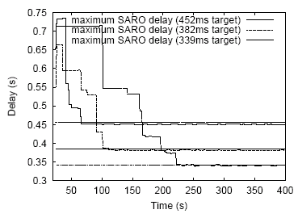
Experiments
SARO Overlay Convergence
-- The figure plots the achieved worst-case delay relative to the delay target as a function of time progressing on the x axis.
-- The tighter the delay target is, the more time the convergence takes.

Slide 46
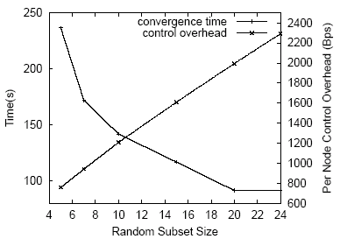
Experiments
Effects of Random Subset Size
-- More information in the random subset decreases the convergence time, but at the cost of increased network probing overhead

Slide 47
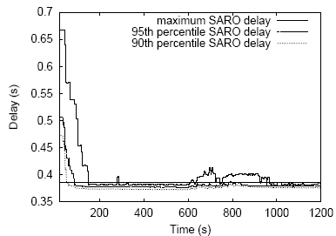
Experiments
Adaptivity
-- the perturbation lasts during t =600 ~ 800.
-- SARO typically quickly recovers from changes to network conditions if the perturbation is not too severe.
Every 25s, increase the propagation delay of some links chosen randomly
Converge again

Slide 48
Summary (in the perspective of evaluation metric)
Completeness | Different notion : eventual detection (failed node will disapper from random sets)
Accuracy | Not applicable
Speed | Different notion : Delivery time = 1 epoch ( >= O(logN=tree height) )
Scalability | Message overhead/epoch With SARO : (depends on random set size=logN) Messages : (Collect,Distribute) + Probing Per node overhead per epoch : O(logN), Network load : NlogN No global locking
Resilience | RanSub : Uniformity suffers with dynamic node condition No guarantee on aliveness SARO : measures to adapt network condition, node failure

Slide 49
Critique & Comments
  In real world deployment, basic protocols are used
    NYSE : all-to-all heartbeat
    IBM SP2 : Ring-based
    Chord, Pastry : small # of neighbors
  How to deploy distributed, probabilistic protocols in real world? What is required? Any good App. Scenario?
  RanSub
    In-degree randomness. What about out-degree randomness? If not-random, what happens to failure recovery?
    Not much experiment on the resilience of RanSub. Multiple failures?

Slide 50
SWIM: Scalable Weakly-consistent Infection-style Process Group Membership Protocol
Abhinandan Das, Indranil Gupta, Ashish Motivala

Slide 51
Why SWIM?
Traditional heart-beating protocols
  Scalability problem
SWIM
  Use a non heartbeat-based Failure Detection component.
  separate the failure detection component and membership update dissemination component.
  Achieve scalability in a large group.
  Reduce false positive frequency.

Slide 52
SWIM in action
II
Failure Detector
Some process
finds out quickly
I pj crashed
III
Dissemination
Unreliable Communication
Network

Slide 53
The Basic SWIM Approach
Two components:
  A Failure Detector Component
  A Dissemination Component

Slide 54
SWIM Failure Detector
Mi
Mj
random Mj
ping
K random
processes
X
ack
random K
ping-req
X
Protocol period
= T’ time units
ping
ack
ack

Slide 55


SWIM Failure Detector
First Detection Time
  at most
  Tune T’ to get application-specified expected detection time.
  independent of group size
False Positive Rate
  Within T’, False positive Rate =
  Tunable by adjusting k
Completeness
  a faulty member will eventually be detected by every non-faulty node
Process Load
  Constant, independent of group size
  Symmetrical across all members.
q_{f}: the fraction of non-faulty node
q_{ml}: the prob. Of timely delivery of a packet.

Slide 56
The Basic SWIM Approach
Two components:
  A Failure Detector Component
  A Dissemination Component

Slide 57
The Basic SWIM Approach
Two components:
  A Failure Detector Component
  A Dissemination Component
    Upon detecting the failure of another group member, multicasts failed(M_{j}) msg to the rest of the group

Slide 58
A more Robust and Efficient SWIM
Infection-Style Dissemination Component
Suspicion Mechanism
Round-Robin Probe Target Selection

Slide 59
A more Robust and Efficient SWIM
Infection-Style Dissemination Component
Suspicion Mechanism
Round-Robin Probe Target Selection

Slide 60
Infection-Style Dissemination Component
multicast
  Only best-effort
Infection-style Dissemination
  Piggyback on failure detector messages
  No extra packets for dissemination
  This epidemic process spreads exponentially fast in the group

Slide 61
A more Robust and Efficient SWIM
Infection-Style Dissemination Component
Suspicion Mechanism
Round-Robin Probe Target Selection

Slide 62
Suspicion Mechanism
Goal
  Reducing the frequency of false positive
False detection, due to
  Network packet losses
  Slow process
Key:
  Avoid to drop a healthy process at the very first instance that it is mistakenly detected as failed.
  suspect a process before declaring it as failed in the group

Slide 63
Suspicion Mechanism
M_{i} pings M_{j}, if M_{i} receives no ack either directly or through indirect probing subgroup
M_{i} does not declare M_{j} as failed.
M_{i} marks M_{j} as a suspected member
  {suspect M_{j}: M_{i} suspects M_{j}} msg is disseminated
If later on, M_{l} successfully pings M_{j}
  {Alive M_{j}:M_{l} knows M_{j} is alive} un-marks suspicion
If M_{h} times-out M_{j}’s suspicion before receipt of an Alive msg
  {Confirm M_{j}: M_{h} declares M_{j} as faulty} will be disseminated
  Confirm msg overrides any previous Suspect or Alive msg.

Slide 64
Suspicion Mechanism
Suspicion Time-out
  tradeoff the rate of false failure detection to detection time.

Slide 65
A more Robust and Efficient SWIM
Infection-Style Dissemination Component
Suspicion Mechanism
Round-Robin Probe Target Selection

Slide 66
Round-Robin Probe Target Selection
In the basic SWIM
  Eventual Strong completeness.
  However, the detection time could be unbounded.
Goal: providing time-bounded strong completeness
Modification
  Select ping target in a round-robin fashion.
  After each traversal, randomly reorder the list.
  Each failure is detected in worst case 2N-1 (local) protocol periods

Slide 67
Performance Evaluation
Current implementation
  Win2K, uses Winsock 2
  Uses only UDP messaging
Experimental platform
  Galaxy cluster: diverse collection of commodity PCs
  100 Mbps Ethernet
Default protocol settings
  Protocol period=2 s
  K=1
  Each infection was piggybacked on at most 3*ceil[log(N+1)] msg
  Suspicion timeouts = 3*ceil[log(N+1)]

Slide 68
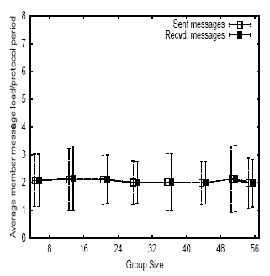
Performance Evaluation
Per-node overhead don’t vary with the group size

Slide 69
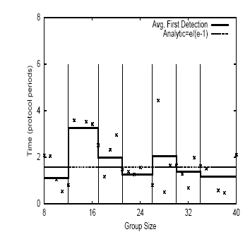
Performance Evaluation
First Detection Dime is uncorrelated to group size.

Slide 70
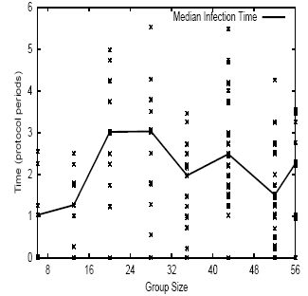
Performance Evaluation
-- -Membership Update Dissemination Time rise slowly with group size.

Slide 71
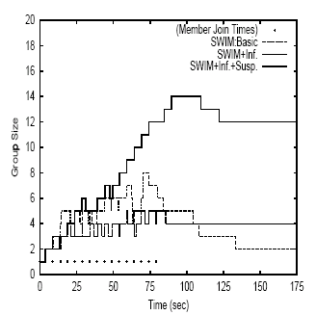
Performance Evaluation
Benefit of the Suspicion mechanism.
-- 17 processes attempted to join a SWIM group sequentially.
-- Each packet was dropped with 10% loss probability.
-- when reach stability, group size
SWIM+Inf.+Susp.:12
SWIM basic: 2
SWIM+Inf : 4

Slide 72
Summary (in the perspective of evaluation metric)
Completeness | Guaranteed Round-Robin probing strategy provides time-bounded strong completeness.
Accuracy | Partially/ probabilistically guaranteed Suspicion mechanism reduces the false positive frequency
Speed | First Detection time : expected constant time
Scalability | Per node overhead : constant overhead Dissemination latency grows slowly (logarithmically) with the group size.

Slide 73
Critique & comments
How to choose the time-out value in suspicion mechanism?
  May need more analysis to address the relationship between this time-out value and the false failure detection rate
No adaptivity
  Dynamically adjust parameter T’,k, (or suspicion time-out) according to the network condition.
Did not address Byzantine failure

