Slide 1
Distributed Computing Seminar
Distributed Communication Systems (Message Passing and Remote Procedure Calls)
Christophe Bisciglia, Aaron Kimball, & Sierra Michels-Slettvet
Summer 2007
Except as otherwise noted, the content of this presentation is (c) 2007 Google Inc. and licensed under the Creative Commons Attribution 3.0 License.

Slide 2
Outline
Motivation
Remote Procedure Calls (RPC)
Message Passing Interface (MPI)

Slide 3
Motivation: Work Queues
P
C
P
C
shared queue
P
C
Producers
Consumers
Work queues allow threads from one task to send processing work to another task in a decoupled fashion

Slide 4
Motivation: Work Queues (2)
P
C
separate machines
P
C
network shared queue
P
C
To make this work in a distributed setting, we would like this to simply “happen over the network”

Slide 5
Work Queues: Questions
Where does the queue live?
How do you access it? (custom protocol? a generic memory-sharing protocol?)
How do you guarantee that it doesn't become a bottleneck / source of deadlock?
... Some well-defined solutions exist to support inter-machine programming, which we'll see next

Slide 6
Remote Procedure Calls (RPC)

Slide 7
How RPC Doesn’t Work
Regular client-server protocols involve sending data back and forth according to a shared state
Client: Server:
HTTP/1.0 index.html GET
200 OK
Length: 2400
(file data)
HTTP/1.0 hello.gif GET
200 OK
Length: 81494
…

Slide 8
Remote Procedure Call
RPC servers will call arbitrary functions in dll, exe, with arguments passed over the network, and return values back over network
Client: Server:
foo.dll,bar(4, 10, “hello”)
“returned_string”
foo.dll,baz(42)
err: no such function
…

Slide 9
Possible Interfaces
RPC can be used with two basic interfaces: synchronous and asynchronous
Synchronous RPC is a “remote function call” – client blocks and waits for return val
Asynchronous RPC is a “remote thread spawn”

Slide 10
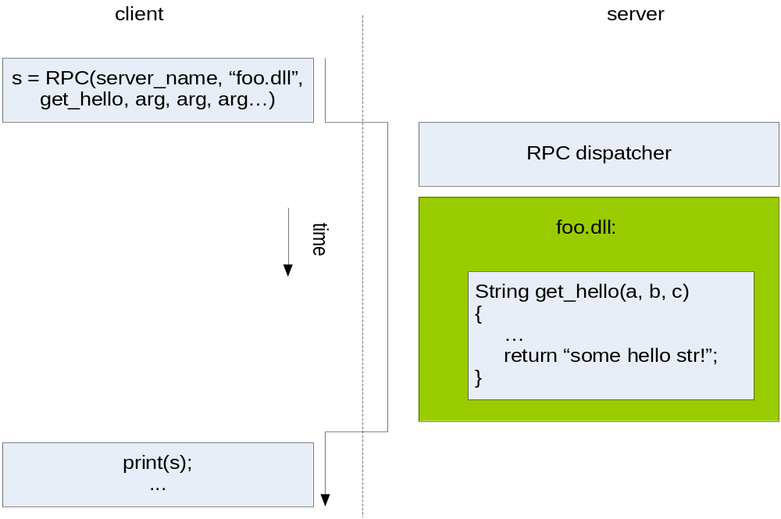
Synchronous RPC

Slide 11
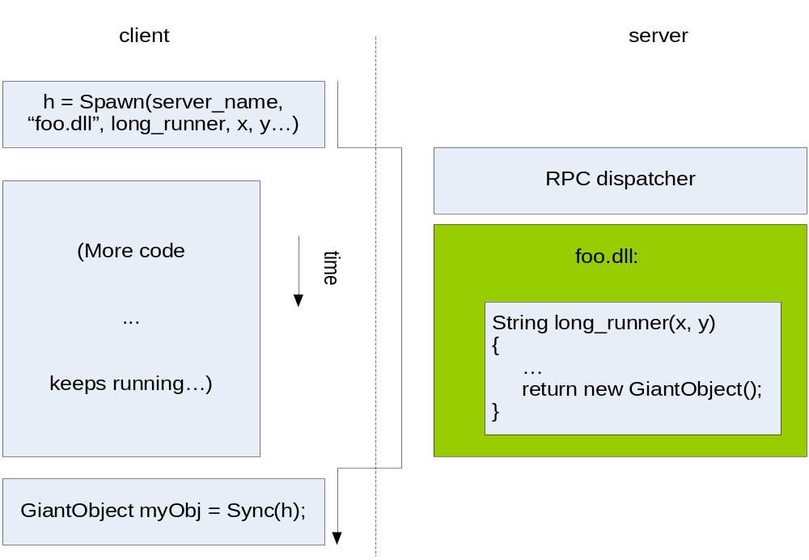
Asynchronous RPC

Slide 12
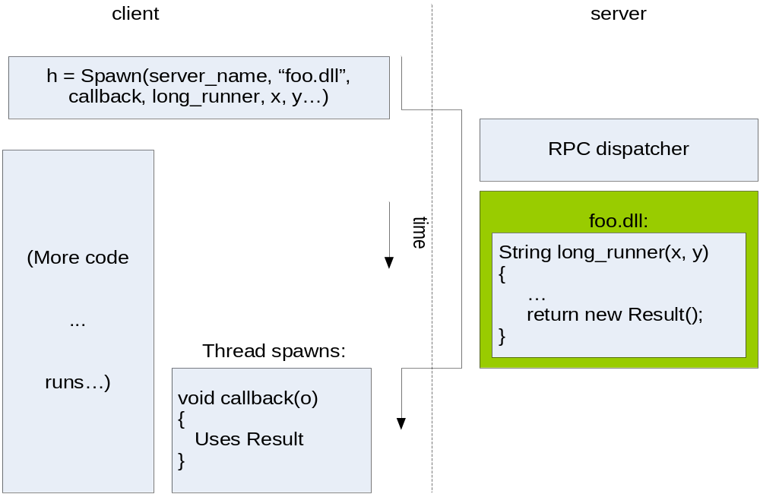
Asynchronous RPC 2: Callbacks

Slide 13
Wrapper Functions
Writing rpc_call(foo.dll, bar, arg0, arg1..) is poor form
  Confusing code
  Breaks abstraction
Wrapper “stub” function makes code cleaner
  bar(arg0, arg1); //programmer writes this;
  // makes RPC “under the hood”

Slide 14
More Design Considerations
Who can call RPC functions? Anybody?
How do you handle multiple versions of a function?
Need to marshal objects
How do you handle error conditions?
Numerous protocols: DCOM, CORBA, JRMI…
Notes:
Object marshalling: do you eagerly or lazily send pointed-to objects? (Eager can cut down on latency, but lazy saves bandwidth… 1 GB lists are too much to send. Maybe send out to a certain horizon of depth of object pointed-ness?)
Error conditions: type errors / fn not found / version mismatches / network connectivity issues
+ Do you stop running RPC hosts?
+ Keep running and save results to a designated file?
+ If the client disconnects at some point after RPC host is finished, do we roll back our state changes?

Slide 15
Beowulf & MPI
“Imagine a Beowulf cluster of these…”
-- common Slashdot meme

Slide 16
Cluster Computing
Traditional cluster computing involves explicitly forming a cluster from computer nodes and dispatching jobs
Beowulf is a style of system that links Linux machines together
MPI (Message Passing Interface) describes an API for allowing programs to communicate with their parallel components

Slide 17
Beowulf
Makes a cluster of computers present a single computer interface
One computer is the “master”
  Starts tasks
  User terminal / external network is connected to this machine
Several “worker” nodes form backend; not usually individually accessed

Slide 18
Advantages of Beowulf
Runs on commodity PCs
Uses standard Ethernet network (though faster networks can be used too)
Open-source software

Slide 19
How It Works
Beowulf is an architecture style
  It is not itself an explicit library
Client nodes are set up in very dumb fashion
  Use NFS to share file system with master
User starts programs on master machine
Scripts use rsh to invoke subprograms on worker nodes

Slide 20
Multi-System Communication
If you need several totally isolated jobs done in parallel, the above is all you need
Most systems require more inter-thread communication than Beowulf offers
Special libraries make this easier
Notes:
Most systems do not have network-wide shared memory
If data needs to be used by multiple threads, it must be explicitly sent from node to node.

Slide 21
MPI: Message Passing Interface
MPI is an API that allows programs running on multiple computers to interoperate
MPI itself is a standard; implementations of it exist in C and Fortran
Provides synchronization and communication operations to processes

Slide 22
Process Spawning
User explicitly spawns child processes to do work
MPI library aware of the size of the “universe” – the number of available machines
MPI system will spawn processes on different machines
  Do not need to be the same executable

Slide 23
Shared Memory
MPI programs define a “Window” of a certain size as a shared memory region
Multiple processes attach to the window
  Get() and Put() primitives copy data into the shared memory asynchronously
  Fence() command blocks until all users of the window reach the fence, at which point their shared memories are consistent
  User is responsible for ensuring that stale data is not read from shared memory buffer

Slide 24
Synchronization
Supports intuitive notion of “barriers” with Fence()
Mutual exclusion locks also supported
  Library ensures that multiple machines cannot access the lock at the same time
  Ensuring that failed nodes cannot deadlock an entire distributed process will increase system complexity

Slide 25
Communication
Basic communication unit in MPI is a message – a piece of data sent from one machine to another
MPI provides message-sending and receiving functions that allow processes to exchange messages in a thread-safe fashion over the network
Also includes multi-party messages...

Slide 26
Multi-party Messages
1:n broadcast – one process sends a message to all processes in a group
n:1 reduce – all processes in a group send data to a designated process which merges the data
n:n messaging communication also supported
Notes:
Note that these operations seem like mapreduce ones…

Slide 27
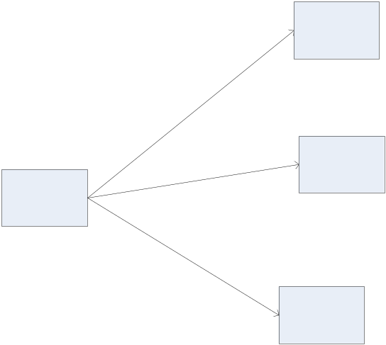
Communication: Message Broadcast
One process in a group can send a message which all group members receive (e.g., a global “stop processing” signal)

Slide 28
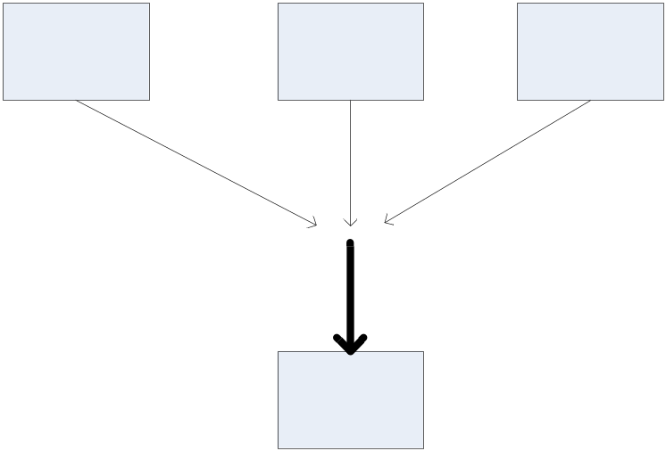
Communication: Reduction Messages
Processes in a group can all report data together (asynchronously) which is gathered into a single message reported to one process (e.g., reporting results of a distributed computation)

Slide 29
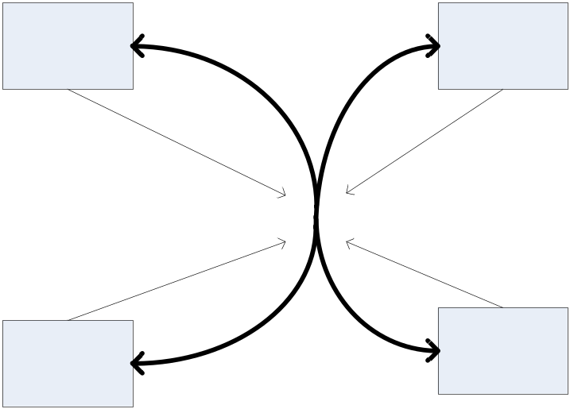
Communication: All-to-All Messaging
Combination of above paradigms; individual processes contribute components to a global message which reaches all group members

Slide 30
Pros/Cons of MPI
Programmers have very explicit control over data manipulation; allows high performance applications
Trade-off is that it has a steep learning curve
Systems such as MapReduce are considerably lower learning curve (but cannot handle as complex of system interactions)

Slide 31
Conclusions
Generic RPC and shared-memory libraries allow flexible definition of software systems
Require programmers to think hard about how the network is involved in the process
Systems such as MapReduce (next lecture) automate much of the lower-level inter-machine communication, in exchange for some inflexibility of design

