Slide 1
GADS12-NYC: Regression Project
Wine Data

Slide 2
Response Variable
"quality" of wine as determined by score from 3 to 8
count 1599.000000
mean 5.636023
std 0.807569
min 3.000000
25% 5.000000
50% 6.000000
75% 6.000000
max 8.000000
dtype: float64

Slide 3
Explanatory Variable
8 Different Explanatory Variable that can potentially explain variables in how wines score in the "quality" metrics
i.e.) Fixed Acidity, pH, level of chlorides, level of sulfur dioxide etc…
Are any of the values of the explanatory variables missing?
Nope
Calculate descriptive statistics (min, max, mean, etc.) for the variables
Next Slide

Slide 4
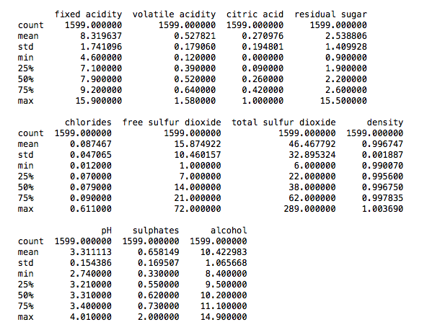
Explanatory Variable - Descriptions

Slide 5
Explanatory Variable – Covariance between pH and Quality
Calculate the covariance of the response variable and some of the explanatory variables. Plot the response variable against some of the explanatory variables. What relationships do you observe?
Covariance calculated for pH and Quality
Covariance between pH and Quality is -0.00719782232481
Variance in pH is 0.0238351805454
beta value for pH and Quality is -0.301983125787
alpha value for pH and Quality is 6.63592282676

Slide 6
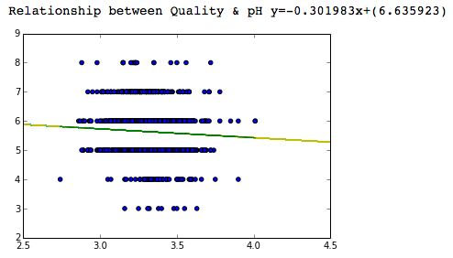
Relationship between pH & Quality
pH and Quality are negatively correlated where the wine quality score tends to decrease as the wine becomes less acidic

Slide 7
Other Relationship between Expl and Resp shown in ipython notebook

