Slide 1
Weather App
By
Gavin Murphy: x22776759
Ahmed:
Derek: x23527293
TK: x24512653

Slide 2
Weather App Overview
Mobile & desktop Application
Provides platform for normal and meteorological weather reports
Reports are tailored to the end users needs
Caters for 3 different kinds of Users:
- Normal User, Professional User, Business User

Slide 3
Weather App Overview
Normal User
-Get notifications of current weather
-request up-to-date reports
Professional User
-get complex meteorologically accurate reports
-meteorological reports include statistics and graphs

Slide 4
Weather App Overview
Business User
-Weather reports of a period of user defined time
-Get Weather Trends
-Statistics of past,current and predicted weather forecast
-tailored to a business needs

Slide 5
Weather App Features
Key Features
-weather notifications
-Account creation and sign up
-Customisable profile section
-Daily weather reports
-Statistics and trend rich reports

Slide 6
SCRUM Roles
SCRUM Master : Gavin Murphy
-Aided in resolving issues within the team
Product Owner : Ahmed
-Had the vision of the original idea for the project
Developers : Derek and T.K.
-Developed product in line with sprint Goals on time

Slide 7
SCRUM Methodology
How our SCRUM Process works
Bi-weekly meetings
Brain storming and engagement
Talk about blockers
Development of sprint goals
Mediation between product owner and development
Ensuring goals are reached on time

Slide 8
SCRUM Process
We hade a total of 4 sprints
We used Trello for sprint backlog/product backlog
We had difficulty agreeing on every topic in the SCRUM
Sprint goals weren’t met all the time(too many ideas, not enough time
Overall we had a positive experience using the SCRUM methodology

Slide 9
Benefits & Drawbacks
Benefits
Flexibility – Rapidly change targets using sprint backlog without much planning work necessary
Robust – We achieved development goals in short times adding to the robustness of our product
Team effort – the regular SCRUM meetings helped us stay focused on on track to the sprint goals
Staying aligned – Because progress is visible in small steps we stay aligned to our main goal in steps

Slide 10
Benefits & Drawbacks
Drawbacks
Time dependent – The regular SCRUM meetings were difficult to manage with other commitments and often ran overtime
Requirement overload – we set to many sprint goals each meeting and were unable to commit to all goals
Redundant goals – failure to meet the low priority goals of our sprints meant we had to drop features in the end
Conflict – There was conflict on a number of topics which took time to resolve

Slide 11
Problems Encountered
When making the front end for the system we had problems with the sign in screen
There needed to be validation added to the password and email fields to make sure incorrect input and errors were addressed
This issue arose in the testing phase were we discovered emails were being valid that were entered according to the rules
We had a meeting to discus this blocker and the issue was addressed and we decided on a number of validation rules for the sign up screen

Slide 12
Problems Encountered
Another problem and major block for our team was disagreement about our Sprint goals at SCRUM meetings
The disagreements happened between developers and the product owner about features that needed to be added to the app
The developers were unable to deliver on all the features as they were too much and the scrum master had to mediate between the 2 groups until a resolution was found.
These disagreements set us back much as we lost time working on other sprint goals

Slide 13
Conclusion
Our experience working together was positive and we learnt a lot about teamwork and mediation
We learnt a lot about the Agile methodology from our disagreements at the meetings and how they got resolved
We benefit from our opportunity to use the Agile methodology in a real world setting and gained experience into how development teams use it in industry

Slide 14
System Overview
The weather app delivers real-time weather updates, forecasts, and alerts to users, gathering data from external weather API and presenting it through a responsive interface. It’s designed for scalability, modularity, and maintainability using java technologies.
Key features:
Current Weather: real-time data(tempeture, humidity, windspeed, moisture)
Forecast: hourly and daily predictive data
Location Services: GPS or manual city search
Notifications: Weather warnings or severe condition alerts

Slide 15
System Overview
Technology Stack
Programming language – Java
Framework – Spring Boot
Database – MySQL
Build Tool – Maven
Frontend – Andriod SDK
Testing - JUnit5

Slide 16
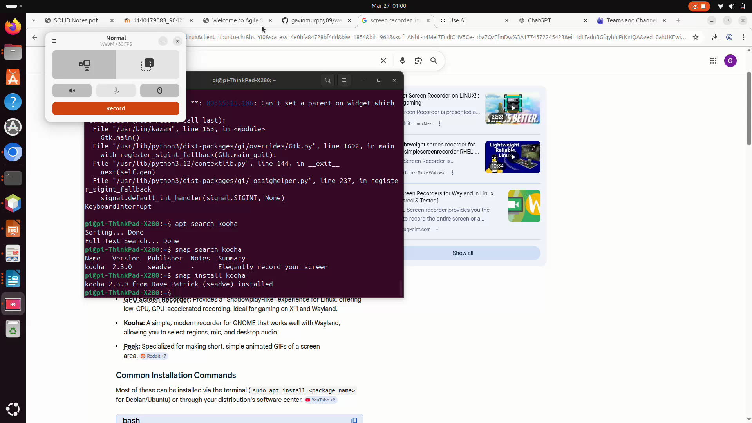
Demonstration

Slide 17
Github
Github repo - git@github.com:gavinmurphy09/weather_app.git

Slide 18
Video Presentation

Slide 19

Questions

