Slide 1
Power and sample size by simulations using R
Mixed modelling in r workshop

Slide 2
about me
Senior Researcher at Dept. of Animal and Veterinary Sciences, Aarhus University
Mainly participating in projects
Consultancy (approx. 2 month/year)
Teaching ... not much – so far
Affiliated Bioinformatic Research Centre (BiRC), Aarhus University, Aarhus, 2008-
MSc in statistics from Dept. of Theoretical Statistics, AU, 1992-1998
PhD in medicine, Health, AU (psychiatric genetics), 2007-2014
25+ years of experience as (bio)statistician in a variety of fields:
ANIS/ANIVET, AU, Mar 2015-
Dept. of Public Health, AU, Jan-Feb 2015
Psychiatric Research, Risskov, 2002-2014 (Aarhus Amt, RM 2007, AU 2013)
Biometry Research Unit, Danish Institute of Agricultural Sciences (DJF), 2000-2002
Aalborg Hospital, Clinical physiology and nuclear medicine,1999-2000
ConStat, Hirtshals, 1998-1999 (statistical consultancy mainly in Fisheries research)

Slide 3
Literature for inspiration
http://www.biomedcentral.com/1471-2288/11/94
I will go through the simr paper
https://doi.org/10.1111/2041-210X.12504

Slide 4
why are power calculations needed? e.g.,
Optimise use of fundings: not to waste resources or miss real effects
If 10 rats per treatment is enough, then we should not use 50.
If 5 plots are not enough, then perhaps we should aim for more.
Ethical reasons
If 13 pigs per treatment is enough, then we should not use sacrifice 50.
If 5 repeats is enough, then we should not stick a needle into the animal more times.
Better chance of publishing – and satisfying the editor and reviewers
It is just easier to write the paper if there is something significant to report.
Quite often the reviewers or editor will ask what the power was.
Calculating post-hoc is not advisable! So do it before the experiment!

Slide 5
what to do if power is too low?
If say 50 cows is not enough to have a reasonable chance to find the hypothesised effects and we cannot afford more cows, then perhaps
Not do the experiment
Pick another method having a higher precision and/or better accuracy
Rethink the experiment and perhaps focus on fewer outcomes
Get more funding so that we can afford a larger experiment
...
Increasing the sample size may help.
Decreasing the variance may help.
Reduce the number of tests if multiple comparison is an issue.

Slide 6
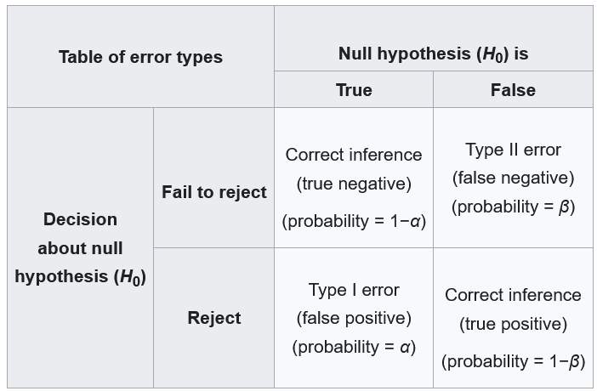
type I error, type II error, and power
Type I error (α)
The mistaken rejection of a null hypothesis (H₀) that is actually true.
False positive
“an innocent person is convicted”
Type II error (β)
The failure to reject a null hypothesis that is actually false.
False negative
“a guilty person is not convicted”
Power = 1 - β
True positive
“a guilty person is convicted”
TRUTH
Type II error
TEST
Type I error
Power
Significance level

Slide 7
Why use simulation
There are cases where we could use analytical formulas to calculate the power
But these are typically either approximations
or require special designs – perhaps too simple to be relevant
Even if appropriate formulas exist,
they might be difficult to understand
more time consuming to find and use than running simulation
Setting up a simulation experiment could
also be (too) complicated for many researchers
The simr R package
is made to provide a solution than avoid some of the complexity
but still allows for a lot of flexibility

Slide 8
How the power calculations work
The basic idea is to simulate a model under the alternative hypothesis (H_{a}) a larger number of times. That is, we simulate under the assumption that the null hypothesis of no effect (H₀) is false.
Then count how often the test fails to detect the effect, i.e. errors of Type II.
Equivalently find the proportion of tests being below the chosen level of significance, i.e. the proportion of correct rejections of H₀, which under H_{a} is the power.
In simr the following steps are each repeated nsim times:
Simulate a new set of data using the fitted model provided.
Refit the model to the simulated data.
Apply a test to the simulated fit.

Slide 9
let us see how this is done in practice
We will use the artificial data set simdata from simr
> str(simdata)
'data.frame': 30 obs. of 4 variables:
$ y: num 8.14 7.95 9.28 7.78 5.8 ...
$ x: int 1 2 3 4 5 6 7 8 9 10 ...
$ g: Factor w/ 3 levels "a","b","c": 1 1 1 1 1 1 1 1 1 1 ...
$ z: int 3 3 3 2 3 2 3 0 2 1 ...
>

Slide 10
simulation of training data like simdata
Instead of using the functions from simr we could also simulate data in the way simdata was generated
. . . depending of course on the model that we wish to examine.
This can also be a way to obtain training data to be used for the simulation using the simr functions.

Slide 11
Initiating the power analysis – fitting a model
The power analysis in simr starts with a model fitted in lme4 i.e., a model fitted with lmer or glmer. Models fitted using lm and glm (i.e. without random effects) are also supported.
> model1 <- glmer(z ~ x + (1|g), family="poisson", data=simdata)
> summary(model1)
# <snip>
Fixed effects:
Estimate Std. Error z value Pr(>|z|)
(Intercept) 1.54079 0.27173 5.670 1.43e-08 ***
x -0.11481 0.03955 -2.903 0.0037 **
Let us have a look at how simdata was generated.

Slide 12
Specifying an effect size
Recall that the power is the proportion of TRUE rejections of a FALSE null hypothesis. (table repeated on next slide)
We therefore want to simulate under the alternative hypothesis by specifying the effect size we wish to be able to find if it truly exists, i.e., if the null hypothesis is FALSE.
Let us consider the power to detect a slope of -0.05 (on the log link scale) in the mixed effects Poisson regression that we fitted in model1:
> fixef(model1)["x"]
x
-0.1148147
> fixef(model1)["x"] <- -0.05

Slide 13
recall the two-by-two table
TRUTH
Type II error
TEST
Type I error
Power
Significance level

Slide 14
Other changes of parameters in the model
It is also possible to change the parameters of the random effects and the residual variance
See the description in the documentation here:
> ?modify

Slide 15
running the power analysis
It may be an idea to use set.seed(#) if you want to be able to reproduce the results!
> set.seed(123)
> powerSim(model1)
Let us do this in R
. . . it takes a couple of minutes depending on your hardware.
It is possible choose another test, e.g., the parametric bootstrap test PBmodcomp from the package pbkrtest: > ?tests
The number of simulations (nsim=1000) can also be changed.
> powerSim(model1,nsim=100)

Slide 16
increasing power by changing design
The power was not good enough to find the effect size of -0.05 so what do we do?
Perhaps we could increase the sample size.
Perhaps we could increase the number of groups.
Imagine that the current pilot data corresponded to observations from 10 weeks.
Perhaps we could extend the experiment up to 20 weeks
. . . let us try to do the power calculation in this scenario
> fixef(model1)["x"]
x
-0.1148147
> fixef(model1)["x"] <- -0.05

Slide 17
increasing the sample size
To change x so that it runs from 1 to 20 instead of 1 to 10, we can use the function extend:
> model2 <- extend(model1,along="x",n=20)
> powerSim(model2)
Let us try this in R (again it takes a couple of minutes)
The along argument specifies which variable is being extended, and n specifies how many levels to replace it with. Let us have a look:
> getData(model2)

Slide 18
optimisation of sample size – examining a range
Perhaps a power of 97% is a bit too much and a waste of resources!?
So let us try a range of samples sizes to figure what will be optimal, e.g., when a power of 80% is reached.
We can use the powerCurved function to explore this:
> pc2 <- powerCurve(model2)
> print(pc2)
> plot(pc2)
This takes a while (10-20 min) so let us cheat.

Slide 19
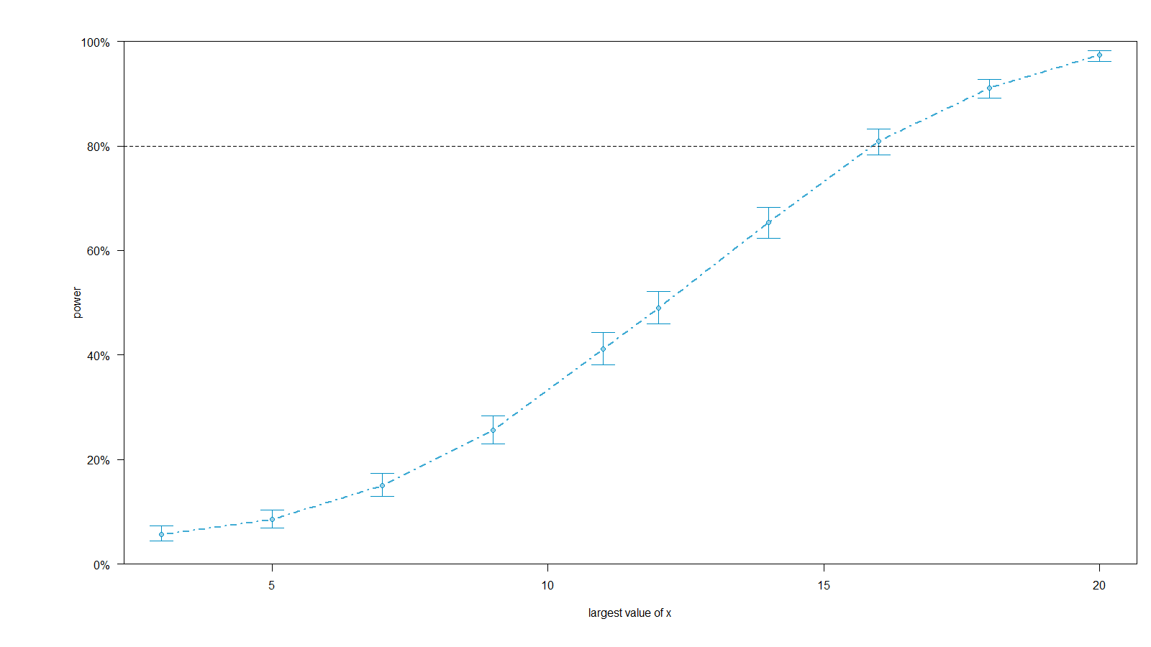
The resulting power curve for model2

Slide 20
optimisation – adding more groups
Perhaps we would not have the time to wait for 16+ weeks to obtain a power of at least 80%
So let us instead try to increase the number and the size of the groups.
To increase the number of groups, we can again use the extend function with the along argument :
> model3 <- extend(model1,along="g",n=15)
> dat3 <- getData(model3)
> pc3 <- powerCurve(model3, along="g")
Note the use of along argument in powerCurve.

Slide 21
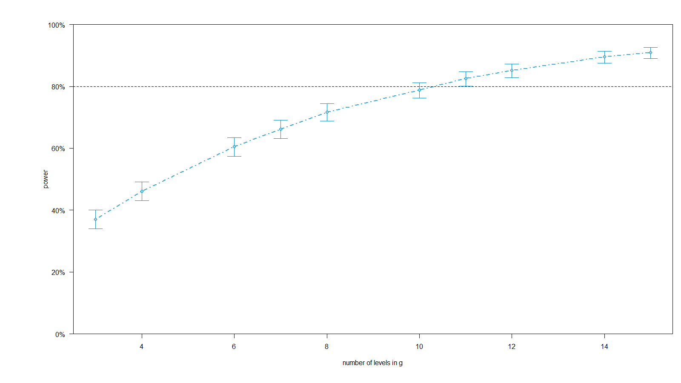
The resulting power curve for model3

Slide 22
optimisation – increasing group size
Another option might be to change the group size.
The size within group can be changed by use of the argument within instead of along in the extend and powerCurve functions :
> model4 <- extend(model1,within="x+g",n=5)
> dat4 <- getData(model4)
> pc4 <- powerCurve(model4,within="x+g",breaks=1:5)
Note the use of the breaks argument in powerCurve!
This gives us 1 to 5 observations per combination of x and g.

Slide 23
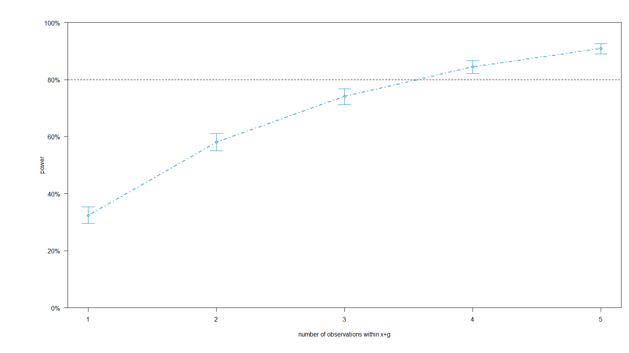
The resulting power curve for model4

Slide 24
Simulation under the null hypothesis
What do you expect we will get if we set the effect size to zero?
> fixef(model1)["x"] <- 0
> powerSim(model1)

Slide 25
recall the two-by-two table
TRUTH
Type II error
TEST
Type I error
Power
Significance level

Slide 26
result for model 1 with x=0
Power for predictor 'x', (95% confidence interval):
4.60% ( 3.39, 6.09)
Test: z-test
Effect size for x is 0.0
Based on 1000 simulations, (0 warnings, 0 errors)
alpha = 0.05, nrow = 30
Time elapsed: 0 h 1 m 34 s

Slide 27
check simulation under the null hypothesis!
Check that the significance level is as set
Here the p-values below 0.05 (say) are false positives
. . . not true positives.
This is the Type I error rate.
A histogram or a qq-plot against the uniform distribution should show a uniform distribution of the p-values.
Let us see how this looks ... and another way to simulate by use of simulate.merMod directly.

Slide 28
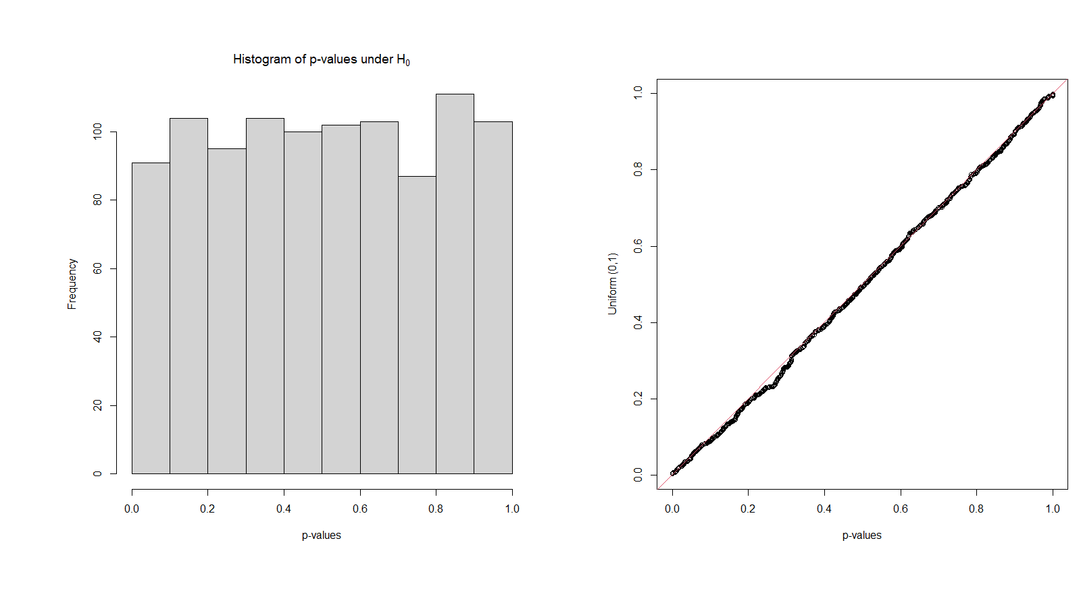
The resulting power curve for model4

Slide 29
Why not to do post-hoc power calculations!
Note the last 3 lines of 2nd column on page 494 in Green & MacLeod (2016):
“Retrospective ‘observed power’ calculations, where the target effect size comes from the data, give misleading results (Hoening & Heisey 2001)”
Hoenig, J.M. & Heisey, D.M. (2001) The abuse of power: the pervasive fallacy of power calculations for data analysis. The American Statistician, 55, 19–24.
https://doi.org/10.1198/000313001300339897
From their Abstract: “... There is also a large literature advocating that power calculations be made whenever one performs a statistical test of a hypothesis and one obtains a statistically nonsignificant result. ... This approach, which appears in various forms, is fundamentally flawed. ...”

Slide 30
Quotes from Hoenig & Heisey (2001)
“This can be called the dilemma of the nonrejected null hypothesis: what should we do when we fail to reject a hypothesis?”
“In our experience as consulting statisticians, authors are not infrequently required to perform such calculations by journal reviewers or editors;”

Slide 31
more Quotes from Hoenig & Heisey (2001)
“... arisen due to applied scientists being heavily tradition-bound to test the usual “no impact null hypothesis,” despite it not always being the relevant null hypothesis for the question at hand”.
“... more emphasis on the investigator’s choice of hypotheses and on the interpretation of confidence intervals.”
“... suggest that introducing the concept of equivalence testing may help students understand hypothesis tests.”

Slide 32
“observed power” is 1:1 function of the p-value
Let the “observed power” be the power of the test for the observed value of the test statistic. That is, assume the effects and variability are equal to the true parameter values.
“... for any test the observed power is a 1:1 function of the p value.”
An example is given in Figure 1 of Hoenig & Heisey (2001), and they give various other arguments against post-hoc power calculations.
“Power calculations tell us how well we might be able to characterize nature in the future given a particular state and statistical study design, but they cannot use information in the data to tell us about the likely states of nature.”

Slide 33
running more examples
Appendix 1 of Green & MacLeod (2016) https://doi.org/10.1111/2041-210X.12504 can be found as the vignette Test examples:
https://cran.r-project.org/web/packages/simr/vignettes/examples.html
Appendix 2 of Green & MacLeod (2016) contains a vignette that shows how to start the power analysis from scratch, including making a pilot data set:
https://cran.r-project.org/web/packages/simr/vignettes/fromscratch.html

Slide 34
Thank you for your attention
mailto://leslie@anivet.au.dk
http://anivet.au.dk/en
http://birc.au.dk
Office: 8867/K27.3205

