Slide 1
Bayesian analysis of field goal attempts in American football

Slide 2
Introduction/Motivation
Field goals are a critical part of NFL strategy
Coaches are faced with the decision:
Attempt a FG or go for it on 4th down in order to win a game
Kickers are kicking father than ever, but many teams such as the Lions and Commanders opt to go for it on 4th down instead of kicking a FG
While other teams, like the Steelers, win games by exclusively scoring with FGs

Slide 3
Introduction/Motivation
Obviously, distance affects field goal success, but by how much?
What distance do teams most often take a field goal from?
To answer these, we will apply Bayesian Inference and Logistical Regression

Slide 4
Methods
Data Source:
Aggregated NFL field goal data from the 2024 season
Categorized into five distance bins: 0–19.5, 19.5-29.5, 29.5-39.5, 39.5–49.5, and 49.5-100 yards
Each bin includes number of successful kicks and attempts
Statistical Approach:
Beta Distribution using Bayesian Inference and Laplace approximation
Uninformative prior
Posterior: MAP estimate (Maximum A Posteriori)
Visualization:
PDF and CDF of attempt distances modeled by a Beta distribution
Logistic Regression Fit (Success Probability vs Distance)

Slide 5
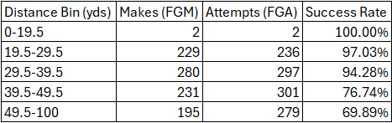
Initial Data
Table 1: Field Goal Makes (FGM) and Attempts (FGA) for the 2024 season

Slide 6
Modeling Field Goal Attempts & Success
1. Normalize Distances
Field goal distances are modeled as “X” which is unitless
X = (distance / 100 yards) so that X ∈ (0,1)
Assume X follows beta distribution with unknown parameters α and 𝛽.
X ∼ Beta(α,β)
2. Bin the Data
Exact distance is not provided; we know how many kicks fall within 5 distance bins
For each bin, the proportion of kicks φ_{k} comes from integrating Beta density over that bin
Notes:
1: Goal Capture the distribution of where on the field kicks tend to happen
2. We don’t have the exact distances from the data only how many fall into yardage bins.

Slide 7
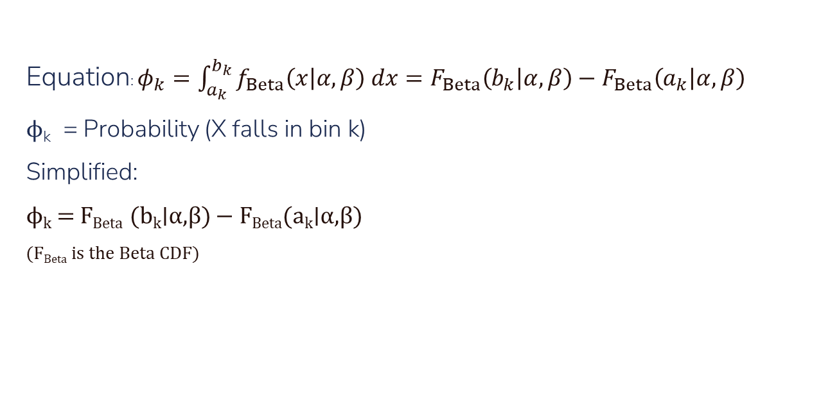
Modeling Field Goal Attempts & Success
Equation: $φ_{k}=\int_{a_{k}}^{b_{k}}{f_{Beta}\left(x | α,β\right) dx}=F_{Beta}\left(b_{k} | α,β\right)−F_{Beta}\left(a_{k} | α,β\right)$
ϕ_{k} ​ = Probability (X falls in bin k)
Simplified:
ϕ_{k}​ = F_{Beta}​ (b_{k​}∣α,β) − F_{Beta}​(a_{k}​∣α,β)
(F_{Beta} is the Beta CDF)
Notes:
We don’t know the exact distances only what bin they fall into. So for each bin, we calculate the probability a kick falls into a bin by integrating the Beta curve over that bin. i.e. the difference between the Beta CDF at the bin edges. This tells us how likely kicks are from each yardage range. These bin probabilities ϕk\phi_kϕk​ represent how field goal attempts are distributed across the field.

Slide 8
Modeling Field Goal Attempts & Success
3. Modeling Attempt Counts
The number of attempts in each bin follows a Multinomial distribution based on the proportions 𝜑_{k}.
4. Modeling Successes
Given attempts, the number of made kicks in each bin follows a Binomial distribution.
The probability of making a field goal depends on distance through a logistic function with parameters 𝛾₀ and 𝛾₁.
Notes:
Multinomial bc theres a fixed # of fgs into non overlapping bins, where each attempt must fall into exactly one bin. Binomial bc number of kicks and number of successes

Slide 9
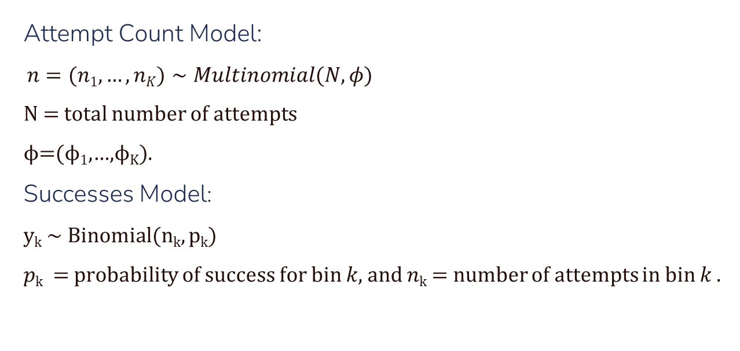
Modeling Field Goal Attempts & Success
Attempt Count Model:
$n=(n1​,…,nK​)∼Multinomial(N,φ)$
N = total number of attempts
ϕ=(ϕ₁,…,ϕ_{K}​).
Successes Model:
y_{k}​ ∼ Binomial(n_{k}​, p_{k}​)
𝑝_{k} ​ = probability of success for bin 𝑘, and 𝑛_{k}​ = number of attempts in bin 𝑘 .
Notes:
Phi = Probability that a random attempt falls into bin k

Slide 10

Modeling Field Goal Attempts & Success
Logistic Function Equation:
$p\left(x | γ_{0},γ_{1}\right)=\frac{1}{1+e^{−\left(γ_{0}+γ_{1}x\right)}}$
Successes Model:
$$p_{k}=\frac{1}{φ_{k}}\int_{a_{k}}^{b_{k}}{p\left(x | γ_{0},γ_{1}\right) f_{Beta}\left(x | α,β\right) dx}$$
Notes:
Probability of making a kick depends smoothly on distance through this logistic curve
This defines the probability of a made field goal in bin k, weighted by the attempt distribution and the success probability.
Expected value over the bin because we don’t know the exact x (distance) only the bin. Gives us an average chance of success for each bin based on distance

Slide 11
Modeling Field Goal Attempts & Success
5. Inference Goal
Infer the 4 unknown parameters: 𝛾₀, 𝛾₁ (make probability curve) 𝛼 , 𝛽 (attempt distance distribution)
6. Bayesian Appraoch
Use Bayes' theorem to combine data and a prior.
Since this model is nonlinear, use Laplace’s approximation around the posterior mode to estimate uncertainty. (Find MAP estimate using fminunc)
Notes:
"By inferring the parameters, we use the observed kicking data to estimate the most likely shape of the attempt distances and the success probability curve.“

Slide 12
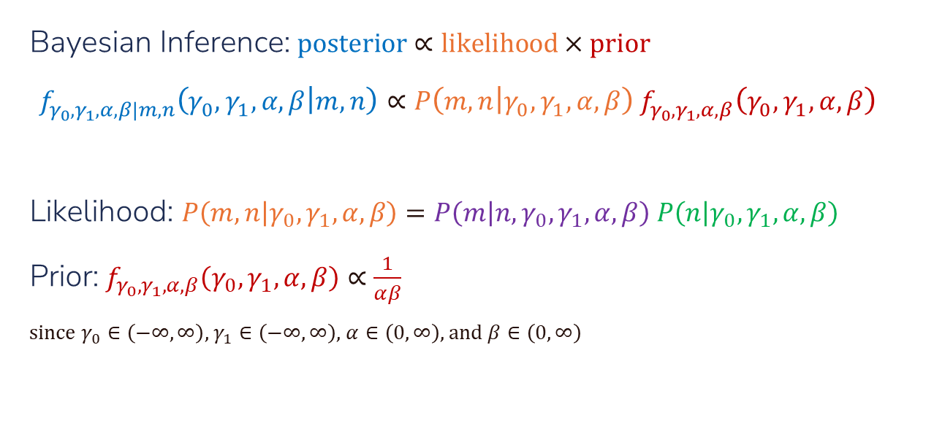
Modeling Field Goal Attempts & Success
Bayesian Inference: $\text{posterior}∝\text{likelihood}×\text{prior}$
$$f_{γ_{0},γ_{1},α,β|m,n}\left(γ_{0},γ_{1},α,β | m,n\right)∝P\left(m,n | γ_{0},γ_{1},α,β\right) f_{γ_{0},γ_{1},α,β}\left(γ_{0},γ_{1},α,β\right)$$
Likelihood: $P\left(m,n | γ_{0},γ_{1},α,β\right)=P\left(m | n,γ_{0},γ_{1},α,β\right) P\left(n | γ_{0},γ_{1},α,β\right)$
Prior: $f_{γ_{0},γ_{1},α,β}\left(γ_{0},γ_{1},α,β\right)∝\frac{1}{αβ}$
since $γ_{0}∈\left(−∞,∞\right)$, $γ_{1}∈\left(−∞,∞\right)$, $α∈\left(0,∞\right)$, and $β∈\left(0,∞\right)$
Notes:
We don’t know the exact distances only what bin they fall into. So for each bin, we calculate the probability a kick falls into a bin by integrating the Beta curve over that bin. i.e. the difference between the Beta CDF at the bin edges.

Slide 13
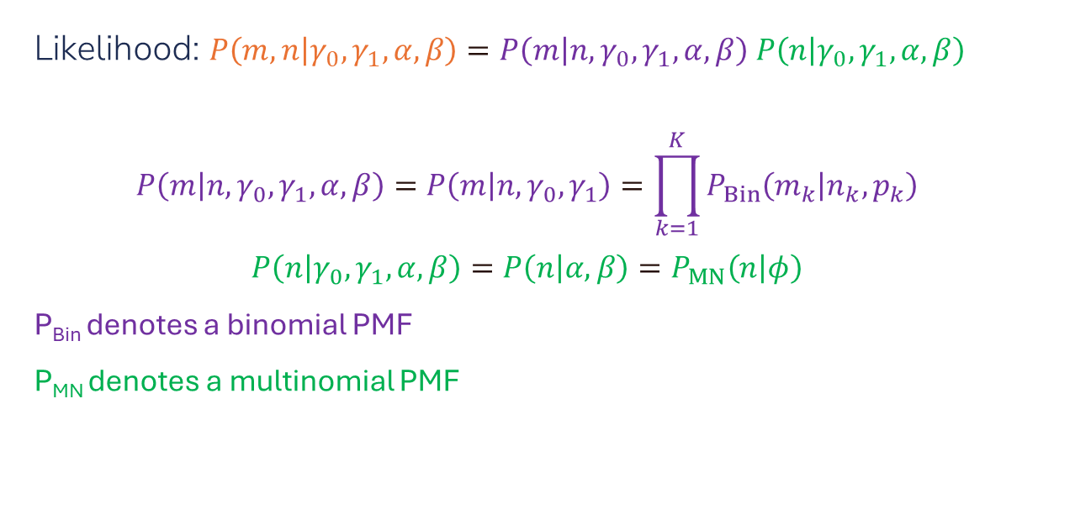
Modeling Field Goal Attempts & Success
Likelihood: $P\left(m,n | γ_{0},γ_{1},α,β\right)=P\left(m | n,γ_{0},γ_{1},α,β\right) P\left(n | γ_{0},γ_{1},α,β\right)$
$$P\left(m | n,γ_{0},γ_{1},α,β\right)=P\left(m | n,γ_{0},γ_{1}\right)=\prod_{k=1}^{K}{P_{Bin}\left(m_{k} | n_{k},p_{k}\right)}$$
$$P\left(n | γ_{0},γ_{1},α,β\right)=P\left(n | α,β\right)=P_{MN}\left(n | φ\right)$$
P_{Bin} denotes a binomial PMF
P_{MN} denotes a multinomial PMF
Notes:
Binomial term: models the number of made kicks mk given attempts nk and success probability pk​ (from logistic function).
Multinomial term: models the number of attempts in each bin nkn_knk​ based on the probability ϕk​ (from Beta distribution).

Slide 14
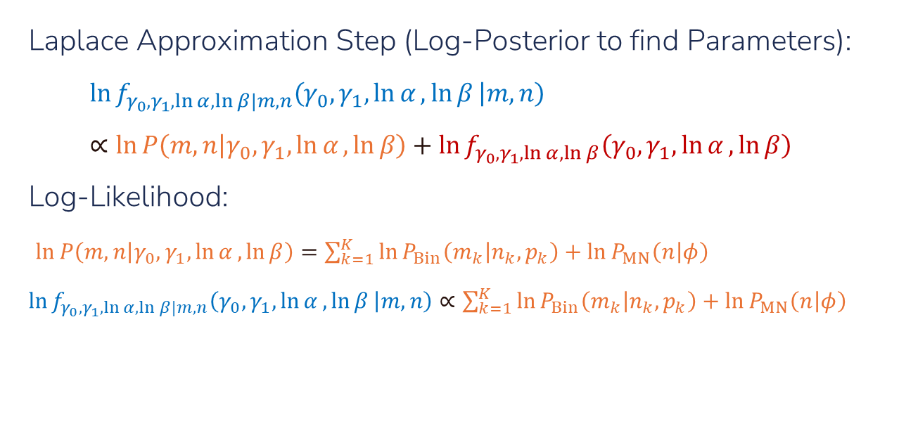
Modeling Field Goal Attempts & Success
Laplace Approximation Step (Log-Posterior to find Parameters):
$$\ln{f_{γ_{0},γ_{1},\ln{α},\ln{β}|m,n}\left(γ_{0},γ_{1},\ln{α},\ln{β} | m,n\right)}∝\ln{P\left(m,n | γ_{0},γ_{1},\ln{α},\ln{β}\right)}+\ln{f_{γ_{0},γ_{1},\ln{α},\ln{β}}\left(γ_{0},γ_{1},\ln{α},\ln{β}\right)}$$
Log-Likelihood:
$\ln{P\left(m,n | γ_{0},γ_{1},\ln{α},\ln{β}\right)}=\sum_{k=1}^{K}{\ln{P_{Bin}\left(m_{k} | n_{k},p_{k}\right)}}+\ln{P_{MN}\left(n | φ\right)}$ $\ln{f_{γ_{0},γ_{1},\ln{α},\ln{β}|m,n}\left(γ_{0},γ_{1},\ln{α},\ln{β} | m,n\right)}∝\sum_{k=1}^{K}{\ln{P_{Bin}\left(m_{k} | n_{k},p_{k}\right)}}+\ln{P_{MN}\left(n | φ\right)}$
Notes:
The posterior distribution is too complex to compute directly. You want a Gaussian (normal) approximation centered at the most likely value (MAP estimate).
You plug this log-posterior into an optimizer like fminunc.
It finds the MAP estimate = values of (γ₀, γ₁, α, β) that maximize the posterior.
Around that mode, you can approximate uncertainty using a Gaussian shape (via the Hessian matrix).

Slide 15
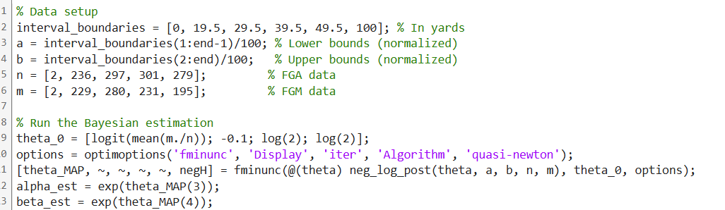
Important Pseudo-Code
Finds MAP estimates of parameters
Minimizes the negative log-posterior

Slide 16
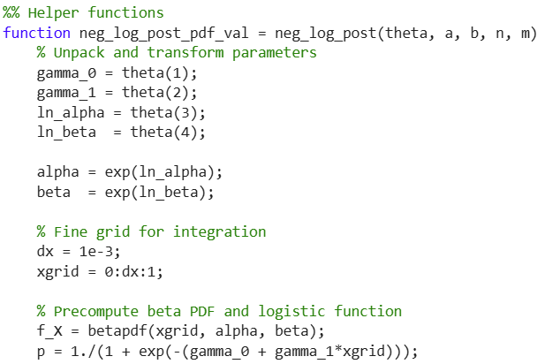
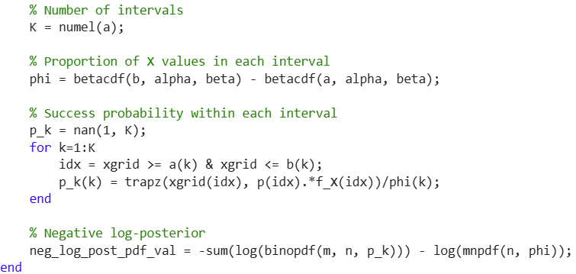
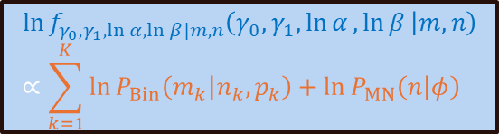

Important Pseudo-Code
$$p_{k}=\frac{1}{φ_{k}}\int_{a_{k}}^{b_{k}}{p\left(x | γ_{0},γ_{1}\right) f_{Beta}\left(x | α,β\right) dx}$$
$$\ln{f_{γ_{0},γ_{1},\ln{α},\ln{β}|m,n}\left(γ_{0},γ_{1},\ln{α},\ln{β} | m,n\right)}∝\sum_{k=1}^{K}{\ln{P_{Bin}\left(m_{k} | n_{k},p_{k}\right)}}+\ln{P_{MN}\left(n | φ\right)}$$

Slide 17
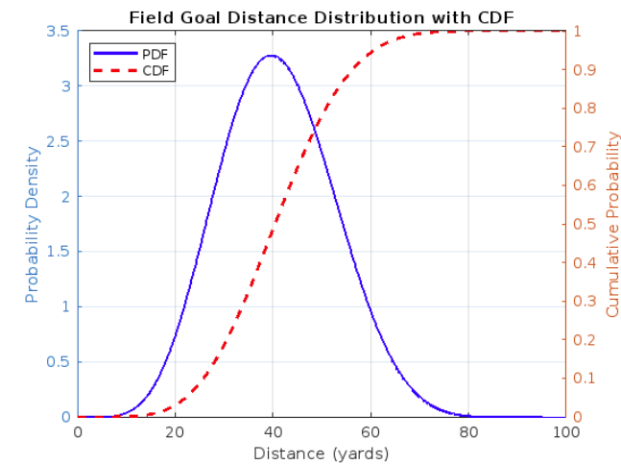
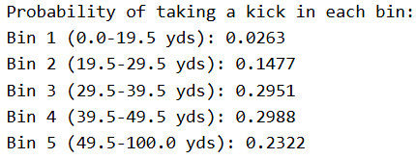
Results
yards⁻¹
Table 2: Probability of taking a kick in each bin
Figure 1: PDF and CDF of Field Goal Distance
ϕ_{k}​ = F_{Beta}​ (b_{k​}∣α,β) − F_{Beta}​(a_{k}​∣α,β)

Slide 18
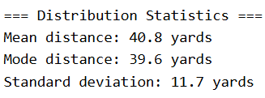

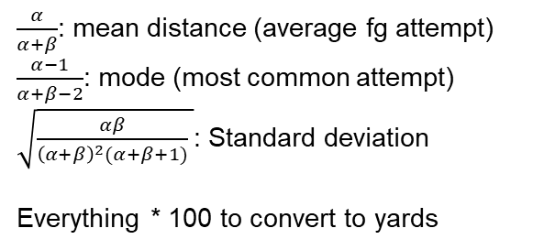
Results
Table 4: Distribution FG Statistics
Table 3: Shape Parameters
α: tendency toward shorter distances
β: tendency toward longer distances
$\frac{α}{α+β}$: mean distance (average fg attempt)
$\frac{α−1}{α+β−2}$: mode (most common attempt)
$\sqrt{\frac{αβ}{{\left(α+β\right)}^{2}(α+β+1)} }$: Standard deviation
Everything * 100 to convert to yards

Slide 19
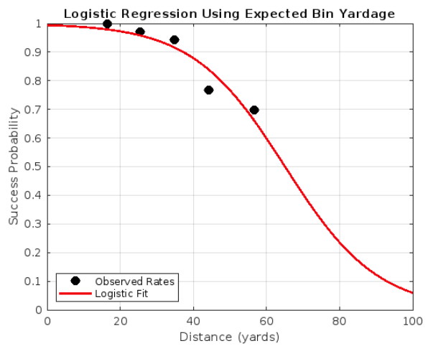
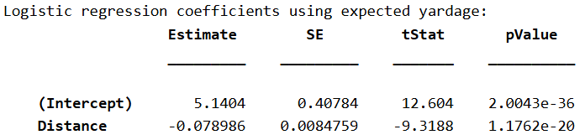
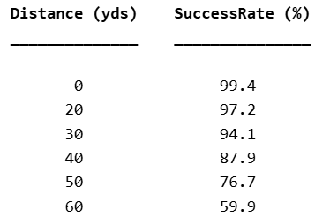

Results
Table 5: γ₀ and γ₁ coefficient outputs
Table 6: Success Rate
$$p\left(x | γ_{0},γ_{1}\right)=\frac{1}{1+e^{−\left(γ_{0}+γ_{1}x\right)}}$$
Figure 2: Logistic Regression using Expected Bin Yardage

Slide 20
Discussion
As expected field goal success decreases as distance increases (Shown in Logistic Curve)
Teams most often take field goals at the 39.5-49.5 range (29.9%)
Teams attempt just as many FGS from 30-40 yard to 40-50 yards despite 22.3% lower success rate
Penalties heavily affect kicks: a 5 yard penalty at 45 yards causes an 80% to 72% success drop
Despite range of kickers these days it may be more statistically viable to go for it on 4th down.

Slide 21
Limitations
Does not account for as we assumed for independence:
Weather conditions
Dome vs outdoors
Kicker skill

Slide 22
Any Questions?

Slide 23
References
2024 NFL Standings & Team Stats. Pro. (n.d.). https://www.pro-football-reference.com/years/2024/#kicking
SlidesGo (Slide Template)

Slide 24
Instructions for use (free users)
In order to use this template, you must credit Slidesgo by keeping the Thanks slide.
You are allowed to:
Modify this template.
Use it for both personal and commercial purposes.
You are not allowed to:
Sublicense, sell or rent any of Slidesgo Content (or a modified version of Slidesgo Content).
Distribute this Slidesgo Template (or a modified version of this Slidesgo Template) or include it in a database or in any other product or service that offers downloadable images, icons or presentations that may be subject to distribution or resale.
Use any of the elements that are part of this Slidesgo Template in an isolated and separated way from this Template.
Delete the “Thanks” or “Credits” slide.
Register any of the elements that are part of this template as a trademark or logo, or register it as a work in an intellectual property registry or similar.
For more information about editing slides, please read our FAQs or visit Slidesgo School:
https://slidesgo.com/faqs and https://slidesgo.com/slidesgo-school

