Slide 1
CNN CIFAR-10 Dataset
Individual Project Presentation

Slide 2
Introduction & Overview
Develop a Convolutional neural network to classify images and evaluate performance based on the CIFAR-10 dataset.
Dataset: Images: 60,000 (colour) Resolution: Small, 32 x 32 pixels Training/Test split: 50,000 (training images) & 10,000 (test images) Balanced Dataset, 10 mutually exclusive classes representing common objects including cars, airplanes, cats, dogs etc. Challenges: Low resolution images Contains variations in object poses, lighting conditions and backgrounds Normalizing: Scaling pixel values by a factor of 1./255
Pixel values in digital images typically range from 0 to 255. Normalizing this data by scaling the pixel values to a standard range between 0 and 1 can often help neural networks converge more quickly and perform more efficiently (Patel, 2023).

Slide 3
Model Architecture
Input Layer
Shape (32, 32, 3). CIFAR-10 Images have 32x32 pixel dimension & 3 colour channels.
Convolutional Layers
2 x Conv2D layers each with 32 filters, 3x3 kernel size, ReLU activation and “same” padding. MaxPooling2D layer with a 2x2 pool size Dropout layer (rate = 0.25) 2 x Conv2D layers each with 64 filters, 3x3 kernel size, ReLU activation and “same” padding. MaxPooling2D layer with a 2x2 pool size Dropout layer (rate = 0.25)
Having 2x convolutional layers with 32 filters followed by 2x convolutional with 64 filters is an effective practice in a convolutional neural network. Dertat (2017) explains as we go deeper into the network, feature maps start to look less like the original image, the low level feature maps detects features like edges and textures while the higher level feature maps captures less information about the image and more about the image class.

Slide 4
Model Architecture
Flattening, Dense & Output Layers
Flatten layer, used to reshape 2D feature maps into a 1D vector.
Flattening is done before feeding the output of the convolution layers to the dense and output layers (Rastogi, 2023). Dense layers require input data in a 1D form as the dense layers cant work with 2D feature maps, once flattened the dense layer performs the final computations and produces the output (Rastogi, 2023).
Dense layer, 512 neurons with ReLU activation function Dropout layer (rate = 0.5) Output layer, 10 neurons (equal to CIFAR-10 classes). Includes a SoftMax activation function to produce probabilities for each class

Slide 5
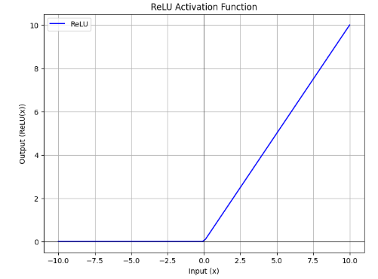
Activation Function
Brown Lee (2020) Provides an excellent summary to the need of an activation function:
“To train a deep neural network using stochastic gradient descent with error backpropagation, an activation function is required which behaves similarly to a linear function but is actually nonlinear. Nonlinearity is crucial as it allows the network to capture and learn complex relationships in the data.”
The model uses the ReLU activation function, simply because it is the most widely used activation function due to its simplicity and effectiveness. ReLU introduces nonlinearity. For input values greater than zero the function is linear, for all values less than zero the output values are always zero, making it a nonlinear function.
The function can be written as f(x) = max{0, z}, think of this as: if input > 0: return input else: return 0
GeeksforGeeks, 2024

Slide 6
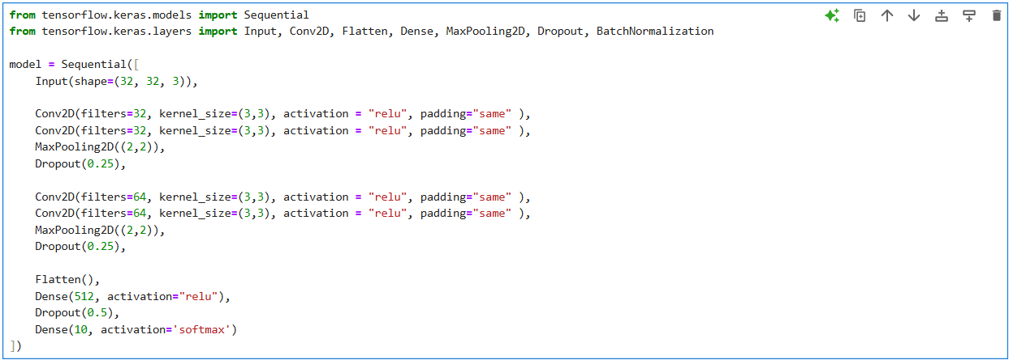
Model

Slide 7
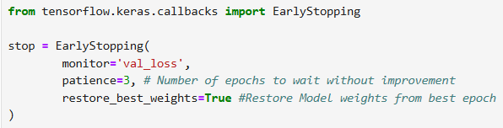
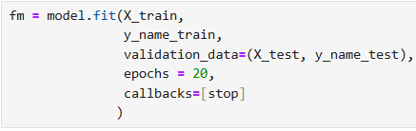
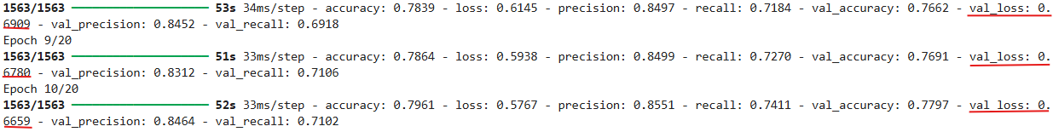
Training Strategy
Loss Function: Categorical Cross-Entropy
Neural networks are typically trained within the framework of Maximum Likelihood Estimation (MLE), using cross-entropy as the loss function (Brownlee, 2019). In multi-class classification problems, categorical cross-entropy is used, while binary cross-entropy is applied for binary classification tasks. For regression problems, the mean squared error (MSE) loss function is commonly used (Brownlee, 2019).
Epochs: 10,15,20 Early-Stopping (monitor: value loss, patience=3, restore best weights=True) = 10 epochs

Slide 8
Design Strategy
Goal: Basic working convolutional network with accuracy > 70%:
Optimizer: Adam. Widely used optimizer which combines the benefits of RMSProp and Adagrad.
Adam optimizer combines RMSprop's adaptive learning rates with momentum to avoid local minima and saddle points, making it highly efficient and often outperforming other algorithms in training deep learning models (Yadav, 2023).
Callbacks: Early-Stopping. Monitor validation loss and will stop training if no improvement for 3 consecutive epochs.
Regularization: Dropout used at 3 points to reduce overfitting
Potential improvements:
Batch Normalization & Data Augmentation

Slide 9
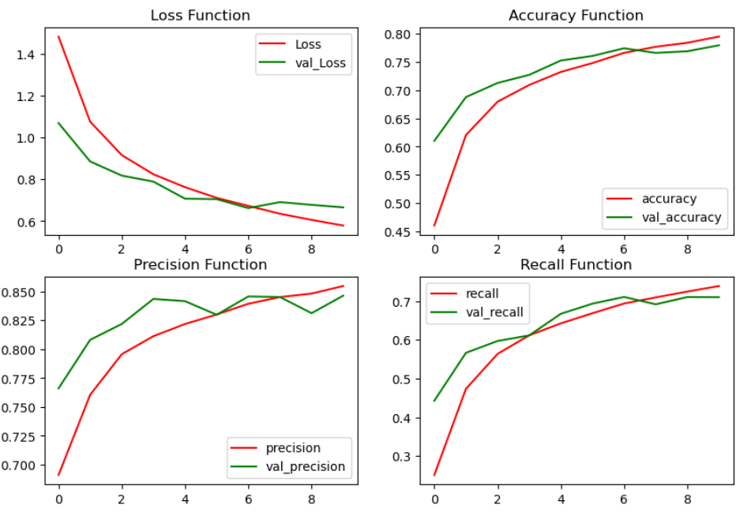

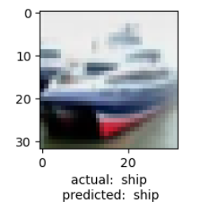
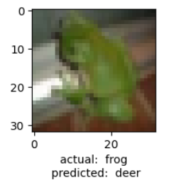
Design Strategy
Performance: Testing:

Slide 10

Reflections and Learnings
First Attempt at building a CNN.
Practice. Using raw datasets.
Data preparation = Model.
Traditional Machine Learning models
Steve Barkley

Slide 11
References
Brownlee, J. (2020) A gentle introduction to the rectified linear unit (RELU), MachineLearningMastery.com. Available from: https://machinelearningmastery.com/rectified-linear-activation-function-for-deep-learning-neural-networks/ [Accessed: 16 January 2025].
Brownlee, J. (2019) Loss and loss functions for training Deep Learning Neural Networks, MachineLearningMastery.com. Available from: https://machinelearningmastery.com/loss-and-loss-functions-for-training-deep-learning-neural-networks/ [Accessed: 17 January 2025].
Dertat, A. (2017) Applied deep learning - part 4: Convolutional Neural Networks, Medium. Available from: https://towardsdatascience.com/applied-deep-learning-part-4-convolutional-neural-networks-584bc134c1e2 [Accessed: 16 January 2025].
GeeksforGeeks (2024) ReLU activation function in deep learning, GeeksforGeeks. Available from: https://www.geeksforgeeks.org/relu-activation-function-in-deep-learning/ [Accessed: 16 January 2025].
Patel, H. (2023) Normalization in image preprocessing: Scaling pixel values by 1/255, Medium. Available from: https://medium.com/@patelharsh7458/normalization-in-image-preprocessing-scaling-pixel-values-by-1-255-111b2fa496d4 [Accessed: 17 January 2025].

Slide 12
References
Rastogi, V. (2023) Flattening in neural network?, Medium. Available from: https://medium.com/@vaibhav1403/flattening-in-neural-network-10e260d2b06f#:~:text=Dense%20layers%20require%20their%20input,score%2C%20regression%20output%2C%20etc [Accessed: 16 January 2025].
Yadav, A. (2023) Taming the optimizers: Adagrad, adam, and RMSprop in Deep Learning, Medium. Available from: https://medium.com/@alok.yadav/taming-the-optimizers-adagrad-adam-and-rmsprop-in-deep-learning-7b0582b0ceba [Accessed: 17 January 2025].

