Slide 1
Mblock
ANDY

Slide 2
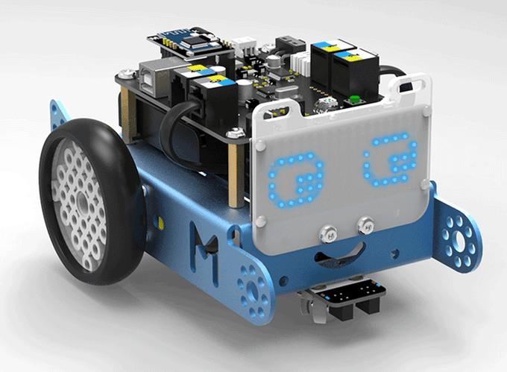
WHAT IS MBLOCK(Y)
Mblock is a programmable kind of a mini car it runs on rechargeable batteries.

Slide 3
THINGS YOU CAN CODE MBOT WITH.
You can code with
IPhone
Ipad
Computer

Slide 4
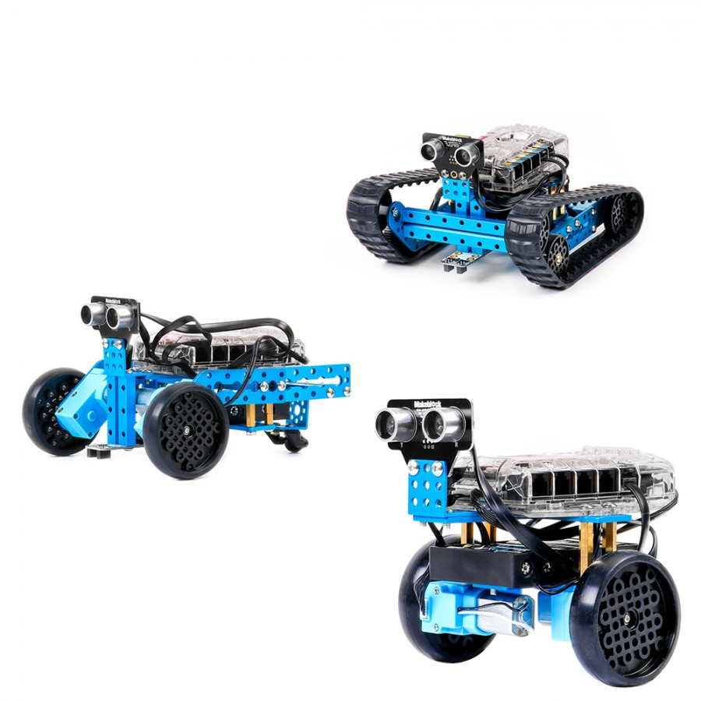
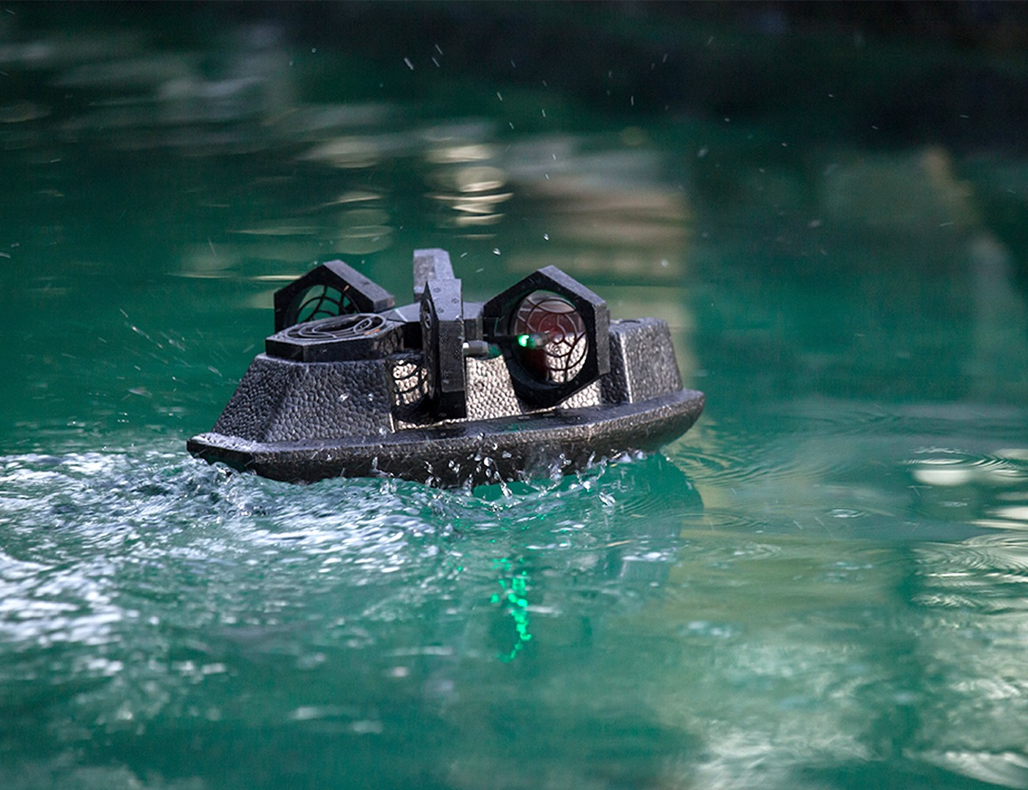
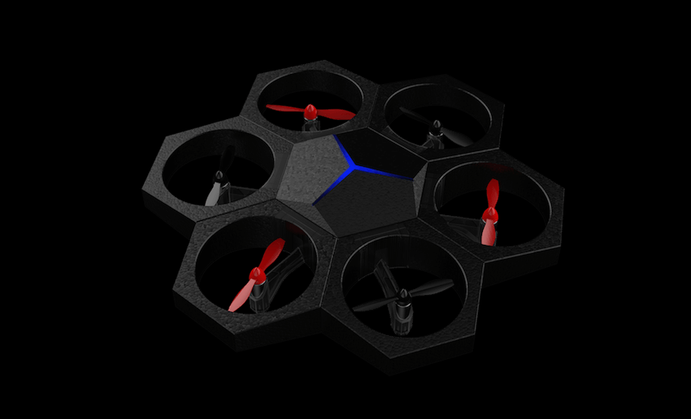
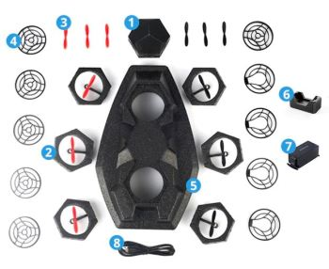
OTHER THINGS MADE BY MBOT'S COMPANY
Mbot ranger
AirBlock
Lots more

Slide 5
VIDIOS
Airblock vidio https://youtu.be/R4

