Slide 1
RUST Quiz
Send + Sync
Concurrency， Thread Safety， Reference
Notes:
https://onesignal.com/blog/thread-safety-rust/

Slide 2
预备知识
线程安全(Thread Safety)
Thread
Send， Sync trait
Rwlock, Mutext, Condvar, Barrier
channel, mpsc

Slide 3
Send
Send trait这个标记trait被用来告知Rust编译器，凡是实现了Send trait的类型在线程间传送是安全的。这意味着：
可以在一个线程中构建一个类型数据的实例，并
将其所有权转让给另外一个线程，并在那个线程中被释放
Rust中大多数类型都实现了Send trait
最常见的非Send类型：
Rc
因为Rc使用了非原子类型的引用计数，而它不是线程间安全传送的
所有原始指针类型（All raw pointer）
Rust并不提供对指针所指向任意数据类型的同步保护

Slide 4
Sync
T类型是Sync当且仅当&T是Send，这是在说在线程间共享不可变的引用必须是安全的
Sync由Send派生并且: 如果&T是Send，那么T就是Sync
最常用的非Sync类型为：
UnsafeCell
Cell
RefCell
这些类型依赖于没有同步的修改，因此不是线程安全的
Notes:
A simpler way to think about this is to imagine if it would be safe to have multiple immutable references of type T being read from in parallel from multiple threads.

Slide 5
总结
如果T: Send，那么将T传到另一个线程中时(按值传送),不会导致数据竞争或其它不安全情况。
Send是对象，可以安全发送到另一个执行体中
Send使被发送对象可以和产生它的线程解耦，防止原线程将此资源释放后，在目标线程中使用出错(不会发生释放后使用的错误)
如果T: Sync，那么将&T传到另一个线程中时，不会导致数据竞争或其它不安全情况。
Sync是可以被同时多个执行体访问而不出错
Sync防止的是竞争
推论：
T: Sync意味着 &T: Send
Sync + Copy = Send
当T: Send时，可推导出&mut T: Send
当T: Sync时，可推导出&mut T: Sync
当&mut T: Send时，不能推导出T: Send

Slide 6
总结(具体的类型)
原始类型(比如：u8, f64)，都是Sync+Copy，因而都是Send
只包含原始类型的复合类型，都是Sync+Copy，因而都是Send
当T: Sync，Box<T> , Vec<T> 等集合类型是Sync
具有内部可变性的的指针，不是Sync的，
比如 Cell , RefCell , UnsafeCell
Rc不是Sync。因为只要一做&Rc<T>操作，就会克隆一个新引用。
它会以非原子性的方式修改引用计数，所以是不安全的
被Mutex和RWLock锁住的类型T: Send，那么该类型就是Sync的
原始指针(*mut , *const)既不是Send也不是Sync

Slide 7
基本行为
Mutex / RwLock

Slide 8
示例程序1
Mutex
use std::sync::{Mutex, Arc, mpsc::channel};
pub fn main() {
let (tx, rx) = channel();
let x = Arc::new(Mutex::new(tx));
std::thread::spawn(move || {
x.lock().unwrap().send(4u8).unwrap();
});
dbg!(rx.recv().unwrap());
}
PS E:\projects\Rust Programming\sourcecode\chapter15\Quiz> rustc .\mutex.rs
PS E:\projects\Rust Programming\sourcecode\chapter15\Quiz>
1

Slide 9
示例程序2
RwLock
use std::sync::{RwLock, Arc, mpsc::channel};
pub fn main() {
let (tx, rx) = channel();
let x = Arc::new(RwLock::new(tx));
std::thread::spawn(move || {
x.read().unwrap().send(4u8).unwrap();
});
dbg!(rx.recv().unwrap());
}
PS E:\projects\Rust Programming\sourcecode\chapter15\Quiz> rustc .\rwlock.rs
error[E0277]: `Sender<u8>` cannot be shared between threads safely
--> .\rwlock.rs:8:3
|
8 | std::thread::spawn(move || {
| ^^^^^^^^^^^^^^^^^^ `Sender<u8>` cannot be shared between threads safely
|
::: C:\Users\Administrator\.rustup\toolchains\stable-2021-06-17-x86_64-pc-windows-msvc\lib/rustlib/src/rust\library\std\src\thread\mod.rs:624:8
|
624 | F: Send + 'static,
| ---- required by this bound in `spawn`
|
= help: the trait `Sync` is not implemented for `Sender<u8>`
= note: required because of the requirements on the impl of `Sync` for `RwLock<Sender<u8>>`
= note: required because of the requirements on the impl of `Send` for `Arc<RwLock<Sender<u8>>>`
= note: required because it appears within the type `[closure@.\rwlock.rs:8:22: 10:4]`
error: aborting due to previous error
For more information about this error, try `rustc --explain E0277`.
？？？

Slide 10
Sender
The std::sync::mpsc::Sender类型属于多生产者单一消费者模型生产者一方 。它被设想在用户调用Sender::clone的时候被使用，并且每个线程只有一个拥有所有权的Sender对象。
这个模式允许Send是不同步（sync）的，因为每个单独的Sender实例没有必要是在多线程间是同步的。Send只需要实例可以从一个线程移动到另一个线程，所有权保持一致。

Slide 11
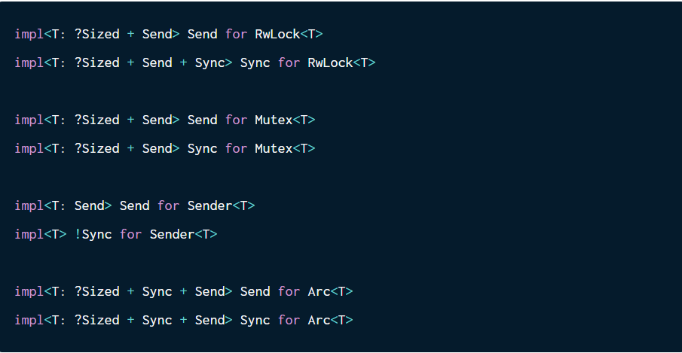
Sender & RwLock & Mutex & Arc
https://github.com/rust-lang/rust/blob/b0c6527912cee113b29a33d7db0e801a58a94de5/library/std/src/sync/mutex.rs
https://github.com/rust-lang/rust/blob/b0c6527912cee113b29a33d7db0e801a58a94de5/library/std/src/sync/rwlock.rs

Slide 12
Sender
Sender<T>是不同步的。所以一个Sender同时在多线程间有多个不可变引用是不安全的。考虑到Sender::send(&self) 仅需要一个不可变引用，这里需要使用某些内部可变性机制
Mutex<T> 是Send+Sync 只要其T是Send。Mutex里的对象永远不会有多个不可变的引用同时活跃在多线程中，这是因为Mutex不允许同时有多个锁(read 或者 write)。
RwLock<T> 是 Send只要T 是Send, 但是它是Sync如果T是Send + Sync. 因为大多数类型是Send + Sync, 所以大多数情况下没有问题。在RwLock中的Sender<T>如果不是Sync，才会造成问题。RwLock允许同时多个读锁
Arc<T> 是 Send +Sync如果其底层T 是 Send + Sync, 这意味着，我们不能跨线程传送Arc<T>当T: !Sync.

Slide 13
关注公众号，获取完整版
COMPANY SLOGUN TEXT HERE
Filter:
CONSULTING
Filter:
MARKET ANALYSIS
Filter:
WEB STRATEGY
Filter:
MARKETING’S
Conveniently iterate top-line alignments for wireless metrics.
Conveniently iterate top-line alignments for wireless metrics.
Conveniently iterate top-line alignments for wireless metrics.
Conveniently iterate top-line alignments for wireless metrics.
BUSINESS PLAN
PRODUCT INFO
CREATIVITY
PROJECT PLAN
Compellingly deliver prospective catalysts for change before economically sound meta-services. Intrinsicly enable optimal results for error-free architectures. Conveniently drive professional communities for extensive functionalities.

Slide 14
关注公众号，获取完整版
COMPANY SLOGUN TEXT HERE
Draw Art: Key
Draw Art: Calendar
Draw Art: Media
90%
30%
42%
950,20k
200,05k
350,11k
⑦
⑦
⑦
EVERLAND
Conveniently iterate top-line alignments for wireless metrics.
CUSCO
Conveniently iterate top-line alignments for wireless metrics.
ARCHER
Conveniently iterate top-line alignments for wireless metrics.
01
02

Slide 15
关注公众号，获取完整版
COMPANY SLOGUN TEXT HERE
58%
STUDIO
15%
MARKETING
2014/08
7:55
ESSENTIAL PRODUCT
Conveniently iterate top-line alignments for wireless metrics.
2014/08
7:55
NEW BRAND EXPO
Conveniently iterate top-line alignments for wireless metrics.
90%
PROFESSIONAL
35%
PROMOTION
2014/08
7:55
UNIQUE MARKETING
Conveniently iterate top-line alignments for wireless metrics.
2014/08
7:55
FASHION PRODUCT
Conveniently iterate top-line alignments for wireless metrics.

Slide 16
关注公众号，获取完整版
COMPANY SLOGUN TEXT HERE
WEB ESSENTIAL
TOOLS
Uniquely architect B2C products and scalable synergy.
JOHN MARTIN, CEO
Dynamically deploy future-proof outsourcing with magnetic vortals. Compellingly synergize robust users after frictionless value. Appropriately seize vertical resources whereas impactful deliverables
+10
CHART CONTENT
Conveniently iterate top-line alignments for wireless metrics.
-10
CHART CONTENT
Conveniently iterate top-line alignments for wireless metrics.
PRODUCTS
TEAM ANALYSIS
GENDER
PRODUCTS
TEAM ANALYSIS
GENDER
COSTUMER GIFTS
2015/08
Conveniently iterate top-line alignments for wireless metrics.
+58%
Marketing team
MARKETING EVENT
2015/10
Conveniently iterate top-line alignments for wireless metrics.
+80%
Marketing team

Slide 17
关注公众号，获取完整版
COMPANY SLOGUN TEXT HERE
A
PRODUCTS
TEAM ANALYSIS
GENDER
COSTUMER GIFTS
2015/08
Conveniently iterate top-line alignments for wireless metrics.
+58%
Marketing team
Uniquely architect B2C products and scalable synergy.
Dynamically deploy future-proof outsourcing with magnetic vortals. Compellingly synergize robust users after frictionless value. Appropriately seize vertical resources whereas impactful deliverables
B
②
58%
AVERAGE: FACEBOOK
Conveniently iterate top-line alignments for wireless metrics.
①
60%
AVERAGE: TWITTER
Conveniently iterate top-line alignments for wireless metrics.

Slide 18
关注公众号，获取完整版
COMPANY SLOGUN TEXT HERE
INFOGRAPHIC
Conveniently iterate top-line alignments for wireless metrics.
INFOGRAPHIC
Conveniently iterate top-line alignments for wireless metrics.
INFOGRAPHIC
Conveniently iterate top-line alignments for wireless metrics.
95%
PROJECT
45%
PROFESSIONAL
70%
POTENTIALS

Slide 19
关注公众号，获取完整版
COMPANY SLOGUN TEXT HERE
Compellingly deliver prospective catalysts for change before economically sound meta-services. Intrinsicly enable optimal results for error-free architectures. Conveniently drive professional communities for extensive functionalities.
Continually deliver market positioning manufactured products whereas maintainable customer service. Rapidiously actualize e-business materials before viral vortals. Compellingly deliver prospective catalysts for change before economically sound meta-services. Intrinsicly enable optimal results for error-free architectures. Conveniently drive professional communities for extensive functionalities.
Continually deliver market positioning manufactured products whereas maintainable customer service. Rapidiously actualize e-business materials before viral vortals.
Compellingly deliver prospective catalysts for change before economically sound meta-services. Intrinsicly enable optimal results for error-free architectures. Conveniently drive professional communities for extensive functionalities.
Continually deliver market positioning manufactured products whereas maintainable customer service. Rapidiously actualize e-business materials before viral vortals. Compellingly deliver prospective catalysts for change before economically sound meta-services. Intrinsicly enable optimal results for error-free architectures. Conveniently drive professional communities for extensive functionalities.
Continually deliver market positioning manufactured products whereas maintainable customer service. Rapidiously actualize e-business materials before viral vortals.

Slide 21


可以在下列情况使用
不限次数的用于您个人/公司、企业的商业演示。
拷贝模板中的内容用于其它幻灯片母版中使用。
不可以在以下情况使用
用于任何形式的在线付费下载。
收集整理我们发布的免费资源后，刻录光碟销售。

