Slide 1
Send + Sync
Thread Safety
Notes:
https://onesignal.com/blog/thread-safety-rust/

Slide 2
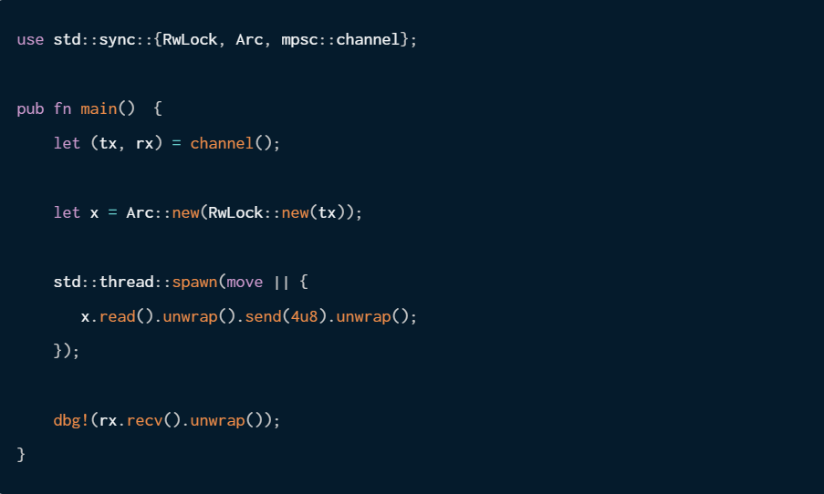

Slide 3
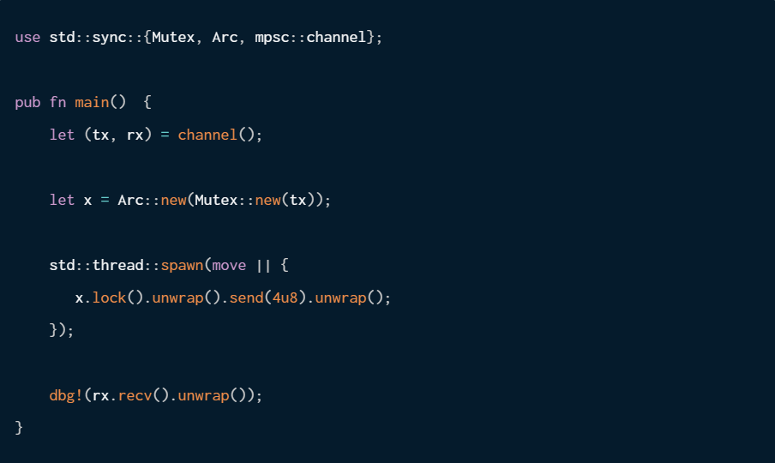

Slide 5
Send
The Send trait is the simpler of the two traits to explain conceptually. A type is Send if it is safe to transfer it across thread boundaries. This means that you can construct an instance of the type on one thread, transfer ownership to another thread, and Drop it on that other thread. Most types in Rust are Send, but there are a few exceptions. The most common non-Send types are Rc and all raw pointer types. The raw pointer types are not Send because Rust cannot make any guarantees about the synchronization mechanisms that are in the underlying types, or when the pointers will be accessed. Rc is not Send because it uses a non-atomic reference counter which is not safe to send between threads.

Slide 6
Sync
Sync is a bit trickier to explain. A type T is Sync if and only if &T is Send. This means that it must be safe to share immutable references of T between threads. A simpler way to think about this is to imagine if it would be safe to have multiple immutable references of type T being read from in parallel from multiple threads. The most common non-Sync types are UnsafeCell, Cell, and RefCell. These types all rely on unsynchronized mutation, so they are inherently not thread-safe.

Slide 7
Sender
The std::sync::mpsc::Sender type is the producer-half of a multi-producer, single-consumer channel. It's intended to be used by calling Sender::clone and using a single owned Sender per-thread. This pattern permits Sender to be non-Sync because each individual instance of Sender does not need to synchronize with itself across multiple threads. It only needs to be Send so that instances can be moved from thread to thread with ownership staying consistent.

Slide 8
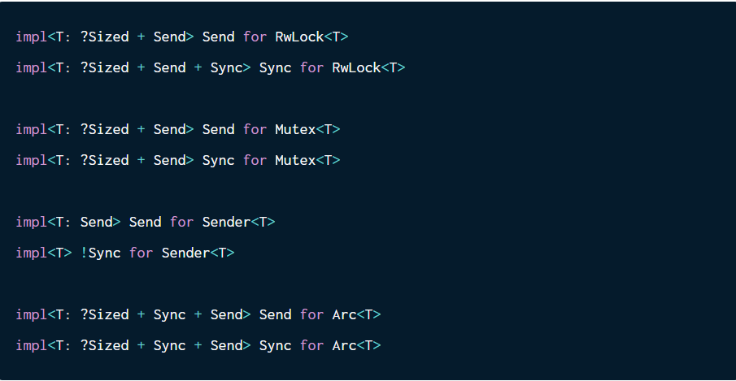
Sender

Slide 9
Sender
Sender<T> is not Sync. It's not safe to have multiple immutable references to a Sender live across multiple threads at the same time. Considering that Sender::send(&self) requires only an immutable reference, there must be some kind of interior mutability going on.
Mutex<T> is both Send and Sync if T inside of it is Send. If something is inside of a Mutex, it will never have multiple immutable references live at the same time since Mutex does not allow multiple locks (read or write) to be taken at the same time. Because of this, Mutex<T> effectively bypasses the restrictions of Sync.
RwLock<T> is Send where T is Send, but it is only Sync if T is both Send + Sync. Since most types are Send + Sync, this is a non-issue. It only causes problems because the Sender<T> within it is not Sync. Recall from our explanation that RwLock allows multiple read locks to be open in parallel.
Arc<T> is only Send and Sync if the underlying T is both Send + Sync, meaning that you cannot send an Arc<T> across thread boundaries where T: !Sync.

