Slide 1
Evidence Desk
A cited condition briefing for health system strategy
One workspace to assemble the care landscape, research pipeline and organizations involved
Current care
Emerging treatments
Companies &
institutions
Applicable guidance,
its date and population
Study stage, activity
and results availability
Documented roles linked
to the underlying research
The analyst confirms a condition, inspects the evidence, then exports a cited report.
01
Notes:
Evidence Desk supports US health system strategy research and service planning. The intended report has the three required sections shown here. It reduces the need to assemble source material by hand while keeping evidence near the summary; time savings and ROI remain unmeasured. Users confirm the condition and scope, inspect source passages and dates, then export cited Markdown or JSON. This is organizational research, with no patient intake or treatment selection. The local prototype is partial: current-care support requires an applicable current US guideline, and the latest example has no accepted general-section statements.
Sources: Wiki/Concepts/healthcare-product-scope.md; healthcare-discovery-summary.md; healthcare-briefing-interface.md; healthcare-evidence-runtime.md; healthcare-evidence-scope-trace.md. Product state: October 27, 2026.

Slide 2
How the evidence becomes a briefing
Confirm
condition + scope
Retrieve
source records
Apply relevance
and evidence rules
AI summary +
citation checks
Review and
export report
Fixed source roles
Inspectable decisions
Separate or
withhold
PubMed: published research
ClinicalTrials.gov: trial activity
and recorded sponsor roles
Exact evidence and source dates
Specific populations kept separate
Opposing findings kept for review
Rules control evidence admission. AI summarizes. Domain reviewers validate.
02
Notes:
The workflow uses fixed biomedical connectors, source identity checks and saved source versions. Condition, subtype, population, study activity and claim-specific support are checked before accepted statements enter the report. Ordering uses evidence type, results, relevant dates and stable IDs; it is a research aid rather than a clinical truth score. The model reads selected evidence within bounded permissions and proposes cited text; it cannot choose source authority or bypass the rules. Every accepted claim links to an exact saved passage or field. Known reports of one study are linked as an evidence family; unknown overlap remains unknown. Potential opposing findings are retained for review, and the detector can miss nuanced disagreement. The diabetes trace showed missing population/activity gates: replay of the original snapshots removed both misplaced trial/sponsor statements while preserving historical reports. NCT01954147 itself excludes pregnancy; pregnancy-specific literature was a separate source.
Sources: Wiki/Concepts/healthcare-evidence-runtime.md; healthcare-evidence-policy.md; healthcare-data-and-provenance.md; healthcare-sourcing-plan.md; healthcare-evidence-scope-trace.md.

Slide 3
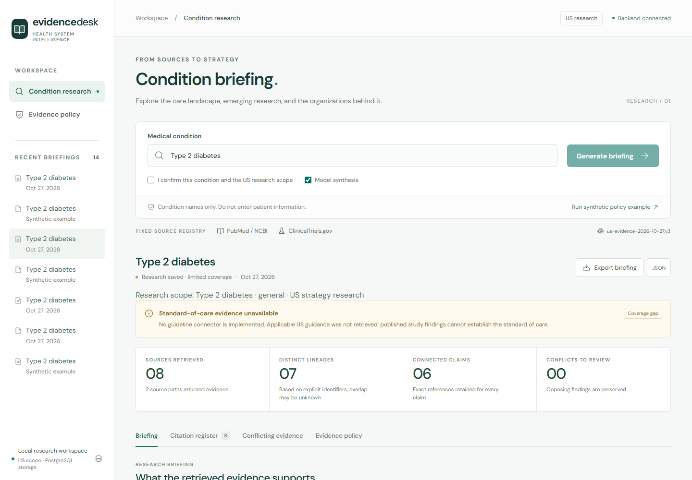
Working prototype and next step
Delivered today
Live literature and trial retrieval
Inspectable evidence and citations
Saved briefings and cited exports
Next: a reviewed pilot
Applicable US guideline coverage
Domain review of rules and claims
Team access and reliable operations
FDA evidence for approval claims
Actual local prototype; limited coverage
Latest example: 8 records and 6 statements for specific populations; general sections remain unavailable.
03
Notes:
Actual screenshot of the local prototype, with no new clinical claims added. Saved live run 71402689-3f21-48b2-977a-56e7cce27885 under policy us-evidence-2026-10-27.v3 retrieves eight citations and accepts six structured statements for three specific-population trials and their sponsors. Six model candidates are withheld. The general current-care, emerging and organization sections remain unavailable in that bounded sample. The prototype has no registered current US guideline or FDA adapter. Thirty-six backend tests plus recorded build/browser checks passed; these engineering observations do not measure clinical accuracy. A reviewed pilot should establish guideline access and source-use permissions, name a domain reviewer, validate representative accepted and withheld claims, and prepare identity, reliable jobs, backups and retention. Measure analyst time to a usable briefing, claim support/relevance, useful coverage, run completion time and cost before expanding scope. Dates and commercial terms are not agreed.
Sources: Wiki/Projects/healthcare-system.md; Wiki/Concepts/healthcare-evidence-runtime.md; healthcare-evidence-scope-trace.md; healthcare-evaluation-plan.md; healthcare-security-and-governance.md. Screenshot: saved local application captured October 27, 2026 in America/New_York.

