Slide 1
Study Design-WU409
Project Goals
Days post immunization
Generate neutralization curves for each participant’s plasma samples from day 28, day 56, and day 365.
Determine if receiving Rabies IG at different timepoints affects plasma potency in neutralizing Rabies G pesudovirus by comparing data between cohorts.
Determine how plasma potency in neutralizing Rabies G pseudovirus changes over time by comparing data between timepoints.
0
8
15
29
57
85
181
366
Cohort 1 (no RIG)
Cohort 2 (RIG d0)
+
Cohort 3 (RIG D28)
Blood sample
Rabies vaccine administered
Rabies IG administered
Blood sample taken

Slide 2
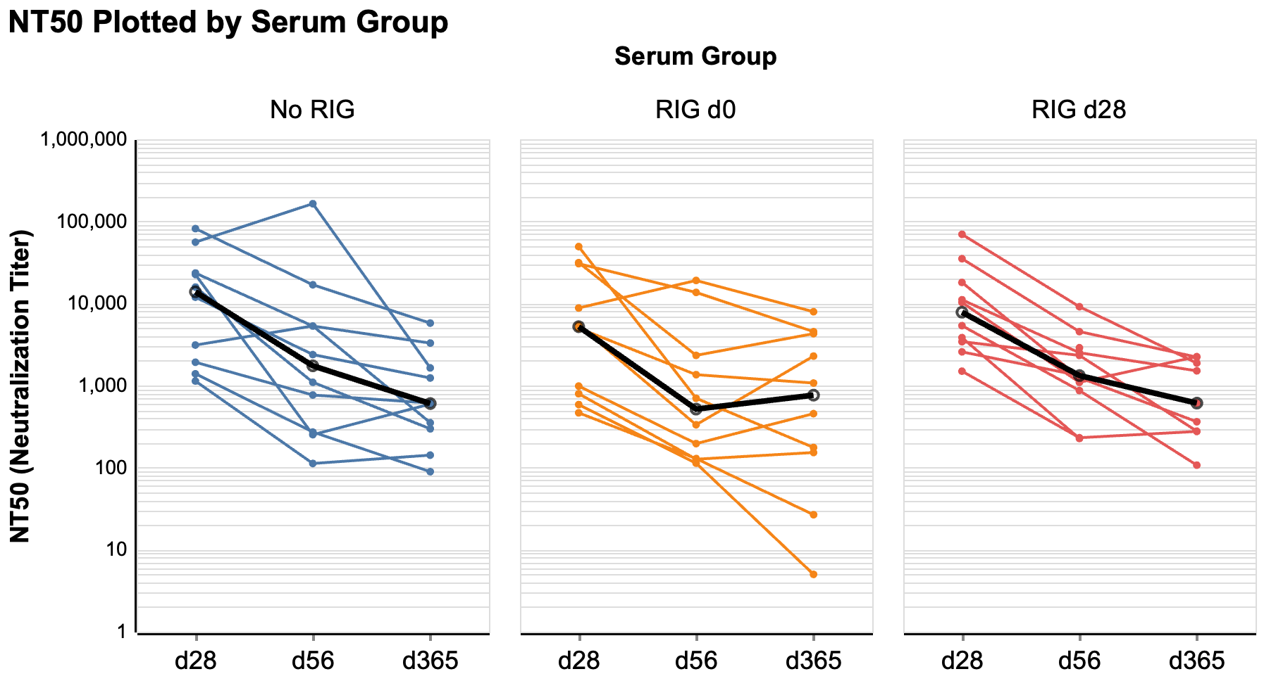
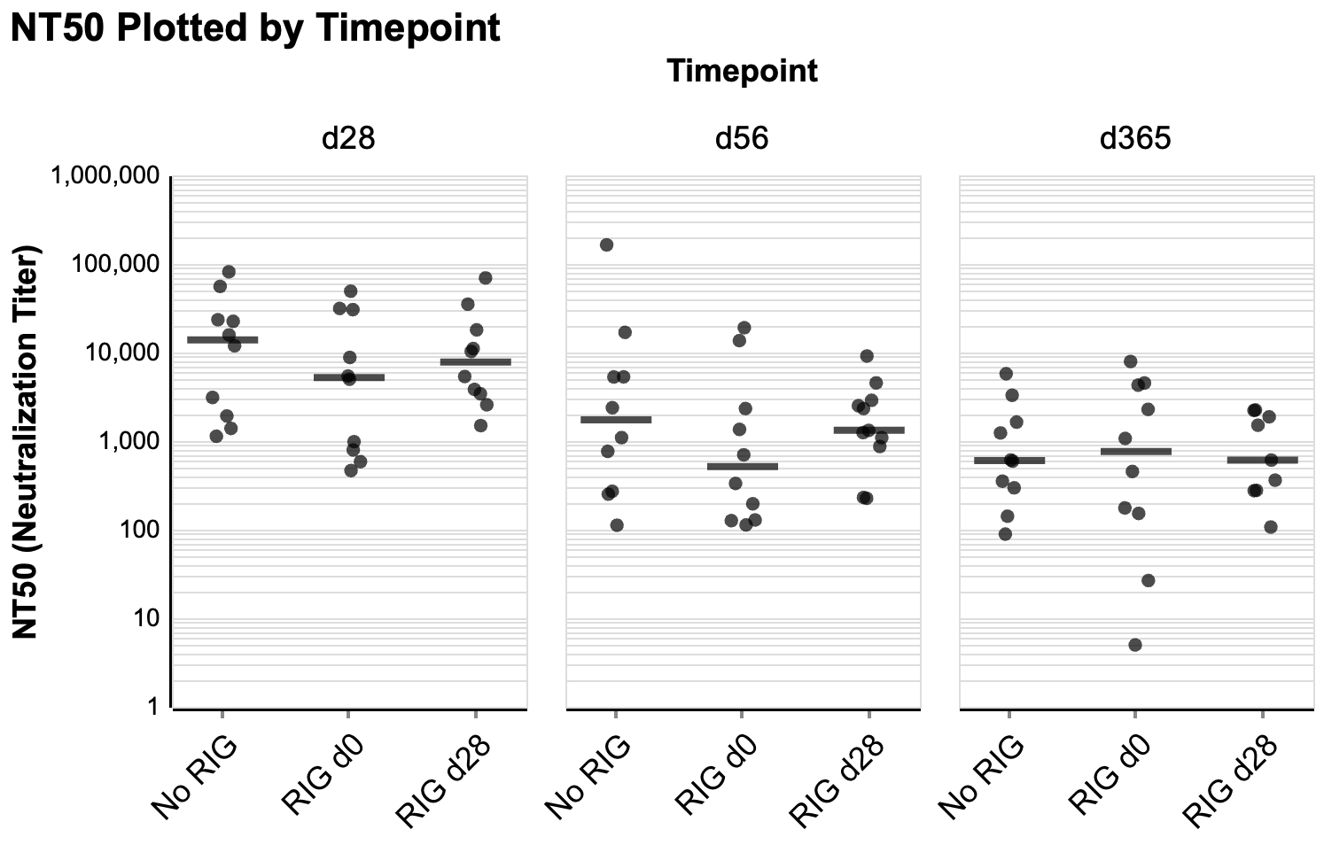
NT50 plots faceted by cohort and timepoint
1. Neutralization Titer (inverse of IC50; log scale) of each participant’s plasma samples across d28, d56, and d365, faceted by cohort. IC50s were generated through neutralization assays of Rabies G pseudovirus with plasma samples. Median NT50 for each timepoint shown in black.
2. Neutralization Titer (inverse of IC50; log scale) of each participant across Cohorts 1, 2, and 3, faceted by timepoint (d28, d56, d365). IC50s were generated through neutralization assays of Rabies G pseudovirus with plasma samples. The horizontal bar represents the median NT50 of each cohort for that timepoint.

Slide 3
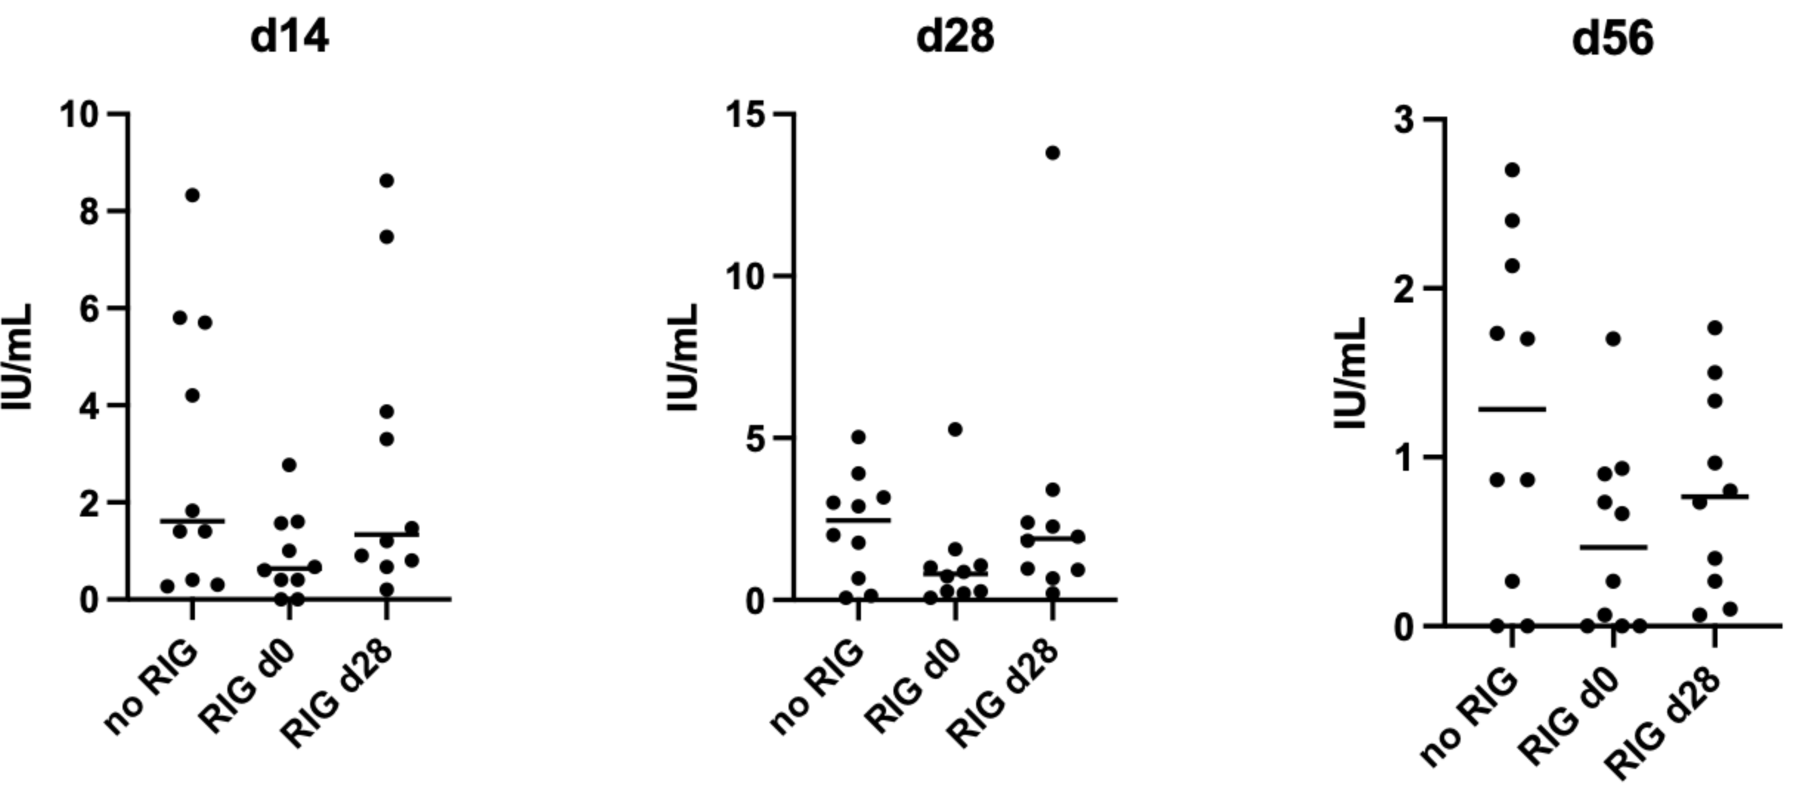
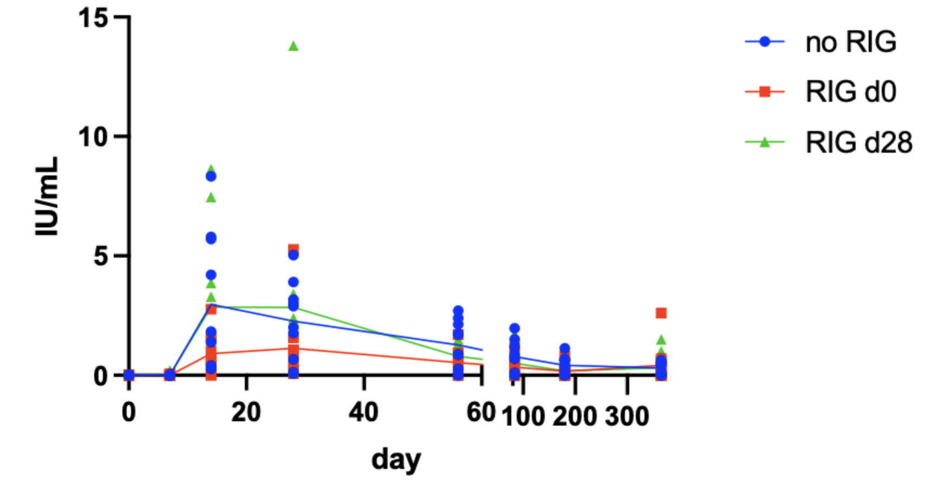
Comparison to previous data
Ali’s live-virus IU data
Ali’s live-virus neutralization kinetics data
*Note that d28 and d56 use different scales

Slide 4
Summary Methods
Methods for Neutralization assays with lentiviral particles pseudotyped with Rabies G
The following methods were adapted from Aditham et al¹.
Neutralization assays were performed using lentiviral particles pesuodotyped with a codon-optimized Rabies G protein from the Pasteur strain (NCBI reference number: NC_001542.1, locus number: NP_056796). A complete map of plasmids used in the pseudotyping process is available here: https://github.com/dms-vep/RABV_Pasteur_G_DMS/tree/main/Additional_Data/PlasmidSequences. 293T cells were transfected with a lentivirus genome expressing zsgreen and luciferase, 26_HDM-Hgpm2, 27_HDM-tat1b, 28_pRC-CMV_Rev1b, and 3968_HDM_Rabies-G_Pasteur_GenscriptOpt3 in a 4:1:1:1:1 ratio, respectively, using BioT according to the manufacturer’s recommendations. The pseudovirus was collected and filtered through a .45 μm SFCA filter and stored at -80° C until used.
Plasma samples were heat inactivated and processed. A 500 μL aliquot was taken from the plasma sample, heat inactivated at 56° C for 40 minutes, then centrifuged at 15,000 rpm for 10 minutes. The resulting supernatant was saved as the processed plasma sample.
The neutralization assays were performed in five batches, consisting of five, six , eight, eight, and eight plates. To monitor batch effects, participant 02’s plasma samples for all three timepoints (d28, d56, and d365) were run with each batch as a batch control.
24 hours prior to infection, black-wall, clear-bottom, poly-l-Lysine coated 96-well plates were seeded at a density of 30,000 293T cells per well. On the day of infection, 96-well setup plates were created, each containing two replicates of each of three plasma samples. The dilution series for each replicate consisted of eight steps of five-fold dilutions in D10 media (Dulbecco’s Modified Eagle Medium supplemented with 10% heat-inactivated fetal bovine serum, 2 mM l-glutamine, 100 U/mL penicillin, and 100 mg/mL streptomycin) supplemented with 4 μg/mL polybrene, beginning with an initial five-fold dilution of the heat inactivated plasma. The setup plates also contained a column of six Rabies G pseudovirus-only wells, located adjacent to the most dilute well of each dilution series.
The outer rim of wells of the setup plates contained only D10 media supplemented with 4 μg/mL polybrene to reduce the effects of evaporation on the experimental wells. Rabies G pseudovirus was diluted 33.33-fold in D10 media supplemented with 4 μg/mL polybrene, so a volume of 60 μL, delivered to all wells except the border wells, would yield a signal in the range of 200,000 – 700,000 RLU. The pseudovirus was delivered to all dilutions of a single plasma sample replicate and that replicate’s adjacent Rabies G pseudovirus-only well at the same time to ensure that each replicate had an associated pseudovirus-only well. After one hour of incubation at 37° C and 5% CO₂, 100 μL from each well of all setup plates was transferred to the corresponding seeded cell plates, which were incubated for 48 hours at 37° C and 5% CO₂.
After 48 hours of incubation, RLU values were measured using the Bright-Glo Luciferase Assay System. 120 μL of media was aspirated from each well (leaving an estimated 50 μL in each well after accounting for evaporation), then 50 μL of Bright-Glo was added to each well. After the back of the plate was stickered to reduce luminescence bleeding from well to well, a plate reader was used to measure luciferase activity. For each concentration of each plasma sample replicate, the fraction infectivity was calculated by dividing the well’s RLU value by the RLU value of that replicate’s associated Rabies G pseudovirus-only well. Neutralization curves and IC50 values were generated from the averaged fraction infectivity values of replicates using the neutcurve package² (https://github.com/jbloomlab/neutcurve).
  Aditham A.K., Radford C.E., Carr C.R., Jasti N., King N.P., Bloom J.D.. Deep mutational scanning of rabies glycoprotein defines mutational constraint and antibody-escape mutations. Cell Host Microbe, 33 (2025), pp. 988-1003, https://doi.org/10.1016/j.chom.2025.04.018.
  Loes AN, Tarabi RAL, Huddleston J, Touyon L, Wong SS, Cheng SMS, Leung NHL, Hannon WW, Bedford T, Cobey S, Cowling BJ, Bloom JD.2024. High-throughput sequencing-based neutralization assay reveals how repeated vaccinations impact titers to recent human H1N1 influenza strains. J. Virol., 98 (2024) e0068924, https://doi.org/10.1128/jvi.00689-24

Slide 5
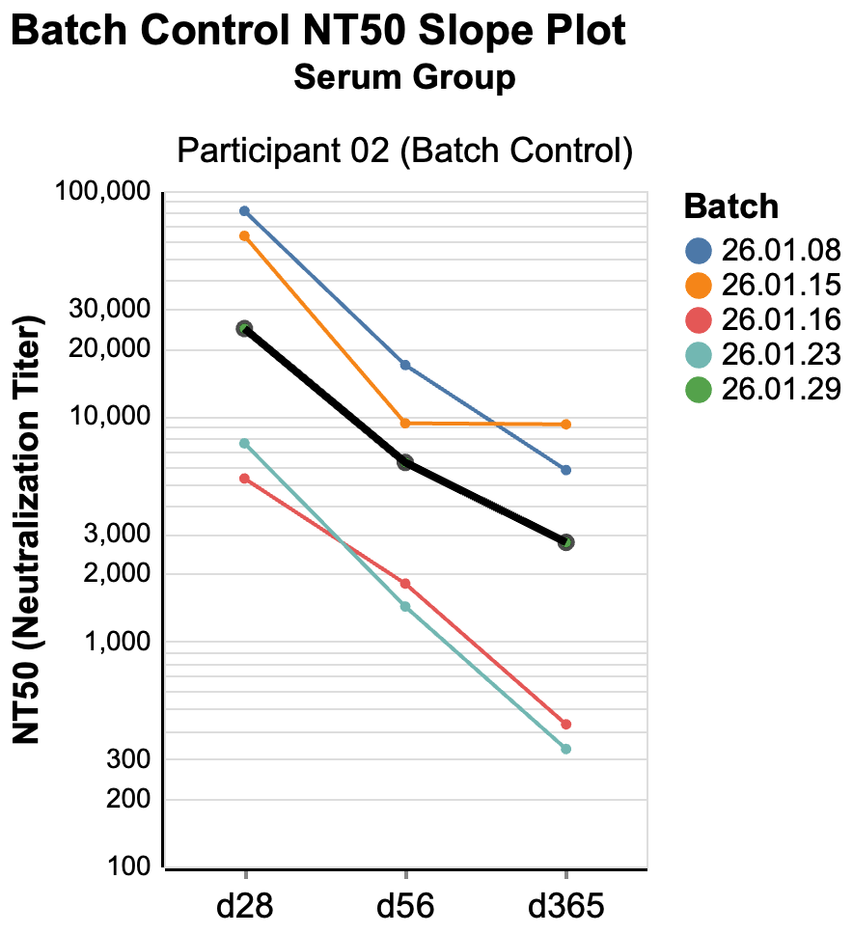
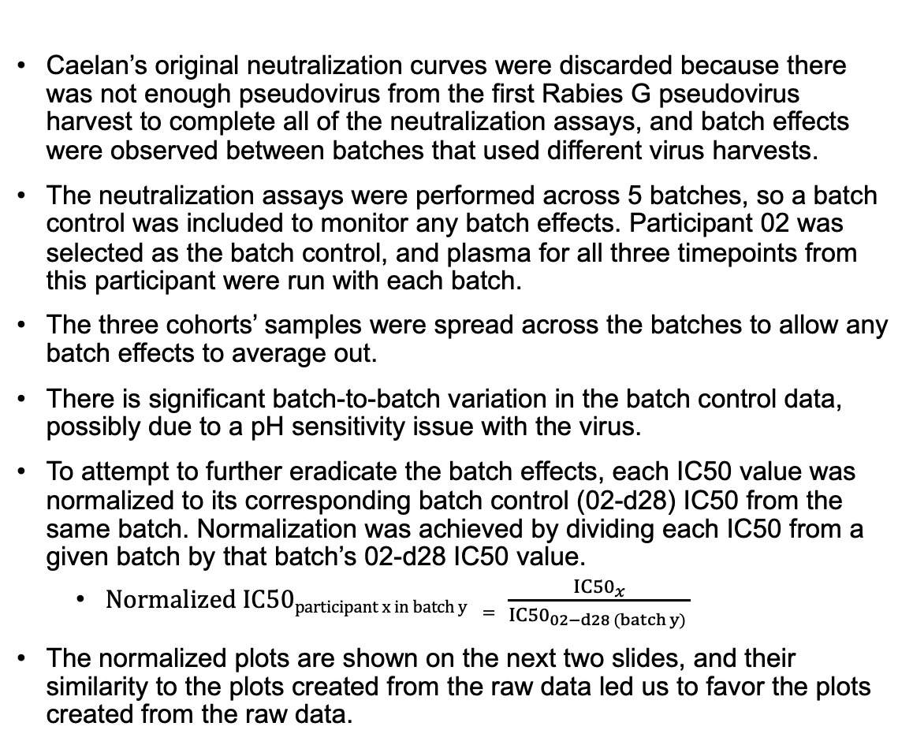
Batch variation
Caelan’s original neutralization curves were discarded because there was not enough pseudovirus from the first Rabies G pseudovirus harvest to complete all of the neutralization assays, and batch effects were observed between batches that used different virus harvests.
The neutralization assays were performed across 5 batches, so a batch control was included to monitor any batch effects. Participant 02 was selected as the batch control, and plasma for all three timepoints from this participant were run with each batch.
The three cohorts’ samples were spread across the batches to allow any batch effects to average out.
There is significant batch-to-batch variation in the batch control data, possibly due to a pH sensitivity issue with the virus.
To attempt to further eradicate the batch effects, each IC50 value was normalized to its corresponding batch control (02-d28) IC50 from the same batch. Normalization was achieved by dividing each IC50 from a given batch by that batch’s 02-d28 IC50 value.
  $Normalized IC50participant x in batch y = \frac{{IC50}_{x}}{{IC50}_{02−d28 (batch y) }}$
The normalized plots are shown on the next two slides, and their similarity to the plots created from the raw data led us to favor the plots created from the raw data.
3. Neutralization Titer (inverse of IC50; log scale) of batch control neutralization assays. Plasma for all three timepoints from participant 02 was run with each batch of assays as the batch control. NT50 values for the same batch control timepoint varied more than 10X between some batches.

Slide 6
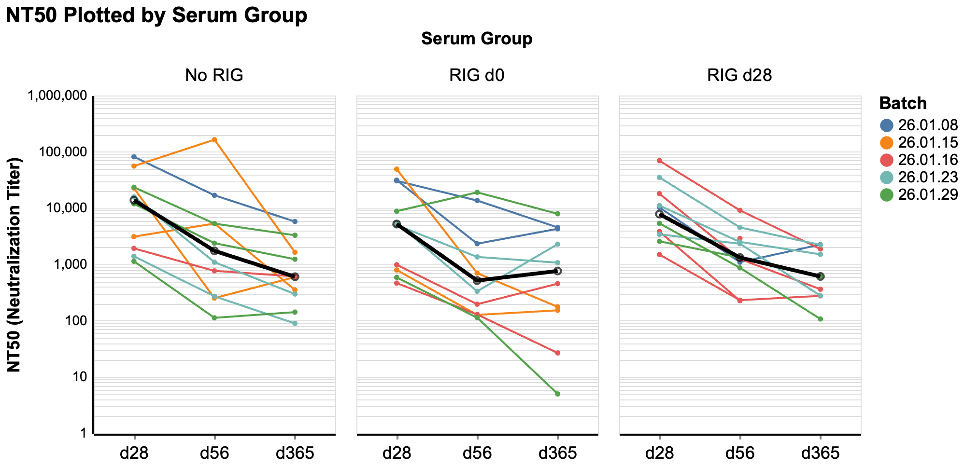
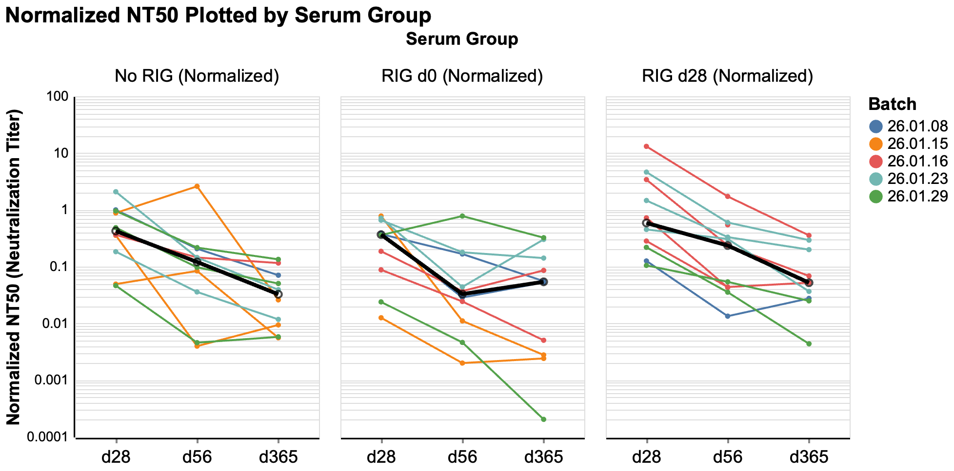
Normalized and non-normalized cohort-faceted plots compared
1. Neutralization Titer (inverse of IC50; log scale) of each participant’s plasma samples across d28, d56, and d365, faceted by cohort. IC50s were generated through neutralization assays of Rabies G pseudovirus with plasma samples. Each participant’s data is color-coded by batch to illustrate each cohort’s distribution across batches. Median NT50 for each timepoint shown in black.
4. Normalized Neutralization Titer (inverse of IC50; log scale) of each participant, faceted by cohort. All IC50 values from a given batch were normalized to that batch’s control (participant: 02, timepoint: d28) by dividing each IC50 value by the batch control IC50. Each participant’s data is color-coded by batch to illustrate each cohort’s distribution across batches. Median NT50 for each timepoint shown in black. Some individual participant NT50s shift relative to the non-normalized data, but the overall trends remain the same.

Slide 7
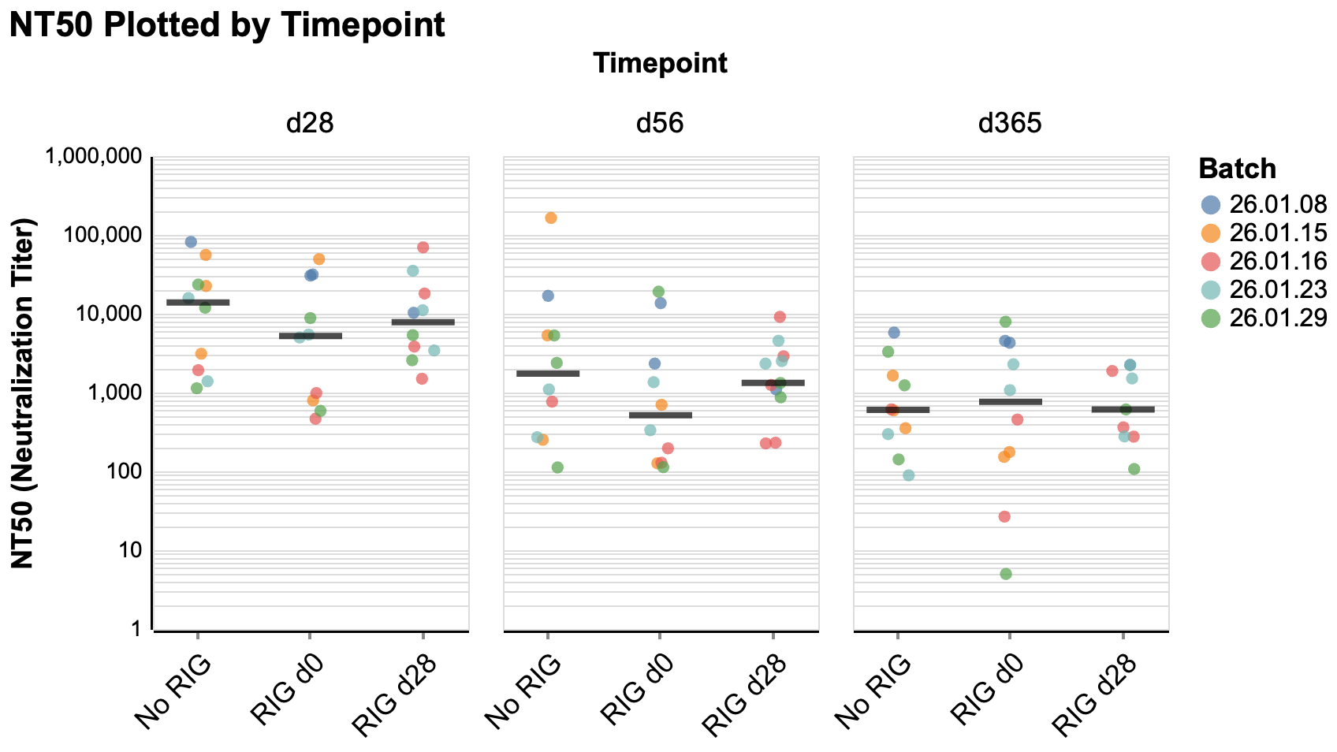
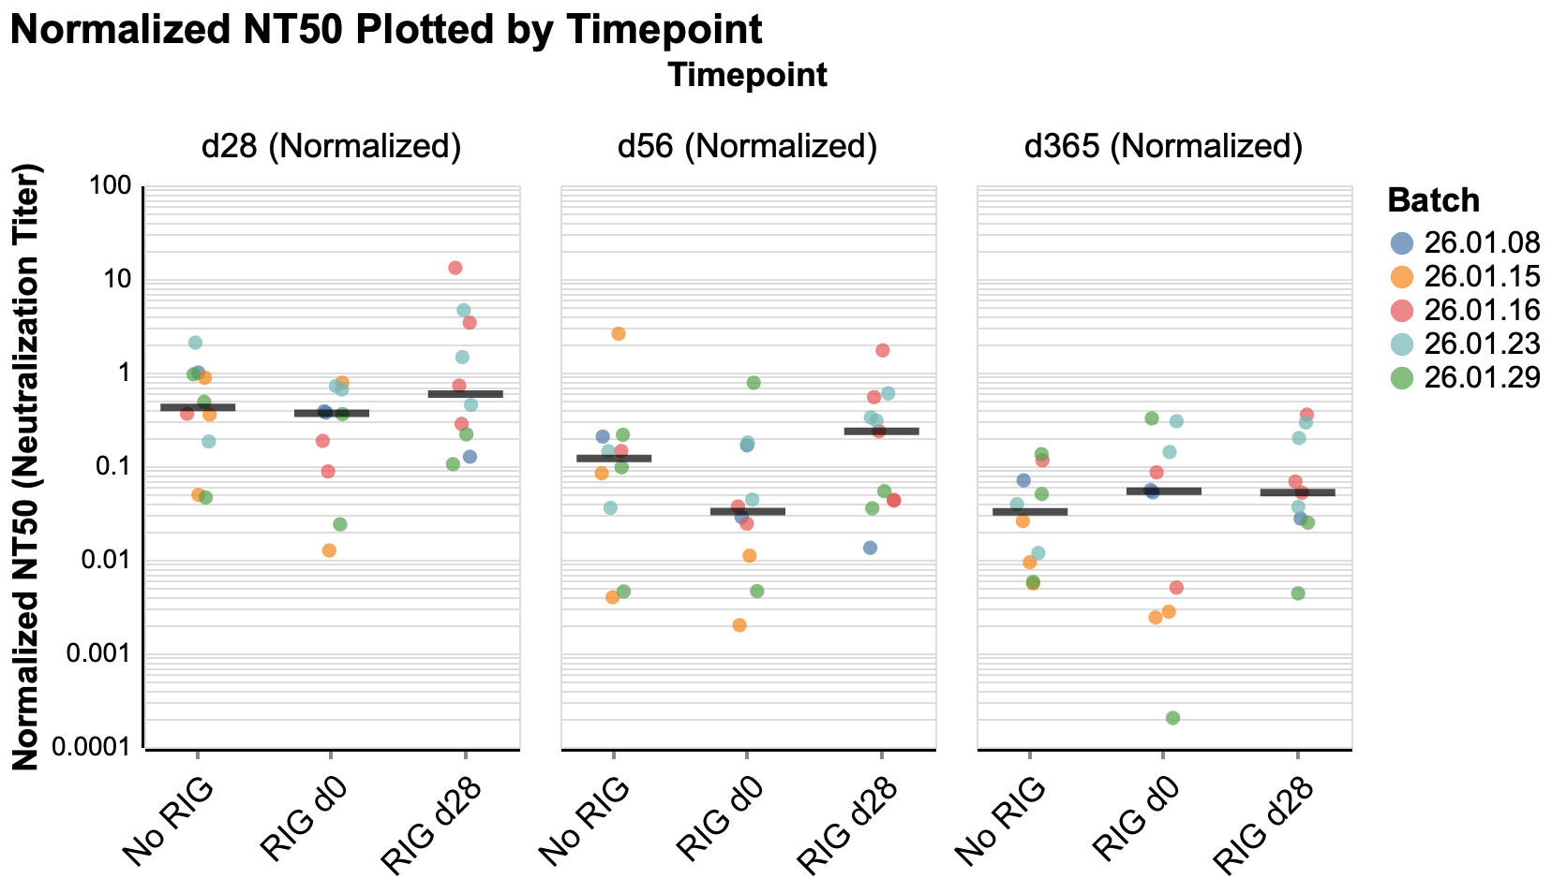
Normalized and non-normalized timepoint-faceted plots compared
2. Neutralization Titer (inverse of IC50; log scale) of each participant across Cohorts 1, 2, and 3, faceted by timepoint (d28, d56, d365). IC50s were generated through neutralization assays of Rabies G pseudovirus with plasma samples. Each participant’s data is color-coded by batch to illustrate each cohort’s distribution across batches. The horizontal bar represents the median NT50 of each cohort for that timepoint.
5. Neutralization Titer (inverse of IC50; log scale) of each participant, faceted by timepoint. All IC50 values from a given batch were normalized to that batch’s control (participant: 02, timepoint: d28) by dividing each IC50 value by the batch control IC50. Each participant’s data is color-coded by batch to illustrate each cohort’s distribution across batches. The horizontal bar represents the median NT50 of each cohort for that timepoint. Although the overall median trends do vary slightly from the non-normalized batches, the differences are minimal.

Slide 8
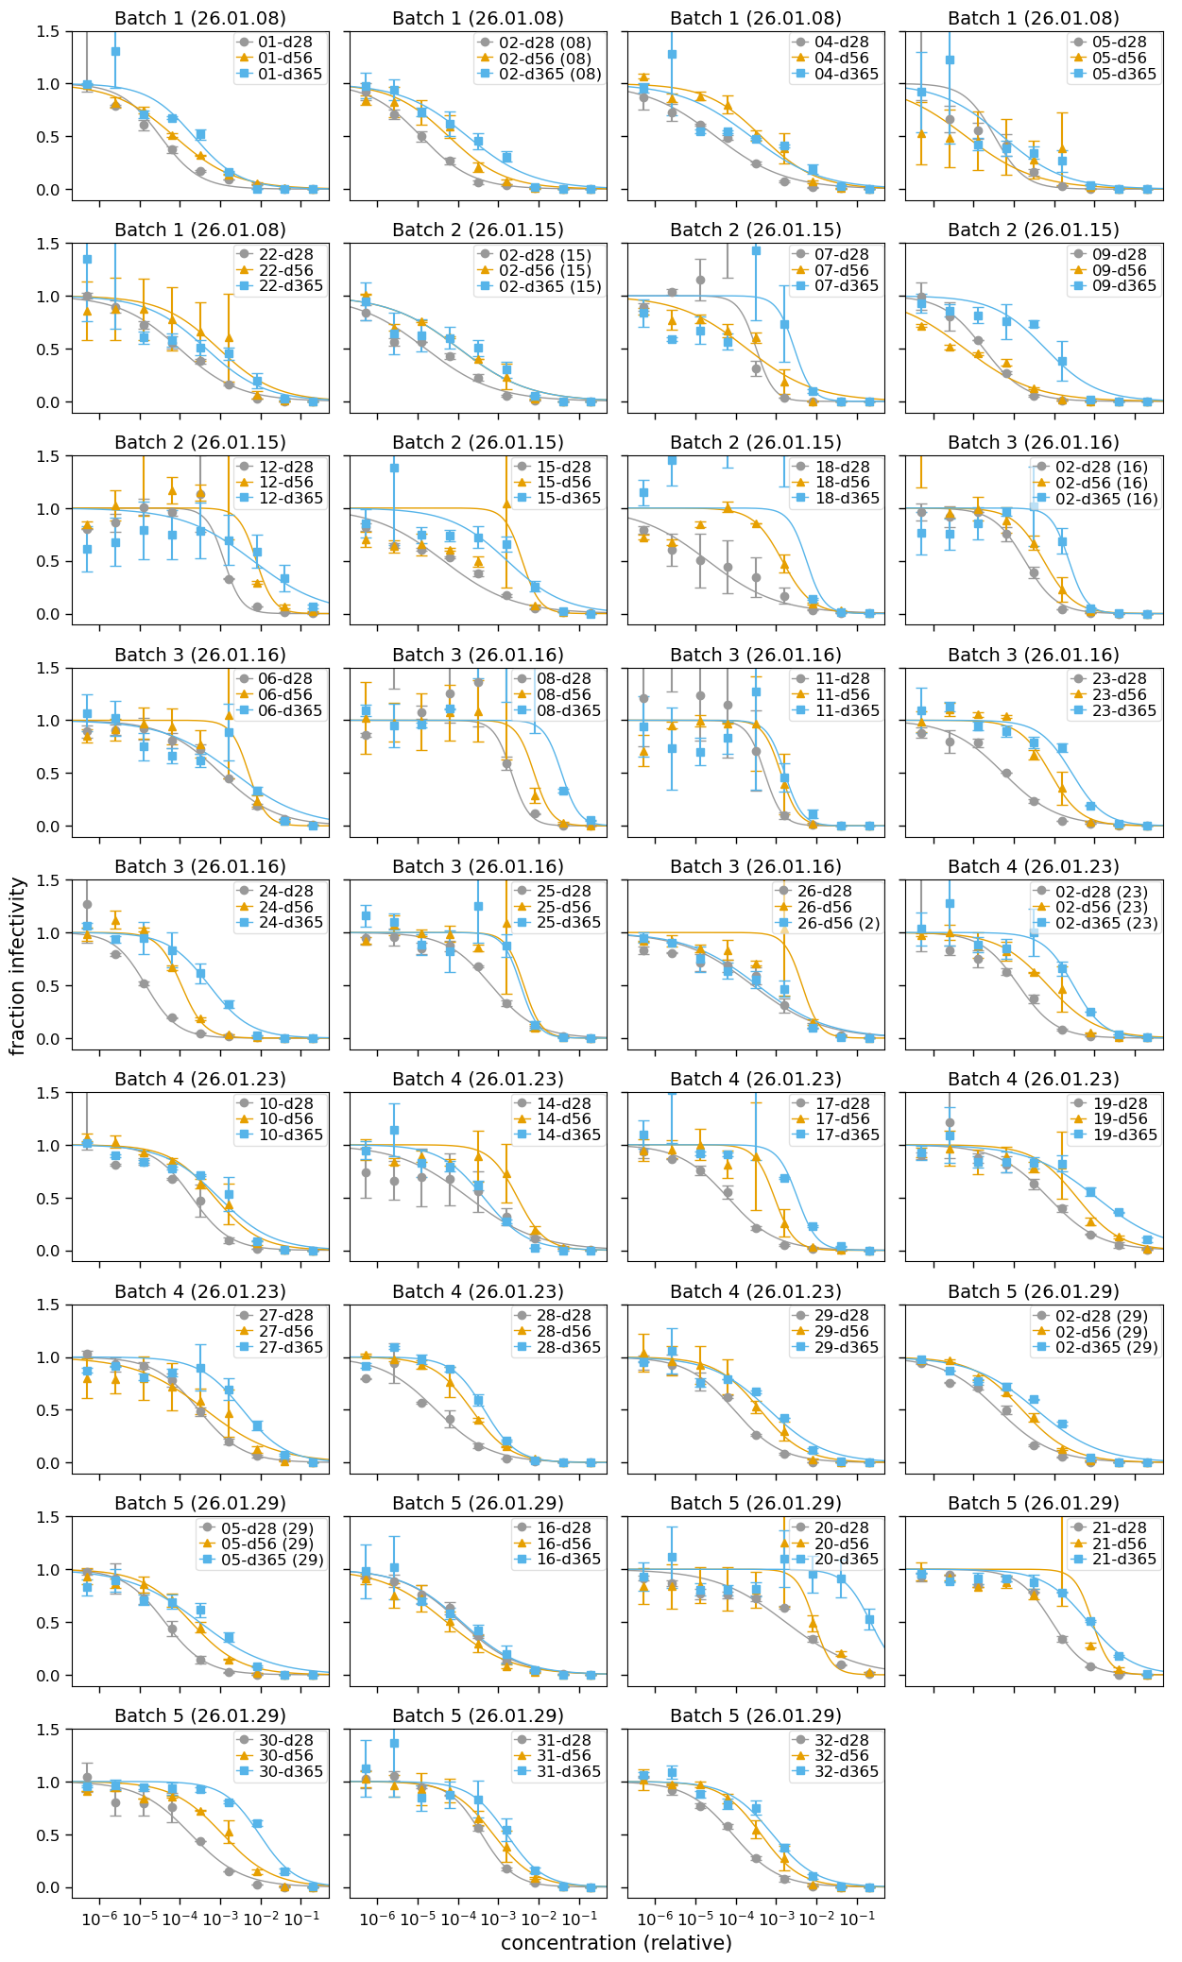
Neutralization curves
Notes:
I feel like the curves get cleaner in the later batches

