Slide 1
An Assembler and Linker for the MC68HC11 Instruction Set
By Lewis Gavin

Slide 2
Content
Background
Project details
Research and Analysis
Project domains and Analysis decisions
Design – Implementation – Testing
Working within the Methodology
Critical Evaluation
Notes:
in depth idea of how the project was conducted
beginning with the original idea and the project outlook
the steps taken between completing the project,
finally an evaluation of my personal experience and the project as an academic experience

Slide 3
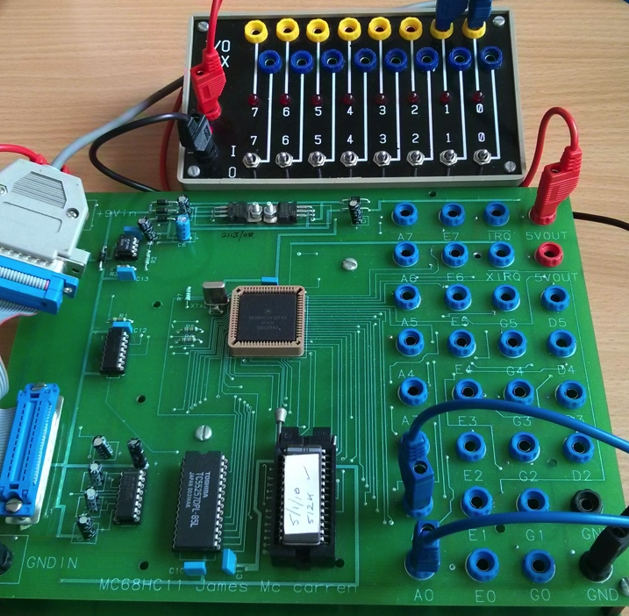
Background
Humans and Computers
Compilers and Assemblers
68HC11 Microcontroller
Assemblers and their Development Environments
Notes:
3 main areas then later a fourth
Human and computer relationship – interpretation of data – introduced programming languages
This lead to history of assemblers and compilers – their functionality/techniques – simpler languages
Used simple example – mc68hc11 – understand how computers work from the bottom up
As project developed – looked into IDE’s and lack of for assemblers

Slide 4
Project Objectives
Gain an understanding using a simple example of how computers operate and interpret programs
Bridge the gap between human readable code and machine code
Develop an assembler for the 68HC11 microcontroller
Enhance technical understanding and skills
Notes:
Objectives - concentrating on the assembler and compiler domain and language translation,
it was a technical challenge and experience - increase my knowledge of computer theory - technical ability.

Slide 5
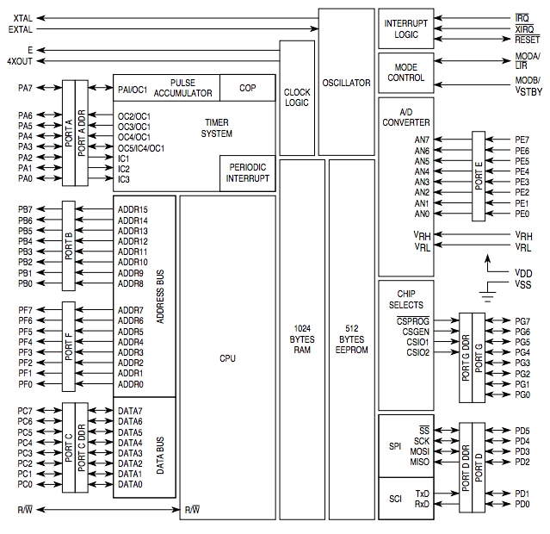
Research and Analysis
MC68HC11 Architecture
8 and 16 bit Registers
Accumulators A, B (8-bit) and D (A+B)
Index Registers X and Y
Program Counter
Stack Pointer
Condition Code Register (8-bit)
Addressing Modes
Direct and Extended
Inherent
Indexed
Immediate
Relative
Notes:
68hc11 architecture - gain an understanding of how microcontroller operated and how it dealt with and understood programs.
Two areas – registers and addressing modes.
Addressing modes for a parser – needed to understand
Research into assemblers and compilers themselves.
Typical data structures used – output files – executable files

Slide 6
Analysis
RUP methodology
Iterative
Flexible
UML based
Token Parsing
Object File Format
Executable Format
Cross Platform Usability
Label
Opcode
Operand
Directive
COFF
ELF
Motorola SREC -S19
Notes:
RUP allowed for a flexible iterative process project domain was initially unknown - allowed me to revisit design and implementation The project could also be very easily broken down into components – each iteration = working code
review this before moving to the next section, and better preparing or designing the next section
token parsing – suitable data structures – vector for program code (keeps data in order), map for opcode lookup and symbol table, allows for quick lookup to prevent duplicates.
Object file format – COFF and ELF – used features from both but created an efficient format of my own as I was in control of the linker that would be utilising it.
Executable format – S19 file – how it was structured
Cross Platform usability – allowing to parse files generated on windows/linux/unix – carriage returns are different on different platforms for example.
Built code using the C++ standard libraries where possible. Used cross platform UI framework using native components to be compiled across multiple platforms.

Slide 7
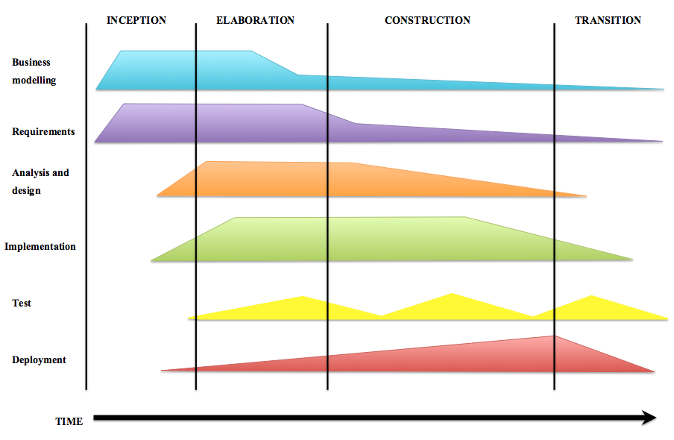
Design, Implementation and Testing
RUP – Iteration based
Each component/class was designed, implemented and tested independently
Integration tests ensured these component worked together
GUI built after all logic was complete
Class designs built upon analysis and requirements
Notes:
3 classes + 1 utility class – could be designed and developed and tested independently
Integration tests across components allowed me to test compatibility
GUI built on top of program logic

Slide 8
Parser
Power to decide language features
One pass
Tokens
Opcode
Label
Directive
Operand
Constant numbers, strings or labels
Data structures
Vector vs. Map
Notes:
One pass assembly – quicker, read a file once – anything unresolved can be checked for resolution when outputting the findings into the object file.
Discuss how tokens were distinguished – checking against opcode map and directives first

Slide 9
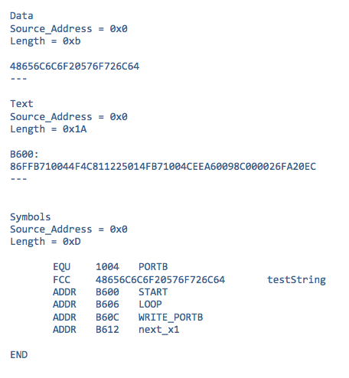
Translator
Early translation – what could the parser do before hand?
Generating the Object file based on analysis and design
Sections
Text
Data
Relocation
Symbol Table
Notes:
Parser converting as many operands to hexadecimal as possible
The different sections and what they contained – the reason for their layout – easy parsing for the linker

Slide 10
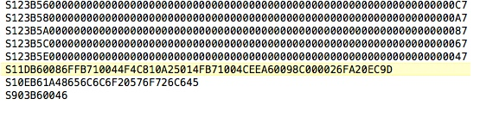
Linker
Parsing Object files
LKF File - Configuration
Resolving data
Symbol value resolution
Address size resolution (Direct to Extended)
Resolving relative branch addresses
Resolving opcode values
Generating S19 File
Notes:
LKF file – using cosmic assembler example – allows the start address of the code to be chosen.
Resolving data – symbol values – using symbol tables to lookup values that were marked as unknown.
-address sizes – unknown dir or ext
Opcode values change – DIR to EXT – EXT opcode is always 0x20 more than the DIR
Generating S19 in the correct format – S record – size – address – code - checksum

Slide 11
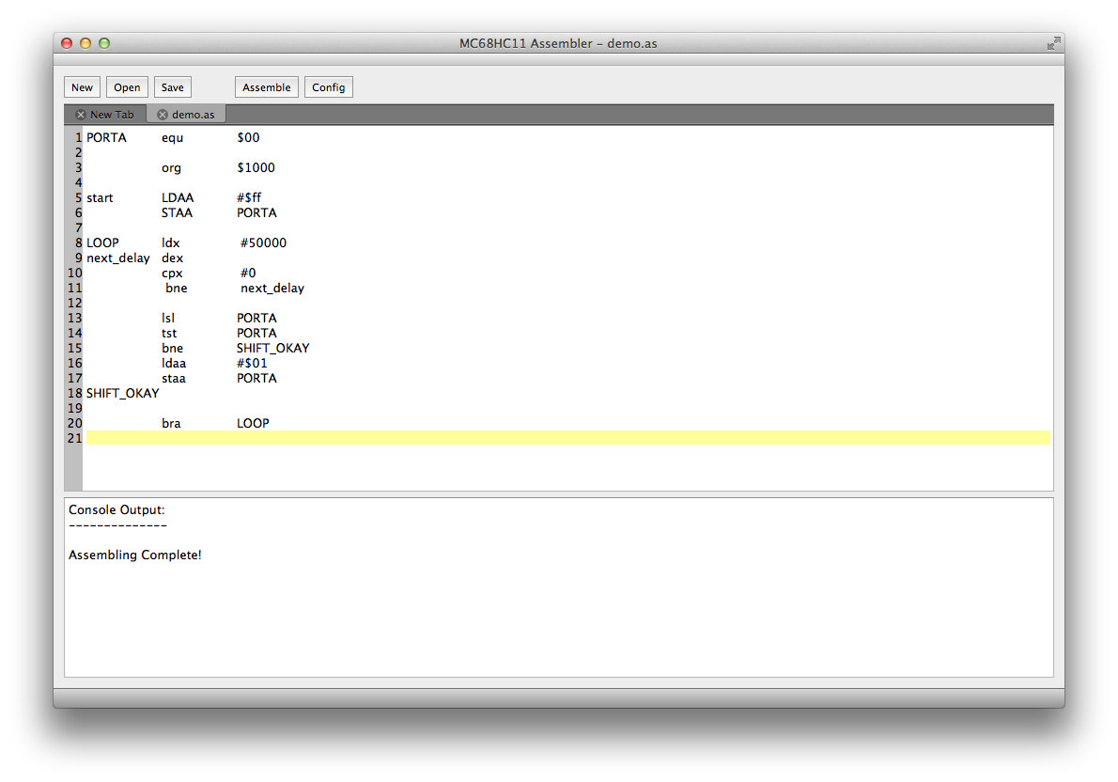
Graphical User Interface
Multi-purpose IDE
Built to allow future extension
Notes:
GUI – allowed for all features of a text editor along with assembly and config –
built to allow further extensions by opening text files of all types so source files in different languages could be used.

Slide 12
Testing
Unit Tests
Integration Tests
System Tests
Comparison against existing systems
Notes:
Unit tests – Test driven programming, allowed for each function to be tested based on a set of example data.
Integration tests – allowed results from each iteration to be tested as a unit instead of individually.
System tests – running the whole system, utilising its executable files – ensuring they run on the 68HC11.
Compiling with an existing assembler and examining the source

Slide 13
Critical Evaluation
Goals
Outcome
Gain an understanding using a simple example of how computers operate and interpret programs
Bridge the gap between human readable code and machine code
Develop an assembler for the 68HC11 microcontroller
Enhance technical understanding and skills
Could investigate computer architecture and program interpretation.
Discovered functionality of Compilers as well as Assemblers – learnt that good compilers/interpreters make better languages
Solution that can be used in the real world to assemble simple programs
Theory knowledge gained was large and technical ability was greatly enhanced
Improved C++ skills
Deeper understanding

Slide 14
Personal Evaluation
Improvements
Strengths
Deeper initial analysis – don’t take anything for granted
Be patient when designing – rushing the process caused problems during development
Trust personal ability
Time management
Organisation of workflow
Independent working

Slide 15
Project Enhancement
Project was built to allow components to be added
High level language compiler to be built on top
Plug in Compiler to the GUI
Prototype for Cloud Compilation Possibility
Allow users to send source through a cloud service
Generate an executable file for user specified platform
Allow the user to download and obtain source file
Useful for mobile device development or sending executable to microcontrollers over internet/Wi-Fi

Slide 16
Final Thoughts…
Perfect Computer Science project
I feel not enough developers understand how their programs work/are interpreted by the computer
Gained great understanding of program interpretation and importance of compilers
Knowledge and skills to be taken into industry
Mentally straining however fully enjoyable
Looking to implement some of the extensions as a summer project

Slide 17
Thanks! Any Questions?

