Slide 1
The Curry-Howard Correspondence: Bridging Types and Logics
Major Area Exam
June 13th 2018
Candidate: Miroslav Gavrilov
💺Ben Hardekopf
Chandra Krintz
Tevfik Bultan

Slide 2
Outline
Motivation
Intuitionistic logic and simply-typed lambda calculus
Classical logic and lambda-mu calculus
Several interesting findings
A more refined perspective
Conclusion
1

Slide 3
Outline
Motivation
Several interesting findings
Classical linear logic and process calculi
Predicate logic and information-flow types
A more refined perspective
Conclusion
1

Slide 4
Outline
Motivation
Several interesting findings
A more refined perspective
Functors and general refinement systems
Conclusion
1

Slide 5
Outline
Motivation
Several interesting findings
A more refined perspective
Conclusion
Review
Opportunities
1

Slide 6
Outline
Motivation
Several interesting findings
A more refined perspective
Conclusion
2

Slide 7
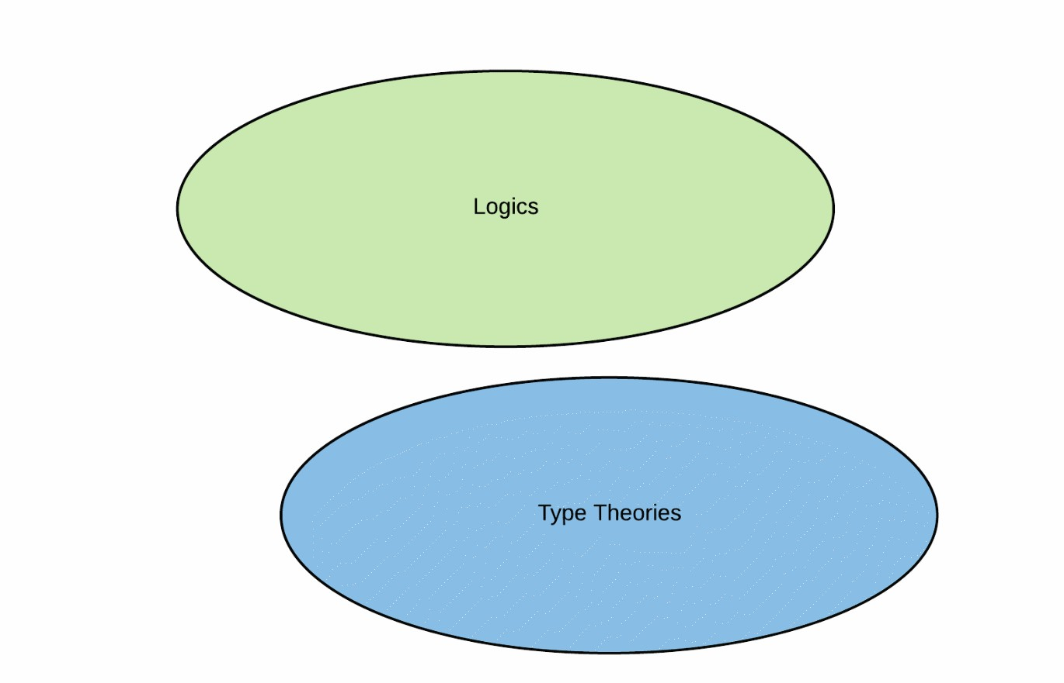
Motivation
3

Slide 8
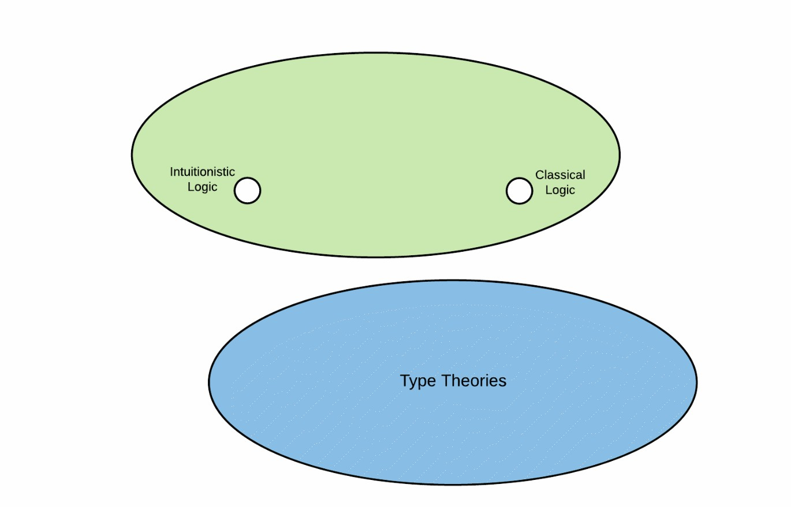
Motivation
3

Slide 9
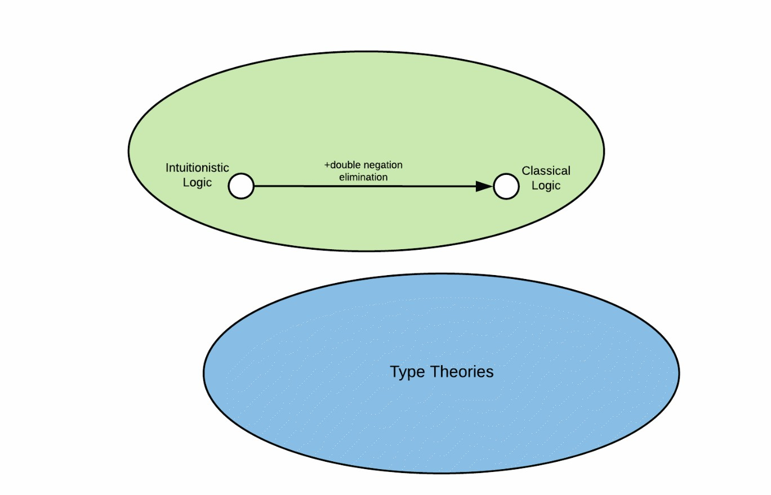
Motivation
3

Slide 10
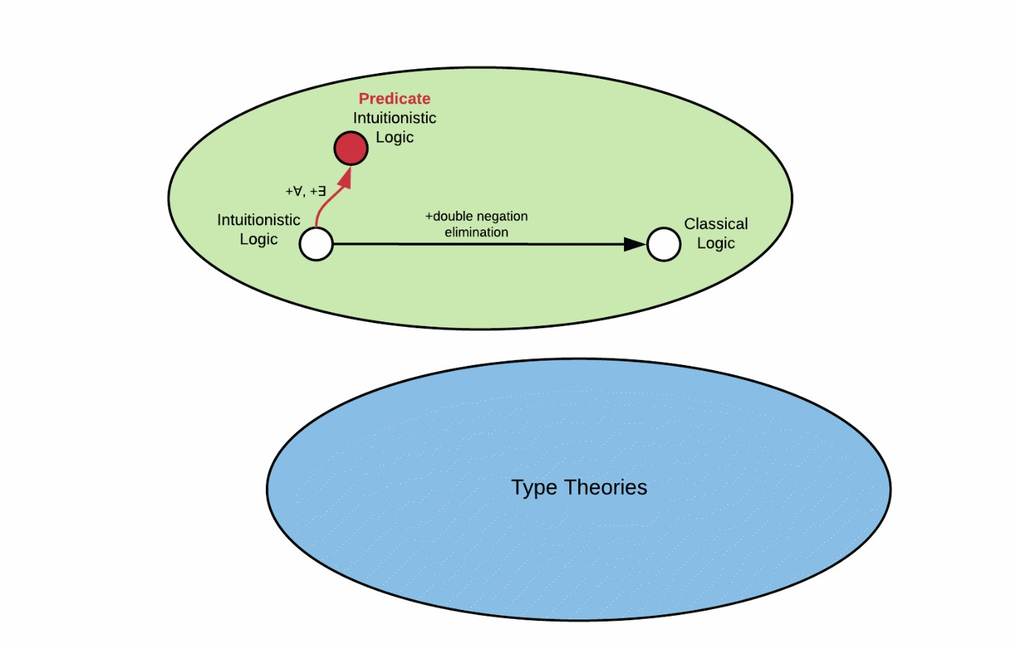
Motivation
3

Slide 11
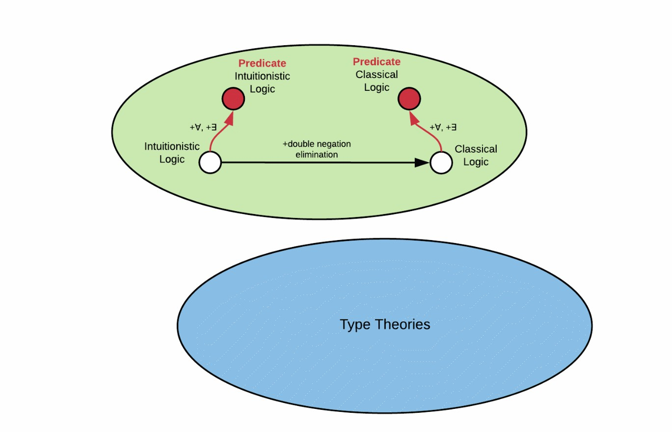
Motivation
3

Slide 12
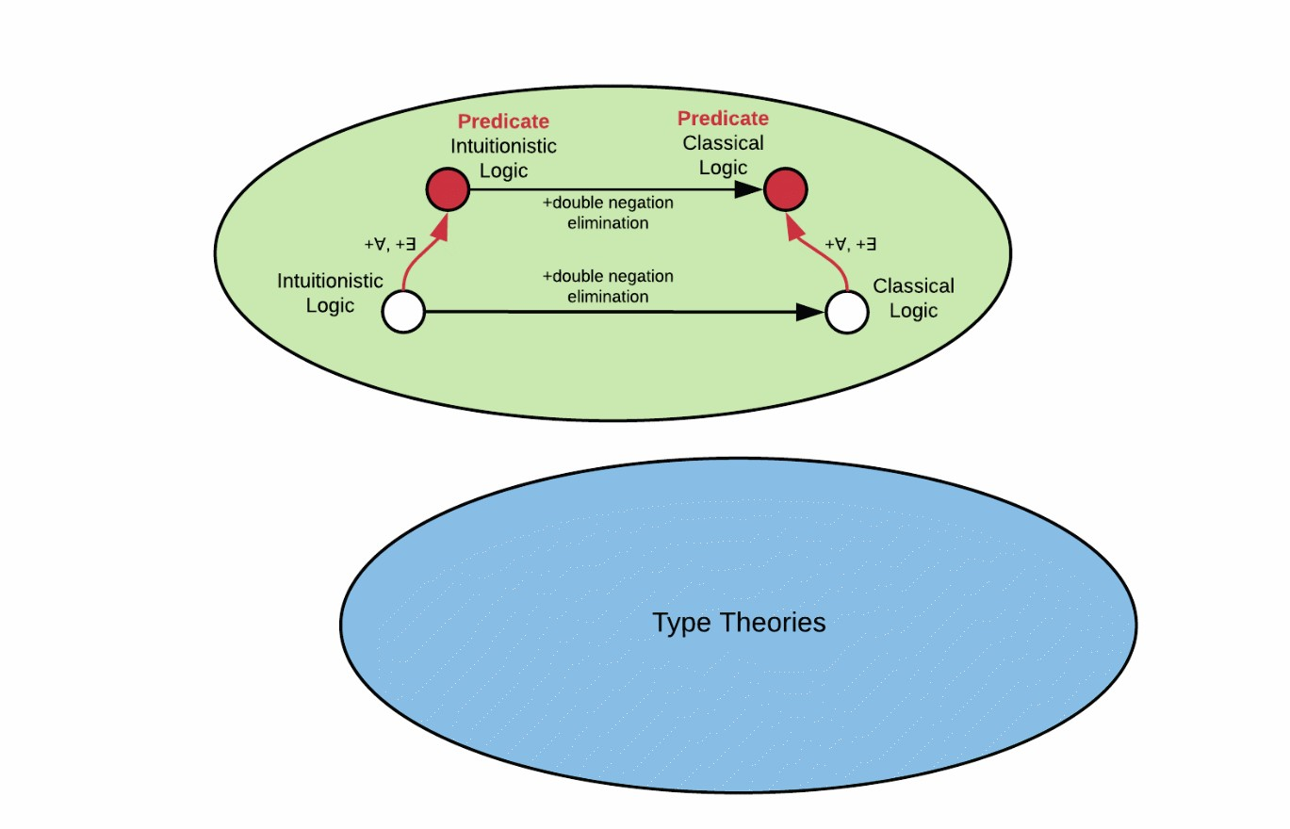
Motivation
3

Slide 13
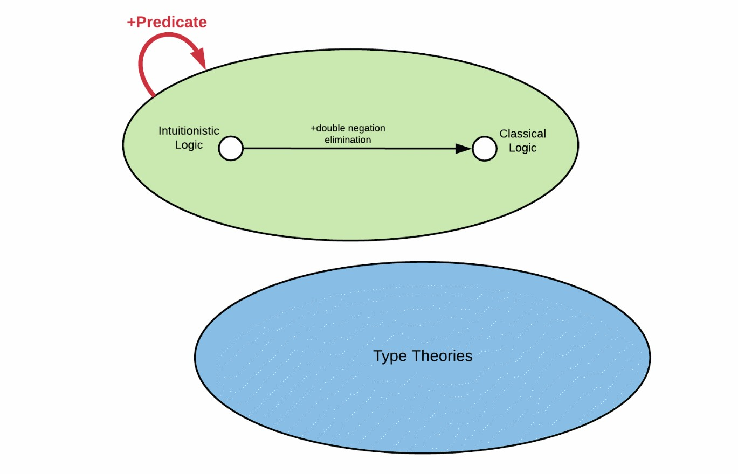
Motivation
3

Slide 14
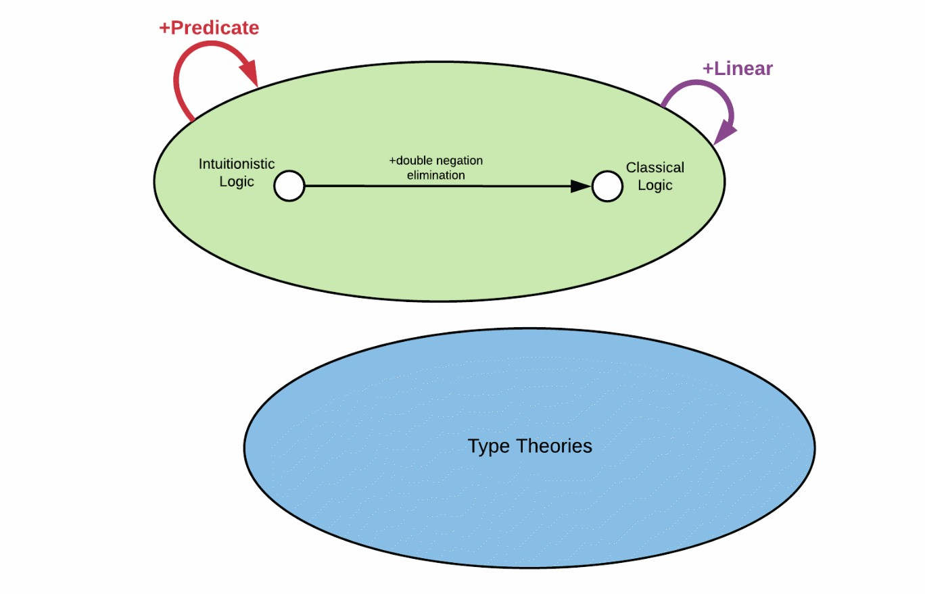
Motivation
3

Slide 15
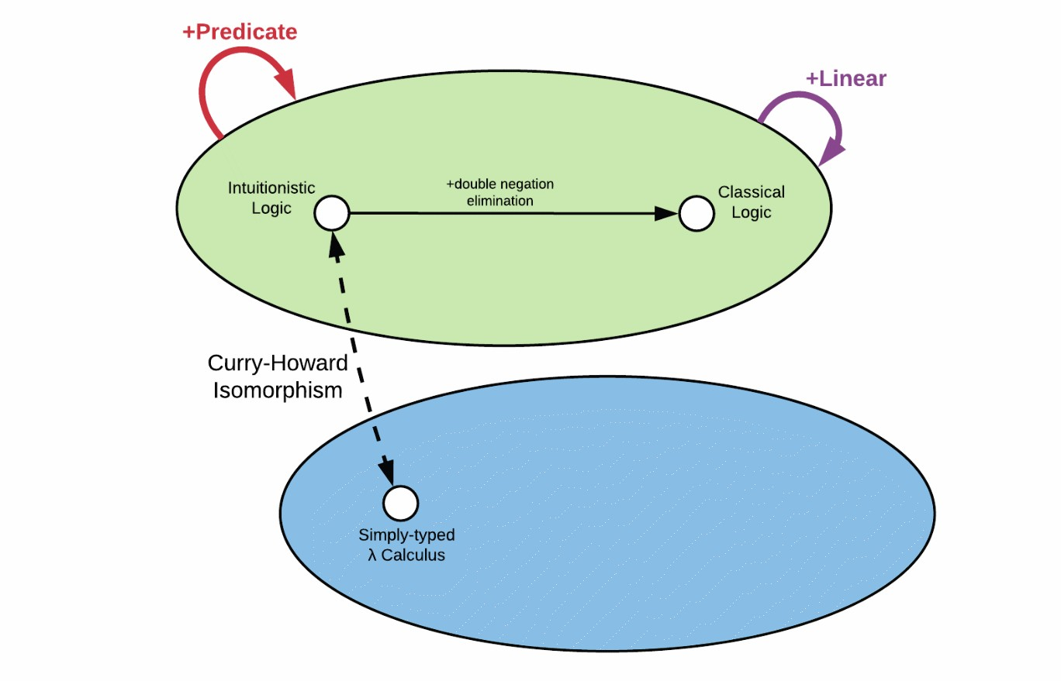
Motivation
3

Slide 16
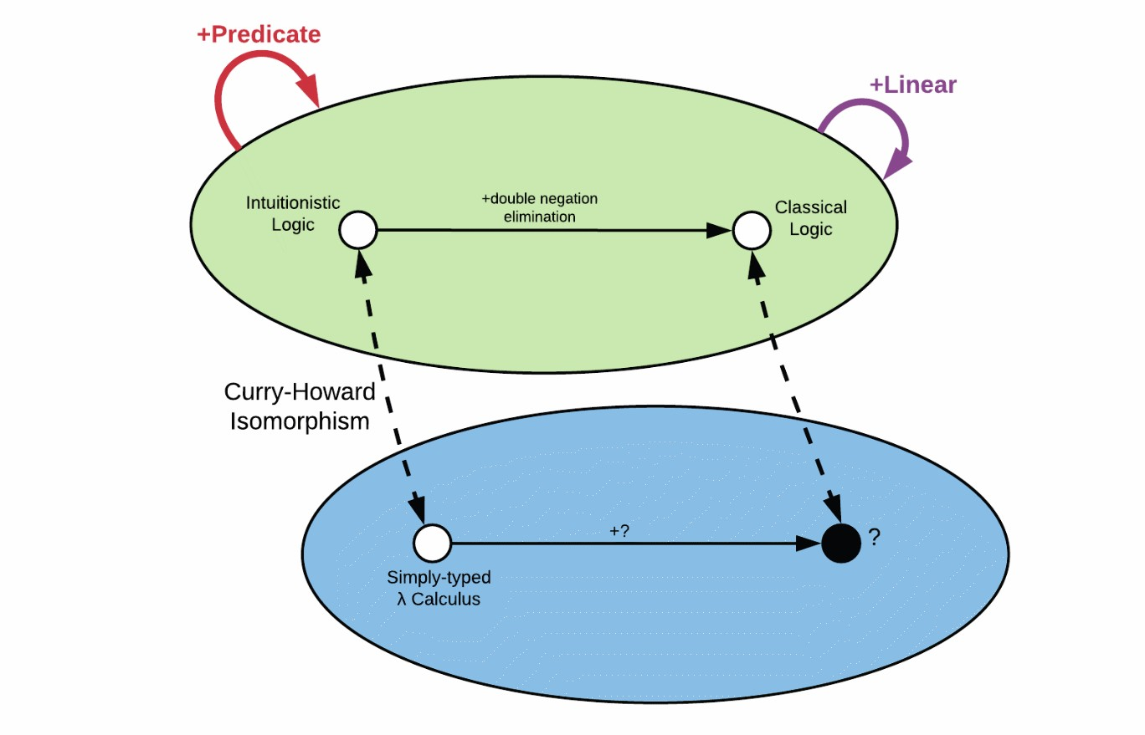
Motivation
3

Slide 17
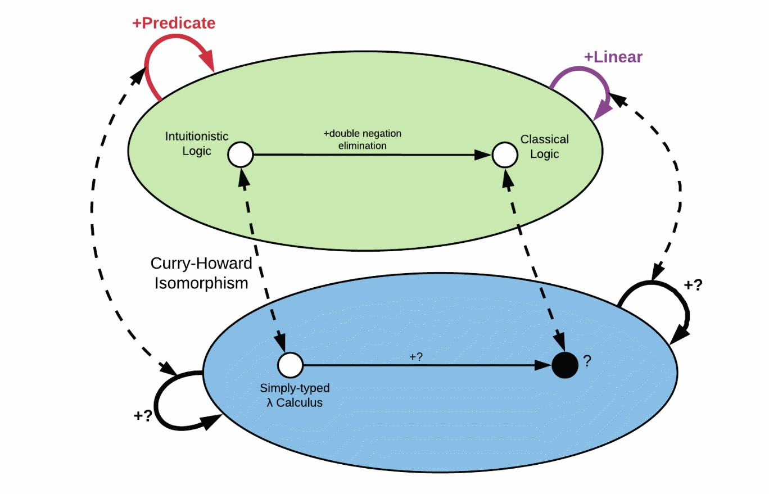
Motivation
3

Slide 18
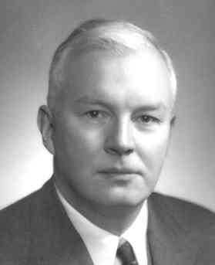

Motivation
Logic equals^{1,2}
Types
A ⇒ B ≡ A → B
A ∨ B ≡ A + B
A ∧ B ≡ A × B
Haskell Curry
William Alvin Howard
[1] H. B. Curry. Functionality in combinatory logic. Proceedings of the National Academy of Science, 20:584–590, 1934.
[2] W. A. Howard. The formulae-as-types notion of construction. In To H. B. Curry: Essays on Combinatory Logic, Lambda Calculus,
and Formalism, pages 479–491. Academic Press, 1980.
4

Slide 19
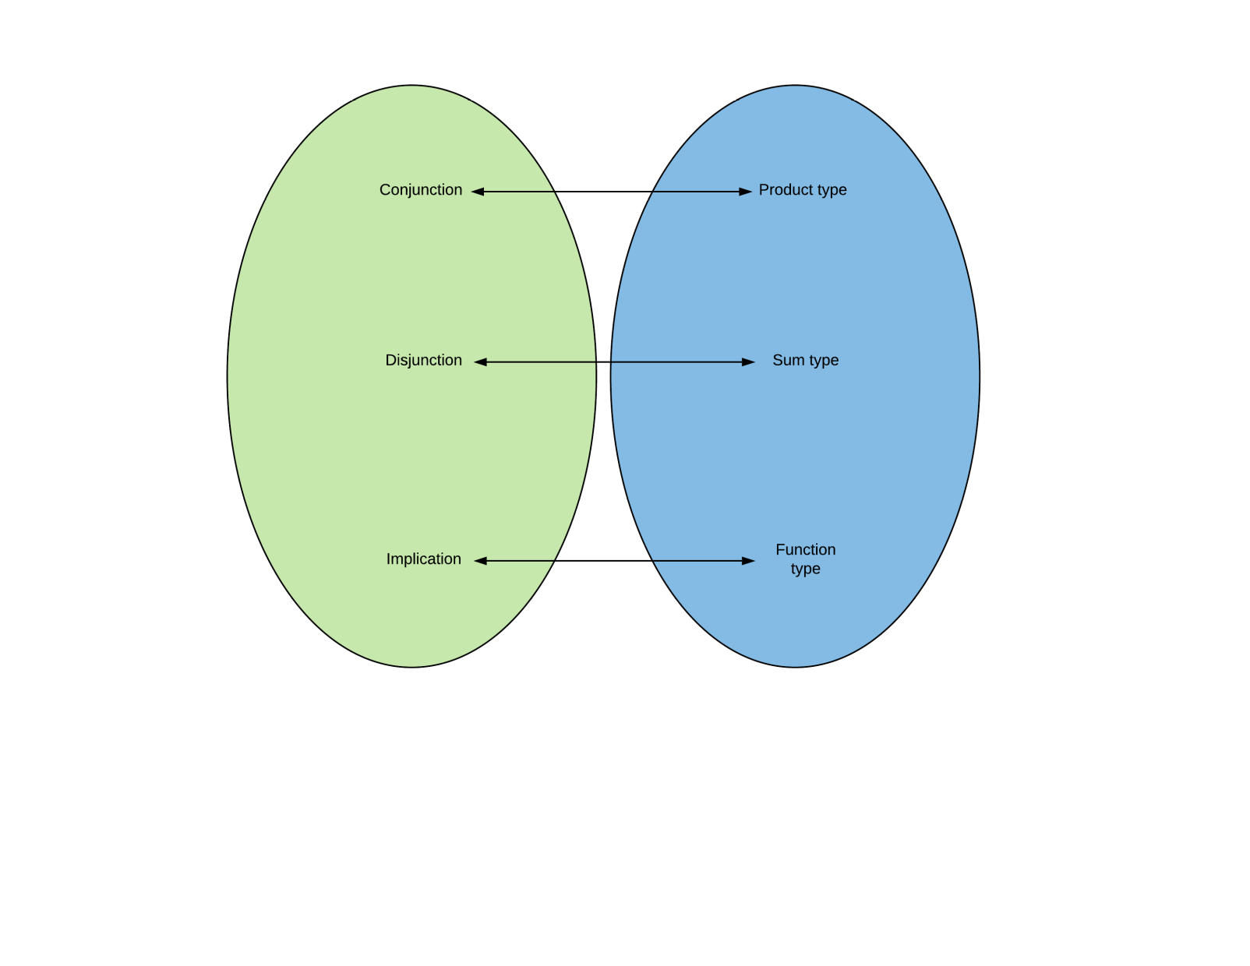
Motivation
Intuitionistic Logic
Lambda
Calculus
5

Slide 20
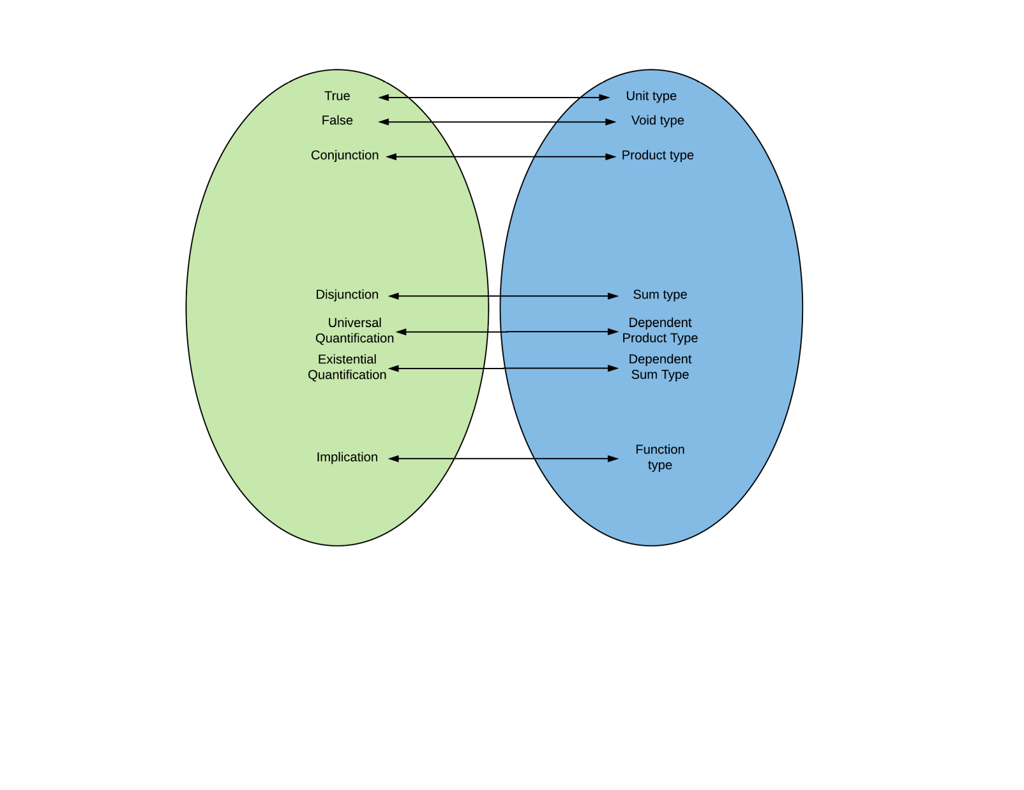
Motivation
Intuitionistic Logic
Lambda
Calculus
5

Slide 21

Motivation
Intuitionistic Logic
Lambda
Calculus
5

Slide 22
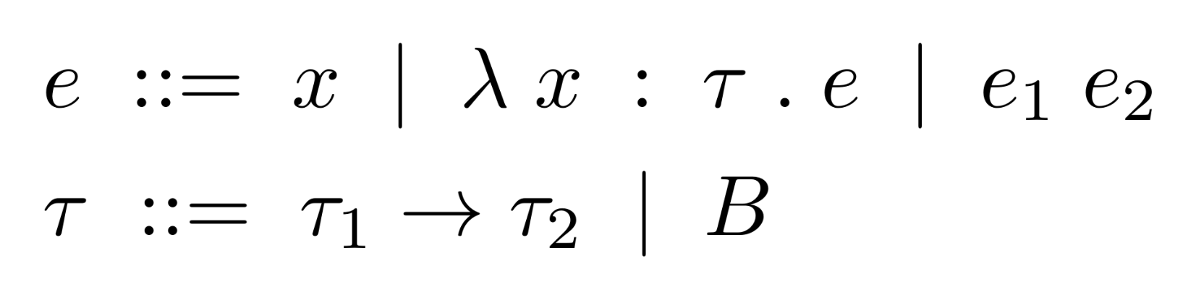
Lambda Calculus
Simply-typed Lambda Calculus
6

Slide 23
Lambda Calculus
Simply-typed Lambda Calculus
6

Slide 24
Lambda Calculus
Simply-typed Lambda Calculus
Variable x
6

Slide 25
Lambda Calculus
Simply-typed Lambda Calculus
Function with argument x of type τ with body e
6

Slide 26
Lambda Calculus
Simply-typed Lambda Calculus
Application of function e₁ to argument e₂
6

Slide 27
Lambda Calculus
Simply-typed Lambda Calculus
6

Slide 28
Lambda Calculus
Simply-typed Lambda Calculus
Function type
6

Slide 29
Lambda Calculus
Simply-typed Lambda Calculus
Base type
6

Slide 30
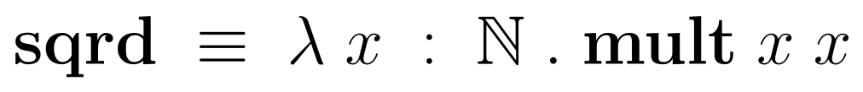
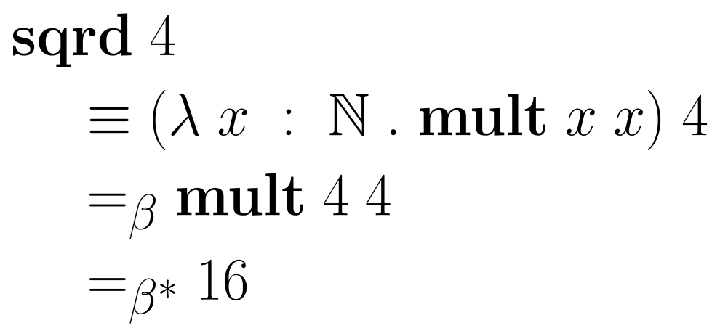
Lambda Calculus
Simply-typed Lambda Calculus Reduction
7

Slide 31
Lambda Calculus
Simply-typed Lambda Calculus Reduction
7

Slide 32
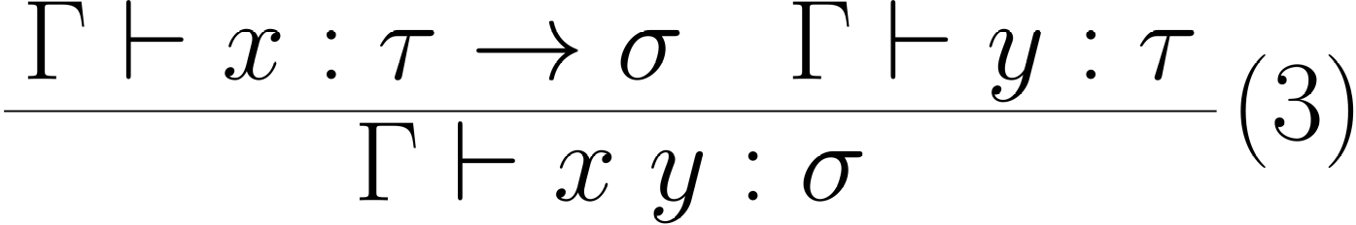
Lambda Calculus
Simply-typed Lambda Calculus Typing Rules: App
8

Slide 33
Lambda Calculus
Simply-typed Lambda Calculus Typing Rules: App
8

Slide 34
Lambda Calculus
Simply-typed Lambda Calculus Typing Rules: App
8

Slide 35
Lambda Calculus
Simply-typed Lambda Calculus Typing Rules: App
8

Slide 36
Lambda Calculus
Simply-typed Lambda Calculus Typing Rules: App
Modus Ponens: A ⇒ B, A ⊢ B
8

Slide 37
Lambda Calculus
Strong Normalization
Most Typed Lambda Calculi are strongly normalizing:
every term can be written in a normal form, such that it
doesn’t reduce further
Strong normalization = All computations terminate
9

Slide 38
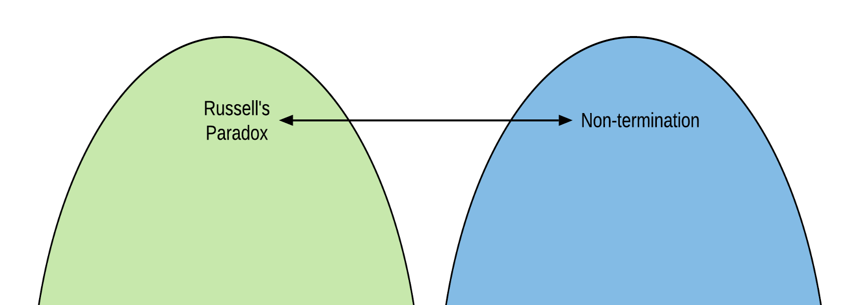
Lambda Calculus
Strong Normalization
Most Typed Lambda Calculi are strongly normalizing:
every term can be written in a normal form, such that it
doesn’t reduce further
Strong normalization = All computations terminate
9

Slide 39
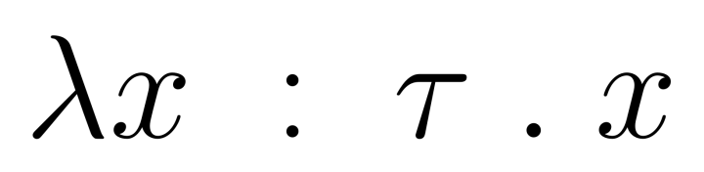
Curry-Howard Isomorphism
10

Slide 40

Curry-Howard Isomorphism
10

Slide 41

Curry-Howard Isomorphism
10

Slide 42
Curry-Howard Isomorphism
this object is proof that type τ → τ isn’t empty
10

Slide 43

Curry-Howard Isomorphism
this object is proof that type τ → τ isn’t empty
10

Slide 44

Curry-Howard Isomorphism
11

Slide 45
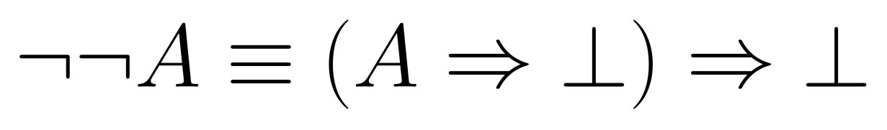
Curry-Howard Isomorphism
11

Slide 46

Curry-Howard Isomorphism
“If you give me a function that can turn A to Void, I can give you Void”
11

Slide 47
Curry-Howard Isomorphism
“If you give me a function that can turn A to Void, I can give you Void”
11

Slide 48
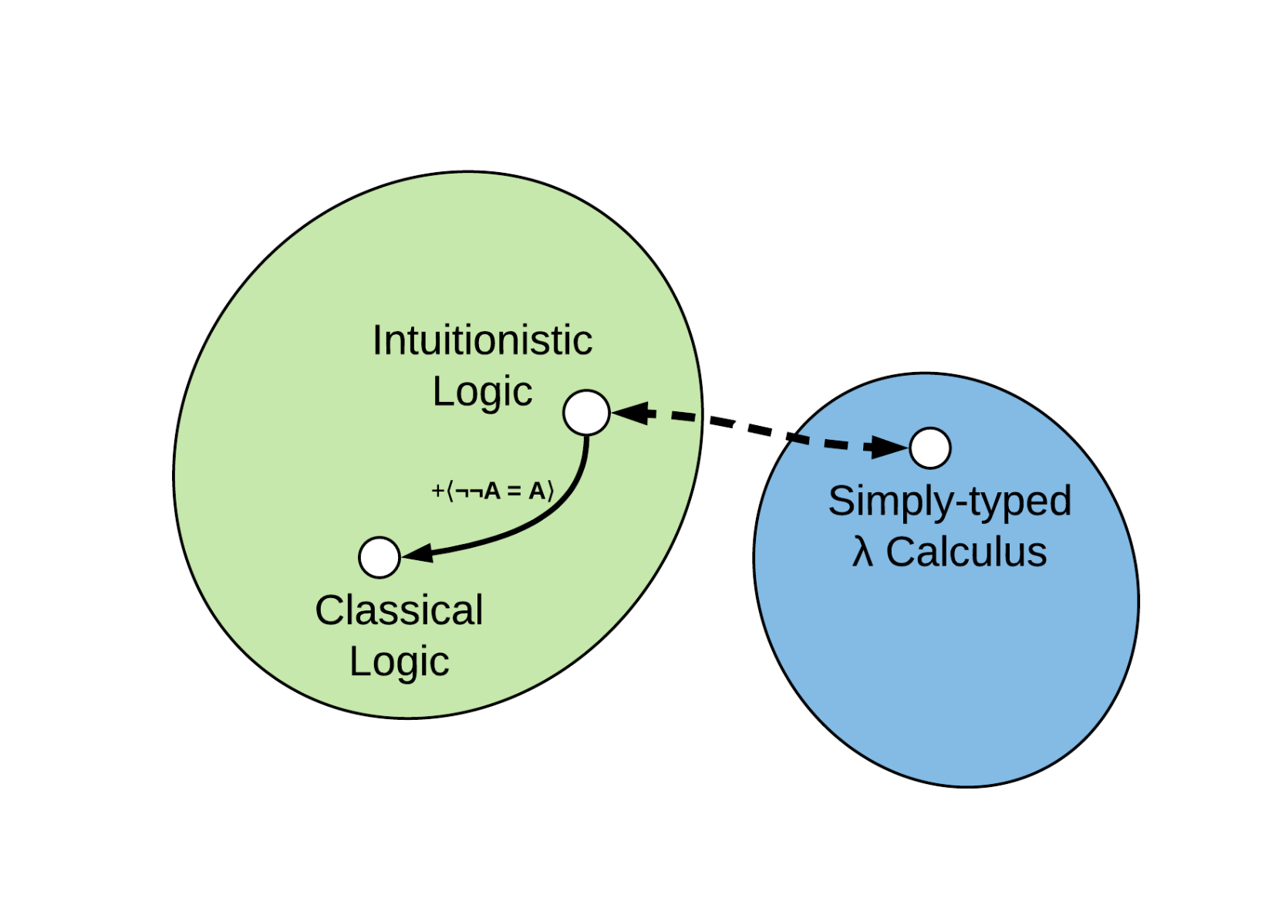
Curry-Howard Isomorphism
12

Slide 49
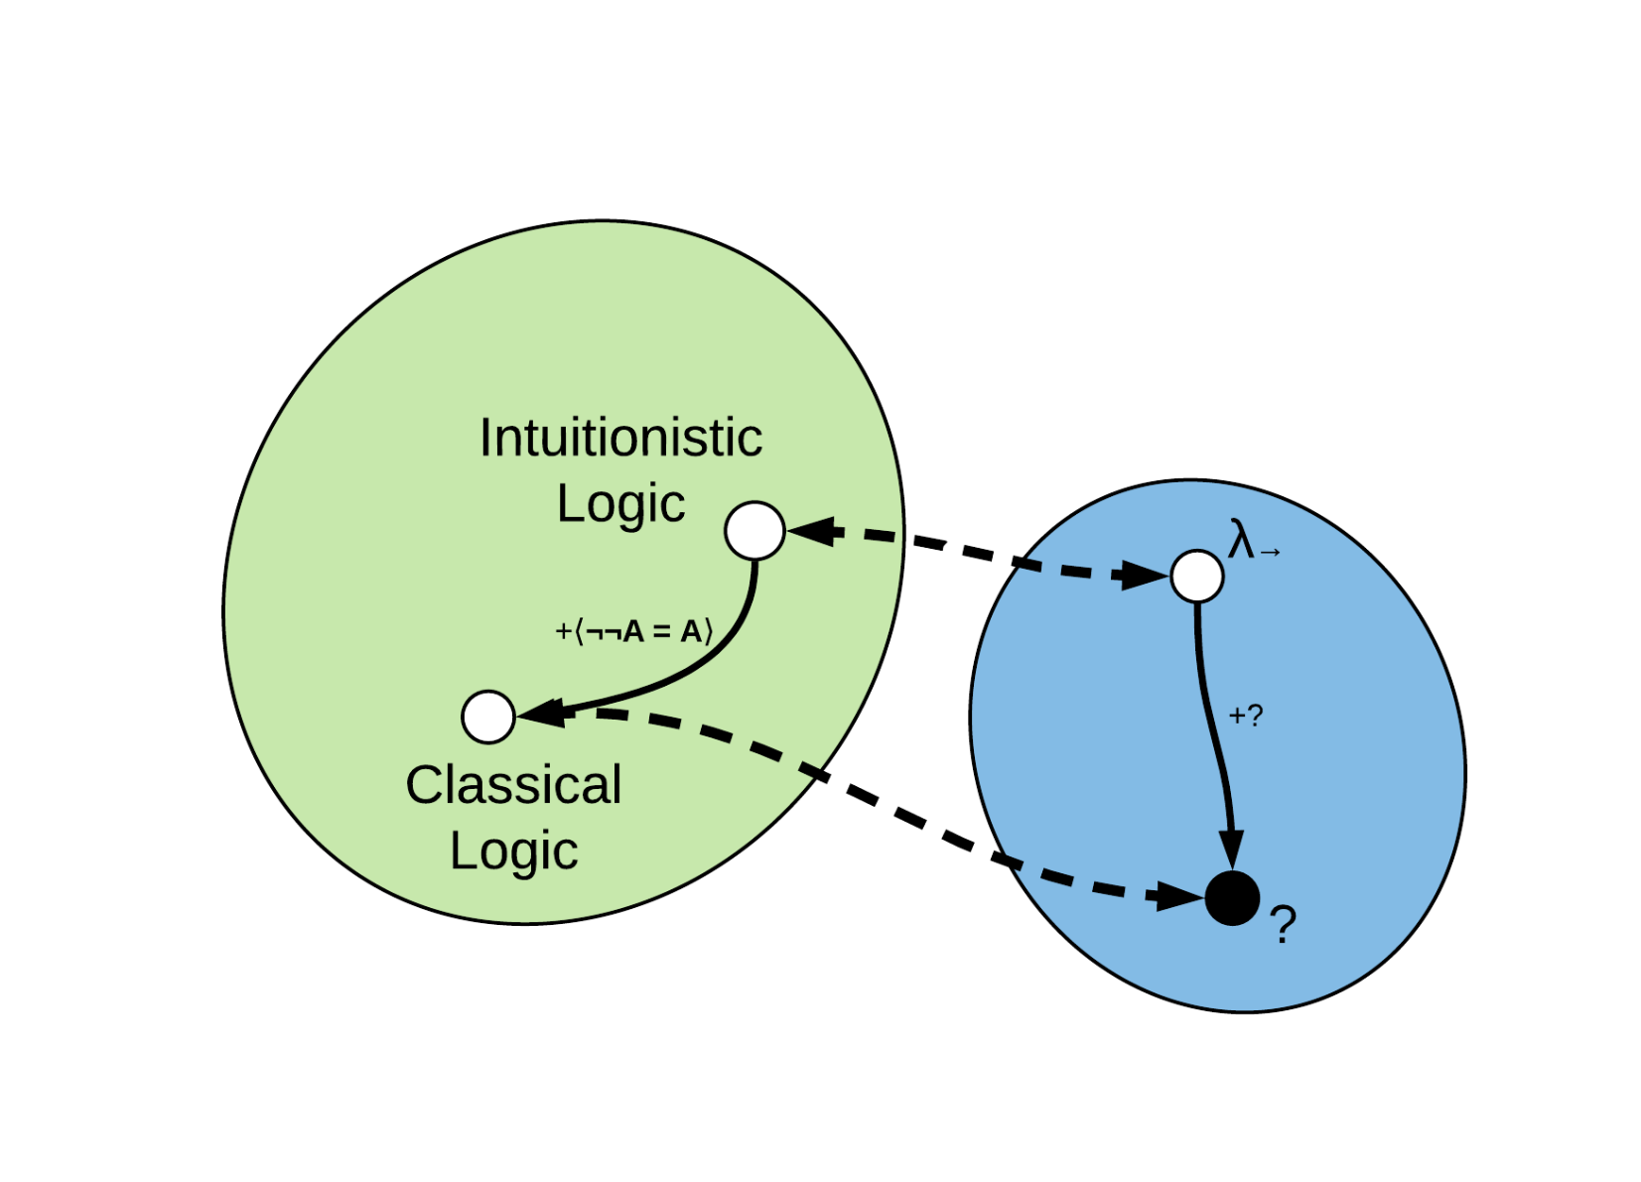
An open invitation
12

Slide 50
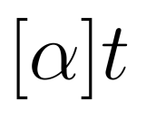
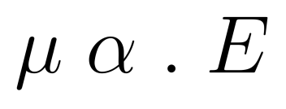
Extending the Correspondence
Parigot’s λμ (lambda-mu) Calculus³
Introduces named terms (mu terms)
Control over which parts of an expression are reduced (commands)
[3] Michel Parigot. 1992. Lambda-My-Calculus: An Algorithmic Interpretation of Classical Natural Deduction. In Proceedings of the International
Conference on Logic Programming and Automated Reasoning (LPAR '92), Andrei Voronkov (Ed.). Springer-Verlag, London, UK, UK, 190-201.
13

Slide 51
Extending the Correspondence
Parigot’s λμ (lambda-mu) Calculus
Introduces named terms (mu terms)
Control over which parts of an expression are reduced (commands)
if argument is a named term with the marker α, E reduces
13

Slide 52
Extending the Correspondence
Parigot’s λμ (lambda-mu) Calculus
Practically implements continuations
Other control mechanisms are easy to construct from it⁴:
call/cc, throw/catch, reset/shift, …
[4] C.-H. L. Ong and C. A. Stewart. 1997. A Curry-Howard foundation for functional computation with control. In Proceedings of the 24th ACM SIGPLAN-
SIGACT symposium on Principles of programming languages (POPL '97). ACM, New York, NY, USA, 215-227.
13

Slide 53
Extending the Correspondence
Parigot’s λμ (lambda-mu) Calculus
Practically implements continuations
Other control mechanisms are easy to construct from it:
call/cc, throw/catch, reset/shift, …
Can formalize a proof for double negation elimination
13

Slide 54
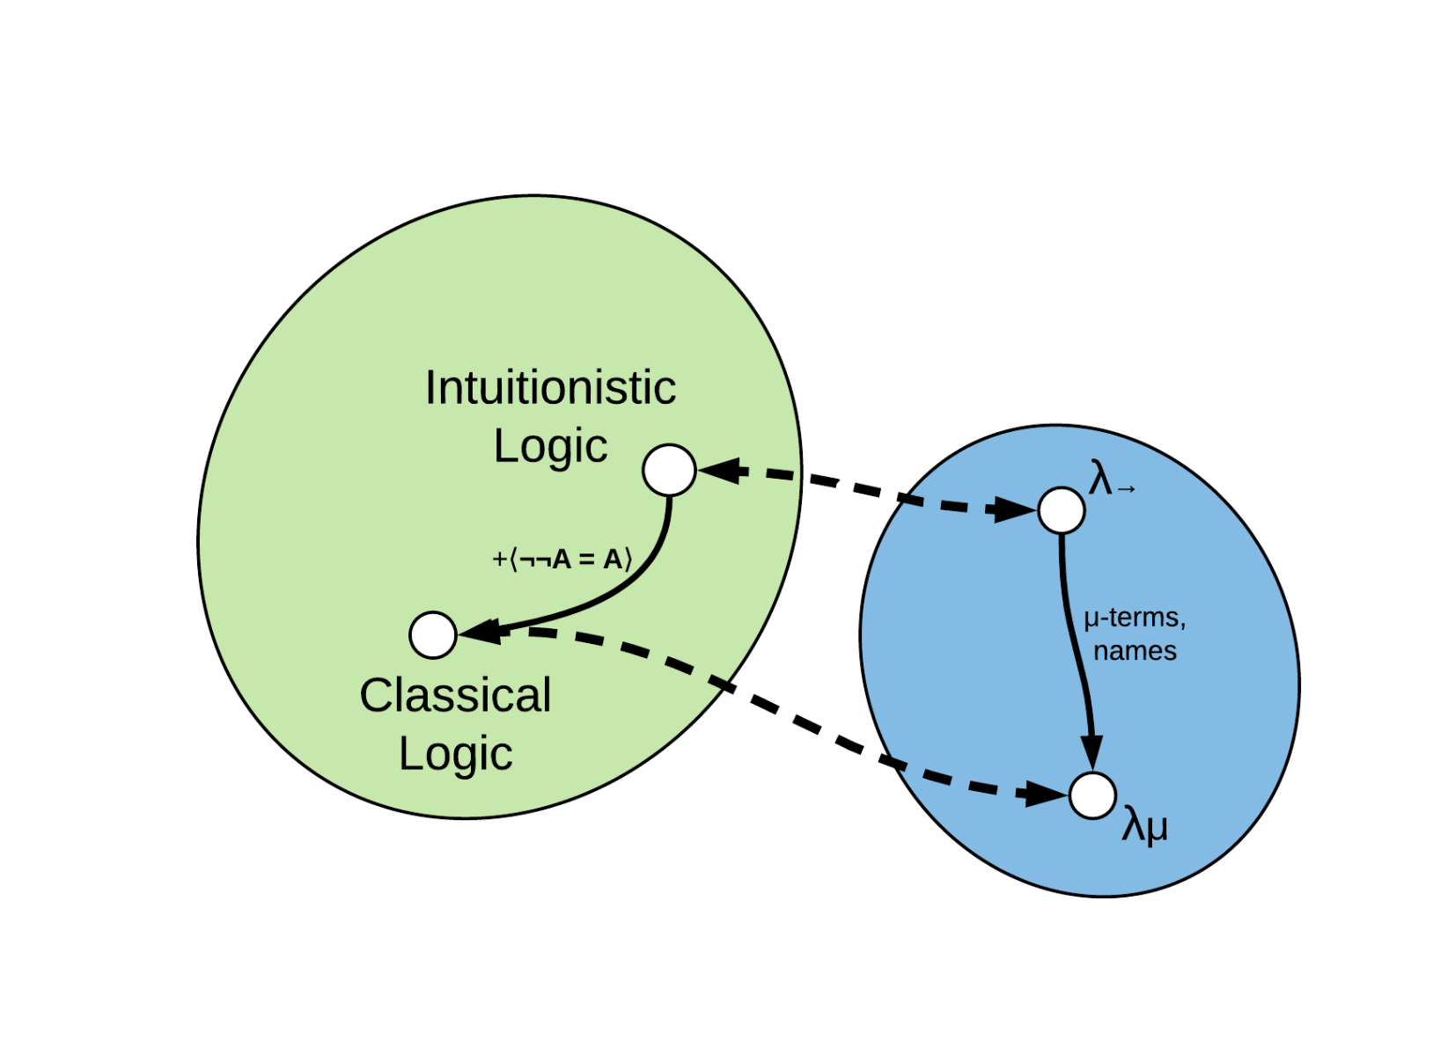
Extending the Correspondence
14

Slide 55

Extending the Correspondence
14

Slide 56
Outline
Motivation
Several interesting findings
A more refined perspective
Conclusion
15

Slide 57
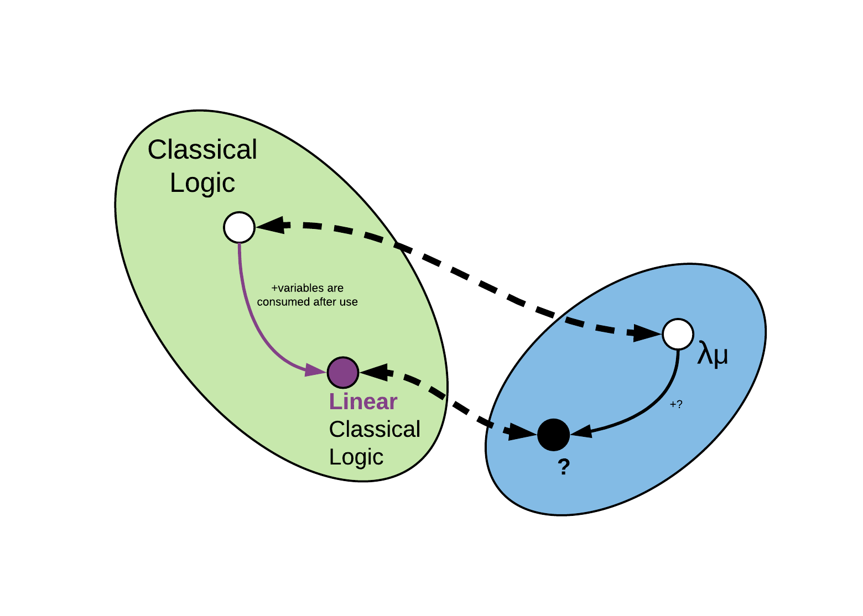
A more Linear Approach
⁵
[5] Jean-Yves Girard. 1987. Linear logic. Theor. Comput. Sci. 50, 1 (January 1987), 1-102.
16

Slide 58
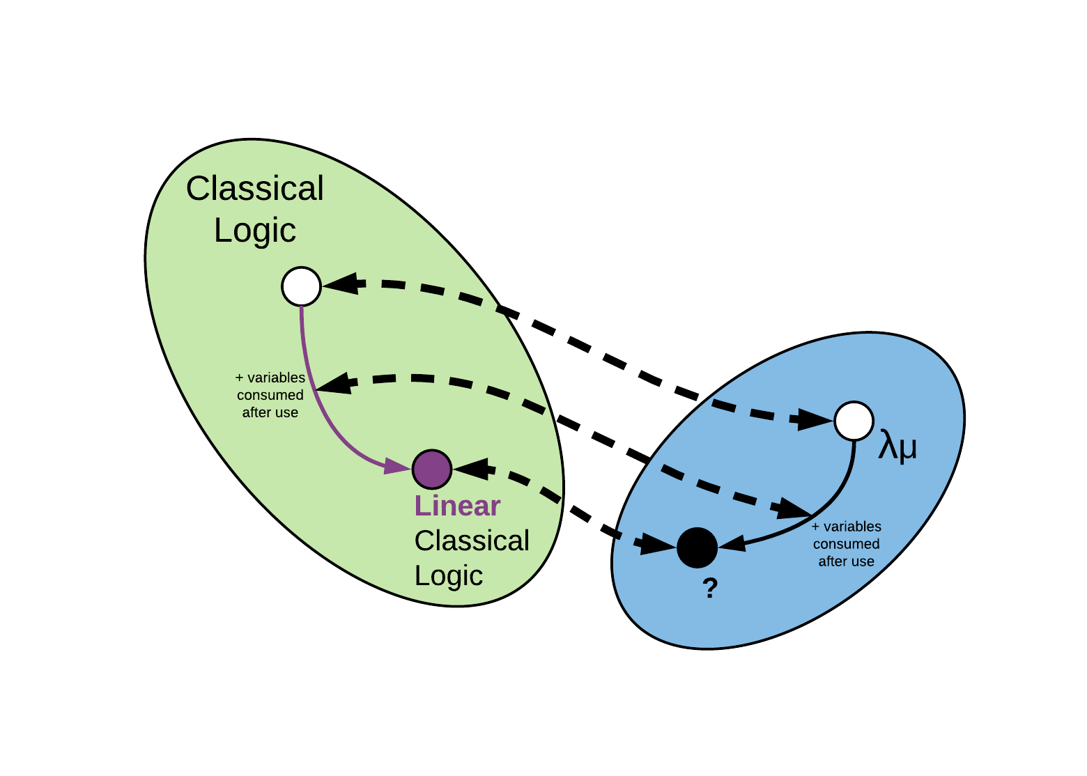
A more Linear Approach
16

Slide 59
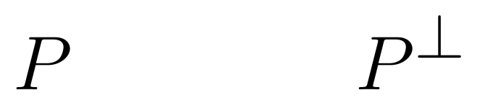
A more Linear Approach
What do we know about this linear logic?
Every variable is consumed after usage (can be used only once).
The classical version has the law of excluded middle:
Every proposition has its dual.
17

Slide 60
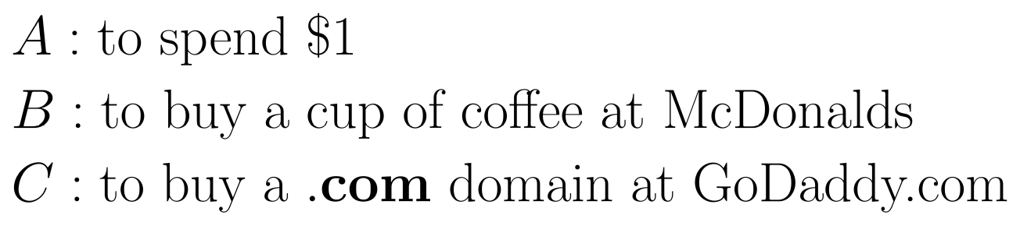
A more Linear Approach
What do we know about this linear logic?
We have different operations from classical logic.
18

Slide 61
A more Linear Approach
What do we know about this linear logic?
We have different operations from classical logic.
18

Slide 62
A more Linear Approach
What do we know about this linear logic?
We have different operations from classical logic.
actually $0.99 but who’s counting
18

Slide 63
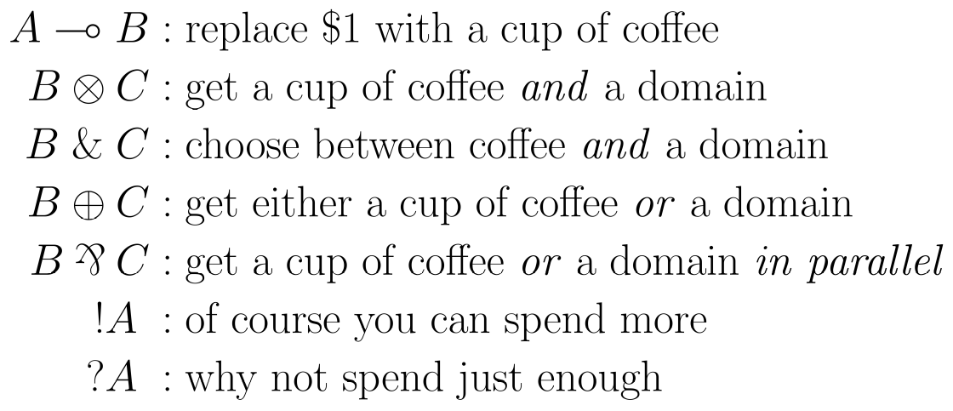
A more Linear Approach
What do we know about this linear logic?
We have different operations from classical logic.
19

Slide 64
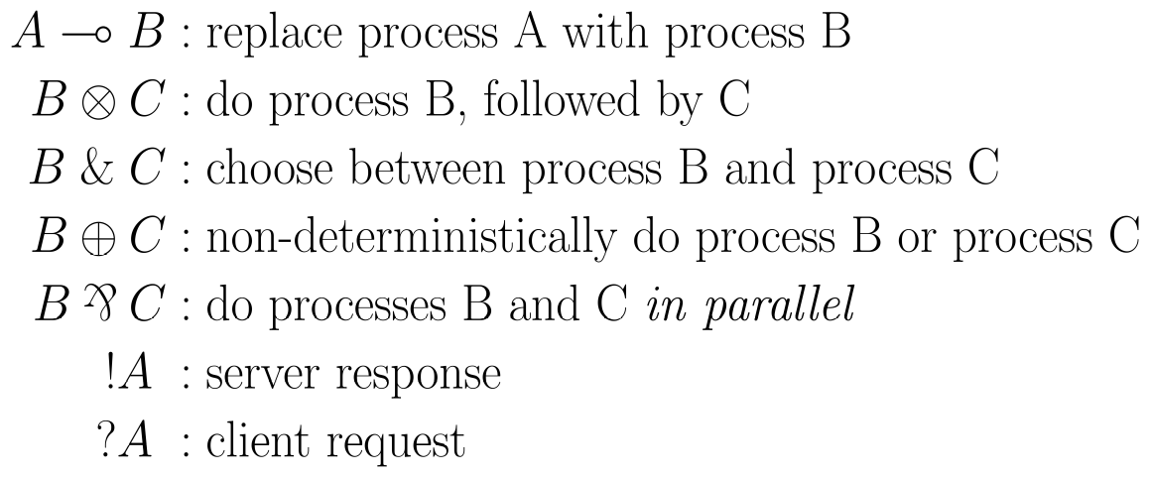
A more Linear Approach
What do we know about this linear logic?
We can model communication with these operations⁶.
[6] Philip Wadler. 2012. Propositions as sessions. In Proceedings of the 17th ACM SIGPLAN international conference on Functional programming(ICFP '12).
ACM, New York, NY, USA, 273-286.
20

Slide 65
A more Linear Approach
Wadler’s CP calculus
Process calculus: models communication and interactions
Session types: types that, together with their duals, define protocols⁷
[7] Ornela Dardha, Elena Giachino, and Davide Sangiorgi. 2012. Session types revisited. In Proceedings of the 14th symposium on Principles and
practice of declarative programming (PPDP '12). ACM, New York, NY, USA, 139-150.
21

Slide 66
A more Linear Approach
Wadler’s CP calculus
Process calculus: models communication and interactions
Session types: types that, together with their duals, define protocols
Deadlock safety?
21

Slide 67
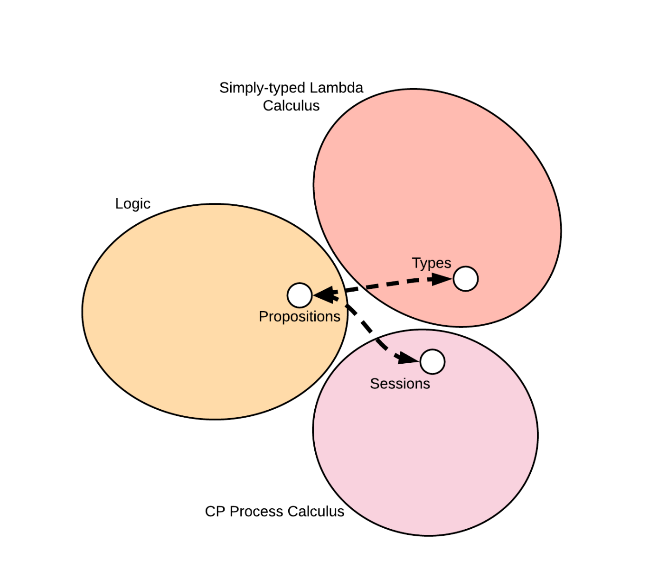
A more Linear Approach
Wadler’s CP calculus
22

Slide 68
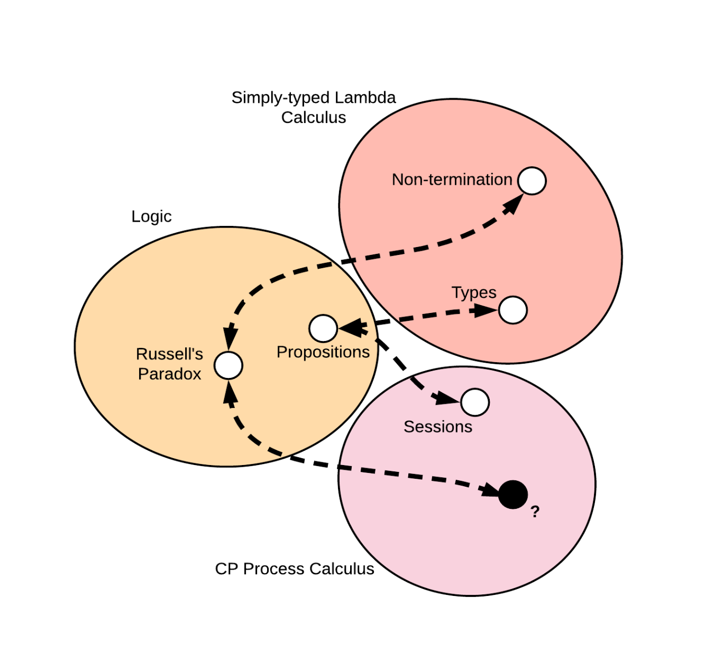
A more Linear Approach
Wadler’s CP calculus
22

Slide 69
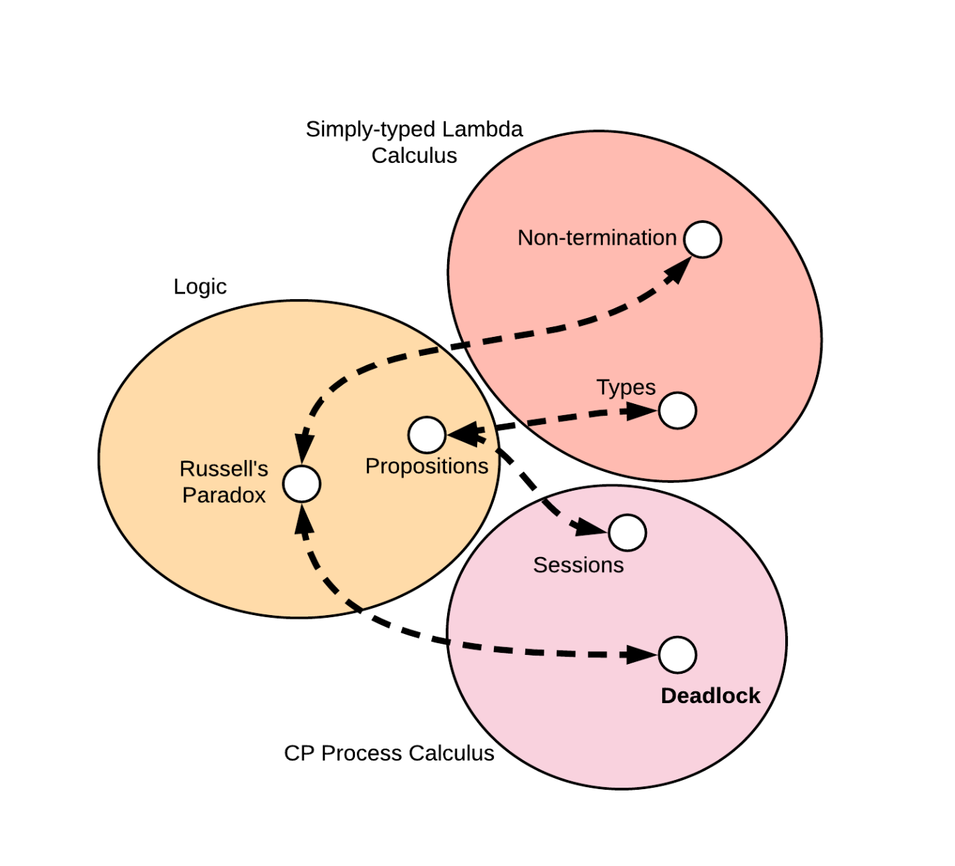
A more Linear Approach
Wadler’s CP calculus
CP is strongly normalizing, thus no deadlock⁶
[6] Philip Wadler. 2012. Propositions as sessions. In Proceedings of the 17th ACM SIGPLAN
international conference on Functional programming(ICFP '12). ACM, New York, NY, USA, 273-286.
22

Slide 70

A more Linear Approach
23

Slide 71
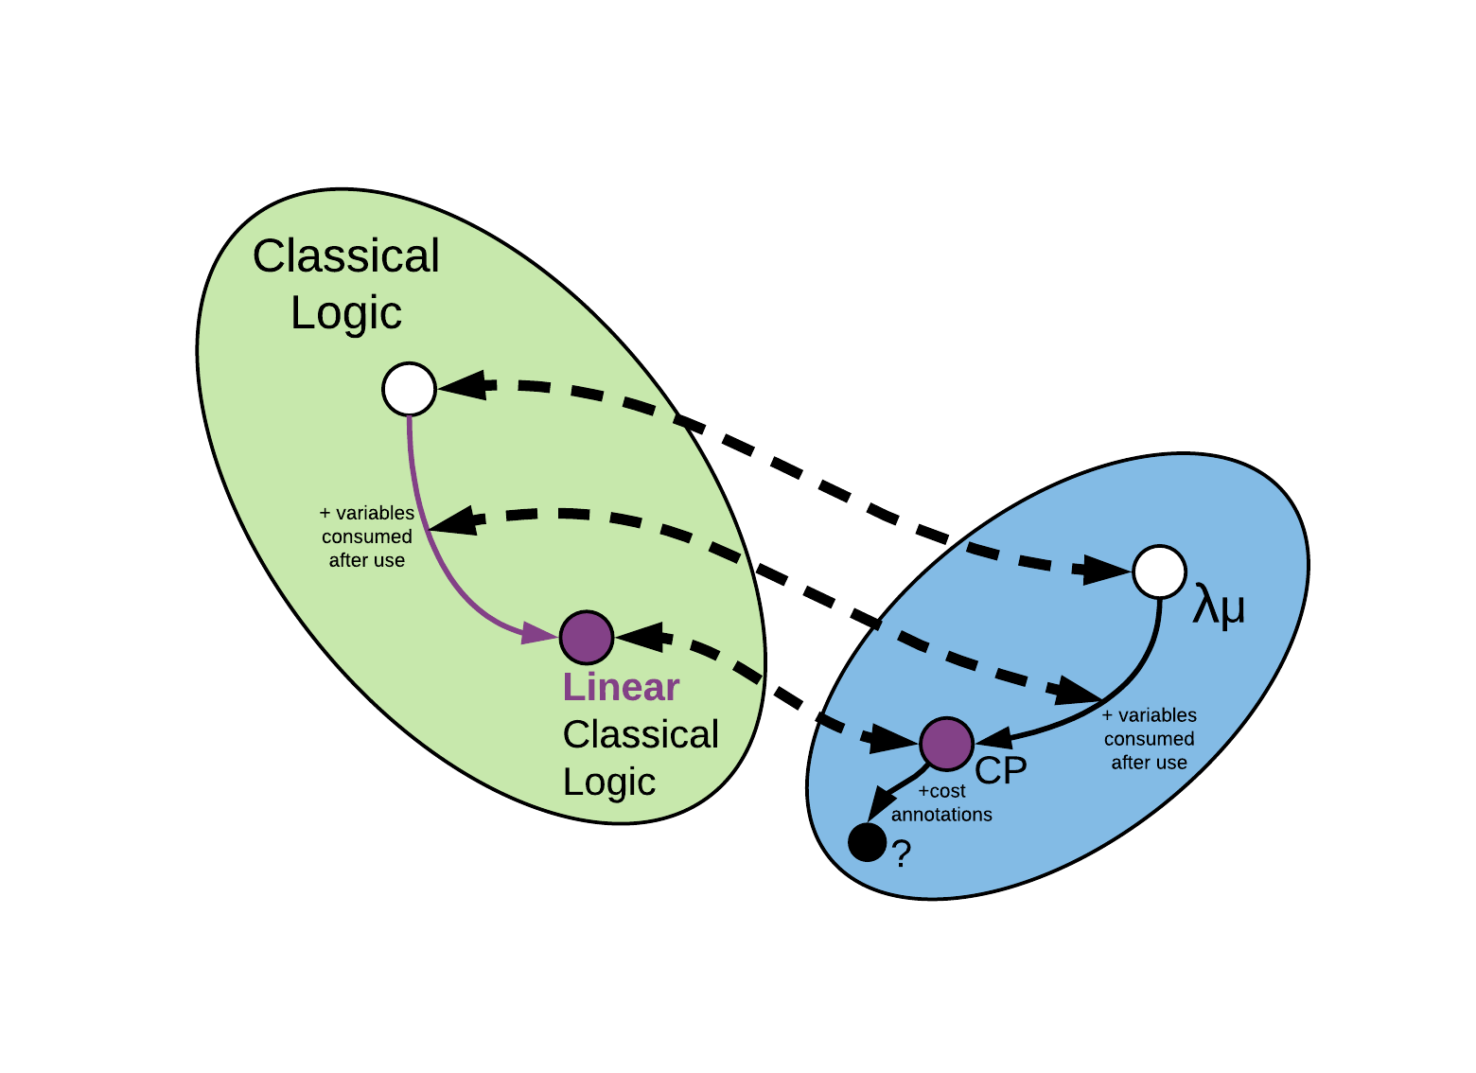
Type-side Extensions?
⁸
[8] Das, A., Hoffmann, J., & Pfenning, F. (2017). Work Analysis with Resource-Aware
Session Types. CoRR, abs/1712.08310.
23

Slide 72
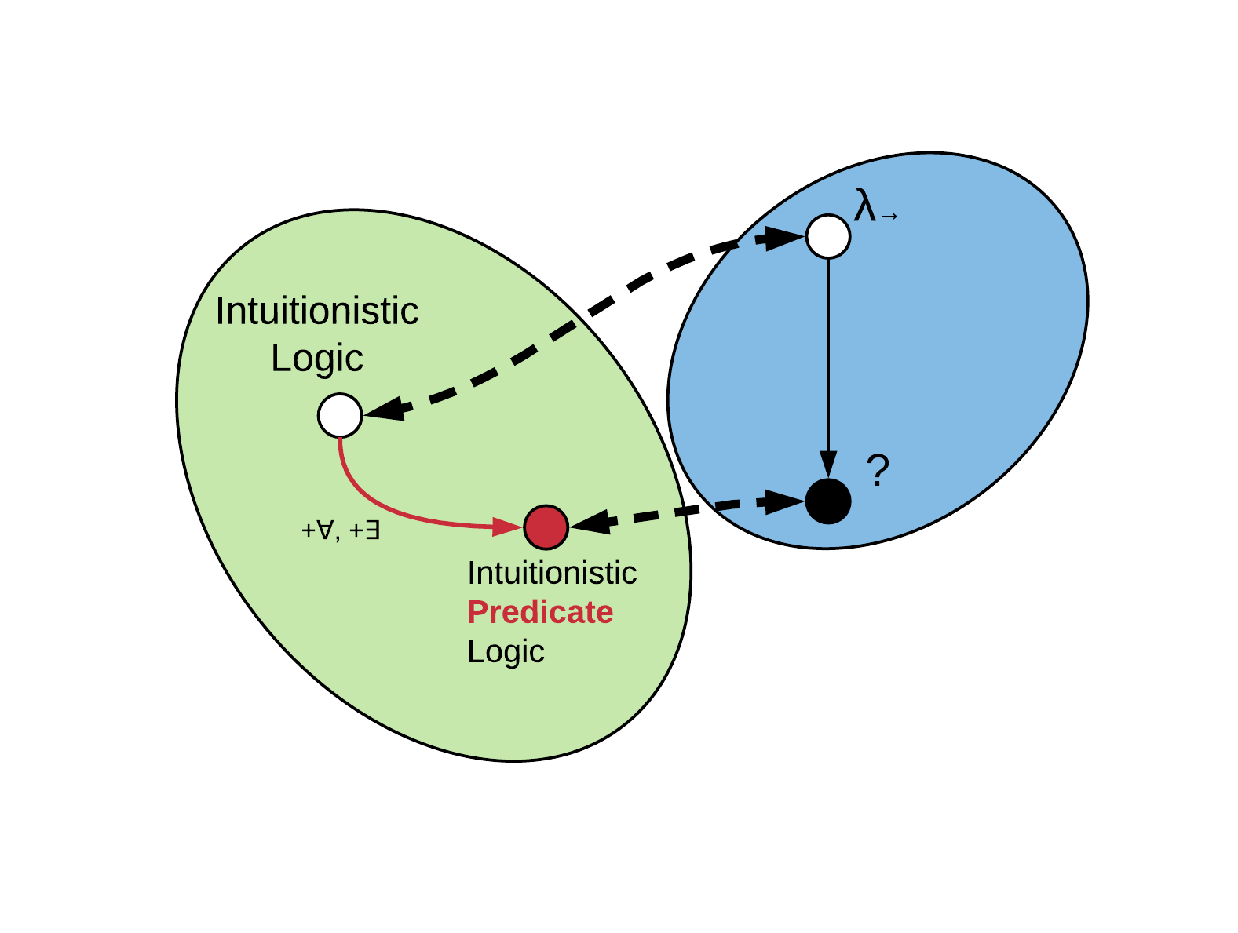
A Segue into Dependencies
24

Slide 73

A Segue into Dependencies
⁹
[9] Martin-Löf, Per, 1971a, An
intuitionistic theory of types,
unpublished preprint.
24

Slide 74

A Segue into Dependencies
λΠ-calculus¹⁰
Quantification = Types Dependent on Values of other Types
B can now depend on the value x
[10] Bernardo Toninho, Luís Caires, and Frank Pfenning. 2011. Dependent session types via intuitionistic linear type theory. In Proceedings of the 13th
international ACM SIGPLAN symposium on Principles and practices of declarative programming (PPDP '11). ACM, New York, NY, USA, 161-172.
25

Slide 75
A Segue into Dependencies
λΠ-calculus
Quantification = Types Dependent on Values of other Types
26

Slide 76
A Segue into Dependencies
λΠ-calculus
Quantification = Types Dependent on Values of other Types
27

Slide 77
A Segue into Dependencies
λΠ-calculus
Quantification = Types Dependent on Values of other Types
27

Slide 78
A Segue into Dependencies
λΠ-calculus
Quantification = Types Dependent on Values of other Types
27

Slide 79
A Segue into Dependencies
λΠ-calculus
Quantification = Types Dependent on Values of other Types
27

Slide 80
A Segue into Dependencies
λΠ-calculus
Quantification = Types Dependent on Values of other Types
The dependency relation doesn’t have to be this simple...
27

Slide 81
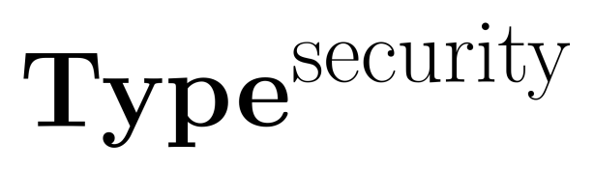

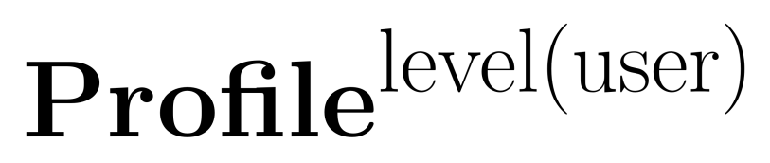

Information-flow Types
Data dependent on security lattices¹¹
[11] Luísa Lourenço and Luís Caires. 2015. Dependent Information Flow Types. In Proceedings of the 42nd Annual ACM SIGPLAN-SIGACT Symposium on
Principles of Programming Languages (POPL '15). ACM, New York, NY, USA, 317-328.
28

Slide 82
Information-flow Types
Data dependent on security lattices
28

Slide 83
Information-flow Types
Data dependent on security lattices
28

Slide 84
Information-flow Types
Data dependent on security lattices
28

Slide 85
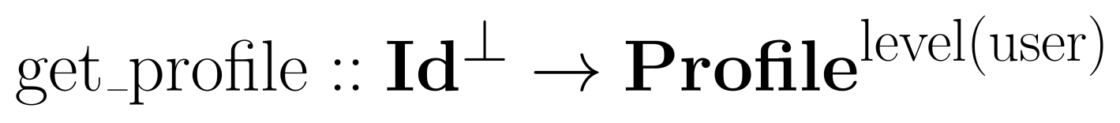
Information-flow Types
Data dependent on security lattices
29

Slide 86
Information-flow Types
Data dependent on security lattices
29

Slide 87
Information-flow Types
Data dependent on security lattices
29

Slide 88
Information-flow Types
Data dependent on security lattices
29

Slide 89
Information-flow Types
Data dependent on security lattices
Security labels are passed through typing judgements,
but such type systems can be too strict
30

Slide 90
Information-flow Types
Data dependent on security lattices
Security labels are passed through typing judgements,
but such type systems can be too strict
Access-policy synthesis¹²: weaker system, and the results
of failed verifications can be used to identify where
sensitive information leaked and automatically repair it
[12] Aleksandar Nanevski, Anindya Banerjee, and Deepak Garg. 2013. Dependent Type Theory for Verification of Information Flow and Access Control
Policies. ACM Trans. Program. Lang. Syst. 35, 2, Article 6 (July 2013), 41 pages.
30

Slide 91
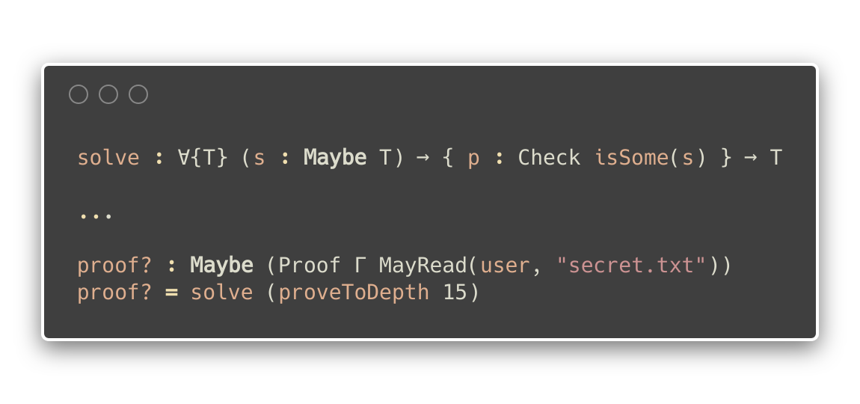
Information-flow Types
Proof assistants can be used to check permissions while
typing out a dependently-typed program¹³!
[13] Jamie Morgenstern and Daniel R. Licata. 2010. Security-typed programming within dependently typed programming. In Proceedings of the 15th ACM
SIGPLAN international conference on Functional programming (ICFP '10). ACM, New York, NY, USA, 169-180.
31

Slide 92
Information-flow Types
Proof assistants can be used to check permissions while
typing out a dependently-typed program!
Finds a type T such that...
31

Slide 93
Information-flow Types
Proof assistants can be used to check permissions while
typing out a dependently-typed program!
...for a given optionally possible argument s, there’s at least one model for s...
31

Slide 94
Information-flow Types
Proof assistants can be used to check permissions while
typing out a dependently-typed program!
...and then return it.
31

Slide 95
Information-flow Types
Proof assistants can be used to check permissions while
typing out a dependently-typed program!
Policy dependent types and the proof environment are sent as argument.
31

Slide 96
Information-flow Types
Proof assistants can be used to check permissions while
typing out a dependently-typed program!
31

Slide 97
Information-flow Types
Proof assistants can be used to check permissions while
typing out a dependently-typed program!
This is an interactive static method of information-flow handling.
31

Slide 98

Are we there yet?
32

Slide 99
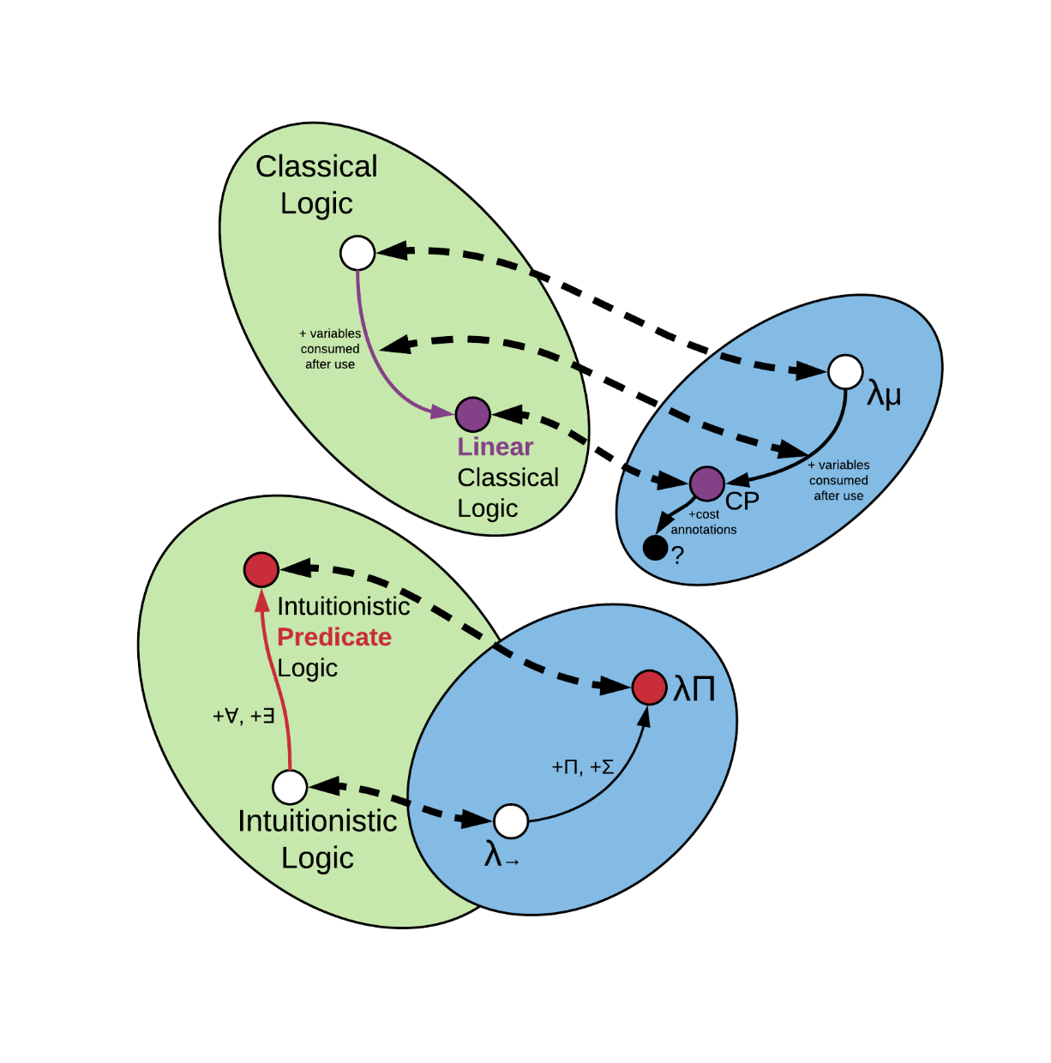
Are we there yet?
32

Slide 100
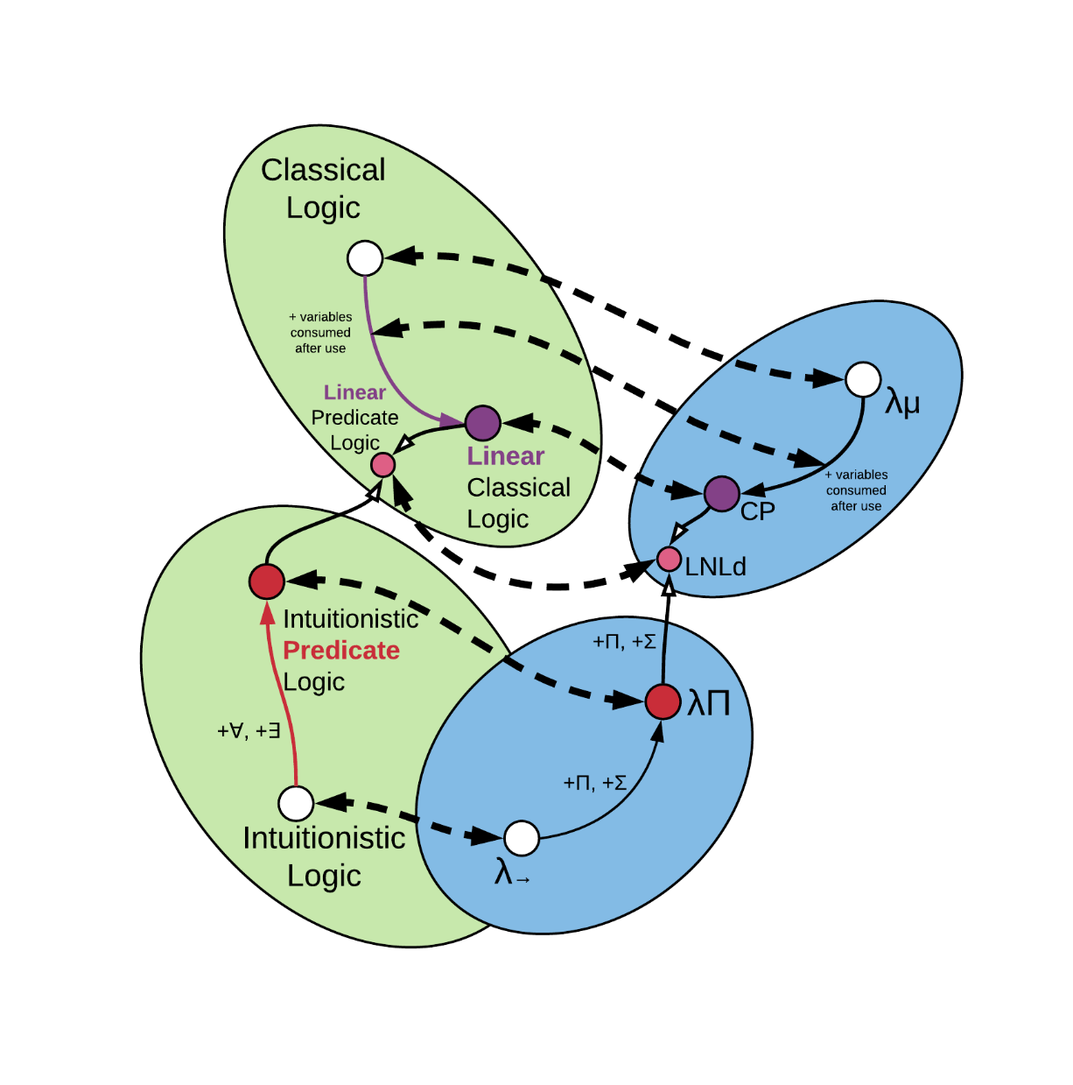
Are we there yet?
[14] Neelakantan R. Krishnaswami, Pierre Pradic, and Nick Benton. 2015. Integrating Linear and Dependent Types. In Proceedings of the 42nd Annual ACM SIGPLAN-SIGACT Symposium on Principles of Programming Languages (POPL '15). ACM, New York, NY, USA, 17-30.
32

Slide 101
Are we there yet?
We did it, but…
Overkill much?
32

Slide 102
Outline
Motivation
Several interesting findings
A more refined perspective
Conclusion
33

Slide 103
Extending Type Systems
Augmenting type systems:
changing them so that they’re more useful is natural.
Type systems as a basis for analyses¹⁵:
- used as a starting point for other analyses
(method inlining, redundant load elimination, etc.)
- small extensions to type systems yield large benefits
(encapsulation checking, race detection, etc.)
- changes along known Curry-Howard lines
(memory management, regions, linear types, etc.)
[15] Jens Palsberg. 2001. Type-based analysis and applications. In Proceedings of the 2001 ACM SIGPLAN-SIGSOFT workshop on Program analysis for
software tools and engineering (PASTE '01). ACM, New York, NY, USA, 20-27. DOI=http://dx.doi.org/10.1145/379605.379635
35

Slide 104
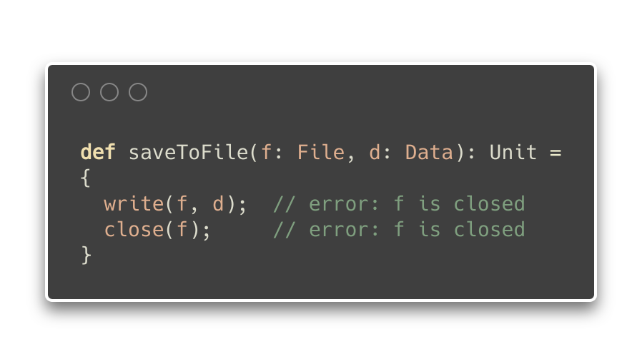
Type Effects¹⁶
Type-and-Effects: enriched type-system, with annotations
for describing intentional aspects of dynamic behaviour¹⁷
[16] Nielson F., Nielson H.R., Hankin C. (1999) Type and Effect Systems. In: Principles of Program Analysis. Springer, Berlin, Heidelberg
[17] Yitzhak Mandelbaum, David Walker, and Robert Harper. 2003. An effective theory of type refinements. In Proceedings of the eighth ACM SIGPLAN
international conference on Functional programming (ICFP '03). ACM, New York, NY, USA, 213-225.
36

Slide 105
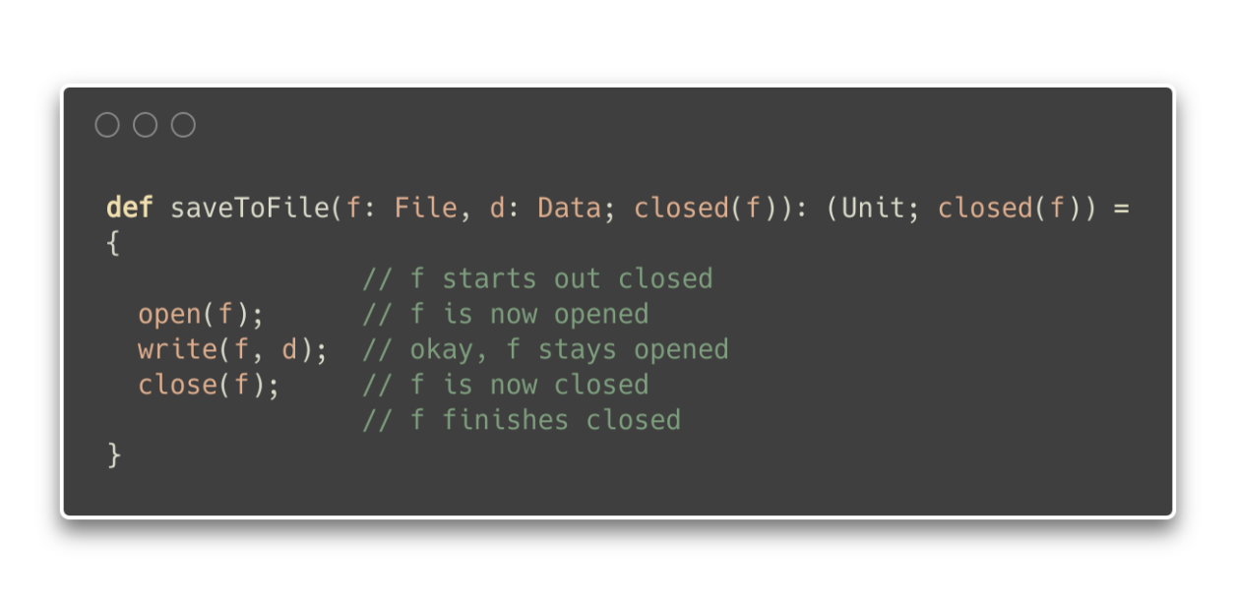
Type Effects
Type-and-Effects: enriched type-system, with annotations
for describing intentional aspects of dynamic behaviour
37

Slide 106
Type Effects
Type-and-Effects: enriched type-system, with annotations
for describing intentional aspects of dynamic behaviour
Assume input effects
37

Slide 107
Type Effects
Type-and-Effects: enriched type-system, with annotations
for describing intentional aspects of dynamic behaviour
Assert output effects
37

Slide 108
Type Effects
Type-and-Effects: enriched type-system, with annotations
for describing intentional aspects of dynamic behaviour
Similar to Hoare logic, but applicable to higher-order
programs and with decidable type-checking
38

Slide 109
Type Refinements
Type Refinements: predicates over type (every refined
type is a subtype of the original type)
Liquid types¹⁸:
Logically Qualified Data Types, combine Hindley-Milner
type inference with predicate abstraction to infer
dependent types
Give type-safety proofs for overapproximation,
preservation and progress.
[18] Patrick M. Rondon, Ming Kawaguci, and Ranjit Jhala. 2008. Liquid types. In Proceedings of the 29th ACM SIGPLAN Conference on Programming
Language Design and Implementation (PLDI '08). ACM, New York, NY, USA, 159-169.
39

Slide 110
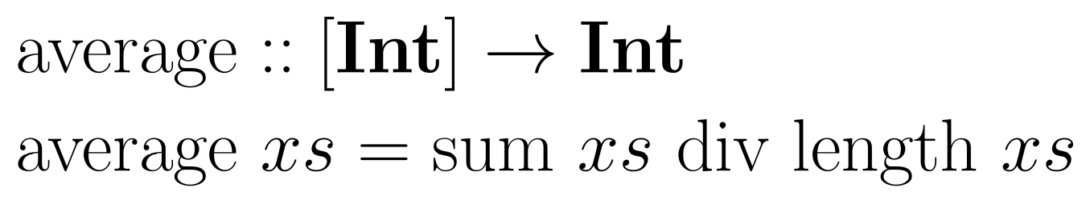
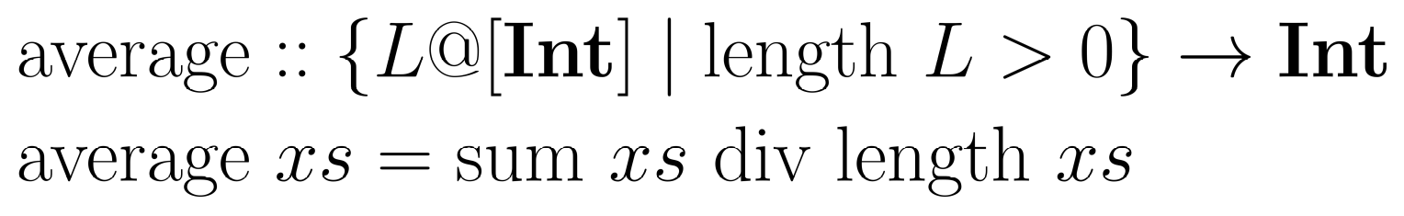
Type Refinements
40

Slide 111
Type Refinements
40

Slide 112
Type Refinements
Type Refinements: predicates over type (every refined
type is a subtype of the original type)
Specifications generally limited to decidable fragments of
underlying logic, with predefined refining operations¹⁹
[19] Niki Vazou, Eric L. Seidel, Ranjit Jhala, Dimitrios Vytiniotis, and Simon Peyton-Jones. 2014. Refinement types for Haskell. In Proceedings of the 19th ACM SIGPLAN international conference on Functional programming (ICFP '14). ACM, New York, NY, USA, 269-282. DOI=10.1145/2628136.2628161
41

Slide 113
Type Refinements
Type Refinements: predicates over type (every refined
type is a subtype of the original type)
Specifications generally limited to decidable fragments of
underlying logic, with predefined refining operations
41

Slide 114
Type Refinement Systems
Type Refinements: actually more general than they seem.
...through a categorical lens
42

Slide 115
Type Refinement Systems
Type Refinements: actually more general than they seem.
...through a categorical lens
Functors are Type Refinement Systems²⁰
Functors: mappings that preserve structure between two
categories
[20] Paul-André Melliès and Noam Zeilberger. 2015. Functors are Type Refinement Systems. In Proceedings of the 42nd Annual ACM SIGPLAN-SIGACT Symposium on Principles of Programming Languages (POPL '15). ACM, New York, NY, USA, 3-16.
42

Slide 116
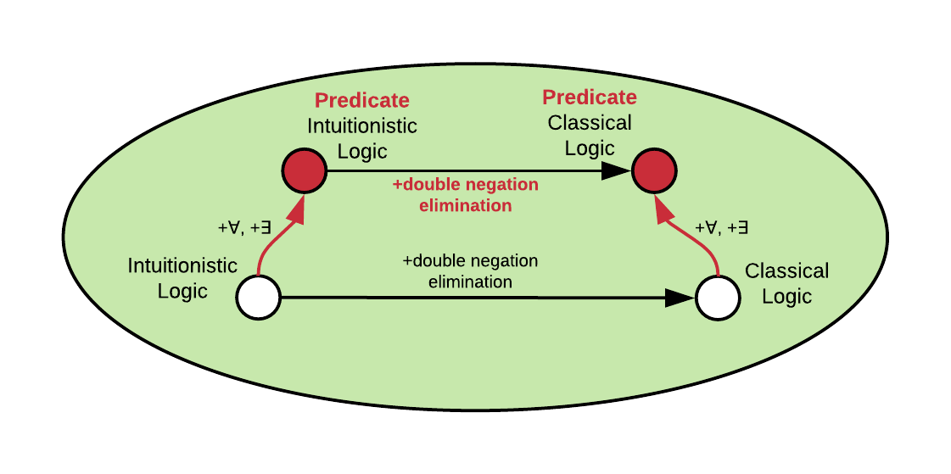
Type Refinement Systems
Functor preserves mapping between two categories
Category
43

Slide 117
Type Refinement Systems
Functor preserves mapping between two categories
Category
43

Slide 118
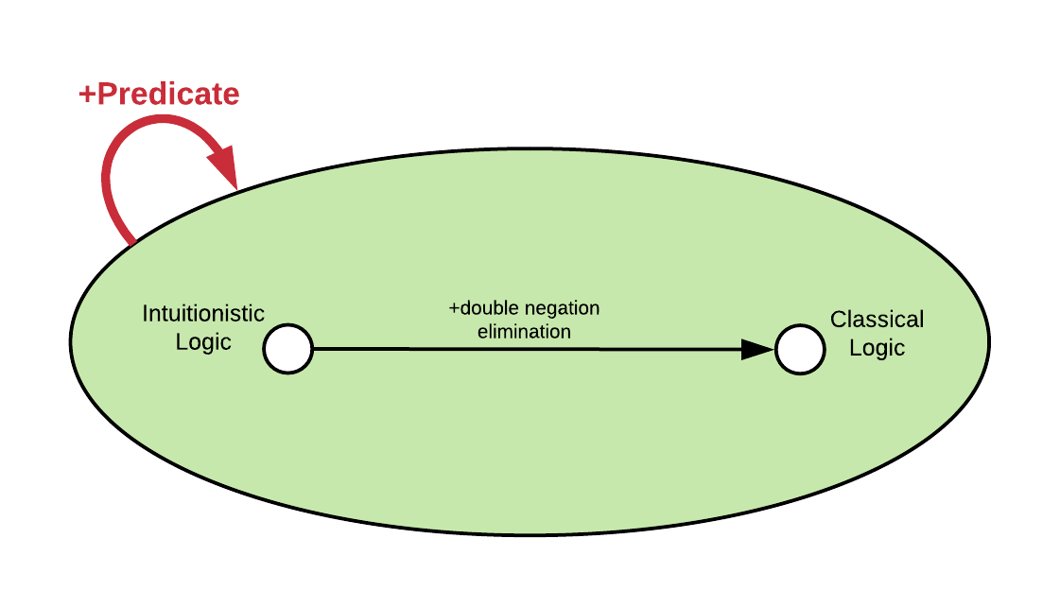
Type Refinement Systems
Endofunctor
Morphism (arrow)
Category
43

Slide 119
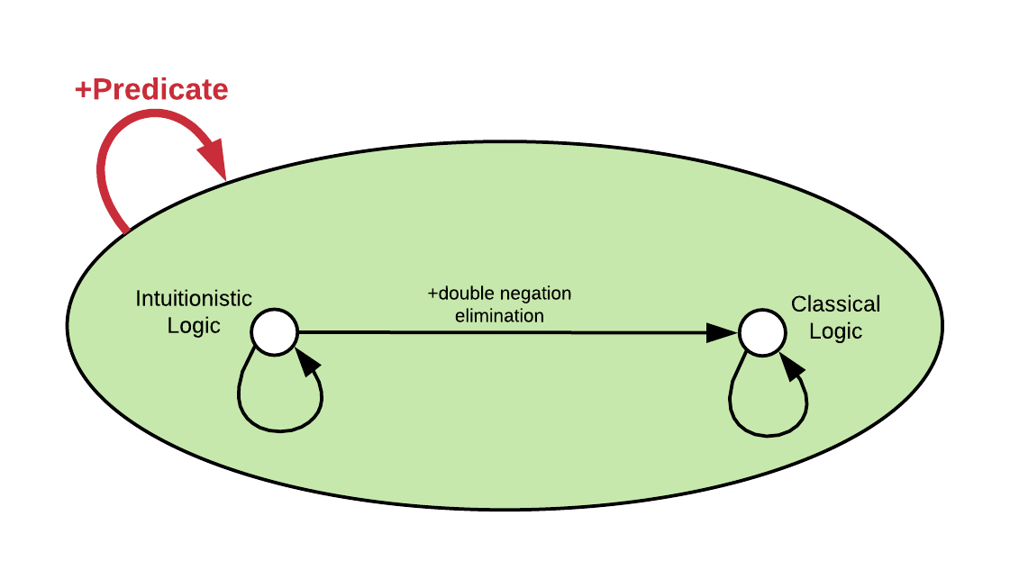
Type Refinement Systems
Endofunctor
+nothing
Identity (+nothing)
Category
43

Slide 120

Type Refinement Systems
44

Slide 121
Type Refinement Systems
The derivations that make sense
44

Slide 122
Type Refinement Systems
The terms that make sense
44

Slide 123

Type Refinement Systems
All three are functors, thus they all
preserve structure
44

Slide 124

Type Refinement Systems
Type system: Opfibration of derivations
and terms into the semantical category
44

Slide 125

Type Refinement Systems
Type Refinements: framing device so that every type
system is a refinement system of some types
Curry-Howard-Lambek Correspondence:
Additionally, functors between categories can establish refinements.
45

Slide 126
The Crazy Part
Curry-Howard seems
to be a functor between
logics (derivations),
languages (terms),
and categorical semantics.
Is there a type system
on the level of the CHL
correspondence?
46

Slide 127
The Crazy Part
Curry-Howard seems
to be a functor between
logics (derivations),
languages (terms),
and categorical semantics.
Is there a type system
on the level of the CHL
correspondence?
Is it the missing body
piece of this butterfly?
46

Slide 128
Outline
Motivation
Several interesting findings
A more refined perspective
Conclusion
47

Slide 129
In Review
Curry-Howard Correspondence
Makes our type systems more systematic
Gives proofs for “free” (e.g. deadlock in CP calculus)
Can support program behaviours if type system is built
with relevant underlying logic that expresses the
bounds for such behaviours
Is everywhere.
48

Slide 130
Opportunities
Spectrum of logics corresponding to automatic memory management methods
Exploring the space between known parts
Program synthesis via Curry-Howard
Solvers for category-theorical proofs
49

Slide 131
Opportunities
Spectrum of logics corresponding to automatic memory management methods
if reference counting is linear logic²¹,
what’s garbage collection?
Exploring the space between known parts
Program synthesis via Curry-Howard
Solvers for category-theorical proofs
[21] Chirimar, Jawahar, Carl A. Gunter, and Jon G. Riecke. "Reference counting as a computational interpretation of linear logic." Journal of Functional Programming 6.2 (1996): 195-244.
49

Slide 132
Opportunities
Spectrum of logics corresponding to automatic memory management methods
Exploring the space between known parts
filling the gaps on the bridge
between logics and type systems
Program synthesis via Curry-Howard
Solvers for category-theorical proofs
49

Slide 133
Opportunities
Spectrum of logics corresponding to automatic memory management methods
Exploring the space between known parts
Program synthesis via Curry-Howard
Solvers for category-theorical proofs
49

Slide 134
Opportunities
Spectrum of logics corresponding to automatic memory management methods
Exploring the space between known parts
Program synthesis via Curry-Howard
Solvers for category-theorical proofs
49

Slide 135
Thank You
50

