Slide 1
The Curry-Howard Correspondence: Bridging Types and Logics
Major Area Exam
Candidate: Miroslav Gavrilov
💺Ben Hardekopf
Chandra Krintz
Tevfik Bultan

Slide 2
Outline
Motivation
Intuitionistic logic and simply-typed lambda calculus
Classical logic and lambda-mu calculus
Several interesting findings
A more refined perspective
Conclusion
1

Slide 3
Outline
Motivation
Several interesting findings
Classical linear logic and process calculi
Predicate logic and information-flow types
A more refined perspective
Conclusion
1

Slide 4
Outline
Motivation
Several interesting findings
A more refined perspective
Functors and general refinement systems
Conclusion
1

Slide 5
Outline
Motivation
Several interesting findings
A more refined perspective
Conclusion
Review
Opportunities
1

Slide 6
Outline
Motivation
Several interesting findings
A more refined perspective
Conclusion
2

Slide 7
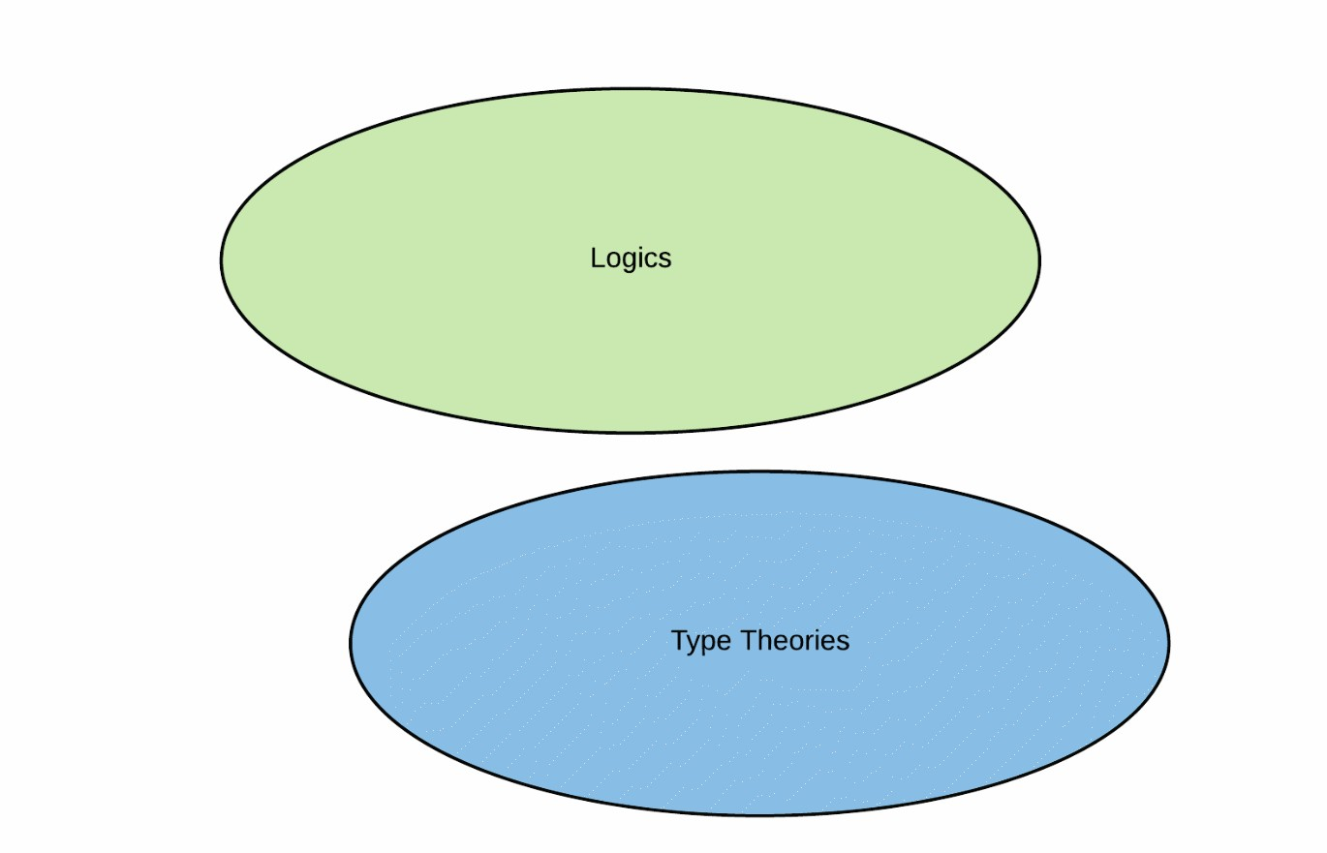
Motivation
3

Slide 8
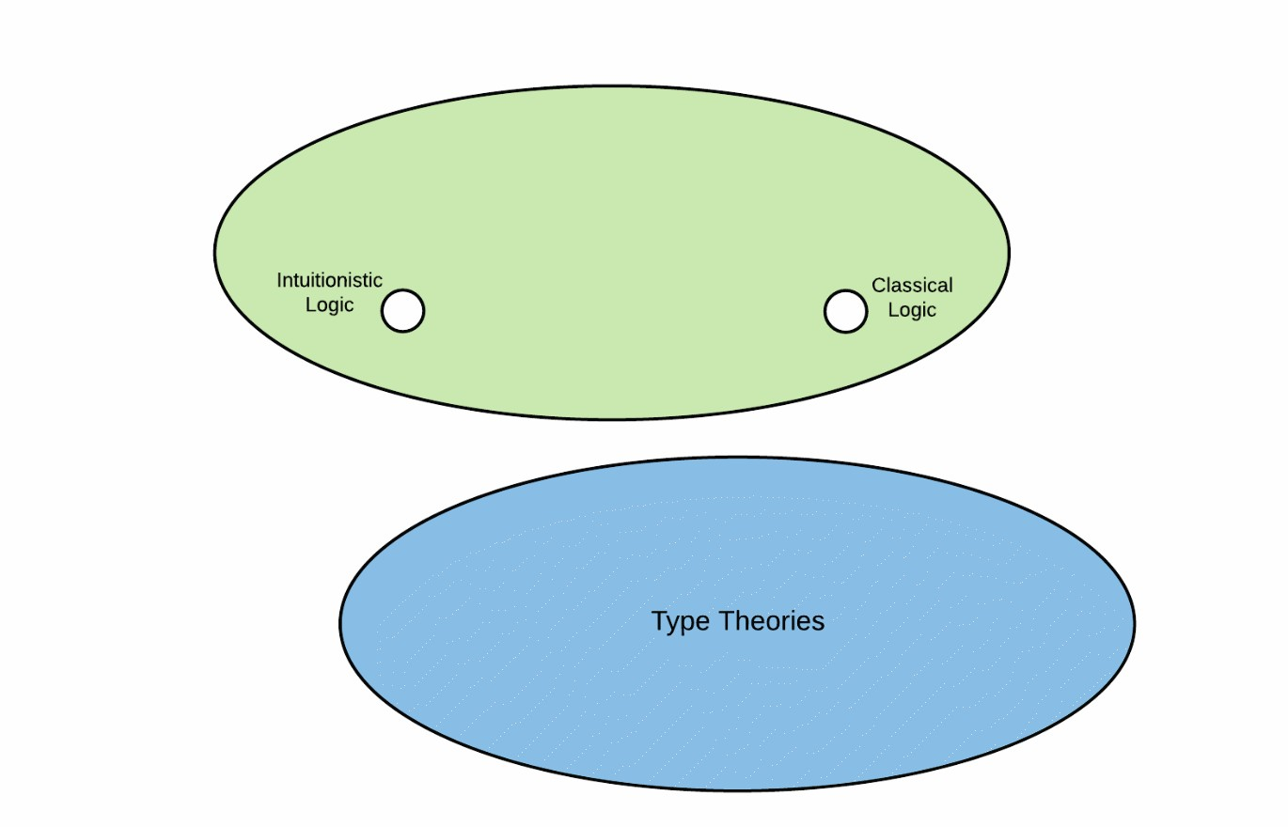
Motivation
3

Slide 9
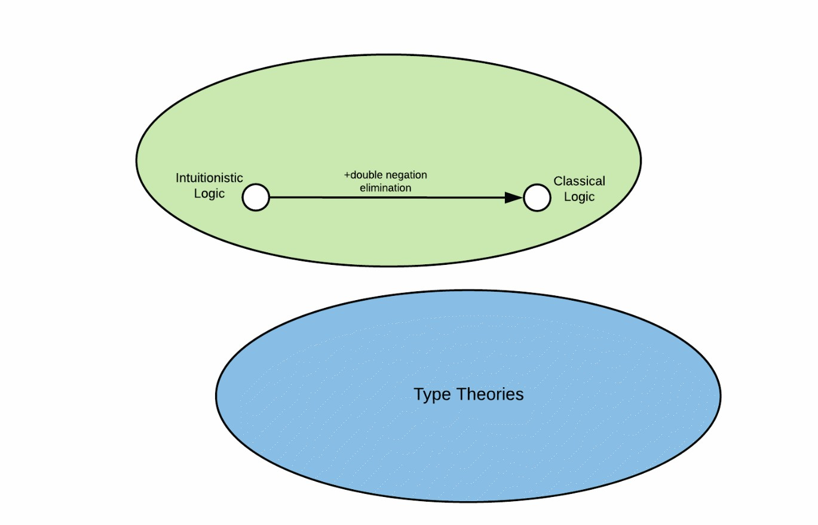
Motivation
3

Slide 10
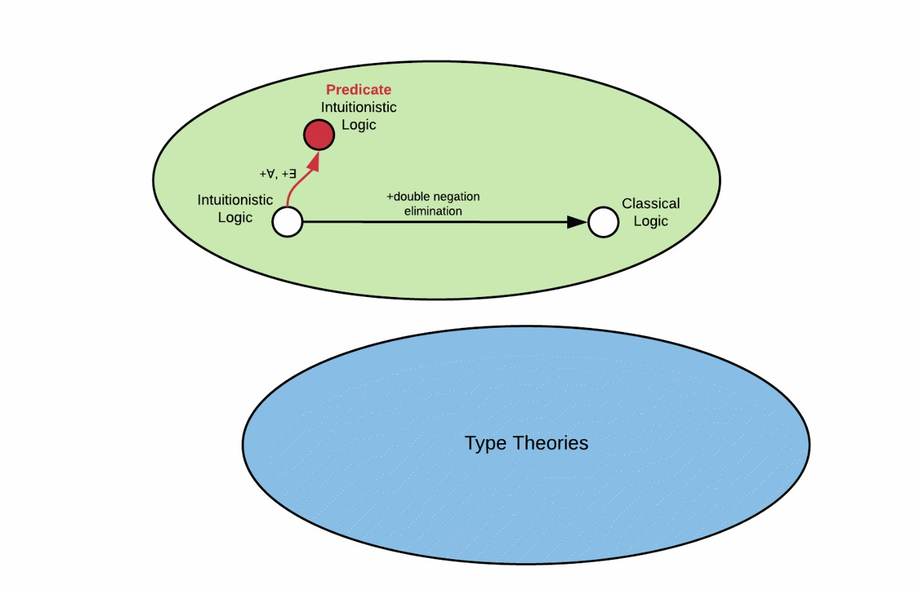
Motivation
3

Slide 11
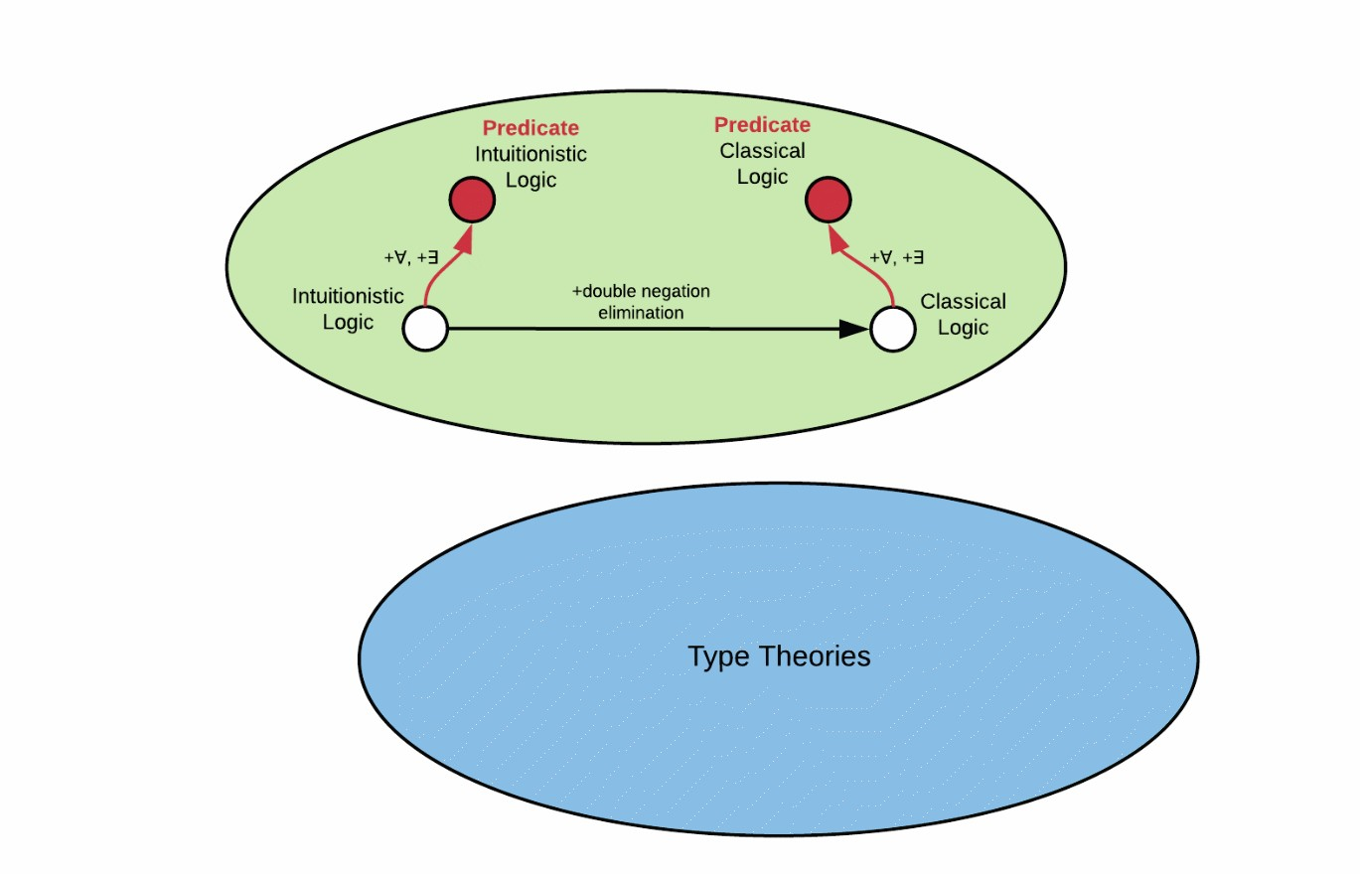
Motivation
3

Slide 12
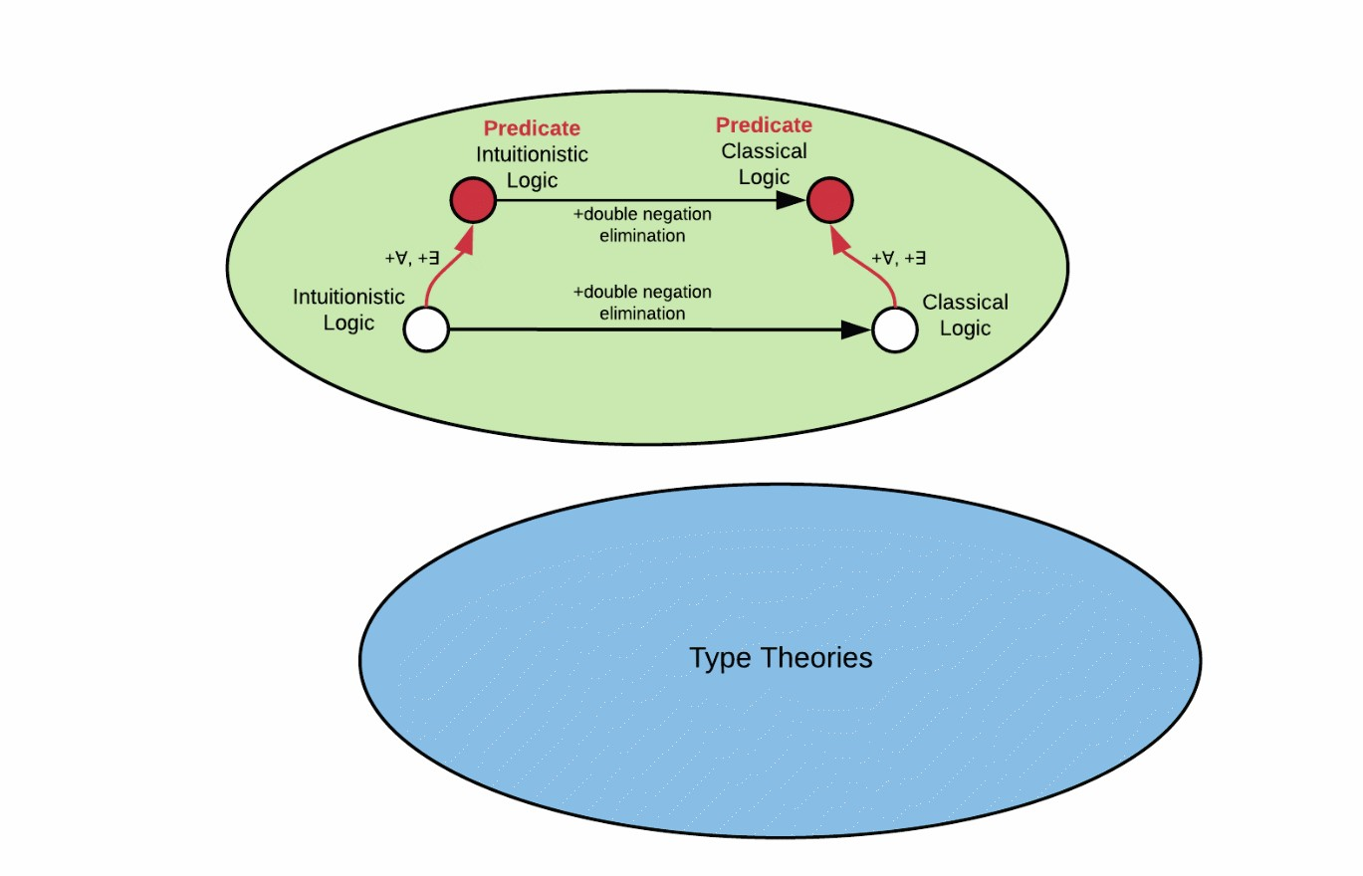
Motivation
3

Slide 13
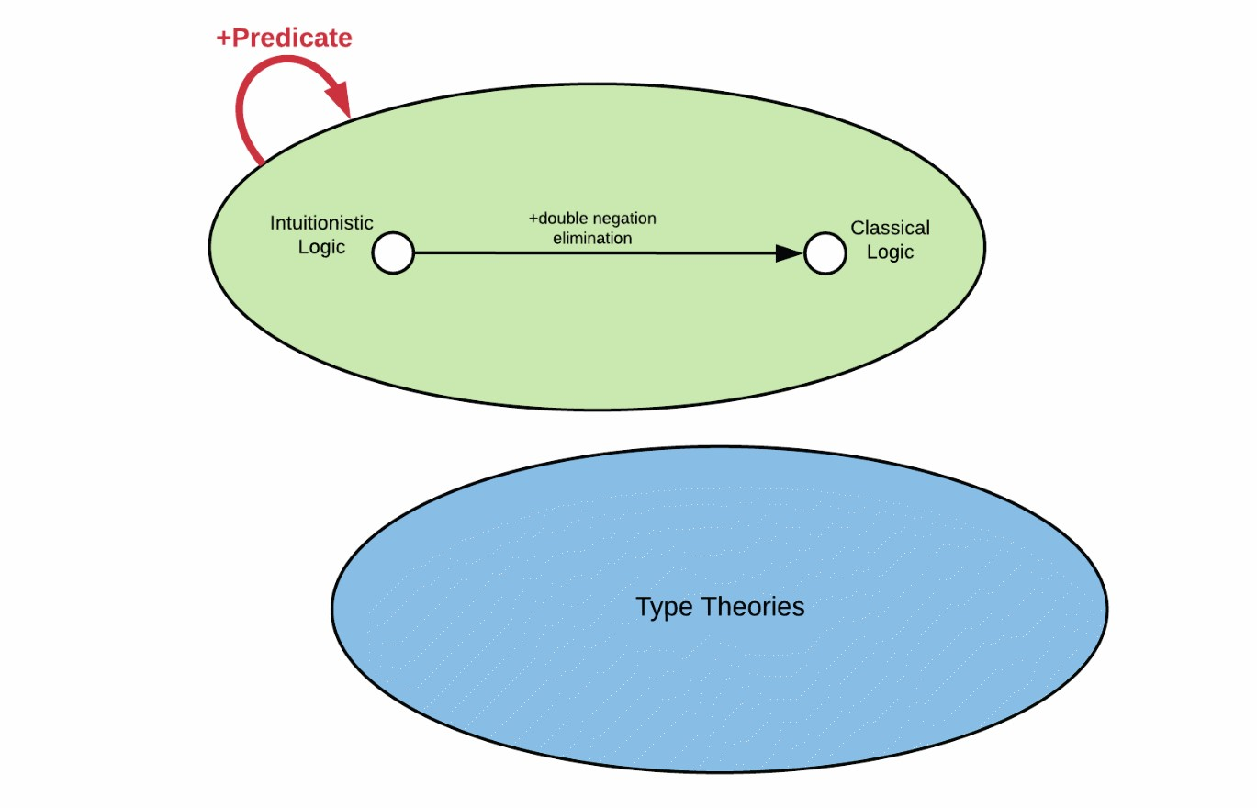
Motivation
3

Slide 14
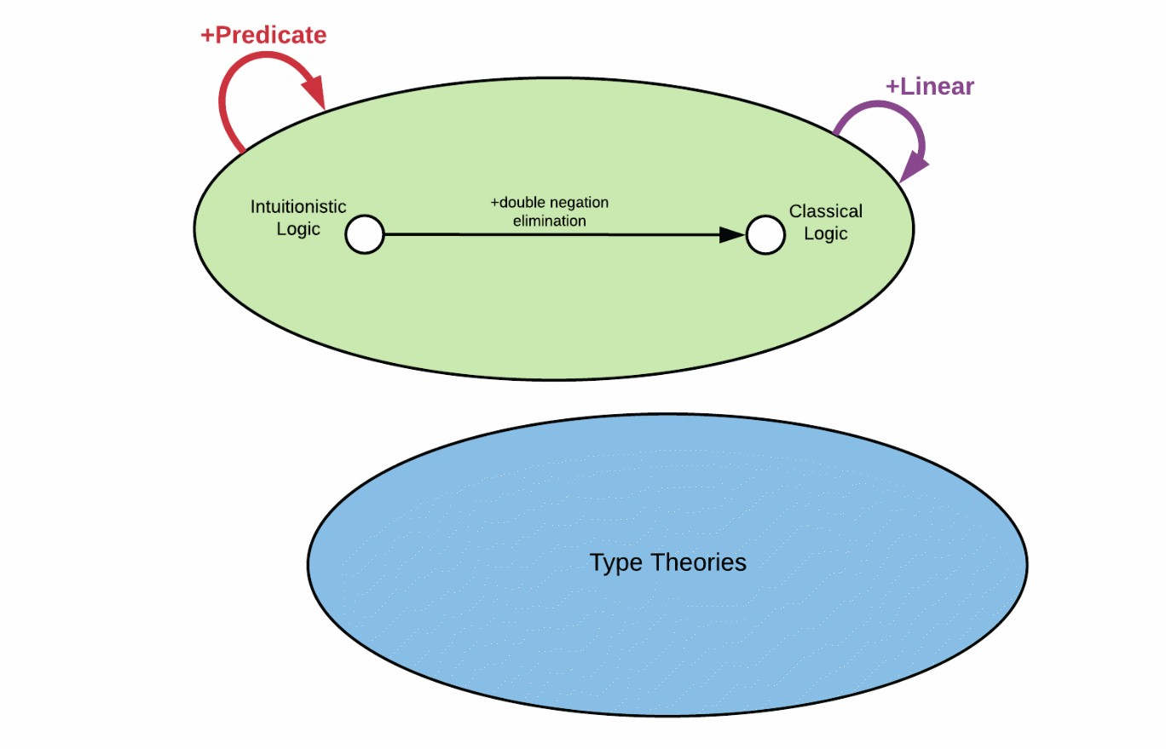
Motivation
3

Slide 15
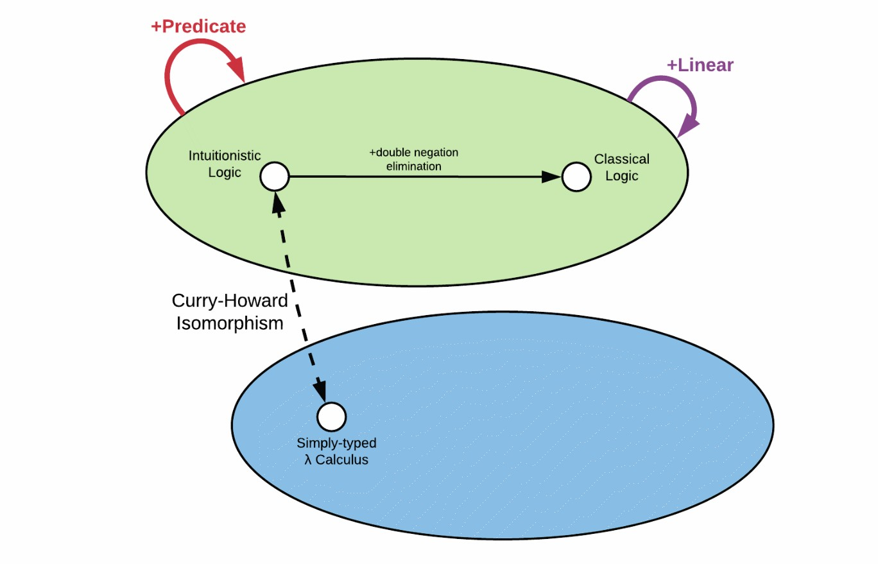
Motivation
3

Slide 16
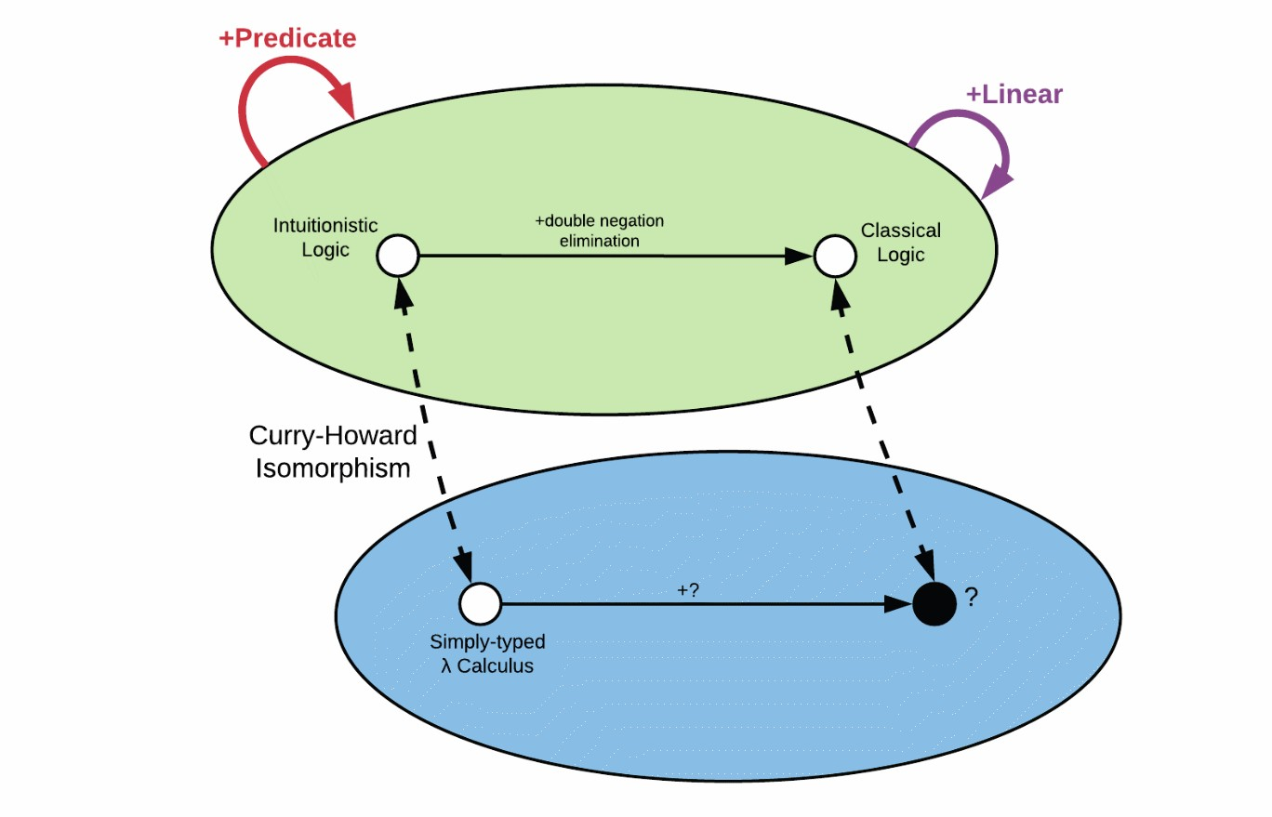
Motivation
3

Slide 17
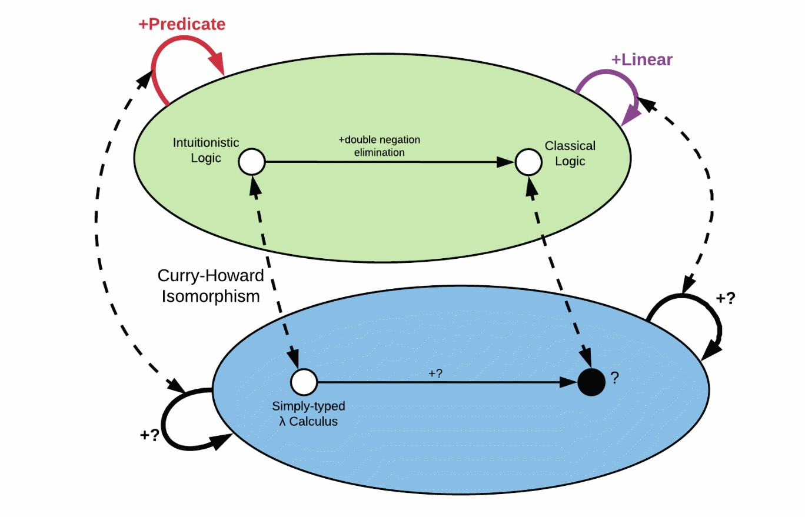
Motivation
3

Slide 18
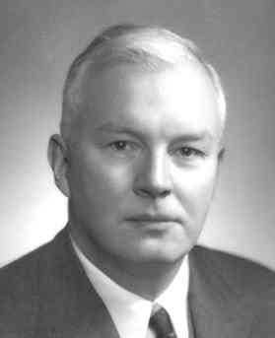

Motivation
Logic equals^{1,2}
Types
A ⇒ B ≡ A → B
A ∨ B ≡ A + B
A ∧ B ≡ A × B
Haskell Curry
William Alvin Howard
[1] H. B. Curry. Functionality in combinatory logic. Proceedings of the National Academy of Science, 20:584–590, 1934.
[2] W. A. Howard. The formulae-as-types notion of construction. In To H. B. Curry: Essays on Combinatory Logic, Lambda Calculus,
and Formalism, pages 479–491. Academic Press, 1980.
4

Slide 19
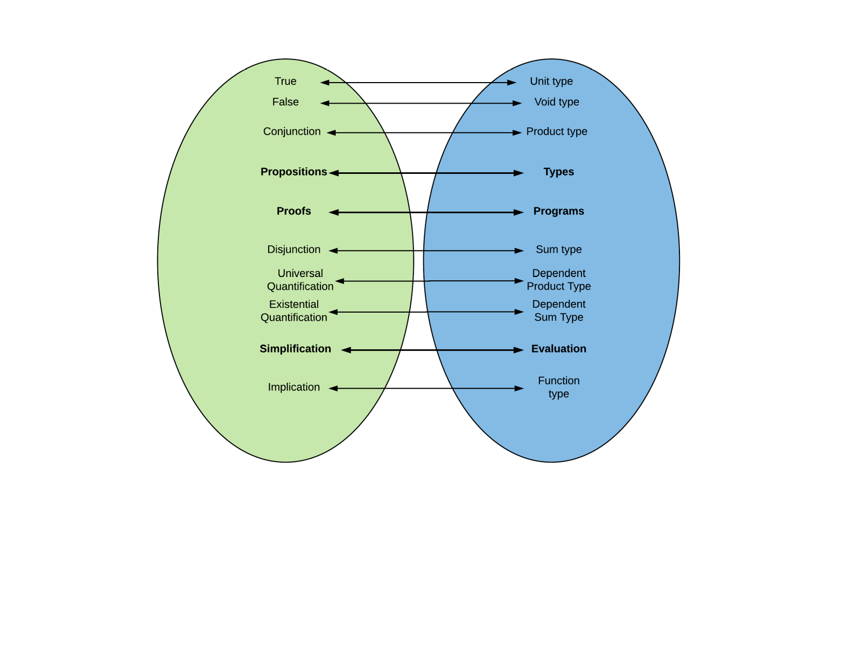
Motivation
Intuitionistic Logic
Lambda
Calculus
5

Slide 20
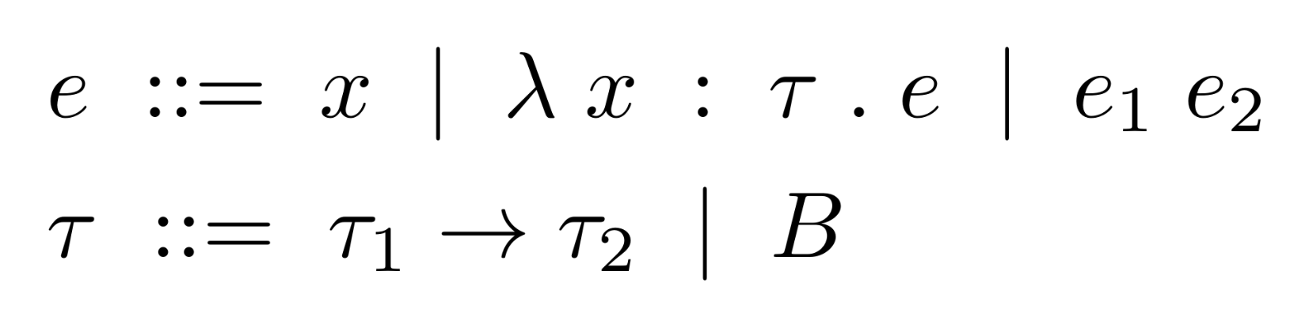
Lambda Calculus
Simply-typed Lambda Calculus
6

Slide 21
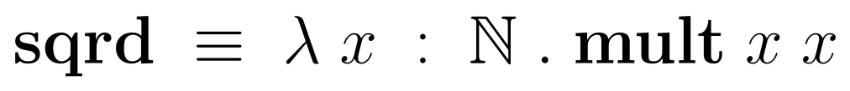
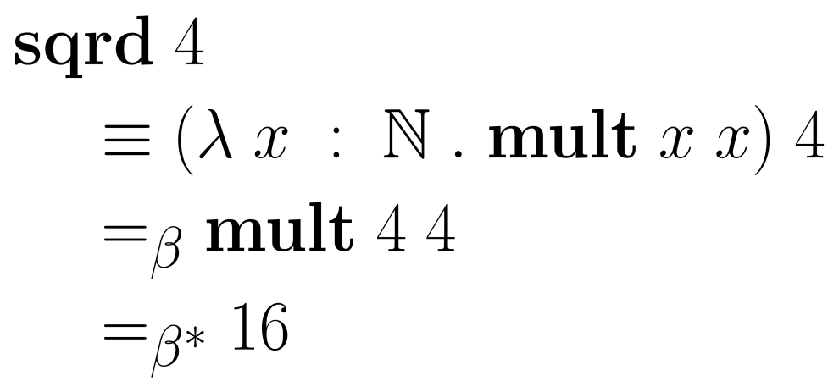
Lambda Calculus
Simply-typed Lambda Calculus Reduction
7

Slide 22
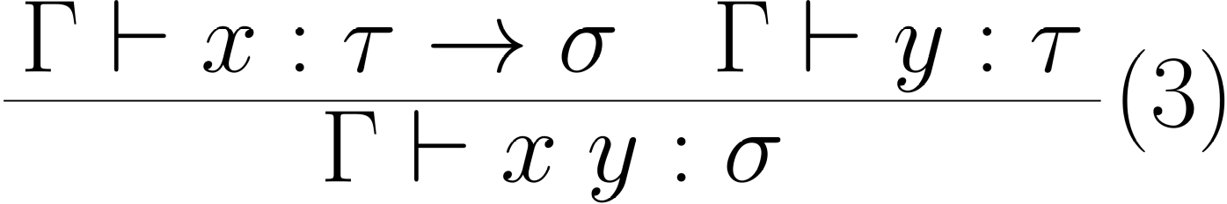
Lambda Calculus
Simply-typed Lambda Calculus Typing Rules: App
Modus Ponens: A ⇒ B, A ⊢ B
8

Slide 23
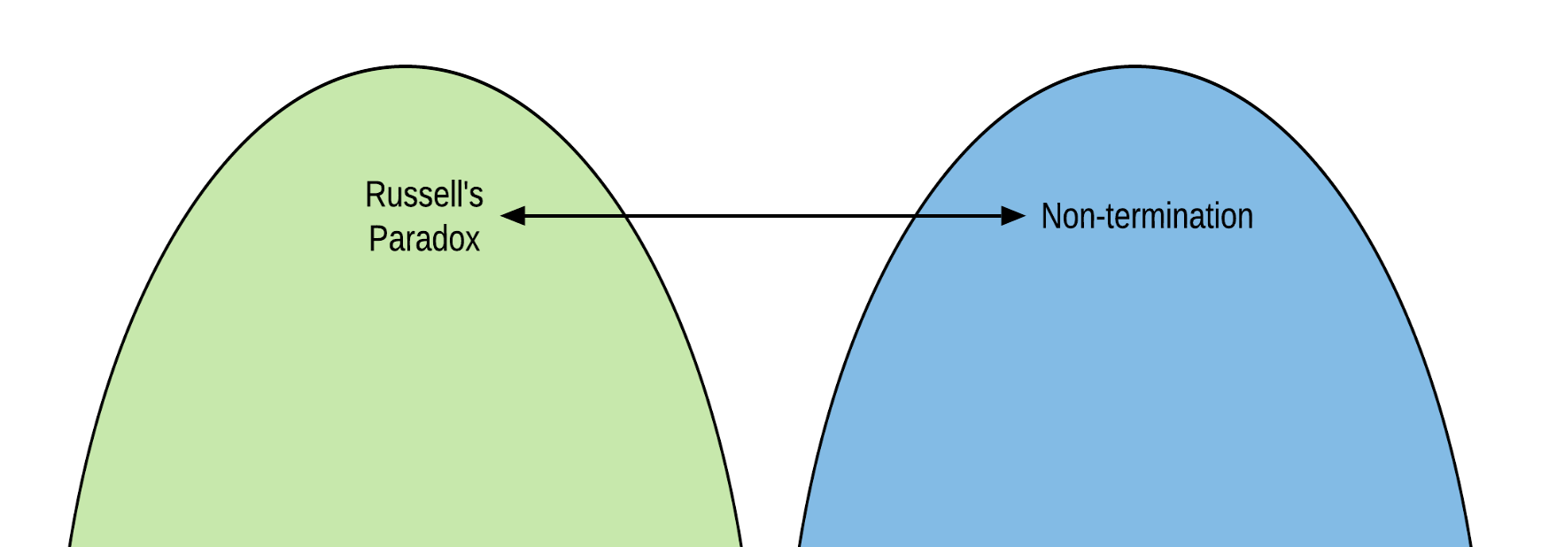
Lambda Calculus
Simply-typed Lambda Calculus Typing Rules: App
Most Typed Lambda Calculi are strongly normalizing:
every term can be written in a normal form, such that it
doesn’t reduce further
Strong normalization = All computations terminate
9

Slide 24
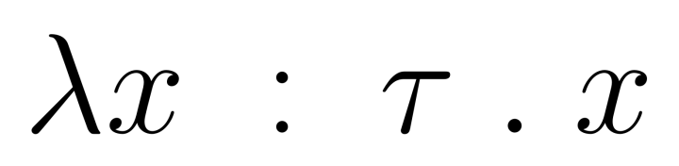



Curry-Howard Isomorphism
this object is proof that type τ → τ isn’t empty
10

Slide 25

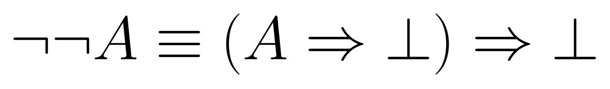
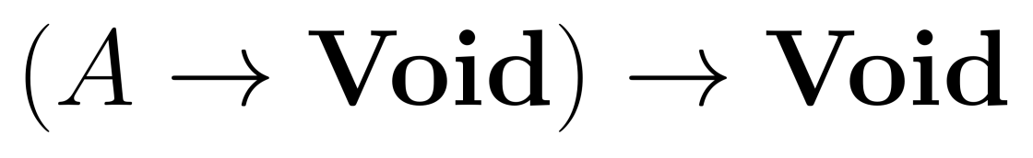
Curry-Howard Isomorphism
“If you give me a function that can turn A to Void, I can give you Void”
11

Slide 26
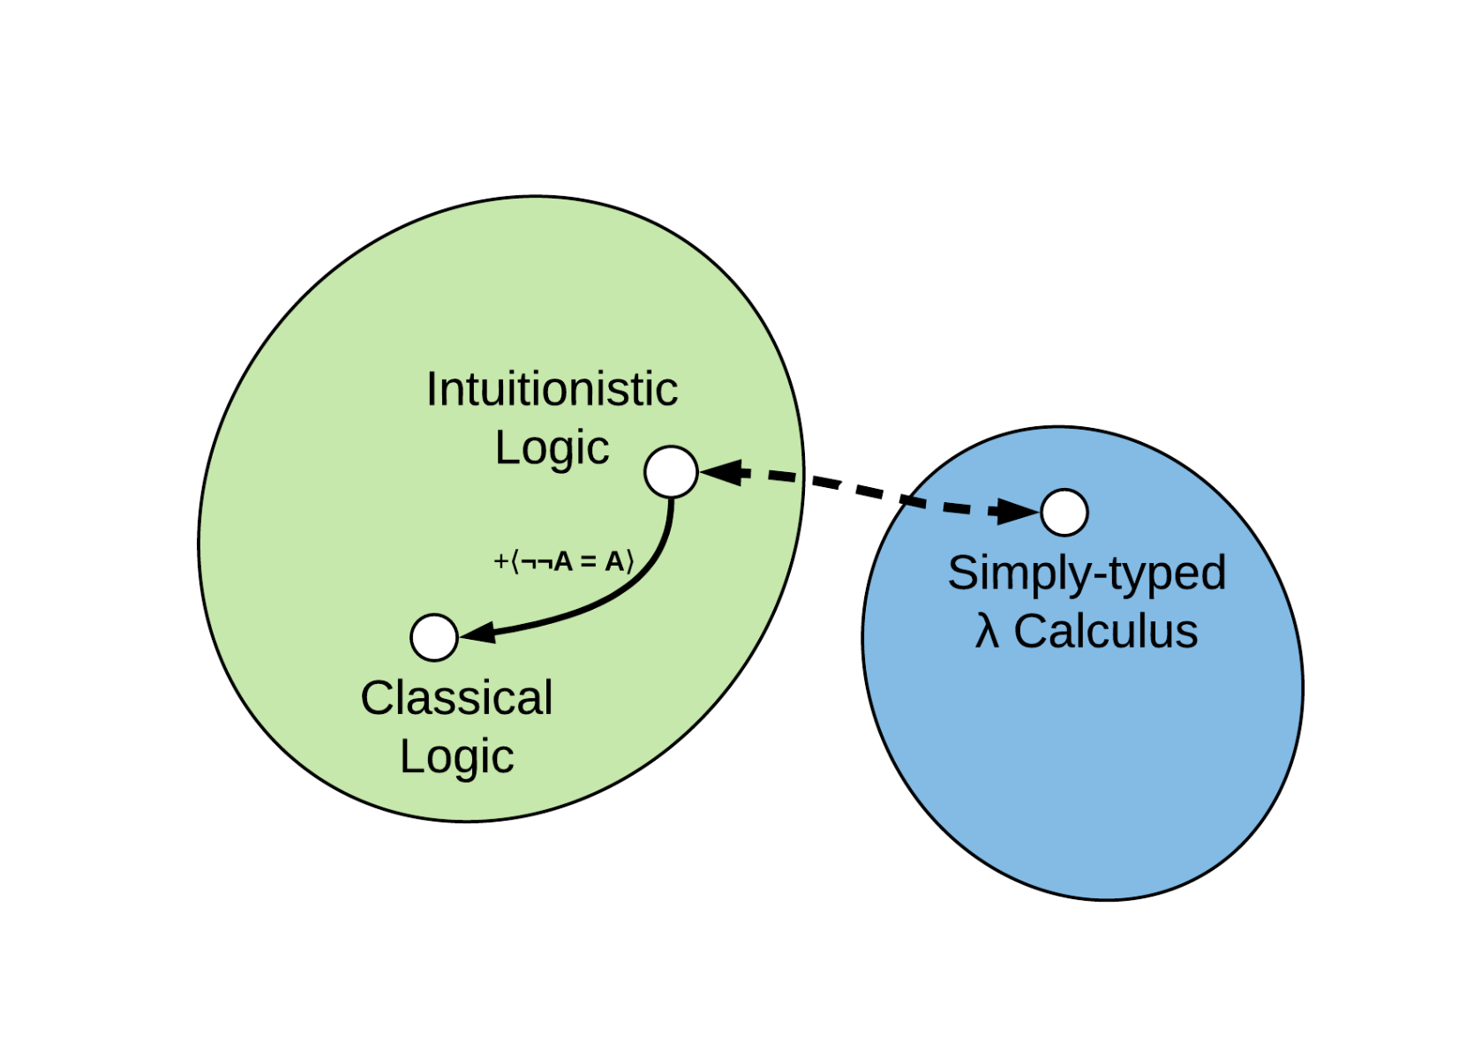
Curry-Howard Isomorphism
12

Slide 27
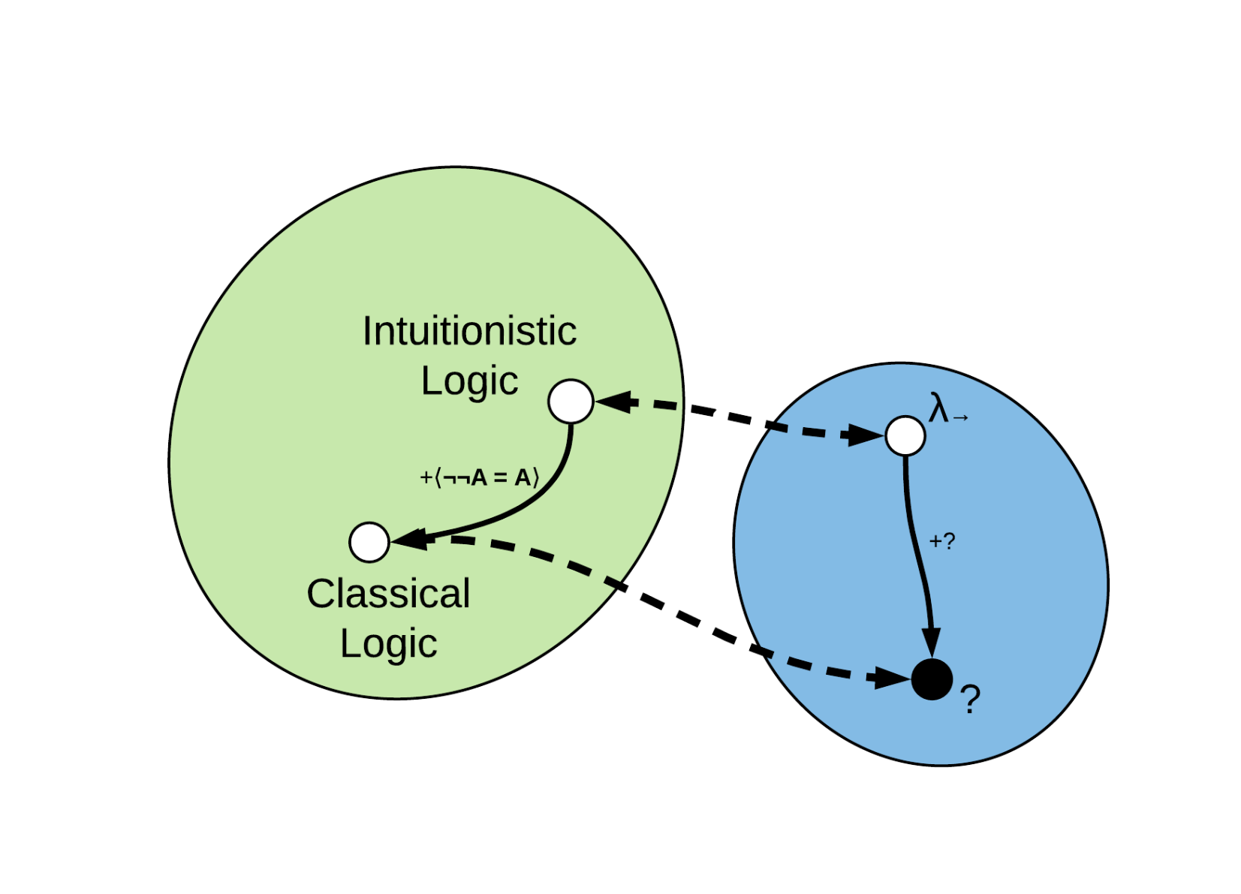
An open invitation
12

Slide 28
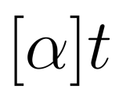
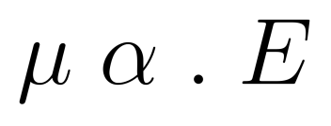
Extending the Correspondence
Parigot’s λμ (lambda-mu) Calculus³
Introduces named terms (mu terms)
Control over which parts of an expression are reduced (commands)
[3] Michel Parigot. 1992. Lambda-My-Calculus: An Algorithmic Interpretation of Classical Natural Deduction. In Proceedings of the International
Conference on Logic Programming and Automated Reasoning (LPAR '92), Andrei Voronkov (Ed.). Springer-Verlag, London, UK, UK, 190-201.
13

Slide 29
Extending the Correspondence
Parigot’s λμ (lambda-mu) Calculus
Practically implements continuations
Other control mechanisms are easy to construct from it:
call/cc, throw/catch, reset/shift, …
Can formalize a proof for double negation elimination
13

Slide 30
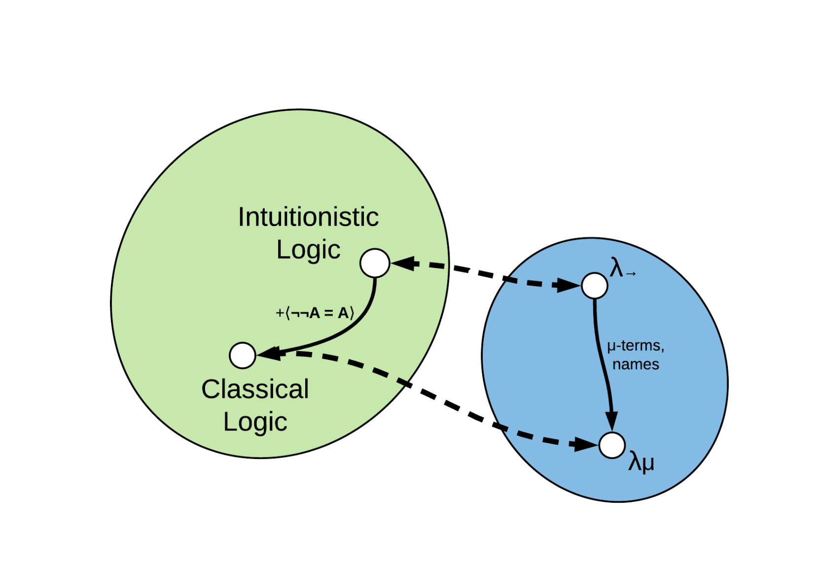
Extending the Correspondence
14

Slide 31

Extending the Correspondence
14

Slide 32
Outline
Motivation
Several interesting findings
A more refined perspective
Conclusion
15

Slide 33
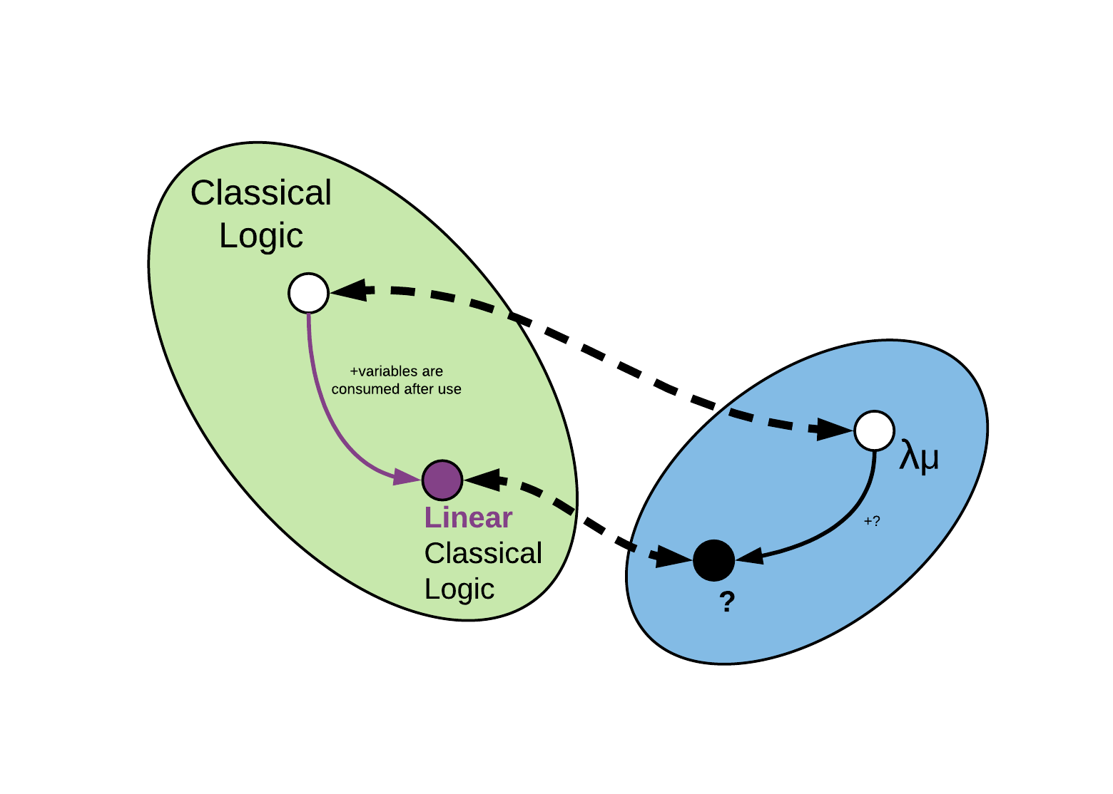
A more Linear Approach
⁵
[5] Jean-Yves Girard. 1987. Linear logic. Theor. Comput. Sci. 50, 1 (January 1987), 1-102.
16

Slide 34
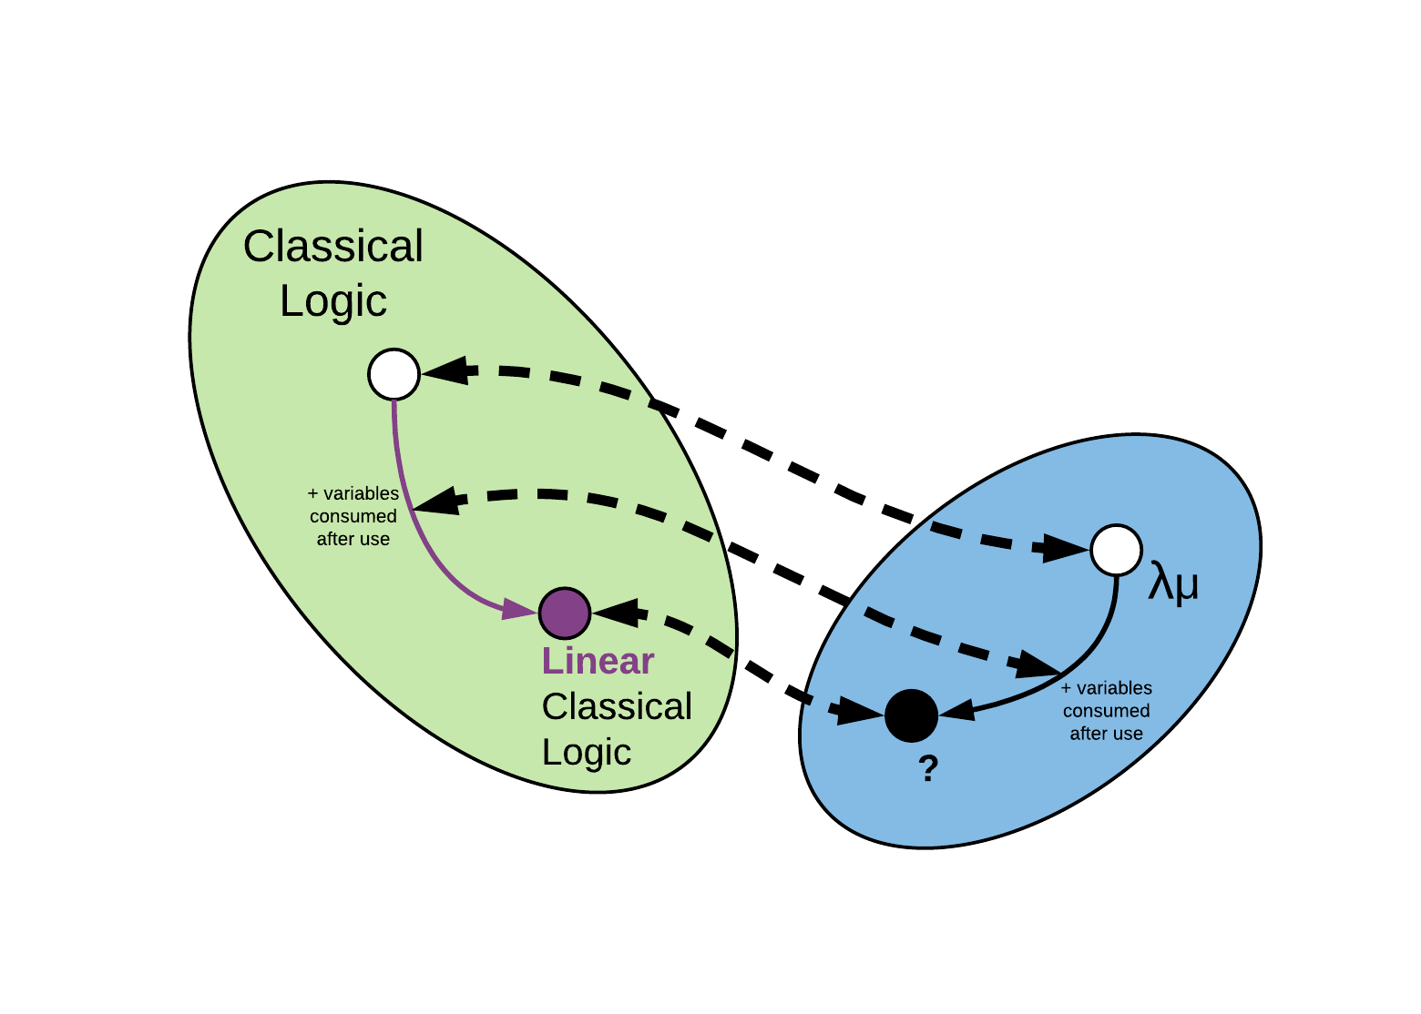
A more Linear Approach
16

Slide 35
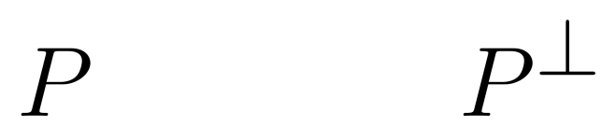
A more Linear Approach
What do we know about this linear logic?
Every variable is consumed after usage (can be used only once).
The classical version has the law of excluded middle:
Every proposition has its dual.
17

Slide 36
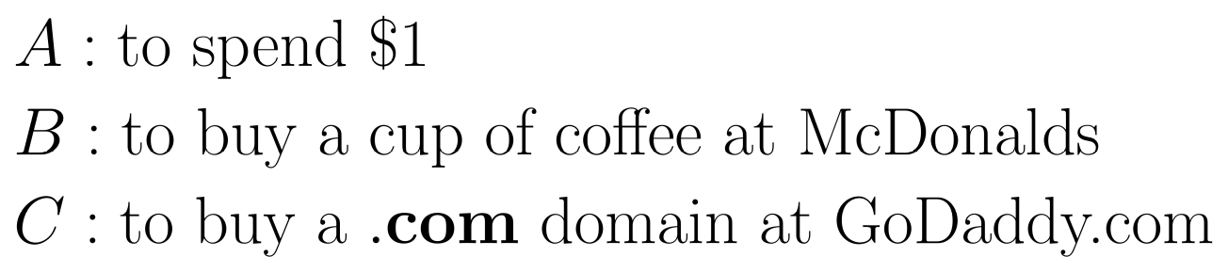
A more Linear Approach
What do we know about this linear logic?
We have different operations from classical logic.
actually $0.99 but who’s counting
18

Slide 37
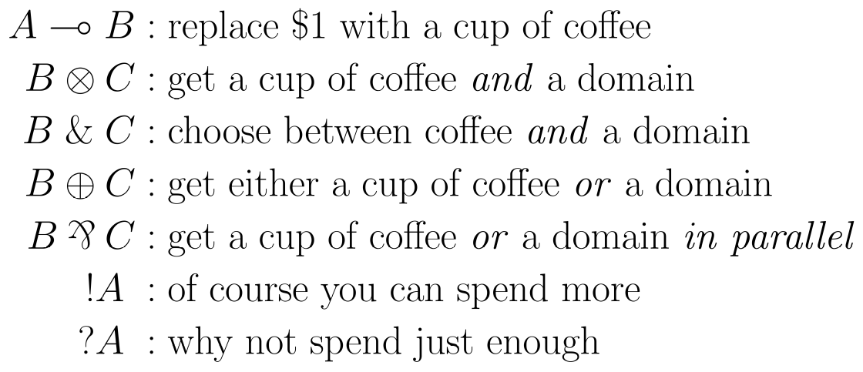
A more Linear Approach
What do we know about this linear logic?
We have different operations from classical logic.
19

Slide 38
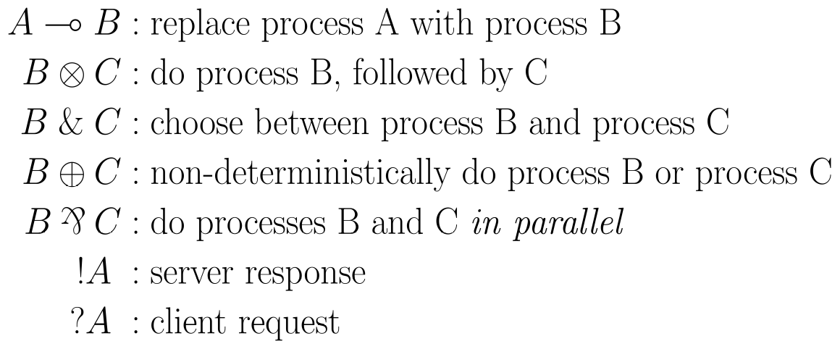
A more Linear Approach
What do we know about this linear logic?
We can model communication with these operations⁶.
[6] Philip Wadler. 2012. Propositions as sessions. In Proceedings of the 17th ACM SIGPLAN international conference on Functional programming(ICFP '12).
ACM, New York, NY, USA, 273-286.
20

Slide 39
A more Linear Approach
Wadler’s CP calculus
Process calculus: models communication and interactions
Session types: types that, together with their duals, define protocols
Deadlock safety?
21

Slide 40
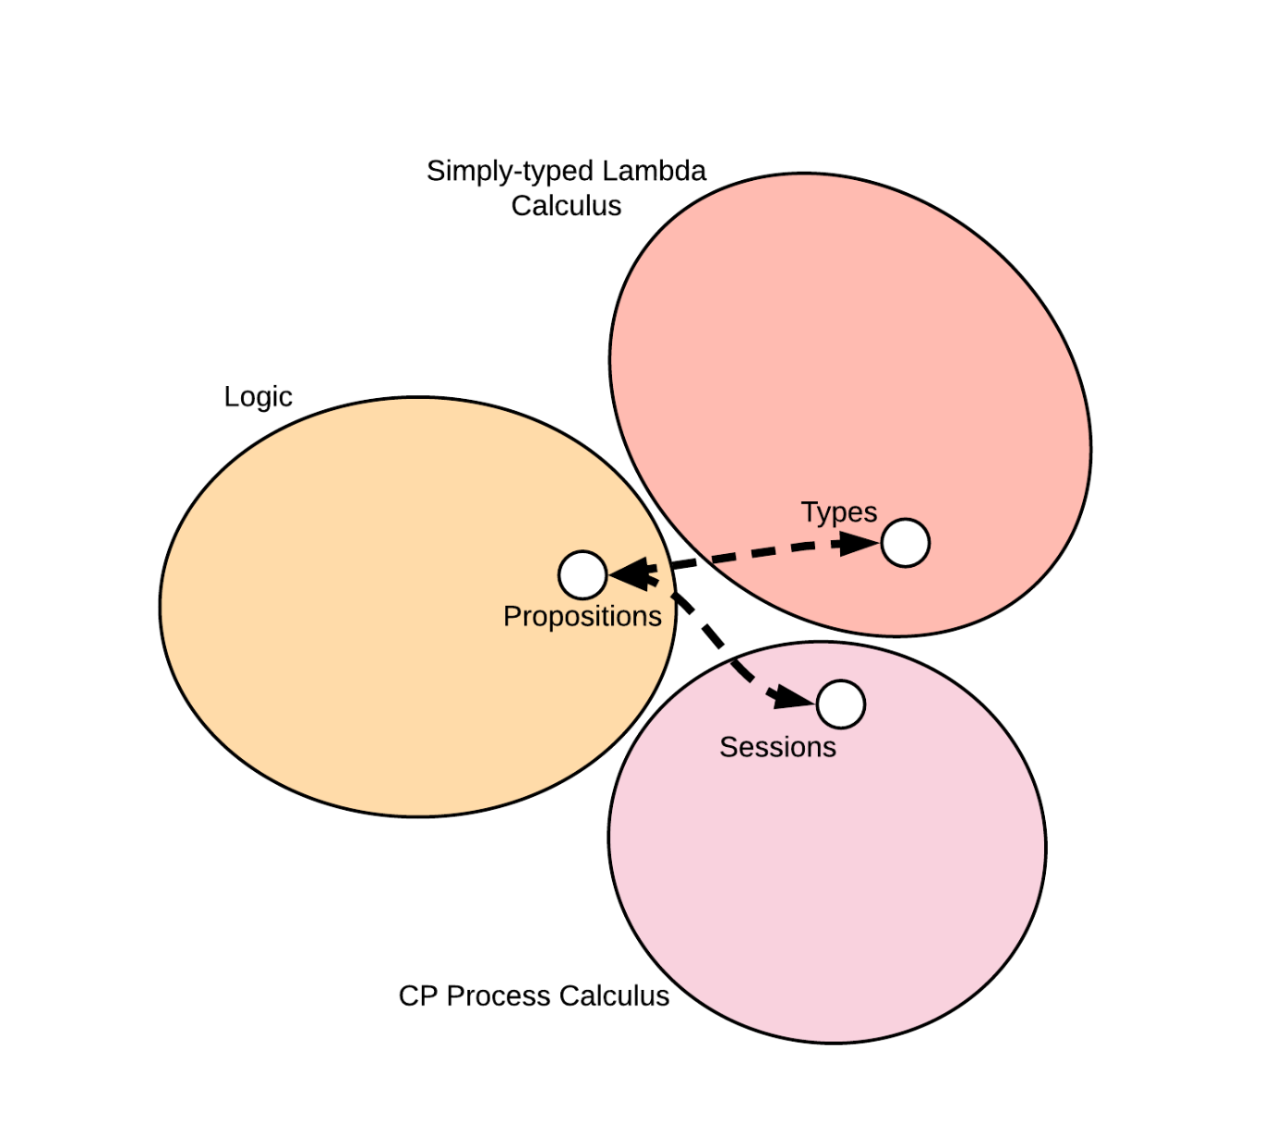
A more Linear Approach
Wadler’s CP calculus
22

Slide 41
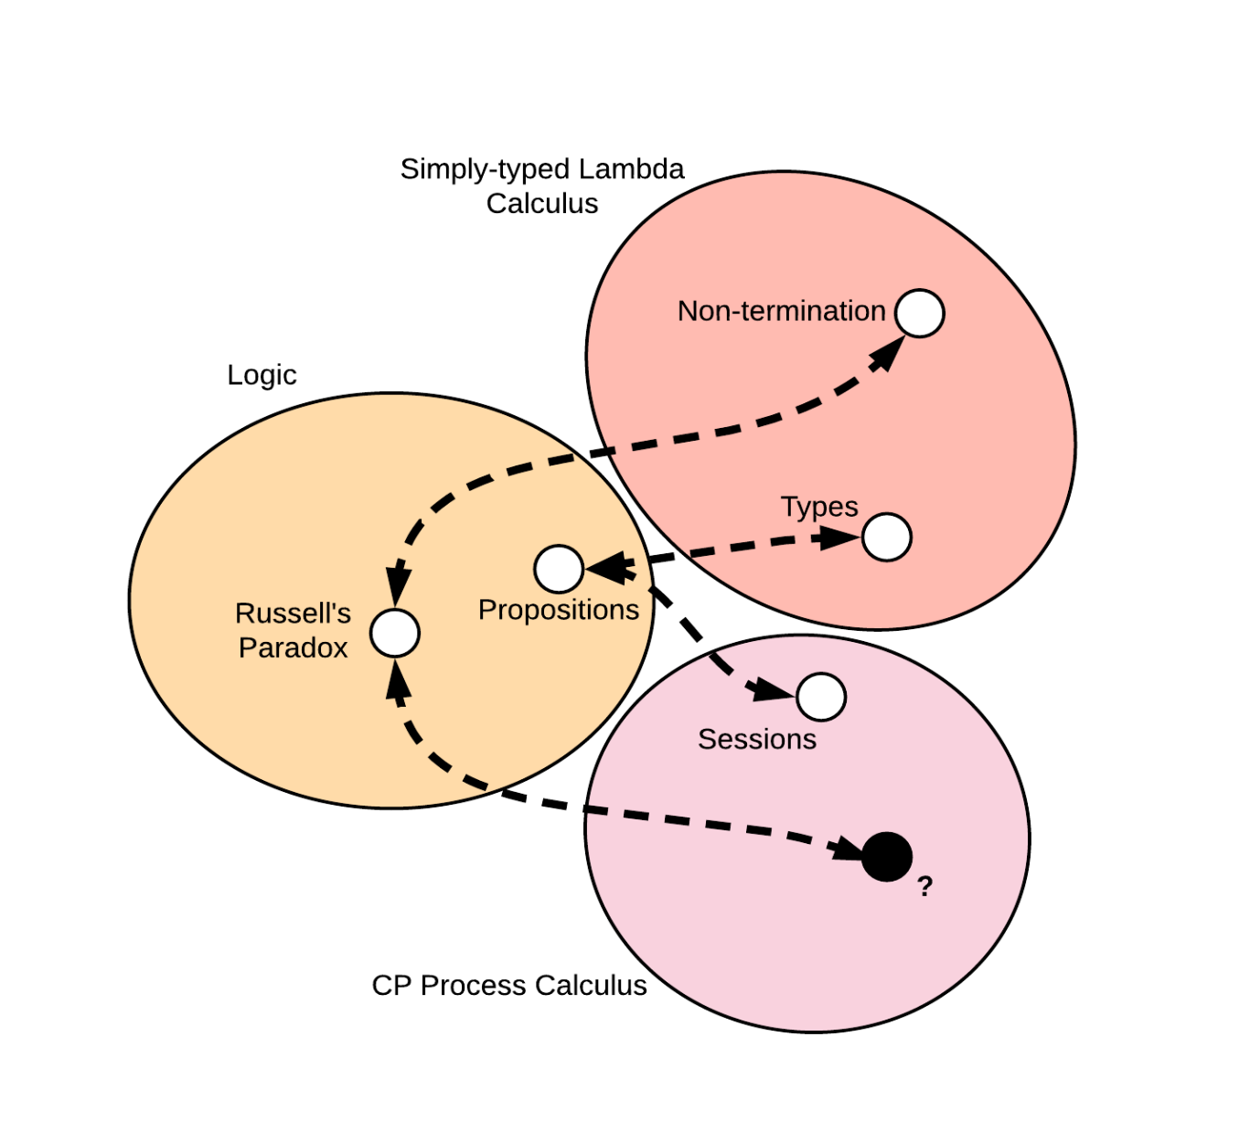
A more Linear Approach
Wadler’s CP calculus
22

Slide 42
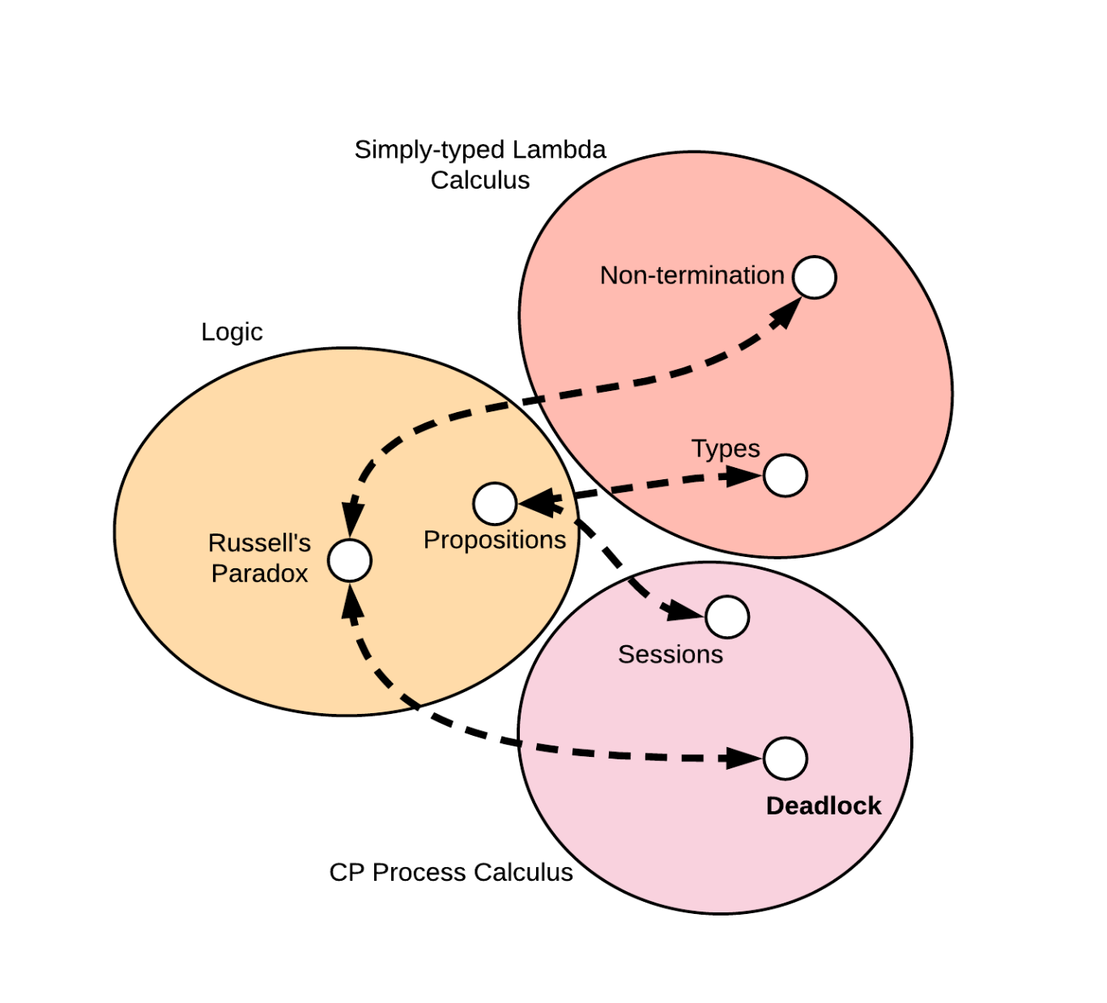
A more Linear Approach
Wadler’s CP calculus
CP is strongly normalizing, thus no deadlock⁶
[6] Philip Wadler. 2012. Propositions as sessions. In Proceedings of the 17th ACM SIGPLAN
international conference on Functional programming(ICFP '12). ACM, New York, NY, USA, 273-286.
22

Slide 43

A more Linear Approach
23

Slide 44
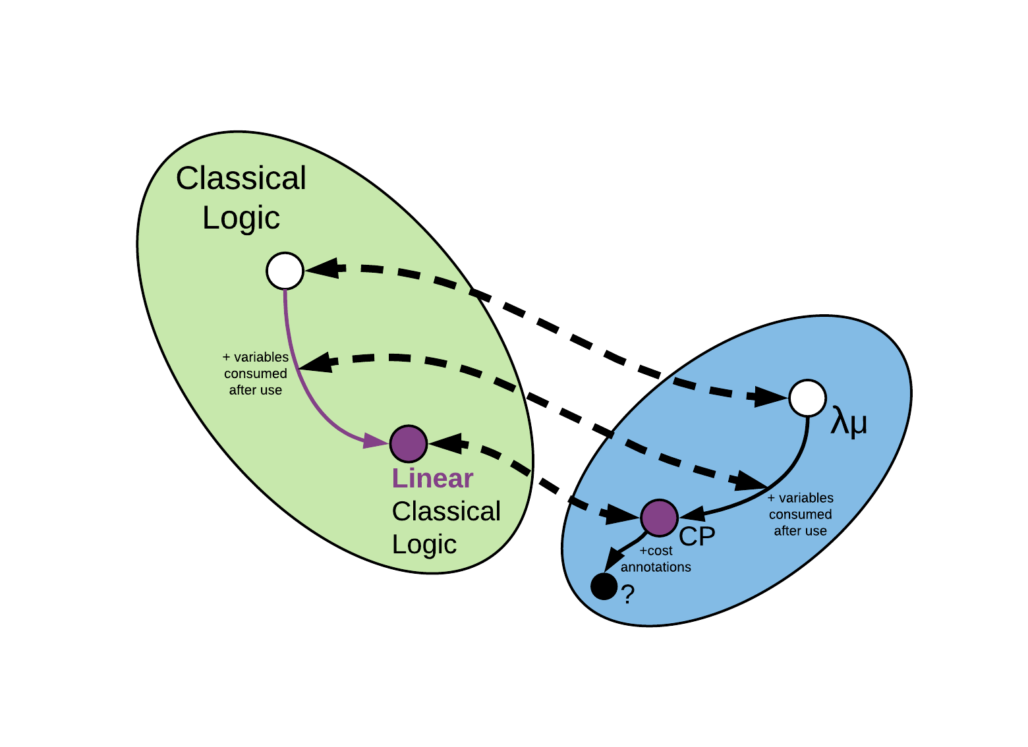
Type-side Extensions?
⁸
[8] Das, A., Hoffmann, J., & Pfenning, F. (2017). Work Analysis with Resource-Aware
Session Types. CoRR, abs/1712.08310.
23

Slide 45
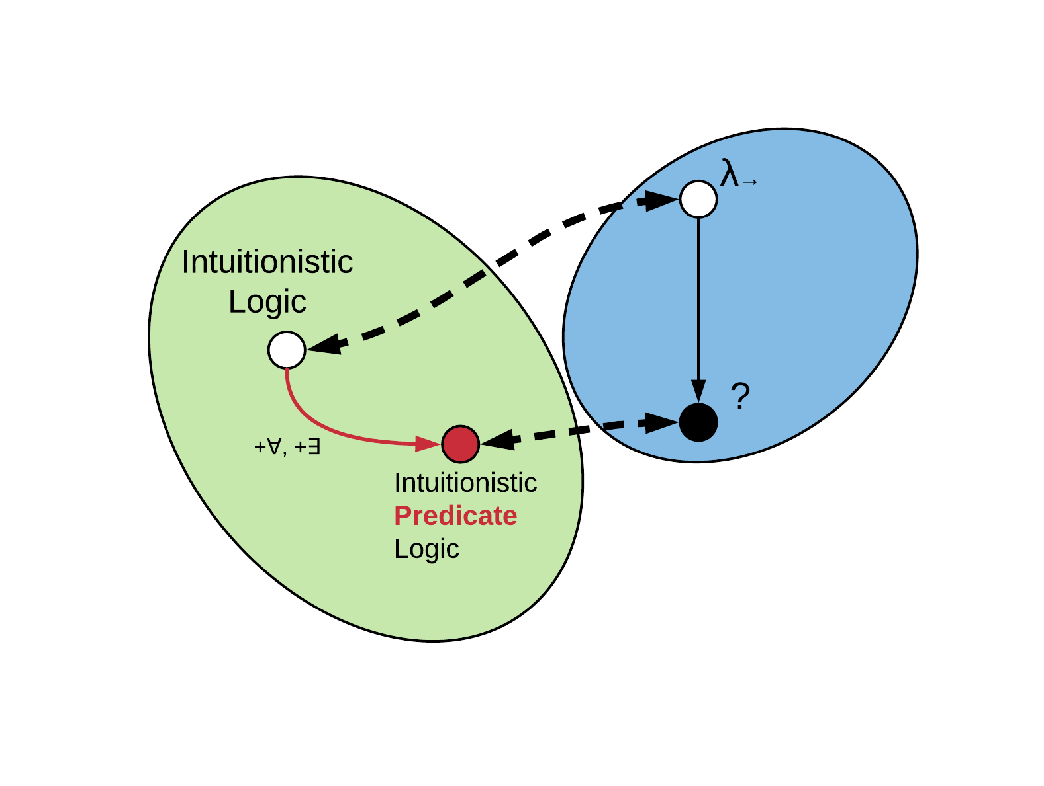
A Segue into Dependencies
24

Slide 46

A Segue into Dependencies
⁹
[9] Martin-Löf, Per, 1971a, An intuitionistic theory of types, unpublished preprint.
24

Slide 47

A Segue into Dependencies
λΠ-calculus¹⁰
Quantification = Types Dependent on Values of other Types
B can now depend on the value x
[10] Bernardo Toninho, Luís Caires, and Frank Pfenning. 2011. Dependent session types via intuitionistic linear type theory. In Proceedings of the 13th
international ACM SIGPLAN symposium on Principles and practices of declarative programming (PPDP '11). ACM, New York, NY, USA, 161-172.
25

Slide 48
A Segue into Dependencies
λΠ-calculus
Quantification = Types Dependent on Values of other Types
26

Slide 49
A Segue into Dependencies
λΠ-calculus
Quantification = Types Dependent on Values of other Types
27

Slide 50
A Segue into Dependencies
λΠ-calculus
Quantification = Types Dependent on Values of other Types
27

Slide 51
A Segue into Dependencies
λΠ-calculus
Quantification = Types Dependent on Values of other Types
27

Slide 52
A Segue into Dependencies
λΠ-calculus
Quantification = Types Dependent on Values of other Types
27

Slide 53
A Segue into Dependencies
λΠ-calculus
Quantification = Types Dependent on Values of other Types
The dependency relation doesn’t have to be this simple...
27

Slide 54
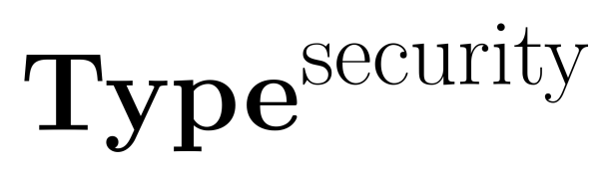

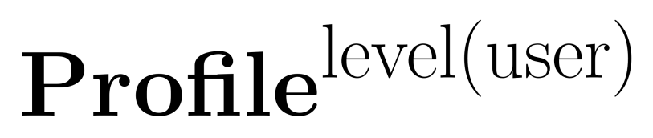

Information-flow Types
Data dependent on security lattices¹¹
[11] Luísa Lourenço and Luís Caires. 2015. Dependent Information Flow Types. In Proceedings of the 42nd Annual ACM SIGPLAN-SIGACT Symposium on
Principles of Programming Languages (POPL '15). ACM, New York, NY, USA, 317-328.
28

Slide 55
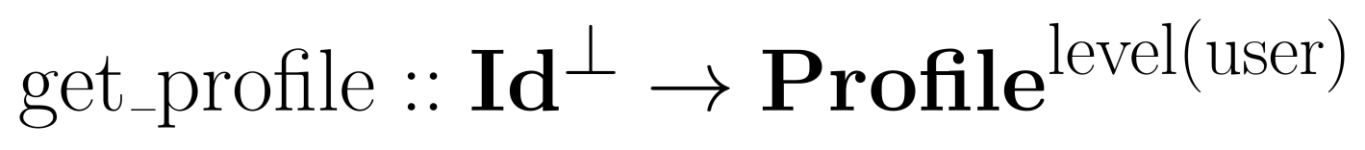
Information-flow Types
Data dependent on security lattices
29

Slide 56
Information-flow Types
Data dependent on security lattices
Security labels are passed through typing judgements,
but such type systems can be too strict
Access-policy synthesis¹²: weaker system, and the results
of failed verifications can be used to identify where
sensitive information leaked and automatically repair it
[12] Aleksandar Nanevski, Anindya Banerjee, and Deepak Garg. 2013. Dependent Type Theory for Verification of Information Flow and Access Control
Policies. ACM Trans. Program. Lang. Syst. 35, 2, Article 6 (July 2013), 41 pages.
30

Slide 57
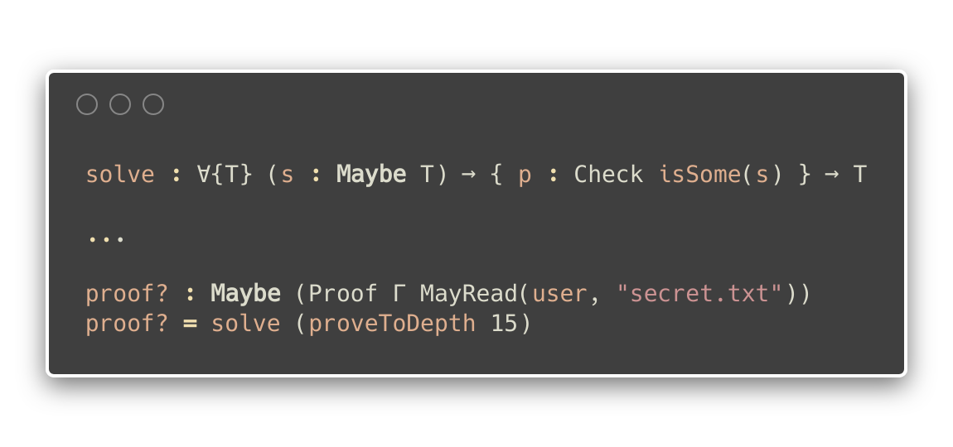
Information-flow Types
Proof assistants can be used to check permissions while
typing out a dependently-typed program¹³!
[13] Jamie Morgenstern and Daniel R. Licata. 2010. Security-typed programming within dependently typed programming. In Proceedings of the 15th ACM
SIGPLAN international conference on Functional programming (ICFP '10). ACM, New York, NY, USA, 169-180.
31

Slide 58
Information-flow Types
Proof assistants can be used to check permissions while
typing out a dependently-typed program!
This is an interactive static method of information-flow handling.
31

Slide 59

Are we there yet?
32

Slide 60
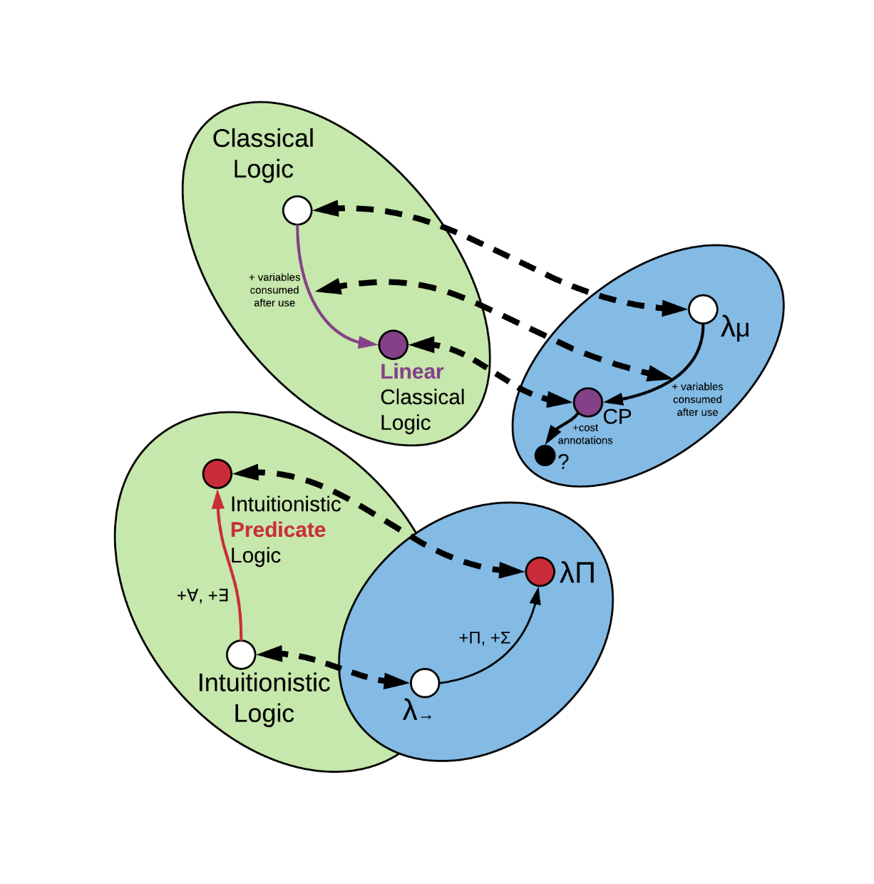
Are we there yet?
32

Slide 61
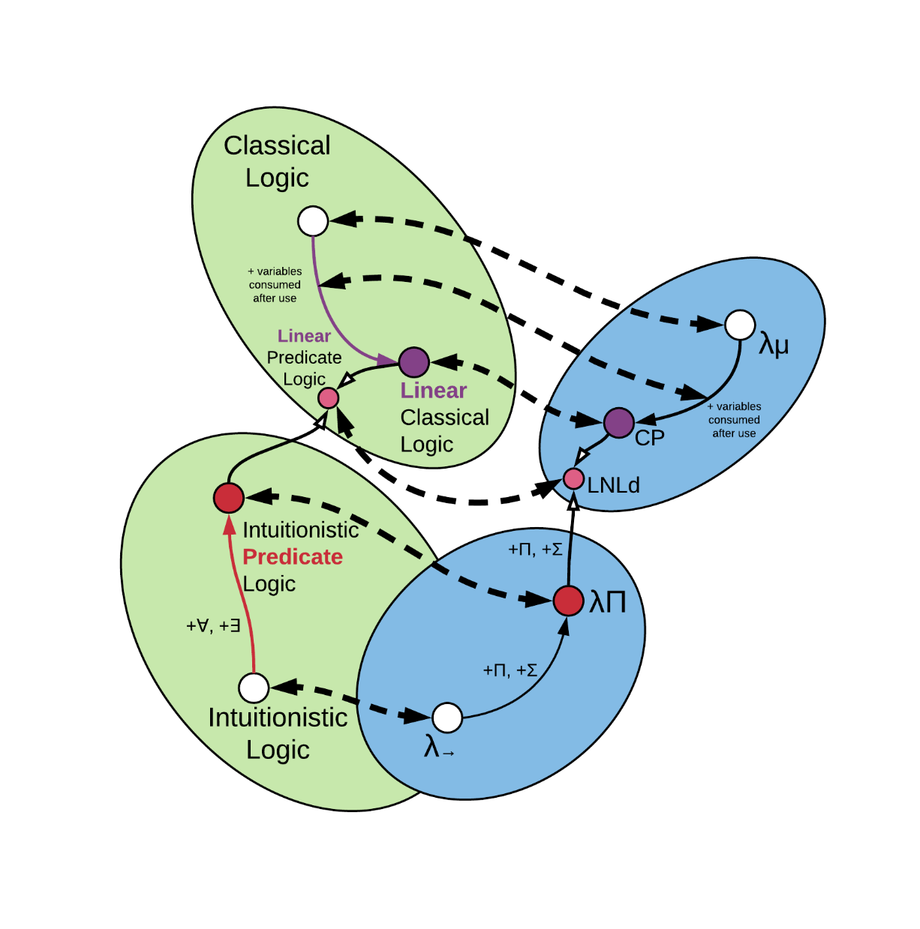
Are we there yet?
[14] Neelakantan R. Krishnaswami, Pierre Pradic, and Nick Benton. 2015. Integrating Linear and Dependent Types. In Proceedings of the 42nd Annual ACM SIGPLAN-SIGACT Symposium on Principles of Programming Languages (POPL '15). ACM, New York, NY, USA, 17-30.
32

Slide 62
Are we there yet?
We did it, but…
Overkill much?
32

Slide 63
Outline
Motivation
Several interesting findings
A more refined perspective
Conclusion
33

Slide 64
Extending Type Systems
Augmenting type systems:
changing them so that they’re more useful is natural.
Type systems as a basis for analyses¹⁵:
- used as a starting point for other analyses
(method inlining, redundant load elimination, etc.)
- small extensions to type systems yield large benefits
(encapsulation checking, race detection, etc.)
- changes along known Curry-Howard lines
(memory management, regions, linear types, etc.)
[15] Jens Palsberg. 2001. Type-based analysis and applications. In Proceedings of the 2001 ACM SIGPLAN-SIGSOFT workshop on Program analysis for
software tools and engineering (PASTE '01). ACM, New York, NY, USA, 20-27. DOI=http://dx.doi.org/10.1145/379605.379635
35

Slide 65
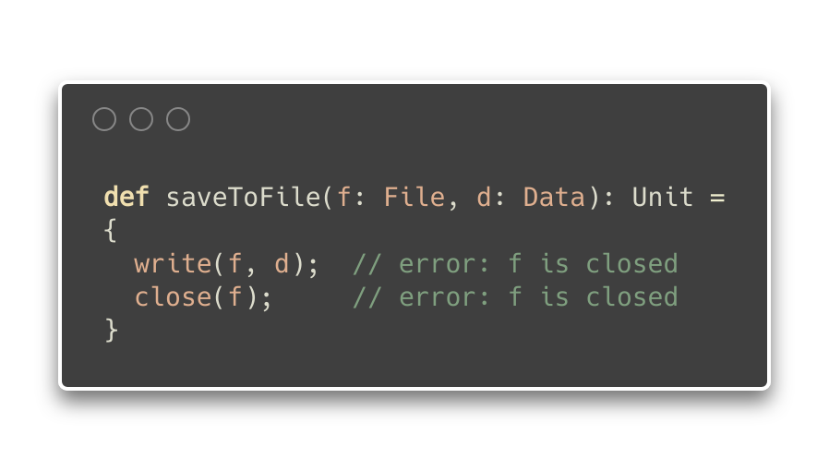
Type Effects¹⁶
Type-and-Effects: enriched type-system, with annotations
for describing intentional aspects of dynamic behaviour¹⁷
[16] Nielson F., Nielson H.R., Hankin C. (1999) Type and Effect Systems. In: Principles of Program Analysis. Springer, Berlin, Heidelberg
[17] Yitzhak Mandelbaum, David Walker, and Robert Harper. 2003. An effective theory of type refinements. In Proceedings of the eighth ACM SIGPLAN
international conference on Functional programming (ICFP '03). ACM, New York, NY, USA, 213-225.
36

Slide 66
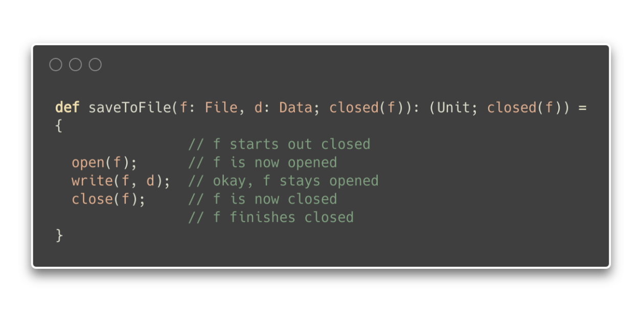
Type Effects
Type-and-Effects: enriched type-system, with annotations
for describing intentional aspects of dynamic behaviour
37

Slide 67
Type Effects
Type-and-Effects: enriched type-system, with annotations
for describing intentional aspects of dynamic behaviour
Assume input effects
37

Slide 68
Type Effects
Type-and-Effects: enriched type-system, with annotations
for describing intentional aspects of dynamic behaviour
Assert output effects
37

Slide 69
Type Effects
Type-and-Effects: enriched type-system, with annotations
for describing intentional aspects of dynamic behaviour
Similar to Hoare logic, but applicable to higher-order
programs and with decidable type-checking
38

Slide 70
Type Refinements
Type Refinements: predicates over type (every refined
type is a subtype of the original type)
Liquid types¹⁸:
Logically Qualified Data Types, combine Hindley-Milner
type inference with predicate abstraction to infer
dependent types
Give type-safety proofs for overapproximation,
preservation and progress.
[18] Patrick M. Rondon, Ming Kawaguci, and Ranjit Jhala. 2008. Liquid types. In Proceedings of the 29th ACM SIGPLAN Conference on Programming
Language Design and Implementation (PLDI '08). ACM, New York, NY, USA, 159-169.
39

Slide 71
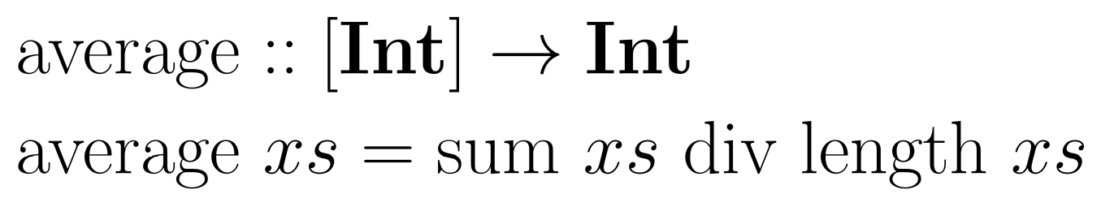
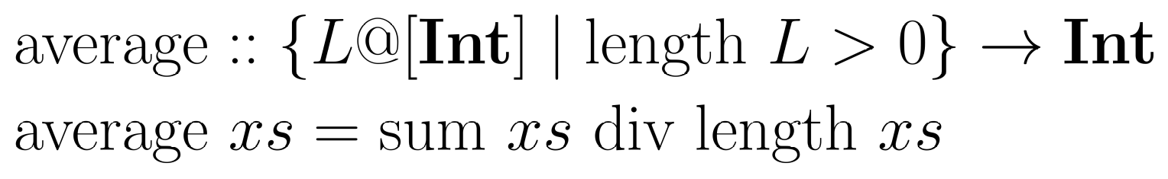
Type Refinements
40

Slide 72
Type Refinements
Type Refinements: predicates over type (every refined
type is a subtype of the original type)
Specifications generally limited to decidable fragments of
underlying logic, with predefined refined operations
41

Slide 73
Type Refinement Systems
Type Refinements: actually more general than they seem.
...through a categorical lens
Functors are Type Refinement Systems²⁰
Functors: mappings that preserve structure between two
categories
[20] Paul-André Melliès and Noam Zeilberger. 2015. Functors are Type Refinement Systems. In Proceedings of the 42nd Annual ACM SIGPLAN-SIGACT Symposium on Principles of Programming Languages (POPL '15). ACM, New York, NY, USA, 3-16.
42

Slide 74
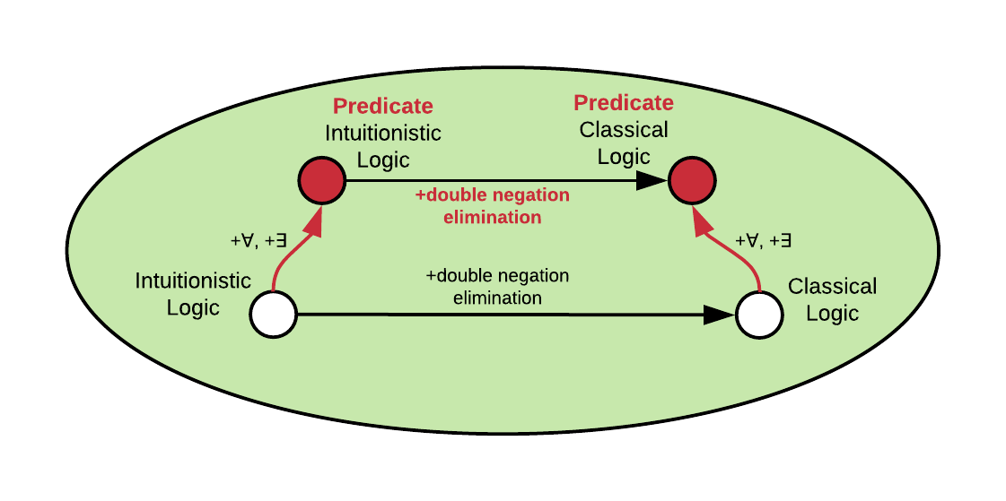
Type Refinement Systems
Functor preserves mapping between two categories
Category
43

Slide 75
Type Refinement Systems
Functor preserves mapping between two categories
Category
43

Slide 76
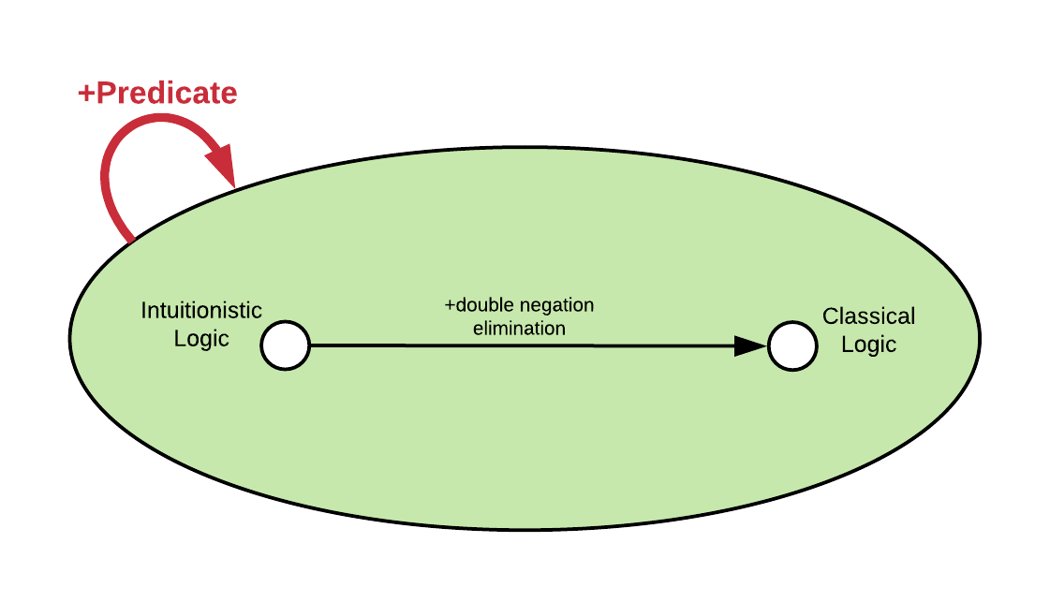
Type Refinement Systems
Endofunctor
Morphism (arrow)
Category
43

Slide 77
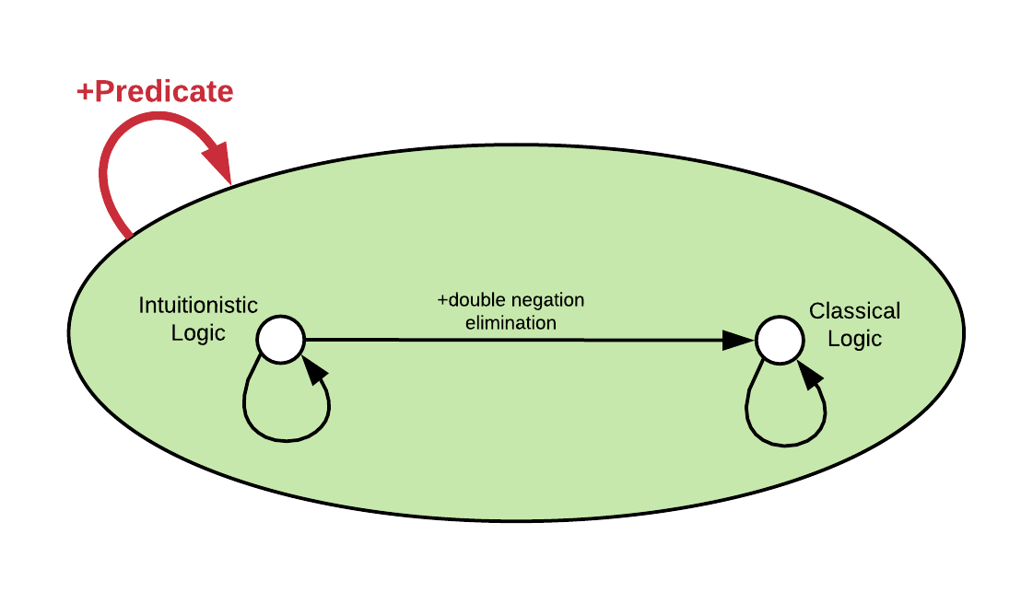
Type Refinement Systems
Endofunctor
+nothing
Identity (+nothing)
Category
43

Slide 78

Type Refinement Systems
44

Slide 79
Type Refinement Systems
The derivations that make sense
44

Slide 80
Type Refinement Systems
The terms that make sense
44

Slide 81

Type Refinement Systems
All three are functors, thus they all
preserve structure
44

Slide 82

Type Refinement Systems
Type system: Opfibration of derivations
and terms into the semantical category
44

Slide 83

Type Refinement Systems
Type Refinements: framing device so that every type
system is a refinement system of some types
Curry-Howard-Lambek Correspondence:
Additionally, functors between categories can establish refinements.
45

Slide 84
The Crazy Part
Curry-Howard seems
to be a functor between
logics (derivations),
languages (terms),
and categorical semantics.
Is there a type system
on the level of the CHL
correspondence?
46

Slide 85
The Crazy Part
Curry-Howard seems
to be a functor between
logics (derivations),
languages (terms),
and categorical semantics.
Is there a type system
on the level of the CHL
correspondence?
Is it the missing body
piece of this butterfly?
46

Slide 86
Outline
Motivation
Several interesting findings
A more refined perspective
Conclusion
47

Slide 87
In Review
Curry-Howard Correspondence
Makes our type systems more systematic
Gives proofs for “free” (e.g. deadlock in CP calculus)
Can support program behaviours if type system is built
with relevant underlying logic that expresses the
bounds for such behaviours
Is everywhere.
48

Slide 88
Opportunities
Spectrum of logics corresponding to automatic memory management methods
Exploring the space between known parts
Program synthesis via Curry-Howard
Solvers for category-theorical proofs
49

Slide 89
Opportunities
Spectrum of logics corresponding to automatic memory management methods
if reference counting is linear logic²¹,
what’s garbage collection?
Exploring the space between known parts
Program synthesis via Curry-Howard
Solvers for category-theorical proofs
[21] Chirimar, Jawahar, Carl A. Gunter, and Jon G. Riecke. "Reference counting as a computational interpretation of linear logic." Journal of Functional Programming 6.2 (1996): 195-244.
49

Slide 90
Opportunities
Spectrum of logics corresponding to automatic memory management methods
Exploring the space between known parts
filling the gaps on the bridge
between logics and type systems
Program synthesis via Curry-Howard
Solvers for category-theorical proofs
49

Slide 91
Opportunities
Spectrum of logics corresponding to automatic memory management methods
Exploring the space between known parts
Program synthesis via Curry-Howard
Solvers for category-theorical proofs
49

Slide 92
Opportunities
Spectrum of logics corresponding to automatic memory management methods
Exploring the space between known parts
Program synthesis via Curry-Howard
Solvers for category-theorical proofs
49

Slide 93
Thank You
50

