Slide 1

Curry-Howard Correspondence through Type-based Program Analyses
June 13, 2018
Major Area Exam Miroslav Gavrilov
Ben Hardekopf Chandra Krintz Tevfik Bultan
chair

Slide 2
Outline
History and Intuition
General Type-based Analyses
Resources and Protocols
feat. Linear Logics
Information Flow
feat. Predicate Logic
Bigger, better, faster, stronger…
feat. Refinements, Effects and Daft Punk

Slide 3
History and Intuition
General Type-based Analyses
Resources and Protocols
feat. Linear Logics
Information Flow
feat. Predicate Logic
Bigger, better, faster, stronger…
feat. Refinements, Effects and Daft Punk

Slide 4
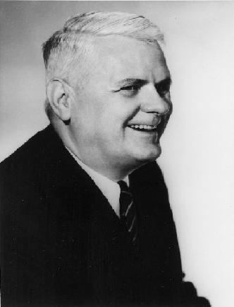
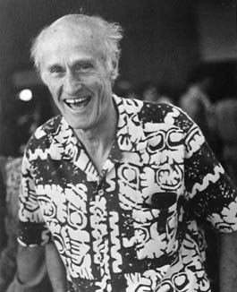
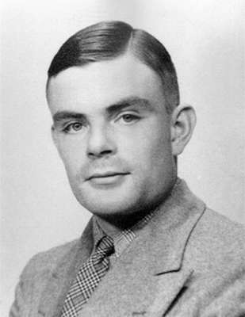
A Historical Perspective
A definition of “effectively calculable”¹:
Lambda Calculus²
Alonzo Church, 1930.
General Recursive Functions³
Stephen Kleene, 1936.
Turing Machines
Alan Turing, 1937.
¹ David Hilbert and Wilhelm Ackermann (1928). Grundzüge der theoretischen Logik. Springer-Verlag, ISBN 0-8218-2024-9.
² Church, Alonzo. An Unsolvable Problem of Elementary Number Theory. AJM 58, no. 2 (1936): 345-63. doi:10.2307/2371045.
³ S. C. Kleene, General Recursive Functions of Natural Numbers. Matematische Annalen, Bd 112 (1935-6), S. 727-742

Slide 5
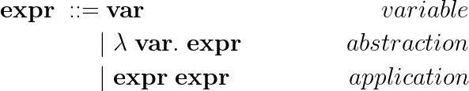
A Historical Perspective
A definition of “effectively calculable”:
Alonzo Church
Lambda Calculus: a concise function notation

Slide 6

A Historical Perspective
A definition of “effectively calculable”:
Alonzo Church
Lambda Calculus: a concise function notation

Slide 7

A Historical Perspective
A definition of “effectively calculable”:
Alonzo Church
Lambda Calculus: a concise function notation
Added semantics of reduction:

Slide 8

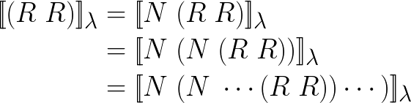
A Historical Perspective
An initial correspondence⁴: Russell’s Paradox = Non-termination
Haskell Curry, 1934.
⁴ Curry, H. (1942). The Inconsistency of Certain Formal Logic. The Journal of Symbolic Logic, 7(3), 115-117. doi:10.2307/2269292

Slide 9
A Historical Perspective
A correspondence between functions and implications⁵.
Haskell Curry, 1934.
(→): The type of every function corresponds
to a provable proposition
(←): For every provable proposition, there was
a function with the corresponding type
⁵ H. B. Curry. Functionality in combinatory logic. Proceedings of the National Academy of Science, 20:584–590, 1934.

Slide 10


A Historical Perspective
A correspondence between types and proposition⁶.
William Alvin Howard, 1969.
Hinted at other correspondences between predicates and value-dependent types.
⁶ W. A. Howard. The formulae-as-types notion of construction. In To H. B. Curry: Essays on Combinatory Logic, Lambda Calculus,
and Formalism, pages 479–491. Academic Press, 1980.

Slide 11
A Historical Perspective
The Curry-Howard Correspondence: a link between programs and logic⁷.
Intuitionistic Propositions as Types.
Proofs as Programs.
Simplification of Proofs as Evaluation of Programs.
⁷ H. B. Curry and R. Feys. Combinatory Logic. North-Holland, 1958.

Slide 12
A Historical Perspective⁸
The Curry-Howard Correspondence: a link between programs and logic.
Classical Propositions as Session Types^{9,10}.
Proofs as Processes.
Cut Elimination as Communication.
⁸ Philip Wadler. 2015. Propositions as types. Commun. ACM 58, 12 (November 2015), 75-84
⁹ Philip Wadler. 2012. Propositions as sessions. In Proceedings of the 17th ACM SIGPLAN international conference on Functional
programming (ICFP '12). ACM, New York, NY, USA, 273-286.
¹⁰ Das, A., Hoffmann, J., & Pfenning, F. (2017). Work Analysis with Resource-Aware Session Types. CoRR, abs/1712.08310.

Slide 13
The Development of Type Theory
Logic blossoms in the 70s. Type systems follow.
Curry-Howard correspondence: Buy one, get one free.
Intuitionistic Propositional Logic: Simply Typed Lambda Calculus
Intuitionistic Predicate Logic: Calculus of Constructions¹¹
Second-Order Logic: Polymorphic Type Systems^{12,13}
Classical Logic: Parigot’s λµ-Calculus¹⁴
Classical Linear Logic: Session Types
¹¹ Thierry Coquand and Gerard Huet. 1988. The calculus of constructions. Inf. Comput. 76, 2-3 (February 1988), 95-120.
¹² J.-Y. Girard. Interprétation functionelle et élimination des coupures dans l’arithmétique d’ordre supérieure, 1972. Université Paris VII, These D’Etat.
¹³ J. C. Reynolds. Towards a theory of type structure. In Symposium on Programming, volume 19 of Lectures in Computer Science, pages 408–423, 1974.
¹⁴ Michel Parigot. 1992. Lambda-My-Calculus: An Algorithmic Interpretation of Classical Natural Deduction. In Proceedings of the International Conference
on Logic Programming and Automated Reasoning (LPAR '92), Andrei Voronkov (Ed.). Springer-Verlag, London, UK, UK, 190-201.

Slide 14
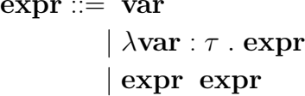




Type Systems Redux
Simply Typed Lambda Calculus
Type definitions:
Typing rules:

Slide 15
Type Systems Redux
Most Typed Lambda Calculi are strongly normalizing:
every term can be written in a normal form, such that it
doesn’t β-reduce further
Strong normalization = All computations terminate¹⁵
Types:
infrastructure for building analyses and
lingua franca for analysis comparison¹⁶.
¹⁵ Girard, Jean-Yves (1972). "Interprétation fonctionnelle et Élimination des coupure de l'arithmétique d'ordre supérieur".
¹⁶ Palsberg, Jens. “Type-based analysis and applications.” PASTE (2001).

Slide 16
Resources and Protocols feat. Linear Logics
History and Intuition
General Type-based Analyses
Information Flow Analysis
feat. Predicate Logic
Bigger, better, faster, stronger…
feat. Refinements, Effects and Daft Punk

Slide 17
Linear Logic
Structural Rules:
Inference rules that operate on judgements directly,
mimic meta-theoretical properties of logic
Weakening
sequents might be extended with additional members
Contraction
two equal members on the same side of the sequent
may be reduced to one
Exchange
two members on the same side of the sequent may be
swapped (permuted)

Slide 18


Linear Logic
Structural Rules:
Inference rules that operate on judgements directly,
mimic meta-theoretical properties of logic
Linear logic²⁹: Weakening, Contraction, Exchange
Every assumption can be used exactly once.
Non-linear Proposition
Linear Proposition
Eating cake makes us full, a cake exists:
eating cake makes us full and cake exists.
²⁹ Girard, Jean-Yves. Linear logic, Theoretical Computer Science, Vol 50, no 1, pp. 1–102, 1987.

Slide 19
Linear Logic
Structural Rules:
Inference rules that operate on judgements directly,
mimic meta-theoretical properties of logic
Linear logic: Weakening, Contraction, Exchange
Every assumption can be used exactly once.
Non-linear Proposition
Linear Proposition
Consuming one cake makes us full, one cake exists:
we can’t both have our cake and eat it³⁰.
³⁰ Philip Wadler. 1993. A Taste of Linear Logic. In Proceedings of the 18th International Symposium on Mathematical Foundations of Computer Science
(MFCS '93), Andrzej M. Borzyszkowski and Stefan Sokolowski (Eds.). Springer-Verlag, London, UK, UK, 185-210.

Slide 20
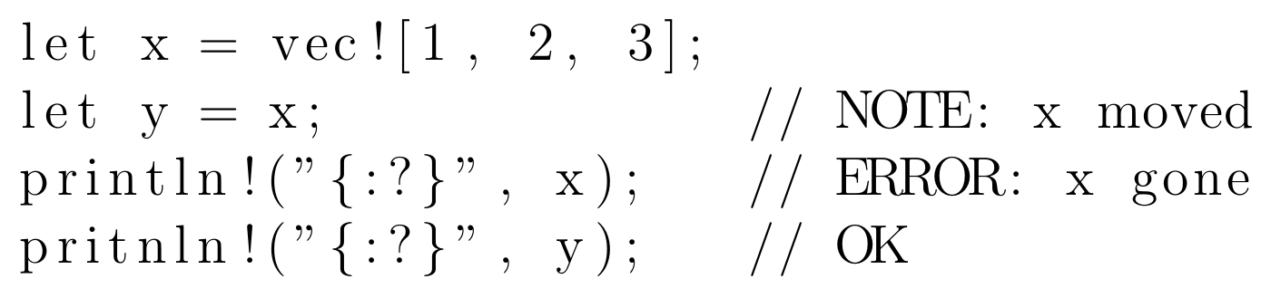
Linear Logic
Rust³¹:
The most well-known example of a linear type system in use.
³¹ Nicholas D. Matsakis and Felix S. Klock, II. 2014. The rust language. In Proceedings of the 2014 ACM SIGAda annual conference on High integrity
language technology (HILT '14). ACM, New York, NY, USA, 103-104

Slide 21
Linear Logic
Observers for linear types³²:
introduces a third possibility for variables (beside linear or non-linear),
observers for linear variables can be duplicated and read concurrently
Linear types as optimizations:
require no garbage collection or reference counting;
Reference Counting as a Computational Interpretation of Linear Logic³³:
demonstrate a precise relationship between type correctness for a
language based on linear logic and the correctness of reference-counting
³² Odersky M. (1992) Observers for linear types. In: Krieg-Brückner B. (eds) ESOP '92. ESOP 1992. Lecture Notes in Computer Science, vol 582.
Springer, Berlin, Heidelberg
³³ Chirimar, Jawahar & A. Gunter, Carl & G. Riecke, Jon. (2000). Reference Counting as a Computational Interpretation of Linear Logic. Journal of
Functional Programming. 6. 10.1017/S0956796800001660.

Slide 22
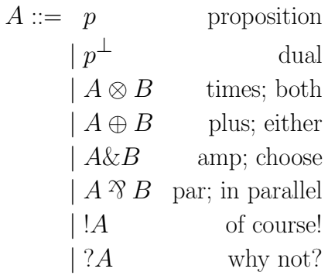
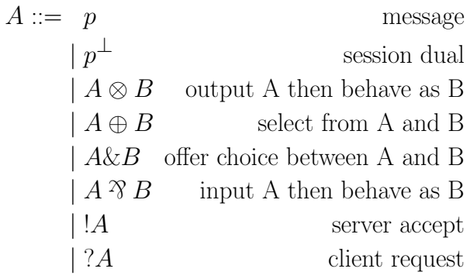
Classical Linear Logic
Propositions as Sessions⁹
Session types:
communication-centric, conforming to protocols
⁹ Philip Wadler. 2012. Propositions as sessions. In Proceedings of the 17th ACM SIGPLAN international conference on Functional
programming (ICFP '12). ACM, New York, NY, USA, 273-286.

Slide 23
Classical Linear Logic
Propositions as Sessions
Builds a linear session-typed lambda calculus (CP) on top of linear logic,
and then a functional language with sessions (GV) on top of that.
The whole stack (linear types → CP → GV) is strongly normalizing.
Deadlock free due to Curry-Howard correspondence:
Russell’s Paradox = Non-termination = Deadlock

Slide 24

Classical Linear Logic
Propositions as Sessions
Builds a linear session-typed lambda calculus (CP) on top of linear logic,
and then a functional language with sessions (GV) on top of that.
The whole stack (linear types → CP → GV) is strongly normalizing.
Deadlock free due to Curry-Howard correspondence:
Russell’s Paradox = Non-termination = Deadlock
Resource-awareness¹⁰:
annotate every binary operation with a communicational cost,
using the extra information to do type-based amortized resource analysis
¹⁰ Das, A., Hoffmann, J., & Pfenning, F. (2017). Work Analysis with Resource-Aware Session Types. CoRR, abs/1712.08310.

Slide 25
Information Flow feat. Predicative Logic
History and Intuition
General Type-based Analyses
Resources and Protocols
feat. Linear Logics
Bigger, better, faster, stronger…
feat. Refinements, Effects and Daft Punk

Slide 26

Linear Dependent Types
Static resource bound analysis, cont’d:
Lago et al³⁴ introduce a linear type-system which describes types dependent
on resource-cost values
Dependent Types:
Curry-Howard correspondence dual of intuitionistic predicate logic³⁵
Types are now indexed by a value.
³⁴ Lago, U.D., Petit, B.: The Geometry of Types. In: (POPL’13) (2013)
³⁵ Martin-Löf, Per, 1971a, An intuitionistic theory of types, unpublished preprint.

Slide 27


Linear Dependent Types
Practical Examples for dependent types:
Some constraints we couldn’t write without dependent types
The type of a vector of strings of length x:
The type of the ≤-relation between two integers:

Slide 28
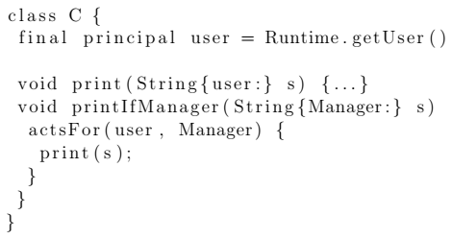
Information-Flow Type Systems
Type systems dependent only on special types³⁶:
pass information-flow through control-flow,
either stop compilation due to value mismatch, or do runtime check
Non-trivial example:
Public key-passing with runtime principals with a proof of soundness
and noninterference³⁷
³⁶ Anindya Banerjee and David A. Naumann. 2002. Secure Information Flow and Pointer Confinement in a Java-like Language. In Proceedings of the 15th IEEE workshop on Computer Security Foundations (CSFW '02). IEEE Computer Society, Washington, DC, USA, 253-.
³⁷ A. Sabelfeld and A. C. Myers. 2006. Language-based information-flow security. IEEE J.Sel. A. Commun. 21, 1 (September 2006), 5-19.

Slide 29

Information-Flow Type Systems
Full dependence of information flow types³⁸
instead of depending on special values (principals)
Constraint-solving at compile-time:
Full dependent types are basically compile-time programs
³⁸ Luísa Lourenço and Luís Caires. 2015. Dependent Information Flow Types. SIGPLAN Not. 50, 1 (January 2015), 317-328.

Slide 30
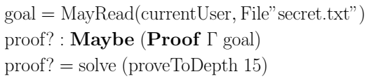
Interactive Access Control Policies
Dependent type languages are often interactive proof assistants:
use the proof assistant part as interactive access control check³⁹
AGDA allows programmer calls to the theorem solver:
³⁹ Jamie Morgenstern and Daniel R. Licata. 2010. Security-typed programming within dependently typed programming. In Proceedings of the 15th ACM
SIGPLAN international conference on Functional programming (ICFP '10). ACM, New York, NY, USA, 169-180.

Slide 31
Interactive Access Control Policies
Dependent type languages are often interactive proof assistants:
use the proof assistant part as interactive access control check
AGDA allows programmer calls to the theorem solver:
Access control mechanism defined in library

Slide 32
Interactive Access Control Policies
Dependent type languages are often interactive proof assistants:
use the proof assistant part as interactive access control check
AGDA allows programmer calls to the theorem solver:
The environment Γ holds access control configurations against which we check

Slide 33
Interactive Access Control Policies
Dependent type languages are often interactive proof assistants:
use the proof assistant part as interactive access control check
AGDA allows programmer calls to the theorem solver:
Implicit type variable: starts theorem solver unification

Slide 34
Interactive Access Control Policies
Dependent type languages are often interactive proof assistants:
use the proof assistant part as interactive access control check
AGDA allows programmer calls to the theorem solver:
Such a type exists that this predicate is valid

Slide 35
Interactive Access Control Policies
Dependent type languages are often interactive proof assistants:
use the proof assistant part as interactive access control check
AGDA allows programmer calls to the theorem solver:
If not, type checking will fail and access control policy is upheld

Slide 36
Dependent Types in Review
We are not limited to one certain dependent type system.
Value-dependent types can be specialized or general.
New languages with selected-domain type-dependence
Permission-dependent types for secure information⁴⁰
Existing languages with full dependent types
Introduce syntactic elements to support information-flow types^{39,41}
Downsides
Require a theorem prover for solving higher-order constraints
Generally high-level of maintenance
⁴⁰ Chen, Hongxu & Tiu, Alwen & Xu, Zhiwu & Liu, Yang. (2017). A Permission-Dependent Type System for Secure Information Flow Analysis.
⁴¹ Lindahl, Eric & Winter, Victor. (2008). Pattern Matching Information Flow using GADT. 3rd International Conference on Information Warfare and
Security.

Slide 37
Bigger, better, faster, stronger... feat. Refinements, Effects and Daft Punk
History and Intuition
General Type-based Analyses
Resources and Protocols
feat. Linear Logics
Information Flow
feat. Predicate Logic

Slide 38


Upgrading Type Systems
Liquid types⁴²:
Logically Qualified Data Types, combine Hindley⁴³-Milner⁴⁴ type inference
with predicate abstraction to infer dependent types
⁴² Patrick M. Rondon, Ming Kawaguci, and Ranjit Jhala. 2008. Liquid types. In Proceedings of the 29th ACM SIGPLAN Conference on Programming Language Design and Implementation (PLDI '08). ACM, New York, NY, USA, 159-169
⁴³ Hindley, J. Roger (1969). "The Principal Type-Scheme of an Object in Combinatory Logic". Transactions of the American Mathematical Society. 146: 29–60
⁴⁴ Milner, Robin (1978). "A Theory of Type Polymorphism in Programming". Journal of Computer and System Science (JCSS). 17: 348–374.

Slide 39
Upgrading Type Systems
Liquid types:
Logically Qualified Data Types, combine Hindley-Milner type inference
with predicate abstraction to infer dependent types
Three step process:
1. Hindley-Milner type inference to get templates
(dependent types with unknown base refinements)
2. Generate constraints to capture subtyping relations
between refinements
3. Solve constraints to find, for each base refinement,
the strongest conjunction of qualifiers to satisfy all constraints

Slide 40
Upgrading Type Systems
Liquid types:
Logically Qualified Data Types, combine Hindley-Milner type inference
with predicate abstraction to infer dependent types
Can be introduced into existing languages (LiquidHaskell, LiquidML, …)
Downsides:
System isn’t very expressive (refinements are usually meta-functions
defined in the native language);
Error reporting is very abstract and requires intimate knowledge of the
system to handle

Slide 41
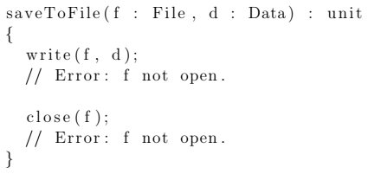
A correspondence of sorts
An additional type-system for type refinements⁴⁵:
Specialized type refinements, such that they present effectful computations
⁴⁵ Yitzhak Mandelbaum, David Walker, and Robert Harper. 2003. An effective theory of type refinements. In Proceedings of the eighth ACM SIGPLAN international conference on Functional programming (ICFP '03). ACM, New York, NY, USA, 213-225

Slide 42
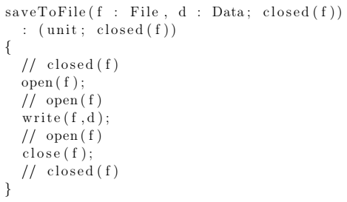
A correspondence of sorts
An additional type-system for type refinements:
Specialized type refinements, such that they present effectful computations
initial conditions are given as
input effects

Slide 43
A correspondence of sorts
An additional type-system for type refinements:
Specialized type refinements, such that they present effectful computations
expected effects are asserted
at function exit

Slide 44
A correspondence of sorts
An additional type-system for type refinements:
Specialized type refinements, such that they present effectful computations
Similar to Hoare logic (assume pre-condition/assert post-condition), but
applicable to higher-order programs and with a decidable type-checking

Slide 45
A correspondence of side-effects
An additional type-system for type refinements:
Specialized type refinements, such that they present effectful computations
The base type system is implicitly dependent on refinements,
and open dependently-type programming is prohibited
A base of system/language-level refinements and refinement-typed functions
must exist for the system to be useful
Can we build a specialized type-effect system without dependent types?

Slide 46
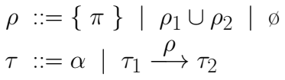
Effect systems
Type-and-Effect systems:
A control flow analysis⁴⁶ built so that the type judgements include the
effects directly
A set of special values, or union thereof
⁴⁶ Flemming Nielson and Hanne Riis Nielson. 1999. Type and Effect Systems. In Correct System Design, Recent Insight and Advances, (to Hans Langmaack on the occasion of his retirement from his professorship at the University of Kiel), Ernst-Rüdiger Olderog and Bernhard Steffen (Eds.). Springer-Verlag, Berlin, Heidelberg, 114-136.

Slide 47
Effect systems
Type-and-Effect systems:
A control flow analysis built so that the type judgements include the
effects directly
A potentially effectful computation

Slide 48
Effect systems
Type-and-Effect systems:
A control flow analysis built so that the type judgements include the
effects directly
Useful for expressing side-effects, binding type analysis,
region structure and causal linear logic:
the last define communication protocols (corresponding to session types)

Slide 49
Very Specialized Effect systems
Music [h]as an effect⁴⁷:
effects don’t have to be sets
⁴⁷ Mycroft A., Orchard D., Petricek T. (2016) Effect Systems Revisited—Control-Flow Algebra and Semantics. In: Probst C., Hankin C., Hansen R. (eds) Semantics, Logics, and Calculi. Lecture Notes in Computer Science, vol 9560. Springer, Cham

Slide 50
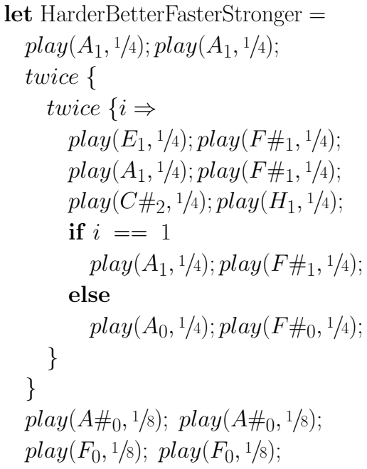
Very Specialized Effect systems
Music [h]as an effect:
⁴⁸ Daft Punk, Harder, better, faster, stronger, Single 2001. https://musescore.com/user/7949346/scores/1817801

Slide 51
Very Specialized Effect systems
Music [h]as an effect:
Musical effects
can compose

Slide 52
Very Specialized Effect systems
Music [h]as an effect:
Musical effects
can repeat

Slide 53
Very Specialized Effect systems
Music [h]as an effect:
Musical effects
can diverge

Slide 54
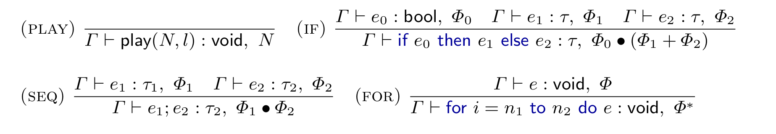
Very Specialized Effect systems
Music [h]as an effect:
The requirements for musical effects seem like regular expressions.

Slide 55
Very Specialized Effect systems
Music [h]as an effect:
The requirements for musical effects seem like regular expressions.
...expected, but...
...found!

Slide 56
Very Specialized Effect systems
Music [h]as an effect:
The requirements for musical effects seem like regular expressions.
...expected, but...
...found!

Slide 57
Very Specialized Effect systems
Music [h]as an effect:

Slide 58
Refinement and Effects in Review
Baring implementational differences,
they can be quite similar in effect (no pun int’d)
Theory of refinements:
Includes the theory of effectful computations, and more
Coeffects⁴⁹:
dual to effects – theory of context-dependent computations
Direct relation to Curry-Howard correspondence:
Visible somewhat more clearly through category theory⁵⁰
⁴⁹ Tomas Petricek, Dominic Orchard, and Alan Mycroft. 2014. Coeffects: a calculus of context-dependent computation. In Proceedings of the 19th ACM
SIGPLAN international conference on Functional programming (ICFP '14). ACM, New York, NY, USA, 123-135.
⁵⁰ Paul-André Melliès and Noam Zeilberger. 2015. Functors are Type Refinement Systems. In Proceedings of the 42nd Annual ACM SIGPLAN-SIGACT
Symposium on Principles of Programming Languages (POPL '15). ACM, New York, NY, USA, 3-16.

Slide 59
Thank You!

Slide 60
Proof that Russell’s Paradox is non-termination

Slide 61


Proof that Russell’s Paradox is non-termination
An initial correspondence: Russell’s Paradox = Non-termination
Haskell Curry, 1934.

Slide 62

Proof that Russell’s Paradox is non-termination
An initial correspondence: Russell’s Paradox = Non-termination
Haskell Curry, 1934.

Slide 63
Proof that Russell’s Paradox is non-termination
An initial correspondence: Russell’s Paradox = Non-termination
Haskell Curry, 1934.

Slide 64

Proof that Russell’s Paradox is non-termination
An initial correspondence: Russell’s Paradox = Non-termination
Y-Combinator, 1933.
Haskell Curry

Slide 65
Further Examples of Correspondence

Slide 66
Further Examples of Correspondence
Intuitionistic Propositional Logic:
Simply Typed Lambda Calculus
Intuitionistic Higher-Order Predicate Logic:
Calculus of Constructions¹¹
Second-Order Logic:
Polymorphic Type Systems^{12,13}
Classical Logic:
Parigot’s λµ-Calculus¹⁴
Classical Linear Logic:
Session Types
Classical First-Order Predicate Logic:
Lambda Calculus with throw/catch mechanisms^{X}
Calculus of Inductive Constructions:
Coq
^{X} Zorzi, Margherita & Aschieri, Federico. (2016). On Natural Deduction in Classical First-Order Logic: Curry-Howard Correspondence, Strong Normalization
and Herbrand’s Theorem. Theoretical Computer Science.

Slide 67
Papers I didn’t have time for

Slide 68
Papers I didn’t have time for
Allyn Dimock, Robert Muller, Franklyn Turbak, and J. B. Wells. Strongly typed flow-directed representation transformations.
In Proceedings ICFP ’97, International Conference on Functional Programming, ACM SIGPLAN Notices 32(8), pages 11–24, 1997.
Suresh Jagannathan, Andrew Wright, and Stephen Weeks. Type-directed flow analysis for typed intermediate languages.
In Proceedings of SAS’97, International Static Analysis Symposium. Springer-Verlag, 1997.
Christian Mossin. Exact flow analysis. In Proceedings of SAS’97, International Static Analysis Symposium, pages 250–264. Springer-Verlag (LNCS), 1997.
Jakob Rehof and Manule Fahndrich. Type-based flow analysis: From polymorphic subtyping to cfl-
reachability. In Proceedings of POPL’01, 28th Annual SIGPLAN–SIGACT Symposium on Principles of Programming Languages, pages 54–66, 2001.
Franklyn Turbak, Allyn Dimock, Robert Muller, and J. B. Wells. Compiling with polymorphic and polyvariant flow types.
In ACM SIGPLAN Workshop on Types in Compilation, June 1997.
J. B. Wells, Allyn Dimock, Robert Muller, and Franklyn Turbak. A calculus with polymorphic and polyvariant flow types. Journal of Functional Programming.
Geoffrey Smith and Dennis Volpano. Secure information flow in multi-threaded imperative language.
In Proceedings of POPL’98, 25th Annual SIGPLAN–SIGACT Symposium on Principles of Programming Languages, pages 355–364, 1998.
Zorzi, Margherita & Aschieri, Federico. (2016). On Natural Deduction in Classical First-Order Logic: Curry-Howard Correspondence, Strong Normalization
and Herbrand’s Theorem. Theoretical Computer Science.

