Slide 1
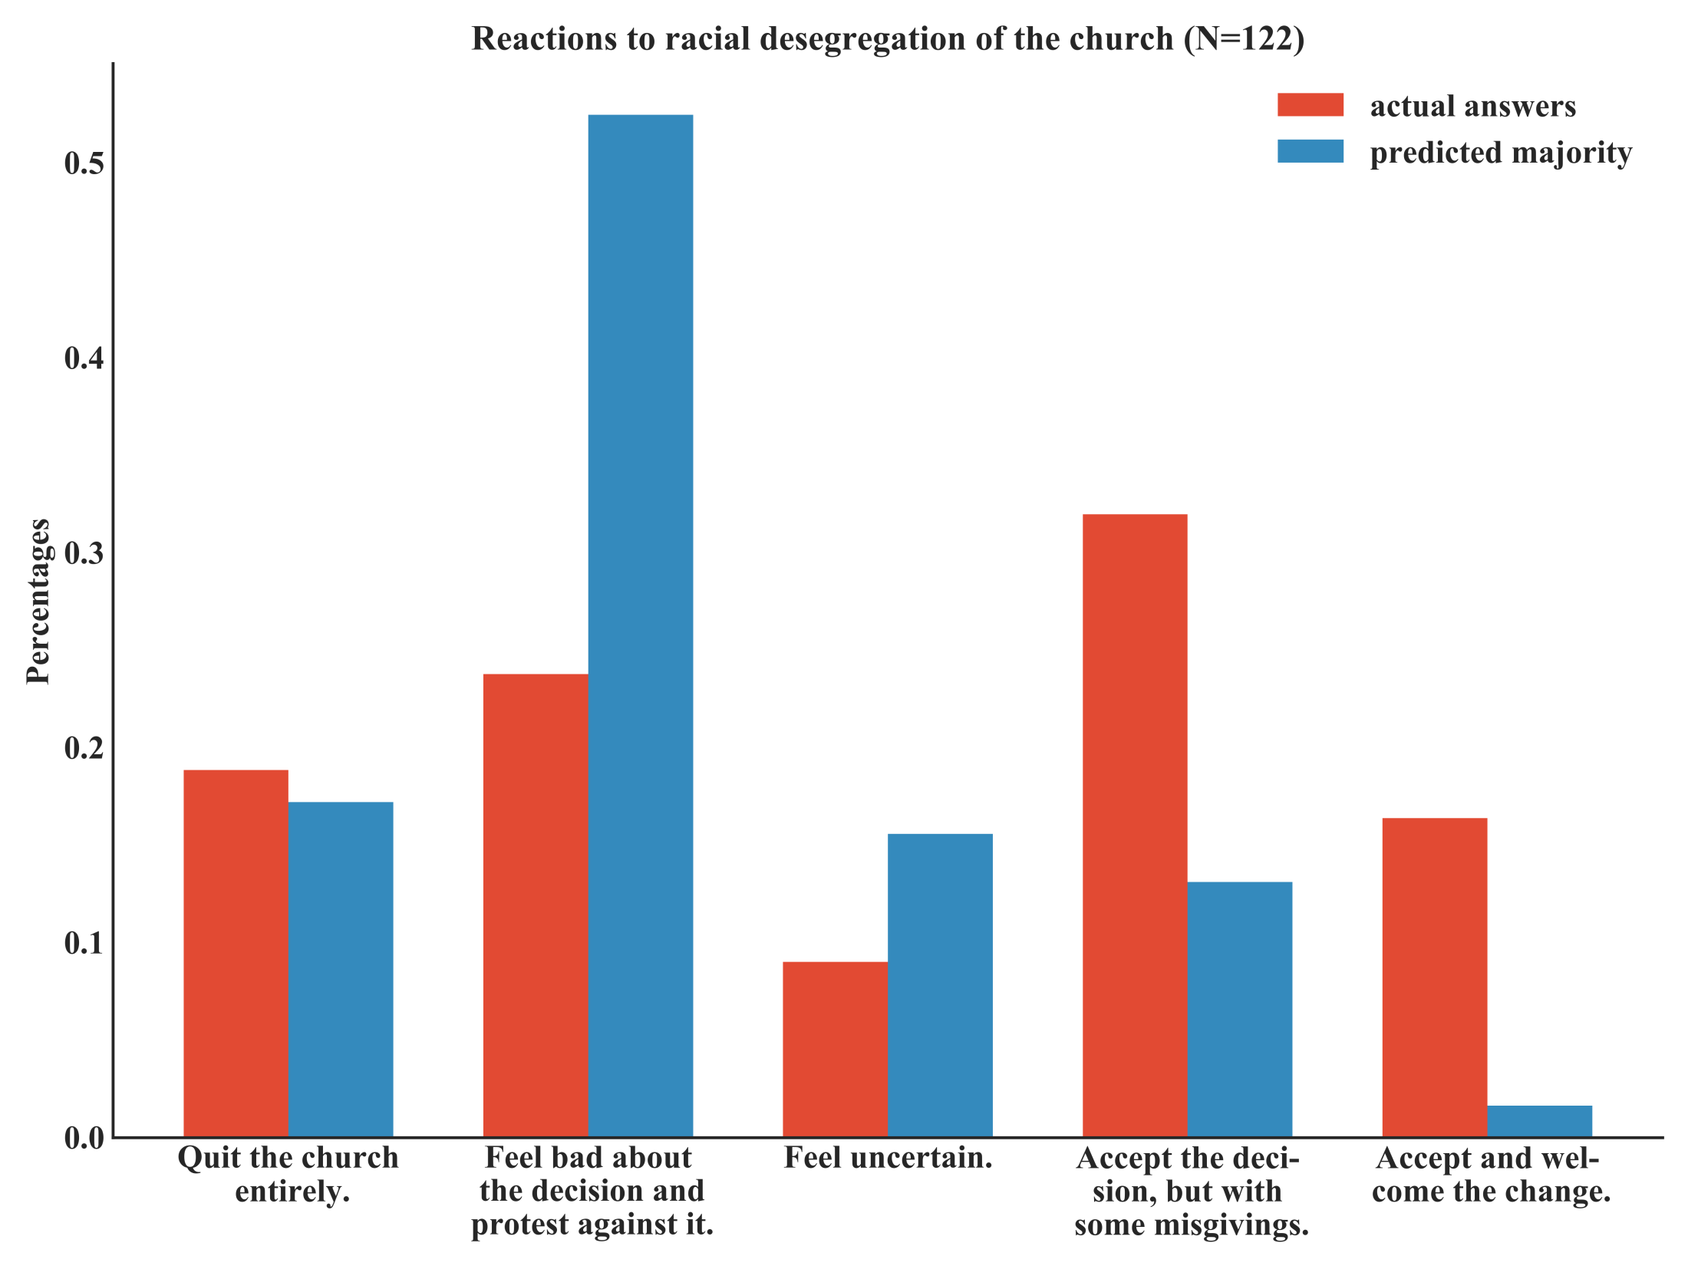
Notes:
Figure 1: The most popular opinion with 32% was to “accept the decision, but with some misgivings”, while a majority of 52% believed that the majority opinion would be to “feel bad about the decision and protest against it”. Also notable are the 16% who did accept and welcome the change (most right red bar), while the predicted support for this response was less than 2% (most right blue bar).

Slide 2
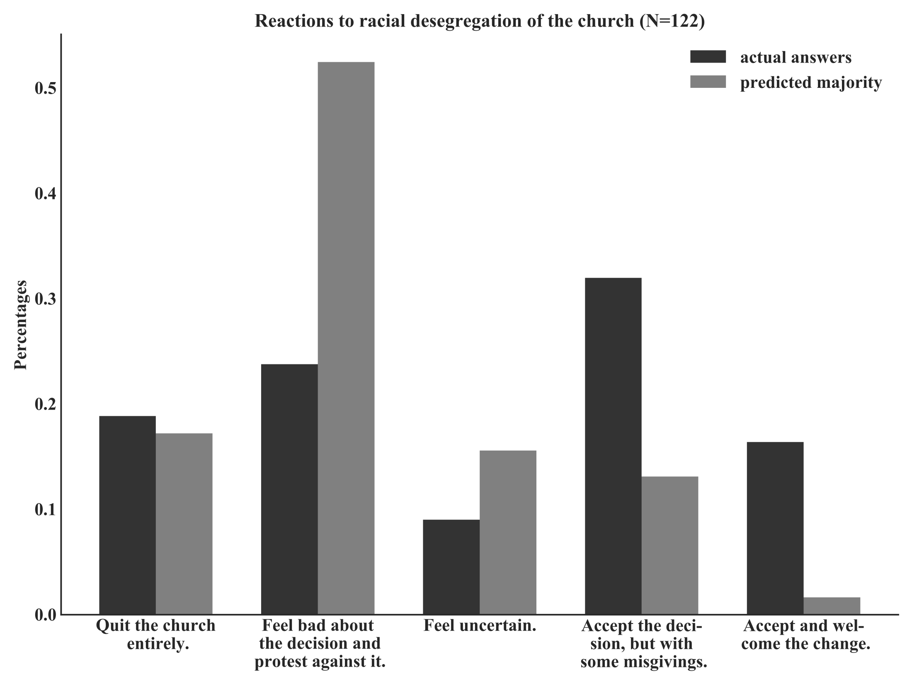
Notes:
Figure 1: The most popular opinion with 32% was to “accept the decision, but with some misgivings”, while a majority of 52% believed that the majority opinion would be to “feel bad about the decision and protest against it”. Also notable are the 16% who did accept and welcome the change (most right dark grey bar), while the predicted support for this response was less than 2% (most light grey bar).

