Slide 1
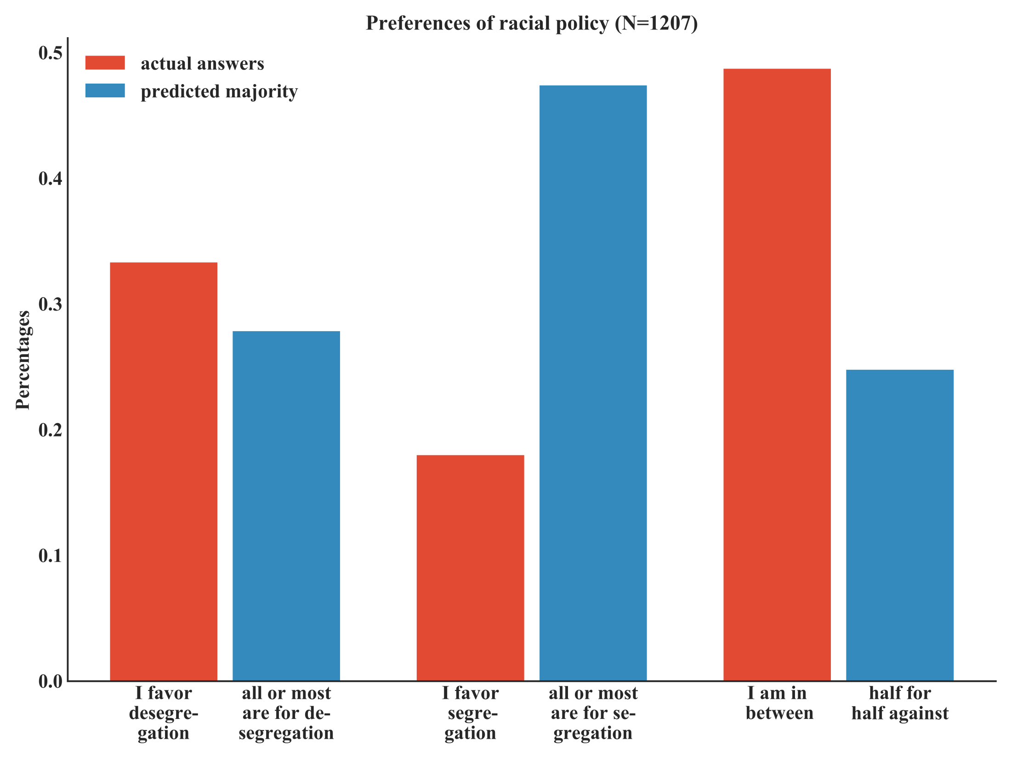
Notes:
Figure 2: Results from asking people their opinion on racial segregation and their estimate of proportional support for or against racial segregation in their area. Note that the measurement scales of the two questions are incompatible: Red bars show results from a question with a nominal scale (do you favor ‘desegregation’, ‘strict segregation’, or are you ‘in between’), while the blue bars show results from a question with an ordinal scale (desegregation is supported by ‘all or most’, ‘less than half or none’, or ‘about half’).

Slide 2
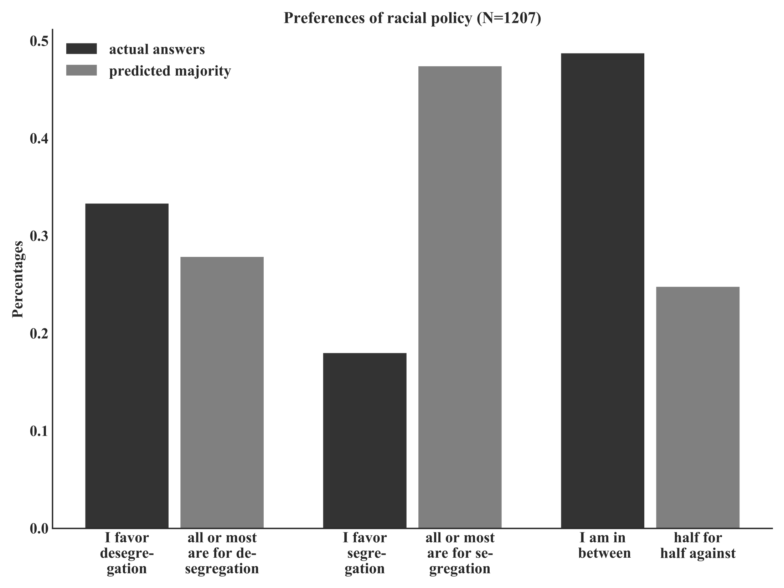
Notes:
Figure 2: Results from asking people their opinion on racial segregation and their estimate of proportional support for or against racial segregation in their area. Note that the measurement scales of the two questions are incompatible: Dark grey bars show results from a question with a nominal scale (do you favor ‘desegregation’, ‘strict segregation’, or are you ‘in between’), while the grey bars show results from a question with an ordinal scale (desegregation is supported by ‘all or most’, ‘less than half or none’, or ‘about half’).

