Slide 1
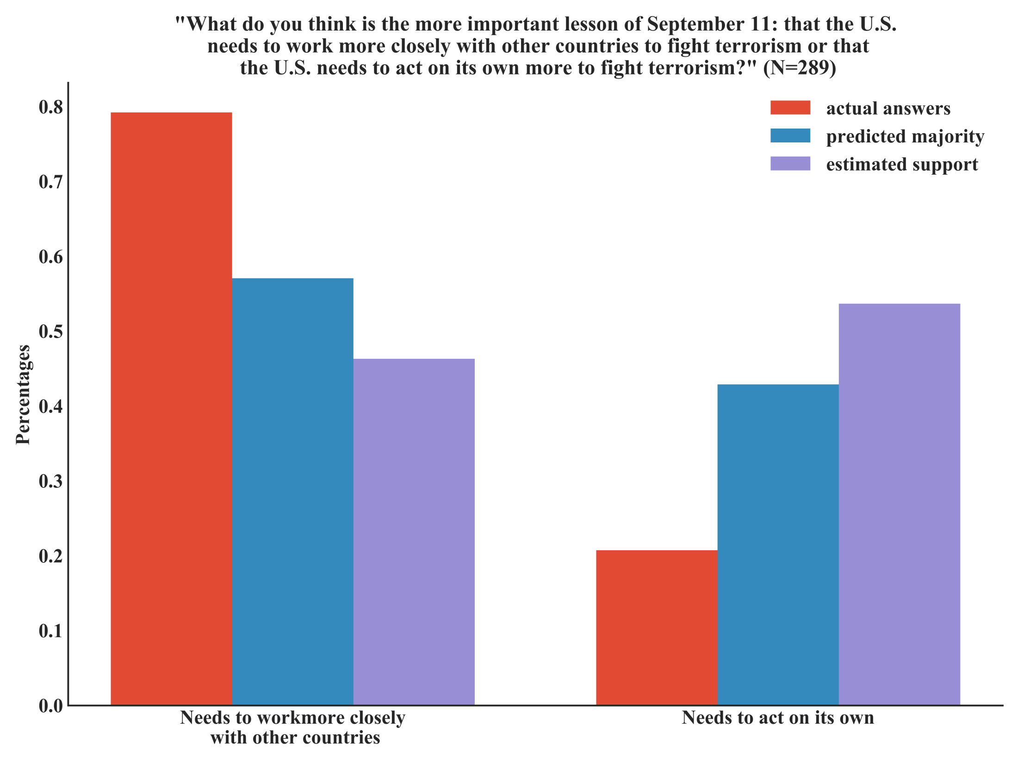
Notes:
Figure 3: 79% of the 289 respondents agreed that the U.S. needs to work more closely with other countries to fight terrorism (left red bar) while 21% thought that the U.S. should act on its own (right red bar). Most respondents (57% - left blue bar) also estimated the multilateral view to be a majority. When looking at the actual estimates, the mean estimated support for the multilateral view turns out to be a minority with 46% (left purple bar).

Slide 2
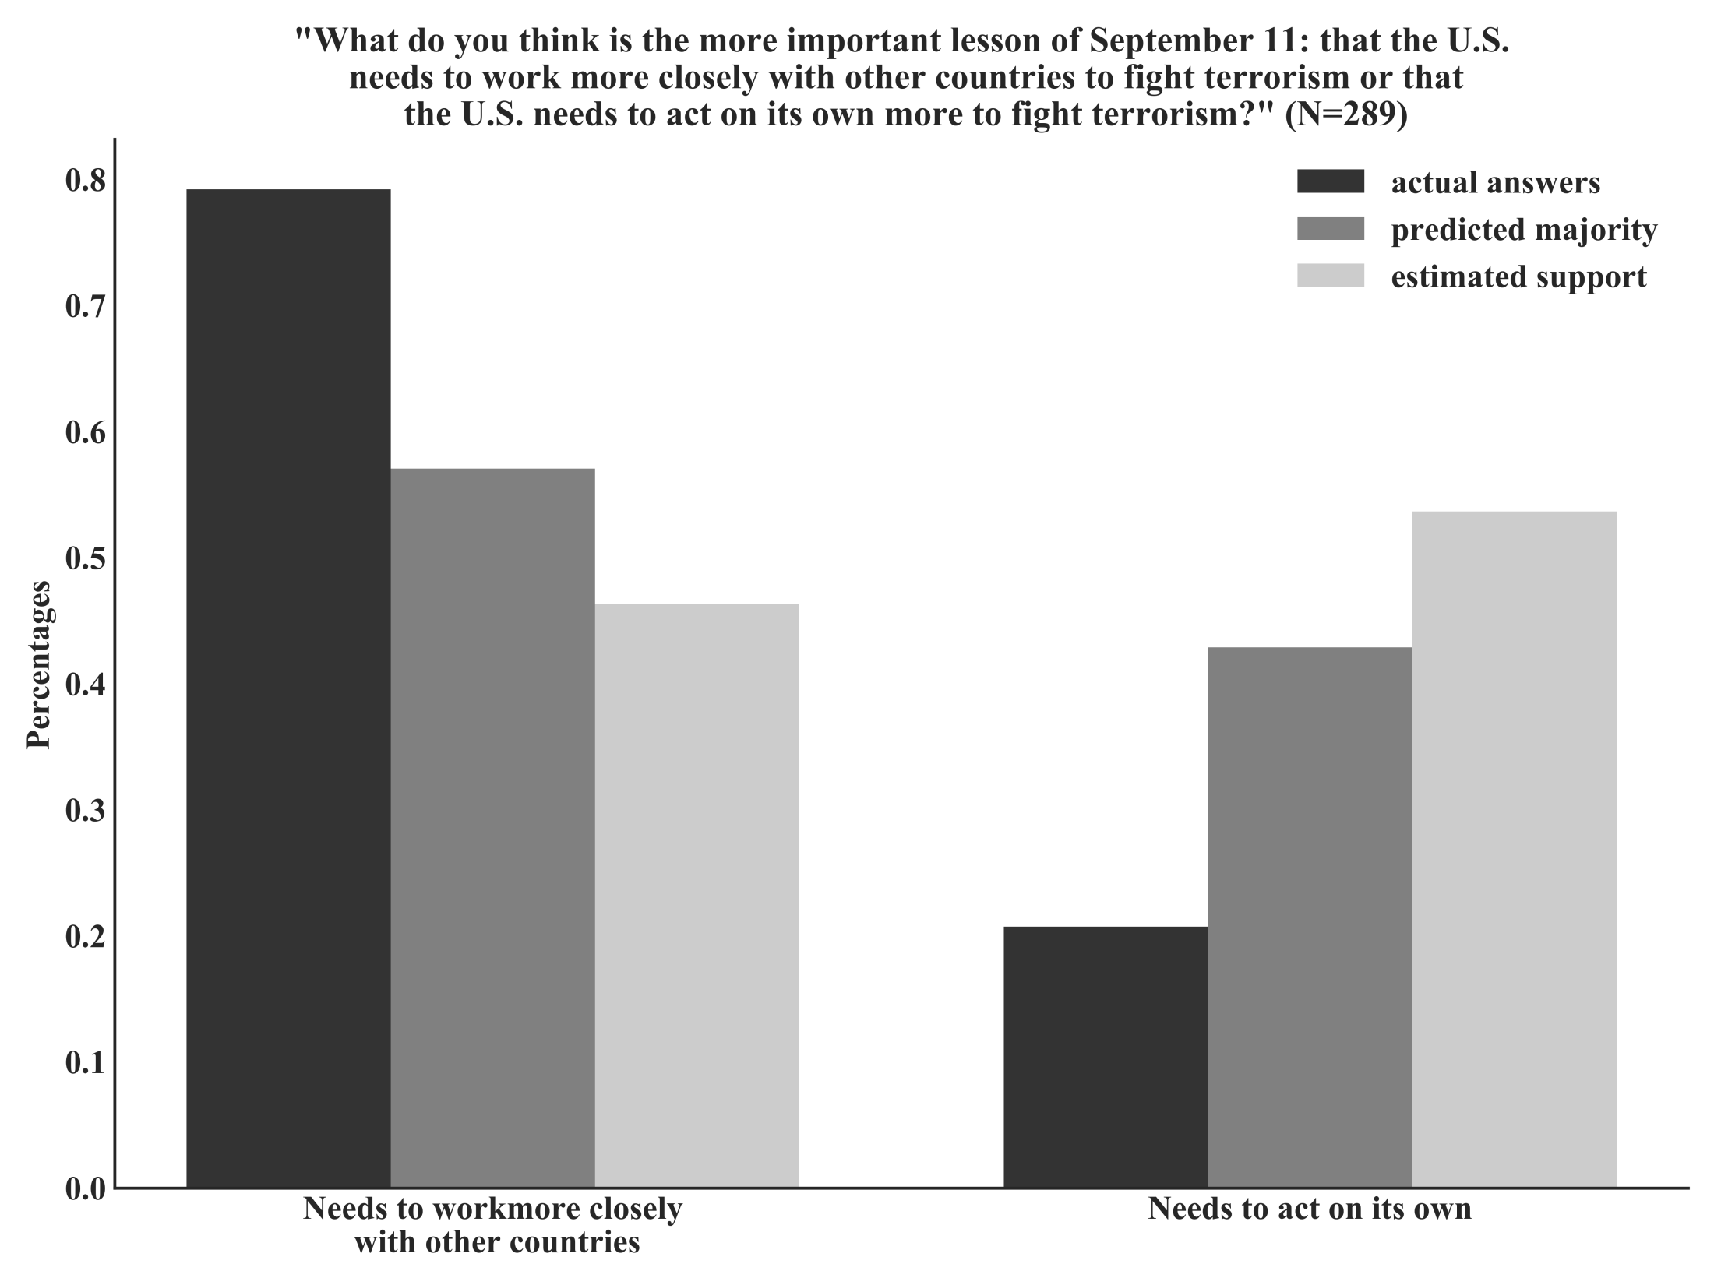
Notes:
Figure 3: 79% of the 289 respondents agreed that the U.S. needs to work more closely with other countries to fight terrorism (left dark grey bar) while 21% thought that the U.S. should act on its own (right dark grey bar). Most respondents (57% - left grey bar) also estimated the multilateral view to be a majority. When looking at the actual estimates, the mean estimated support for the multilateral view turns out to be a minority with 46% (left light grey bar).

