Slide 1
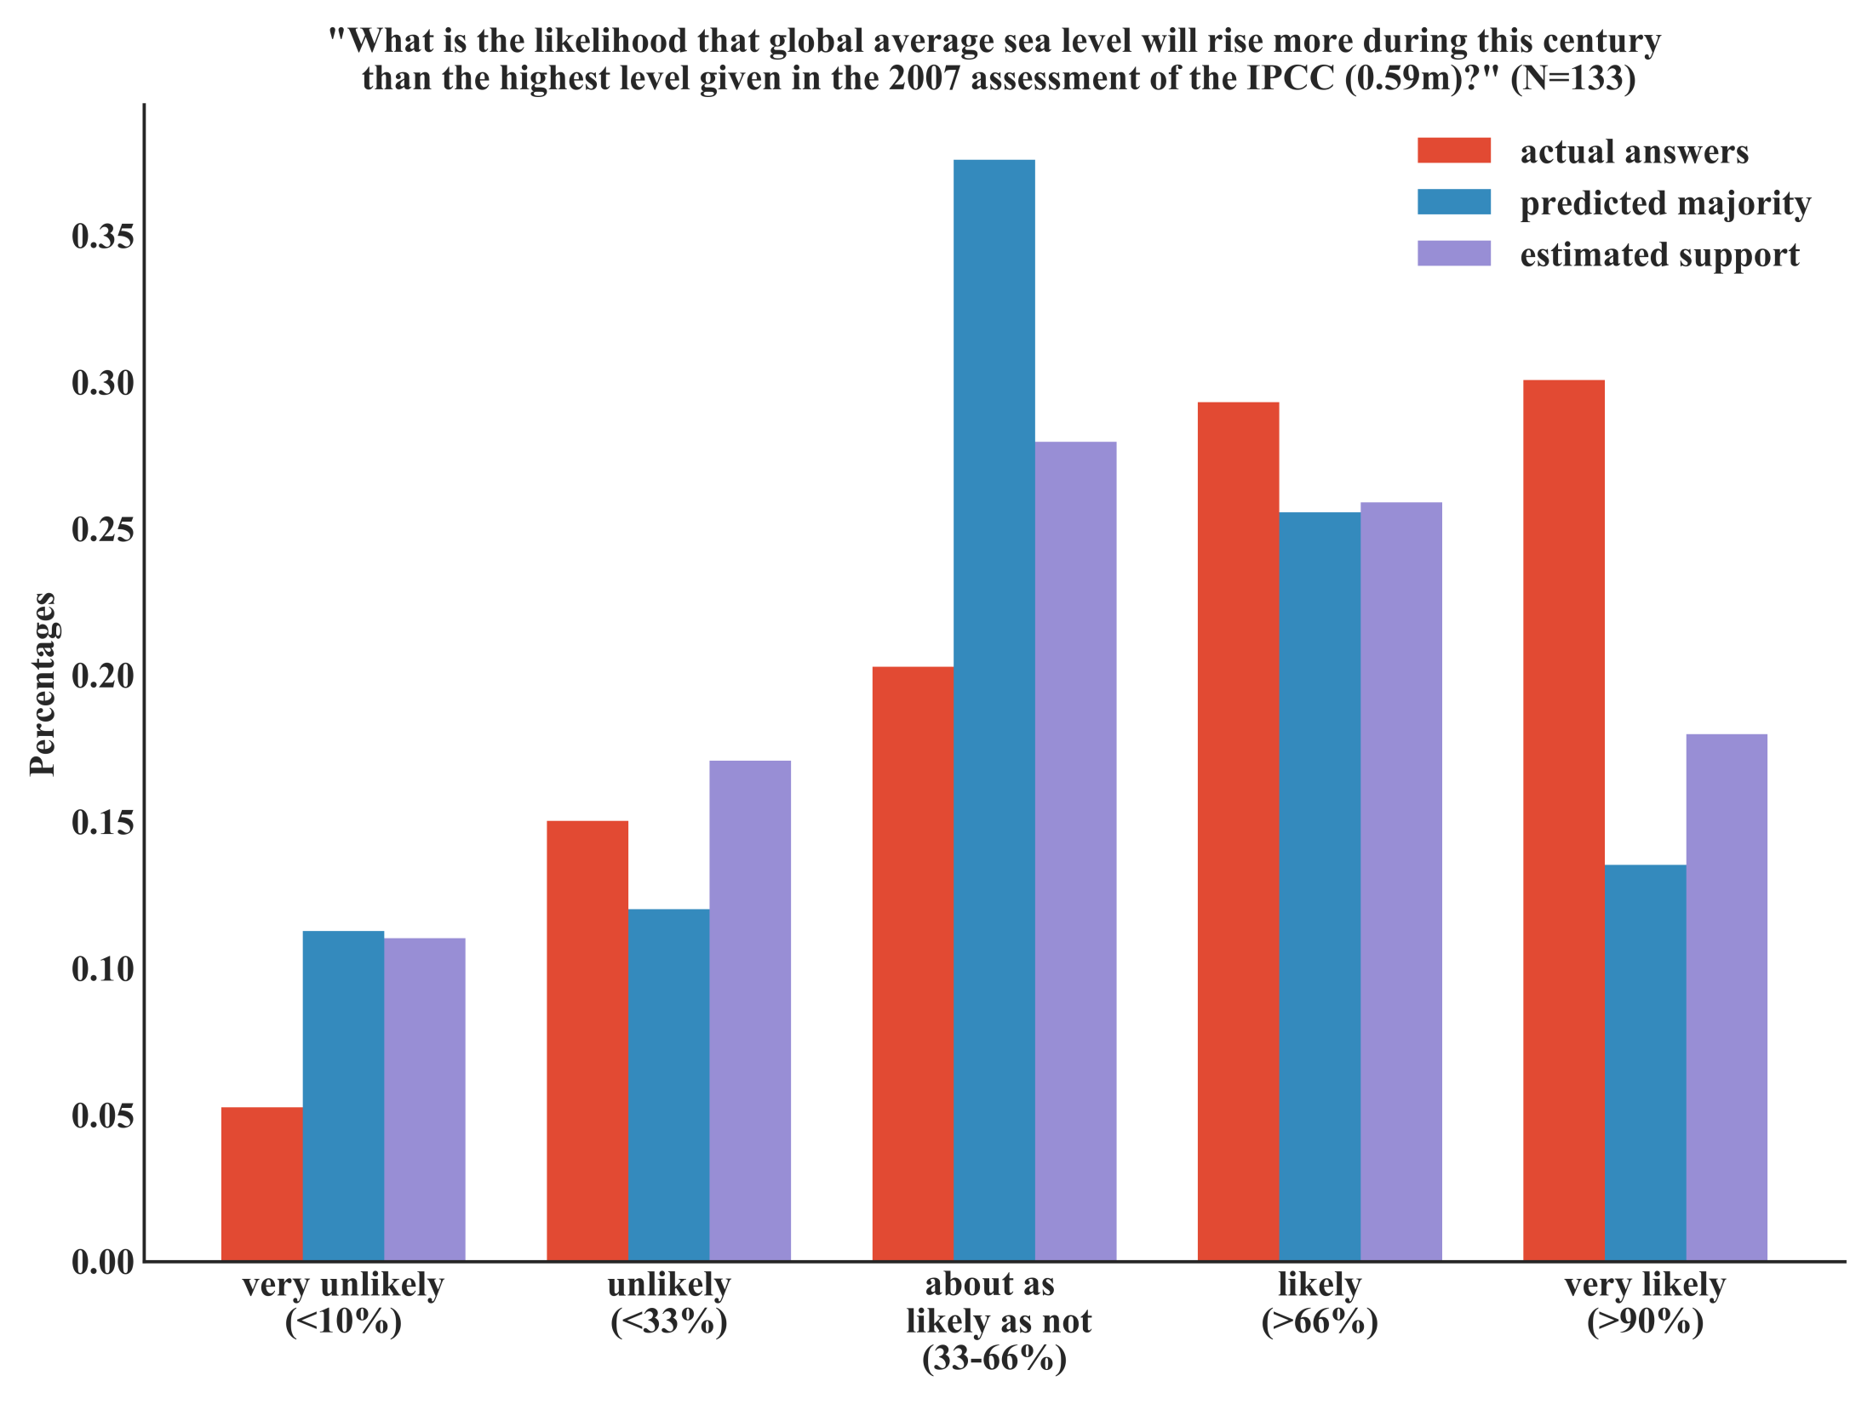
Notes:
Figure 4: Only 7 (5%) of the 133 participating climate change experts agreed with the assessment of the IPCC (most left red bar) that it is “very unlikely” that global sea level rise will be more than 0.59 meter during this century. 15% of the experts partly agreed with this worst case scenario, while 20% (middle red bar) thought it to be no more correct than incorrect. A majority of experts thought that IPCC’s worst case scenario was too optimistic (29%) or way too optimistic (30% - red bar “very likely”). Predictions of the majority opinion (blue bars) show that climate change experts were not aware of each other’s skepticism: The predominant prediction with 38% (middle blue bar) was that most colleagues would consider IPCC’s worst case scenario to be fair. The numerical estimates (purple bars) show a similar pattern as the blue bars, but slightly biased towards personal opinions.

Slide 2
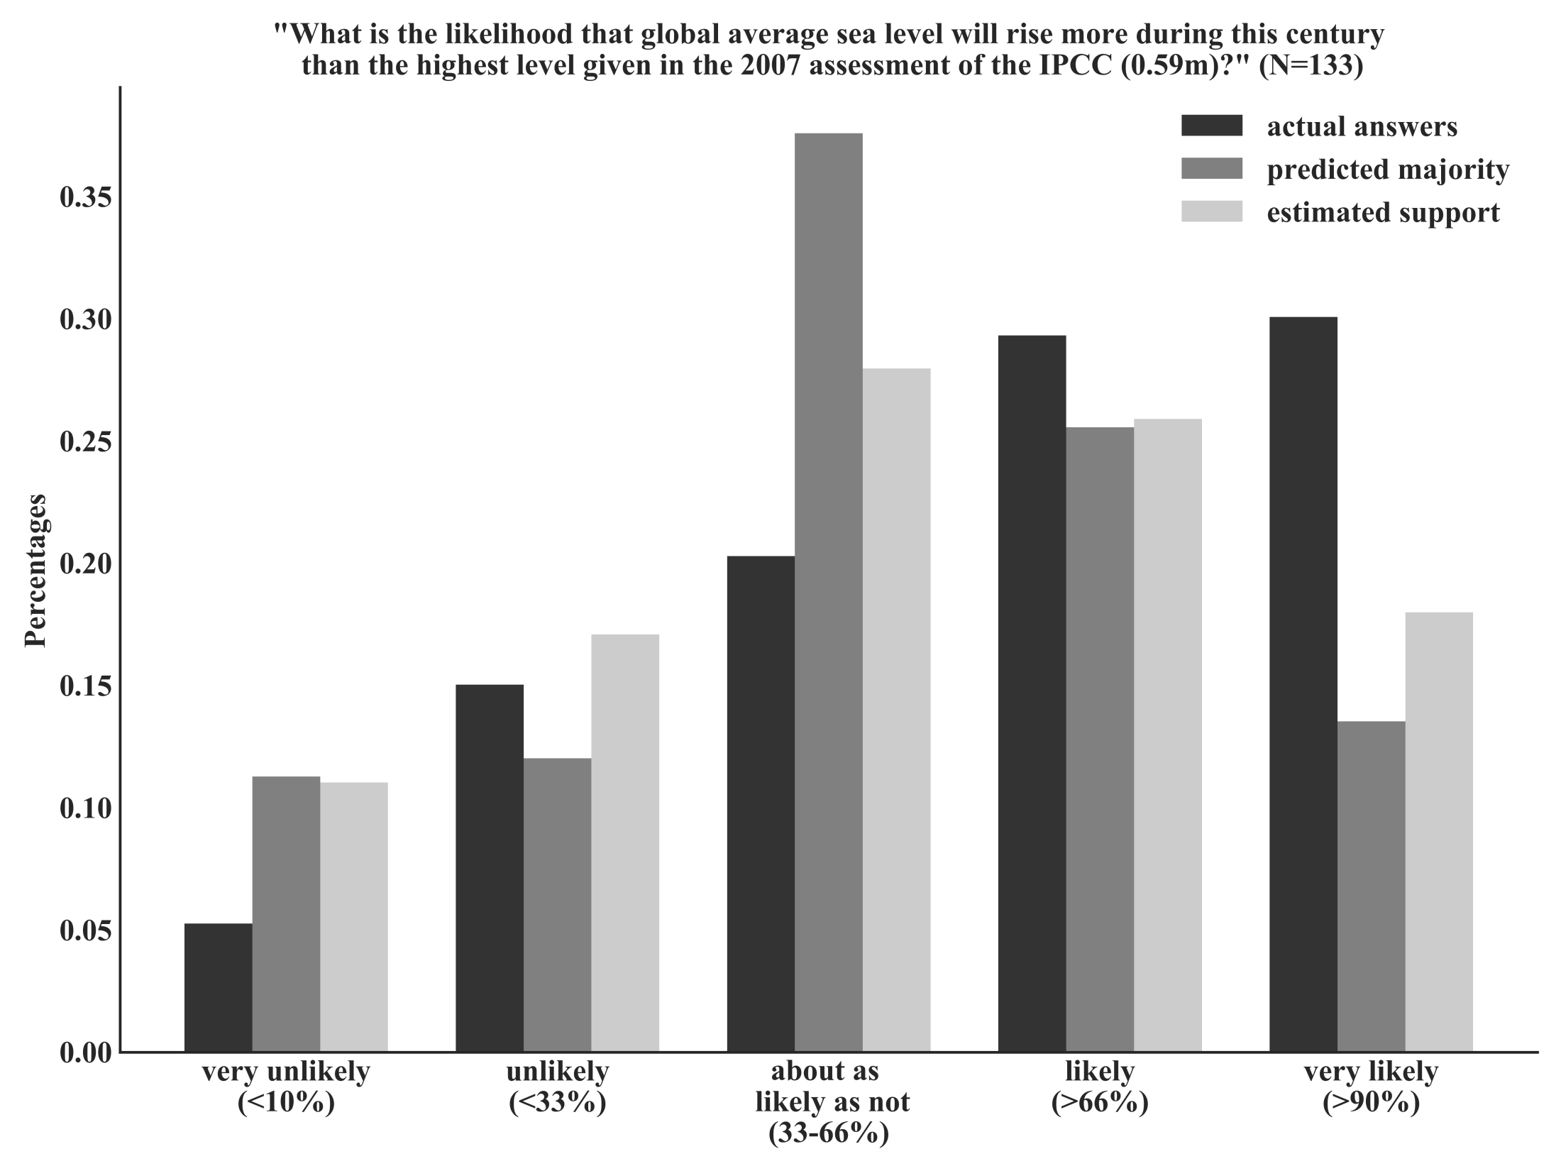
Notes:
Figure 4: Only 7 (5%) of the 133 participating climate change experts agreed with the assessment of the IPCC (most left red bar) that it is “very unlikely” that global sea level rise will be more than 0.59 meter during this century. 15% of the experts partly agreed with this worst case scenario, while 20% (middle red bar) thought it to be no more correct than incorrect. A majority of experts thought that IPCC’s worst case scenario was too optimistic (29%) or way too optimistic (30% - red bar “very likely”). Predictions of the majority opinion (blue bars) show that climate change experts were not aware of each other’s skepticism: The predominant prediction with 38% (middle blue bar) was that most colleagues would consider IPCC’s worst case scenario to be fair. The numerical estimates (purple bars) show a similar pattern as the blue bars, but slightly biased towards personal opinions.

