Slide 1
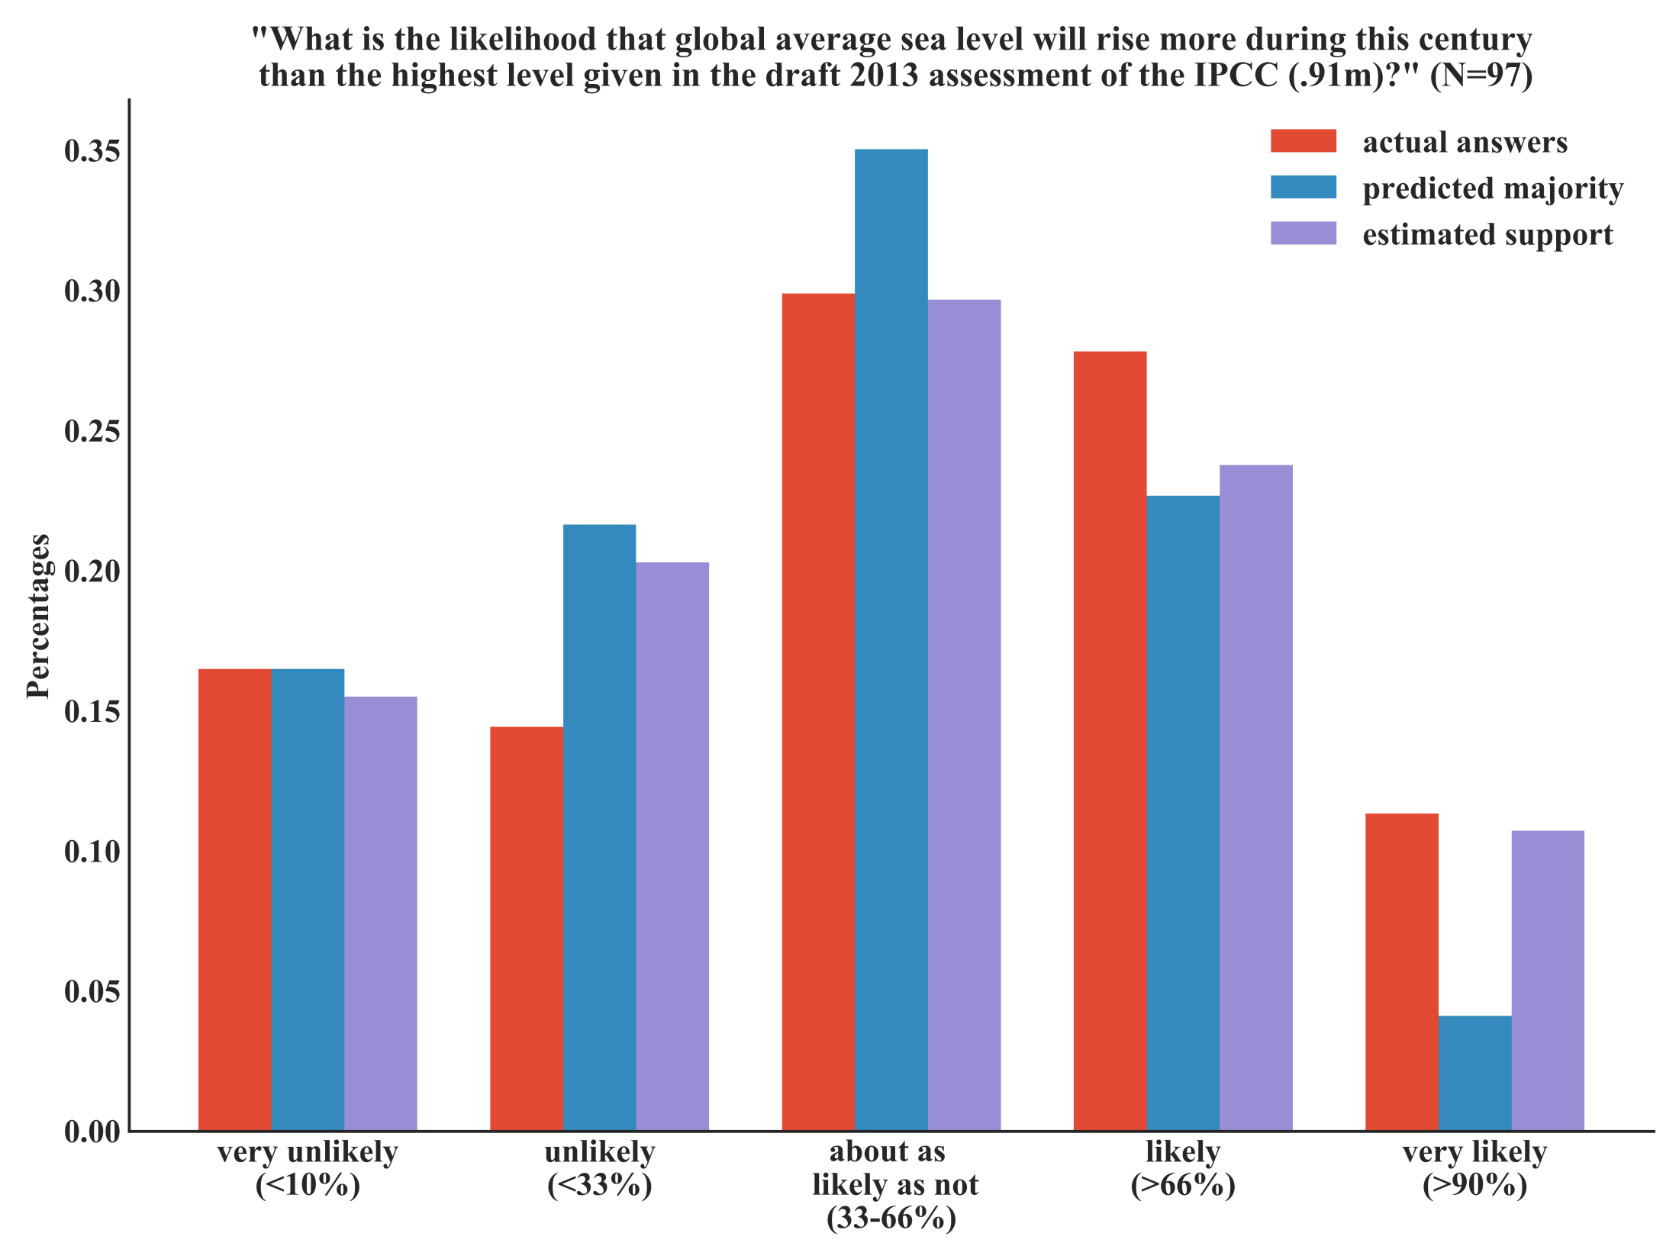
Notes:
Figure 5: Results from the second poll on sea level rise, after the IPCC had increased their highest estimated sea level rise by 2100 to 0.91 meter.

Slide 2
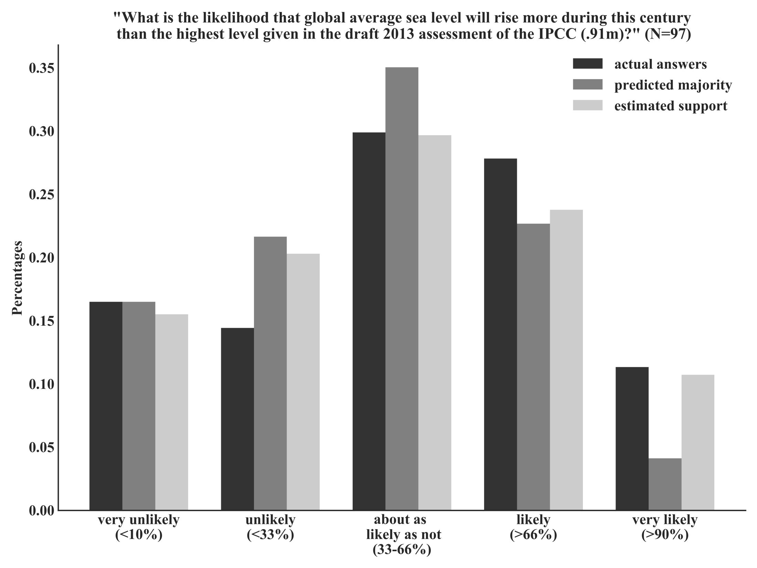
Notes:
Figure 5: Results from the second poll on sea level rise, after the IPCC had increased their highest estimated sea level rise by 2100 to 0.91 meter.

