Slide 1


Cyclistic Bike-Share Speedy Success Create by Pei Tao

Slide 2

Executive Summary
Business Ask
Problem Statement: Cyclistic currently has a user base where 70% are casual riders, not opting for annual memberships, leading to a substantial untapped revenue potential.
Task: The company need a comprehensive analysis of user behavior to help uncover the underlying opportunity and formulate strategies.
Goal: 10% increase in annual membership subscriptions through selected media channels within the next six months.
Stakeholders
External Stakeholders: Customer marketing analytics team | executive team
Internal Stakeholders: Marketing director Lily Moreno | Data analytics team
Summary Index
Data sources
Data preparation
Analysis summary
Data visualizations & key findings
Top-3 recommendations

Slide 3
Data Source & Data Frame
Data Sources: This analysis use Cyclistic’s 2023 bike-share trip data, provider by Google Data Analytic Certificate course, made available by Motivate International Inc. Copyright under license https://ride.divvybikes.com/data-license-agreement
Time Frame: January – July 2023
Original Data Size:
Original Data Schema:
Data Sample:
Total Files | Total Size (MB) | Total Rows | File Names
7 | 605.77 | 3158109 | Divvy_Trip202301.csv Divvy_Trip202302.csv Divvy_Trip202303.csv Divvy_Trip202304.csv Divvy_Trip202305.csv Divvy_Trip202306.csv Divvy_Trip202307.csv
ride_id | member_casual | rideable_type | start_lat | start_lng
A unique identifier for each ride | The type of user (e.g., "member", "casual") | The type of bike used for the ride | The latitude of the start location. | The longitude of the start location.
started_at | start_station_name | start_station_id | end_lat | end_lng
The start timestamp of the ride | The name of the station where the ride started | The ID of the station where the ride started | The latitude of the end location. | The longitude of the end location.
ended_at | end_station_name | end_station_id
The end timestamp of the ride | The name of the station where the ride ended | The ID of the station where the ride ended

Slide 4
Data Preparation
Data Location:
Original: D:\Case_Study\BikeShare\2_Data\BikeShare_Data_AnalyOP_Backup
Analysis: D:\Case_Study\BikeShare\3_Analysis Results
Data Operation: BigQuery (link)
Data Preparation:
Union all data files into table 2023 under dataset divvy_trip
Added Columns
Data Cleaning Check (TBD)
Analysis Planning (Pivot table) (TBD)
User type trends by time
User type trends by ride length
Casual rider frequent stations
ride_length AS INT64 | hour AS INT64 | day_of_week AS INT 64 | month AS INT 64 | season AS INT 64
The delta between “started_at” and “ended_at” timestamp | The hour of the “started_at” timestamp | The day of the week of the “started_at” timestamp | The month of the “started_at” timestamp | The season of the “started_at” timestamp

Slide 5
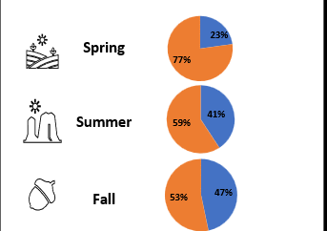
User Type Trends by Time
abc
abc

Slide 6
User Type Trends by Time
abc
abc

Slide 7
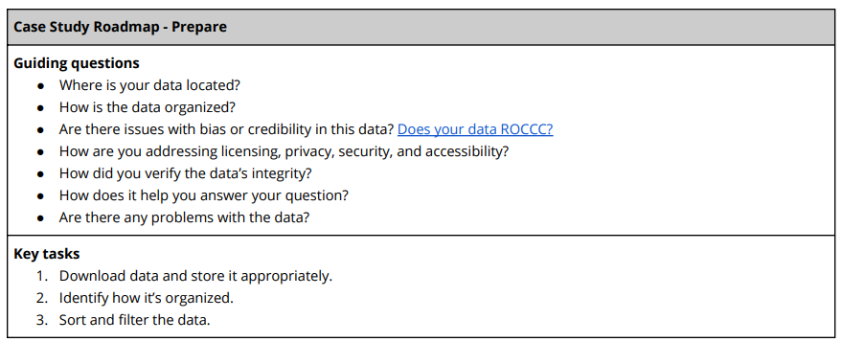
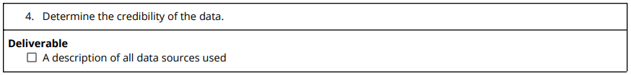
Data Preparation
Data location
Data organization
Data bias & creditability assess (ROCCC)
Licensing
Privacy
Security
Accessibility
Data integrity assess
Data and business goal relevance:
Data issues:

