Slide 1
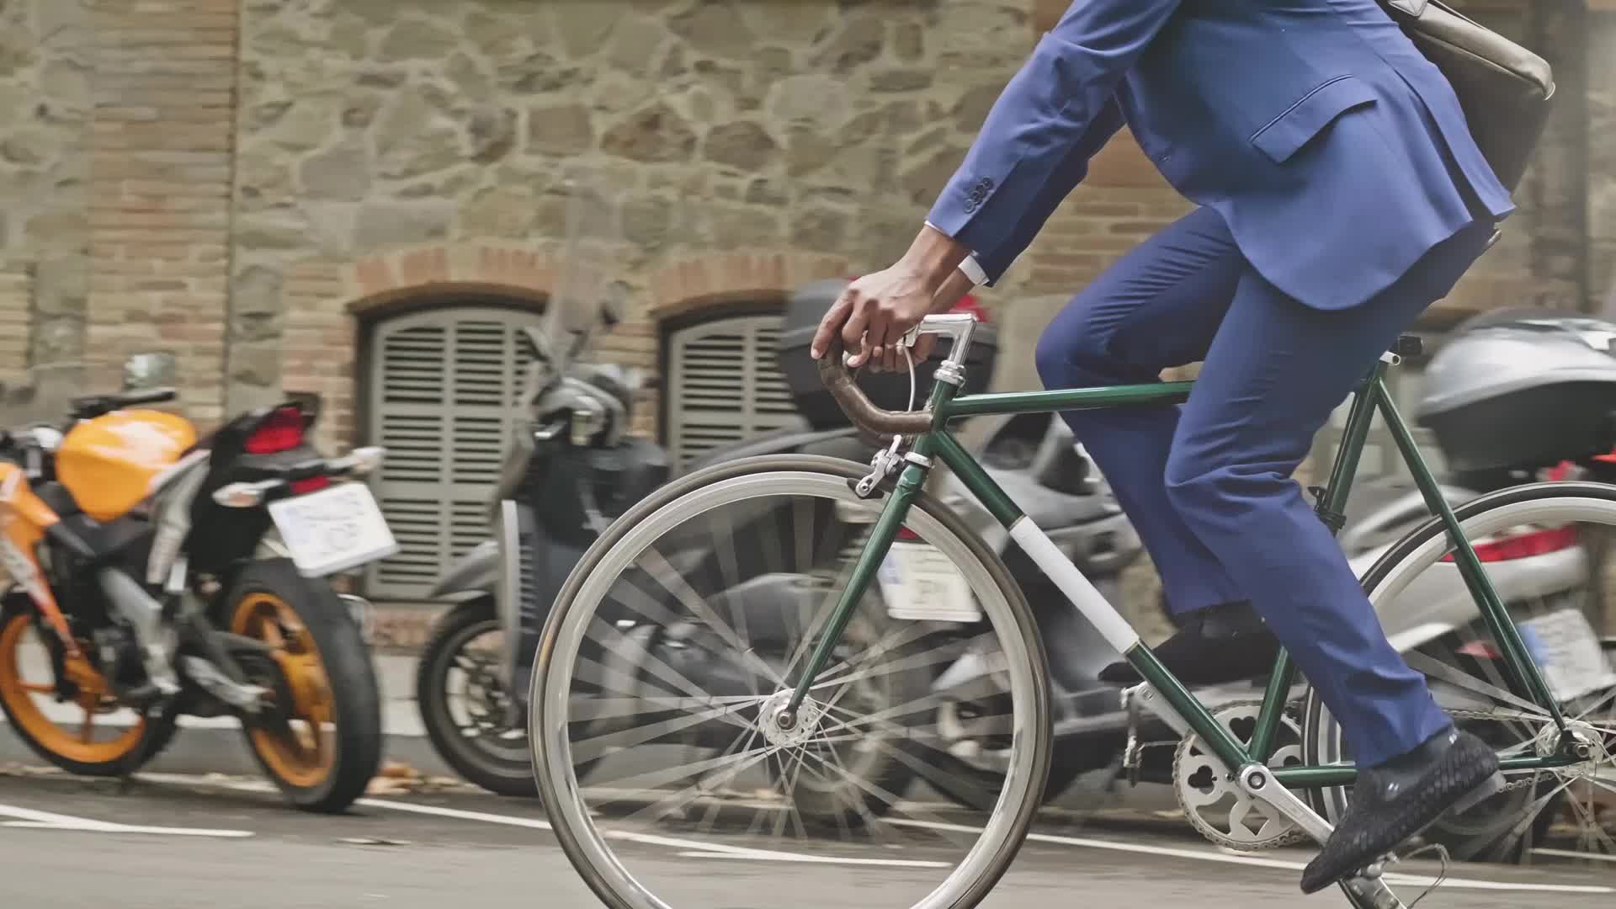
Cyclistic Bike-Share Speedy Success Create by Pei Tao

Slide 2

Executive Summary
Business Ask
Problem Statement:
Cyclistic currently has a user base where 70% are casual riders, not opting for annual memberships, leading to a substantial untapped revenue potential.
Task:
The company need a comprehensive analysis of user behavior to help uncover the underlying opportunity and formulate strategies.
Goal:
10% increase in annual membership subscriptions through selected media channels within the next six months.
Stakeholders
External: Customer marketing analytics team | executive team
Internal: Marketing director Lily Moreno | Data analytics team
Summary Index
Data sources
Data preparation
Analysis summary
Data visualizations & key findings
Top-3 recommendations

Slide 3
Data Source & Data Frame
Data Sources: This analysis use Cyclistic’s 2023 bike-share trip data, provider by Google Data Analytic Certificate course, made available by Motivate International Inc. Copyright under license https://ride.divvybikes.com/data-license-agreement
Time Frame: January – July 2023
Original Data Size:
Original Data Schema:
Data Sample:
Total Files | Total Size (KB) | Total Rows | File Names
7 | 605.77 | 3158109 | Divvy_Trip202301.csv Divvy_Trip202302.csv Divvy_Trip202303.csv Divvy_Trip202304.csv Divvy_Trip202305.csv Divvy_Trip202306.csv Divvy_Trip202307.csv
ride_id | member_casual | rideable_type | start_lat | start_lng
A unique identifier for each ride | The type of user (e.g., "member", "casual") | The type of bike used for the ride | The latitude of the start location. | The longitude of the start location.
started_at | start_station_name | start_station_id | end_lat | end_lng
The start timestamp of the ride | The name of the station where the ride started | The ID of the station where the ride started | The latitude of the end location. | The longitude of the end location.
ended_at | end_station_name | end_station_id
The end timestamp of the ride | The name of the station where the ride ended | The ID of the station where the ride ended

Slide 4
Data Preparation
Step1: Data Location:
Original: D:\Case_Study\BikeShare\2_Data\BikeShare_Data_AnalyOP_Backup
Analysis: D:\Case_Study\BikeShare\3_Analysis Results
Step 2: Data Operation: BigQuery (link)
Step 3: Data Preparation:
Union all data files into table 2023 under dataset divvy_trip
Added Columns
Data and business goal relevance: The data provide signal trip graduality and user type info allowing behavior analysis between user types to support business goal.
Data Issue & Cleaning Steps
Analysis Planning
User type trends by time
User type trends by ride length
member rider frequent stations
Casual rider frequent stations
ride_length AS INT64 | hour AS INT64 | day_of_week AS INT 64 | month AS INT 64 | season AS INT 64
The delta between “started_at” and “ended_at” timestamp | The hour of the “started_at” timestamp | The day of the week of the “started_at” timestamp | The month of the “started_at” timestamp | The season of the “started_at” timestamp

Slide 5



User Type Usage Overview
Member Usage
Started High: More than 3 times higher than casual users’ usage from January to March,2023.
Ended Low: More than 50 % drop from March to April and continue downward to June, while usage started to pick up in July.
Waring Sign: Need an urgent research for the reasons of usage sharp drop.
Protect Revenue: Retention promotions are.
Casual Usage
Seasonal Overview
Growth: Casual usage showed a slow and steady increase from January to July, resulting in a total usage growth of 106%.
User Type %
Casual User Lifestyle: The growing trend implies that casual users have developed a health awareness about the service and increasingly incorporated it into their lifestyle.
Sign-up Incentive: Membership package according casual user lifestyle would keep stimulate the growth.
Spring
Summer
Fall (July Only)
* Seasonal trend confirm member usage drop & casual usage growth.

Slide 6
User Type Trends by Time
Member Usage
Casual Usage
Rush Hours: 8 am and 5 pm were the morning and evening rush spiks.
Weekday Rides: Member usage is high during weekdays and low on weekends.
Off Peak Hours: Steady upward trend during times of day and peak at 5 pm.
Weekend Peaks: Weekend casual usage exceeded weekday usage.
Regular & Frequent Daily Commute: Members likely relied on bike sharing for work or school.
Promotion: Reward on ride frequency would help membership retention.
Promotion Time: Weekday around 8 am and 5 pm.
Activity Types: Casual users likely used the service for leisure activities, errands, or spontaneous trips.
Promotion: Member benefits such as off-peak hour rate or weekend cross-marketing events could motive sign-ups.
Promotion Time: Around 5 pm on weekends.
Member
Casual

Slide 7
User Type Trends by Average Ride Length
Member Usage
Casual Usage
Around 20 Mins Rides: Casual users average ride length is about 20 minutes.
Late Night Peak: 3-4 am average ride length is 32 mins.
Weekends Peak: Weekend ride length is longer than weekday ride length.
Around 10 Mins Regular Rides: Members took regular and consistent daily commute rides between 9 to 13 minutes.
Route: Likely from their resident areas to near by stations, thus they are urban residence.
Bike Availability: Providing bikes in popular areas or offering information on nearby bike availability helps members with their daily routines.
Frequency Rewards: Reward ride frequency to keep the sense of membership value. Ex: accumulative 50 or 100 rides a month would get free rides for the rest of the month; or a free day pass to their non-member family members or friends.
Outskirt urban residential area: Casual riders living in outskirt urban residential areas can use the service for running errands.
Late Night Discount: Offering a late-night rate for members provides a competitive advantage for late-night leisure or work-related transportation needs.
Family or Friend Weekend Recreation: Offering multiple-rider deals or sign-up gifts on weekends could encourage casual riders to convert to members.

Slide 8
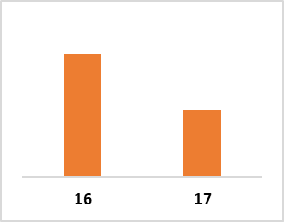
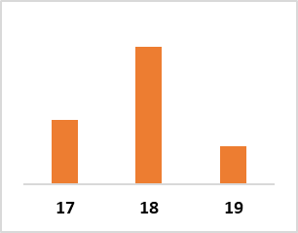
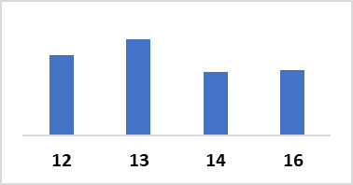
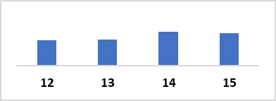
User Frequent Stations by Time
Member User Weekday Top Stations & Hours
Casual User Weekend Top Stations & Hours
Top Start Station | Top End Station
Michigan Ave & Lake St | Streeter Dr & Grand Ave
Top Start Station | Top End Station
Streeter Dr & Grand Ave | DuSable Lake Shore Dr & Diversey Pkwy
Bike Availability: Very high bike demand on the stations with those peak time. Shortage would interrupt members’ regular journey thus affect their loyalty and dependency on bike-share.
Real-Time Information: Use Cyclitic App to provide real time bike availability at near by bike hubs could help the issue.
Promotion around the stations & the times: Cross-marketing membership discounts with nearby restaurants before dinner time would enhance the convenience of members' daily lives.
Restaurant Deal Added Value: This deal will encourage users to explore a broader range of bike hubs, thus reducing the concentration of bike demand in specific areas.
Promotion Time: These hours are idea to launch promotion activities at the stations.
Promotion around the stations & the times:
Digital promotion: Launch browser keyword or podcast advertisement on weekend morning when people search weekend events.
Signs or sales rap near bike hubs: Instant promotion reminder before casual user use the service.
Cross marketing deals: membership discount with shops, restaurants or beverage company around the stations and time would stimulate impulse sign-ups.

Slide 9
Top 3 Recommendations
Business Ask
10% increase in annual membership subscriptions through selected media channels within the next six months.
Finding Summary
Current member retention and casual rider sign up promotion both are important to contribute 10 % increase annual membership subscriptions.
Top 3 Strategy Recommendation
Member Retention:
Focusing on rewarding ride frequency and enhancing daily routine convenience.
Utilize the Cyclistic App to send promotions between 12 pm and 5 pm on weekdays.
Examples of rewards include accumulating a certain number of rides to receive gifts, free ride passes, or discounts at restaurants.
Casual Rider Sign-up Boost:
Design a membership bundle to suit casual rider’s lifestyle.
Combine off-peak, late-night, and weekend deals to provide value, and consider adding gifts for impulse purchases.
Utilize social media, podcasts, and digital ads to raise deal awareness and boost promotions at popular stations during peak times with sign-up gifts and signage.
Further Research:
Investigate the reason on 50% member usage decrease to help identify potential risk, in revenue and operation
Further survey casual riders’ trip purpose to help the promotion strategies that solidify their loyalty to bikeshare.

