Slide 1
Drivers and prediction of anti-measles immunization Rates in Texas
Grace Awantang
Capstone presentation;
Data Science Bootcamp

Slide 2
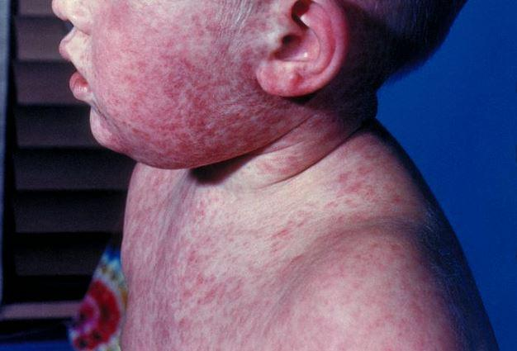
Problem
Measles was declared eliminated from the US in 2000
However, in late January of 2025, cases of measles were confirmed in West Texas
This outbreak has been linked to lower vaccination rates
Notes:
Measles symptoms start with cold-like signs (cough, runny nose, red/watery eyes, fever) followed by tiny white spots in the mouth, then a flat red rash appearing on the face and spreading down the body. This highly contagious illness can lead to severe complications like pneumonia or brain swelling
This disease is especially dangerous for babies and young children.

Slide 3
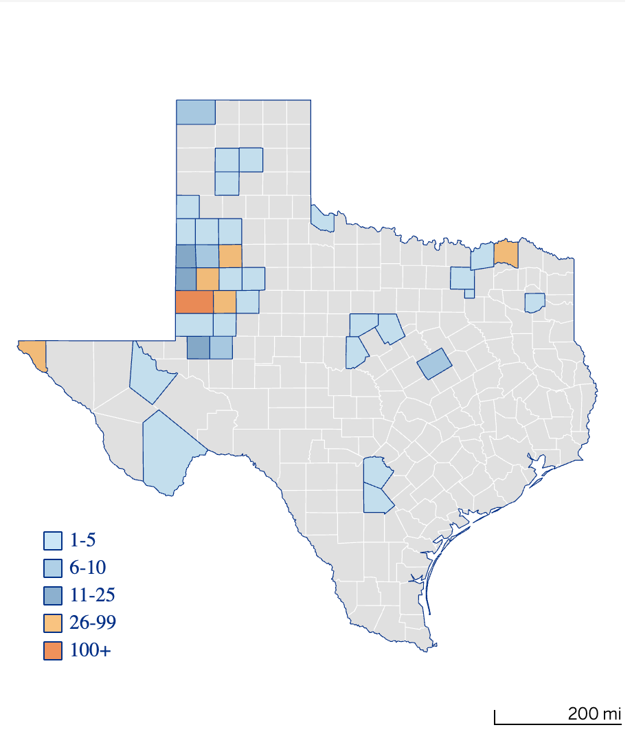
Problem
The initial handful of cases quickly ballooned to hundreds across many counties in and outside of Texas
Cases were also reported in neighboring New Mexico as well as Kansas, and Iowa

Slide 4
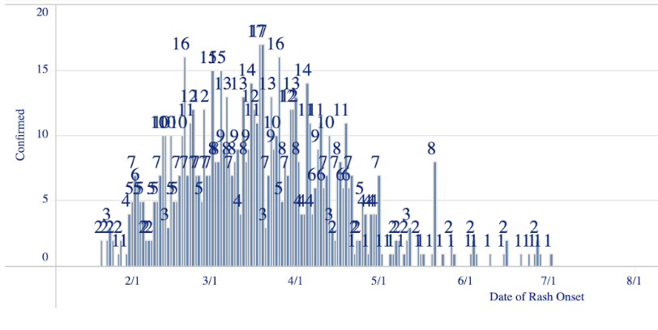
Problem
West Texas Outbreak of Measles Cases by Date of Rash Onset

Slide 5
Problem
95% of kindergarten-aged children need to be vaccinated against measles to prevent disease outbreaks (WHO, UNICEF 2025)
Researchers have documented nation-wide decreases in the proportion of American kindergarteners receiving the MMR and DTaP vaccine since the COVID-19 pandemic as well as an increase in requested exemptions
Notes:
measles-mumps-rubella (MMR)
Diptheria, tetanus, and accelular pertussis vaccine

Slide 6
Questions
What are the strongest predictors of high county-level measles vaccination rates across Texas being up-to-date on the MMR vaccine series?
What ability do machine learning models have in predicting future (i.e. 2023) county-level measles vaccination immunization coverage rates based on available data from previous years (2000 – 2022)?

Slide 7
Questions
What are the strongest predictors of high county-level measles vaccination rates across Texas being up-to-date on the MMR vaccine series?
Answer:
1.) Hepatitis B coverage, (+)
2.) the number of live births in a county, (-)
3.) polio vaccine coverage, (-)
4.) the concern for COVID-19 vaccination rollout index (+) and
5.) the Primary Care Physicians Rate (+).
However! Model performance was very poor. The correlates included did not appear to explain much of the variance in estimated coverage rates.
Notes:
The CVAC index reflects a county’s ability to handle a COVID-19 outbreak and is based on a community's access to health care, affordable housing, transportation, childcare, or safe and secure employment. CVAC Index values range from 0 (least vulnerable) to 1 (most vulnerable)

Slide 8
Questions
What ability do machine learning models have in predicting future (i.e. 2023) county-level measles vaccination immunization coverage rates based on available data from previous years (2000 – 2022)?
Answer:
Model prediction performance was weak given the available data The correlates included did not appear to explain much of the variance in predicted coverage rates.

Slide 9
Data wrangling: data sources
Source | Description
DSHS school-vaccination coverage data | Proportion of children entering kindergarten that meet measles vaccination requirements (two doses) upon entering school.
County Health Rankings (CHR) | Includes various health, economic and socio-demographic indicators from multiple Texas state agencies including: Residential Black/White segregation index Median household income Proportion of children without health insurance Infant mortality COVID-19 Vaccine Coverage (CVAC) Index Social vulnerability index (SVI)
Big Query | Health Professional Shortage Area (HPSA) scores Medically Underserved Area (MUA) COVID-19 vaccine hesitancy collected via the Household Pulse Survey
Notes:
CSV files were downloaded from respective websites for 254 counties and for four years (2020 through 2023).

Slide 10
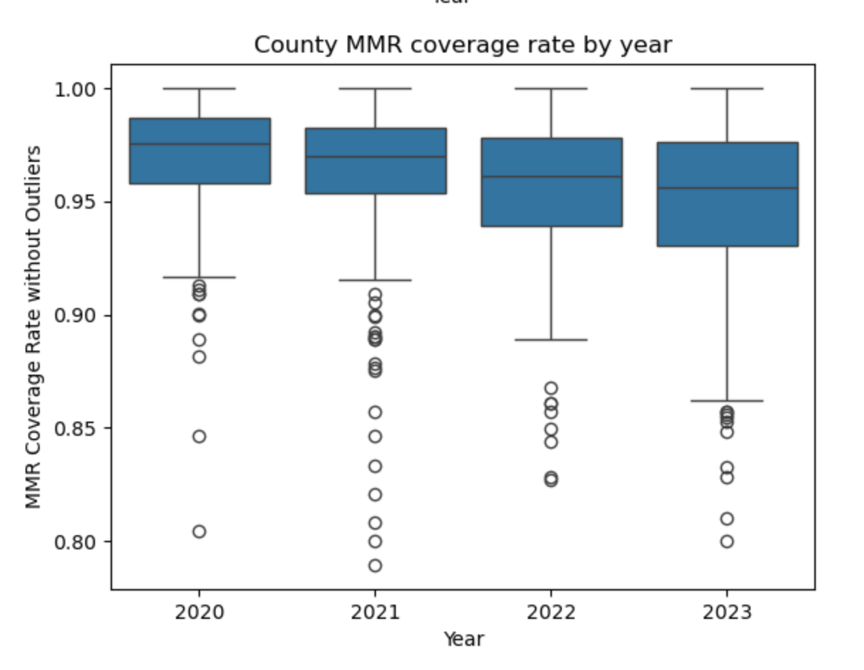
Data wrangling: EDA
Data is highly skewed towards 100% with the most variation in 2023
7 counties had missing MMR coverage rate values for at least one year and 3 counties – DeWitt, Loving, and McMullen were missing data for all four years
County x years with missing MMR coverage values were dropped from analysis
Notes:
CSV files were downloaded from respective websites for 254 counties and for four years (2020 through 2023).

Slide 11
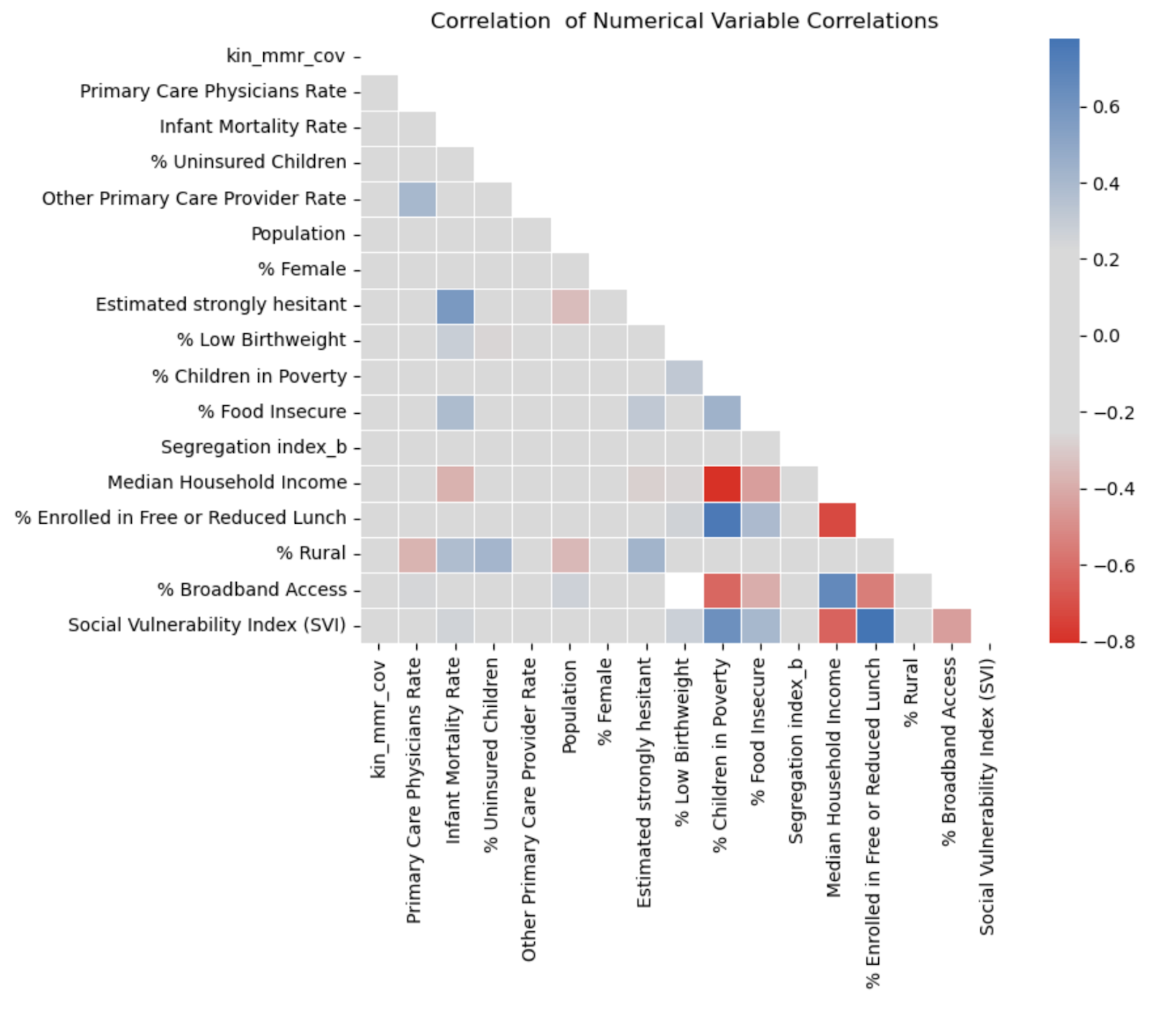
Correlation among POTENTIAL PREDICTORS
Strong associations (collinearity) among several features relating to economics and household internet access
More moderate associations
between SVI and economic indicators as well as
between the % strongly hesitant to take COVID-19 vaccine and the infant mortality rate
Notes:
CSV files were downloaded from respective websites for 254 counties and for four years (2020 through 2023).

Slide 12
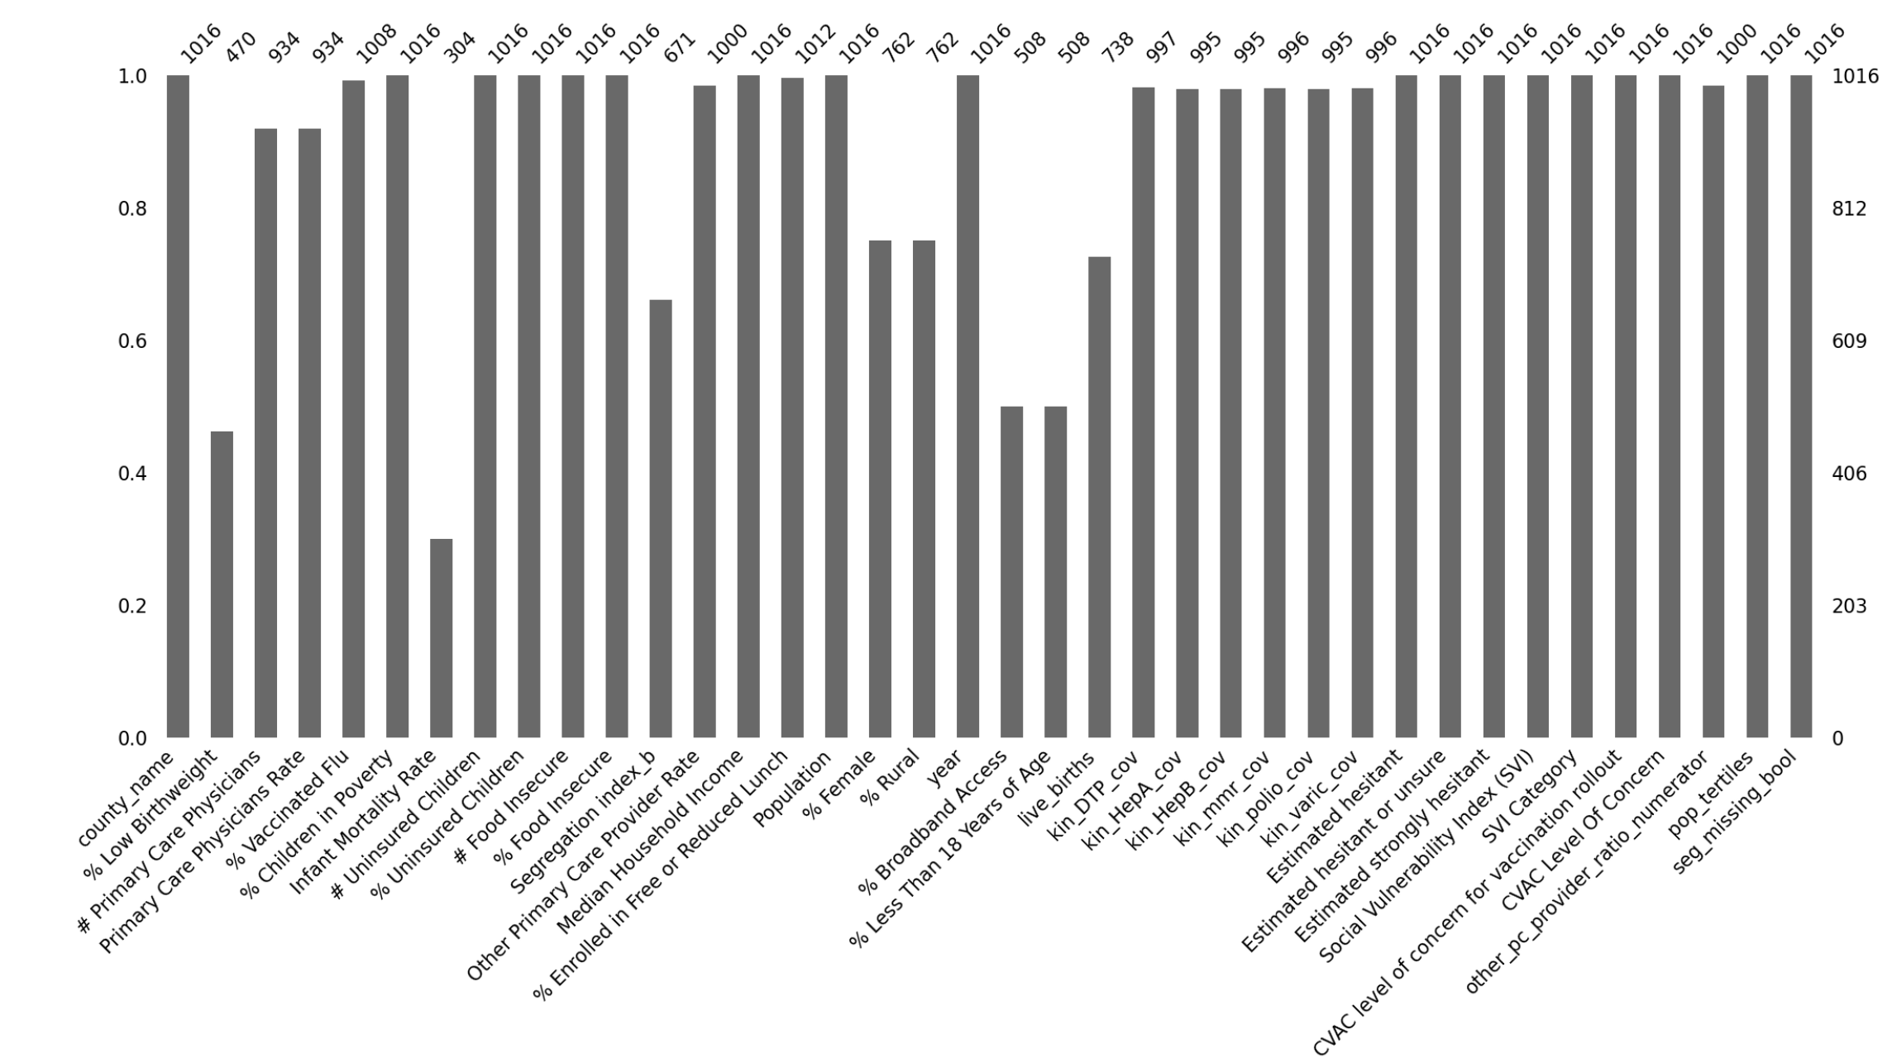
Data wrangling: imputation
County-specific imputation based on median for variables that changed <3% over the years of available data
County-specific linear interpolation
Global imputation (not county-specific)
Notes:
Eight variables were missing 25% or more of their values including: infant mortality rate, % low birthweight, % less <18 yrs of age, % broadband access, % rural, % Female

Slide 13
Modeling: Correlates of coverage
Linear Regressor
OLS
Ridge
XGBoost
RandomForest
75/25 county split such that all years for a given county were either in train or test data sets
SelectKBest
Cross-validation (5 folds)

Slide 14
Modeling: Correlates of coverage
Ridge
param_grid = {
'feature_selection__k': [5, 10, 20, 30, 'all'],
'ridge__alpha': [0.1, 1, 10, 100, 1000, 10000, 1000000]
}
XGBoost
param_grid = {
'regressor__alpha': [0.1, 1.0, 10.0, 100.0, 1000.0, 10000.0, 1000000],
'regressor__max_depth': [2, 6, 10, 14],
'regressor__eta': [0.5, 1.0, 1.5]
}
RandomForest
param_grid = {
'regressor__min_samples_leaf': [1,3,5],
'regressor__max_depth': [2, 6, 10, 14],
'regressor__min_samples_split': [2, 5, 8],
'regressor__max_features': ["sqrt", "log2"],
'regressor__n_estimators': [100,150,200],
}
Hyperparameter tuning results for 3 models are shown to the left bolded and underlined

Slide 15
Modeling: Correlates of coverage
Table 1: Model metrics for estimating new county MMR coverage rates
Model | Training data |  | Test data
 | R squared | RMSE | R squared | RMSE
Linear Regression | 0.025 | 0.0434 | -0.0968 | 0.0320
Ordinary Least Squares | 0.034 | 0.0425 | 0.0849 | 0.0310
Ridge | -0.0108 | 0.0430 | -0.0553 | 0.0010
Random Forest | 0.0584 | -0.00174 | 0.0584 | -0.00105
XGBoost | -0.00000 | -0.00185 | N/A | N/A
Notes:
The best values for each column are highlighted in blue

Slide 16
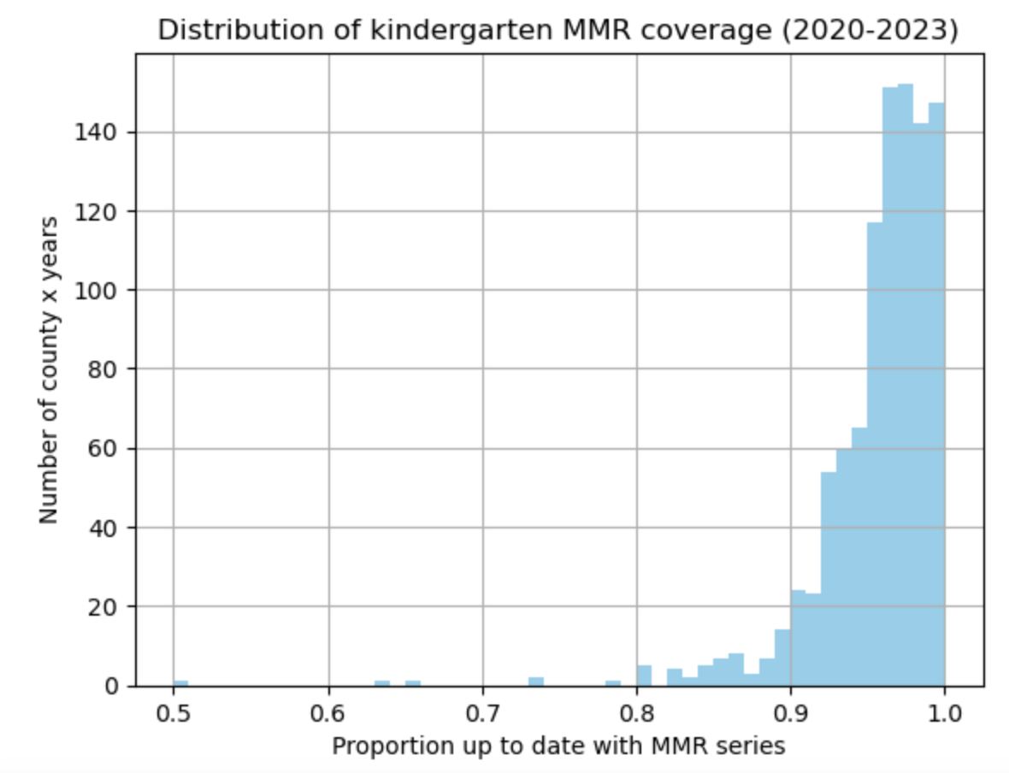
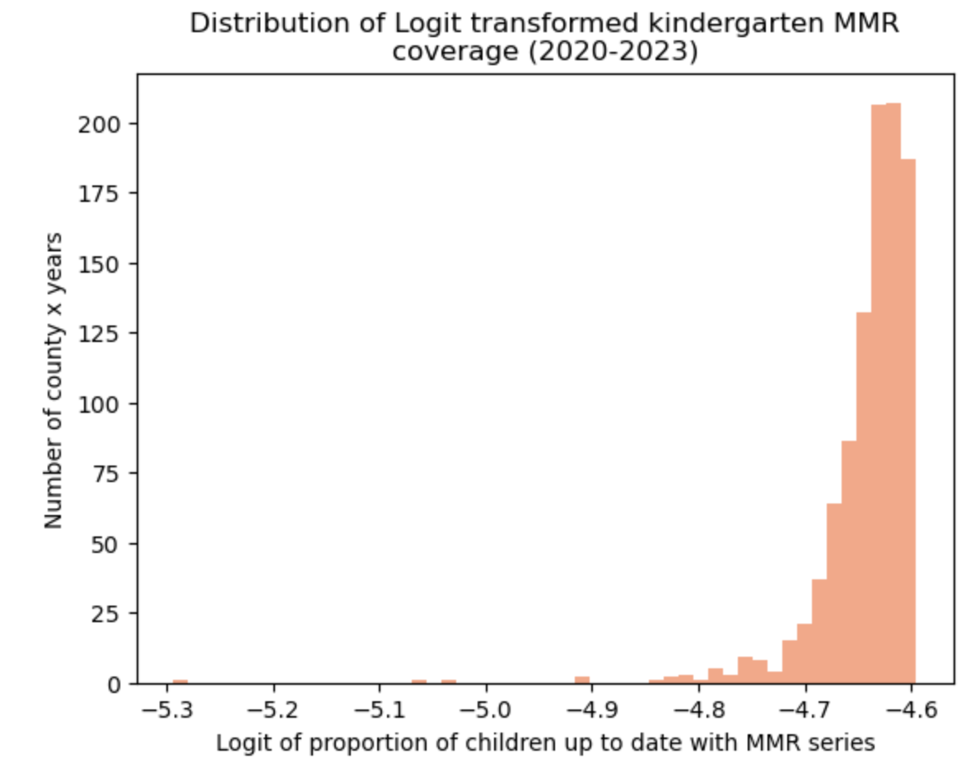
Modeling: Correlates of coverage
Applied a logit transformation to percentage of children vaccinated (p) whereby logit(p) = log(1−pp​) in order to expand differences in values close to 100% coverage.

Slide 17
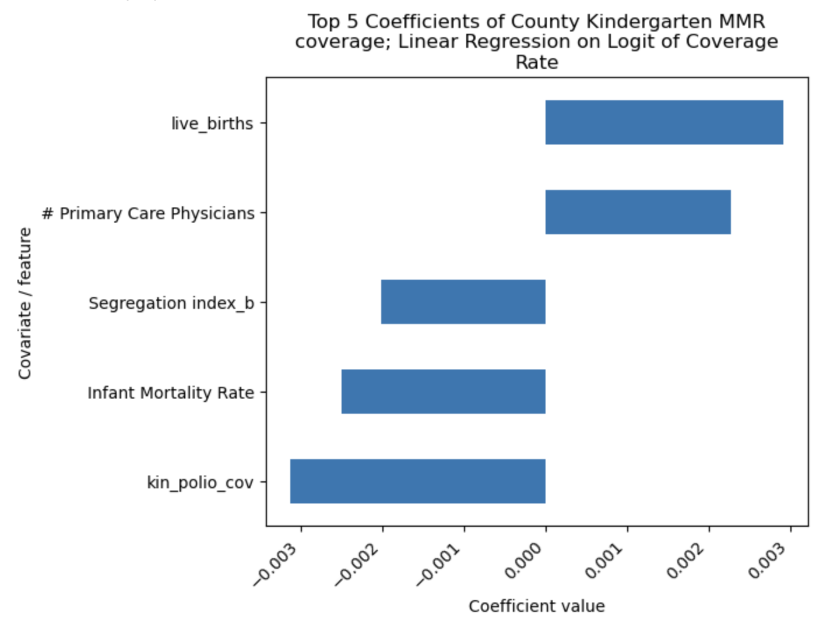
MODELING: Correlates of Coverage
Using transformed coverage as outcome had little effect on which correlates were most important (in terms of magnitude) nor did it improve model performance on training or testing data significantly (RMSE 0.0505, 0.0356 respectively)

Slide 18
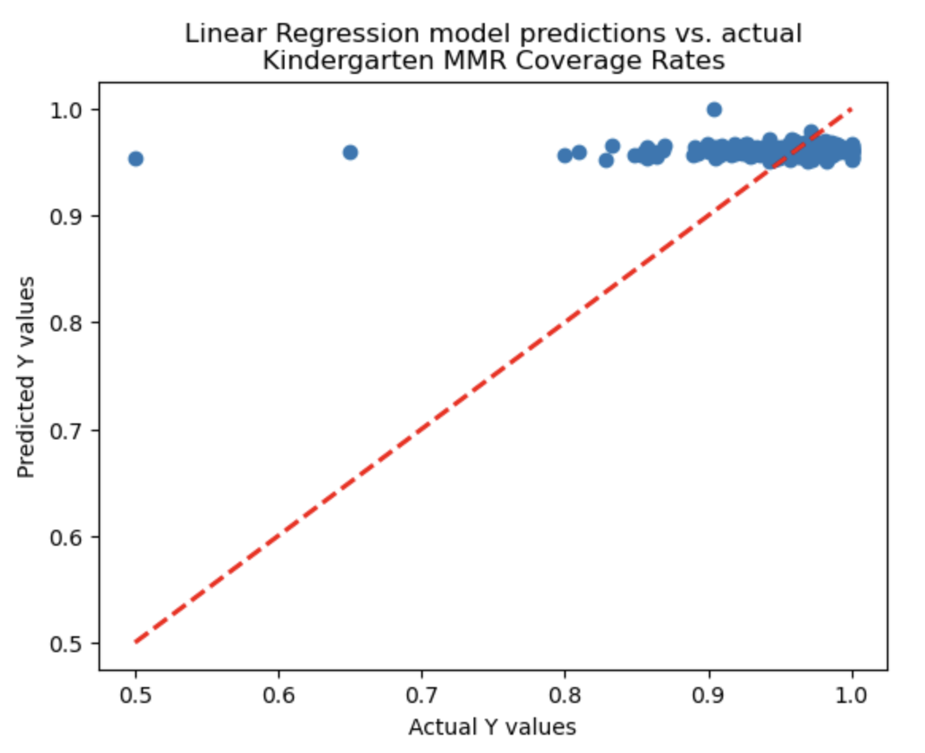
MODELING: Correlates of Coverage
The estimated Y values based on the linear regressor model
Little variation in estimates, especially inappropriate for counties with lower MMR coverage rates

Slide 19
Modeling: PREDICTING coverage
Linear Regressor
75/25 county split such that all years for a given county were either in train or test data sets
SelectKBest
Cross-validation (5 folds)

Slide 20
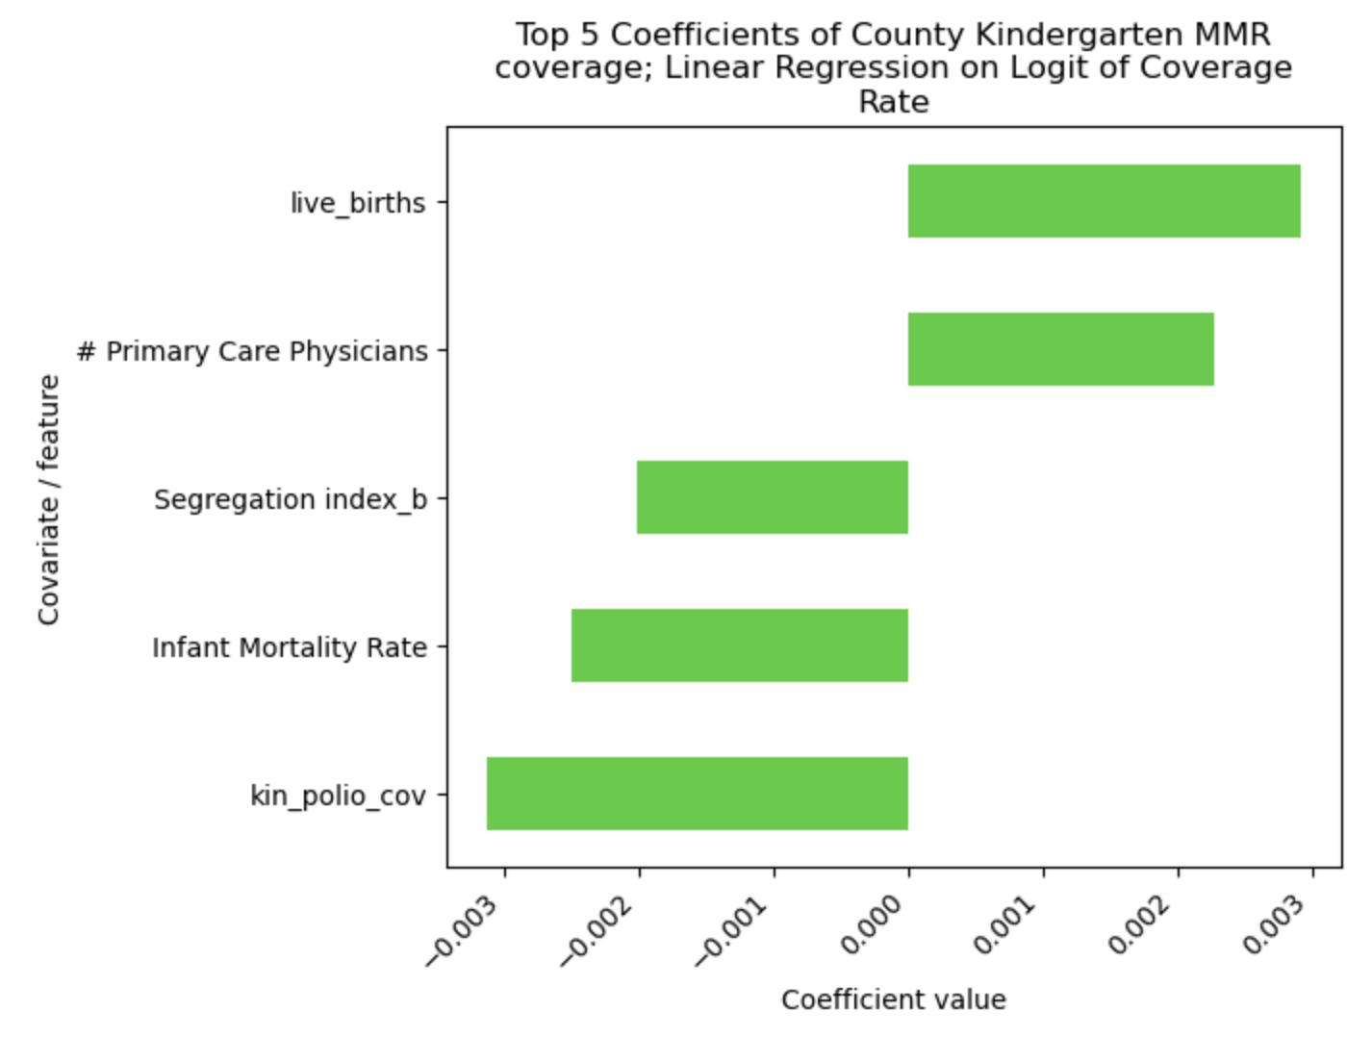
MODELING: PREDICTORS OF COVERAGE
Predictors on training data changed slightly to include # and % of Primary Care Physicians, the infant mortality rate, and black/white segregation index
The # of live births and polio coverage remained among the top five features identified

Slide 21
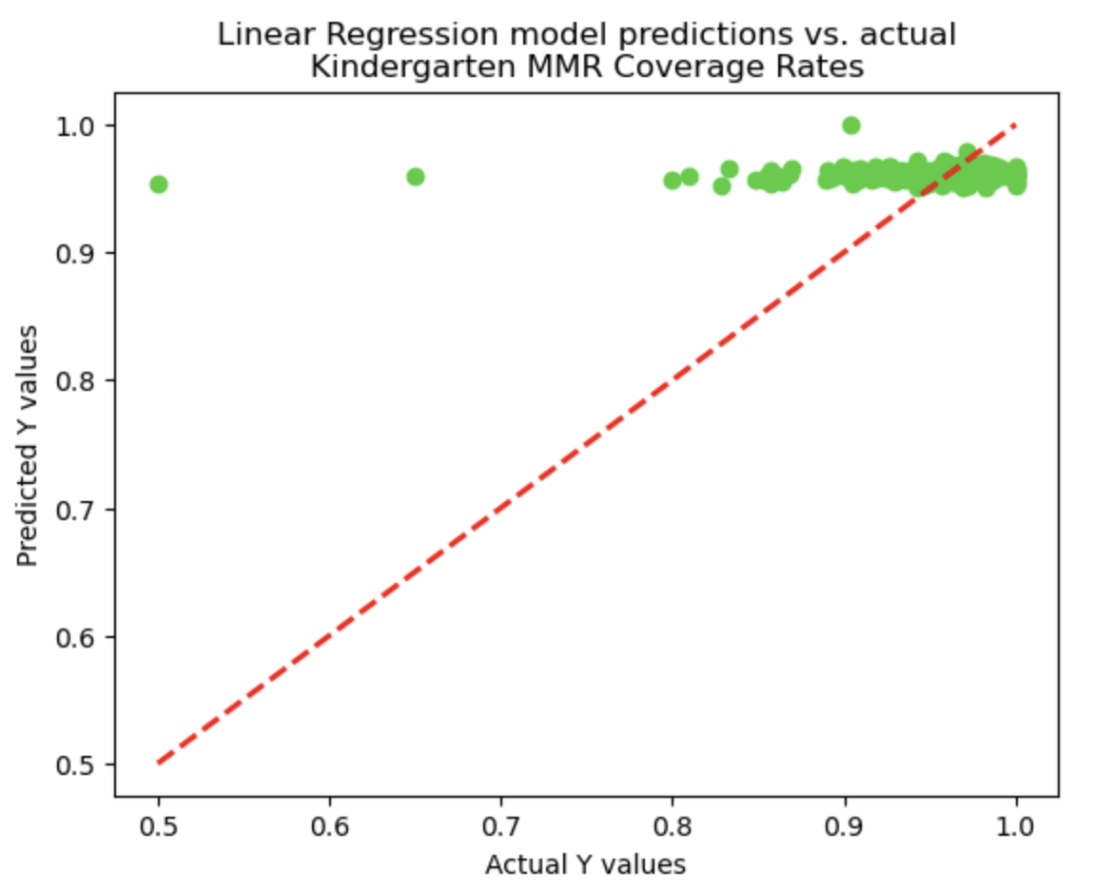
MODELING: PREDICTORS OF COVERAGE
Line graph shows coverage rates converted back from log odds
Prediction ability of the model was similarly poor with an R-squared of -0.0996 and an RMSE of 0.0356 on test data

Slide 22
Questions
What are the strongest predictors of high county-level measles vaccination rates across Texas being up-to-date on the MMR vaccine series?
Answer:
1.) Hepatitis B coverage, (+)
2.) the number of live births in a county, (-)
3.) polio vaccine coverage, (-)
4.) the concern for COVID-19 vaccination rollout index (+) and
5.) the Primary Care Physicians Rate (+).
However! Model performance was very poor. The correlates included did not appear to explain much of the variance in estimated coverage rates.
Notes:
Analysis results raise questions about why HepB and polio are associated in opposite directions? Maybe explained by caregiver hesitancy of polio vaccine? Both are part of routine immunizations in Texas
Access
Primary Care Physicians as one of the most important feature points to the role of access and a possible health worker structural barrier that could be addressed in counties with the lowest proportion and # of PCPs
Number of live births may suggest that areas with rapidly growing populations need more attention to make sure kids <5 get the recommended vaccines
While the COVID-19 vaccine rollout index was a top factor, this isn’t as useful as the index reflects a number of different socio-demographic characteristics for each county.
Omitted variables :
It would be helpful to understand how caregivers feel about the MMR vaccine specifically as well as how local policies and implementation of routine vaccination differ from county to county

Slide 23
Questions
What ability do machine learning models have in predicting future (i.e. 2023) county-level measles vaccination immunization coverage rates based on available data from previous years (2000 – 2022)?
Answer:
Model prediction performance was weak given the available data. The correlates included did not appear to explain much of the variance in predicted coverage rates.
Notes:
Omitted variables :
It would be helpful to understand how caregivers feel about the MMR vaccine specifically as well as how local policies and implementation of routine vaccination differ from county to county
- The elevated importance in IMR , and segregation index may reflect systemic health and demographic inequities that play a role in influencing vaccine coverage. For example, a higher IMR may reflect limited or delayed access to care for pregnant mothers or poor quality of care, or other resource barriers

Slide 24
CONCLUSIONS
The county-level data that is publicly available doesn’t explain the variation in coverage rates well
Even after removing outliers there may be some data quality issues that remain which resulted in unusually low MMR coverage rates for certain county x years
Analysis raises further questions about why hepatitis B and polio have opposite associations with MMR coverage
Further data enrichment (additional variables from CHR and additional years of data) and model tweaking may be need to produce more reliable results

