Slide 1
OCR (Optical Character Recognition USING NEURAL NETWORK)
Project Member:
.Rupesh Vaman Gawas
Ketan Krishna Kadam

Slide 2
Abstract
The aim of the project is to develop OCR software for English character recognition.
OCR is an optical character recognition and translation of images of typewritten or handwritten (usually captured by a scanner) into machine-editable text.
In this project , the focus is on recognition of English alphabet and numeric digits in a given scanned text document with the help of Neural Network.

Slide 3
Introduction:
Character is the basic building block of any language that is used to build different structure of a language. Characters are the alphabets and the structures are the words, strings and sentences etc.
Optical character recognition (OCR) is a process of converting a printed document or scanned page into ASCII (Editable text) characters that a computer can recognise.
The advantages of the character recognition process are that it can save both time and effort when developing a digital replica of the document. It provides a fast and reliable alternative to typing manually.

Slide 4
Problem Statement:
A character can be written in a number of ways differing in shape and properties, such as Tilt, stroke, Cursively and Overall shape. A plethora of Fonts are available for use in any commonly used Word Processing Application Software. Yet, while perceiving any text written in a variety of ways, humans can easily recognize and read each character. This is because the human perception processes the information by the features that define a character’s shape in an overall fashion. Thus, while modeling the human perception model in machines, ANN can be applied for classification of characters.
Furthermore, OCR is aimed at developing the ability to ‘read’, also known as Computer Vision. Thus, a recognized character should be carefully classified, if the same ‘symbol’ may signify more than one character at different places.

Slide 5
Existing System:
Template-matching and correlation techniques.
The matrix containing the image of the input character is directly matched with a set of prototype characters representing each possible class.
The technique is simple and easy to implement in hardware and has been used in many commercial OCR machines.
However, this technique is sensitive to noise and style variations and has no way of handling rotated characters.
Drawbacks of Existing System:
More time complexity.
Unable to recognize stylized fonts.
Blur image cannot be recognized.
Brocken characters cannot be read easily.

Slide 6
Proposed System:
Technologies use
ANN Training and Classification
It work like a human brain.
Before the character recognition can take place, the ANN is ‘trained’, so that it can develop the capability of mapping various inputs to the required outputs and effectively classify various characters.
ANN uses algorithm for Learning.

Slide 7
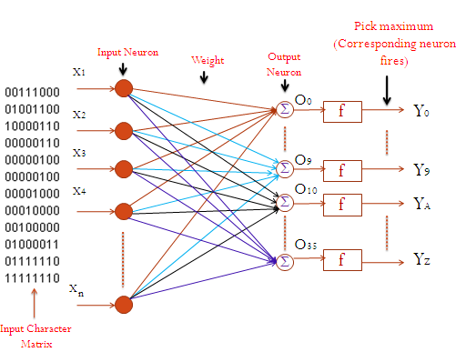
System Architecture:
Proposed feed forward network architecture

Slide 8
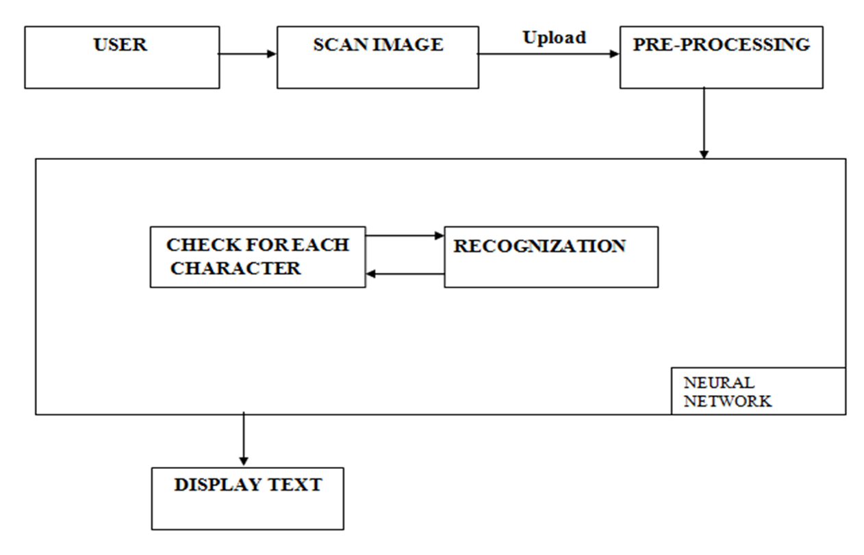
System Architecture

Slide 9
User : In this block, user will open the OCR for recognition of image. Scan Image: User will scan the image of document and upload into the OCR. Pre-Processing: In this block Pre-processing process is start. It consists of digitization, noise removal and boundary detection of the digitized character matrix. Neural Network: After Pre-processing we get character matrix, which is further given to Neural Network. Neural Network recognized for each and every character based on its trained database. Display Text: In this block, recognized character in display on screen that can be edited or saved.
System Architecture

Slide 10
Methodology Used:
The whole recognition process consists of four basic steps: pre-processing, normalized character matrix creation, network establishment and recognition. Pre-processing consists of digitization, noise removal and boundary detection of the digitized character matrix.
1 Input Character Image:
Our system is able to recognize any colored printed character image with white background and font size is between 18 and 96.
2 Normalization :
Normalization is the process of equating the size of all extracted character bitmaps (binary array).For size invariant character recognition, we have converted the boundary detected input character matrix into normalized matrix.

Slide 11
3. Digitization and Matrix Creation from Character Image
In order to able to recognize characters by computer the character image is first digitized into a matrix i.e. transformed into a binary form for the ease of handling by the computer.
Color image is first converted to the gray scale image as follows:
Y= (int) (0.33 * R + 0.56 *G +0.11 *B)
4. Boundary Detection
For top boundary detection, scan the character matrix starts at the top-left corner and remove all rows from top having only 0’s.
Similarly for bottom, left and right.

Slide 12
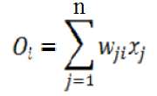
Algorithms:
Algorithm for Training of Neural network
Take a random training sample for any character and then generate normalized matrix.
Generate the corresponding initial weight_matrix.
Calculate the weighted sum Oi(net activation) as follows:
Where, i=0, 1, 2……..n.
4. Calculate the sum of positive weight, Pwi of the weight_matrix.

Slide 13
Calculate Yi=f (Oi) =Oi/Pwi
Where, Oi →Net activation for each character i (e.g. 0, 1, 2,……9,A, B……Z)
Pwi→ the sum of positive weight of the weight_matrix for the each character.
6. Pick the maximum Yi.
Check if the corresponding neuron fires. If neuron fires then save the weight matrix into a file.
Check with other training samples of the same character and update the weight described as above.
Fixed the weight matrix and save into a file after the final training samples for that character.
Repeat steps 1 to 8 for any other character.
If the training is complete then the network is established.

Slide 14
Algorithm for Recognition:
Take a random sample for any character and then generate matrix.
Calculate the weighted sum Oi(net activation) as follows:
Where, i=0, 1, 2……..n.
3. Calculate the sum of positive weight, Pwi of the weight_matrix.

Slide 15
4. Calculate Yi=f (Oi) =Oi/Pwi.
Where,
Oi →Net activation for each character i (e.g. 0, 1, 2,……9,A, B……Z)
Pwi→ the sum of positive weight of the weight_matrix for the each character.
5. Pick the maximum Yi.
6. Check if the corresponding neuron fires.
7. If neuron fires, recognize corresponding character.
8. Repeat steps 1 to 7 for any other character.

Slide 16
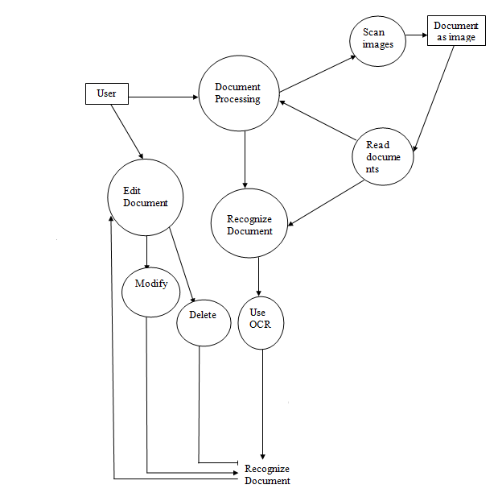
Designs:
DFD(Data Flow Diagram):

Slide 17
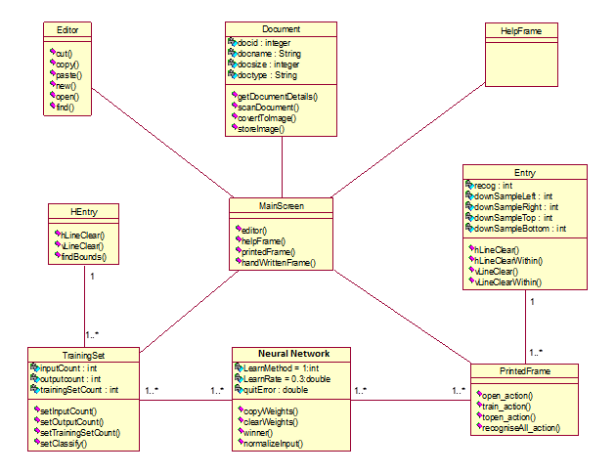
Designs:
Class Diagram:

Slide 18
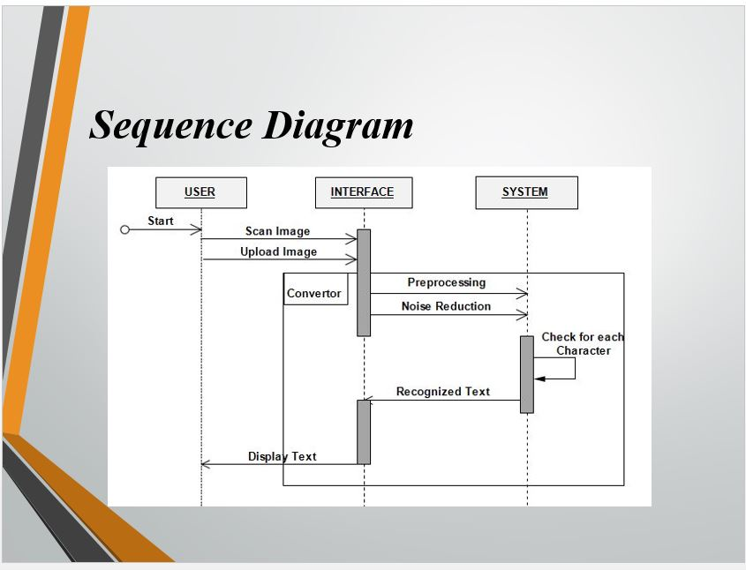
Designs:
Sequence Diagram:

Slide 19
Advantages:
Increasing the DATABASE used for training the ANN, so as to enable it to recognize stylized fonts also.
Using better algorithms for training the ANN, so as to decrease the Time complexity while handling larger databases.
OCR recognize machine-printed or hand-printed characters.
Quick retrieval for editing and reprocessing

Slide 20
Hardware Requirements Processor type : Pentium III-compatible processor or faster. Processor speed : Minimum:1.0 GHz, Recommended : 2.0 GHz or faster RAM : 512 MB or more HARD DISK : 20GB or more Monitor : VGA or higher resolution 800x600 or higher resolution Software Requirements Operating system : Windows 8 and above Front End : Asp.Net 2.0 Coding languages : Visual C sharp.Net Back end : SQL server 2013
Requirements

Slide 21
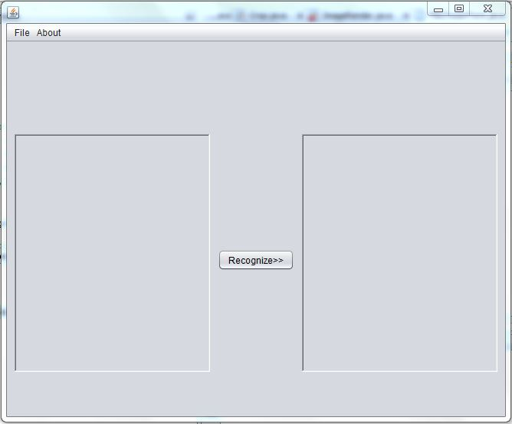
GUI Design:
frame
Window button
Icon
Close button
Menu bar
Minimize
button
image area
Text area
Submit button

Slide 22
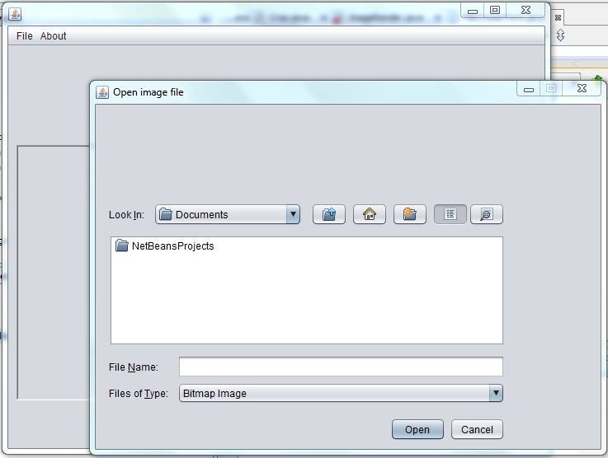
frame
Close button
Minimize
button
Selection panel
Cancel button
Open button

Slide 23
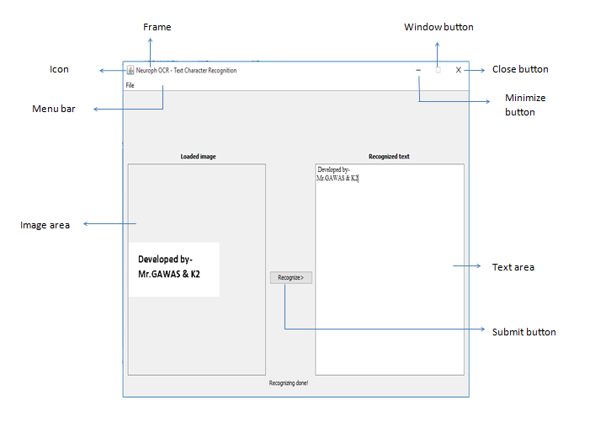

Slide 24
Conclusion:
we have proposed an artificial neural network-based simple color and size invariant character recognition system to recognize English alphanumeric characters. Our proposed system gives excellent result for numeric digits and letters when they are trained and tested separately but produce satisfactory result when they are processed together. In addition our system is computationally inexpensive and easier to implement.

Slide 25
Thank You !!!

