Slide 1
Gated Recurrent Convolution Neural Network for OCR
Uzair Sayed and Divyansh Ahuja

Slide 2
The General Idea
OCR refers to a set of computer vision problems that require us to convert images of digital or hand-written text images to machine readable text in a form your computer can process, store and edit as a text file or as a part of a data entry and manipulation software.
Unlike Recurrent Attention Models, CRNNs don't treat our OCR task as a reinforcement learning problem but as a machine learning problem with a custom loss. The loss used is called CTC loss- Connectionist Temporal Classification.
The convolutional layers are used as feature extractors that pass these features to the recurrent layers - bidirectional LSTMs .
These are followed by a transcription layer that uses a probabilistic approach to decode our LSTM outputs. Each frame generated by the LSTM is decoded into a character and these characters are fed into a final decoder/transcription layer which will output the final predicted sequence.

Slide 3
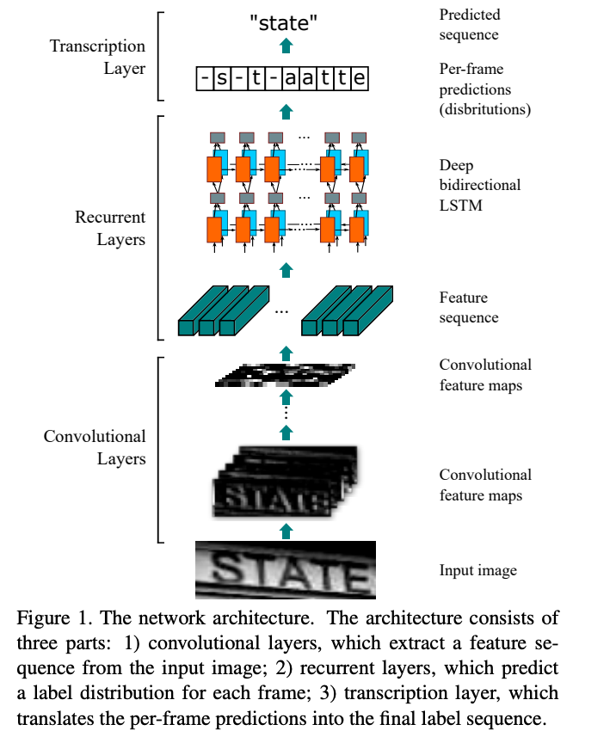

The Network Architecture for RCNN
Generic RNN Model
A CNN that contains RCL is called RCNN

Slide 4
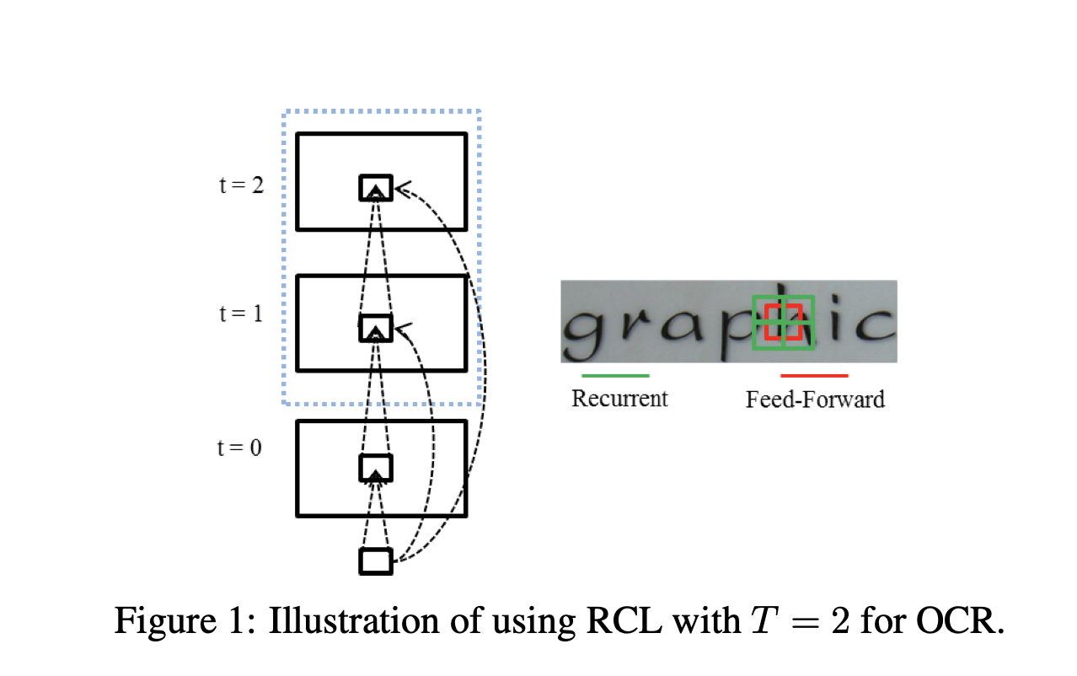

Slide 5
Gated Recurrent Convolution Layer (GRCL)
This module is equipped with a gate to control the context modulation in RCL and it can weaken or even cut off some irrelevant context information.
This is because, with increasing iterations, the size of the effective receptive field will increase unboundedly, which contradicts the biological fact. One needs a mechanism to constrain the growth of the effective receptive field.
In addition, from the viewpoint of performance enhancing, one also needs to control the context modulation of neurons in RCNN.

Slide 6
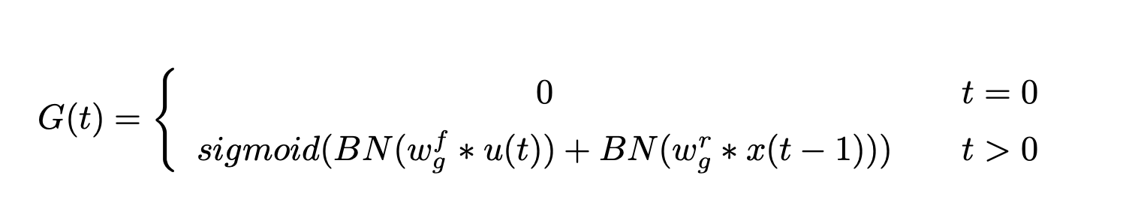
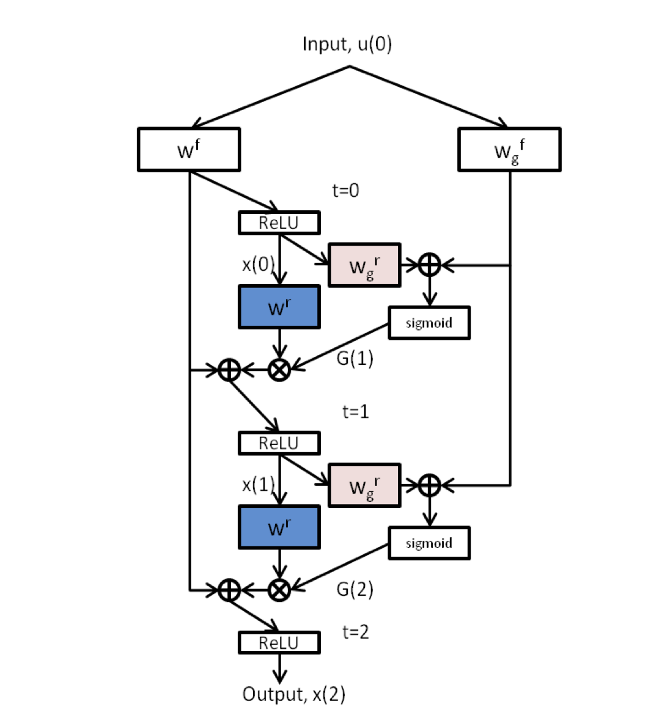
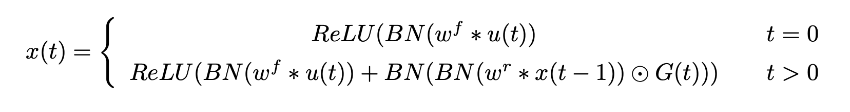
The gate of GRCL
GRCL
"⊙" denotes element-wise multiplication
Batch normalization (BN) is applied after each convolution and element-wise multiplication operation. The parameters and statistics in BN are not shared over different time steps. It is assumed that the input to GRCL is the same over time t, which is denoted by u(0).
GRCL with T=2

Slide 7
Feature Sequence Extraction
The input to the network is a whole image and the image is resized to fixed length and height.
The feature map in the last layer is sliced from left to right by column to form a feature sequence. Therefore, the i-th feature vector is formed by concatenating the i-th columns of all of the maps.
Each feature vector generated by the GRCL represents a larger region. This feature vector contains more information than the feature vector generated by the basic convolutional layer, and it is beneficial for the recognition of text.

Slide 8
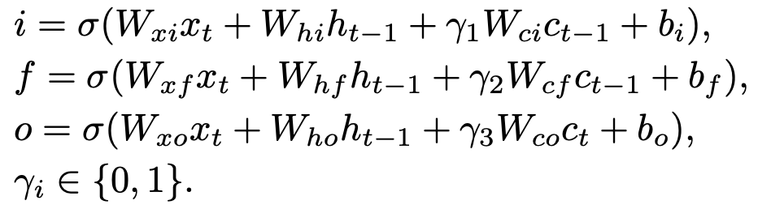
Sequence Modeling
An LSTM is used on the top of feature extraction module for sequence modeling.
γi is defined as an indication factor and its value is 0 or 1. When γi is equal to 1, the gate receives the modulation of the cell’s state.
However, LSTM only considers past events. In fact, the context information from both directions are often complementary. Therefore, we use stacked bidirectional LSTM in our architecture.

Slide 9
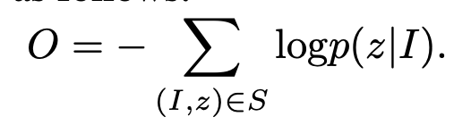
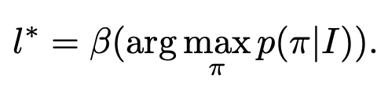
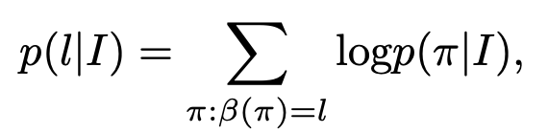
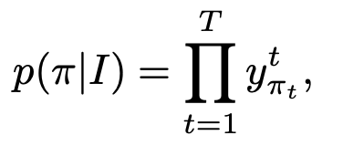
Transcription
We use a lexicon-free transcription, which converts per-frame predictions to real labels without the use of a dictionary
Given an input image I, the prediction of RNN at each time step is denoted by π_{t}. The sequence π may contain blanks and repeated labels (e.g. (a − b − −b)=(ab − −bb)) and we need a concise representation l (the two examples are both reduced to abb).

Slide 10
Results
Method | Dataset IC03
Jaderberg et al. | 89.6%
Baoguang et al. | 89.4%
Chen-Yu et al. | 88.7%
ResNet-BLSTM | 89.9%
Jianfeng Wang | 91.2%
Our Implementation | Train(95.7%) Test(88%)

