Slide 1
STL-FM: Trajectory Planning Through
STL-Guided Flow Matching
Imposing temporal requirements on a generative motion prior at inference time
Gawtam Chithra Ramesh
Master’s thesis, carried out at ABB Robotics
Examiner: Dimos V. Dimarogonas
Supervisors: Luzia Knödler, Shaohang Han, Matthew Lock and Jonathan Styrud
Notes:
A robot learns its motion from demonstrations. This thesis imposes a requirement on that learned motion afterwards, at inference, without retraining.

Slide 2
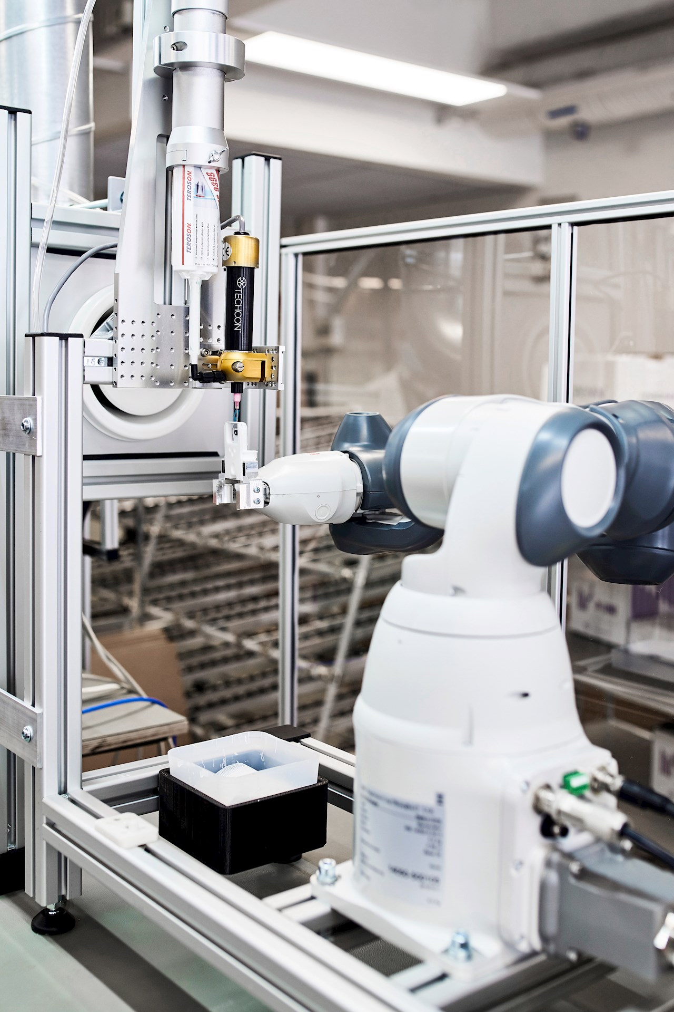
Adhesive bonding with an ABB YuMi
Motivation → Background → Method → Results → Conclusions
A single-arm YuMi applies a bead of fast-setting glue
to a prototype part.
The part changes on a rapid schedule,
so the program changes with it.
“Even in half an hour, we can get some major changes done to the code.”
Photo and quote: ABB customer story,
IRB 14050 at GE Healthcare, Helsinki
Notes:
A real cell from ABB.
At GE Healthcare in Helsinki a single-arm YuMi picks a prototype component from a jig, applies a bead of fast-setting glue that is hard to apply by hand, and returns the part.
The prototypes change on a rapid schedule.
The customer's own words: even in half an hour they can get major changes done to the code. Every change of the product or the process requires a change of the program.
[ABB customer story, IRB 14050 at GE Healthcare]

Slide 3
Current practice
Motivation → Background → Method → Results → Conclusions
Adhesive A
Adhesive B, faster curing
Bead moved
programmed once, then replayed
need to re-program
need to re-program
open time
open time
programmed bead
current bead
✓
✗
✗
run 1
seated too late
placed off the bead
✓
✓
✓
run 2, identical
timing reprogrammed
path reprogrammed
✓
run 3, identical
time
time
position
Each change in the product or the process requires a change in the code
The timing and the position are not stated explicitly, and the program encodes them only implicitly
Notes:
How such a cell works today. The motion is taught or programmed once and replayed exactly, run after run, and every run seats the part inside the adhesive's open time. [Click] A faster-curing adhesive shortens the open time. The same program now seats the part too late. [Click] An engineer changes the timing in the code. [Click] The bead is laid at a different position. The same program places the part off the bead. [Click] An engineer changes the path in the code. [Click] Each change of product or process requires a code change, because the requirements, when to seat and where, are not stated explicitly, and the program encodes them only implicitly. [§1.1; ABB customer story]

Slide 4
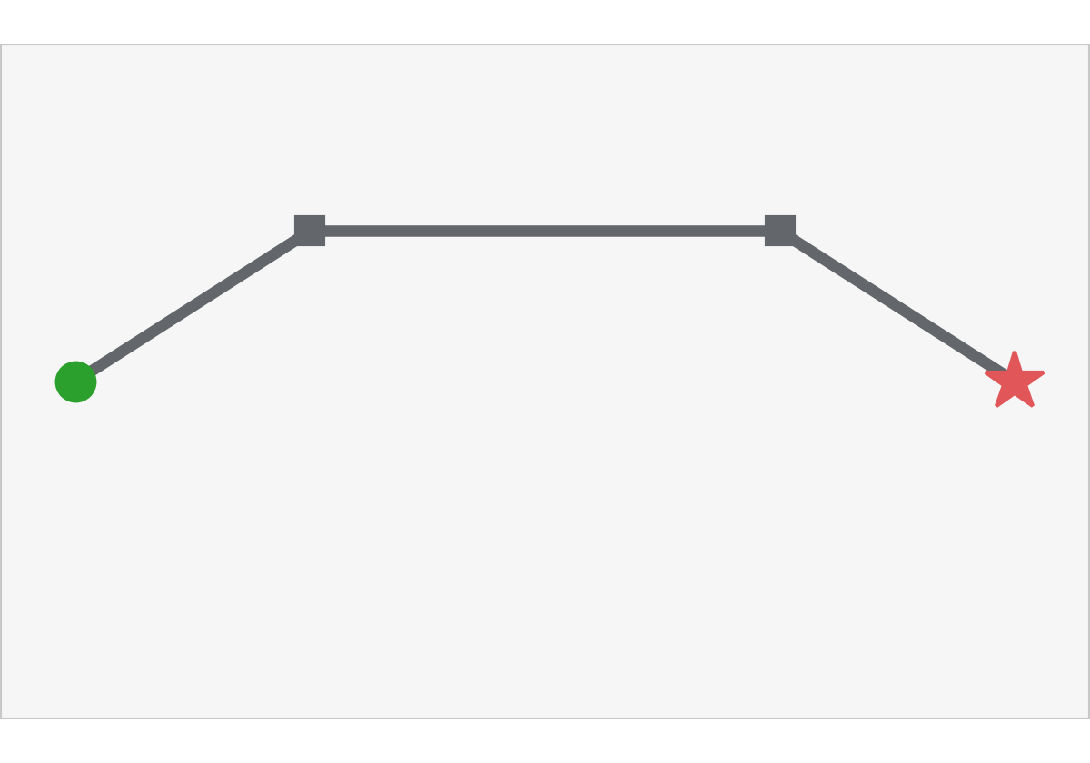
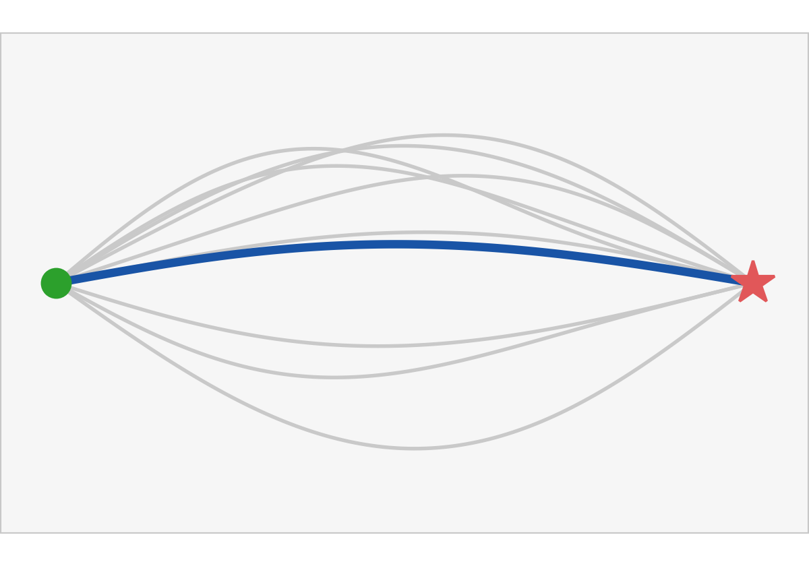
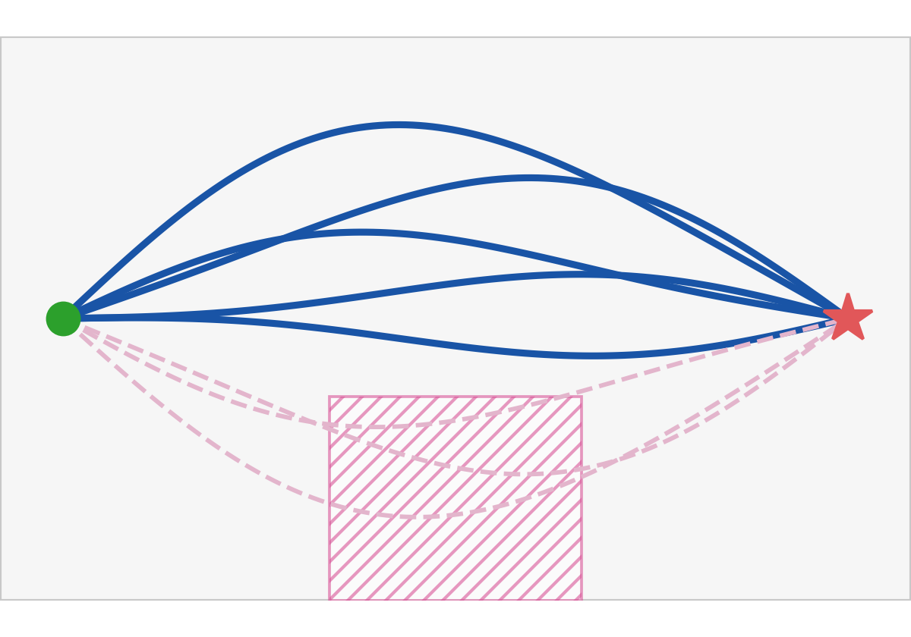
From programming to generation
Motivation → Background → Method → Results → Conclusions
Program
Imitate
Generate
zone stated after training
One motion, coded by hand
Change code for a different state
Show multiple Demonstrations
Robot predicts the most probable trajectory for a given state
Plausible samples, which a requirement stated after training accepts or rejects
State : Robot joint positions, environment (camera, sensor, etc.. )
Notes:
There are three ways to obtain the motion.
One: program it. One motion, coded by hand, and every change is a code change, as on the previous slide.
[Click] Two: record demonstrations instead, and train a network on them. Ordinary regression predicts the most likely motion for each state; it generalizes to states near the demonstrations, but it returns a single trajectory, and the same input returns the same trajectory every time. It also blends distinct demonstrated motions into an average.
[Click] Three: a generative model represents the distribution of plausible motions, and two draws give two different, plausible trajectories. The method depends on this property, because selection by a requirement stated after training is possible only where alternatives exist. Here a zone stated after training rules out three samples and leaves five. [§3.3.1; ALVINN, Ross et al.; §1.4]

Slide 5
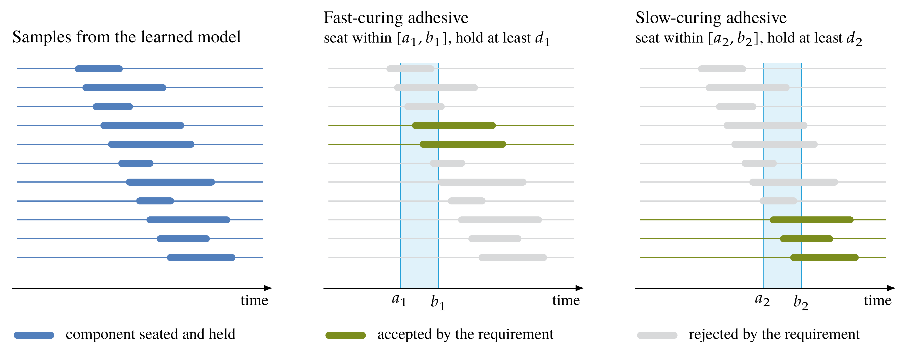
Requirements that change after training
Motivation → Background → Method → Results → Conclusions
Notes:
This slide states the timing explicitly. In a load-and-bond cell the robot seats a component on an adhesive bead. It must seat within the adhesive's open time, hold for a minimum duration, and keep clear of the operator's side. Left, samples of a model trained on demonstrations. The same samples satisfy the requirement for one adhesive and violate it for another. The window and the hold depend on the adhesive, so they can change after the demonstrations are recorded. [§1.1, eq. 1.1]

Slide 6
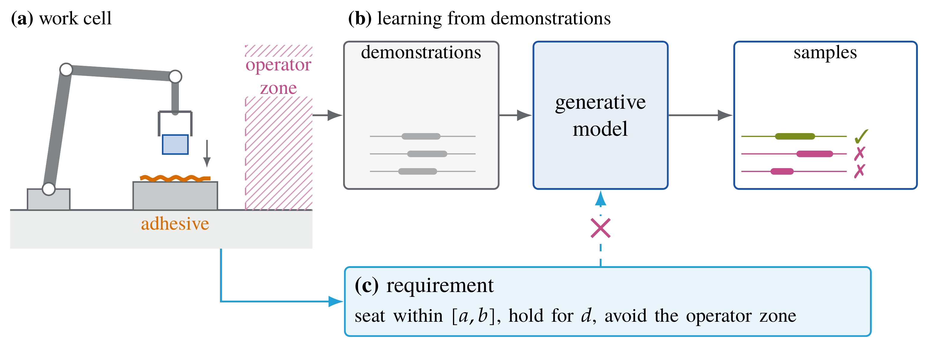
Problem
Motivation → Background → Method → Results → Conclusions
Given demonstrations recorded before training and a requirement φ stated after it, generate a trajectory that is plausible under the demonstrations and satisfies φ, without retraining.
Training-time conditioning learns the requirement from paired data and can require retraining outside its distribution
Notes:
A demonstration records the instant of seating, not the required window: it witnesses that the requirement can be satisfied without determining it. A model trained on demonstrations alone has no input for the requirement, so a sample can seat too late and still end on the housing, and a benchmark that judges the final state counts it as a success. [Click] The problem: given demonstrations recorded before training and a requirement stated after it, generate a trajectory that is plausible under the demonstrations and satisfies the requirement, without retraining. Training-time conditioning, such as TeLoGraF, learns the requirement from paired data and degrades outside its training distribution. [§1.1, §1.2, Problem 4.1]

Slide 7
Aim and research questions
Motivation → Background → Method → Results → Conclusions
Aim
A method for imposing STL requirements on a trained generative model at inference time
The trained model is called the learned prior, because it provides the motion that the requirement does not specify
RQ1
Does a demonstration determine the requirement?
RQ2
Does the robustness score alone determine a trajectory?
Method
STL-FM, robustness guidance of the learned prior
Notes:
The aim, from Section 1.3: a method for imposing STL requirements on a trained generative model at inference time. Section 1.2 identifies two open questions, which concern the requirement itself rather than the performance of a planner: whether a demonstration determines the requirement, and whether the robustness score alone determines a trajectory. The first two contributions answer them by proof (Chapter 4, Appendix A). The third contribution is the method, STL-FM, which guides the learned prior, an unconditional model trained once by flow matching, by the gradient of STL robustness at one constant strength, evaluated in Chapter 5. [§1.2, §1.3]

Slide 8
Approach
Motivation → Background → Method → Results → Conclusions
Offline, once
Per instance
Demonstrations
Flow-matching training
Learned prior
Guided sampler
Per requirement, at inference
STL requirement φ
Compiler
Robustness score ρ
Plan
Execution
Notes:
The trained model is called the learned prior, because it provides the motion the requirement does not specify. The prior is trained once, offline, on demonstrations. Each requirement is compiled into a robustness score at inference. The guided sampler combines the two into a plan, which a controller executes. The bar at the top of each slide shows the section. [§1.3, Fig. 5.1]

Slide 9
Stating the requirement as an STL
Motivation → Background → Method → Results → Conclusions
Offline, once
Per instance
Demonstrations
Flow-matching training
Learned prior
Guided sampler
Per requirement, at inference
STL requirement φ
Compiler
Robustness score ρ
Plan
Execution
Notes:
First, how the requirement is written and how it is scored.

Slide 10
Signal Temporal Logic
Motivation → Background → Method → Results → Conclusions
Seat within [a, b], hold for d, avoid the operator zone
The requirement bounds when the part is seated and where the robot may not go
Maler and Nickovic 2004
Notes:
Signal Temporal Logic expresses time bounds over real-valued signals, such as a robot trajectory. [Click] Eventually, the diamond, means at some instant of its window. Always, the box, means at every instant. The requirement says: at some instant in [a, b] the part becomes seated and stays seated for d, and at every instant the robot stays out of the operator zone. [Click] The requirement bounds only the timing of the seating and the region to avoid. The grasp, the approach and the rest of the motion are hard to write as a formula and are learned from the demonstrations. [§1.1, eq. 1.1; §3.2]

Slide 11
Evaluated fragment
Motivation → Background → Method → Results → Conclusions
Construct
Reads as
In the load-and-bond requirement
μ
a predicate, h(x) ≥ 0
seated, the part within tolerance of the seat
¬μ
μ does not hold
¬operator, outside the operator zone
φ₁ ∧ φ₂
both hold
seated on time and outside the zone
◇_{[a,b]} φ
φ at some instant of [a, b]
the part is seated within the open time
◻_{[a,b]} φ
φ at every instant of [a, b]
held for d, outside the zone throughout
Disjunction and until are part of STL and are compiled, but no study in this thesis evaluates them
Notes:
The fragment of Remark rem:fragment. A predicate is a margin function of the state that is non-negative when the predicate holds, for example the part within a tolerance of the seat. Negation, conjunction and the two bounded temporal operators build every requirement evaluated in the thesis. Disjunction and until are compiled but not evaluated. [§3.2; Remark rem:fragment; §1.4]

Slide 12
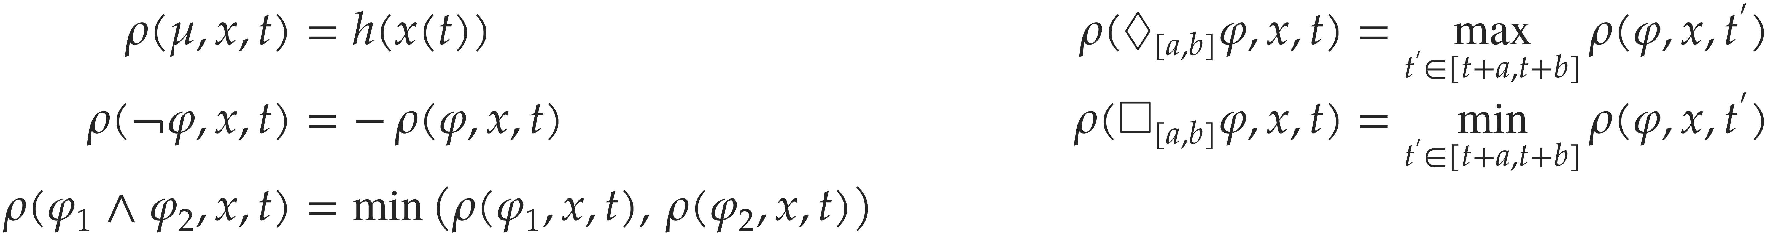
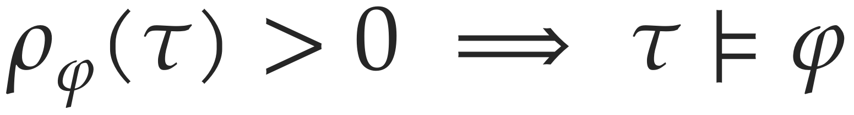
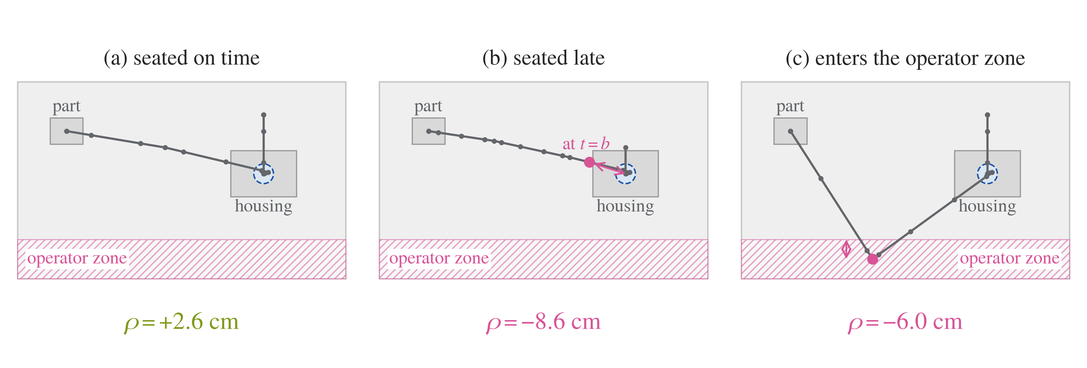
Quantitative robustness
Motivation → Background → Method → Results → Conclusions
Donzé and Maler 2010. Values in the figure are illustrative.
Notes:
Robustness replaces the Boolean verdict with a real number, defined by recursion over the formula. A predicate gives its margin h, negation changes the sign, conjunction and always take a minimum, eventually a maximum over its window. Soundness: a positive score certifies satisfaction. Below, three executions in the cell. (a) The part is seated inside the window and held, so the margin is positive. (b) At the end of the window the part is still 8.6 cm from the seat. (c) The robot crosses 6 cm into the operator zone. The margin is a distance, in the units of the predicate, not a time. [§3.2, def:robustness, eq:robustness-sound]

Slide 13
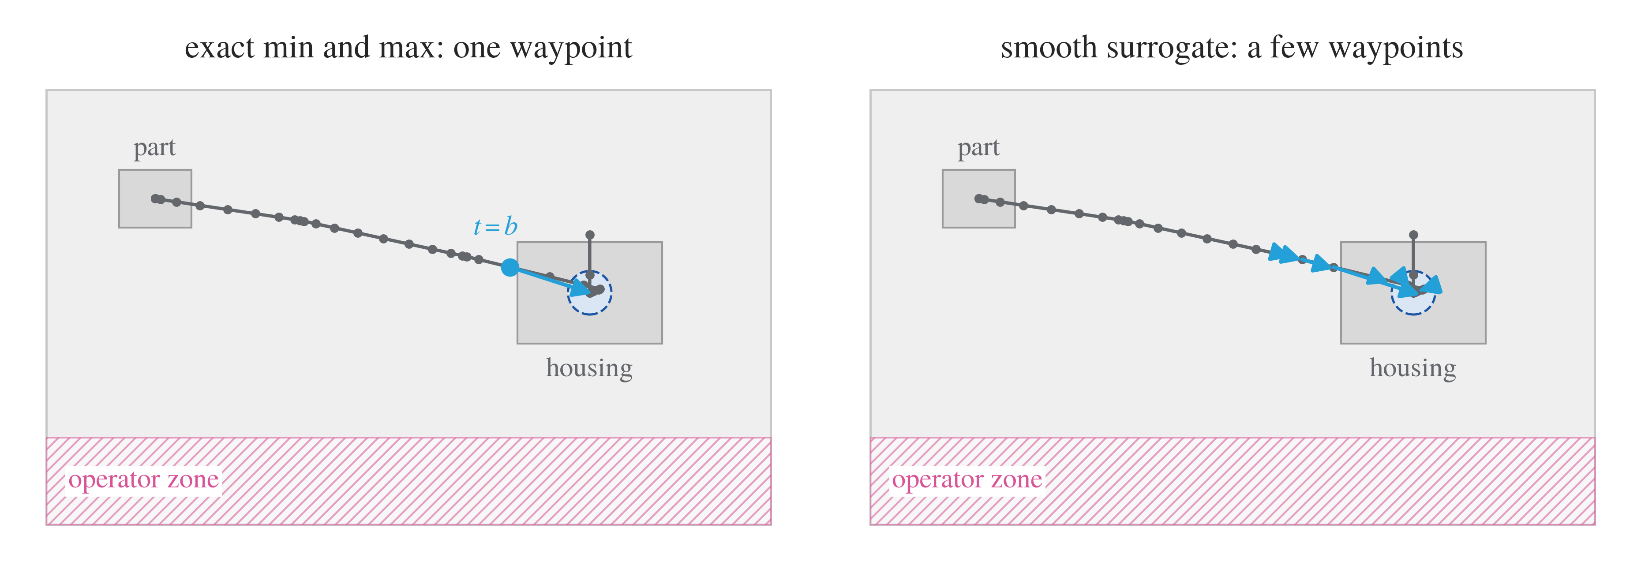
Smooth robustness
Motivation → Background → Method → Results → Conclusions
Guidance uses the surrogate at κ = 10. Satisfaction is always scored with the exact semantics.
Leung et al. 2021; Kapoor et al. 2025 (STLCG++)
Notes:
The exact min and max have a gradient on a single argument. With the exact semantics the gradient acts on a single waypoint, here the state at the end of the open time. Log-sum-exp replaces max and min, and at sharpness kappa = 10 in the experiments it spreads the gradient over a few neighbouring waypoints. The formula is compiled by recursion over its syntax tree into this differentiable score, with no learned component, so a new requirement requires only a new syntax tree. The smoothed score is sound only up to a margin, so satisfaction is always scored exactly. Implementation: stljax, the JAX library of STLCG++. [§3.2.3, eq:logsumexp; §4.2, alg:build-rho, prop:smoothing-bias]

Slide 14
Learning the prior
Motivation → Background → Method → Results → Conclusions
Offline, once
Per instance
Demonstrations
Flow-matching training
Learned prior
Guided sampler
Per requirement, at inference
STL requirement φ
Compiler
Robustness score ρ
Plan
Execution
Notes:
Second, the learned prior that generates the motion.

Slide 15
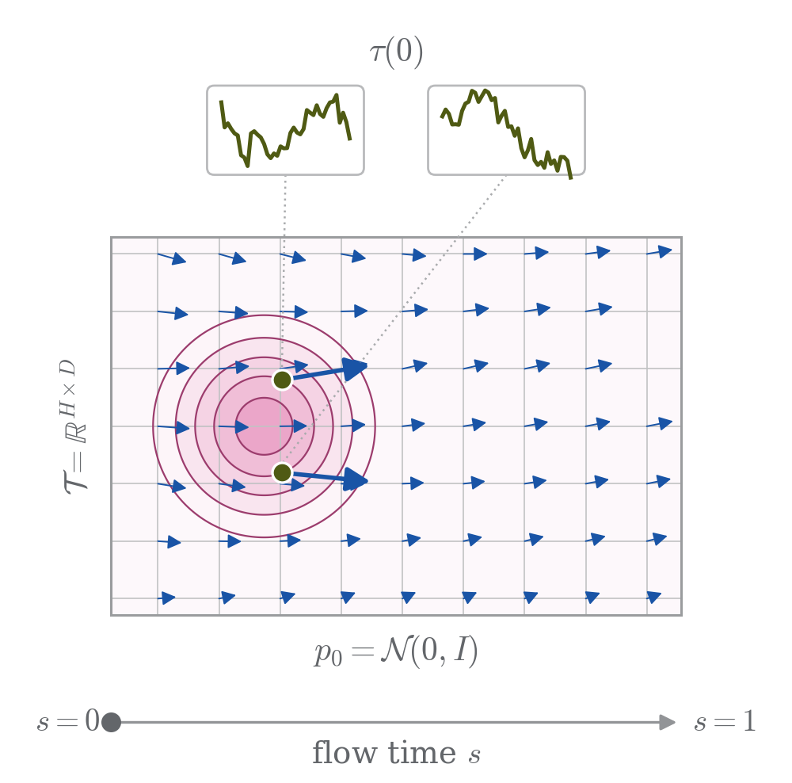
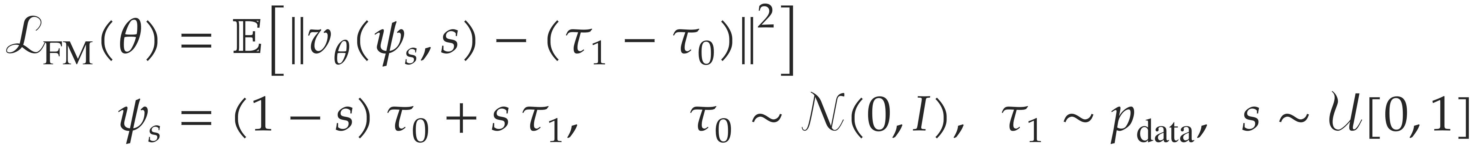
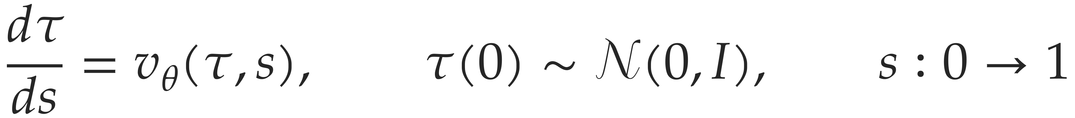
Flow matching
Motivation → Background → Method → Results → Conclusions
Training
Sampling
K = 64 Euler steps. The prior is unconditional, trained once on
demonstrations, and its only conditioning is the start state.
Lipman et al. 2023; Liu et al. 2022
Notes:
[Click to play] A point of this space is a whole trajectory. Flow matching trains a velocity field v_theta by regression onto the straight-line target tau_1 minus tau_0, from noise to data. Sampling integrates the field from s = 0 to s = 1, here in K = 64 Euler steps. The density deforms from one Gaussian into two modes, two plausible behaviours, here passing a fixture on either side. The prior is unconditional, trained once on demonstrations, and its only conditioning is the start state. [§3.3, def:fm, eq:fm-loss, eq:fm-ode-bg, Fig. 3.1; §5.1.1]

Slide 16
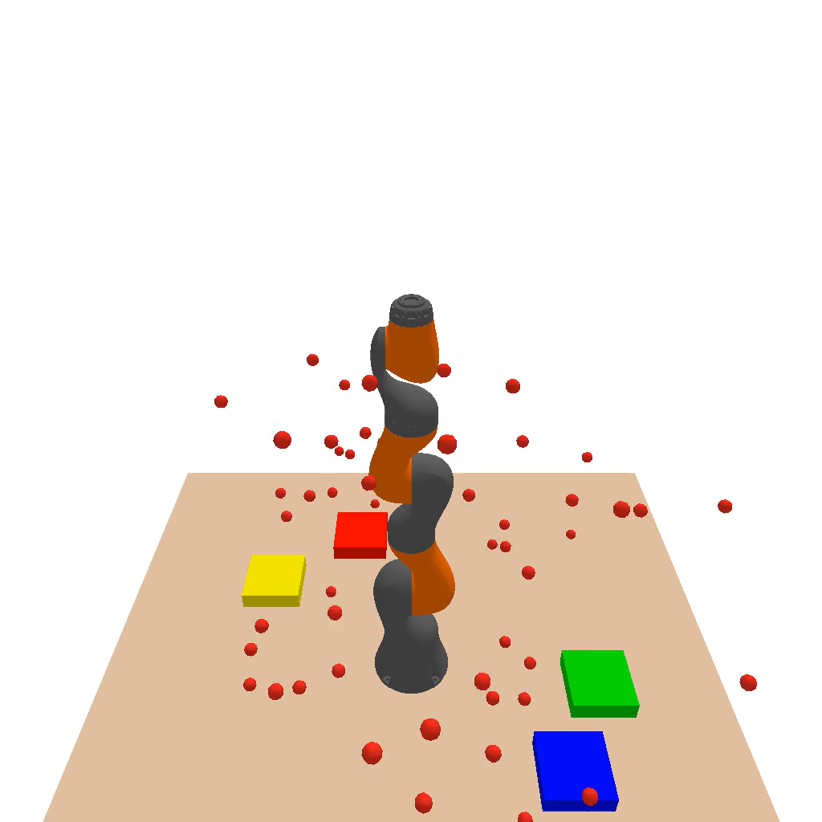
How it looks in 3D
Motivation → Background → Method → Results → Conclusions
micheal janner et. Al ??? Or something
Notes:
[Click to play] Generation from noise, applied to a robot trajectory. This clip shows a diffusion model. Flow matching produces the same kind of result along straight-line paths. The prior used here is unconditional, trained once on demonstrations, and its only conditioning is the start state. [§3.3; §5.1.1]

Slide 17
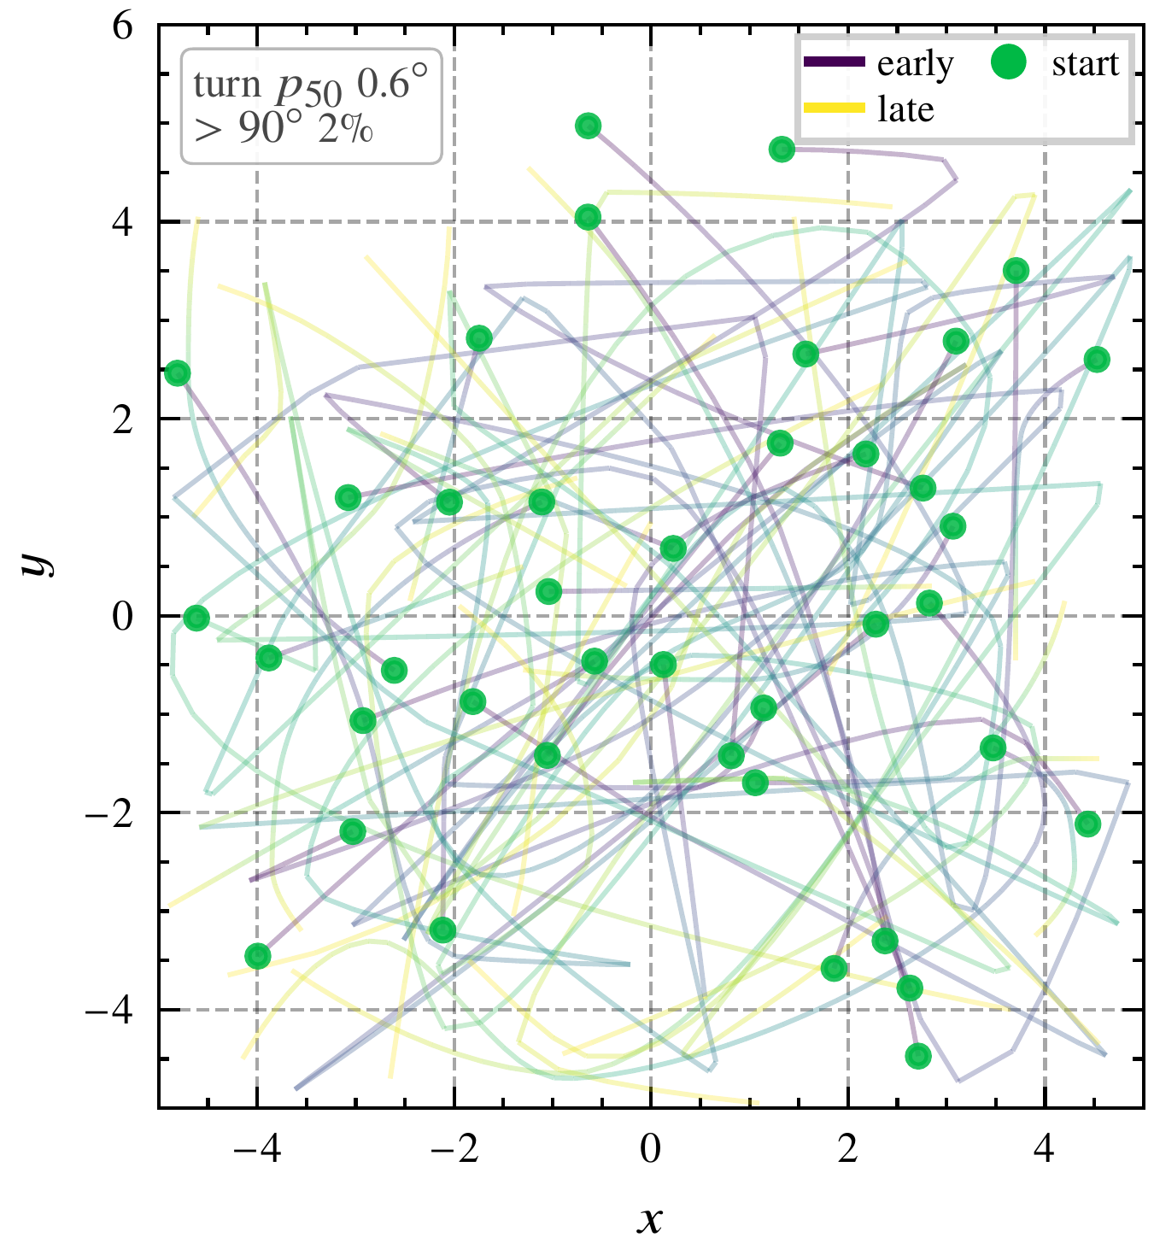
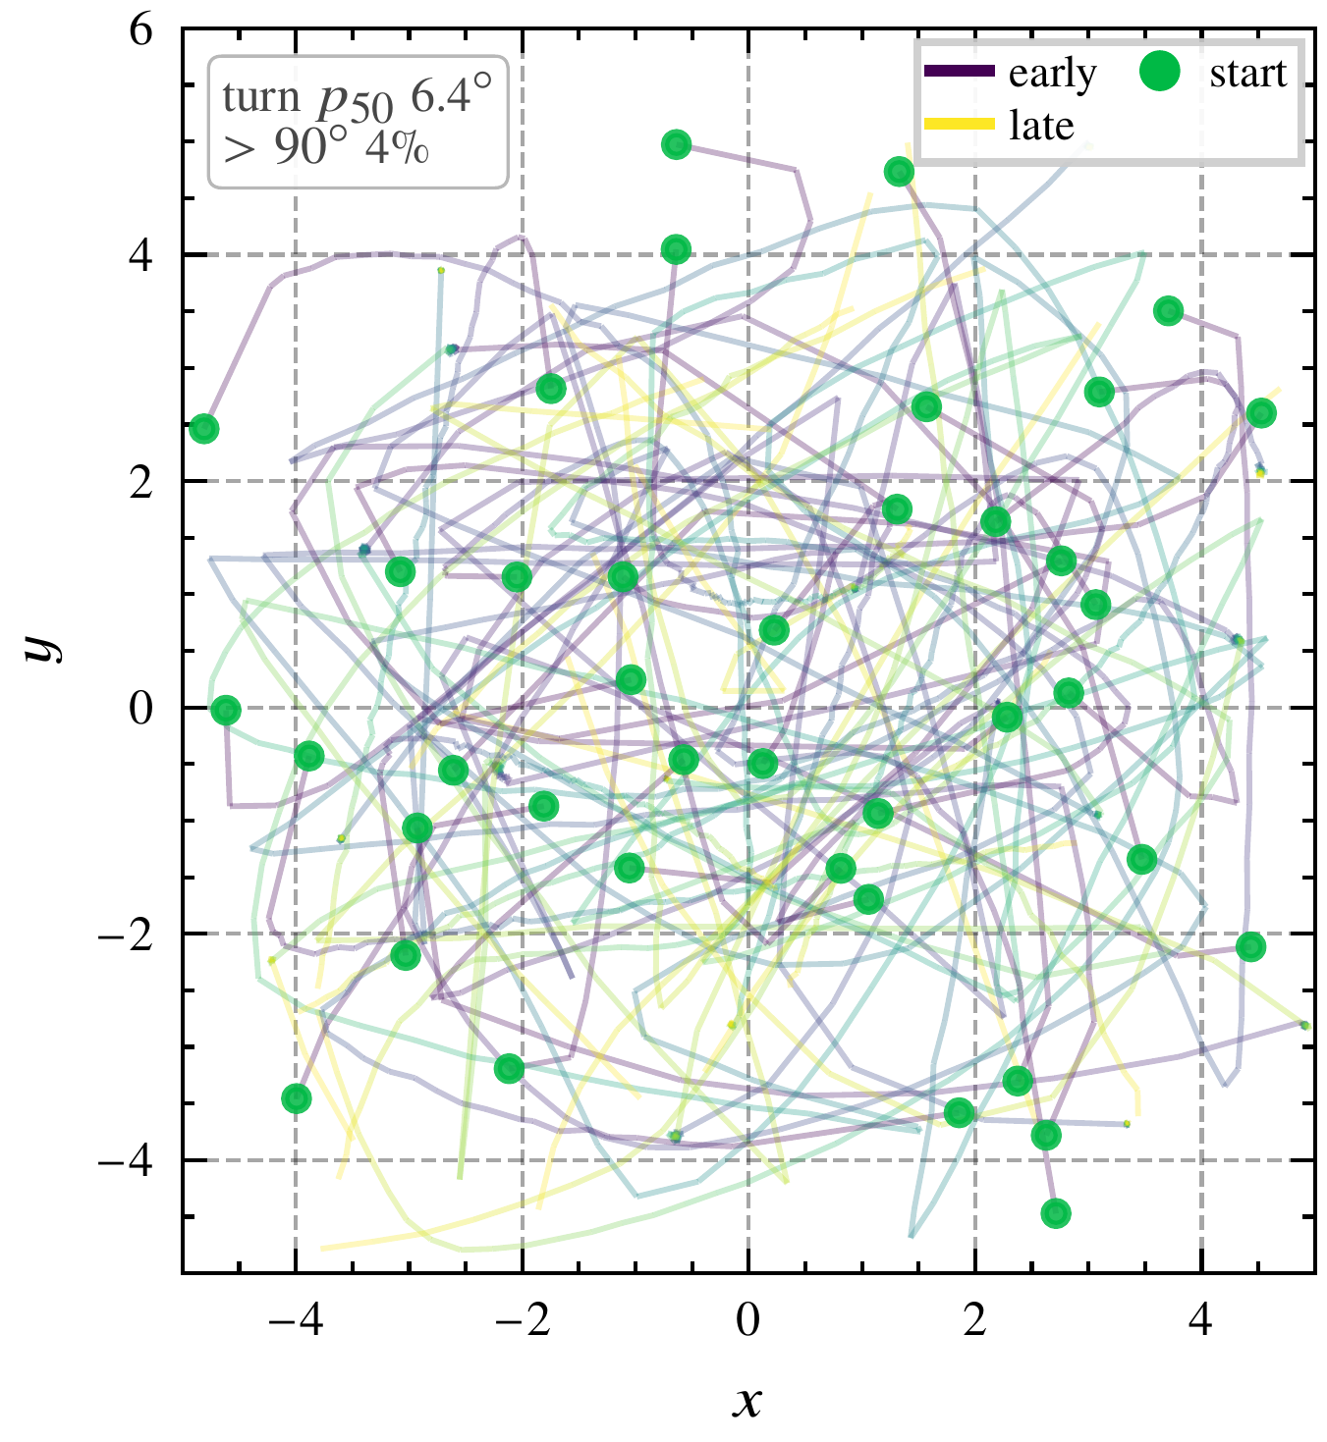
Learned prior
Motivation → Background → Method → Results → Conclusions
Demonstrations
Samples of the unguided prior
Notes:
Forty demonstrations and forty prior samples from the same start states, with no requirement imposed. The prior reproduces the extent of the demonstrated motion and the spread of the endpoints, and it has no input for any requirement. If asked: the prior samples are rougher than the demonstrations, a median turn angle of 6.4 against 0.6 degrees. [§5.2, fig:nav-data-prior]

Slide 18
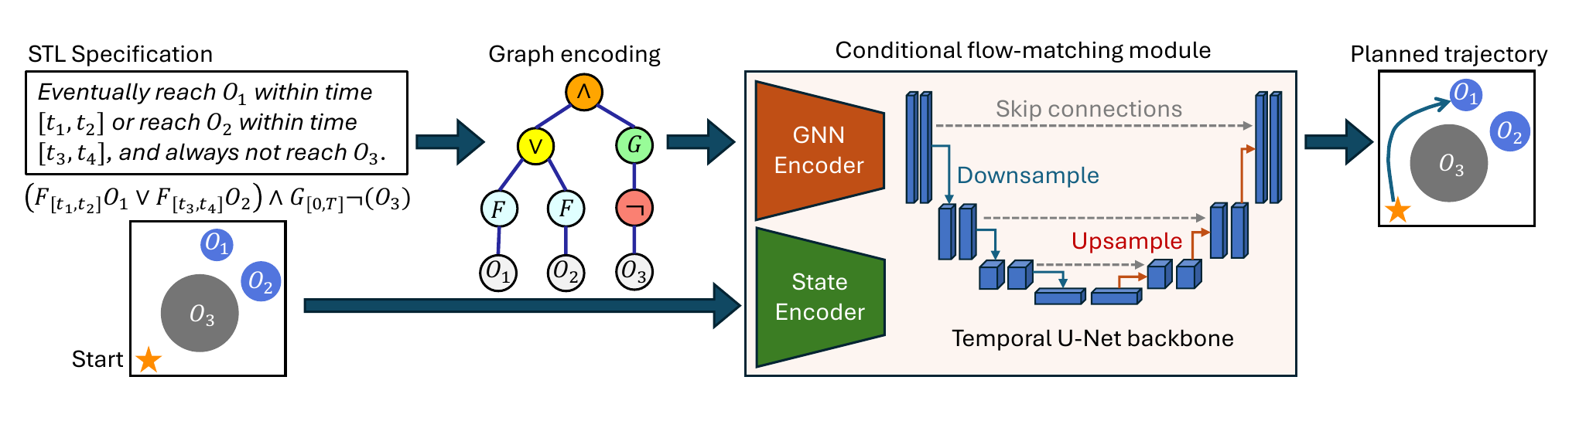
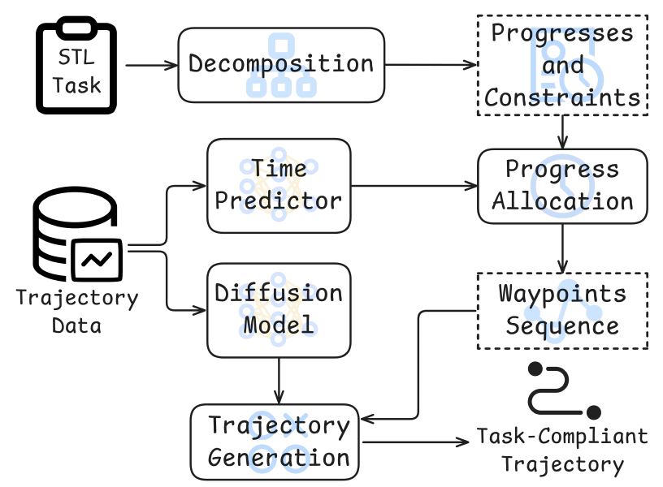
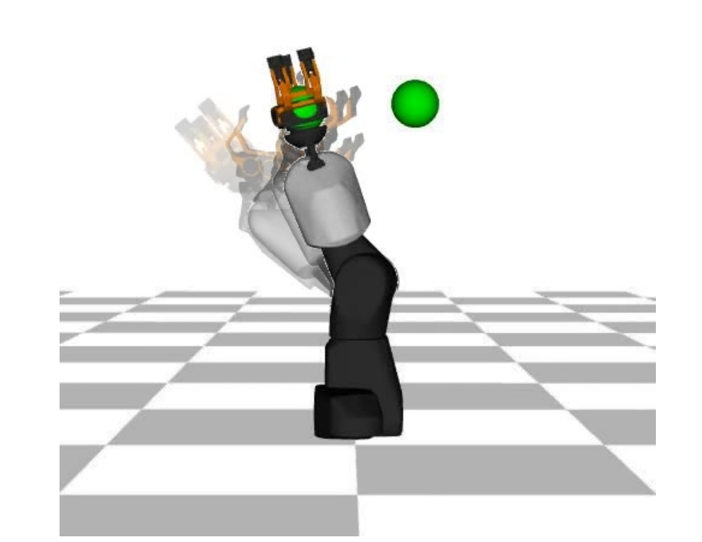
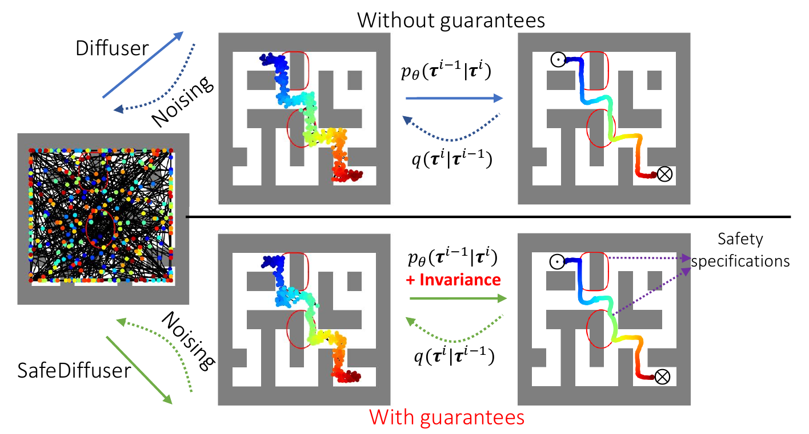
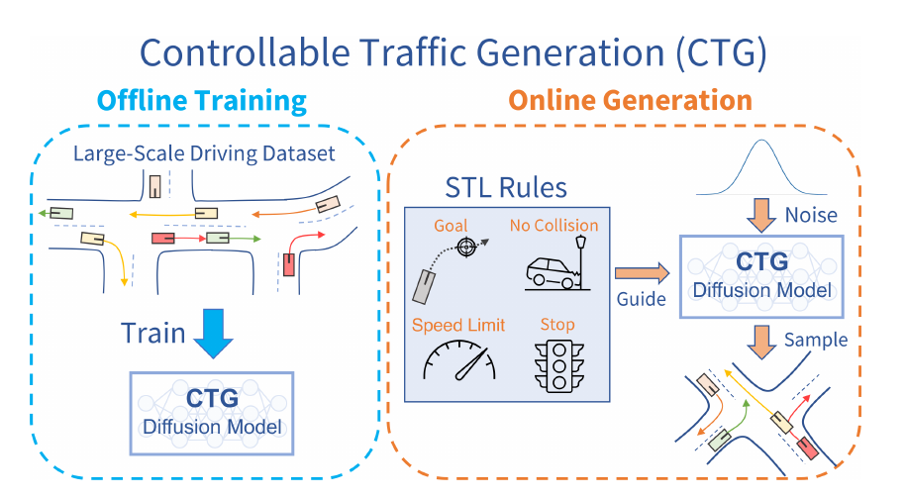
Related work
Motivation → Background → Method → Results → Conclusions
Training-time conditioning
Decompose-and-stitch
Trajectory optimization
TeLoGraF, Meng and Fan 2025
ZSTP, Liu et al. 2025
Kurtz and Lin 2021
Safe-set enforcement
Inference-time robustness guidance
SafeDiffuser, Xiao et al. 2023
CTG, Zhong et al. 2022
STL-FM
on a flow-matching prior
Overview figures reproduced from the cited papers
Notes:
Previous work differs in where the requirement enters. Training-time conditioning, such as TeLoGraF, learns the requirement from paired data and degrades outside the conditioning distribution. Decompose-and-stitch, such as ZSTP, splits the formula into timed waypoints before generation and fixes each operator's timing in advance. Trajectory optimization uses robustness with a known dynamics model, specified by hand. Safe-set enforcement, such as SafeDiffuser, keeps samples in a time-invariant safe set, which expresses no dwell or order. STL-FM belongs to inference-time robustness guidance, with CTG. Unlike CTG, it guides a flow-matching prior, whose velocity is bounded, so one constant strength is well posed where diffusion needs a schedule. It also evaluates long-horizon dwell, sequence and avoidance, including nested operators. [Ch. 2, §2.7]

Slide 19
Comparison of approaches
Motivation → Background → Method → Results → Conclusions
Approach
Requirement enters
Rest of the motion from
Property
Trajectory optimization
Kurtz and Lin 2021
cost or constraint, with a known dynamics model
dynamics model, costs and feasibility constraints
specified by hand
Control barrier functions
Lindemann and Dimarogonas 2019
time-varying barrier functions, quadratic program
dynamics model and control cost
boundedness conjoined to the requirement
Training-time conditioning
TeLoGraF, Meng and Fan 2025
training, from requirement–demonstration pairs
conditioned flow-matching model
degrades outside the conditioning distribution
Decompose-and-stitch
ZSTP, Liu et al. 2025
timed waypoints, before generation
pretrained diffusion model, between waypoints
timing of each operator fixed in advance
Safe-set enforcement
SafeDiffuser, Xiao et al. 2023
barrier invariance in each denoising step
diffusion model
time-invariant safe set, no temporal operators
Inference-time robustness guidance
CTG, Zhong et al. 2022
robustness gradient, during sampling
diffusion model
strength coupled to the noise level, no certificate
STL-FM
this thesis
robustness gradient at the predicted endpoint, during sampling
learned prior, trained by flow matching
one constant strength, no retraining, no certificate
Entries summarize Chapter 2 of the thesis
Notes:
The table compares each approach by where the requirement enters and by what determines the rest of the motion. Trajectory optimization and control synthesis with barrier functions represent the requirement explicitly, as STL-FM does, and the dynamics model and costs determine what the score leaves free; the barrier-function formulation of Lindemann and Dimarogonas also conjoins a boundedness clause to the requirement, and later work extends it to disjunctions and nested operators. Training-time conditioning learns the requirement from requirement-demonstration pairs. Decompose-and-stitch fixes the timing of each operator before generation. Safe-set enforcement gives an invariance certificate, but for a time-invariant safe set. CTG shares the guidance mechanism, on a diffusion model. STL-FM takes the rest of the motion from a learned prior, at one constant strength, and gives no certificate; a barrier-based tracker could execute an STL-FM plan, which is future work. [Ch. 2: rw-modelbased, rw-guidance, rw-decompose, rw-conditioning, rw-constraints, positioning]

Slide 20
Guiding the prior
Motivation → Background → Method → Results → Conclusions
Offline, once
Per instance
Demonstrations
Flow-matching training
Learned prior
Guided sampler
Per requirement, at inference
STL requirement φ
Compiler
Robustness score ρ
Plan
Execution
Notes:
Third, the guided sampler that combines the learned prior with the robustness score.

Slide 21
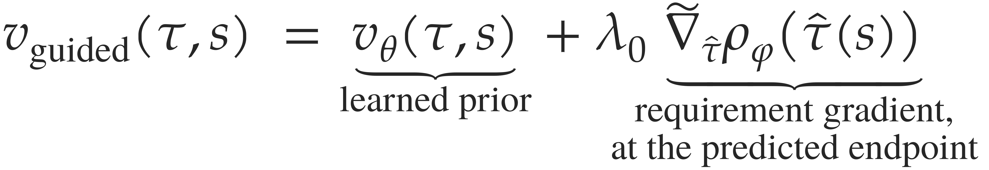
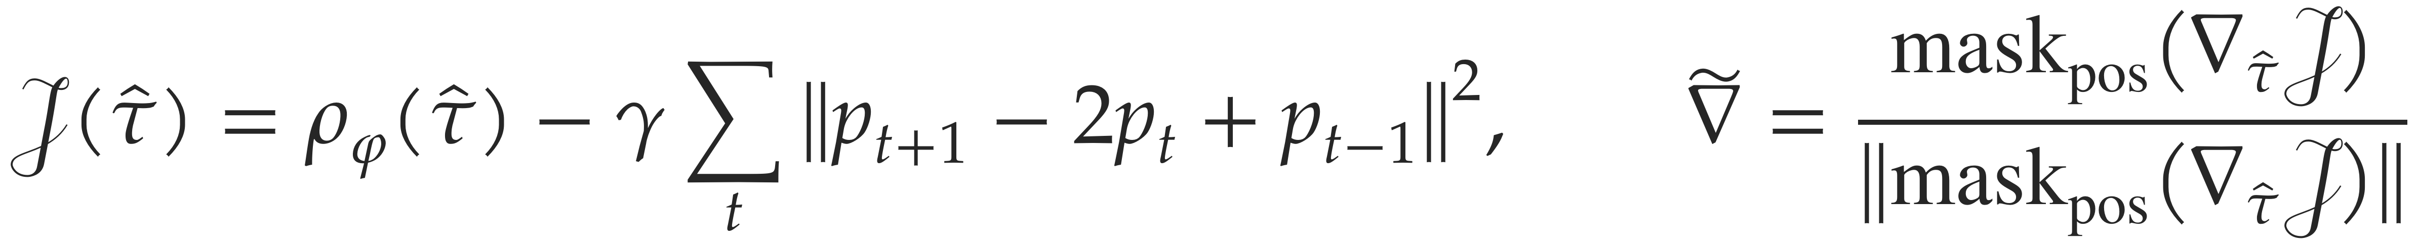
Guided velocity field
Motivation → Background → Method → Results → Conclusions
with the penalized objective and the conditioned gradient
λ₀ ≥ 0 is one constant strength for the whole flow.
No component of the sampling loop is trained, and the requirement is not an input to the network.
Notes:
The sampler integrates the guided velocity from the same Gaussian start as the prior. The prior velocity moves the iterate toward trajectories likely under the learned prior. The requirement term moves it toward satisfaction. The gradient is taken of a penalized objective, the robustness minus a small finite-difference smoothness penalty, masked to the position coordinates, and normalized to unit length, so lambda_0 is a step size that transfers across requirements. This is a soft realization of the constrained problem, not a solution with a certificate. [§4.3, eq:guided-velocity; §4.5, eq:smoothness-penalty, eq:grad-normalize]

Slide 22
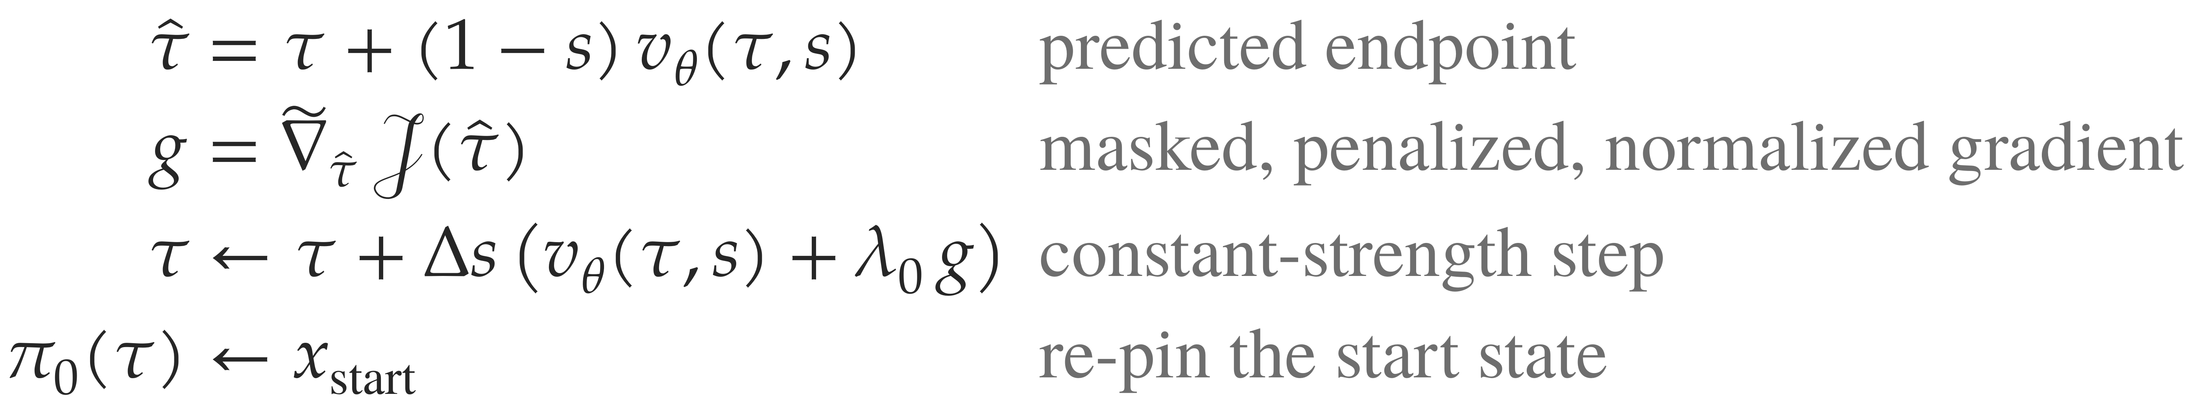
Guided sampler
Motivation → Background → Method → Results → Conclusions
For k = 0, …, K − 1 with s = kΔs, Δs = 1/K and K = 64, from τ ~ N(0, I) with the start state pinned
The gradient is taken with respect to the predicted endpoint, not through the network.
Early in the flow the iterate τ(s) is mostly noise, whereas τ̂(s) is the prior’s estimate of the finished trajectory.
Algorithm 2 of the thesis, lines 4 to 13
Notes:
One step of the sampler. Early in the flow the iterate is mostly noise, and the gradient of its robustness points in a direction unrelated to any plausible trajectory. The predicted endpoint is the prior's running estimate of the finished trajectory, obtained from the straight-line path. The requirement is scored on that estimate, and the gradient is taken with respect to it, not through the network. Then mask and normalize, take a constant-strength Euler step, and re-pin the start state. [§4.4, eq:predicted-endpoint; §4.7, alg:guided-ode]

Slide 23
Evaluating the plans
Motivation → Background → Method → Results → Conclusions
Offline, once
Per instance
Demonstrations
Flow-matching training
Learned prior
Guided sampler
Per requirement, at inference
STL requirement φ
Compiler
Robustness score ρ
Plan
Execution
Notes:
Finally, the evaluation: what the plans satisfy, and what their executions achieve.

Slide 24
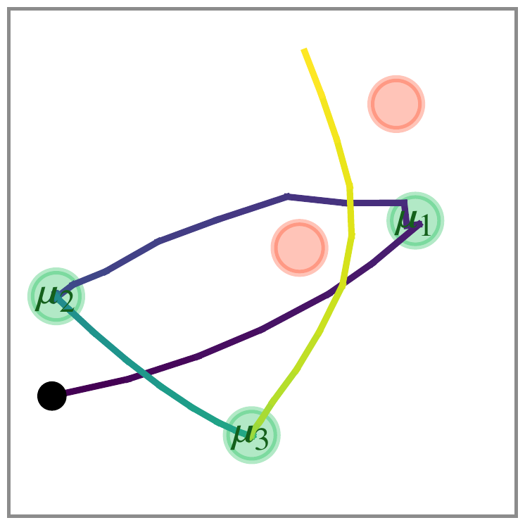
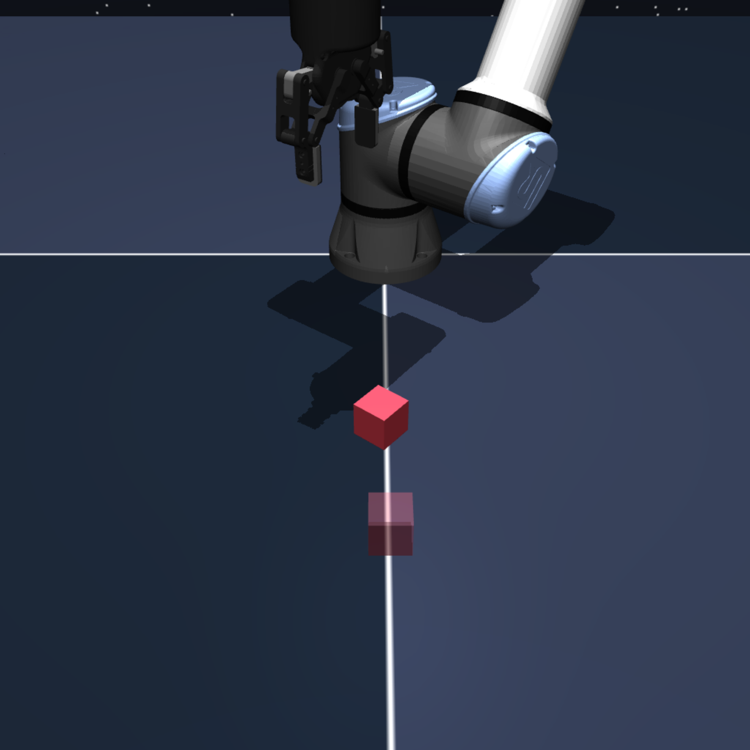
Experimental setup
Motivation → Background → Method → Results → Conclusions
Planner
Learned prior
Requirement
Endpoint pin
Endpoint-inpaint planner
✓
✓
STL-FM
✓
✓
Requirement-only optimizer
✓
Planar navigation
Cube manipulation
100 runs per class, plans only
10 runs per class, executed
STL-FM with endpoint pin differs from STL-FM in satisfaction rate by at most 0.05 on any class (backup)
Notes:
Two settings. Planar navigation: 100 runs per class on one fixed instance per class, plans only. Cube manipulation in OGBench: 10 runs per class on three classes, each plan executed in the simulator. Each baseline differs from STL-FM in one component. The endpoint-inpaint planner replaces the requirement by a pinned endpoint instead of the robustness gradient. The requirement-only optimizer keeps the requirement and removes the prior; it descends the violation penalty with a smoothness penalty and a velocity limit. A fourth planner, STL-FM with endpoint pin, differs from STL-FM in satisfaction rate by at most 0.05 on any class. [§5.1.2-5.1.3, tab:families, tab:planners]

Slide 25
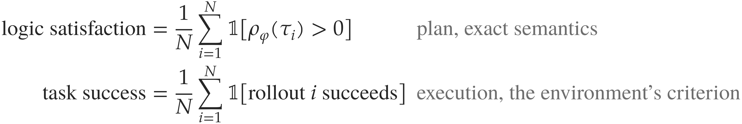
Evaluation metrics
Motivation → Background → Method → Results → Conclusions
A run is one planner producing one plan for one requirement instance.
The instance is fixed within a class, so a rate measures reliability on that instance
under the planner’s own randomness, not generalization across scenes.
In the cube study a proportional controller tracks the plan and a gripper state machine follows the plan.
Notes:
Logic satisfaction is the fraction of plans with positive robustness under the exact semantics, which certifies that the plan satisfies the requirement by soundness. Task success is decided by the environment on the executed trajectory: a proportional controller tracks the planned effector, and a gripper state machine follows the plan. The two do not coincide, so they are reported separately. The requirement instance is fixed within a class, so a rate measures reliability on that instance under the planner's own randomness, not generalization across scenes. [§5.1.4, rem:fixed-instance]

Slide 26
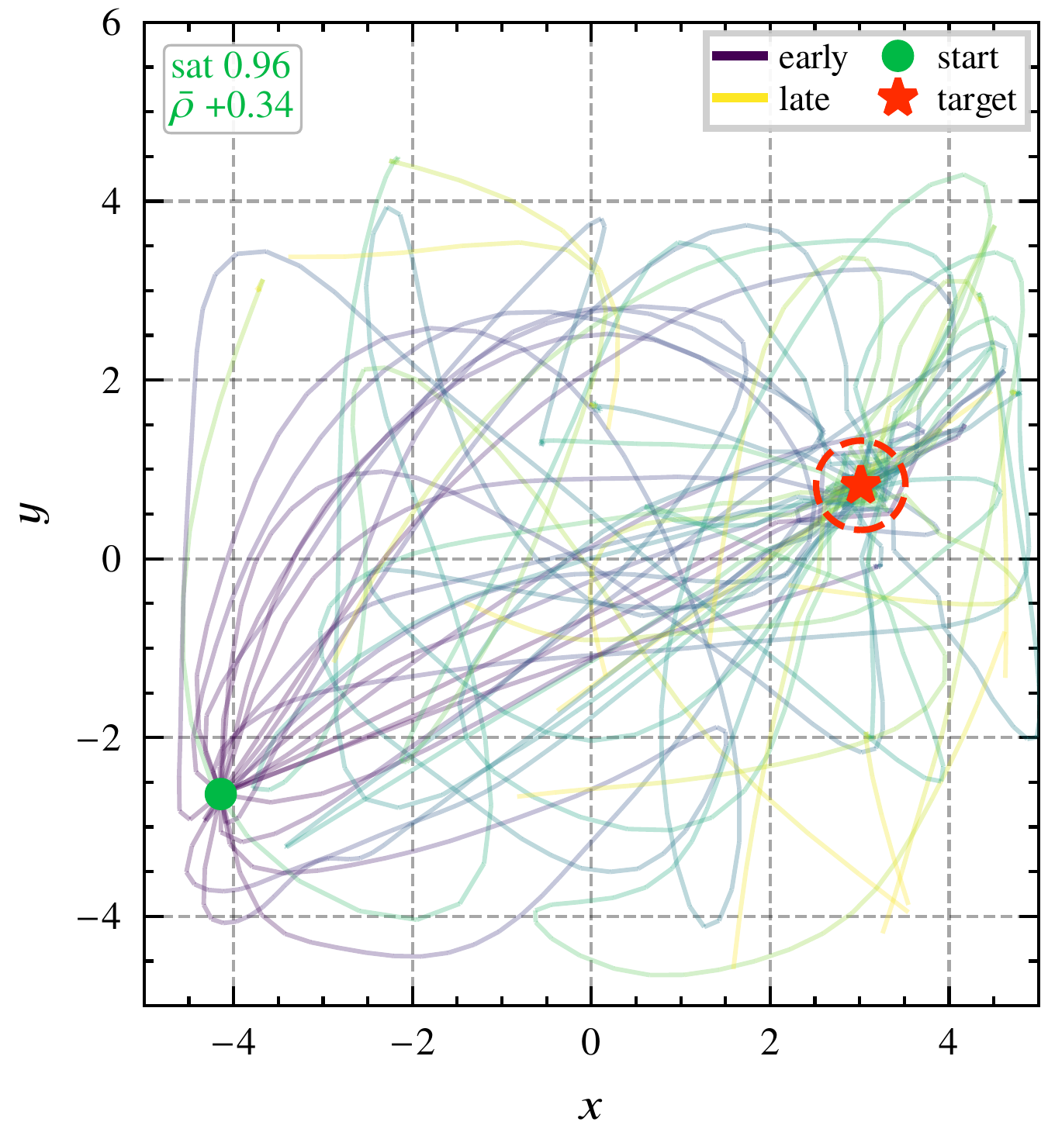
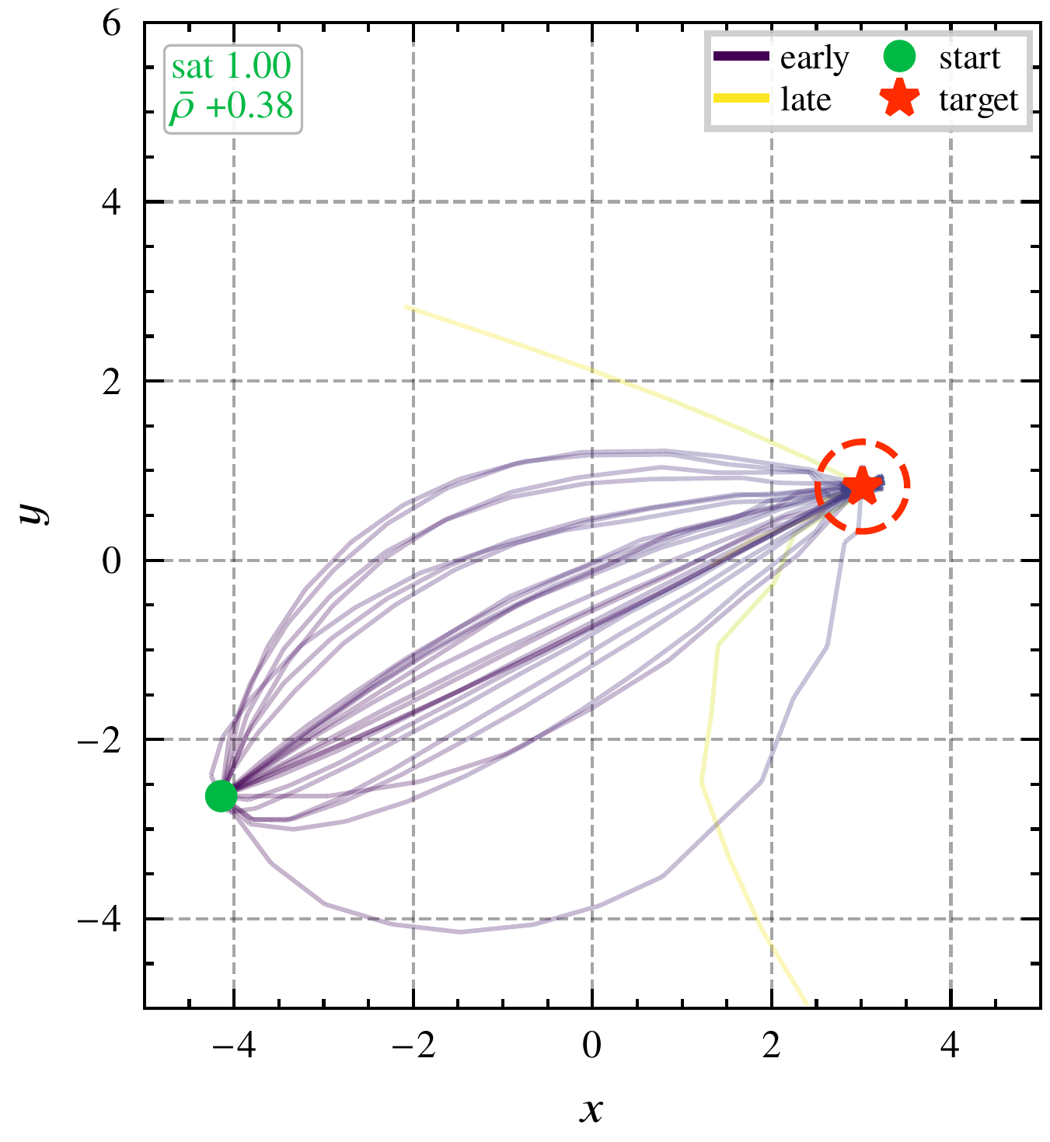
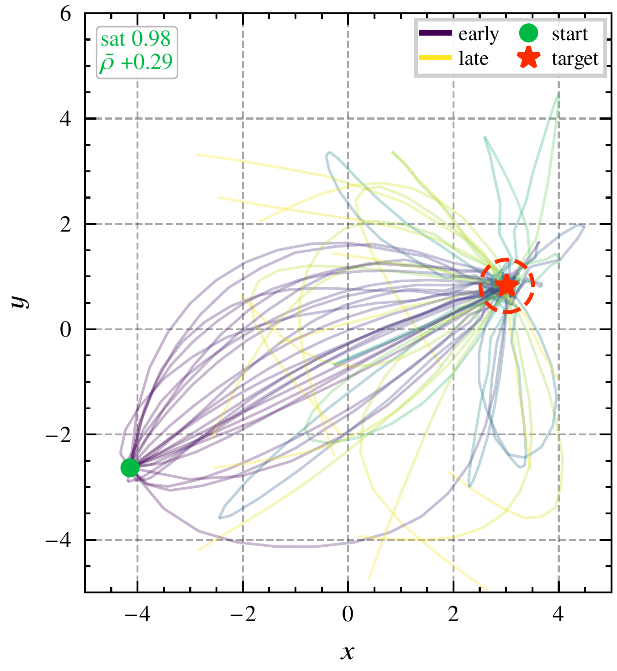
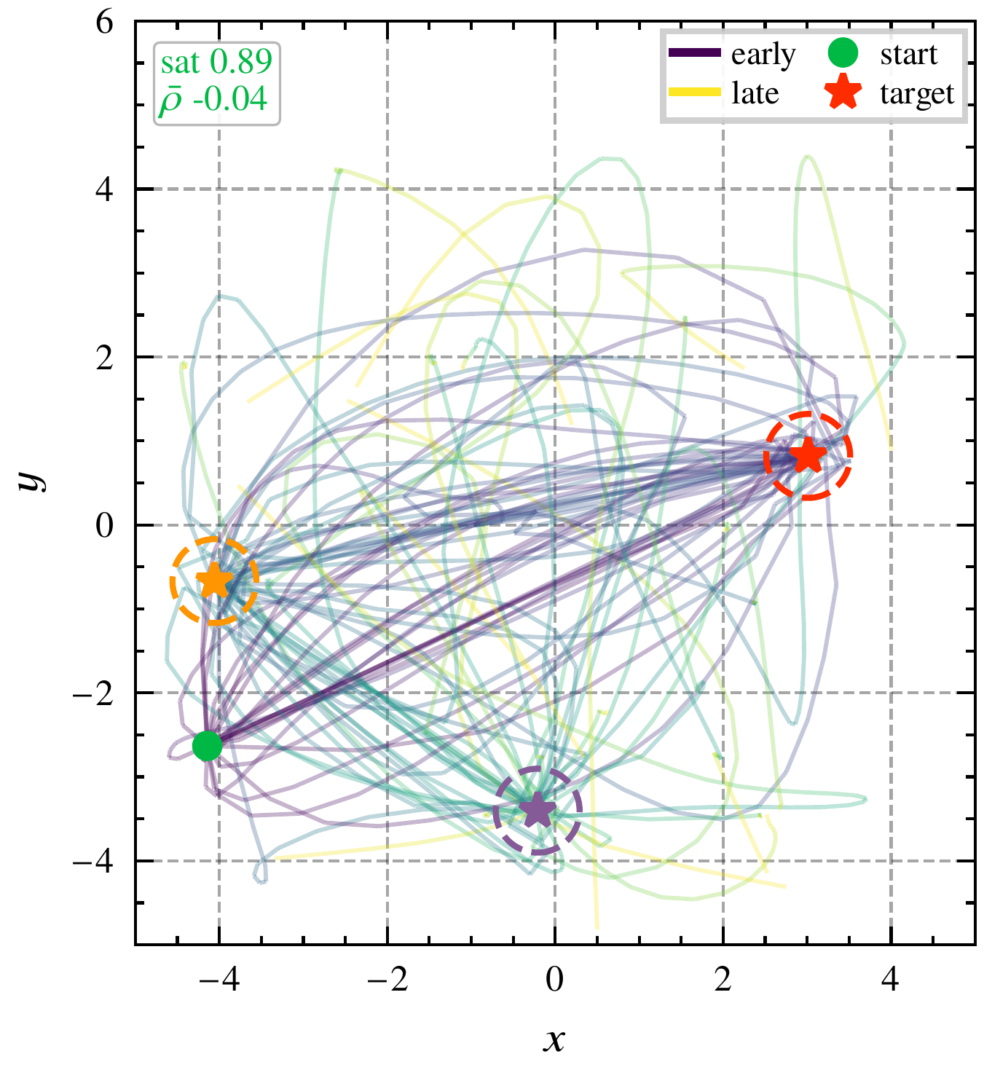
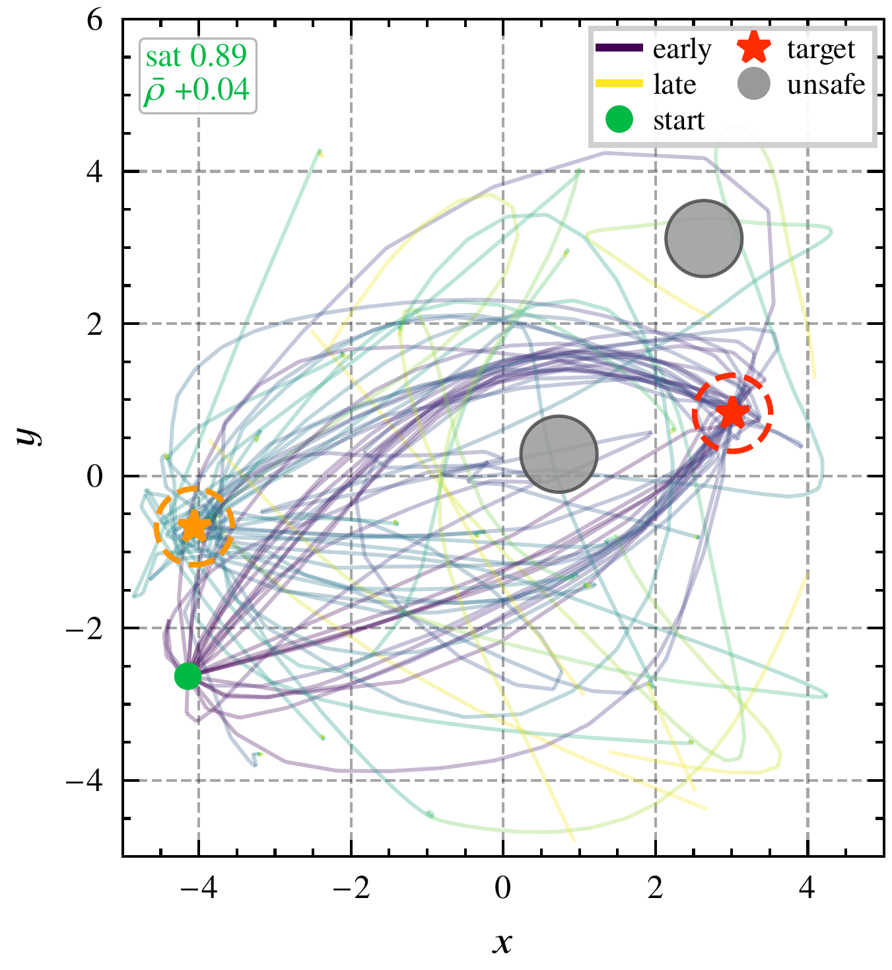
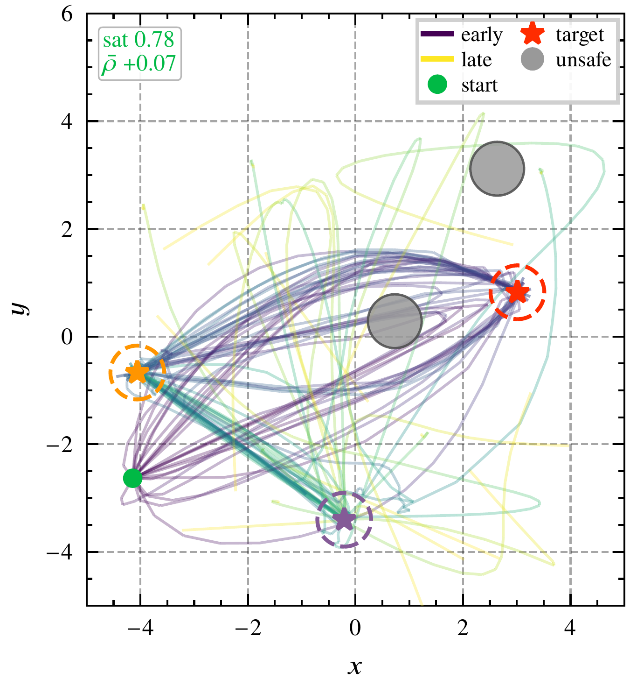
Six requirement classes
Motivation → Background → Method → Results → Conclusions
Reach
Nested reach-and-dwell
Recurrence
Sequence
Sequence with avoidance
Composite
One learned prior and one constant strength λ₀ are used for all six requirement classes
Notes:
The same prior and the same lambda_0 for all six classes. A new requirement requires only a new syntax tree. Satisfaction rates of STL-FM: reach 0.96, nested reach-and-dwell 1.00, recurrence 0.98, sequence 0.89, sequence with avoidance 0.89, composite 0.78. A sweep of one requirement's own parameters is future work, so this does not test adaptation to a changed parameter. If asked about roughness: on nested reach-and-dwell 47 percent of turns exceed a right angle. [tab:families; tab:openloop; §4.2; §6.1; §7.2]

Slide 27
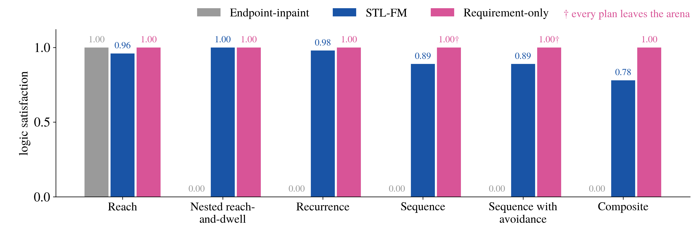
Logic satisfaction in navigation
Motivation → Background → Method → Results → Conclusions
Logic satisfaction alone does not distinguish STL-FM from the requirement-only optimizer
Notes:
Over 100 runs per class.
The endpoint-inpaint planner satisfies reach on every run and no other class on any run: the pin fixes the end, and the prior generates the remainder of the trajectory, which contains no dwell, order or avoidance.
STL-FM satisfies the five history-dependent classes at 0.78 to 1.00. The requirement-only optimizer satisfies every class on every run, so satisfaction alone does not separate it from STL-FM. Evidence about the prior must come from other properties of the plans. Plan time: 0.71 s for STL-FM, 20.14 s for the requirement-only optimizer. [tab:openloop, tab:anytime, §6.1]

Slide 28
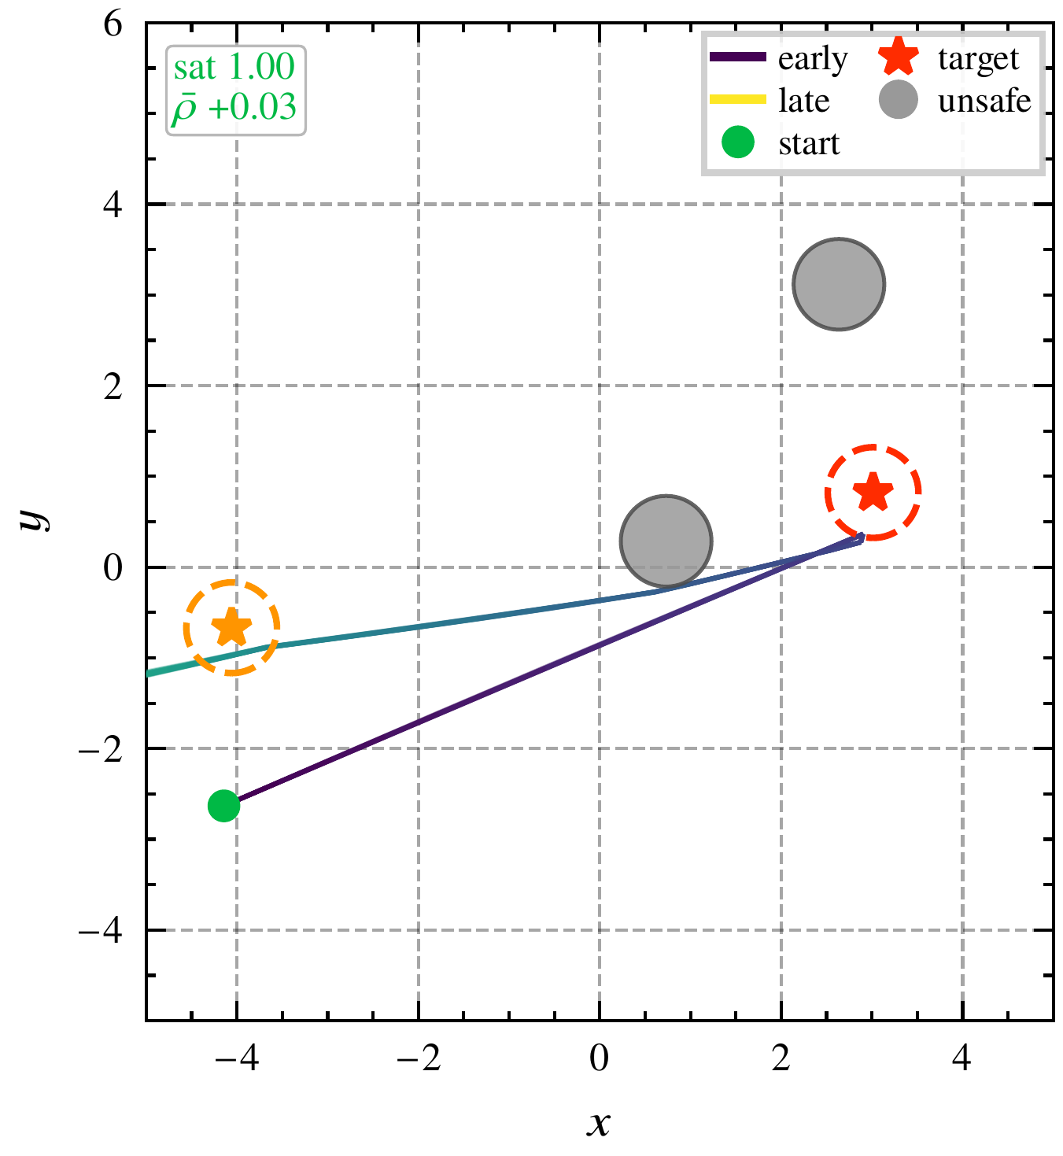
Arena excursion
Motivation → Background → Method → Results → Conclusions
Requirement-only optimizer, no prior
STL-FM
Sequence with avoidance, 25 of 100 plans per planner, arena clipped at its edge
Every plan of the requirement-only optimizer for sequence with avoidance leaves the arena
Notes:
The requirement-only optimizer removes the prior and optimizes robustness directly. It descends the violation penalty with a smoothness penalty and a velocity limit. It satisfies every requirement class on every run. On sequence with avoidance every one of its plans leaves the arena, at a median largest coordinate of 10.27 against a half-width of 5.0. The excursion lies at steps 31 to 63, which no reach window covers. Deleting the avoidance conjuncts leaves the plans outside the arena, so the avoidance conjuncts do not cause the excursion. Plans that use the prior cross the arena edge in at most 4 of 100 runs, by at most 0.10. [§5.1.3; §5.2.2; §6.1; app:noobs-ablation]

Slide 29
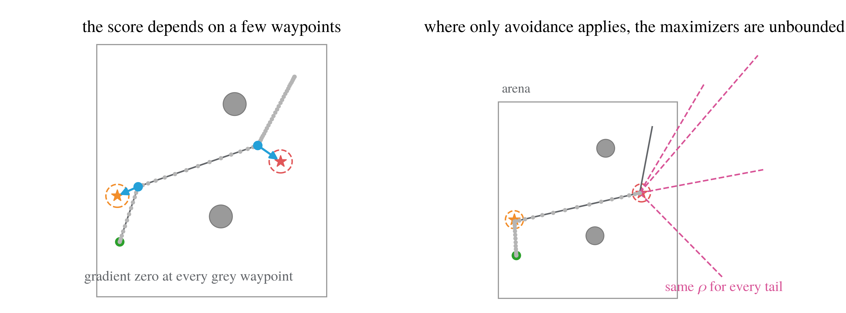
Underdetermination by robustness
Motivation → Background → Method → Results → Conclusions
At most m of 64 to 256 waypoints determine the score, with m between 1 and 5
Robustness alone does not determine a trajectory (Propositions A.3.1 and A.3.4, backup)
Notes:
Robustness is computed from a few predicate evaluations combined by min and max. A formula with m predicate occurrences is determined by at most m waypoints, and m is between 1 and 5 here, against horizons of 64 to 256. Under the exact semantics the gradient is zero at every other waypoint, and the score is flat along a subspace of dimension at least (H - m) d. At steps that only avoidance constrains, the set of maximizers is unbounded. A planner guided by robustness therefore needs a component besides the requirement to determine the rest of the trajectory. Here that is the learned prior. Its contribution is measured, not assumed, because the prior does not meet the idealized conditions of Theorem thm:prior-resolves. [Contribution 2; §4.1.1; prop:sparse-gradient, prop:no-maximizer; rem:prior-idealization]

Slide 30
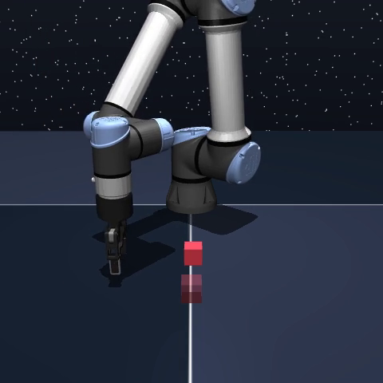
Cube manipulation
Motivation → Background → Method → Results → Conclusions
Sequence requirement
Grasp the cube within 20 steps,
place it between steps 20 and 100
pick, the effector within 5 cm of the cube
place, the cube within 4 cm of the target, the environment’s tolerance
STL-FM plan, executed
STL-FM completes 10 of 30 executions, the requirement-only optimizer none (Fisher exact test, p = 0.0008)
Notes:
OGBench single cube. The prior generates the effector and the cube position over 128 steps, so the requirement and the environment's success criterion refer to the same cube. Place is a 4 cm ball about the target, the environment's own tolerance; pick holds when the effector is within 5 cm of the cube. [Click to play] A proportional controller tracks the effector and a gripper state machine follows the plan. STL-FM completes 10 of 30 runs, the requirement-only optimizer none, Fisher exact test p = 0.0008. The endpoint-inpaint planner completes 1. [§5.3, tab:closedloop]

Slide 31
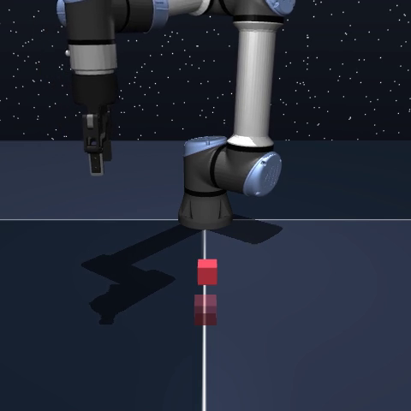
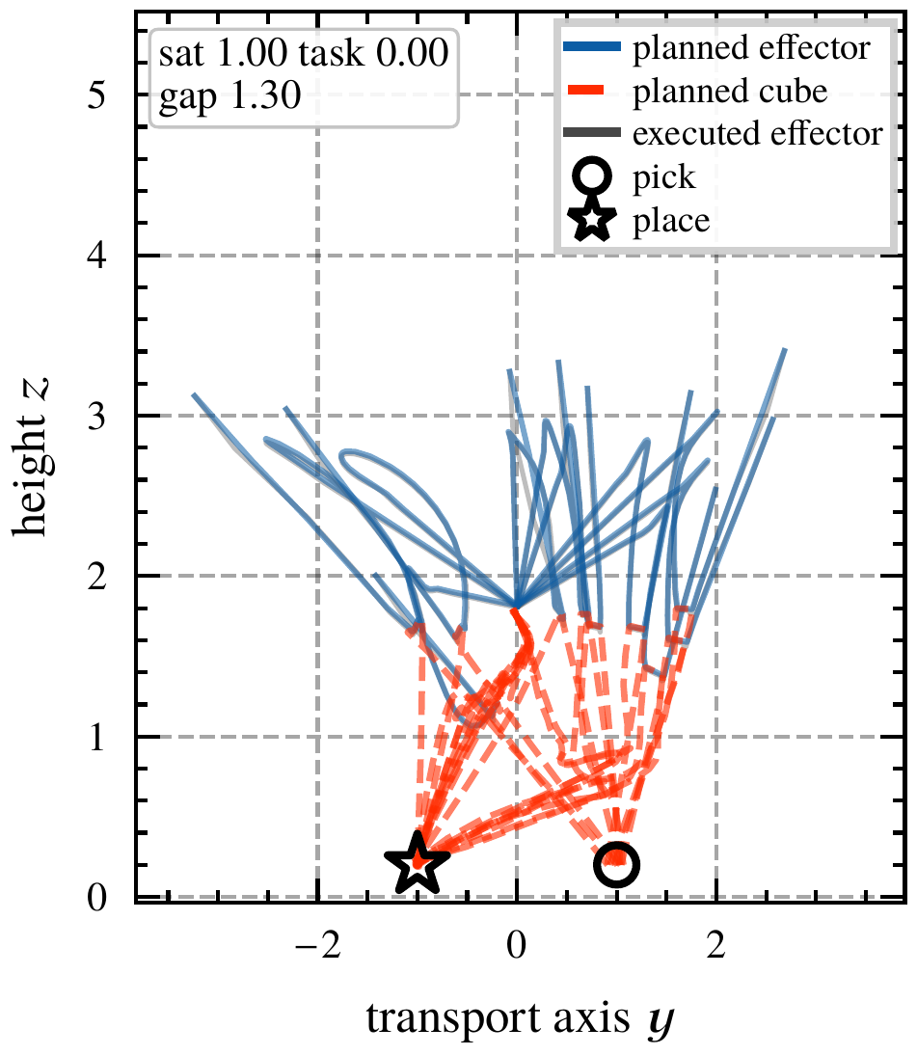
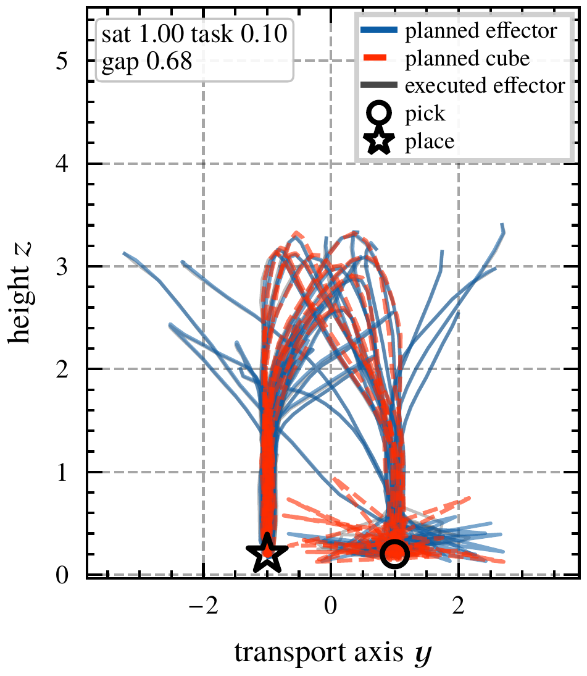
Carry gap
Motivation → Background → Method → Results → Conclusions
Requirement-only, planned
STL-FM, planned
Pooled median carry gap, 12.5 cm for the requirement-only optimizer and 6.9 cm for STL-FM
Requirement-only plan, executed
Without the prior, the planned cube moves without contact
Notes:
The carry gap is the mean distance between the effector and the cube over the steps in which the planned cube moves. Planned effector paths are solid and planned cube paths dashed, sequence class, all ten runs. The requirement-only plans satisfy the requirement at the largest margin the place predicate admits, +0.40. The planned cube crosses the table in near-straight lines while the planned effector departs upward. [Click to play] Executed, the arm never reaches the cube. Carry gap 12.5 cm against 6.9 cm for STL-FM, Mann-Whitney p < 1e-6. The requirement has no clause that the cube moves only when carried. The prior provides that property, because no demonstration contains a cube moving without contact. [§5.3, fig:closedloop-sequence, §6.1]

Slide 32
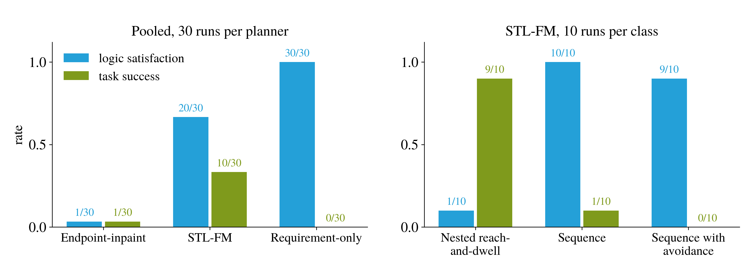
Logic satisfaction and task success
Motivation → Background → Method → Results → Conclusions
Logic satisfaction and task success each occur without the other
Notes:
Left, pooled over the three classes. Right, STL-FM per class. On nested reach-and-dwell STL-FM satisfies the requirement in 1 of 10 runs and completes the task in 9. The requirement constrains the grasp and the placement to hold over windows that close by step 30, whereas success requires only that the cube arrive. On sequence it satisfies 10 of 10 and completes 1. A requirement written on the generated variables constrains only those variables. The kitchen study shows the same gap more strongly (backup). [tab:closedloop, §6.2]

Slide 33
Conclusions
Motivation → Background → Method → Results → Conclusions
RQ1
Does a demonstration determine the requirement?
A demonstration witnesses a requirement without determining it (Proposition A.1.2), so the requirement is stated separately from the demonstrations.
RQ2
Does the robustness score alone determine a trajectory?
The robustness score alone does not determine a trajectory. Its gradient depends on at most m waypoints, and its maximizers are unbounded where only avoidance applies (Propositions A.3.1 and A.3.4). Without the prior, plans for the two sequence classes leave the arena, and the planned cube moves without contact.
Method
STL-FM guides the learned prior at one constant strength, without retraining
STL-FM satisfies the requirement at rates of 0.78 to 1.00 across the six navigation classes and completes 10 of 30 cube executions, against none for the requirement-only optimizer.
Logic satisfaction and task success do not coincide. A requirement constrains only the variables the prior generates.
Notes:
Back to the two questions. RQ1: a demonstration witnesses a requirement without determining it, so the requirement is stated as a formula and the demonstrations provide plausibility. RQ2: the robustness score alone does not determine a trajectory; its gradient acts on a few waypoints and its maximizers are unbounded where only avoidance applies. The learned prior provides the rest of the trajectory, as the navigation excursion and the cube carry gap show, and its contribution is not smoothness. The method: STL-FM guides the learned prior at one constant strength, without retraining, and covers nested and recurrent operators. Finally, satisfying the requirement on the plan is not completing the task: a requirement written on the generated variables constrains only those variables. STL-FM is a soft realization without a certificate. [§7.1; §6.1-6.3]

Slide 34
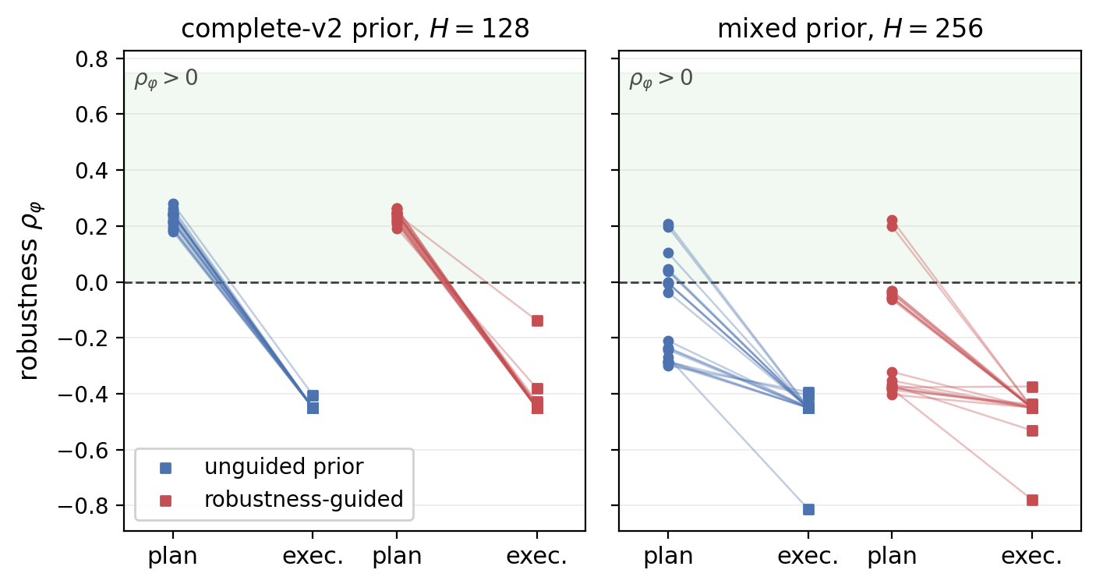
Future work
Motivation → Background → Method → Results → Conclusions
1.
A differentiable dynamics model
so that a requirement can constrain contact and object pose
2.
Execution on the physical platform
plans for the GoFA door task, executed and scored on the robot
3.
A sweep of a requirement’s parameters
the same prior under changed windows and dwell times
4.
A barrier-filtered controller for execution
for an execution-time guarantee
Kitchen study, planned against executed
robustness (backup)
5.
An evaluation of disjunction and until
both are compiled but not yet evaluated
Notes:
First, a differentiable dynamics or world model, so that a requirement can be written on contact, an object's pose or a hinge angle and constrain the executed behaviour. In the kitchen study under the complete-v2 prior every plan satisfies the requirement, and no execution does. Second, completion of the physical study: the GoFA prior is trained and the requirement compiled, but no plan has been executed. Third, a sweep of a requirement's own parameters with the prior held fixed, such as the open time or the dwell, which tests adaptation without retraining directly. Fourth, a barrier-filtered controller paired with the planner, for an execution-time guarantee. Fifth, an evaluation of disjunction and until. [§7.2; §2.6]

Slide 36
Supplementary material
Answers to likely questions

Slide 37
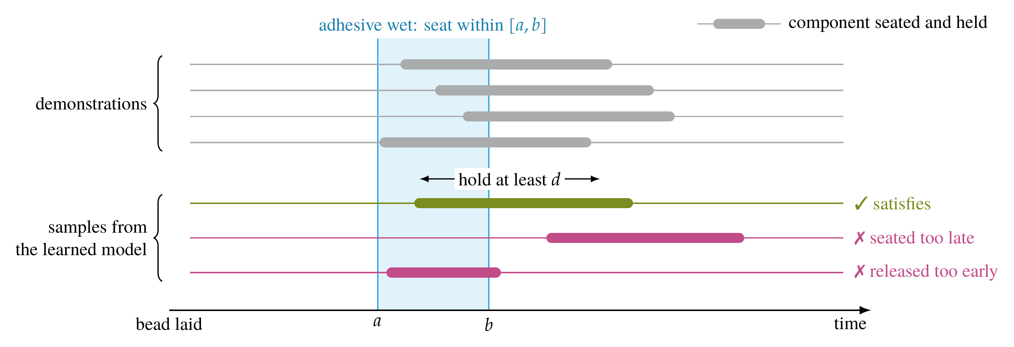
Plausible samples that violate the requirement
Notes:
Backup for the problem slide. The demonstrations record the instant of seating. Samples of the learned prior can satisfy the window, seat too late, or release too early, and still end with the component on the housing. [§1.1, Fig. 1.1(b)]

Slide 38
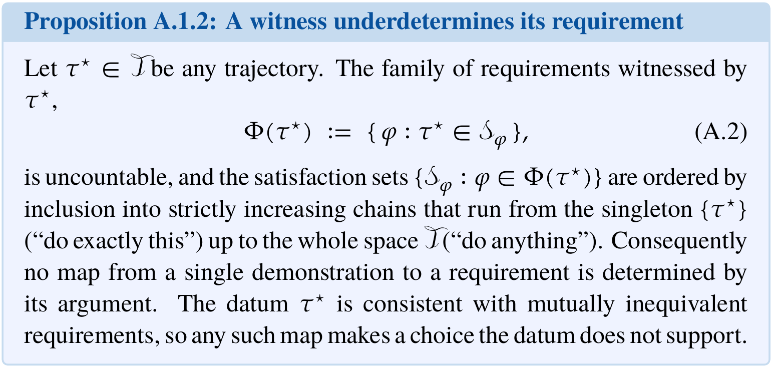
Proposition A.1.2
Notes:
Contribution 1, RQ1. Any trajectory witnesses uncountably many requirements, ordered from 'do exactly this' to 'do anything', so no map from one demonstration to a requirement is determined by its argument. The requirement is therefore stated, not inferred. [App. A, prop:witness-underdetermines]

Slide 39
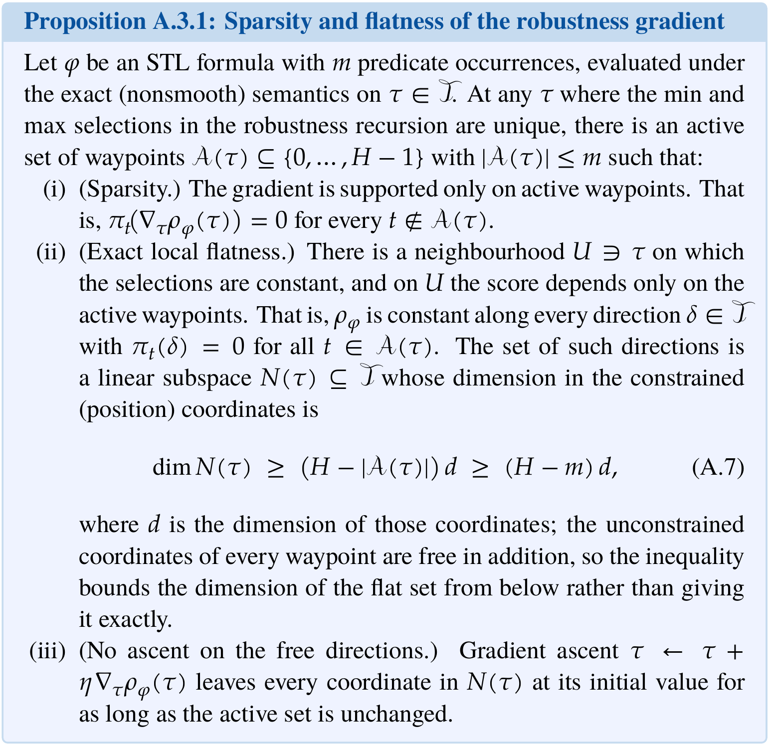
Proposition A.3.1
Notes:
Contribution 2, RQ2, first half. Under the exact semantics the gradient is supported on at most m active waypoints, and the score is flat along a subspace of dimension at least (H - m) d. [App. A, prop:sparse-gradient]

Slide 40
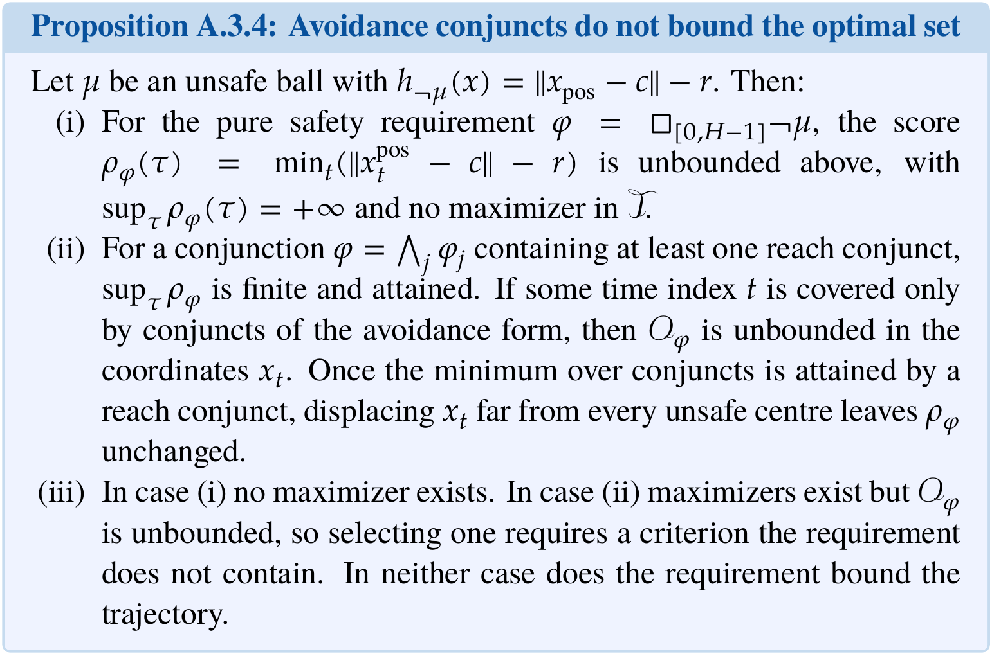
Proposition A.3.4
Notes:
Contribution 2, RQ2, second half. Pure safety has no maximizer; with a reach conjunct the maximizers exist but are unbounded at time indices covered only by avoidance. In neither case does the requirement bound the trajectory. Control-synthesis formulations obtain the bound from the dynamics and costs, or conjoin a boundedness clause (Lindemann and Dimarogonas 2019). [App. A, prop:no-maximizer; §2.2]

Slide 41
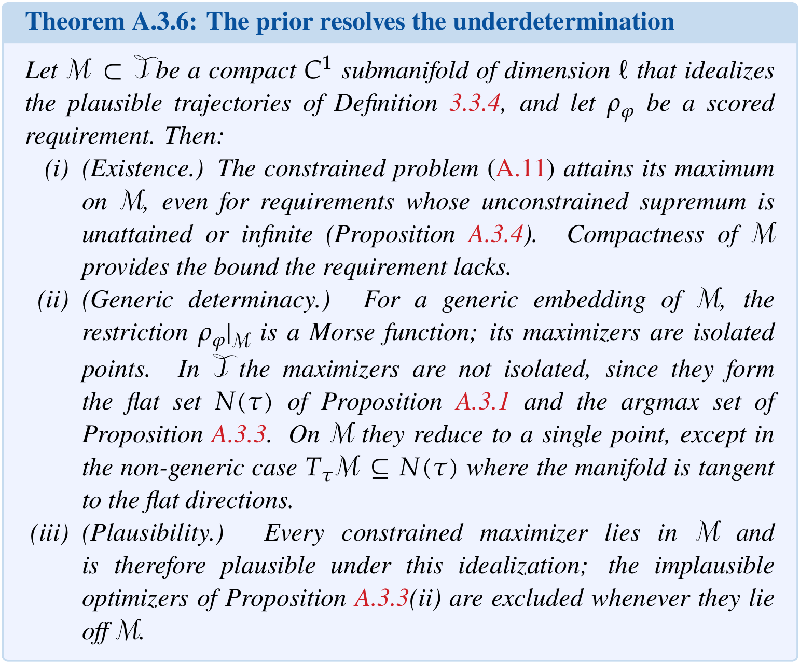
Theorem A.3.6
Notes:
Under idealized conditions, a compact manifold of plausible trajectories, the constrained problem attains its maximum and its maximizers are isolated. The learned prior meets neither hypothesis (Remark rem:prior-idealization), so the contribution of the prior is measured in Chapter 5, not assumed. [App. A, thm:prior-resolves]

Slide 42
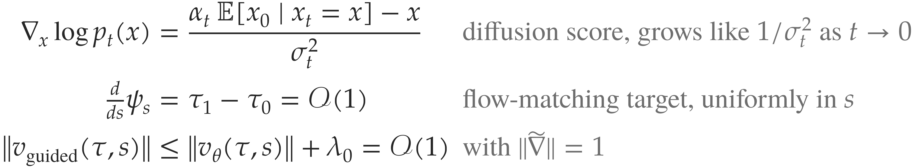
Constant guidance strength
Both terms are of the same bounded order at every flow time, so the ratio of guidance to prior is Θ(λ₀)
and a constant λ₀ is well posed without a schedule. λ₀ = 50 in navigation and cube, without retuning.
On a diffusion substrate the guidance weight is coupled to the noise schedule,
λ(t) ∝ σ_{t}^{k} with k ∈ {1, 2}.
Notes:
Why one constant strength is well posed. The diffusion score grows like 1 over sigma_t squared as the noise vanishes, so a constant guidance weight has an influence that varies with the noise level, and diffusion guidance needs a schedule. Under the straight-line path the flow-matching target is tau_1 minus tau_0, of order one at every flow time, and the conditioned gradient has unit norm, so the guided velocity is bounded uniformly in s. One lambda_0 therefore has the same meaning throughout the flow. The thesis says well posed, not that a constant suffices in every setting. The same lambda_0 = 50 is used in navigation and cube without retuning. [eq:tweedie; §3.3; §4.6, eq:guided-bounded; tab:diffusion-vs-fm]

Slide 43
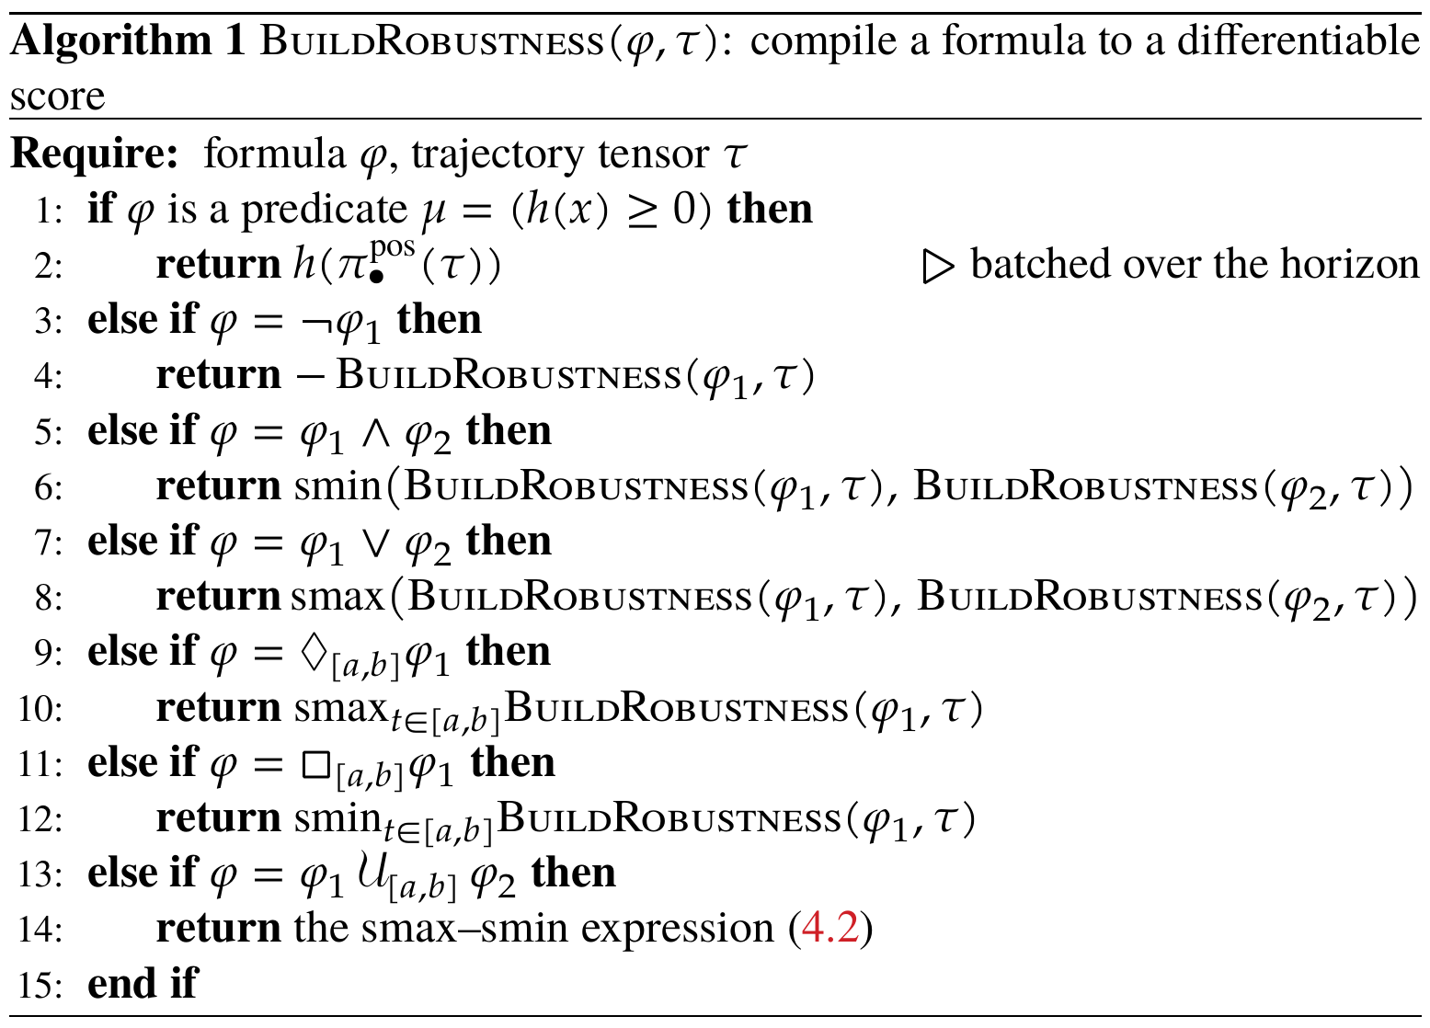
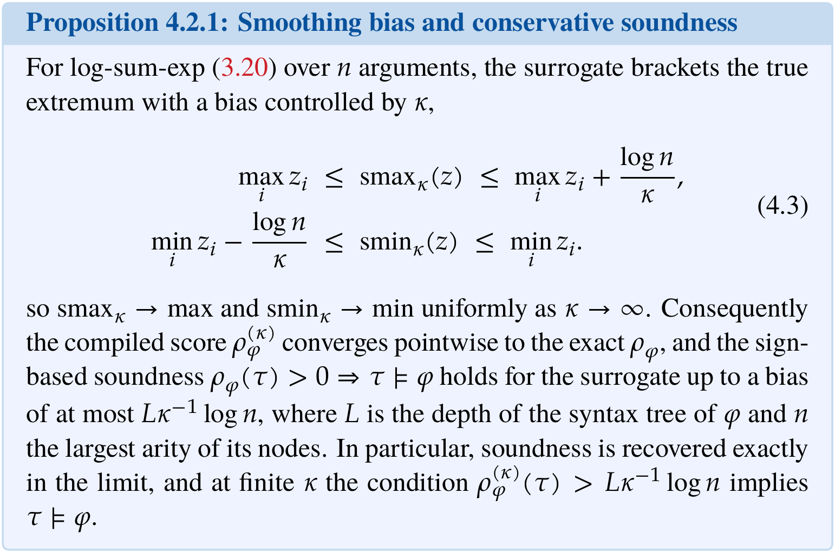
Algorithm 1 and Proposition 4.2.1
Notes:
The compilation is a post-order traversal of the syntax tree with no learned component. Smoothing replaces min and max by log-sum-exp; the bias is bounded by log n over kappa per node, and soundness is recovered exactly as kappa grows. kappa = 10 in the experiments, and satisfaction is scored with the exact semantics. [§4.2, alg:build-rho, prop:smoothing-bias]

Slide 44

Algorithm 2
Notes:
Algorithm 2 in full. Line 5, predicted endpoint; line 6, penalized requirement gradient; line 7, mask and normalize; line 8, constant-strength update; lines 9 to 10, optional clamp, off in all reported runs; line 13, re-pin the start. [§4.7, alg:guided-ode]

Slide 45


Navigation results, all four planners
Notes:
Table 5.4: satisfaction and mean robustness over 100 runs; a star marks entries whose plans all leave the arena. Table 5.5: when each planner first satisfies and when it does best, and the wall-clock plan time. STL-FM with endpoint pin differs from STL-FM by at most 0.05. [tab:openloop, tab:anytime]

Slide 46

Cube results, all three classes
Notes:
Table 5.6: sat is logic satisfaction on the plan, task is success on the rollout, gap the mean carry gap. The pooled gap row of the table reads 0.64, 0.69 and 1.25, whereas the class rows are in centimetres and the text gives pooled medians of 12.5 and 6.9 cm. [tab:closedloop]

Slide 47

Kitchen study
Complete-v2 prior, unguided,
mean robustness of plan +0.23
and of execution −0.45, a fall of 0.68
against a margin of at most 0.3
Task success in 0 of 80 executions
Notes:
D4RL kitchen. The requirement: open the microwave within steps 60 to 130, then move the kettle onto its burner within 140 to 230, with predicates on the fixtures' own state at the environment's tolerance. Two priors, complete-v2 and mixed, and two planners, the unguided prior and STL-FM, 20 runs each. Under complete-v2 every plan satisfies the requirement under both planners, because the demonstrations operate the fixtures in the required order, so guidance performs no selection. Under mixed, 6 of 20 without and 2 of 20 with guidance, Fisher p = 0.235, no effect detected. No execution satisfies the requirement: the planned microwave crosses the threshold in every complete-v2 plan, the executed one in none. The prior generates the state, not the actions that produce it. [§5.4, tab:kitchen, §6.2]

Slide 48


Physical platform
ABB GoFA CRB 15000,
five door-opening
demonstrations,
six joint angles and
the gripper state,
H = 128
No demonstration
satisfies the carry
requirement
Notes:
ABB GoFA CRB 15000-12/1.27 with a parallel gripper. Five door-opening demonstrations of 894 to 1872 frames at 15 fps. The prior generates six joint angles and the gripper state over 128 steps. The carry requirement states that between grasp and release the tool must not rotate by more than 5 degrees about any axis, compiled through differentiable forward kinematics. No recorded demonstration satisfies it. Distance to the demonstration falls from 0.451 to 0.315 in the first 10,000 steps and then stays flat; only smoothness keeps improving; diversity falls about sevenfold, measured on four samples per checkpoint. No plan has been executed on the robot. The carry interval is a proxy read from the gripper trace. [§5.5, tab:gofa-checkpoints, §6.3]

Slide 49
Roughness of guided plans
Trajectories
Median turn angle
Turns above 90°
Demonstrations
0.6°
2 %
Unguided prior, start pinned
6.4°
4 %
Unguided prior, both endpoints pinned
8.2°
7 %
STL-FM, nested reach-and-dwell
30.9°
47 %
STL-FM, recurrence
9.9°
STL-FM, composite
18.5 %
Requirement-only optimizer, pooled
0.3°
The evaluation does not distinguish two explanations. Either the prior is undertrained, or guidance
moves iterates away from plausible trajectories faster than the prior moves them back. The evidence
for the contribution of the prior is the carry gap and the arena excursion.
Notes:
Moving steps are steps longer than 0.05 world units. The prior does not reproduce the smoothness of its demonstrations, and guidance raises the turn angle on nested reach-and-dwell, where nearly half the turns exceed a right angle. On sequence and sequence with avoidance the guided plans are no rougher than the prior. The requirement-only optimizer is smoother than the demonstrations because of its hand-specified smoothness penalty. Two explanations remain open, and the thesis does not distinguish them. The evidence for the contribution of the prior is the cube carry gap and the navigation excursion. [§5.2, §6.1]

Slide 50
Limitations
Fixed requirement instances
every rate is measured on one instance per class
No certificate
the guided sampler is a soft realization, so it gives a rate, not a guarantee
Sampled-state semantics
robustness does not constrain the path between two sampled states
Evaluated fragment
disjunction and until are compiled but not evaluated, and the fragment has no unbounded operators
Requirement-neutral prior
a modelling assumption, although demonstrations can retain task structure
Reproducibility
runs with identical seeds agree on the satisfaction count in 27 of 28 cells and differ by one run in the other
Physical carry interval
a proxy read from the gripper trace, longer than the planning horizon
Notes:
The limitations as stated in §6.3, one line each.

