Slide 1
Loan Repayment Assessment in Banking
- Gayathri Keerthivasagam

Slide 2
Problem Statement
Build and train a model that identifies a customer will repay or default from
the loan dataset.
The primary objective is to create a reliable tool that assists the bank in assessing
the creditworthiness of loan applicants, thereby minimizing the risk of default and
optimizing lending decisions.

Slide 3
Data collection and Exploration Data collection and Exploration
The dataset was sourced from the provided link and the data description
is mentioned in the next slide.
A comprehensive exploration of the dataset was conducted, meticulously examining each feature in detail.
Different visualization techniques such as histograms, box plots, pair plots,
count plots are used to understand relationships between features and
target variable.

Slide 4
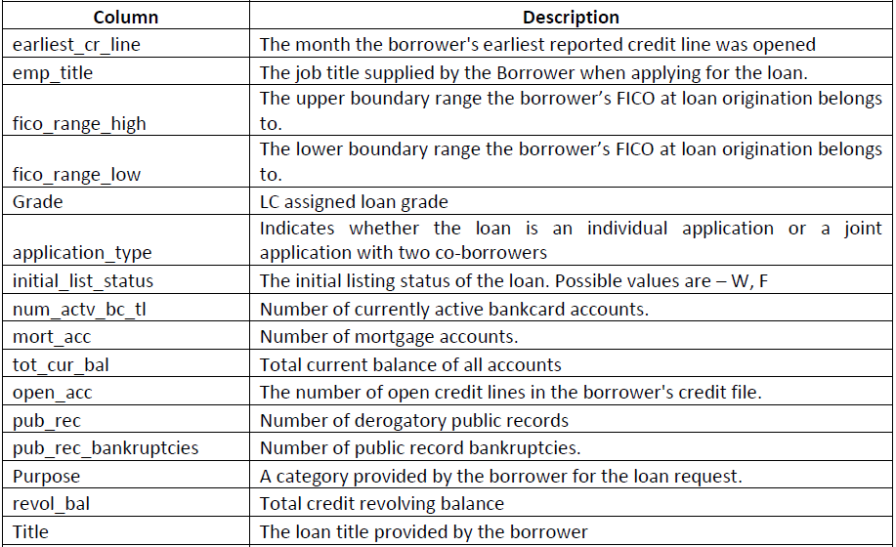
Data Description Data collection and Exploration

Slide 5
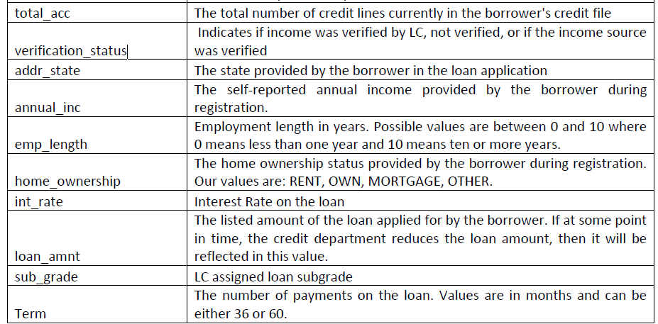
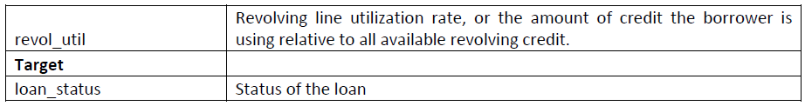
Data Description Data collection and Exploration

Slide 6
Data Cleaning and Preprocessing Data collection and Exploration
Observed null values in the following features
emp_length
emp_title
num_actv_bc_tl
mort_acc
tot_cur_bal
pub_rec_bankruptcies
revol_util and title
Null values were imputed successfully using either the mean or median
based on the business requirements.
No duplicates found in the training dataset.

Slide 7
Feature Engineering and Selection Data collection and Exploration
The target label is encoded as 0 and 1.
Heatmap is plotted to identify the correlation between the numerical features.
The outliers are visualized and successfully removed wherever it is needed.
Features like pub_rec, pub_rec_bankruptcies, fico_range are successfully grouped and labelled.
Dropped the least important features like ‘grade’, ’emp_ title’, ’emp_length’ according
to the chi-square statistical methods.
Performed feature encoding (one hot encoding) for categorical features.
Performed feature scaling for numerical features.

Slide 8
Dealing with Imbalanced Data Data collection and Exploration
Techniques used for balancing the data:
SMOTE
Random Undersampling
Random Oversampling
A detailed comparative analysis was conducted for different resampling
techniques and identified the best sampling method for better f1-score.

Slide 9
Model Selection Data collection and Exploration
ML models used are
Logistic regression
K Nearest Neighbors
Random Forest Classifier
Gradient Boosting.
XGBoost
Found the ensemble technique of Logistic regression + XGBoost outperforms
in the F1 score.

Slide 10
Hyperparameter Tuning Data collection and Exploration
A grid search is conducted to find optimal parameters (penalty,C) for
logistic regression.
A grid search is conducted to find optimal parameters (n_estimators, max_depth,
learning_rate) for XGBoost.
Following the search, the best estimator are identified.
The soft vote-based ensemble classifier has been implemented using XGBoost and
logistic Regression.

Slide 11
Prediction on Test Dataset Data collection and Exploration
The preprocessing for test dataset is done in the same manner as the train dataset.
The successfully trained tuned model is fitted on the test dataset.
The prediction for ‘loan_status’ is done and saved as a excel file.

Slide 12
Conclusion Data collection and Exploration
Loan repayment assessment project has provided valuable insights into the factors influencing loan repayment behavior.
By analyzing historical data and applying machine learning techniques, we have identified key predictors of loan repayment likelihood.
This information will help the bank widely in improved decision making.

Slide 13
Thank You

