Slide 1
Project Review – 2 (Literature Review and Applications Survey)
1
3
2
4
Responsive
and
Scalable
Front-End Development Frameworks | TaskForge
|Hridya – 2410030280 , Tanvi – 2410030470 , Gayathri - 2410030494|
Ms. P. Sree Lakshmi | CSE
State management for AI features
Interactive and Dynamic UI
Ecosystem and Integrations

Slide 2
React: Relevance to Project Title
1
2
3
4
Interactive and Dynamic UI
State management for AI features
Ecosystem and Integrations
Responsive
and
Scalable

Slide 3
Literature, References:
ARTICLE NAME | RELEVANCE | LINK
A Review of Daily Productivity Growth Using Todo Manager - Kejriwal et al., IRJMETS (Dec 2020) | Highlights phased task completion, priority-based filtering, streak tracking, reminders, and progress analytics - all foundational for our AI-powered to-do list. | 1628083219.pdf
Trying to find the perfect Todo list app - Colin Wren, Medium (Oct 2023) | Identifies gaps in existing apps - missing week/month views, lack of smart lists, hidden subtasks, and manual upkeep. TaskForge addresses these with AI-driven automation and better UI design. | Trying to find the perfect Todo list app | by Colin Wren | Medium

Slide 4
Literature Review: Details
React (Chosen framework) :
Component-based, great for modular UI elements like timers, progress bars, and focus mode screens.
Strong ecosystem for integrating AI APIs, chart libraries (weekly insights), and calendar integrations.
Year | Author(s) | Key Findings | Relevance to TaskForge
2020 | Suyash Kejriwal , Vaibhav Vishal, Aastha Gulati, Gaurav Gambhir | Phased task completion, priority filters, reports, streaks, reminders | Guides phased progress bars, streak tracker, and priority-based filtering in React
2023 | Colin Wren | Missing multi-granularity views, smart lists, visible subtasks, focus modes; paywalls | Inspires AI grouping, multi-view boards, always-visible subtasks, integrated focus mode

Slide 5
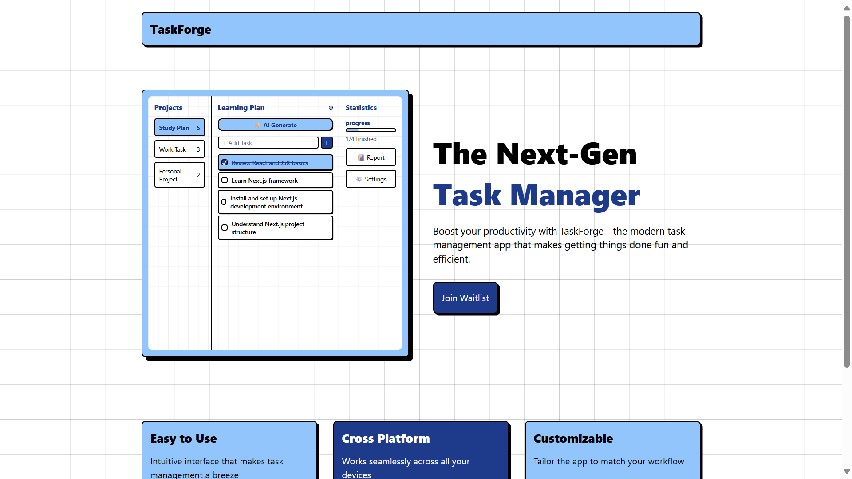
Critical Analysis, Synthesis, Gap Identification
Existing Solutions Provide | Limitations or Gaps in Existing Solutions | How we plan to do better
Basic reminders & due dates Some focus/timer modes and subtask handling | Binary task completion (no partial progress) Poor time-granularity and lack of smart relative lists Manual upkeep for recurring/grouped tasks Key features behind paywalls | Phased completion + visual Priority-based filtering & AI-suggested duration Multi-granularity boards Integrated focus mode with timers Calendar sync, streak tracking, and weekly insights Free useful features

Slide 6
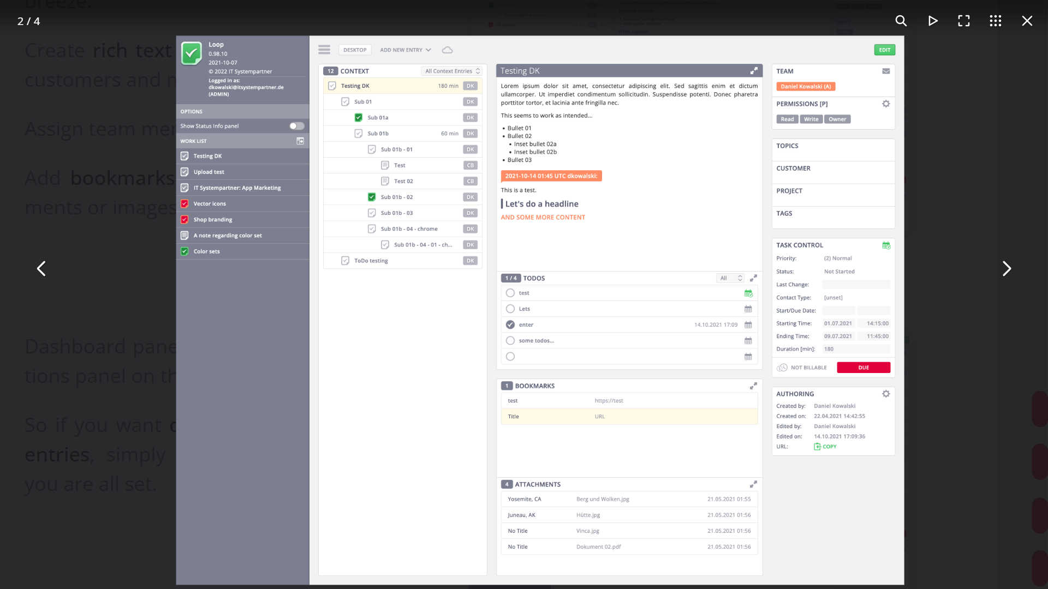
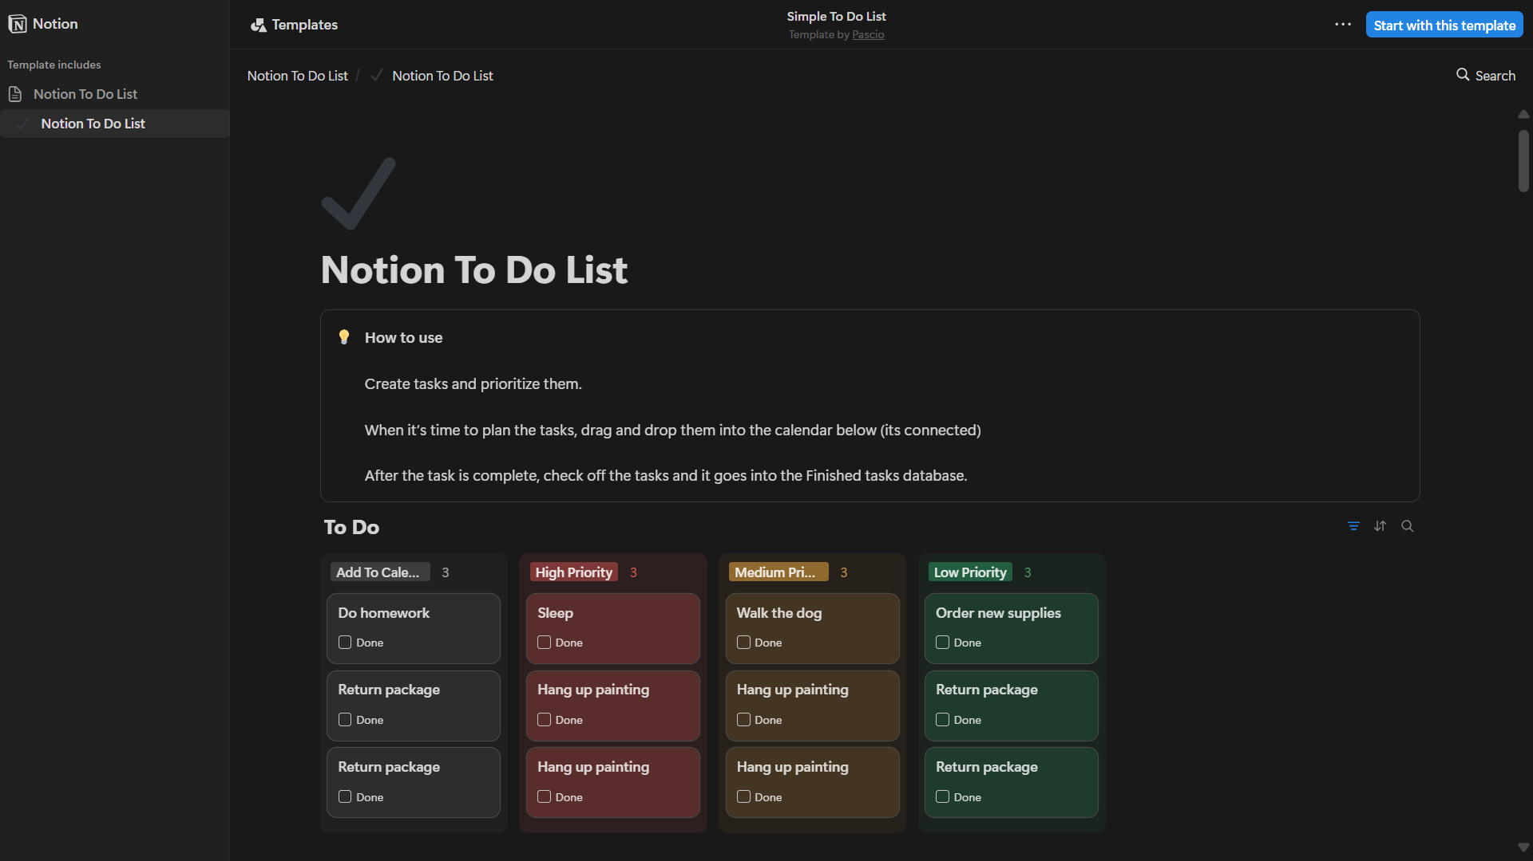
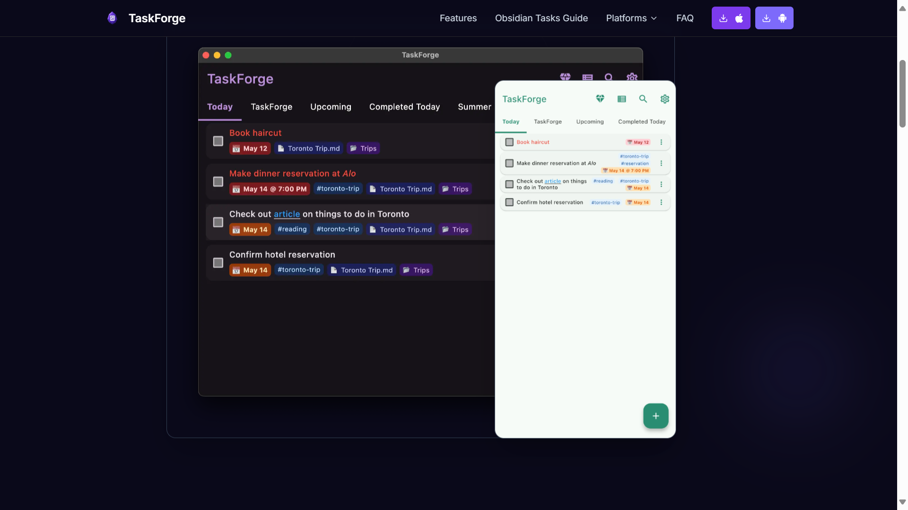
Notes:
https://gettaskforge.com/

Slide 7
Notes:
2. https://taskforge.app/

Slide 8
Notes:
https://www.notion.com/templates/simple-to-do-list

Slide 9
Notes:
https://taskforge.md/

Slide 10
THANK YOU

