Slide 1

PYTHON PROGRAMMING BASICS
BY
GAYATHRI S

Slide 2
Introduction To Python
Python is a high-level, interpreted, interactive and object-oriented scripting language which finds its application in many areas like -
Web scripting
3d Modelling (Blender)
Desktop Applications -`Games (Pygame)
Scientific usage (SciPy/NumPy)
Good language to teach programming

Slide 3
FEATURES:
A simple language which is easier to learn
Free and open-source
Portability
Extensible and Embeddable
A high-level, interpreted language
Large standard libraries to solve common tasks
Object oriented
Very powerful and Ubiquitous
Established interface with all major DB's

Slide 4
Reasons to Choose Python as First Language
Simple Elegant Syntax
Not overly strict
Expressiveness of the language- Python allows you to write programs having greater functionality with fewer lines of code.
Great Community&Support-There are numerous active forums online which can
be handy if you are stuck which include:
Learn Python sub reddit
Google Forum for Python
Python Questions - Stack Overflow

Slide 5
Technical Features:
Object-oriented (supports both functional and structured programming)
Dynamically and strongly typed
Whitespace delimited (Indentation)
Scripting language which supports large applications.
High-level dynamic data types and supports dynamic type checking
Automatic garbage collection
Interpreted makes compiler interact with developer.
Easy integration with C, C++, COM, ActiveX, CORBA and Java.

Slide 6
Python Implementations:
CPython - Python implementation on standard C language.
Jython - Python implementation with Java virtual machine to blend with Java.
Pypy - Python implemented in Python and its Just-in time compiler making it fastest.
Iron Python - for windows, which implements common runtime libraries to
interface with .NET.

Slide 7
Difference between Python 2&3
Print:
Python 2 treats “print” as statement rather a function.
Python 3 explicitly treats “print” as a function.
Integer Division:
Python 2 treats numbers without any digits.(Output of expression 3 / 2 is 1, not 1.5). To get the result 1.5, you would have to write 3.0 / 2.0.
Python 3 evaluates 3 / 2 as 1.5 by default, which is more intuitive for new programmers.

Slide 8
List Comprehension Loop Variables: Common name for the variables that is iterated over in a list comprehension as a global variable get interchanged. This is fixed in Python 3.
Unicode Strings: By default Python 3 stores strings as Unicode unlike Python 2.
Raising Exceptions: Python 3 requires different syntax for raising exceptions.
Python 2:raise IOError, “some error message”
Python3: raise IOError(“some error message”)

Slide 9
Keywords and Identifiers
KEYWORDS
KEYWORDS
There are 33 keywords which are case sensitive. All the keywords except True, False and None are in lowercase and they must be written as it is.
General rules for identifiers are applicable here
Identifier can be of any length.
Multiple words can be separated using an underscore or CamelCase Writing, this_is_a_load or ThisIsALoad

Slide 10
Whitespace Indentation & Comments &docstring in Python
Programming languages like C, C++,
Java use braces { } to define a block of code. Python uses indentation.
A code block (body of a function, loop etc.) starts with indentation and ends with the first unindented line.
General amount of indentation:
4whitespaces
In Python, we use the hash (#) symbol to start writing a comment.
If we have comments that extend multiple lines, way of doing this is to use triple quotes, either ''' or "“”
Documentation string is a string that occurs as the first statement in a module, function, class, or method definition. We must write what a function/class does in the docstring.
Docstring is available to us as the attribute __doc__ of the function

Slide 11
Variables & Constants
In Python we don't assign values to the variables, whereas Python gives the reference of the object (value) to the variable.
Variables do not need declaration to reserve memory space. The "variable declaration" or "variable initialization" happens automatically when we assign a value to a variable.
Python is a type inferred language, it can automatically infer (know) the type of a variable
Constants are containers that hold information which cannot be changed later.
Constants are usually declared and assigned on a module. The module means a new file containing variables, functions etc which is imported to main file. Inside the module, constants are written in all capital letters and underscores separating the words. Eg.,
PI = 3.14 GRAVITY = 9.8
import constant
print(constant.PI)
print(constant.GRAVITY)

Slide 12
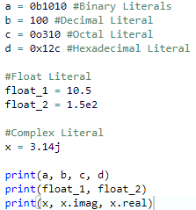
Numeric Literals
Numeric Literals are immutable (unchangeable). Numeric literals can belong to 3 different numerical types Integer, Float and Complex
OUTPUT : 10 100 200 300
10.5 150.0
3.14j 3.14 0.0

Slide 13

String Literals & Boolean Literals
A string literal is a sequence of characters surrounded by quotes. We can use both single, double or triple quotes for a string. And, a character literal is a single character surrounded by single or double quotes.
A Boolean literal can have any of the two values: True or False
In Python, True represents the value as 1 and False as 0.

Slide 14
DataTypes in Python
Every value in Python has a datatype. Since everything is an object in Python programming, data types are actually classes and variables are instance (object) of these classes. There are various data types in Python. Some of the important types are listed below.
Python Numbers-int,float,complex
List
Tuple
Strings
Set
Dictionary

Slide 15
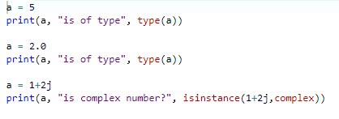
Python Numbers
We can use the type() function to know which class a variable or a value belongs
to and the isinstance() function to check if an object belongs to a
particular class.
Integers can be of any length, it is only limited by the memory available.
A floating point number is accurate up to 15 decimal places.

Slide 16
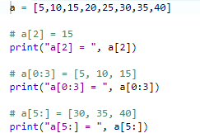
List
List is an ordered sequence of items. It is one of the most used datatype in Python
and is very flexible.
All the items in a list do not need to be of the same type

Slide 17
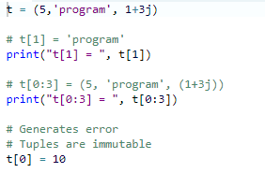
Tuple
Tuple is an ordered sequence of items same as list.The only difference is that tuples are immutable. Tuples once created cannot be modified.Tuples are used to write-protect data and are usually faster than list as it cannot change dynamically.
It is defined within parentheses () where items are separated by commas.

Slide 18
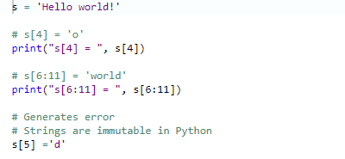
Strings
String is sequence of Unicode characters. We can use single quotes or double quotes to represent strings. Multi-line strings can be denoted using triple quotes, ''' or """.
Like list and tuple, slicing operator [ ] can be used with string. Strings are immutable.

Slide 19
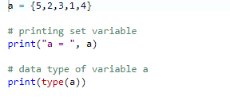
Set
Set is an unordered collection of unique items. Set is defined by values separated by comma inside braces { }. Items in a set are not ordered.
We can perform set operations like union, intersection on two sets. Set have unique values. They eliminate duplicates. Since, set are unordered collection, indexing has no meaning. Hence the slicing operator [] does not work.

Slide 20
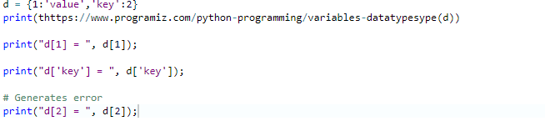
Collections and Mapping Types
range Type and function-generates a sequence of integers
dict Type-this allows creating an associative array of keys and values
set Type-this provides mappig of unique immutable elements

Slide 21
COMPREHENSIONS-List,Set
A special notation for building up lists, dictionaries and sets from other lists, dictionaries and sets, modifying and filtering them in the process.
They allow you to express complicated looping logic in a tiny amount of space.

Slide 22
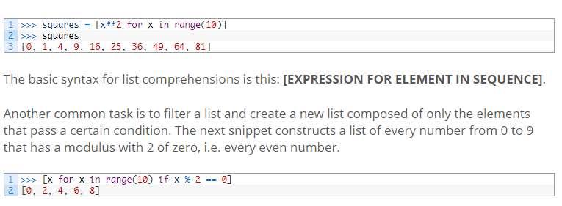
List Comprehension

Slide 23
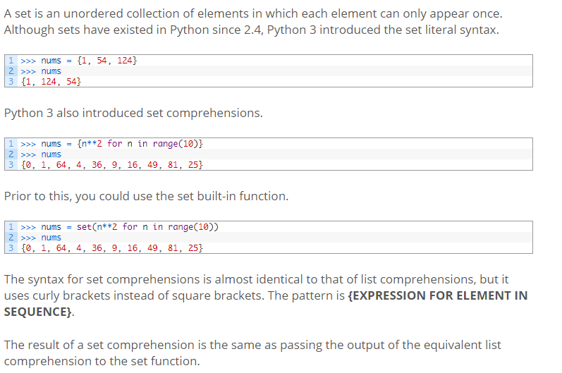
Set Comprehensions

Slide 24
Map, Filter and Reduce
These are three functions which facilitate a functional approach to programming.
MAP-map applies a function to all the items in an input_list.
Filter-filter creates a list of elements for which a function returns true.
Reduce-reduce is a function for performing some computation on a list and returning the result. It applies a rolling computation to sequential pairs of values in a list.

Slide 25
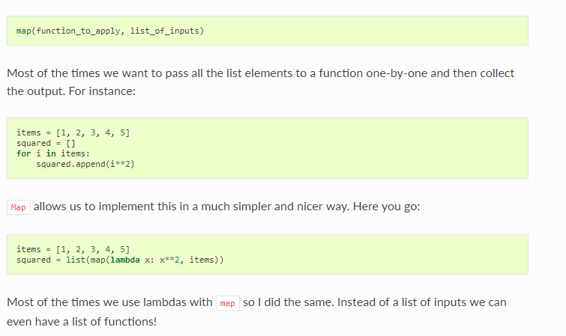
Map-Example

Slide 26
Filter-Example
number_list = range(-5, 5)
less_than_zero = list(filter(lambda x: x < 0, number_list))
print(less_than_zero)
# Output: [-5, -4, -3, -2, -1]

Slide 27
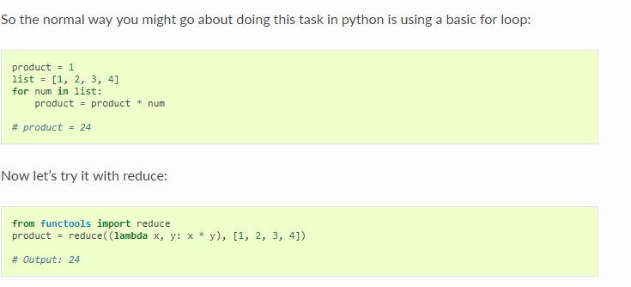
Reduce-Example

Slide 28
Python Flow Control
if
if test expression:
statement(s)
if...else
if test expression:
Body of if
else:
Body of else
if..elif..else
if test expression:
Body of if
elif test expression:
Body of elif
else:
Body of else

Slide 29
LOOPS
while loop
while test_expression:
Body of while
break statement:terminates the loop containing it
continue: terminates the current iteration of the loop
pass statment:pass is a null statement. The difference between a comment and pass statement in Python is that, while the interpreter ignores a comment entirely, pass is not ignored.Its a NO operation statement.
for loop
for val in sequence:
Body of for
NOTE:A for loop and while loop can have an optional else block as well. The else part is executed if the items in the sequence used in for loop exhausts.

Slide 30
FUNCTIONS
Function is a group of related statements that perform a specific task.
Functions help break our program into smaller and modular chunks. As our program grows larger and larger, functions make it more organized and manageable.Furthermore, it avoids repetition and makes code reusable.
def function_name(parameters):
"""docstring"""
statement(s)
return statement is optional here. The function can return None value
(instead of void)

Slide 31
Function Types
Built-in functions - Functions that are built into Python.
User-defined functions - Functions defined by the users themselves.
Writing a userdefined function
Step 1: Declare the function with the keyword def followed by the function name.
Step 2: Write the arguments inside the opening and closing parentheses of the function, and end the declaration with a
Colon.
Step 3: Add the program statements to be executed.
Step 4: End the function with/without return statement.

Slide 32
Function Arguments
Default arguments:
Python has a different way of representing syntax and default values for function arguments. Default values indicate that the function argument will take that value if no argument value is passed during function call. The default value is assigned by using assignment (=) operator.
def defaultArg( name, msg = "Hello!"):
Required Arguments:
Required arguments are the mandatory arguments of a function. These argument values must be passed in correct number and order during function call. Below is a typical syntax for a required argument function.
def requiredArg (str,num):

Slide 33
Variable number of arguments
This is very useful when we do not know the exact number of arguments that will be passed to a function. Or we can have a design where any number of arguments can be passed based on the requirement. Below is the syntax for this type of function call.
Function definition def varlengthArgs(*varargs):
Function call varlengthArgs(30,40,50,60)
Keyword arguments:
Keyword arguments are relevant for Python function calls. The keywords are mentioned during the function call along with their corresponding values. These keywords are mapped with the function arguments so the function can easily identify the corresponding values even if the order is not maintained during the function call. The following is the syntax for keyword arguments.
Function definition def keywordArg( name, role ):
Function call keywordArg( name = "Tom", role = "Manager")

Slide 34
HCF program
# Python program to find the H.C.F of two input numbers
# define a function
def computerHCF(x, y):
"""This function takes two
integers and returns the H.C.F""“
# choose the smaller number
if x > y:
smaller = y
else:
smaller = x
for i in range(1,smaller + 1):
if((x % i == 0) and (y % i == 0)):
hcf = i
return hcf
num1 = 54
num2 = 24
# take input from the user
# num1 = int(input("Enter first number: "))
# num2 = int(input("Enter second number: "))
print("The H.C.F. of", num1,"and", num2,"is", computeHCF(num1, num2))

Slide 35
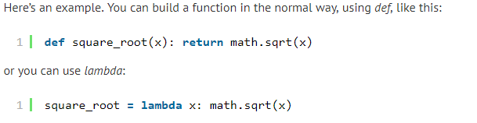
Lambda is a tool for building functions
Lambda is a tool for building functions, or more precisely, for building function objects. That means that Python has two tools for building functions: def and lambda.

Slide 36
Class
class ClassName:
<statement-1>
.
.
.
<statement-N>
Or
pass

Slide 37
Sample Program - class, object
class MyClass:
"""A simple example class""" #doc string
i = 12345 # Data member
def f(self): #Member function
return 'hello world'
>>>x = MyClass()
Class Name: Myclass
Object Name: x

Slide 38
__init__
>>> class Complex:
... def __init__(self, realpart, imagpart):
... self.r = realpart
... self.i = imagpart
...
>>> x = Complex(3.0, -4.5)
>>> x.r, x.i
(3.0, -4.5)

Slide 39
student class example
class student:
def get(rno, na , **subjects):
t=0
print "Roll Number:", rno
print "name", name
for x in subjects:
t=t+subjects[x]
print "subject: ", x, subjects[x]
print "total", t
print "avg",t/3
s=student()
s.get(rno=1, na ="kavitha",s1=70,s2=80,s3=90)

Slide 40
Inheritance
The whole point of the namespace created by the class statement is to support name inheritance.
Python searches the namespace tree from bottom to top, beginning with object, looking for the first attr it can find. This includes references to self attributes in your methods.
Because lower definitions in the tree override higher ones, inheritance forms the basis of specialization.

Slide 41

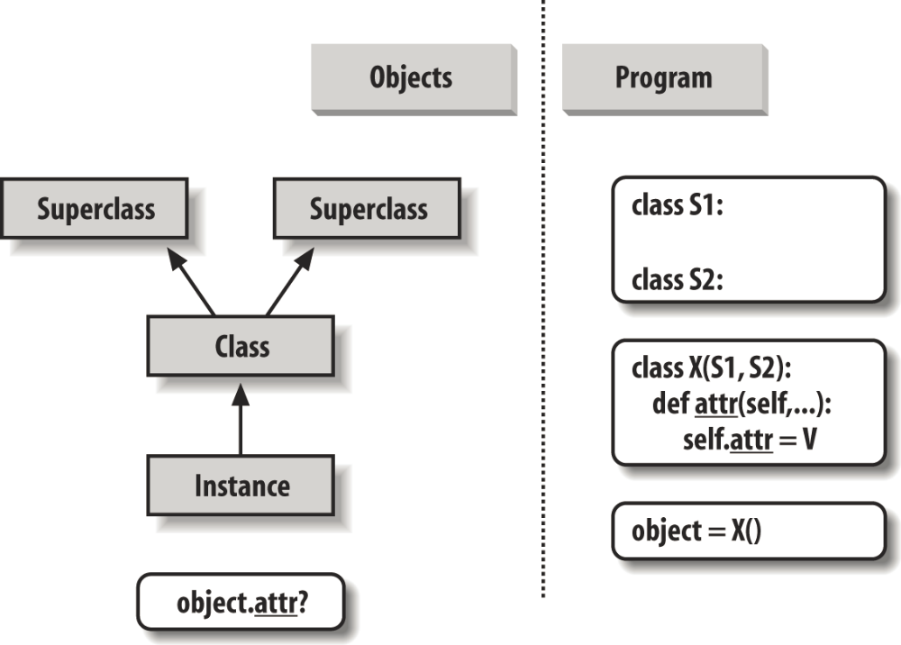
Attribute Tree Construction

Slide 42
Inheritance example
For instance, subclasses may replace inherited attributes completely,
class Super:
  def method(self):
  print('in Super.method')
  class Sub(Super):
  def method(self): # Override method
  print('starting Sub.method')
  Super.method(self) # Run default action
  print('ending Sub.method')

Slide 43
WHY PYTHON?
Python is user-friendly for beginners but you can create more advanced project as well.
And yes, it’s perfect for data science (but also for web development, machine learning and many more) so, you wont have problems with finding a job.
There are five most important reasons why people use Python
is powerfull and fast
plays well with others”
“runs everywhere”
is easy to learn (so you can use it even when your adventure with programming has just begun)
is friendly (thanks to the community hosts conferences and meetups, collaborates on code, and much more)

Slide 44
THANK YOU

