Slide 1
ALTO (Application Layer Traffic Optimization)

Slide 2
What is Application Layer Traffic Optimization?
Congestion control is done in Transport Layer.
Packet rerouting is done in Network layer.
Can Application Layer implementations such as client applications be built with traffic optimization features?
As a result ALTO introduced.

Slide 3
Motivation
Goal
Proposed Mechanisms
Architecture
Use cases
Advantages
Disadvantages
Alternatives
References
Conclusion

Slide 4
Motivation
P2P applications consumes the global internet traffic even the resources available locally, because of the selection of resource peers are random in most of the cases.
Even some applications have improved algorithms to optimize peer selection they give sub optimal results because they are based on RTT value at the connection establishment which is not a better value to take decision.
Wrong peer selection leads the application to perform in an inefficient way.
Some important research results indicates that higher number of commercial ISPs suffer from poor latency to the local DNS resolvers and also some ISPs shows signs of load balancing which leads to a poor usage of DNS cache.
Applications themselves cannot achieve proper selection of resource peers because of the lack of knowledge in network topology information, network operational costs and network policies.

Slide 5
Goal
Provide guidance to applications that have to select one or several hosts from a set of candidates capable of providing a desired resource.

Slide 6
Proposed Mechanisms
Establish ALTO servers in order to gather resource locations and maintain resource directories where the clients running P2P applications can send queries and ask for the optimized peers to deal with.
Need a protocol for communication. ALTO protocol.
To find an ALTO service, service discovery mechanism is required.
ALTO servers will consider the link capacity, topology those do not change frequently in a network rather than considering the congestion control on transport layer.
Important factors to be considered in creating ALTO service
Operator's policies
Geographical location or network proximity (e.g., the topological distance between two peers).
The transmission costs associated with sending/receiving a certain amount of data to/from a peer, or the remaining amount of traffic allowed by a peer's operator (e.g., in case of quotas or limited flat-rate pricing models).

Slide 7
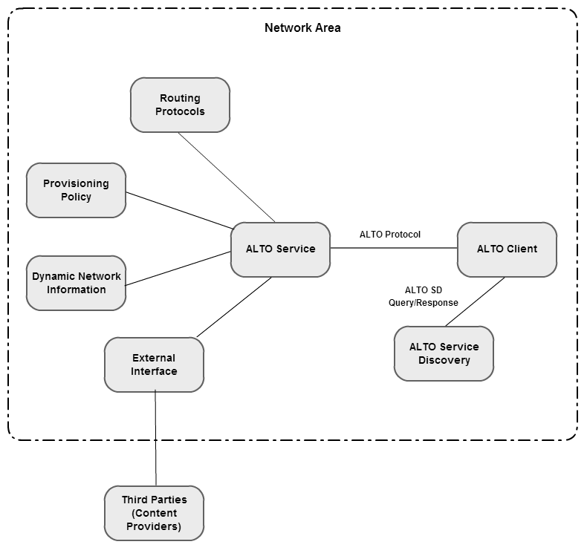
Architecture
ALTO server gather information from multiple sources as shown in the diagram in order to provide a better response for the queries.

Slide 8
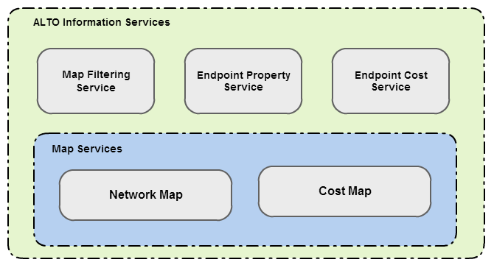
Architecture
ALTO service framework
ALTO Client can request each service individually.
Map Services are to provide batch information to clients.
Map filtering service allow filtering on Map services without requesting batch information
Endpoint property service provide individual properties of endpoints such as connectivity type (ADSL)
Endpoint Cost Service provides numerical costs or rankings directly amongst Endpoints

Slide 9
Architecture
Query Modes
Client can provide a list of known host to the ALTO server and get the sorted list of peers with performance.
The clients periodically query the ALTO server with required host characteristics and client cache the replies and use them when required.
Operation Modes
Client itself can query the ALTO server suitable for DHT implementations.
A central server query the service on behalf of client such as a tracker in Bittorrent.
ALTO servers should have a mechanism to inform the clients when it is overloaded. Possible approaches are refusing connections, redirect the request to another server, send a message to request later or send the response with a message to wait a certain period to request next.

Slide 10
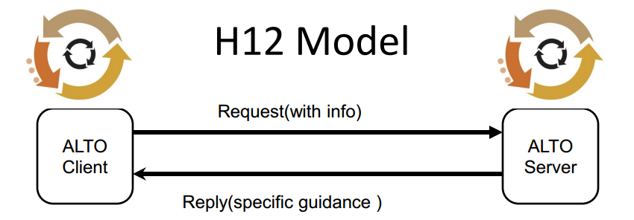
Use cases
ALTO H12 Protocol
Based on HTTP/1.1
XML based message body for information exchange
Supports caching in network and in H12 client

Slide 11
ALTO H12 Protocol
client send info
–IP address, IP address prefixed (e.g., /24)
–up to the client to decide how specific
server works out his preferences by using client’s info
server replies with specific guidance
–can be a 1:1 answer of request (replying with /24)
–can be much broader answer (replying with /16)
–can be more narrow answer (replying with multiple /24)

Slide 12
Use cases
P4P ALTO Protocol
HTTP based implementation.
Each ALTO Server maintains a “my-Internet” view
A my-Internet view consists
A set of network locations.
ALTO Cost between each pair of network locations for a given ALTO Cost Type.
Basic ALTO Query:
A set of source (resource consumer) network locations on the “my-Internet” view
A set of destination (resource provider) network locations on the “my-Internet” view
An ALTO Cost Type. Mode: numerical or ordinal (ranking)
ALTO Response:
Numerical values/ranking from given sources togiven destinations

Slide 13
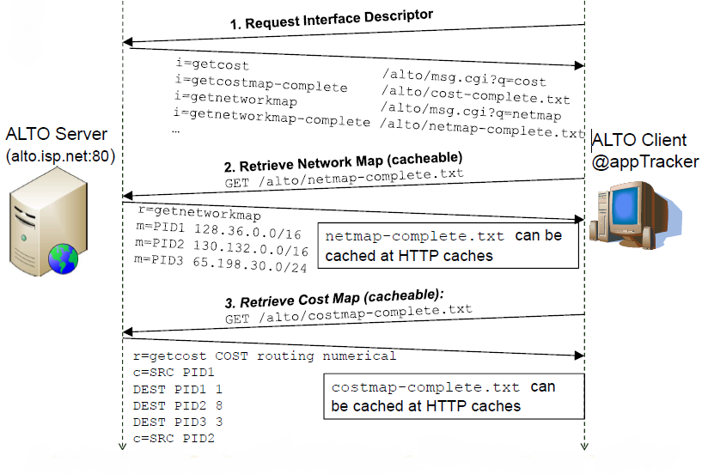
P4P ALTO Protocol
ALTO client embedded in tracker application

Slide 14
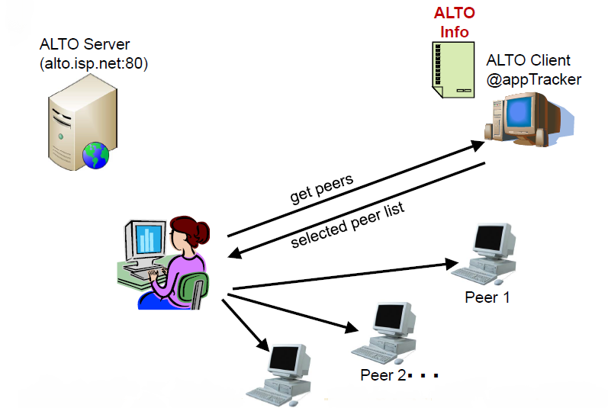
P4P ALTO Protocol

Slide 15
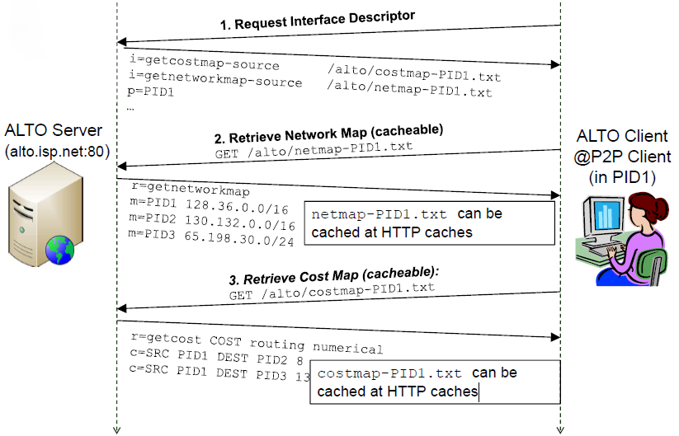
P4P ALTO Protocol
ALTO client embedded in P2P client

Slide 16
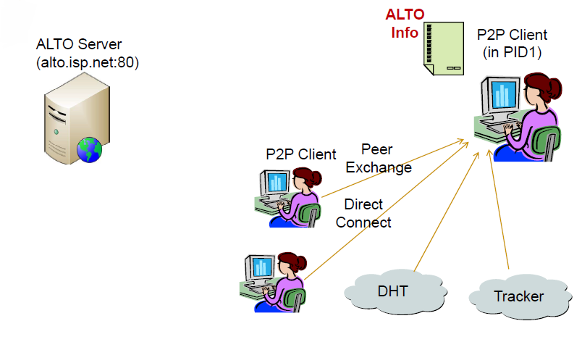
P4P ALTO Protocol

Slide 17
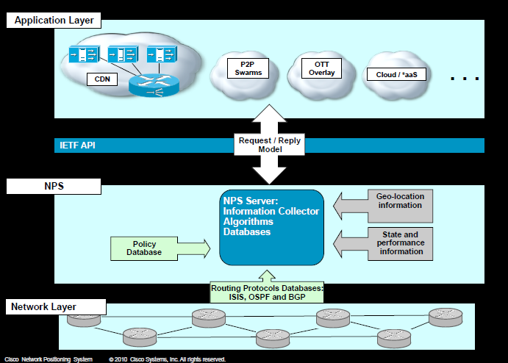
Use cases
Cisco Network Positioning System
An ALTO implementation that computes the location of and distance between endpoints.

Slide 18
Advantages
A network that provides an ALTO Service can achieve better utilization of its networking infrastructure.
An application that uses an ALTO Service can benefit from better knowledge of the network to avoid network bottlenecks.
International bandwidth utilization can be reduced.

Slide 19
Disadvantages
Different alto implementations provide different levels of detail. Depending on the system architecture, this may have implications on the quality of the guidance
Applications using ALTO guidance MUST NOT rely solely on the ALTO guidance to avoid causing network congestion. Instead, they MUST use other appropriate means, such as TCP-based transport.
Therefore, ALTO cannot be a replacement for TCP-like congestion control mechanisms.
Information disclosure of the ALTO service maintaining parties such as network topology.
User privacy may be compromised. What files user shares with P2P application.

Slide 20
Alternatives

Slide 21
References
http://datatracker.ietf.org/wg/alto/charter/
http://tools.ietf.org/html/rfc6708 - requirements
http://tools.ietf.org/html/rfc5693 - problem statement
http://tools.ietf.org/html/draft-marocco-alto-problem-statement-05
http://www.pcmag.com/article2/0,2817,2373918,00.asp
http://datatracker.ietf.org/doc/draft-ietf-alto-protocol/?include_text=1
https://ietf.org/doc/draft-ietf-alto-server-discovery/?include_text=1
https://atlas.ripe.net/
http://www.ietf.org/proceedings/74/slides/alto-5.pdf

