Slide 1
SupportPage
Jake Koperski, Matthew Meacham, Spencer Nussrallah

Slide 2
The Numbers

Slide 3


Building Customer Relationships
Notes:
Our platform will help the industry transform from the past of the customer relationship consisting of the hostile billing relationship and move towards the future of become a more engaging customer engagement relationship. We plan to bring this about in three main ways

Slide 4
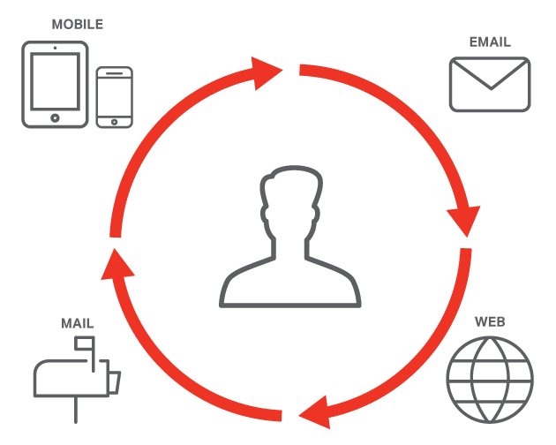
Omnichannel Approach
Notes:
The first our omnichannel approach. We will allow our customers to reach us in the way that they want to reach us. We offer them the flexibility and we make what was once a very informal relationship into a much more personal relationship. This includes not only an easy to use platform for customers to find all of the support resources they need quickly and in one efficient place but also an approach that very few companies have rolled out, that of the video conference with the support agent. Ultimately our goal is to foster a relationship between the customer and the support agent so that when the customer has problems in the future they come back to the agent that was so helpful before and whom they know will be as helpful once again increasing the customer’s perception of our company, our NPS, and ultimately our bottom line. We also tie in a plethora of other platforms, from the phone call, to instant messaging, to email.

Slide 5


The Support Team
Notes:
Second we recognize that the stronger the moral of our support team the better the service that they will provide to our customer. Therefore we will also incorporate a platform to motivate the support team and to enable them to have the best experience they can possibly have while working for our company. We do this through a badge earning system. Many of the badges that they are able to earn revolve around the video experience, the more videos you are able to make the bigger badges you unlock, the more people who view your videos the more recognition you get. Who doesn’t want to be the best at their job? We provide a measurable route to obtain this.

Slide 6

Webcasts
Notes:
Finally we have been disappointed in the number of tutorials that are out there by way of video. For class we can go online and find a plethora of information about the topic and many easy to use videos, however once you enter the real world quality seems to drop. we recognize that many of our customers will have the same problems and in an effort to search for efficiencies our agents will host live sessions where they will not only train the viewers in the topic of the session, but also will be ready to answer questions as they arise. After these sessions have been streamed they will be made available on the support team website ready whoever needs to view them in the future.

Slide 7
Live Demo
Go

