Slide 1






A Brief Introduction of Phishing
Huanjun Zhao
Dany Bonilla
Augustine Gayang
Ramez Halasah
Instructor: Ryan Henry
CPSC 329
PPT is made by Huanjun

Slide 2

Unessay Group 18, CPSC329
Phishing Scams
Phone
Emails
Websites
Learn More
Learn More
Learn More

Slide 3


Phishing Phone Calls
—is the use of fraudulent phone calls to trick people into giving money or revealing personal information

Slide 4
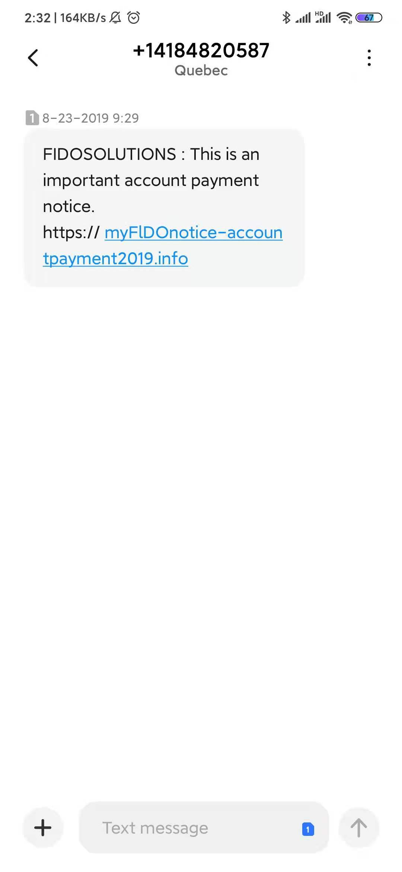
Vishing???
01
02
03
Express delivery /
Bills
Free offer / Big prize
“Police Warn”
Notes:
Three most comment:
Big prize but need to pay tax/ delivery fee. Bills: Fido; Delivery: DHL
Police say the victim received a call from a scammer advising her that she had been the victim of identity theft. The victim was directed to Google York Regional Police and to call to confirm her information.“The victim did this and believed she had spoken to an officer, however, through the investigation police have determined that suspects utilized a line-trapping technology to remain connected to her phone line,”

Slide 5



Phishing Emails
—is an attempt to steal sensitive information via an email that appears to be from a legitimate organization.
Notes:
We knew a lot!

Slide 6
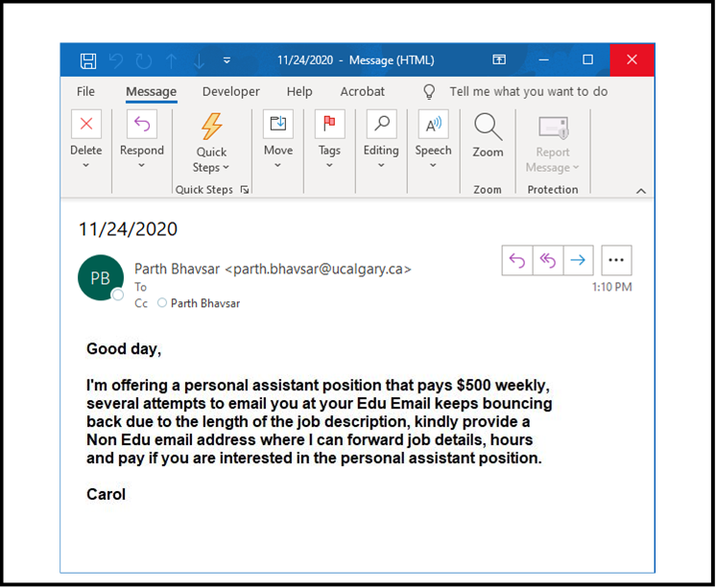

Emails
Pay 120% Attention!
TD:
Bills
Facebook:
Account Suspended
Job Offer

Slide 7
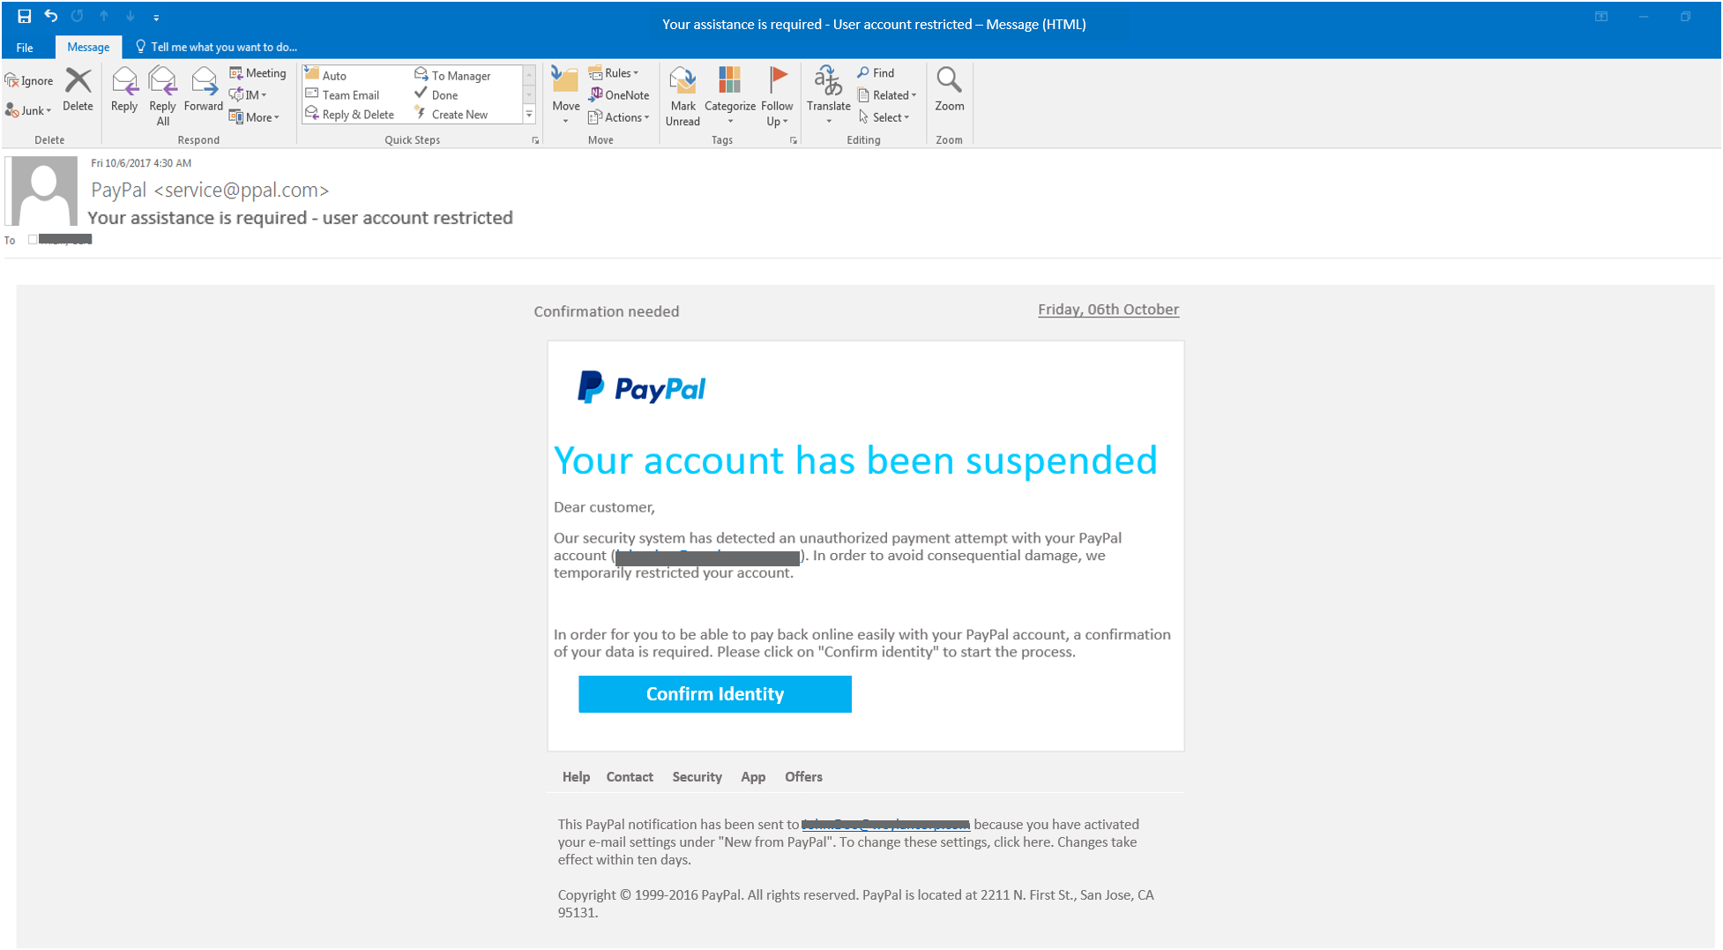

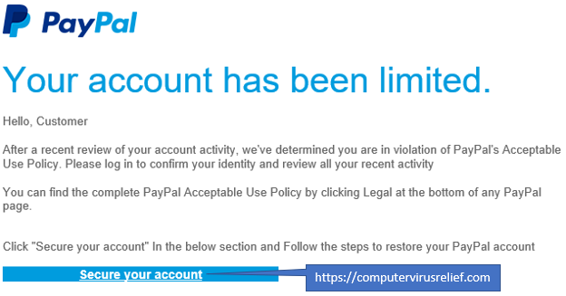


Retrieved from: CPSC 329 Phishing Email Quiz
Retrieved from: https://www.sonicwall.com/phishing-iq-test-landing/
Notes:
The sender address is misspelled- ppal.com
This email was not addressed to you. PayPal will always address you by name.
PayPal messages do not include links. Hover over the action button to view the underlying URL. The embedded URL does not look like a PayPal website

Slide 8
Phishing Websites
Looking into the sunset I can‘t help but noticethat despite her beauty,a sense of struggle and hopeless surround the sky .

Slide 9

Do you know?
In 2020
How many phishing emails are sent daily?
306.4 billion*
* Data from www.statista.com

Slide 10
How does it work in general?
Five steps of how phishing websites work.
Criminals through the background display data to steal
Phishing Pages
False Promotion and Dissemination
Users input Information
Post request into the database

Slide 11
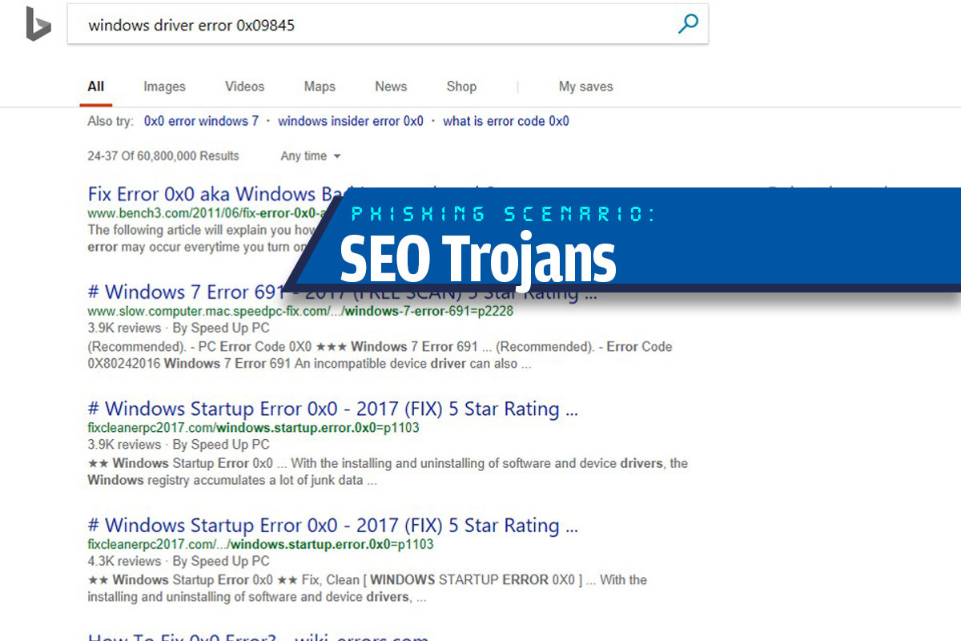

Websites!
The website showing up at top may be a fake website!
Search Engine
Retrieved from: https://www.csoonline.com/article/3235520
Notes:
This is also a very common type of online scams that induces users to install malware. When users encounter technical problems, they will search on the Internet to find the reason. When users open the search results on the Internet, usually showing up at the top of search engine, they will jump to a fake website. The page will require users to install some software to solve the problem, and there will be malicious code in the installed software.

Slide 12


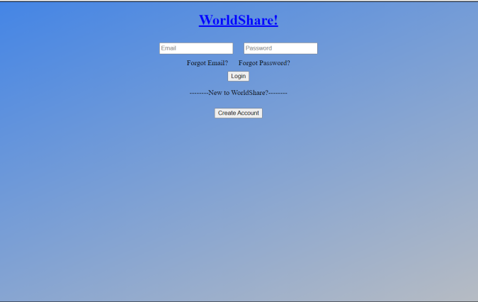
Solid Project’s
Our Website!
Html
Java Script
CSS
“Our Walkthrough”

Slide 13

How to prevent phishing
Suggestions from “Blog Test”

Slide 14
Always suspect phone calls, visits, or emails from individuals asking for employees or other inside information.
If an unknown person claims to be from a legitimate organization, try verifying their identity directly with the company.
Do not provide organizational or personal information, including organizational or network structure, unless you determine that person has a right to use the information.

Slide 15

Do not disclose personal or financial information in an email, and do not respond to email requests for such information, including links sent via email.
Do not send sensitive information over the Internet until you have checked the security of your website.
Note the URL of the site. An ADDRESS beginning with HTTPS indicates that the site is secure, not HTTP.
If not sure whether E-mail request legal, please directly contact the company for their verification.

Slide 16
Do not use the contact information provided on the site associated with the request.
Install and maintain antivirus software, firewalls, and email filters to reduce some of this traffic.
Take advantage of any anti-phishing features provided by email clients and web browsers.

Slide 17
Thanks

