Slide 1
Data-Aware Task Scheduling for Approximate DAG Workflows in Federated Fog Systems
Wildfire response when the cloud is unreachable
Gayani Gupta · Amisha Gupta · Mohsen Amini Salehi · Antonio Fernández Anta · Sanjukta Bhowmick · José Aguilar
University of North Texas · UC Berkeley · IMDEA Networks Institute · IMDEA Software Institute · Universidad de Los Andes
Notes:
Imagine the cloud connection going down in the middle of a wildfire. Cameras and sensors keep producing data, but responders still need useful information quickly. Our question is whether nearby fog computers can work together to finish that analysis in time. I’ll walk through the challenge, our scheduling methods, the experiments, and what the results tell us.

Slide 2
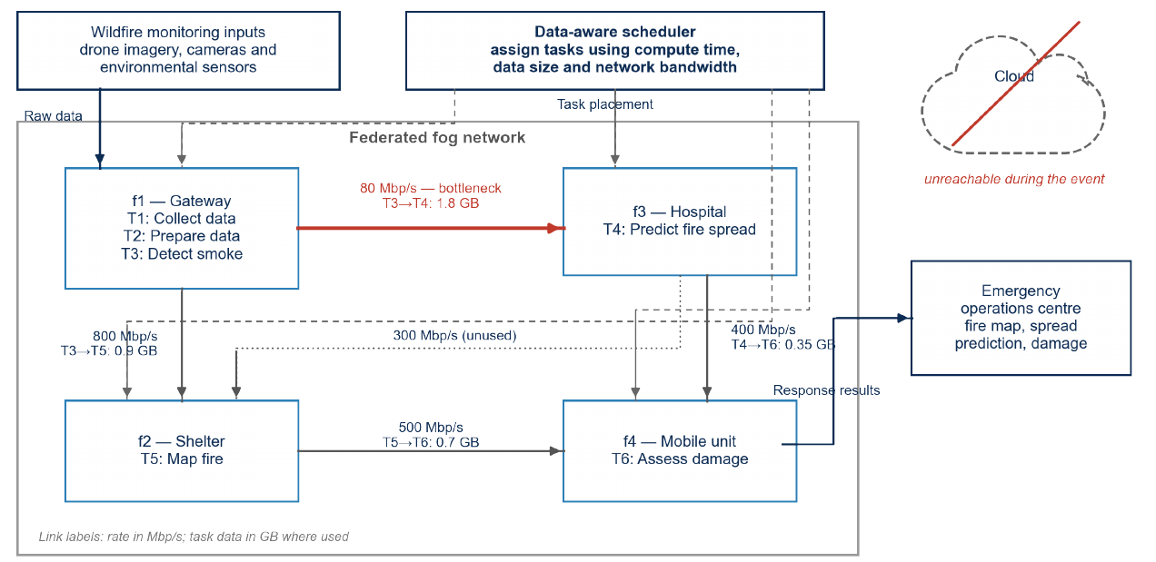
When the cloud fails, fog nodes must carry the workflow
1 · RESEARCH PROBLEM
1
Data movement
A task’s input can take as long to arrive as the task takes to run. Fast remote nodes can lose time on transfer.
2
Approximate execution
Many tasks can run partially: a less accurate result in less time, often the right trade-off under a deadline.
Fig. 1 of the paper · tasks T1–T6 placed on four fog nodes; the red link is the 80 Mb/s bottleneck
Existing fog schedulers mostly reason about compute only, and run each task fully or not at all.
Notes:
Picture cameras, drones, and weather stations feeding a chain of tasks. If the cloud is unreachable, nearby fog sites have to cooperate. Two things make that harder than ordinary scheduling: data must travel between tasks, and some tasks can trade a little accuracy for a faster result. Many existing schedulers focus mainly on computing and treat each task as all-or-nothing. We account for both data movement and partial execution.

Slide 3
The workflow is a DAG; every edge carries data
1 · RESEARCH PROBLEM
Transfer delay
T2
T4
c_{ji}^{ba} = D_{ji} / B_{ba} (0 if same node)
0.45 GB
1.2 GB
0.35 GB
T3 on f1 → T4 on f3
180 s
T1
T6
1.8 GB
1.8 GB = 14.4 Gb over an 80 Mb/s link. T4 cannot start until T2 and T3 have both delivered.
2.4 GB
0.7 GB
T3
T5
0.9 GB
T1 collect · T2 prepare env. data · T3 detect smoke · T4 predict spread · T5 map fire · T6 assess damage
Notes:
Follow the arrows from T1 through the workflow. Each arrow means the next task must wait for its input, and that input has a size. If T3 runs on f1 and T4 on f3, the 1.8-gigabyte output crosses an 80-megabit-per-second link: 14.4 gigabits, or about 180 seconds. If both tasks share a node, there is no network delay. Placement therefore affects waiting time as well as compute time.

Slide 4
The scheduling problem: where to run, and how much
1 · RESEARCH PROBLEM
Given
Decide
Maximize
Workflow DAG G=(T,E)
e_{ia}: the one node that runs T_{i}
Average accuracy (1/n) Σ A_{i} Σ l_{ia}
Run times t_{ia}, eligibility P_{ia}
l_{ia}: fraction of T_{i} executed
Subject to: precedence + transfer delay
Data sizes D_{ji}, bandwidths B_{ba}
Each task stays on a single node
Placement eligibility
Accuracy weights A_{i}, deadline t_{max}
Fraction ℓ costs ℓ·t, earns ℓ·A
Every task done by t_{max}
Approximate execution (illustrative: 100 time units available)
ℓ = 1.0 · 120
At full quality the task needs 120 units and misses the deadline. At ℓ = 0.8 it needs 96 and fits, at 80% of its accuracy.
ℓ = 0.8 · 96
deadline
Notes:
For each task, we choose one eligible node and how much of the task to execute. The goal is to maximize average accuracy while ensuring every task and its incoming data finish before the deadline. In this model, a fraction of a task costs the same fraction of its time and yields the same fraction of its accuracy. The example makes that concrete: 80 percent takes 96 units, so it fits within a 100-unit deadline where the full 120-unit run would not.

Slide 5
Four contributions
2 · CONTRIBUTIONS
1
Data- and bandwidth-aware MILP
2
Three scalable schedulers
Placement and execution fraction decided jointly: maximize average accuracy under precedence, transfer delay, eligibility and one deadline.
LP relaxation + randomized rounding, a bandwidth-aware greedy, and a genetic algorithm, all on the same cost model.
3
Simulation study
4
Correctness and linearization
Deadline slack, federation size, workflow size, task failures and link-bandwidth degradation, with a bandwidth-blind baseline.
Proof that feasible solutions match valid schedules, plus an exact big-M linearization of the e·M product.
To our knowledge, no earlier model treats per-edge data, per-link bandwidth and partial execution together.
Notes:
We make four contributions: a data- and bandwidth-aware MILP; three faster alternatives—LP rounding, greedy scheduling, and a genetic algorithm; a simulation study across deadlines, federation size, workflow size, failures, and link degradation; and a correctness argument with an exact linearization. Our novelty claim is scoped: to our knowledge, earlier models do not combine per-edge data, per-link bandwidth, and partial execution in this way.

Slide 6
One cost model, four schedulers
3 · METHODOLOGY
Shared inputs: DAG · t_{ia} · D_{ji} · B_{ba} · P_{ia} · t_{max} → every method evaluates c_{ji}^{ba} = D_{ji} / B_{ba}
MILP
LP + rounding
Greedy
Genetic algorithm
Base method · exact
LP-guided sampling
Fast heuristic
Metaheuristic
Decides node and fraction jointly
Relax e_{ia} to [0,1], sample nodes
Ready task → earliest-finish node
Chromosome = nodes + fractions
Optimal when solved to certification
Second LP sets fractions and timing
One global fraction ℓ, shrunk if late
Fitness rewards accuracy, penalizes lateness
Binary variables grow as n × N
No optimality guarantee
Cannot look ahead
Fixed budget as n grows
Notes:
All four schedulers use the same inputs and transfer-delay calculation, so we compare them on equal terms. The MILP jointly chooses placements and fractions; when it finishes with a certificate, its result is optimal for the model. The other methods trade that guarantee for speed or scalability: one samples from an LP, one makes greedy choices task by task, and one searches a population of whole schedules.

Slide 7
MILP: maximize accuracy under data-aware constraints
BASE METHOD · MILP
max (1/n) Σ_{i} A_{i} Σ_{a} l_{ia}
Objective (2): average accuracy
Decision variables
e_{ia} ∈ {0,1}
Σ_{a} e_{ia} = 1, e_{ia} ≤ P_{ia}
(3)–(4) one eligible node
node that runs T_{i}
l_{ia} ∈ [0, e_{ia}]
0 ≤ l_{ia} ≤ e_{ia}
(5) fraction only where placed
fraction executed
M_{ia}
earliest start time
M_{ia} ≥ y_{j} + Σ_{b} e_{jb} c_{ji}^{ba}
(6) data-aware: wait for inputs
y_{i}
completion time
y_{i} = Σ_{a} e_{ia}(M_{ia} + t_{ia} l_{ia}) ≤ t_{max}
(8)–(9) finish by the deadline
The MILP optimum is the best achievable accuracy: the benchmark for the other methods.
Notes:
The variables capture the key choices: e says where a task runs, l says what fraction runs, M is its start time, and y is its completion time. The objective rewards average accuracy. Placement constraints choose one eligible node, and the fraction is tied to that placement. The data-aware constraint makes a task wait for its predecessor and the transfer of its output. The remaining constraints define completion and enforce the deadline.

Slide 8
Linearizing e × M so standard solvers apply
BASE METHOD · MILP
The quadratic term in (8)
e_{ia} = 0
y_{i} = Σ_{a} e_{ia}(M_{ia} + t_{ia} l_{ia}) contains e_{ia} · M_{ia}
node not selected
z_{ia} = 0
Replace with z_{ia} = e_{ia} M_{ia}, U = t_{max} + max c_{ji}^{ba}:
y_{i} = Σ_{a} z_{ia} + Σ_{a} t_{ia} l_{ia}
0 ≤ z_{ia} ≤ e_{ia} U
e_{ia} = 1
M_{ia} − (1 − e_{ia}) U ≤ z_{ia} ≤ M_{ia}
node selected
z_{ia} = M_{ia}
Theorem 2: same feasible (e, l) pairs and same optimal value, now solvable with standard MILP solvers.
Notes:
The completion-time equation includes a binary placement variable multiplied by a continuous start time, which makes the model quadratic. We introduce z to represent that product and use big-M bounds based on the maximum relevant time. If a node is not selected, z is zero; if selected, z equals the start time. This gives an exact linear formulation that standard MILP solvers can use without changing the feasible placements or optimal value.

Slide 9
LP relaxation with randomized rounding
METHOD 2 · LP RELAXATION
1
Relax
2
Interpret
3
Sample
4
Optimize
Let e_{ia} ∈ [0,1] and solve the linearized LP; call the values r_{ia}.
Read r_{ia} as a distribution over eligible nodes, renormalized over P_{ia} = 1.
Draw one node per task. Discard infeasible draws and resample.
Fix the placement; a second LP sets l_{ia} and the timing values.
Illustration for T4: LP gives f1 70% · f3 30%. The draw picks f3, the second LP sets ℓ and timing. If the draw misses the deadline, resample.
No optimality guarantee, but a distribution from a real optimization. Cost: 26.6 s at n=100 (Table II).
Notes:
The LP method first relaxes binary placement choices to values between zero and one. We use those values as weights over eligible nodes, sample one placement per task, and reject infeasible samples. With placements fixed, a second LP chooses execution fractions and timing. There is no optimality guarantee, but choices are guided by the same data-aware model. The T4 split is illustrative; the reported scheduler time at 100 tasks is about 26.6 seconds.

Slide 10
Bandwidth-aware greedy: earliest finish, task by task
METHOD 3 · GREEDY
1
Pick a ready task
Illustrative: where does T4 finish first?
π_{i} = β A_{i} + (1−β) CP_{i}
T4 on f1 · inputs at 60 s and 80 s
2
Try every eligible node
M_{ia} = max_{j}(y_{j} + c_{ji}^{ba}); finish = M_{ia} + t_{ia} ℓ
finish 300 s
T4 on f3 · inputs at 100 s and 260 s
3
Commit the earliest finish
Record placement, release successors
finish 330 s
4
If makespan > t_{max}
gray = waiting for inputs · colour = compute (220 s on f1, 70 s on f3)
ℓ ← ℓ − δ and rebuild; below ℓ_{min}: infeasible
Faster node, later finish: f3 saves 150 s of compute but its input needs 180 s to arrive. Greedy picks f1.
Notes:
The greedy scheduler works through tasks in dependency order. It prioritizes ready tasks using accuracy and critical-path urgency, then picks the eligible node with the earliest finish, including input-transfer time. If the schedule misses the deadline, it lowers one shared execution fraction and rebuilds. Here f3 computes faster, but its input arrives later: T4 finishes at 330 seconds there versus 300 seconds on f1. The method does not look ahead.

Slide 11
Genetic algorithm: search over whole schedules
METHOD 4 · GENETIC ALGORITHM
Chromosome (illustrative): one node and one fraction per task
 | T1 | T2 | T3 | T4 | T5 | T6
node f(i) | f1 | f1 | f1 | f1 | f2 | f4
fraction ℓi | 1.0 | 1.0 | 1.0 | 0.9 | 1.0 | 1.0
Fitness Φ = (1/n) Σ A_{i} ℓ_{i} − λ₁ · 1[Y_{max} > t_{max}] − λ₂ · (Y_{max} − t_{max})⁺ / t_{max}
Y_{max} from a forward pass: M_{i} = max_{j}(y_{j} + c_{ji}), y_{i} = M_{i} + t_{i} ℓ_{i}
Initialize
Evaluate
Select + cross
Mutate + repair
Elitism
Feasible population; seed co-location of data-heavy edges
Score Φ by a forward pass over the DAG
Tournament or roulette; one-point crossover on f and ℓ
Reassign nodes, jitter ℓ; co-locate across slow links
Keep the top-k; stop at max generations
Notes:
The genetic algorithm searches complete candidate schedules. Each candidate specifies a node and execution fraction for every task. A forward pass computes finish times, and the fitness rewards accuracy while penalizing deadline violations. Initialization and repair account for data movement, including co-locating tasks when links are slow. This broader search can find patterns greedy misses, but a fixed search budget becomes a disadvantage as workflows grow.

Slide 12
Same decision, four ways of searching
METHODS COMPARED
Method | How it decides | Guarantee | Scheduler time | Main limitation
MILP | Placement and fractions jointly, exactly | Optimal when certified | 0.39 s at n=100; capped at 800 variables | Binary variables grow as n × N
LP + rounding | Sample nodes from LP, then LP for fractions | None | 26.59 s at n=100 | Samples stop passing feasibility at low bandwidth
Greedy | Earliest finish per task, one global ℓ | None | 0.003 s at n=100; 0.15 s at n=1000 | No look-ahead
Genetic algorithm | Population search over (f, ℓ) | None | 5.37 s at n=100; 73.13 s at n=1000 | Fixed budget; score drops with n
Notes:
This table puts the trade-offs side by side. The MILP can certify an optimum but is capped in size. LP rounding and the genetic algorithm have no optimality guarantee and take longer in these examples. Greedy is much faster—about 0.003 seconds at 100 tasks and 0.15 seconds at 1,000—but has no look-ahead. These are scheduler times, not total workflow execution times.

Slide 13
Simulation setup and five experiments
4 · EXPERIMENTS
Setup
1
Deadline slack
α from 1.0 to 2.0, t_{max} = α · T_{cp}
Task times 3–10 min · payloads 1–8 GB · links 80–640 Mb/s
Node speeds 0.8–1.25×; ~15% of task–node pairs ineligible
Default: n=50, m=5, α=1.5, density 0.15, 10 replications
MILP: 60 s limit, 300 s certified re-solve, cap 800 variables
Metrics: accuracy Ā, deadline feasibility, makespan, scheduler time
2
Federation size
N from 2 to 10 nodes
3
Workflow size
10, 100 and 1000 tasks
4
Task failures
0–50% per task, retry once
5
Link bandwidth
scaled ×1.0 down to ×0.05, deadline fixed
Compared: MILP · LP rounding · greedy · GA, plus a bandwidth-blind greedy baseline.
Notes:
We evaluate the methods in a discrete-event simulator using synthetic disaster-response workflows. Task runtimes range from three to ten minutes, payloads from one to eight gigabytes, and links from 80 to 640 megabits per second. The default experiment uses 50 tasks, five nodes, and ten replications. We vary five factors, compare against a greedy baseline that ignores bandwidth, and track accuracy, deadline feasibility, makespan, and scheduler time.

Slide 14
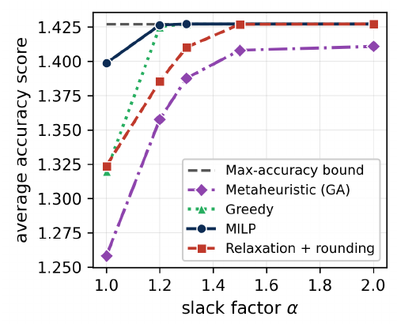
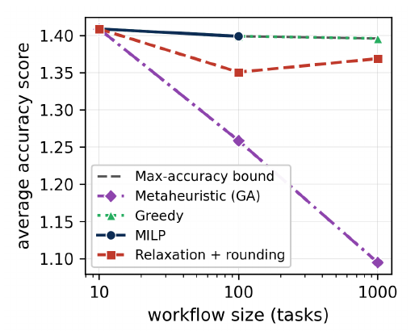
Tight deadlines and large DAGs separate the methods
5 · RESULTS
Slack α=1.0 (bound 1.43): MILP 1.40 · rounding and greedy ≈1.32 · GA 1.26. From α=1.2 greedy and certified MILP reach the bound.
At 1000 tasks: greedy stays on the bound (≈0.15 s); GA falls to 1.12 (≈73 s); MILP exceeds its size cap.
Scheduler choice matters most when the deadline binds. Extra nodes add feasible placements, not accuracy.
Notes:
The first result is about deadline slack. At alpha 1.0, the MILP reaches 1.40 against a bound of 1.43; rounding and greedy are around 1.32, and the genetic algorithm is at 1.26. From alpha 1.2, greedy and the certified MILP reach the bound. At 1,000 tasks, greedy remains at the bound in roughly 0.15 seconds, while the genetic algorithm falls to 1.12 and the MILP exceeds its size cap.

Slide 15
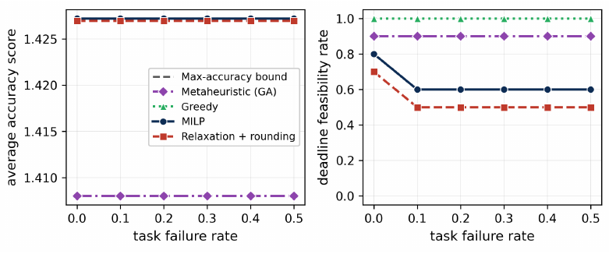
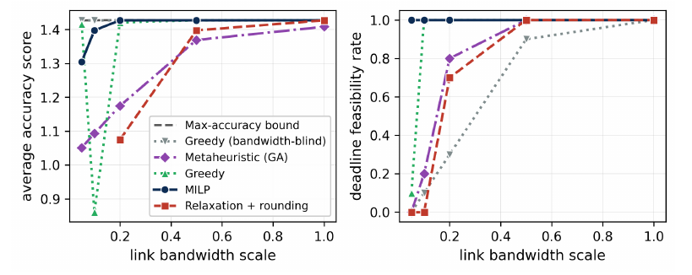
Feasibility, not score, separates methods under stress
5 · RESULTS
Retry-once failures. Scores flat. Feasible runs: greedy 100%, GA ~90%, MILP ~60%, rounding ~50%.
Slower links. Blind baseline keeps the bound-level score but misses the deadline at ×0.5 and fails every run at ≤×0.1. MILP stays feasible throughout (−9% score at ×0.05); greedy to ×0.1.
A high score can hide a missed deadline: report accuracy together with deadline feasibility.
Notes:
Under stress, feasibility tells a different story from score. With retry-once failures, scores stay flat, but feasible runs are 100 percent for greedy, about 90 for the genetic algorithm, 60 for the MILP, and 50 for rounding. As bandwidth degrades, the bandwidth-blind baseline can report a bound-level score while missing the deadline. The data-aware MILP stays feasible across tested levels, with about a 9 percent score reduction at 5 percent bandwidth. Report accuracy and feasibility together.

Slide 16
What we learned, and what comes next
6 · TAKEAWAYS
Findings
Limits
Next
MILP wins when deadlines bind (1.40 vs 1.26–1.32)
Linear time–quality model, no contention
Sparse and decomposed formulations
Greedy matches the bound at scale in ≈0.15 s
Retry-once failures only
Adaptive GA budgets; replication and checkpointing
Data-aware placement keeps schedules feasible when links degrade
MILP cap, fixed GA budget, dense storage; simulation only
Online rescheduling; real fog testbed
Code, instances and solver logs: github.com/gayanigupta/data-aware-scheduling
Notes:
To close, the MILP is useful when deadlines are tight and an optimality benchmark matters; greedy can match the bound at scale in a fraction of a second; and modeling data movement helps preserve feasibility as links degrade. Limits include a linear time–quality model, no network contention, retry-once failures, and simulation rather than a real testbed. Next steps include sparse and decomposed models, adaptive search budgets, resilience mechanisms, online rescheduling, and a real fog deployment. The code and data are linked on this slide.

