Slide 1
Scheduling Data-Intensive DAG Workflows
across Federated Fog Systems
— a three-part research arc —
Gayani Gupta, Amisha Gupta, Mohsen Amini Salehi,
Antonio Fernandez Anta, Sanjukta Bhowmick, Jose Aguilar
University of North Texas | UC Berkeley | IMDEA Networks | Universidad de Los Andes
github.com/gayanigupta/data-aware-scheduling
Notes:
Welcome. This deck tells one continuous story in three parts: what we published at IEEE Cloud Summit 2025, the data-aware scheduling work that extends it, and the proposed next project — dynamic partial repartitioning after resource failure.

Slide 2
The road we will take
PART I
Published foundation — Efficient task allocation for DAG workflows across federated fog (IEEE Cloud Summit 2025)
PART II
Current work — Data-aware scheduling of approximate DAG workflows (this submission)
PART III
Proposed work — Dynamic partial repartitioning after fog-resource failure
Notes:
Three movements. Part I: the published foundation — federated fog scheduling with MILP, relaxation, greedy, and a genetic metaheuristic. Part II: this work — making the model truly data-aware, adding approximation, a bound, richer failure and bandwidth experiments, and an honest look at scale. Part III: the proposal — what happens when a whole fog resource fails mid-workflow.

Slide 3
PART I
Published Foundation
Towards Efficient Allocation of Tasks in DAG-based Workflows across Federated Fog Systems — IEEE Cloud Summit 2025
Notes:
Part I is the work already published at IEEE Cloud Summit 2025. It established the formulation and the four schedulers that everything else builds on.

Slide 4
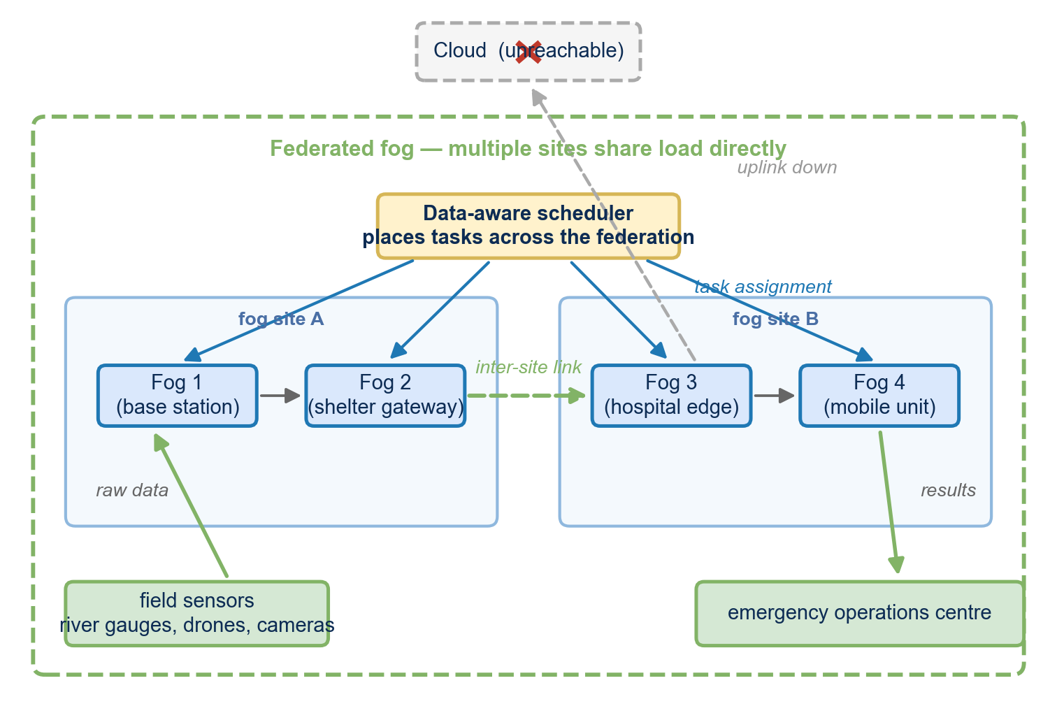
The Compute Continuum
Three tiers cooperate to run a scientific workflow:
  Edge — sensors, acquisition, immediate preprocessing
  Federated fog — latency-sensitive DAG execution near the data
  Cloud / HPC — elastic capacity for non-urgent, heavy stages
Placement is a three-way trade-off: compute capacity, data locality, network availability
Our focus: the federated fog tier — where deadlines are tight and links are variable
Federated fog tier in the compute continuum
Part I | Published work — IEEE Cloud Summit 2025
3
Notes:
The first paper framed fog scheduling inside the Compute Continuum: edge devices capture data, the federated fog tier runs latency-sensitive DAG tasks, and cloud/HPC provides elastic capacity for work that can tolerate the distance. Our paper focused on the fog tier — the most constrained, latency-sensitive part.

Slide 5
The scheduling bottleneck we identified
Every task placement is a high-stakes trade-off
A 'fast' remote node can lose more time shipping the input than it saves executing
Cloud-network assumptions (high, stable bandwidth) do not hold at the edge
Disaster and monitoring workloads make it worse: the event that needs the answer also degrades the network
No existing model jointly priced placement + data volume + per-link bandwidth + execution fractions
Part I | Published work — IEEE Cloud Summit 2025
4
Notes:
In the continuum, intermediate data must cross heterogeneous links of variable bandwidth. A placement that looks optimal on compute alone can blow the deadline because moving the input data costs more than the execution saves. Cloud-centric schedulers assume fat, stable links; in the fog that assumption breaks.

Slide 6
The model we published
DAG G = (T,E); task T_i, resource f_a, edge data D_ji
Communication delay c = D_ji / B_ba when placed on different resources; 0 when co-located
Eligibility P_ia — not every task can run everywhere
Approximate execution: fraction of full computation -> fraction of accuracy
Global deadline t_max; non-preemptive execution
MILP with correctness proofs — the benchmark for everything that follows
Part I | Published work — IEEE Cloud Summit 2025
5
Notes:
The formulation: tasks T_i on resources f_a; edge data D_ji crossing link bandwidth B_ba gives delay D_ji over B_ba — zero if co-located. Eligibility matrix P_ia; non-preemptive tasks; approximate execution expressed as a fraction of full computation. Deadline t_max over all tasks.

Slide 7
Four schedulers
MILP — global optimum; the reference point
Randomized relaxation — solve the LP, round assignments, re-solve fractions
Data-aware greedy — priority pi = a*A_i + (1-a)*CP_i; earliest-finish placement on ready tasks
Genetic metaheuristic — chromosome = assignment + fractions; fitness rewards accuracy, penalizes lateness
Part I | Published work — IEEE Cloud Summit 2025
6
Notes:
Four methods, same model: the exact MILP; a randomized relaxation that solves the continuous LP and rounds; a bandwidth- and data-aware greedy with a composite accuracy/critical-path priority; and a genetic metaheuristic searching the assignment-plus-fraction space.

Slide 8
Orchestration: turning a solution into a system
Static state: DAG, data sizes, execution profiles, eligibility, deadline, approximation requirements
Dynamic state: availability, load, bandwidth estimates, reachability, policy
Key rule: resource discovery is coupled with data-path discovery
  a stronger remote node is not a candidate unless its input can arrive in time
Every decision is logged for provenance and reproducibility
Part I | Published work — IEEE Cloud Summit 2025
7
Notes:
A placement solution needs an operational procedure around it. The journal framework adds an orchestration loop: gather static workflow state and dynamic resource state; a key rule — resource discovery must be coupled with data-path discovery; a powerful remote resource is useless if its prerequisites cannot arrive in time.

Slide 9
A scheduler-selection policy
Small/stable workflow, time to plan -> MILP
Large workflow, quality-sensitive -> randomized relaxation
Tight reaction deadline -> greedy
Broad dynamic search space -> genetic metaheuristic
Node failure / bandwidth loss / policy change -> re-evaluate on updated resource graph
The policy makes the comparison operational, not just academic
Part I | Published work — IEEE Cloud Summit 2025
8
Notes:
No single method wins everywhere, so we distilled the comparisons into an operational policy: MILP when the instance is small or stable; randomized relaxation when the workflow is large but quality matters; greedy for rapid local response; the GA when the search space is broad and planning time exists; and on failure or degradation, re-evaluate on the updated state.

Slide 10
An adaptive execution and resilience loop
1. Detect a state change; identify affected tasks and dependencies
2. Update eligibility and communication estimates
3. Decide: continue under the existing plan, or replan?
4. Re-schedule only the unresolved tasks; record the reconfiguration
Named but not yet built: checkpoint/restart, partial repair — the seed of Part III
Part I | Published work — IEEE Cloud Summit 2025
9
Notes:
Schedules are monitored, not fire-and-forget. Four steps: detect a change and identify affected tasks; update eligibility and transfer estimates; decide whether the remaining work can continue as-is or needs replanning; invoke the scheduler only for the unresolved tasks. Checkpoint-and-restart was named as a future extension.

Slide 11
What the evaluation covered
Four dimensions of comparison:
  deadline slack alpha in [1.0, 2.0]
  federated fog nodes: 2, 4, 6, 8, 10
  workflow size: 10, 100, 1000 tasks
  workflow-node failure rate: 0% - 50%
Published findings:
  MILP is the quality reference
  relaxation + GA track it most closely
  greedy is the low-overhead option under pressure
Part I | Published work — IEEE Cloud Summit 2025
10
Notes:
Four dimensions: deadline slack 1.0 to 2.0; federation size 2 to 10 nodes; workflow scale 10/100/1000 tasks; failure rates 0 to 50 percent. Findings: MILP the quality reference; relaxation and GA track it best; greedy fastest but lowest accuracy under pressure; accuracy falls with failures.

Slide 12
What the first paper left open
Failure study measured accuracy loss — not recovery
No link-degradation dimension (what if bandwidth itself shrinks?)
No explicit max-accuracy bound drawn against the methods
Scalability limits of each solver left unquantified
Recovery protocol described conceptually — not built
Part II closes the first four. Part III attacks the last.
Part I | Published work — IEEE Cloud Summit 2025
11
Notes:
Honest gaps at the end of Part I: the failure model treated accuracy loss, not recovery; no bandwidth-degradation dimension; no explicit accuracy bound for comparison; scalability limits unexplored; and no recovery protocol — replanning was described, not built.

Slide 13
PART II
Data-Aware Scheduling of Approximate DAG Workflows in Federated Fog Systems
Making the model honest: bounds, bandwidth degradation, retry semantics, scalability limits — and a reproducible artifact
Notes:
Part II is the current work. Same core model — now hardened and stress-tested. The story: a disaster scenario, a joint formulation, four schedulers on one cost model, five experiments, and what the data actually says.

Slide 14
The scenario
A disaster unfolds: flood, wildfire, offshore incident
The deadline is hard: a forecast that arrives late is a forecast nobody uses
The uplink to the cloud is degraded or gone — the work must run on nearby fog machines
SENSE
MODEL
FORECAST
PLAN
ALERT
deadline
cloud uplink
Part II | Current work — Data-aware approximate scheduling
13
Notes:
A river basin floods. The response workflow — sense, model, forecast, plan, alert — runs as a DAG. The deadline is hard: a forecast after the water is useless. And the cloud uplink is degraded or gone. The work must happen on fog computers near the disaster area.

Slide 15
One fog site is not enough — so sites federate
Fog sites near the event: cell-tower racks, roadside cabinets, platform servers
Individually too weak; but they keep fast, stable links to each other even when the cloud link fails
Federation = a small local cloud built from nearby sites
The catch: every task can now run in many places —
  and wherever it runs, its input data has to get there first
Federated fog deployment around a disaster area
Part II | Current work — Data-aware approximate scheduling
14
Notes:
A single fog site rarely has capacity for the whole workflow. But nearby sites keep fast local links to each other even when the cloud link dies. Federating them creates a small local cloud — at the price of a placement choice for every task, where every choice ships data across a link.

Slide 16
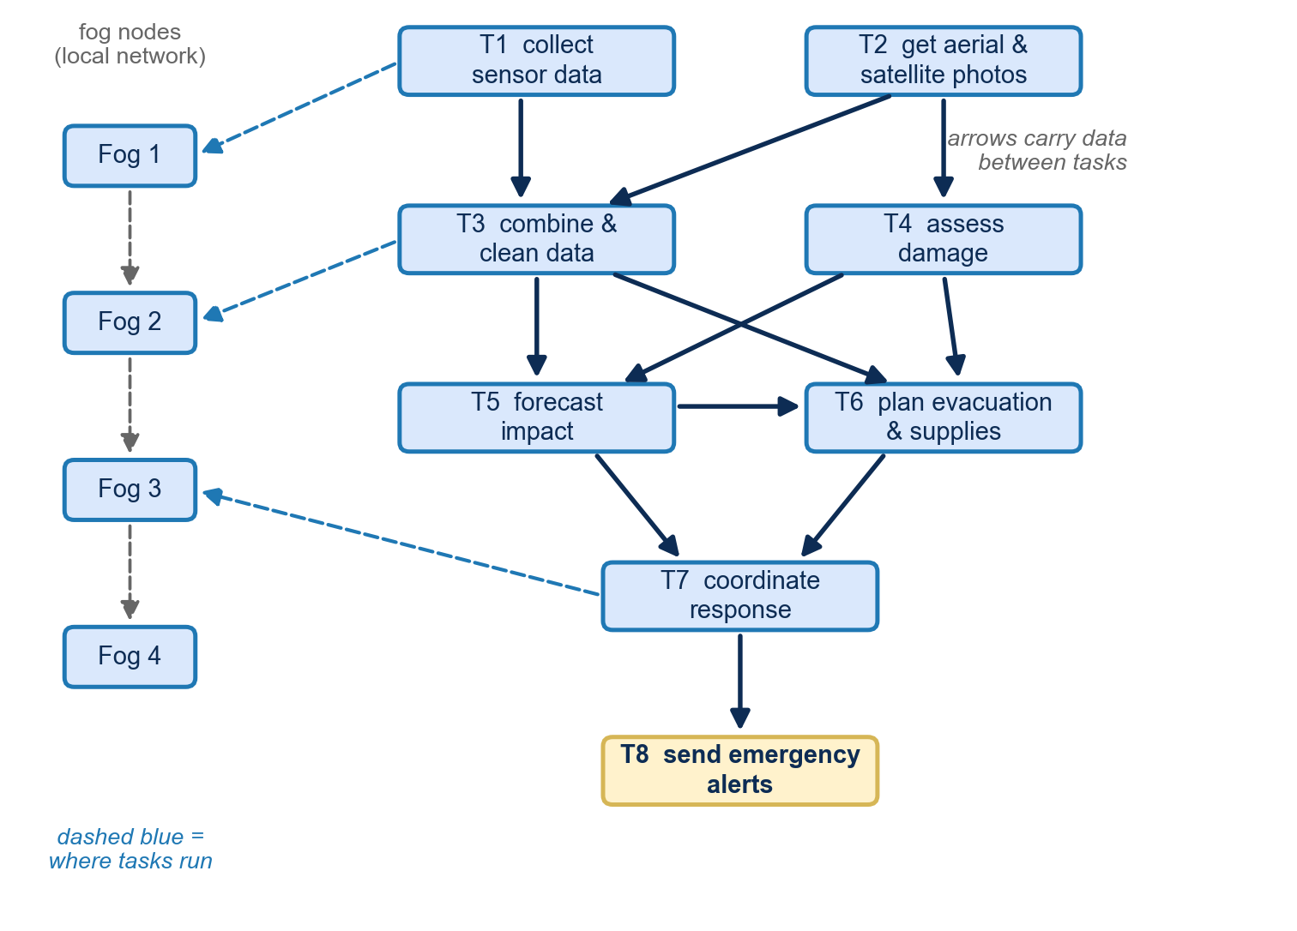
The workflow is a DAG — and data is the glue
Tasks = nodes, dependencies = edges (a DAG)
Every edge carries data, D_ji, across a link of bandwidth B
  transfer time = D_ji / B — comparable to task runtime
Tasks are approximate: running a fraction l costs l of the time and returns l of the accuracy
  a flood model at 80% fidelity still warns in time
Example disaster-response DAG used in the study
Part II | Current work — Data-aware approximate scheduling
15
Notes:
Tasks are nodes, dependencies are edges, and each edge carries data that must cross a link. Transfer time D over B can rival the task's own runtime — that is lever one. Lever two: tasks can run partially — a fraction l of the work costs l of the time and returns l of the accuracy.

Slide 17
The problem, in one sentence
Assign every task to a fog node AND choose how much of it to run,
so that the DAG finishes before the deadline
with the highest possible average accuracy.
Why it is hard:
  data transfer time rivals execution time — the 'fastest' node can be the worst once you pay to move the input
  accuracy is a tradeable resource — tight deadline? run partially, arrive on time
  the two choices interact: placement decides transfers, fractions decide runtimes
Part II | Current work — Data-aware approximate scheduling
16
Notes:
Place every task on a node, choose how much of each to run, finish before the deadline, maximize accuracy. Two things make it hard: data movement rivals execution, and accuracy is a tradeable resource — and the two choices interact.

Slide 18
Why existing schedulers do not fit
HEFT (Heterogeneous Earliest Finish Time): the classic DAG scheduler
  ranks tasks, places each where it finishes earliest
  but: full execution only; transfers are static edge weights
Fog schedulers handle capacity and placement — but assume tasks always run completely
Approximate-computing work trades quality for time — but ignores inter-node data movement
Our gap: jointly optimize placement + data movement + execution fraction under one deadline
Part II | Current work — Data-aware approximate scheduling
17
Notes:
HEFT — the classic reference — ranks tasks and places each where it finishes earliest, but assumes full execution and static edge weights. Fog schedulers do placement without approximation. Approximate-computing work trades quality for time without data movement. Nobody combined all three.

Slide 19
The formulation: one MILP
Decisions: e_ia in {0,1} (task i on node a), l_ia in [0,1] (fraction), M_ia (start time)
Objective: max (1/n) sum_i A_i sum_a l_ia — average accuracy
One eligible node per task: sum_a e_ia = 1
Precedence + data: task i waits until every predecessor j finished AND D_ji/B_ba arrived
Deadline: sum_a e_ia (M_ia + t_ia l_ia) <= t_max for all i
NP-hard even on unrelated parallel machines — the MILP is the benchmark, not the product
Part II | Current work — Data-aware approximate scheduling
18
Notes:
Decisions: assignment e_ia, fraction l_ia, implied start M_ia. Objective: average accuracy. Constraints: one eligible node per task; precedence waits for finish AND data arrival (the D over B term); completion inside the deadline. NP-hard — the MILP is the benchmark, and proofs plus a solver-ready linearization are in the paper.

Slide 20
Four schedulers, one cost model
MILP (HiGHS) — optimal at small/medium scale; the benchmark
LP relaxation + randomized rounding
  relax e_ia to [0,1]; sample each task's node from the LP; re-solve the LP for fractions
Data-aware greedy
  priority = beta*A_i + (1-beta)*critical-path; earliest-finish among ready tasks; on deadline miss, retry with a lower global fraction
Genetic algorithm
  chromosome = assignment + per-task fractions; fitness rewards accuracy, penalizes lateness; co-location repair for heavy edges
Part II | Current work — Data-aware approximate scheduling
19
Notes:
Because it is NP-hard: three scalable schedulers share the same communication-cost model — so differences are about the algorithm, not the accounting. LP rounding samples nodes from the fractional solution; greedy uses priority plus earliest finish with a fraction-retry; the GA searches assignments and fractions together.

Slide 21
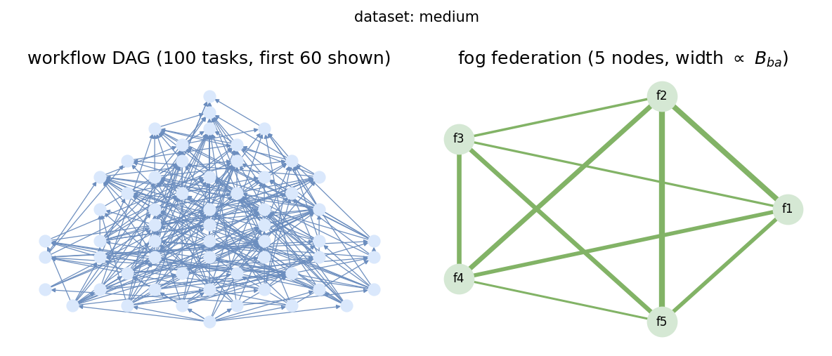
How we test it
Discrete-event simulator (NumPy + SciPy HiGHS)
Contested regime: t in [1,5], D in [5,50], B in [10,100] — a transfer can rival a task
Datasets: 10/3, 100/5, 500/8, 1000/10 tasks-nodes; ~15% ineligible placements; ~2x speed range
Five sweeps: slack | federation | workflow | failure | bandwidth
Metric: average accuracy vs the max-accuracy bound (dashed); plus feasibility and wall time
New baselines: max-accuracy bound; bandwidth-blind greedy
A generated dataset (100 tasks / 5 nodes)
Part II | Current work — Data-aware approximate scheduling
20
Notes:
Discrete-event simulator, NumPy plus SciPy HiGHS. Parameters chosen so the regime is contested — a transfer can genuinely rival a task. Four datasets, five sweeps, five reps each. New in this work: the max-accuracy bound as the dashed-line yardstick, a retry-once failure model, a bandwidth-degradation sweep, and a blind baseline.

Slide 22
Five questions
Q1 Deadline slack alpha in {1.0 ... 2.0} — how tight is the deadline?
Q2 Federation size N in {2 ... 10} nodes — does capacity help?
Q3 Workflow size n in {10, 100, 1000} — who scales?
Q4 Failure rate in {0 ... 0.5}, retry-once — who stays feasible?
Q5 Bandwidth x {1.0 ... 0.05} — what is data-awareness worth?
5 fresh instances per point; means reported
Part II | Current work — Data-aware approximate scheduling
21
Notes:
Each sweep isolates one variable. Slack: how tight is the deadline. Federation: how many nodes. Workflow: how many tasks. Failures: retry-once. Bandwidth: link degradation. Five fresh instances per point.

Slide 23
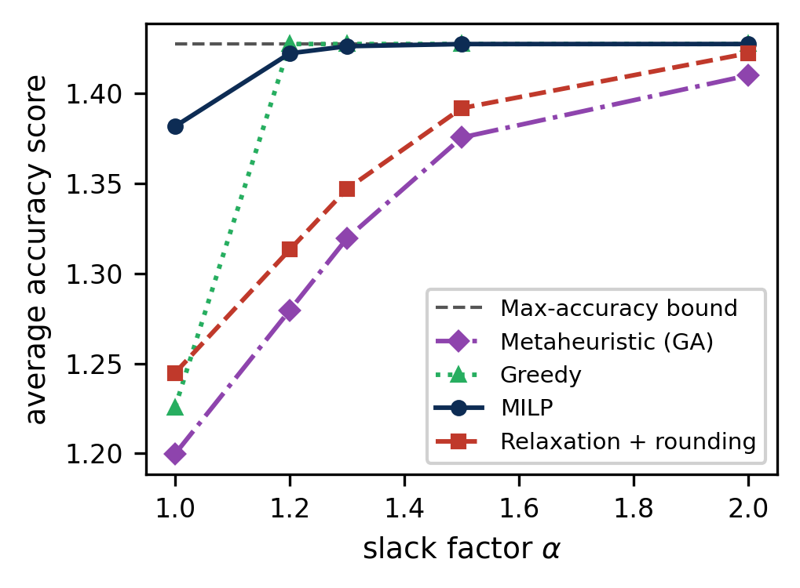
Q1 — Slack: the scheduler matters exactly when it hurts
alpha = 1.0: MILP 1.38 vs bound 1.43; rounding 1.25, greedy 1.23, GA 1.20
alpha >= 1.2: greedy reaches the bound; MILP joins by 1.5
Rounding and GA trail 2.5-8% even at alpha = 2.0 — a fixed budget cannot fully recover
Lesson: method choice matters most exactly where the deadline binds
Part II | Current work — Data-aware approximate scheduling
22
Notes:
At alpha=1.0 the deadline barely fits: MILP leads at 1.38 vs bound 1.43; rounding 1.25, greedy 1.23, GA 1.20. From alpha=1.2 greedy reaches the bound; MILP by 1.5. Rounding and the GA trail 2.5-8% even at loose slack — a fixed search budget never quite recovers.

Slide 24
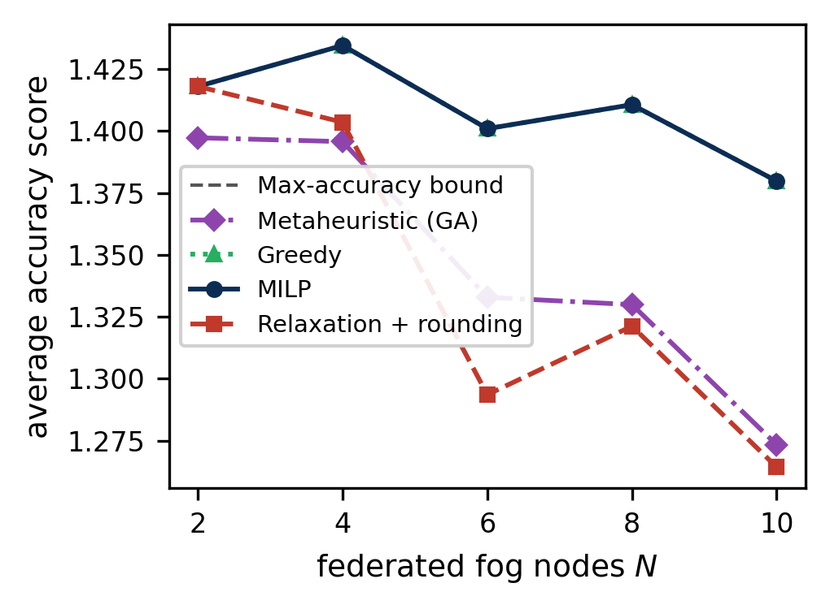
Q2 — Federation: capacity buys feasibility, not accuracy
MILP and greedy match the bound at every N
GA: ~1.5% below bound at N=2 -> ~8% below at N=10; rounding similar (~8% at N=10)
Reason: placement space grows with N but the search budget is fixed
Extra nodes never exceed the bound — they buy feasibility, not accuracy
Part II | Current work — Data-aware approximate scheduling
23
Notes:
Two to ten nodes. MILP and greedy on the bound at every size. GA drifts 1.5% to ~8% below; rounding similar. The placement space grows but the search budget is fixed — and extra nodes never exceed the bound: they buy feasible placements, not accuracy.

Slide 25
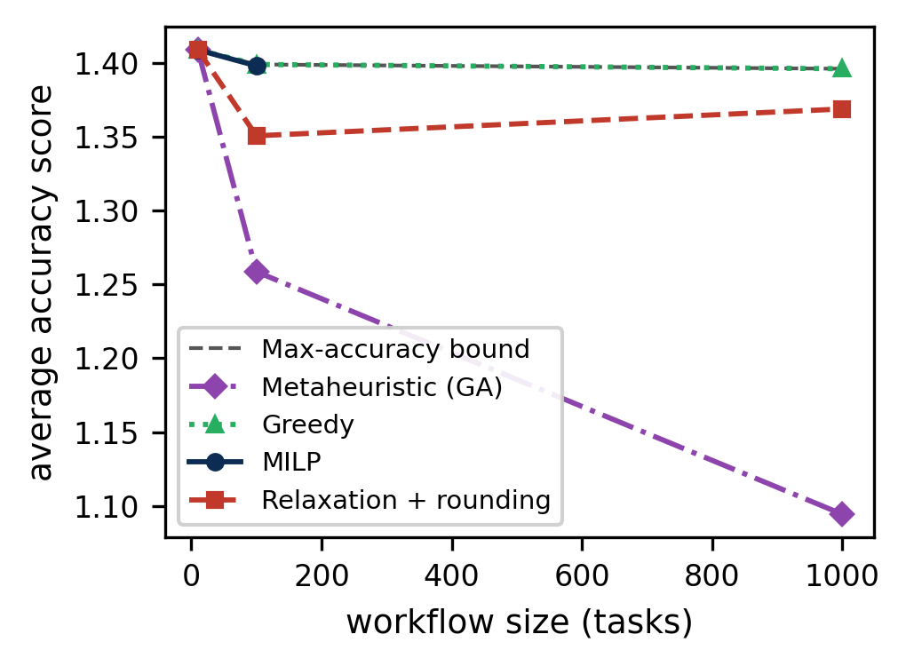
Q3 — Workflow size: the simple greedy holds up best
n = 10: all methods on the bound (1.41)
n = 100: MILP + greedy on bound; GA first to drift (1.26)
n = 1000: MILP past the 800-var cap; greedy on bound in 0.15 s; rounding 1.37 (~93 s/LP re-solve); GA 1.10 in ~159 s
GA budget is spread over a combinatorially growing space
Part II | Current work — Data-aware approximate scheduling
24
Notes:
Scale the DAG. n=10: everyone on the bound. n=100: GA first to drift. n=1000: MILP past its cap; rounding survives at ~93 s per LP re-solve; GA falls to 1.10 in ~159 s. The greedy stays on the bound in 0.15 seconds — the only method both fast and bound-level.

Slide 26
Same story on the four test datasets
small (10/3): all four methods identical score 1.64; greedy fastest, shortest makespan (16.8 vs ~18)
medium (100/5): MILP + greedy 1.44; rounding 1.32; GA 1.27 — but greedy makespan 43.1 vs ~61
large (500/8): only greedy + GA fit: 1.42 vs 1.17, makespan 50 vs 71
xlarge (1000/10): greedy 1.41 in 0.14 s; GA 1.13 in 73 s, makespan 120
Accuracy is not free in wall time — and neither is the makespan
Part II | Current work — Data-aware approximate scheduling
25
Notes:
The per-dataset table agrees. Small/medium: everyone near the same score, greedy fastest with the shortest makespan. Large/xlarge: only greedy and GA fit; greedy keeps ~1.41 while the GA falls to 1.17 then 1.13, with a ~40% longer makespan and 73 seconds of search.

Slide 27
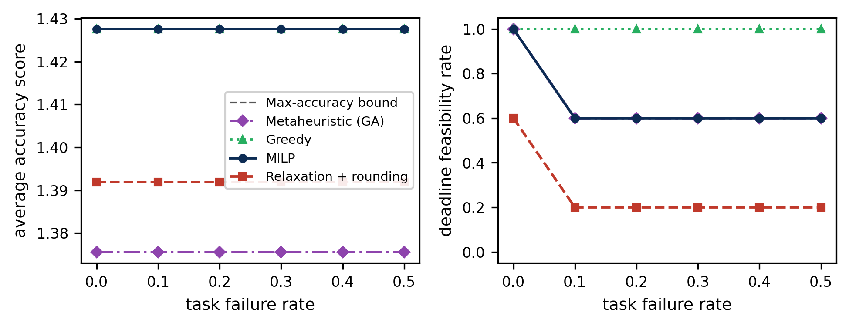
Q4 — Failures: scores stay flat; feasibility is the story
Retry-once model: failed task reruns in place; accuracy kept if the retry meets the deadline
Scores flat in failure rate — retries preserve accuracy
Feasibility at rate 0.5: greedy 100%; MILP/GA ~60%; rounding ~20%
Greedy's edge: it finishes early (makespan ~30 vs 40-80), leaving room for retries
Part II | Current work — Data-aware approximate scheduling
26
Notes:
Retry-once: a failed task reruns in place; accuracy is kept if the retry still meets the deadline. Scores are flat — watch feasibility. Greedy stays feasible at every rate; MILP and GA ~60% at 0.5; rounding ~20%. Greedy's edge: it finishes early, so a retry fits inside the deadline.

Slide 28
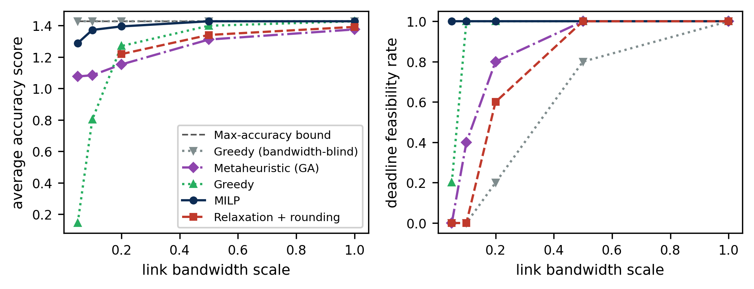
Q5 — Link degradation: what data-awareness is worth
Bandwidth-blind greedy: bound-level scores at every level — but infeasible (80% at 0.5x, 20% at 0.2x, 0% below)
MILP: feasible at all levels; ~10% score loss at 0.05x
Greedy: feasible to 0.1x, pays in accuracy; collapses at 0.05x
GA: holds to 0.1x; rounding survives only above 0.5x
High score + late = a missed alert, not a result
Part II | Current work — Data-aware approximate scheduling
27
Notes:
Degrade every link down to 5% of nominal. The blind baseline is the cautionary tale: bound-level scores at every level — but the schedules are late (feasibility 80% -> 20% -> 0%). MILP stays feasible everywhere, ~10% score loss at 0.05x; greedy feasible to 0.1x paying accuracy; GA fails at 0.05x; rounding only above 0.5x.

Slide 29
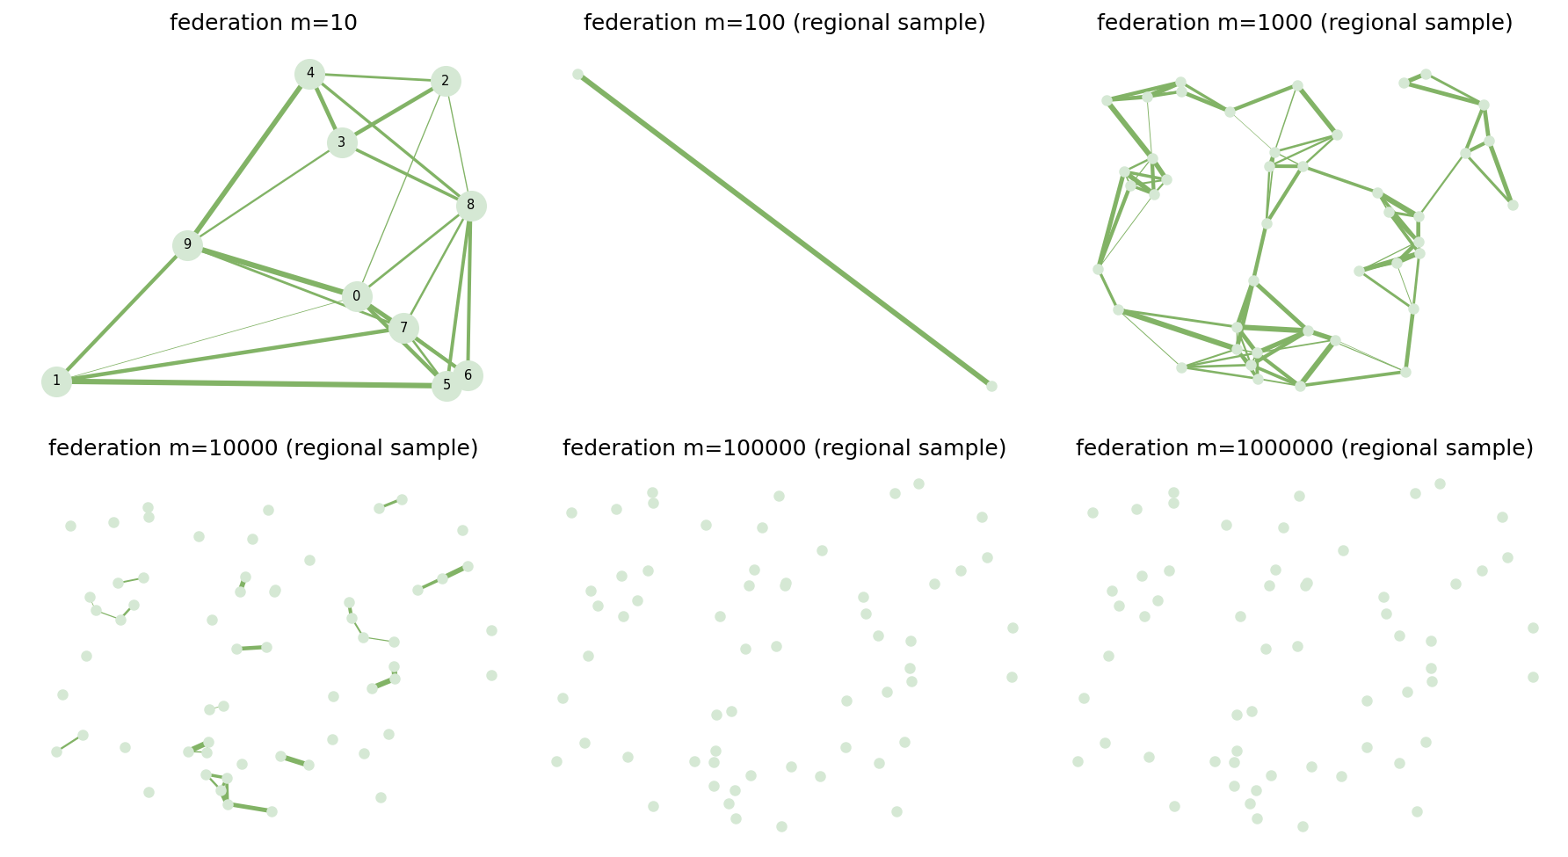
Beyond the sweeps: 10^6-task structures
DAG generator: 10^6 tasks / ~3M edges in ~3 s; depth grows like log n (24 -> 91 for 100 -> 10^6)
Resource graphs: 10^6 fog nodes in ~7 s; avg degree ~5, bandwidth 10-100
Structural generation is cheap; schedulable dense instances stop where constraints do
  MILP: ~800 assignment vars; LP: ~10^5 rows at n=1000; dense instancing ~10^4 tasks
Generated federated resource graphs (up to 10^6 nodes)
Part II | Current work — Data-aware approximate scheduling
28
Notes:
Separately we stress-tested generation: million-task DAGs in ~3 s with depth growing like log n; million-node resource graphs in ~7 s, degree ~5. Structural instances only — schedulable dense instances stop where constraints and memory do.

Slide 30
What we learned
1. The scheduler matters most exactly where the deadline binds — at loose slack almost anything works
2. Accuracy under a binding deadline costs wall time: greedy 0.15 s vs rounding ~372 s vs GA ~159 s at n=1000
3. Data-awareness buys feasibility, not score: the blind baseline's 'perfect' scores are late schedules
4. Fixed search budgets decay — GA quality erodes with both n and N
Rule of thumb: MILP at moderate scale, greedy at large scale, rounding/GA only where their cost is affordable
Part II | Current work — Data-aware approximate scheduling
29
Notes:
Four takeaways: the scheduler matters most exactly where the deadline binds; accuracy under a binding deadline costs wall time; data-awareness buys feasibility, not score; and fixed search budgets decay. Rule of thumb: MILP at moderate scale, greedy at large scale.

Slide 31
Honest limits
MILP capped at ~800 assignment variables — a deliberate boundary, not an oversight
LP relaxation: ~10^5 constraint rows at n=1000; rounding trials reduced as size grows
GA uses one fixed budget across all sizes — its gap is partly budget, partly search
Failure model is retry-once-in-place — no replication, checkpointing, or cross-node migration yet
Dense schedulable instances stop near 10^4 tasks; the 10^6 experiments are structural
Part II | Current work — Data-aware approximate scheduling
30
Notes:
What we do not claim: the MILP is capped at ~800 assignment vars; the LP grows to ~10^5 rows at n=1000; the GA has one fixed budget; the failure model is retry-once-in-place — no replication, checkpointing, or migration. Dense schedulable instances stop near 10^4 tasks.

Slide 32
Part II wrap-up
One joint formulation: placement + execution fraction + inter-node data movement, under a hard deadline
Four schedulers sharing one cost model; five parameter sweeps; a bound at every scale
MILP leads under pressure at moderate scale; the data-aware greedy is fast and bound-level at large scale
Everything reproduces: code, CSVs, executed notebook, this deck
Still open: the schedule is decided up front — what happens when a whole resource fails mid-workflow?
Part II | Current work — Data-aware approximate scheduling
31
Notes:
One joint formulation, proved and linearized. Four schedulers on one cost model. Five sweeps with real data. MILP leads under pressure at moderate scale; the data-aware greedy is fast and bound-level at large scale. What it still cannot do: react to a resource failing mid-workflow. That is Part III.

Slide 33
PART III
Proposed Research
Dynamic Partial Repartitioning of DAG Workflows After Resource Failures in Federated Fog Environments
Notes:
Part III is the proposal. Every experiment so far decided the schedule up front. Now: a fog resource fails while the workflow is running. The question is how to repair the smallest possible part.

Slide 34
From task failures to resource failures
Parts I-II: task-level failures, retry-once, assignment decided up front
Reality in a disaster zone: whole fog resources die — power loss, link cut, hardware failure
Unfinished tasks on the failed resource cannot continue
Naive answer: repartition and reschedule the whole workflow —
  too slow; moves tasks that were running correctly; wastes completed work; adds migration traffic
Our answer: repair only what broke
Part III | Proposed work — Partial repartitioning after failure
33
Notes:
The failure sweep retried a task in place. The harder, real-world event is a whole resource dying — power loss, link cut, hardware failure — mid-execution. Unfinished tasks on it are stranded. The naive fix is to repartition everything: too slow, disturbs healthy tasks, wastes finished work. We want to repair only what broke.

Slide 35
The research question
Dynamic Partial Repartitioning of DAG Workflows After Resource Failures in Federated Fog Environments
How can we quickly repartition and reschedule only the affected part of a DAG workflow after a fog resource fails — while reducing recovery time, communication cost, task movement, and workflow completion time?
Preserve: completed tasks never restart; unaffected assignments never move
Repair: only the smallest affected DAG region is repartitioned
Part III | Proposed work — Partial repartitioning after failure
34
Notes:
The proposal in one line, and the main research question.

Slide 36
Two graphs, one coupling
Partition = which task group lives on which resource
Resource attrs: capacity, memory, workload, availability
Link attrs: delay, bandwidth, transfer cost
A failure is a node deletion in one graph that must be repaired in the other
Task DAG
Infra graph
R2
T2
R1
T1
T4
R4
T3
R3
dashed = partition mapping
Part III | Proposed work — Partial repartitioning after failure
35
Notes:
Two graphs: the task DAG and the infrastructure graph with resource attributes (capacity, memory, workload, availability) and link attributes (delay, bandwidth, transfer cost). The partition maps task groups to resources. A resource failure is a node deletion in one graph that must be repaired in the other.

Slide 37
A resource fails mid-workflow
Monitor detects the failure during execution
Stranded unfinished tasks must be rescued
Completed tasks never restart; unaffected tasks never move
The boundary question: is rescuing just the stranded tasks enough, or must dependents move too?
before
after R2 fails
R2
R2
R1
R1
R4
R4
R3
R3
stranded tasks
Part III | Proposed work — Partial repartitioning after failure
36
Notes:
Monitoring detects the failed node. Stranded unfinished tasks must be rescued; completed work is never redone. The subtle decision is the boundary: check parents and children of stranded tasks — sometimes dependents must move too, for data locality or to make the deadline.

Slide 38
The method, step by step
1
2
3
4
5
6
7
Initial
partition
Detect
failure
Isolate affected
subgraph
Pick replacement
resources
Repartition
the region
Assign + update
paths
Resume from
last good point
Repartition cost model: execution time + communication delay + data size + deadline + move cost + load balance
Rule throughout: completed tasks never restart, unaffected assignments never move — change as little of the original schedule as possible.
Part III | Proposed work — Partial repartitioning after failure
37
Notes:
The pipeline: initial partition; detect failure; isolate stranded tasks; grow the minimal affected subgraph; pick replacement resources using shortest paths toward where parents and children live; repartition under exec time, comm delay, capacity, deadline, move cost, and load balance; assign; update only the affected paths; resume from the last good point.

Slide 39
Reuse, don't recompute: incremental shortest paths
Moved tasks need new communication paths to parents and children
Recomputing all shortest paths on the infra graph is too slow mid-workflow
Instead: dynamic/incremental shortest-path update (Bhowmick's dynamic SPT idea)
  update only paths touching the failed node and the moved tasks
This is what makes partial repair fast enough to matter
Part III | Proposed work — Partial repartitioning after failure
38
Notes:
Moved tasks need new communication paths. Recomputing all shortest paths is the expensive part of recovery — so we build on Bhowmick's dynamic shortest-path work: update only the paths touched by the node deletion and the reassignment. That is what makes partial repair fast enough to matter.

Slide 40
What is new
Known: dynamic shortest-path updates (Bhowmick et al.) — but never applied to workflow repartitioning
Known: fog rescheduling on uncertain events; task redistribution on node join/leave
Known: partial workflow reconsideration — but without the two-graph coupling
New: a dependency-aware method that maps an infra-node failure to the smallest affected DAG region,
  repartitions only that region, preserves unaffected assignments,
  and updates communication paths incrementally
Part III | Proposed work — Partial repartitioning after failure
39
Notes:
The pieces exist separately: dynamic shortest-path updates, fog rescheduling, task redistribution on join/leave, partial workflow reconsideration — but nobody couples them. The novelty: map an infrastructure-node failure to the smallest affected DAG region, repartition only that, preserve everything else, and update paths incrementally.

Slide 41
What the research must build
A principled boundary rule for the affected subgraph
A stay-or-move decision for dependent tasks (data locality vs deadline)
The repartitioning algorithm for the affected region
Replacement-resource selection (capacity, memory, paths)
Incremental communication-path updates
Minimization of task movement and recovery time — with guarantees or strong evidence
Part III | Proposed work — Partial repartitioning after failure
40
Notes:
The concrete contributions to defend: a boundary rule for the affected subgraph; a stay-or-move rule for dependents; the repartitioning algorithm; replacement-resource selection; incremental path updates; and minimization of movement and recovery time.

Slide 42
How we will evaluate it
Baselines: complete repartition | greedy recovery | static schedule | MILP (small cases — Part II's stack)
Metrics:
  failure-recovery time, workflow completion time
  communication cost, tasks moved, data transferred
  energy, deadline success rate, repaired-schedule quality
Same simulator, same failure injection — Part II's platform is the testbed
Part III | Proposed work — Partial repartitioning after failure
41
Notes:
Four baselines — complete repartition, greedy recovery, static scheduling, and the MILP for small cases (this paper's stack supplies it). Metrics: recovery time, makespan, communication cost, tasks moved, data moved, energy, deadline success, repaired-schedule quality. Same simulator, same failure injection — the platform already exists.

Slide 43
The arc: paper 1 -> paper 2 -> proposal
PAPER 1
Efficient DAG task allocation across federated fog — model + 4 schedulers (IEEE Cloud Summit 2025)
PAPER 2
Data-aware approximate scheduling — bound, retry, bandwidth, scale limits + artifact (this work)
PROPOSED
Partial repartitioning after resource failure — minimal-region repair, incremental paths
Part III | Proposed work — Partial repartitioning after failure
42
Notes:
The continuity in one slide. Paper 1 established the model and four schedulers. Paper 2 hardened it — bound, retry semantics, bandwidth degradation, honest scale limits. The proposal changes the failure granularity from task retry to resource loss, and the scheduling granularity from whole-DAG placement to minimal-region repair. Same two graphs, same cost model — and the baselines are already built.

Slide 44
Thank you
Questions & discussion
github.com/gayanigupta/data-aware-scheduling
Notes:
Questions welcome. Thank you.

