Slide 1
SOCIAL NETWORK ANALYSIS • CASE STUDY
Information Diffusion
in Social Networks
SNA Case Study
How does information spread, and what determines how far, how fast, and through whom it spreads?
Team Members
Vijay Krishna CB.SC.U4CSE23112
Gayas Sheik CB.SC.U4CSE23118
Manish S CB.SC.U4CSE23125
FINAL PRESENTATION / REVIEW

Slide 2
1. Problem & Research Question
02
Problem
Focus
Research question
Analyze how information spreads through social networks.
Focus on user influence, network structure, communities, platforms, and time.
Research question: How does information spread, and what factors determine how far, how fast, and through whom it spreads?
SNA CASE STUDY • INFORMATION DIFFUSION

Slide 3
2. Dataset & Methodology
03
50,000
10,000
1,000
interactions
users
information items
25
5
1,876
communities
platforms
information cascades identified
Network model
Analysis methods
Directed interaction network + propagation network.
Centrality: degree, PageRank, betweenness, closeness, eigenvector.
Cascade, cross-platform, cross-community, and temporal analysis.
SNA CASE STUDY • INFORMATION DIFFUSION

Slide 4
3. Network Structure & Influence
04
48,463
9,421 users
0.805
unique interaction edges; density ≈ 0.000485.
largest weakly connected component.
mean influence • Influential users.
r = 0.7014
Interpretation
Influence ↔ PageRank.
structurally important users tend to have higher influence in the synthetic network.
SNA CASE STUDY • INFORMATION DIFFUSION

Slide 5
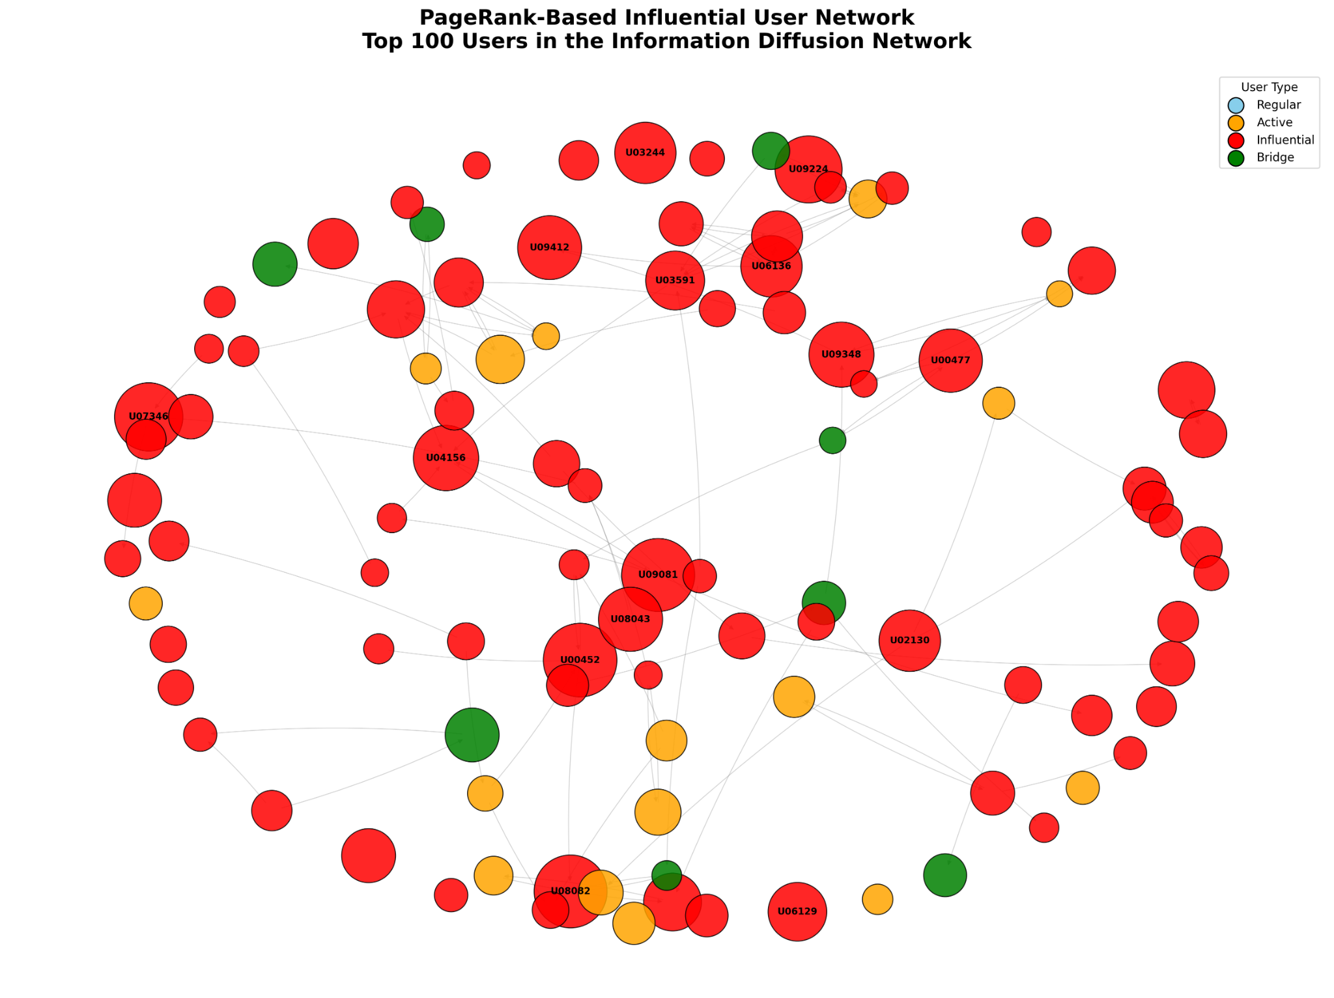
3A. PageRank-Based Influential User Network
04A
WHAT IT SHOWS
The 100 users with the highest PageRank are shown as a directed interaction subnetwork. Node size represents PageRank; color represents user type.
KEY FINDING
Influential users are structurally prominent in the network. This visualization complements the correlation result of r = 0.7014 between influence score and PageRank.
SNA CASE STUDY • INFORMATION DIFFUSION

Slide 6
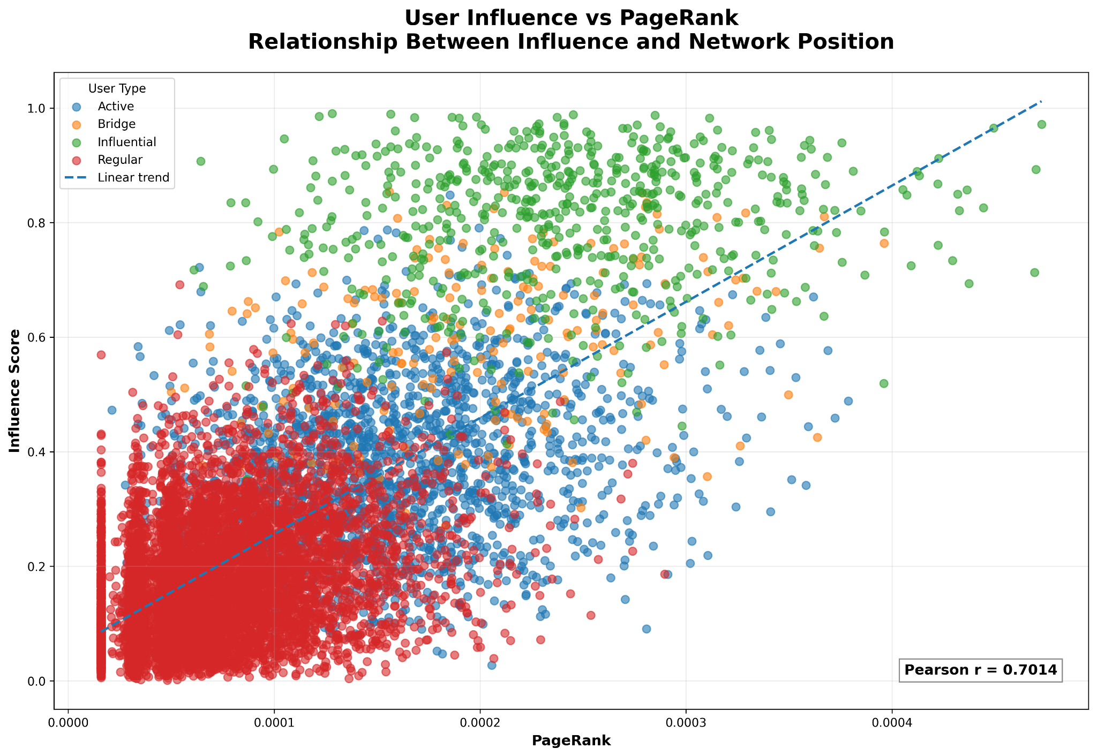
3B. User Influence vs PageRank
04B
HOW TO READ
Each point is a user. The x-axis is PageRank and the y-axis is influence score. Colors distinguish user types; the dashed line shows the linear trend.
KEY FINDING
Pearson r = 0.7014 indicates a strong positive association in this synthetic network: users with higher PageRank generally tend to have higher influence scores.
SNA CASE STUDY • INFORMATION DIFFUSION

Slide 7
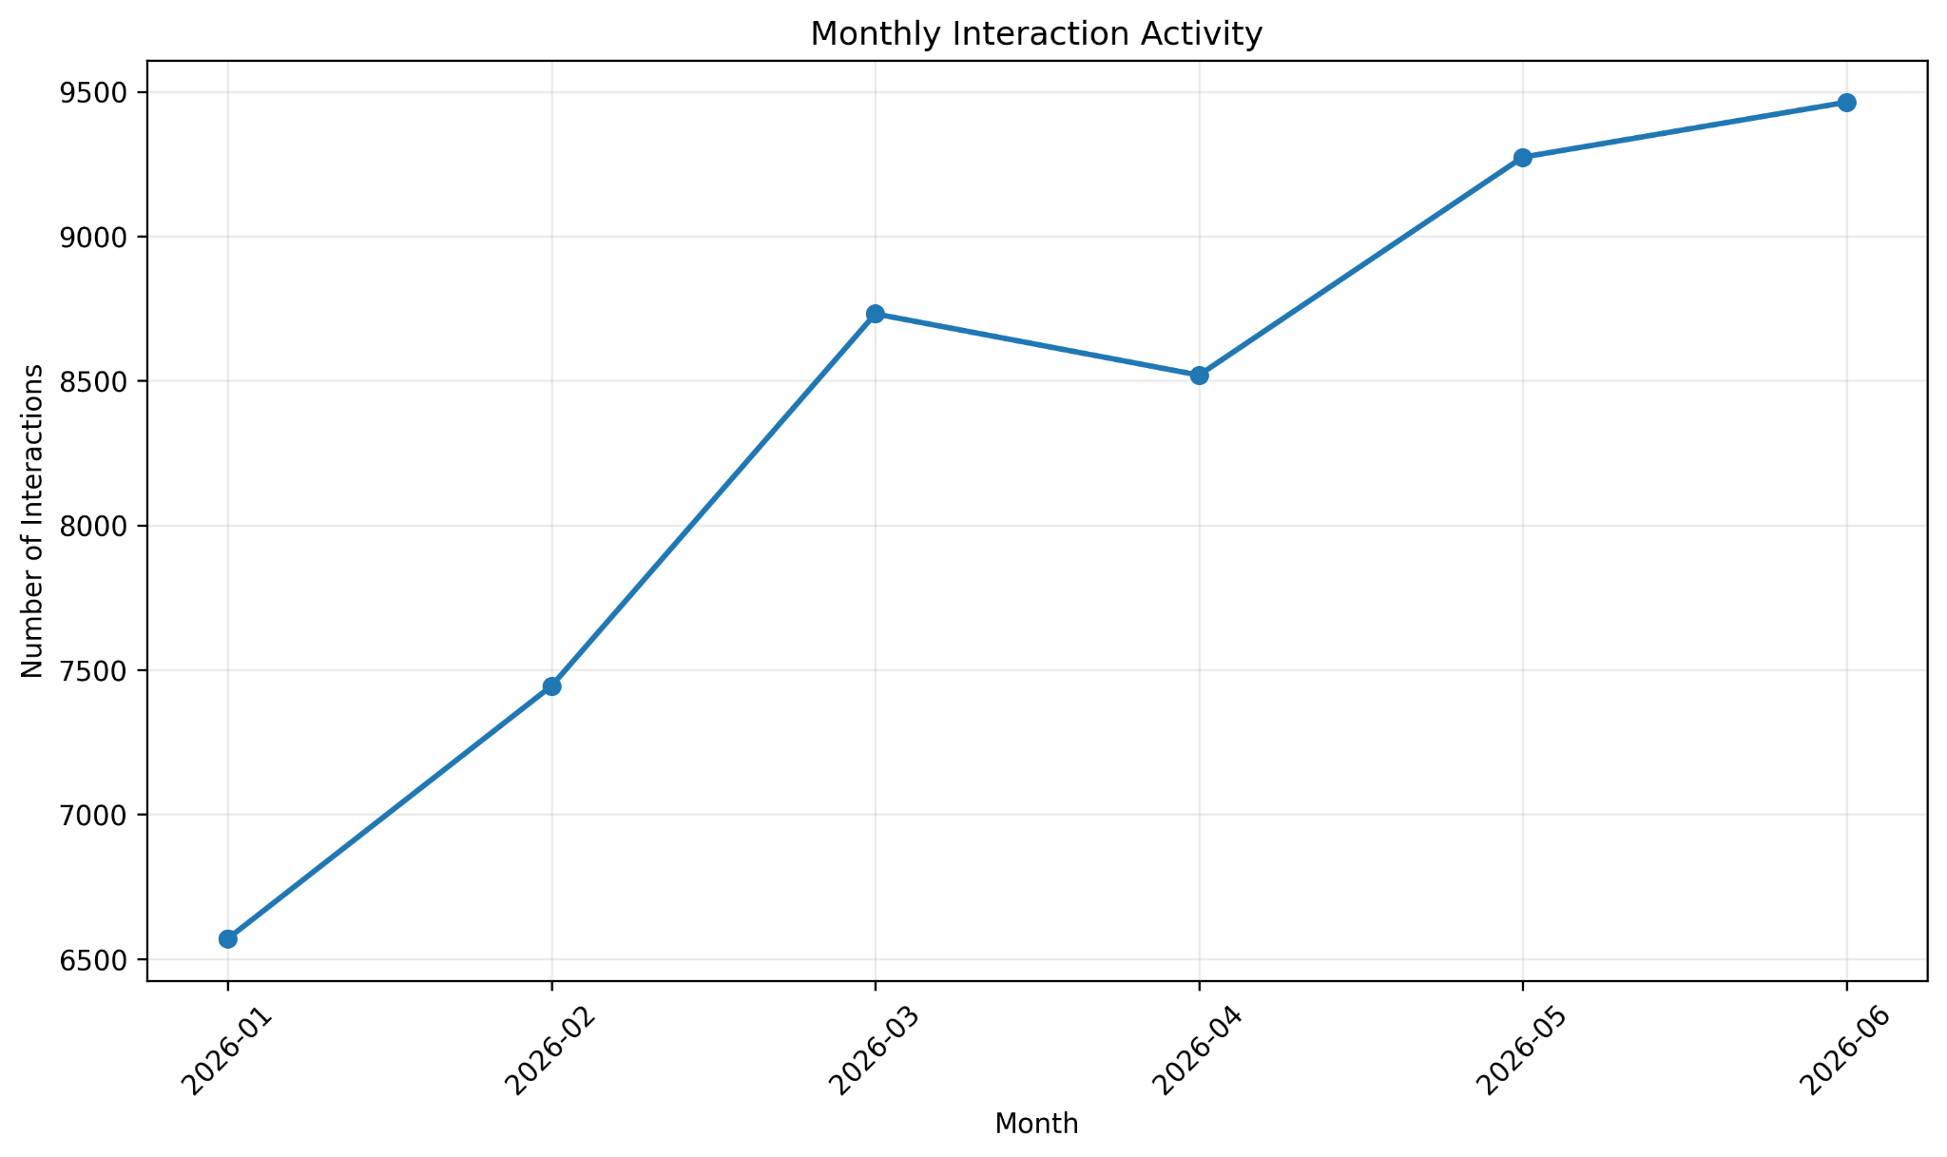
4. Monthly Interaction Activity
05
KEY TAKEAWAY
Activity rises overall from 6,570 interactions in January to 9,463 in June, with a small dip in April.
SNA CASE STUDY • INFORMATION DIFFUSION

Slide 8
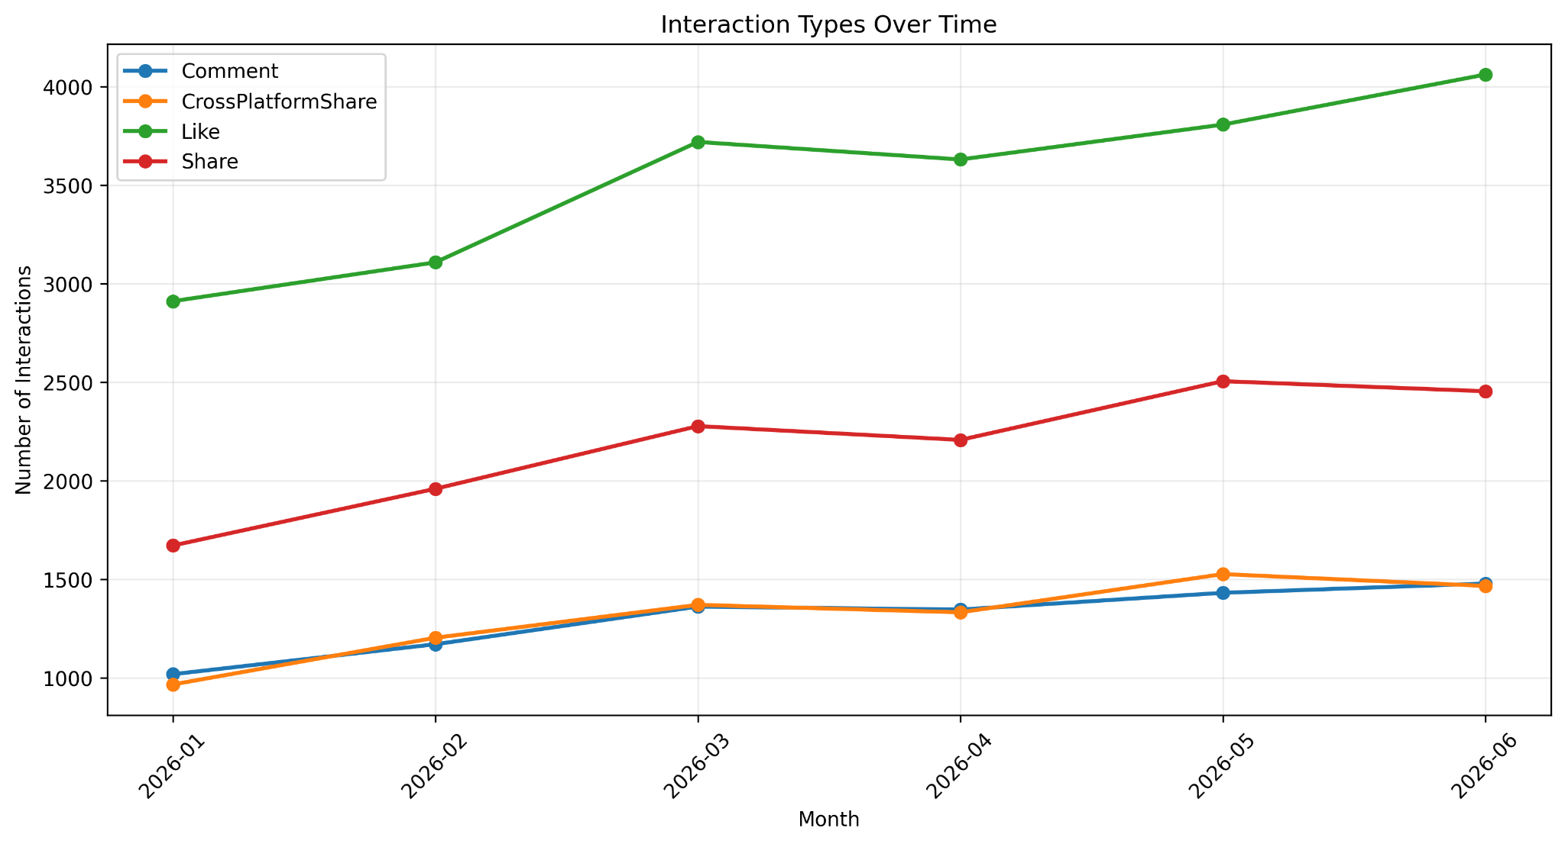
5. Interaction Types Over Time
06
KEY TAKEAWAY
Likes remain the largest interaction category, while shares and cross-platform shares also increase over the observation period.
SNA CASE STUDY • INFORMATION DIFFUSION

Slide 9
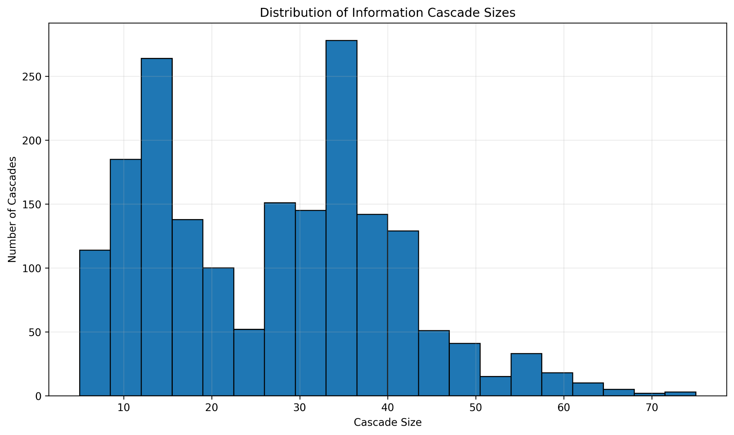
6. Information Cascade Sizes
07
KEY TAKEAWAY
There are 1,876 cascades; mean size is 26.65, median 28, and maximum 75.
SNA CASE STUDY • INFORMATION DIFFUSION

Slide 10
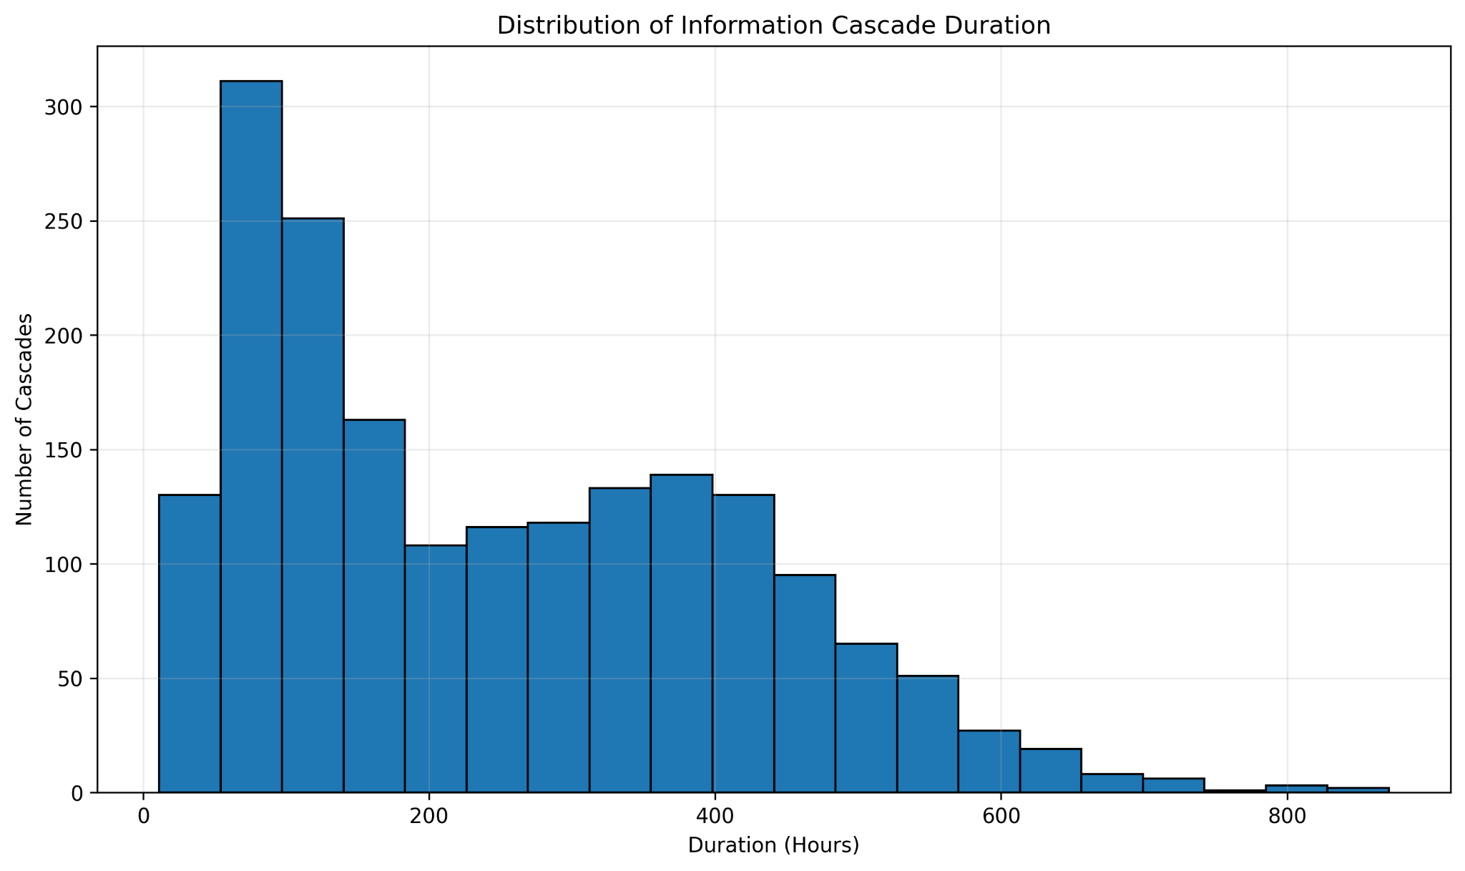
7. Information Cascade Duration
08
KEY TAKEAWAY
Cascade durations show substantial variation, including a long tail toward several hundred hours.
SNA CASE STUDY • INFORMATION DIFFUSION

Slide 11
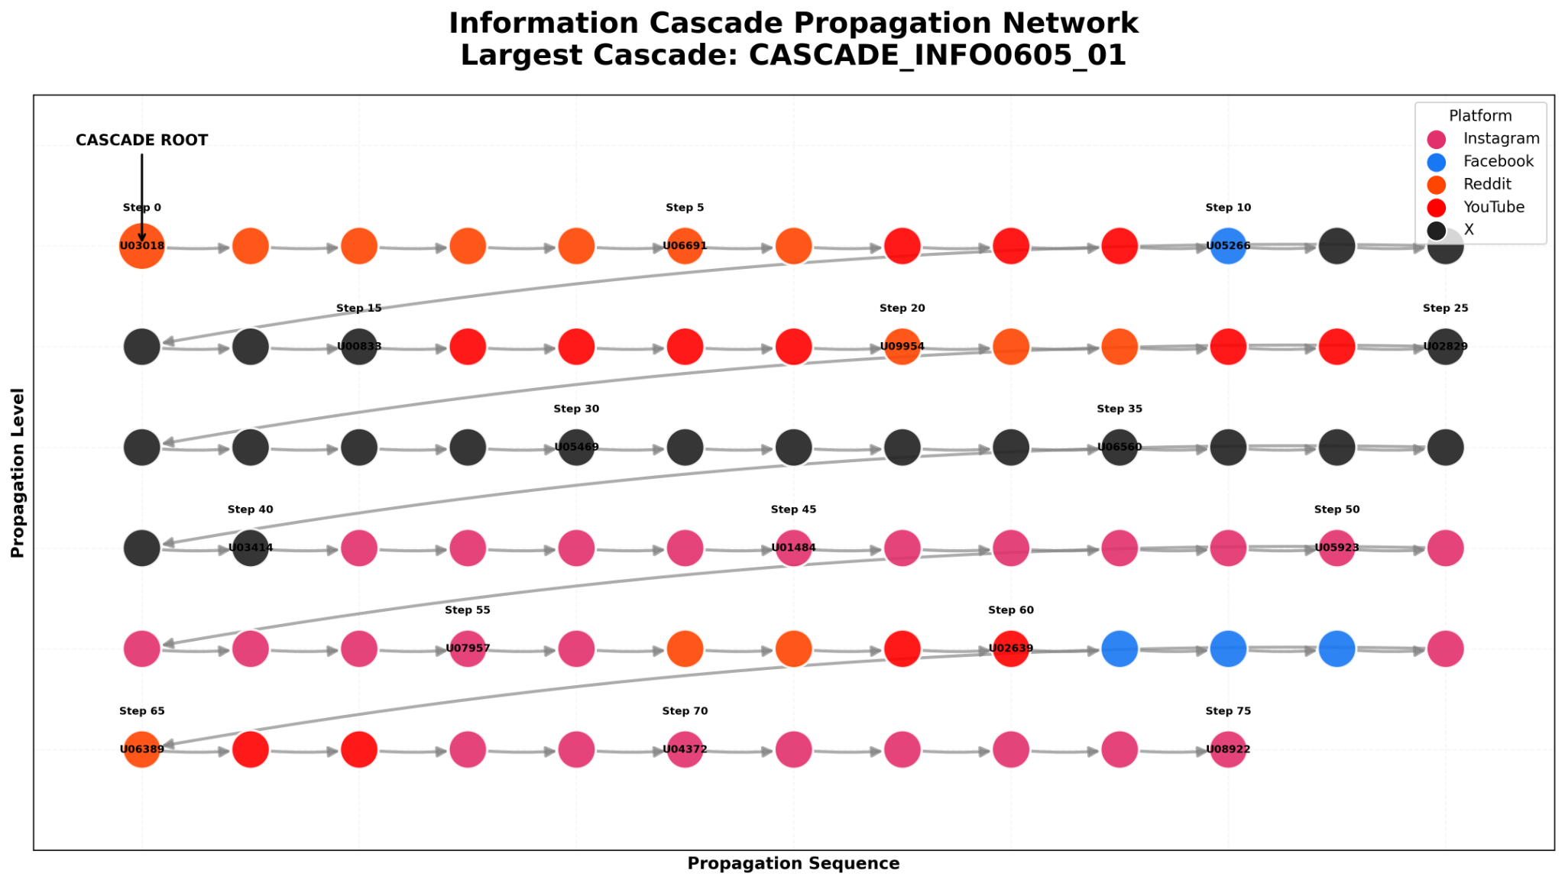
7A. Information Cascade Propagation Network
08A
WHAT IT SHOWS
The largest observed cascade, CASCADE_INFO0605_01, contains 76 users connected by 75 directed propagation steps.
KEY FINDING
The cascade reaches 5 platforms and 17 communities. Its chain-like structure also illustrates the study limitation that branching diffusion is limited in the synthetic generator.
SNA CASE STUDY • INFORMATION DIFFUSION

Slide 12
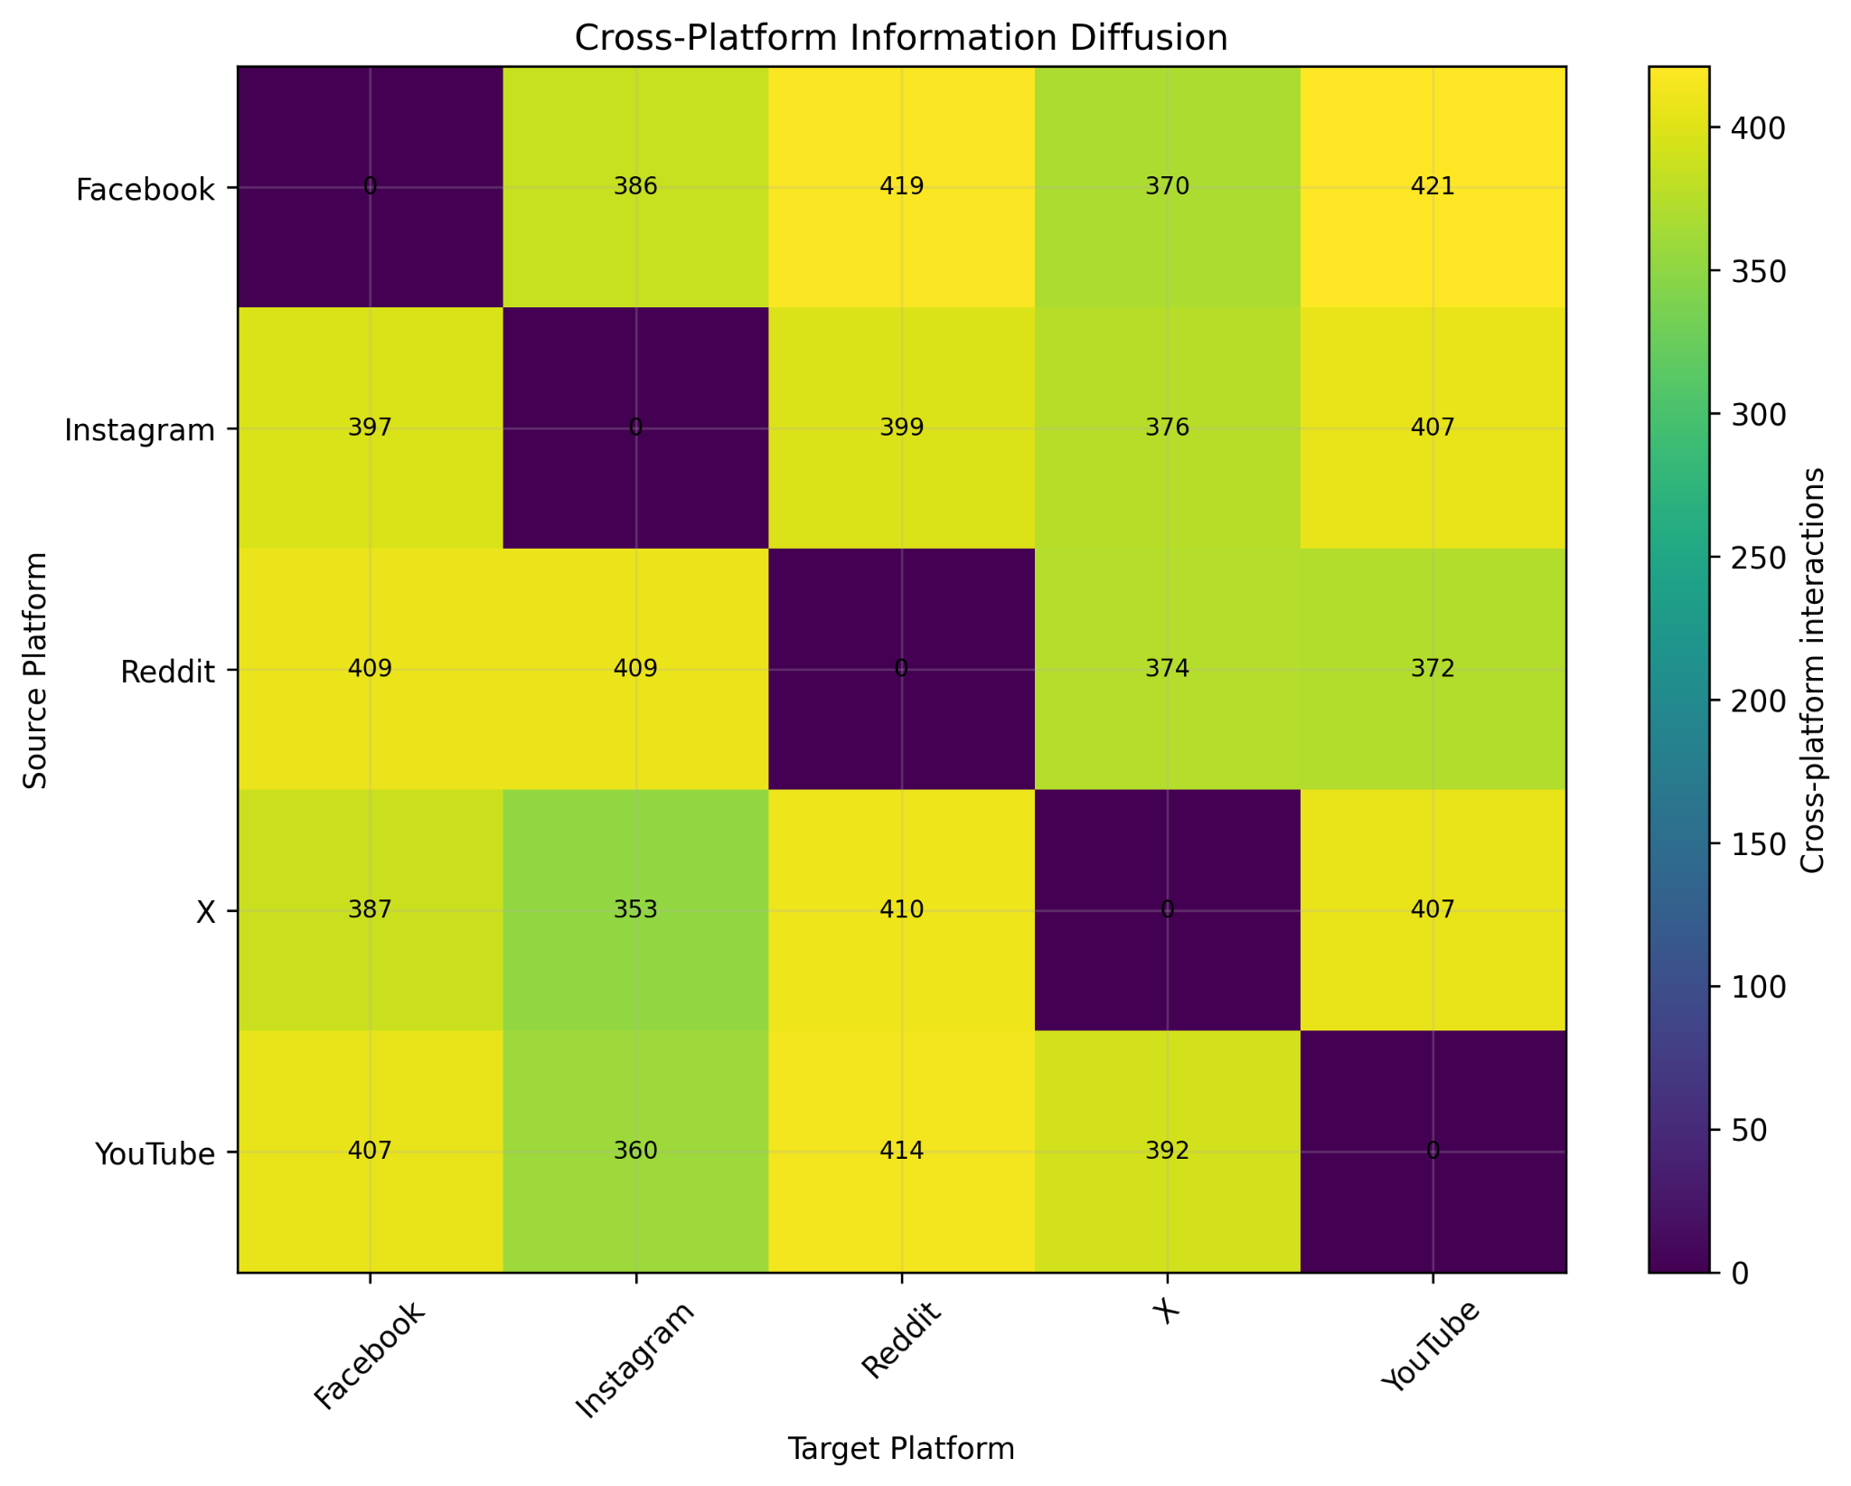
8. Cross-Platform Diffusion
09
KEY TAKEAWAY
92.16% of cascades involve cross-platform propagation. All 20 directed platform pairs occur.
SNA CASE STUDY • INFORMATION DIFFUSION

Slide 13
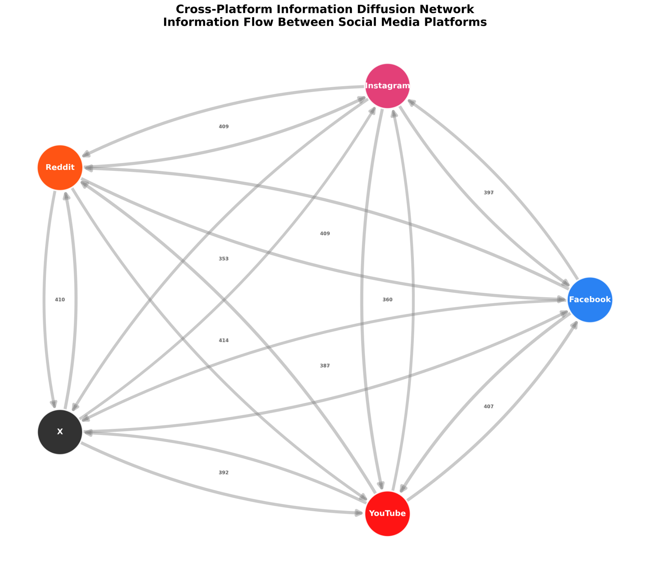
8A. Cross-Platform Information Diffusion Network
09A
WHAT IT SHOWS
Five platform nodes are connected by directed edges representing cross-platform diffusion pathways. Edge labels show observed transition counts.
KEY FINDING
All 20 directed platform pairs occur. The network shows that information movement is not confined to a single platform; Facebook → YouTube is the largest observed pathway with 421 events.
SNA CASE STUDY • INFORMATION DIFFUSION

Slide 14
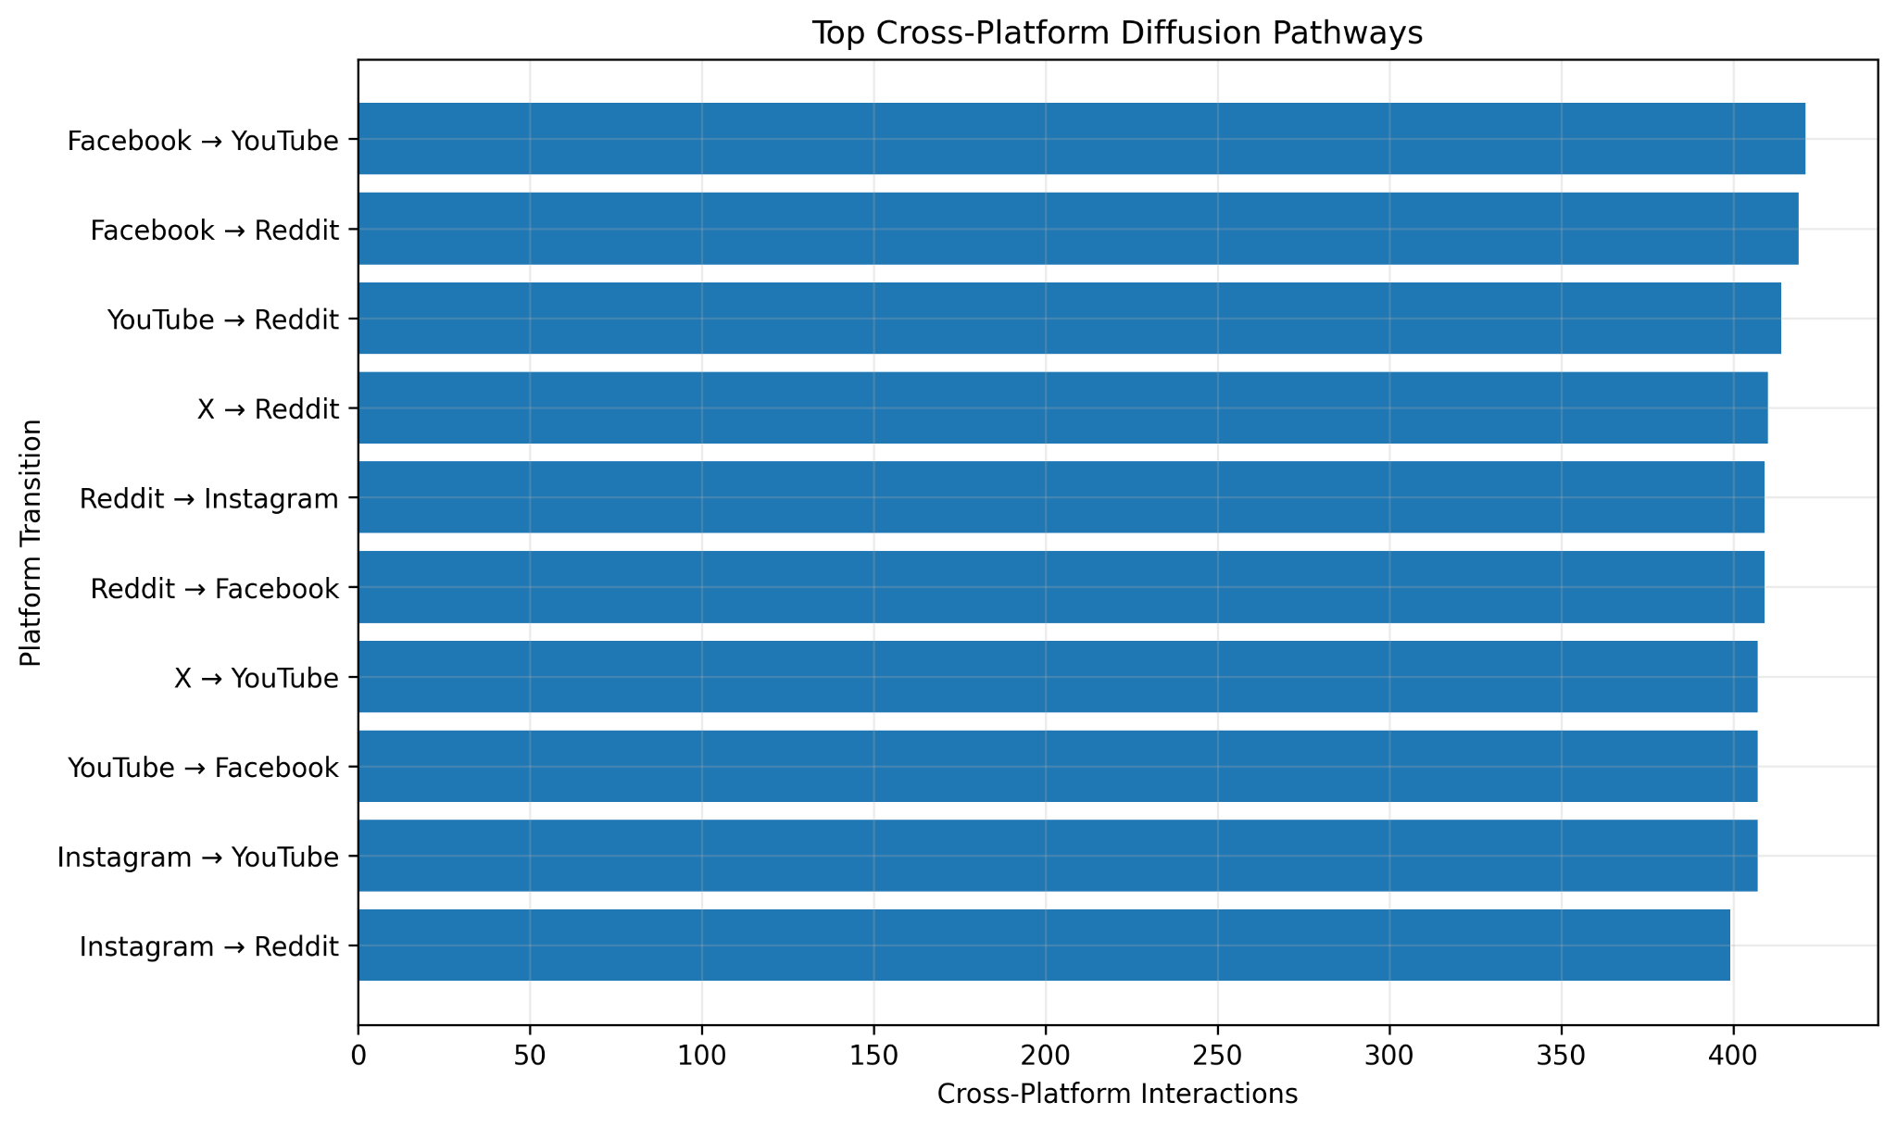
9. Top Cross-Platform Pathways
10
KEY TAKEAWAY
Facebook → YouTube is the largest observed transition with 421 events.
SNA CASE STUDY • INFORMATION DIFFUSION

Slide 15
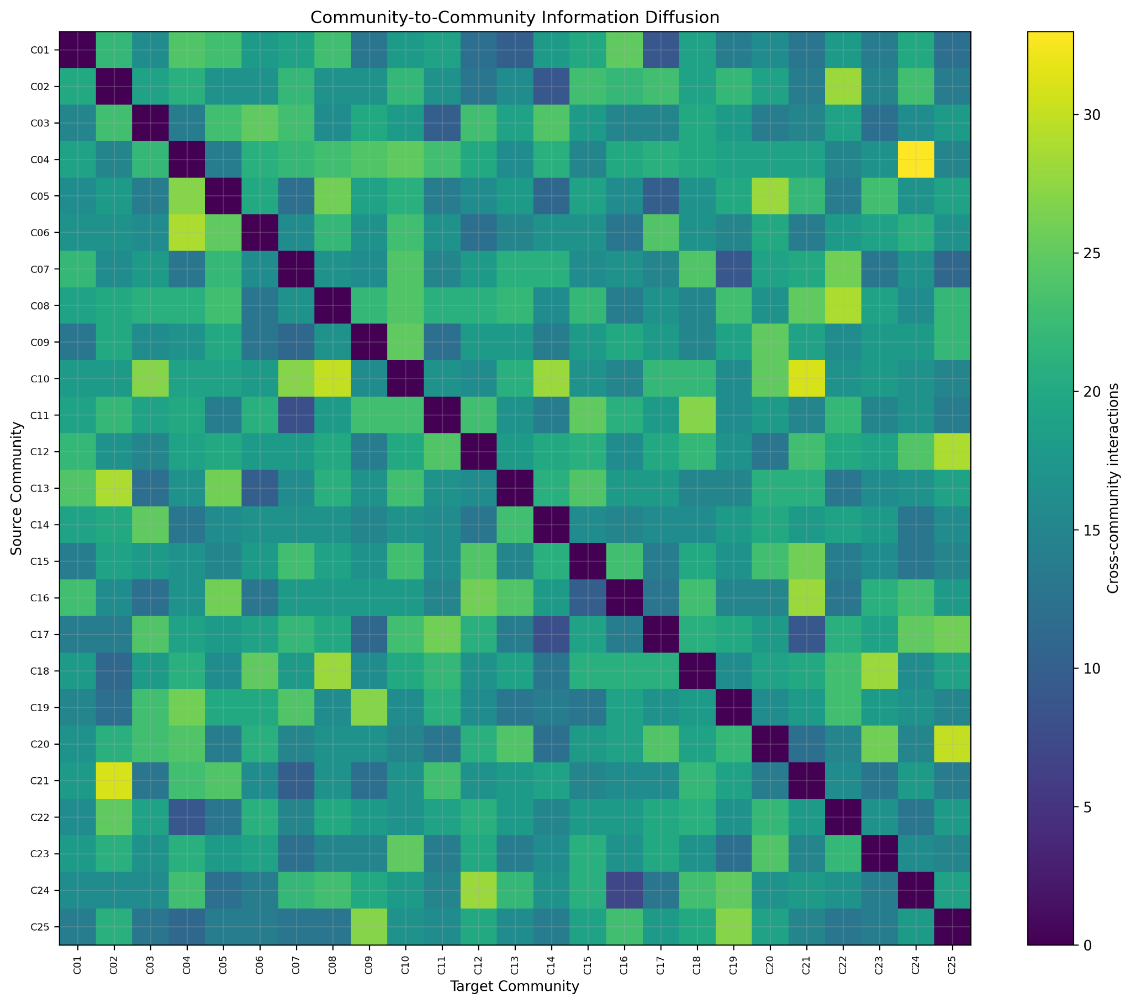
10. Cross-Community Diffusion
11
KEY TAKEAWAY
97.12% of cascades involve multiple communities, indicating widespread community-to-community movement in the simulation.
SNA CASE STUDY • INFORMATION DIFFUSION

Slide 16
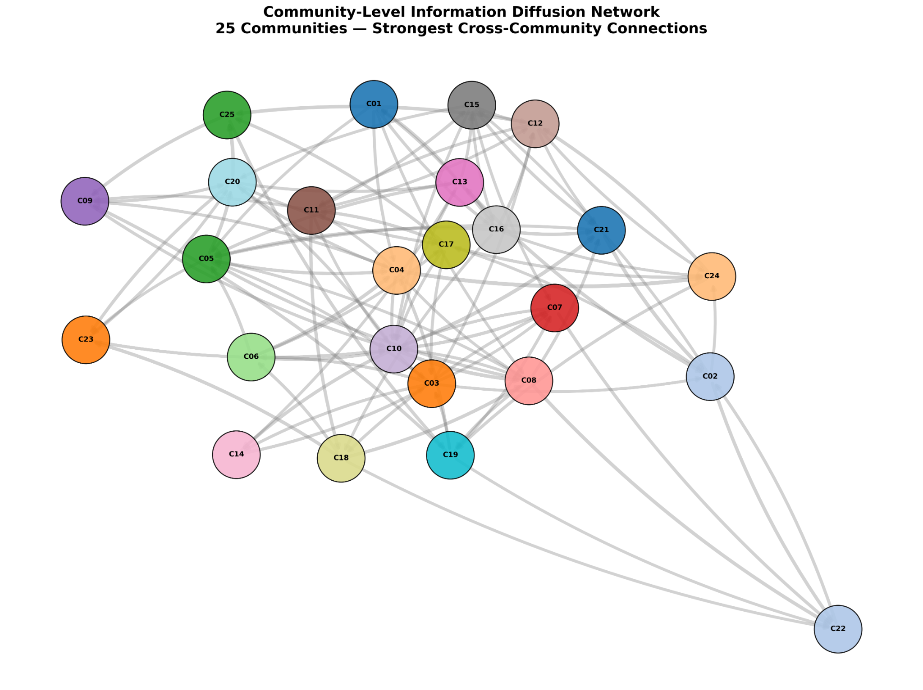
10A. Community-Level Information Diffusion Network
11A
WHAT IT SHOWS
The 25 communities are represented as nodes. The strongest 100 cross-community connections are drawn as directed edges.
KEY FINDING
97.12% of cascades involve multiple communities. The dense cross-community structure supports the conclusion that diffusion frequently crosses community boundaries in the simulation.
SNA CASE STUDY • INFORMATION DIFFUSION

Slide 17
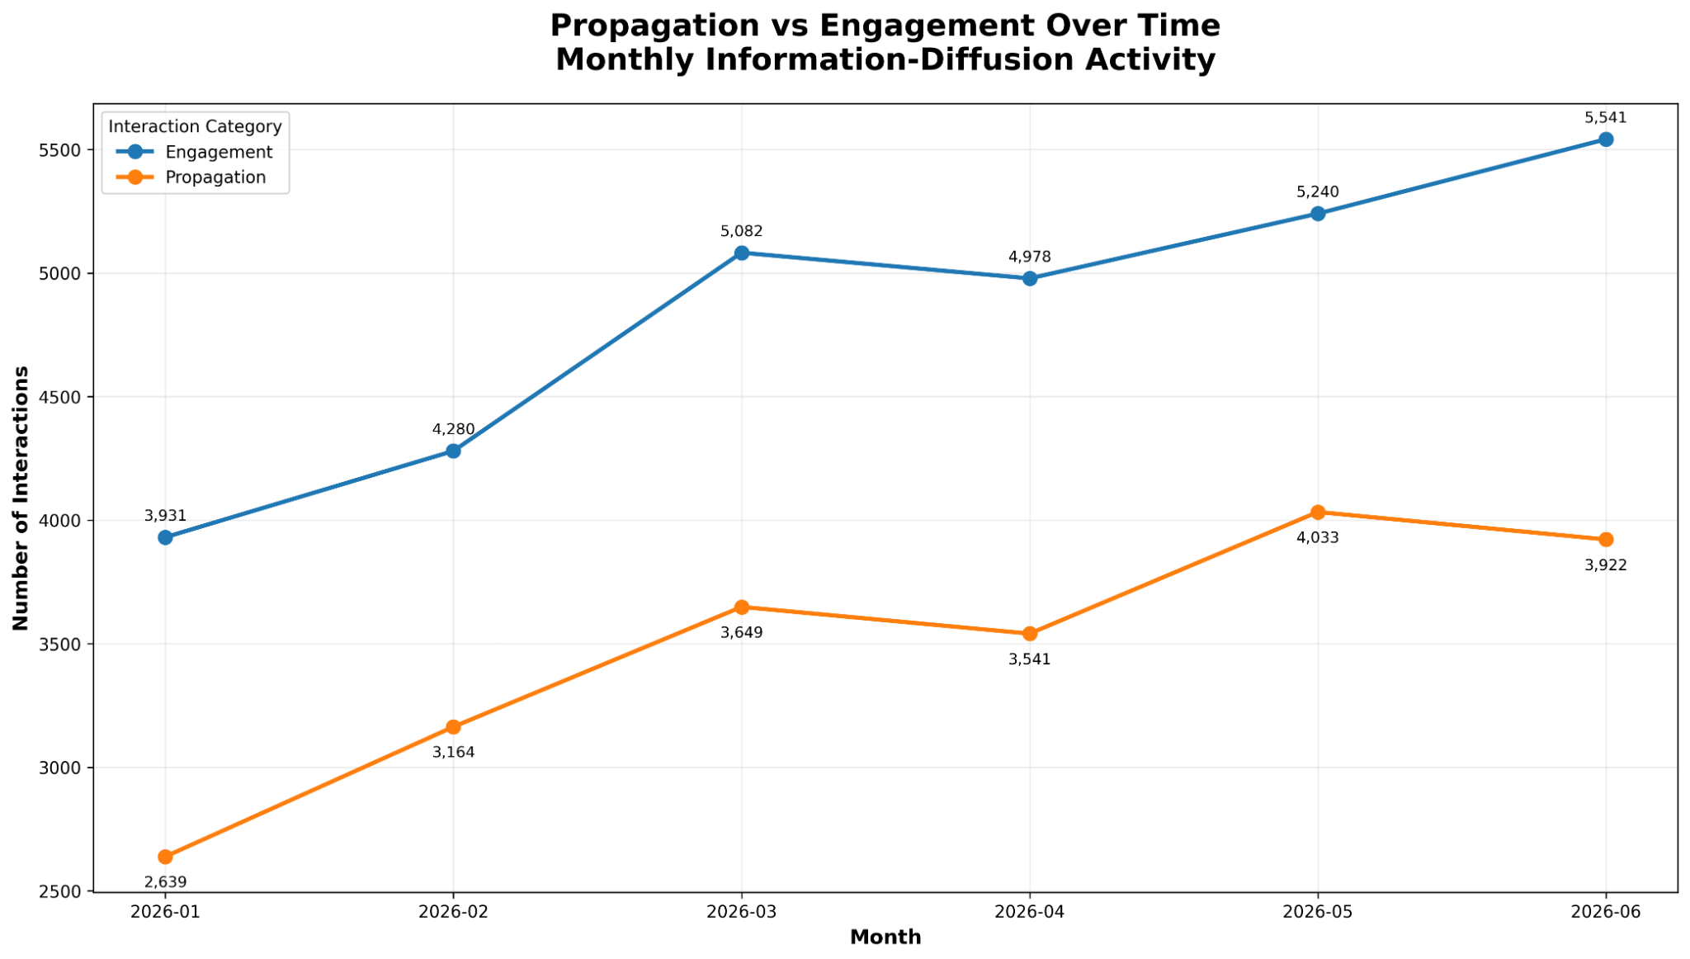
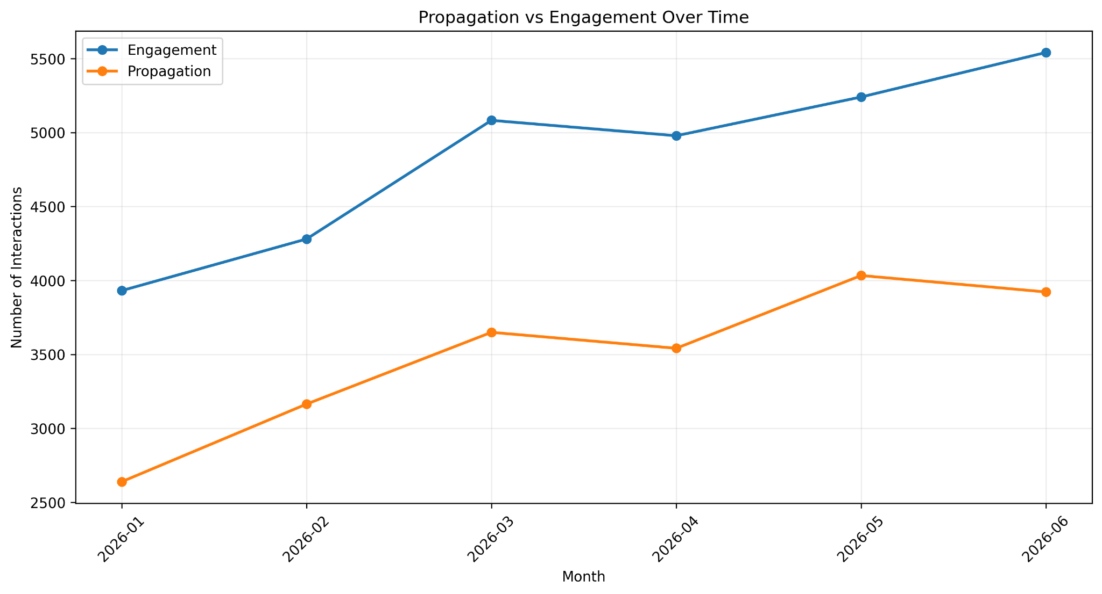
11. Propagation vs Engagement
12
KEY TAKEAWAY
Propagation-oriented activity remains below total engagement. Propagation peaks in May at 4,033 interactions before a small June decline.
SNA CASE STUDY • INFORMATION DIFFUSION

Slide 18
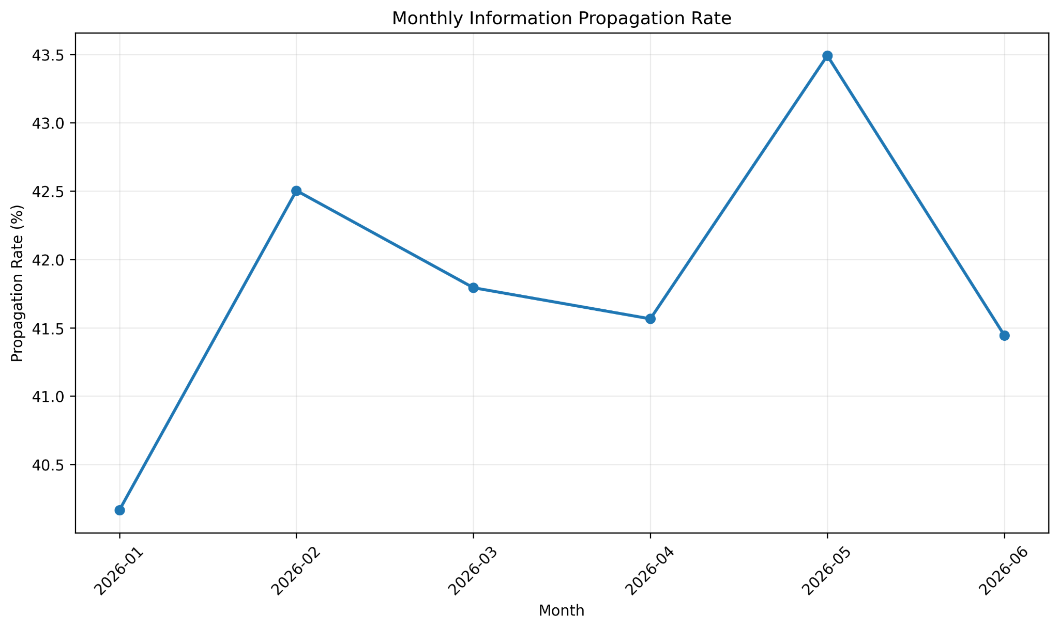
12. Monthly Propagation Rate
13
KEY TAKEAWAY
The monthly rate is relatively stable: average 41.83%, maximum 43.49% in May 2026.
SNA CASE STUDY • INFORMATION DIFFUSION

Slide 19
13. Temporal Patterns
14
Peak simulated hour
Peak simulated weekday
23:00 with 2,568 interactions.
Tuesday with 8,564 interactions.
Interpretation
These are properties of the controlled synthetic dataset.
They should not be presented as real-world behavioral or causal findings.
SNA CASE STUDY • INFORMATION DIFFUSION

Slide 20
14. Discussion & Implications
15
Network position
Diffusion boundaries
Network position is associated with user influence.
Information frequently crosses platform and community boundaries.
Temporal dimension
Potential applications
Temporal variation provides another dimension for understanding diffusion.
Potential applications: influencer identification, propagation monitoring, and community-to-community tracking.
SNA CASE STUDY • INFORMATION DIFFUSION

Slide 21
15. Limitations & Future Work
16
Limitations
Future work
Synthetic dataset → findings are simulation-based.
Cascades are predominantly chain-like → branching topology is limited.
Platform/community distributions are controlled.
Future: real-world validation, branching cascades, diffusion models, and time-to-event analysis.
SNA CASE STUDY • INFORMATION DIFFUSION

Slide 22
16. Conclusion
FINAL TAKEAWAY
Information diffusion is multi-dimensional.
Network structure, user position, cross-platform movement, cross-community movement, and time all shape the observed simulation patterns.
Study scope
The study demonstrates an end-to-end SNA workflow from network construction to integrated diffusion findings.
Conclusions are explicitly limited to the synthetic setting.
SNA CASE STUDY • INFORMATION DIFFUSION

