Slide 1

Collections

Slide 2
Learning Objective
Introduction
Collection & Generics
List
Stack
Queue
Dictionary
Comparison and Sorting
LINQ with access Collection

Slide 3
Collections
Manage groups of related objects.
Flexible way to work with groups of objects.
Namespace - System.Collections

Slide 4
Generic
Contains elements of only one data type
Type safe

Slide 5

List
Represents a list of objects
Accessed by index
Methods for search, sort, and modify
Maintains Insert order

Slide 6

Stack
Represents a variable size last-in-first-out (LIFO)
Discards an element after retrieving it.

Slide 7

Queue
First-in, first-out collection of objects.
Objects stored are inserted at one end and removed from the other

Slide 8
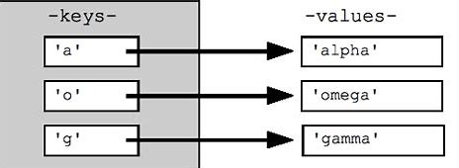
Dictionary
Represents a collection of keys and values
Each addition consists of a value and its associated key
Retrieving a value by using its key is very fast
Keys should be unique and cannot be null.

Slide 9

Comparison and Sorting
Comparison is required when searching the collection
Equals method
Sorting the collection
User defined class collection should implement IComparable/IComparer

Slide 10

LINQ to Collection
Language-Integrated Query
Queries provide
Filtering
Ordering
Grouping

Slide 11
Summary
Easy to manage
Type safe
In-built method support

