Slide 1
Operators
Operators
Types of Operators
Notes:
Click through to the next slide…

Slide 2

Learning Objectives and Overview
After completing this learning unit, you should be able to :
In this section, we will discuss the following
Use different types of operators.
Identify precedence of operators.
Extend operators in expressions.
What are operators?
What are the types of operators.
What is operator precedence?
What are statements and expressions?
Notes:
Course or Module Title
2
Date or Rev. #
Our objective here is to understand the importance of Polymorphism in Java and the ways we are going to implement it in Java.
After doing the practice exercises included in this section, you should be able to include polymorphism concept wherever it is appropriate to your code.
Excellere Restricted

Slide 3
Operators

Slide 4

What are Operators?
Operators are symbols that cause C# to take an action.
Operators are symbols that specify which operation to perform in an expression.
int A=10;
int c=a+b;
C# provides a large set of operators.

Slide 5
Operators - Examples
10+10
20
10-10
0
10*10
100
1
10/10

Slide 6
Types of Operators

Slide 7
Types of Operators
Roll over your mouse for more detail.
Operators
Arithmetic
Relational
Logical
Shift
Increment & Decrement
Assignment
Compound Assignment
Concatenate
Conditional
Cast

Slide 8
What are Arithmetic Operators?
Four standard arithmetic operators
C# uses five arithmetic operators.
The four operators for standard calculations are +, -, * and /.
The fifth operator % returns the remainder in integer division.
21
4
25
21
4
17
21
4
104
Modulo operator
21
4
1
21
4
5

Slide 9
Arithmetic Operators Demo

Slide 10
For VIDEO only – do not use for content. Use this slide to place the demo videos.

Slide 11
What are Relational Operators?
Relational operators are used to compare two values.
Relational operator returns a Boolean value.
The relational operators are:
== (is equal to)
!= (not equal to)
> (greater than)
>= (greater than equal to)
< (less than)
<= (less than equal to)
<=
==
<
!=
>=
>

Slide 12
Relational Operators - Examples
Note: bigValue = 100, smallValue = 50
Name | Operator | Expression | Result
Equals | == | bigValue == 100 bigValue == 80 | true false
Not equals | != | bigValue != 100 bigValue != 80 | false true
Greater than | > | bigValue > smallValue | true
Greater than or Equals | >= | bigValue >= smallValue smallValue >= bigValue | true false
Less than | < | bigValue < smallValue | false
Less than or equals | <= | smallValue <= bigValue bigValue <= smallValue | true false

Slide 13
Relational Operators Demo

Slide 14
For VIDEO only – do not use for content. Use this slide to place the demo videos.

Slide 15
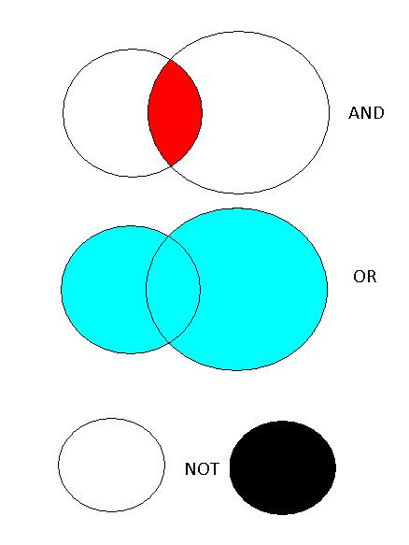
What are Logical Operators?
The logical operators are used to compare Boolean expressions.
Example: if ((A>B)&&(A>C))
A logical operator returns a Boolean value like true or false.
If the condition is true, then true will be returned otherwise a false will be returned.
The logical operators are:
&&(AND)
||(OR)
!(NOT)

Slide 16
Logical Operators - Examples
Note: x = 5, y = 7
Name | Operator | Expression | Result
AND | && | (x == 3) && (y == 7) | False
OR | || | (x == 3) || (y == 7) | True
NOT | ! | ! (x == 3) | True

Slide 17
What are Logical Short Circuit Operators?
&& (AND) and ||(OR) are also called short circuit operators because they are optimized.
&& checks the first condition. If it is false it does not evaluate the second condition.
|| checks the first condition. If it is true it does not evaluate the second condition.
For Example:
Note: int i=0; int j=2;
Expression | Result
bool b= (i>j) && (j++>i); | j has a value 2
!(i > j) | True
17

Slide 18
What are Bitwise Operators?
Operand 1 | Operand 2 | & Bitwise AND | | Bitwise OR | ^ Bitwise XOR | ~ Bitwise NOT
0 | 0 | 0 | 0 | 0 | 1
0 | 1 | 0 | 1 | 1 | 1
1 | 0 | 1 | 1 | 1 | 0
1 | 1 | 1 | 1 | 0 | 0
byte x=1; // 0000 0001 byte y=3; // 0000 0011 | Example | Result
 | x&y; | 1
 | x|y; | 3
 | x^y; | 2
 | ~x; | -2

Slide 19
Logical & Bitwise Operators Demo

Slide 20
For VIDEO only – do not use for content. Use this slide to place the demo videos.

Slide 21
What are Shift Operators?
If the first operand is an int or uint (32-bit), the shift count is given by the low-order five bits of the second operand.
If the first operand is a long or ulong (64-bit), the shift count is given by the low-order six bits of the second operand.
Goes out.
0 | 0 | 0 | 0 | 0 | 1 | 0 | 1
Goes out.
0 | 0 | 0 | 0 | 1 | 0 | 1 | 0
Make it zero
0 | 0 | 0 | 1 | 0 | 1 | 0 | 0
So after a<<2 the value 5 becomes 20

Slide 22
More About Shift Operators
The high-order bits of the first operand are discarded and the low-order empty bits are zero-filled.
Shift operations never cause overflows.
Expression | Result
2<<1 | 4
-1>>2 | -1
2 >>32 | 2
2 >>33 | 1

Slide 23
Shift Operators Demo

Slide 24
For VIDEO only – do not use for content. Use this slide to place the demo videos.

Slide 25
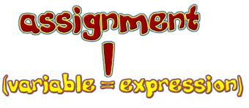
What are Assignment Operators?
The assignment operator assigns a new value to a variable.
The left operand of an assignment must be an expression classified as a variable, a property access, an indexer access, or an event access.
The = operator is called the simple assignment operator.
Example:
A = 10;
A = B + C;

Slide 26
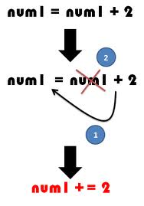
What are Compound Assignment Operators?
The assignment operators other than the = operator are called the compound assignment operators. (=, +=, -=, *=, /=, %=, &=, |=, ^=, <<= and >>= )
Example:
A += 4; //If A is already 6 now it will be 10 (A = A + 4)
A -= 4; //If A is already 6 now it will be 2 (A = A – 4)
The assignment operators are right-associative.
Example:
An expression of the form a = b = c is evaluated as a = (b = c).

Slide 27
Assignment and Compound Assignment Operators Demo

Slide 28
For VIDEO only – do not use for content. Use this slide to place the demo videos.

Slide 29
What are Conditional Operators?
The conditional operator (?:) returns one of two values depending on the value of a Boolean expression.
Syntax: condition ? first expression : second expression;
First Exp.
C = A
Condition
A>B
Second Exp.
C= B
True
False

Slide 30
What are Checked and Unchecked Operators?
byte b =255;
b++;
Incrementing the value of b causes overflow since byte can hold values in the range 0 to 255 only.
The value of b is 0 finally.
To make the CLR throw an error at runtime when overflow occurs, the above code can be written inside the checked block.
Right opposite to checked operator is unchecked operator.
Unchecked is the default behavior.
byte b =255;
checked{ b++;}

Slide 31
Conditional & Checked and Unchecked Operators Demo

Slide 32
For VIDEO only – do not use for content. Use this slide to place the demo videos.

Slide 33
What are String Concatenation Operators?
With string concatenation operator , two or more strings become one.
Two strings can be concatenated by using the plus(+) operator.
The C# compiler converts the plus operator into string.Concat.
Example:
String s1=”Hello”;
String s2=”world”;
String s3 = s1+s2;
“The” | “cat”
“The | cat” | “ate”
“The | cat | ate” | “the”
“The | cat | ate | the” | “mouse”
“The | cat | ate | the | mouse”

Slide 34
String Concatenation Operator Demo

Slide 35
For VIDEO only – do not use for content. Use this slide to place the demo videos.

Slide 36
What are Increment and Decrement Operators?
Increment and decrement operators are unary operators that add or subtract one from their operand respectively.
The two types of unary operators are prefix and postfix operators.
These unary operators can be overloaded.
The ++ and the -- are the increment and decrement operators.
The increment operator adds 1 to its operand, and the decrement operator subtracts 1.
Name | Operator | X = 100 | Y = X
Pre-increment | ++X | 101 | 101
Post-increment | X++ | 100 | 101
Pre-decrement | --X | 99 | 99
Post-decrement | X-- | 100 | 99

Slide 37
Increment and Decrement Operators Demo

Slide 38
For VIDEO only – do not use for content. Use this slide to place the demo videos.

Slide 39
Operator Precedence
Precedence | Operators
Highest | + - ! ~ ++x --x (T)x
 | * / %, + -
 | << >>, < > <= >= is as
 | == !=, &,^,|,&&,||,:?
Lowest | = *= /= %= += -= <<= >>= &= ^= |=
X = a+b – c*d / e
a
b
c
d
e
*
+
/
-
=
X

Slide 40
What is a Statement?
A complete program instruction is called a statement.
Program consists of sequences of statements.
Each statement must end with a semicolon (;).
C# statements are evaluated in order.
The compiler starts from the beginning of a statement list and makes its way to the bottom.
Examples:
int x;
x = 23;
int y = x;

Slide 41

Smart Programming Considerations
The assignment operators are right-associative, which means that operations are grouped from right to left.
= is an assignment operator and == is a comparison operator.

Slide 42
Summary
Operators
Arithmetic
Shift
Compound
Concatenate
Relational
Logical

